Slide 1

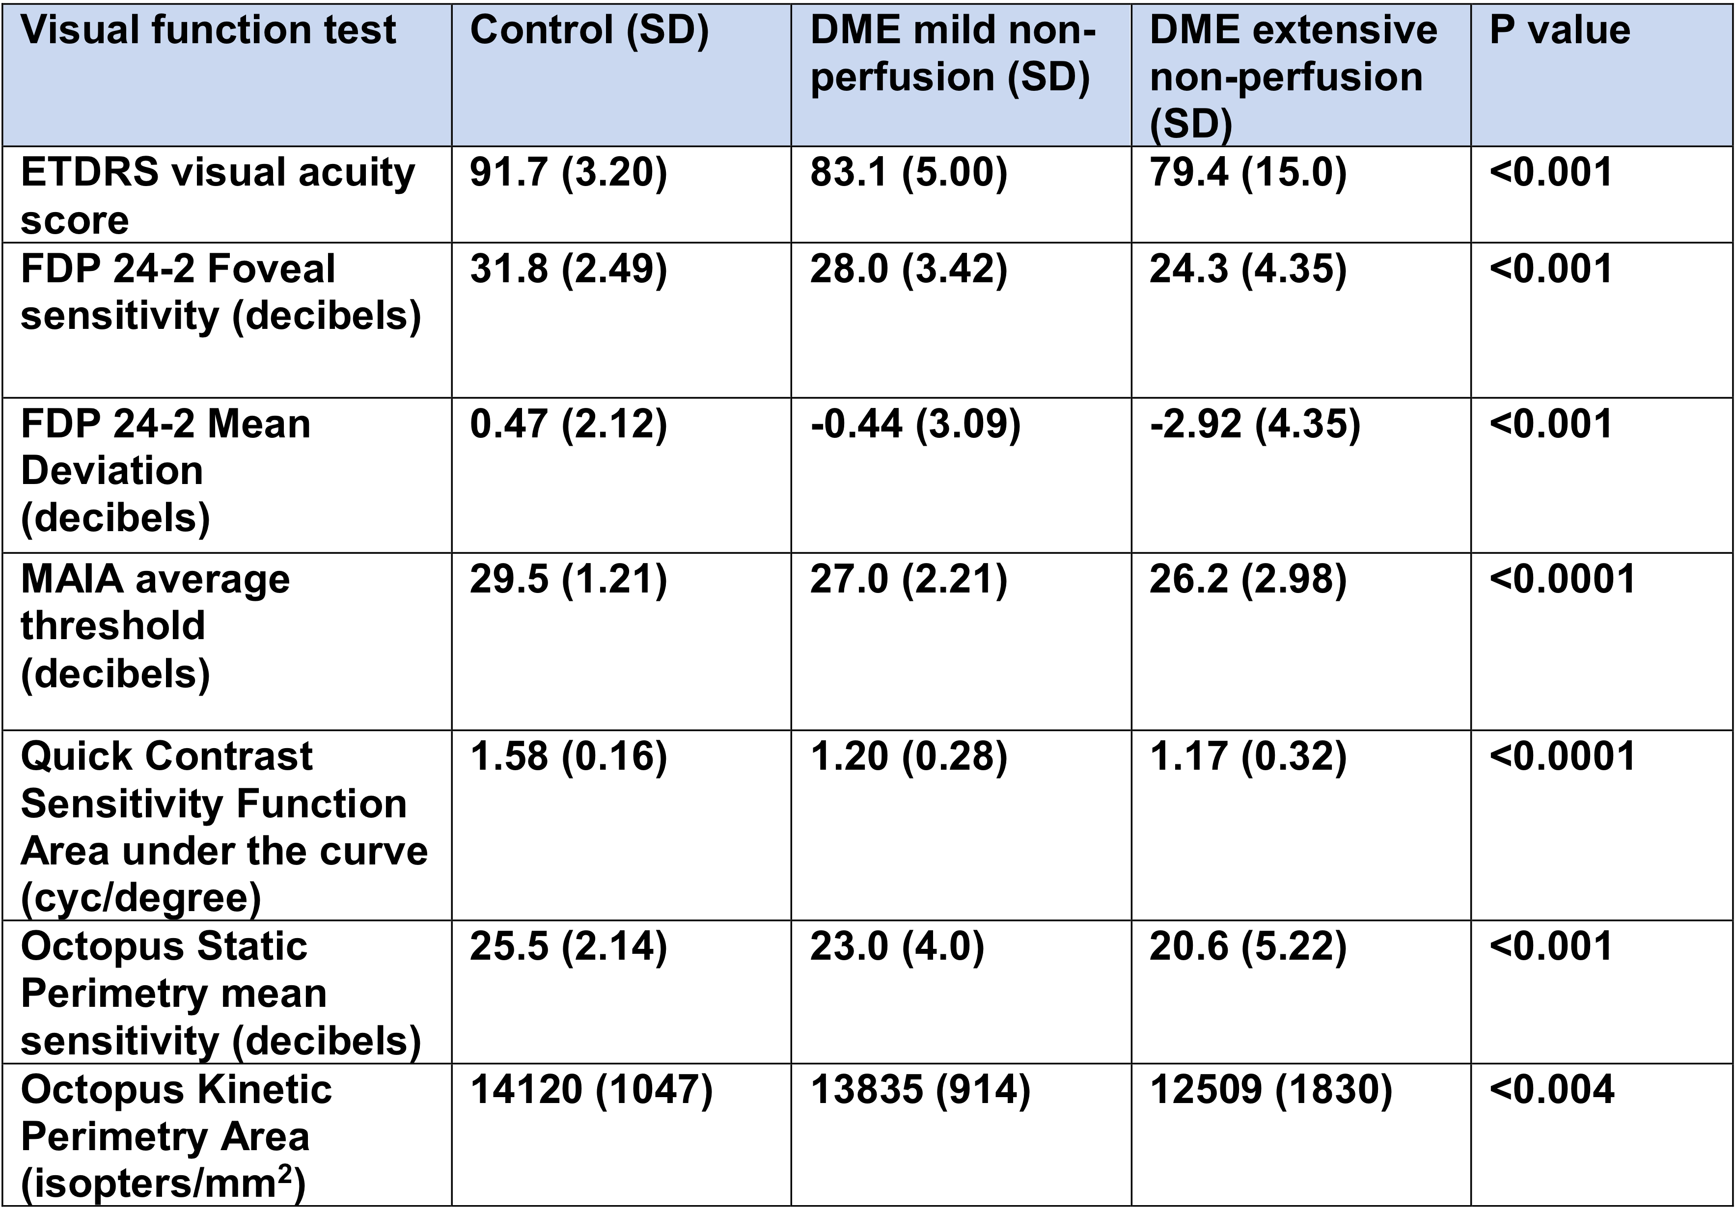
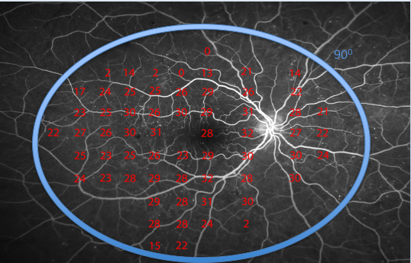
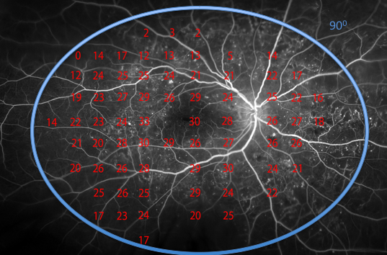

The Role of Midperipheral Retinal Non-perfusion in Diabetic Macular Edema
Amro Omari^{1,2}; Lydia Su^{1,}; Katherine A. Joltikov¹; Christopher A. Sesi^{1,2}; Rajesh Rao, MD¹; Thiran Jayasundera, MD¹; Anjali Shah, MD¹; Thomas W. Gardner, MD, MS¹
¹Department of Ophthalmology and Visual Sciences, Kellogg Eye Center, University of Michigan, Ann Arbor, MI
²University of Michigan Medical School, Ann Arbor, MI
BACKGROUND
RESULTS
Diabetic macular edema (DME) is the most common cause of vision loss in diabetic retinopathy (DR).
Previous approaches to DME have solely focused on the macula, so the role of the midperipheral retina remains an important knowledge gap.
I) Demographics
II) Midperipheral non-perfusion correlates with worse macular and peripheral visual function
 | Control (n=21) | Mild nonperfusion (n=8) | Severe nonperfusion (n=15)
Age, yrs (SD) | 53.6 (11.8) | 55.0 (8.91) | 51.4 (10.3)
Sex, M/F | 10/11 | 5/3 | 13/2
DM Type, I/II | n/a | 0/8 | 1/14
DM Duration, yrs (SD) | n/a | 11.6 (7.74) | 12.9 (5.52)
BMI (SD) | 25.6 (3.4) | 35.6 (3.21) | 34.8 (6.54)
HbA1c, % (SD) | 5.4 (0.33) | 7.99 (1.66) | 7.80 (1.69)
logMAR BCVA, (SD) | -0.1 (0.07) | 0.06 (0.12) | 0.13 (0.31)
B
A
PURPOSE
To evaluate the effect of midperipheral retinal non-perfusion on visual functioning in eyes with DME.
II) Midperipheral non-perfusion correlates with loss of visual field sensitivities
B
A
METHODS
Subjects: 23 treatment naïve subjects with DME and 21 controls without diabetes mellitus. DME subjects were divided into “mild” and “extensive” nonperfusion groups.
Exclusion Criteria: BCVA ≤ 20/200, history of other systemic, neurologic, or ocular disease.
Visual Function Tests: e-ETDRS visual acuity, quick contrast sensitivity function (qCSF) method on the AST Sentio Platform, 24-2 frequency doubling perimetry (FDP) on the Humphrey Matrix, MAIA Microperimetry, Goldmann visual field on the Octopus 900 automated perimeter.
Photography: Fluorescein angiography (FA), fundus photography, and optical coherence tomography (OCT)
Statistical Analysis: One way analysis of variance (ANOVA); IBM SPSS Statistics v22.0.
B
A) DME patient with mild midperipheral non-perfusion and preserved peripheral visual field sensitivities.
DISCUSSION
REFERENCES
More extensive midperipheral non-perfusion is associated with worse visual function in eyes with DME.
A better understanding of the role of the midperipheral retina in DME may improve outcomes and lead to more patient specific therapies.
Limitations: small sample size, lack of a universal grading system for nonperfusion on FA.
Future Directions: 1) Examine changes in retinal function and structure after patients receive anti-VEGF therapy 2) use non-invasive ways like OCT angiography to assess midperipheral non-perfusion.
Tan G. Diabetic macular oedema. Lancet Diabetes Endocrinol.
Silva PS et al. Diabetic Retinopathy Severity and Peripheral Lesions Are Associated with Nonperfusion on Ultrawide Field Angiography. Ophthalmology 2015;122(12):2465–2472.
Wessel MM et al. Peripheral retinal ischaemia, as evaluated by ultra-widefield fluorescein angiography, is associated with diabetic macular oedema. Br. J. Ophthalmol. 2012;96(5):694–698
4. Henricsson M, Heijl A. Visual fields at Different Stages of Diabetic Retinopathy. Acta Ophthalmol. (Copenh.) 1994;72:560–569.
B) DME patient with severe non-perfusion in the midperphery that correlates with loss of peripheral visual field sensitivities.
SUPPORT
RO1 EY20582
R24 DK82841
Kellogg Clinical Research Center (KCRC)

