Slide 1
Informal Data Citation:
Its Impact on Tracking
Shared Data Reuse
Elizabeth Moss & Jared Lyle
IASSIST
Sydney, NSW, Australia
May 29, 2019
Notes:
Abstract: In the social science literature, most data attribution is incomplete and does not include persistent identifiers (PIDs). Instead, authors mention data informally. Without explicit data citation, a publication cannot automatically or definitively link to a data source. The human effort required to find, interpret, and link opaque citations is costly and inefficient, so data use often goes untracked, and data creators go uncredited.
In this paper, we outline the challenges specific to repositories, we categorize types of informal citation currently in use (based on our experience managing the ICPSR Bibliography of Data-related Literature, a continuously-updated database of more than 82,000 citations of works using data held in the ICPSR archive), and we offer suggestions for ameliorating the effort and expense of tracking data use, and for changing author behavior at the beginning of the publication process.

Slide 2
Overview
Why data citations matter
Challenges of tracking informal data citation
Specific types of informal data citation
Suggested improvements
Notes:
Here is the overview of our presentation…

Slide 3

http://www.icpsr.umich.edu
Notes:
First, let me give some background on where we work, ICPSR.

Slide 4
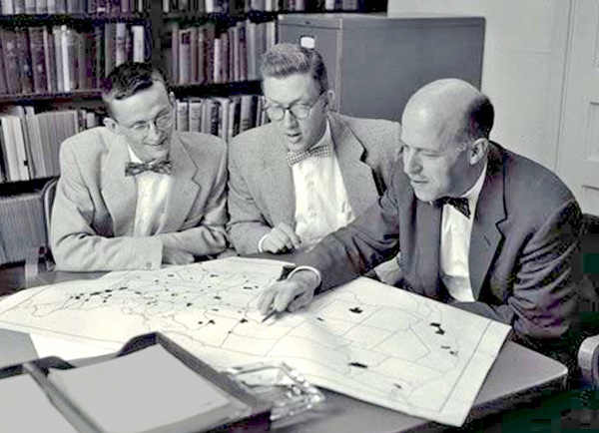
ICPSR
Established 1962
Originally 22 Members, now consortium of 776 world-wide
Originally Political Science, now all social and behavioral sciences
Philip Converse, Warren Miller, and Angus Campbell
Source: http://www.icpsr.umich.edu/icpsrweb/content/membership/history/timeline.html
Notes:
ICPSR stands for the Inter-university Consortium for Political and Social Research (ICPSR)…

Slide 5
ICPSR
Current holdings
  10,000+ studies, quarter million files
  1500+ are restricted studies, almost always to protect confidentiality
Approximately 60,000 active MyData (“shopping cart”) accounts
Thematic collections of data about addiction and HIV, aging, arts and culture, child care and early education, criminal justice, demography, health and medical care, and minorities
Notes:
ICPSR has a large collection and user base. We curate and preserve lots of social science data, spanning disparate thematic collections.

Slide 6
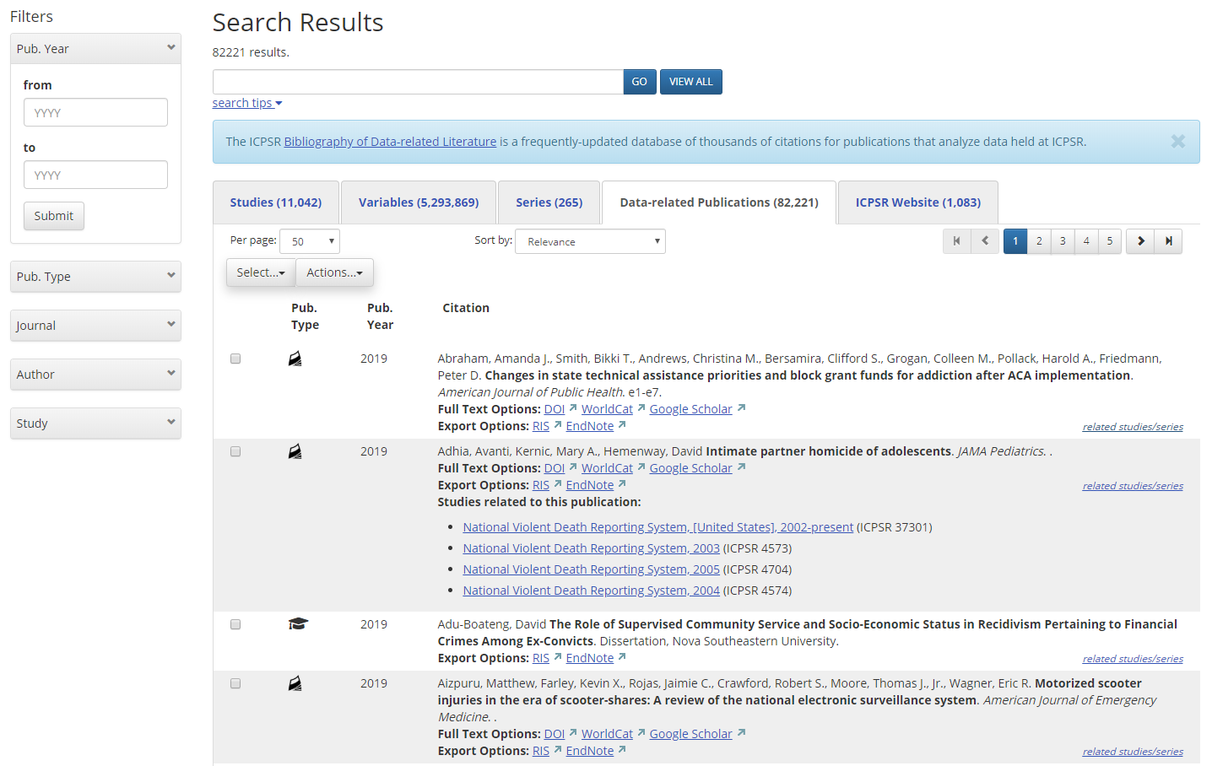
ICPSR Bibliography
82,000 citations of published and unpublished works resulting from analyses of data held in the ICPSR archive.
Notes:
One of the very unique resources at ICPSR is the Bibliography of Data-related Literature. The ICPSR Bibliography of Data-Related Literature links data to publications using or analyzing the data. Users can also discover data by exploring the publications and then linking to the underlying data.
For close to two decades, we have tracked data citations. This provides a unique resource for our users. Not many archives collect data-related publications. And fewer still evaluate those data-related publications for actual data usage.

Slide 7
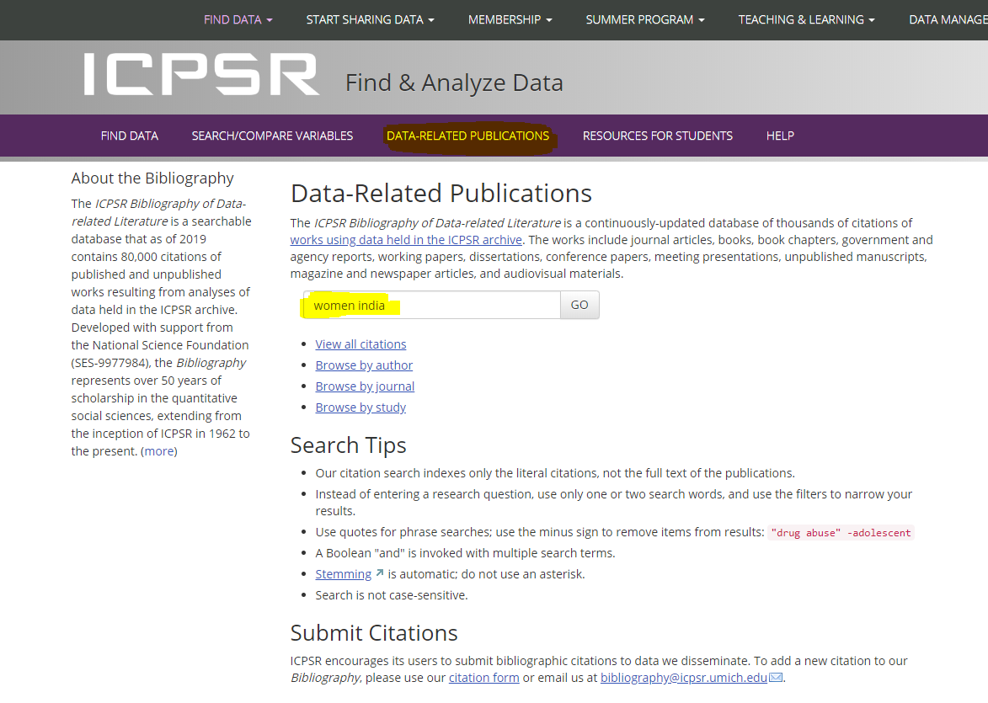
Notes:
One of the two main ways ICPSR site visitors use the Bibliography’s collection. They can discover and access data via the literature—by searching and browsing citation metadata, and being linked from publications to the underlying data.

Slide 8
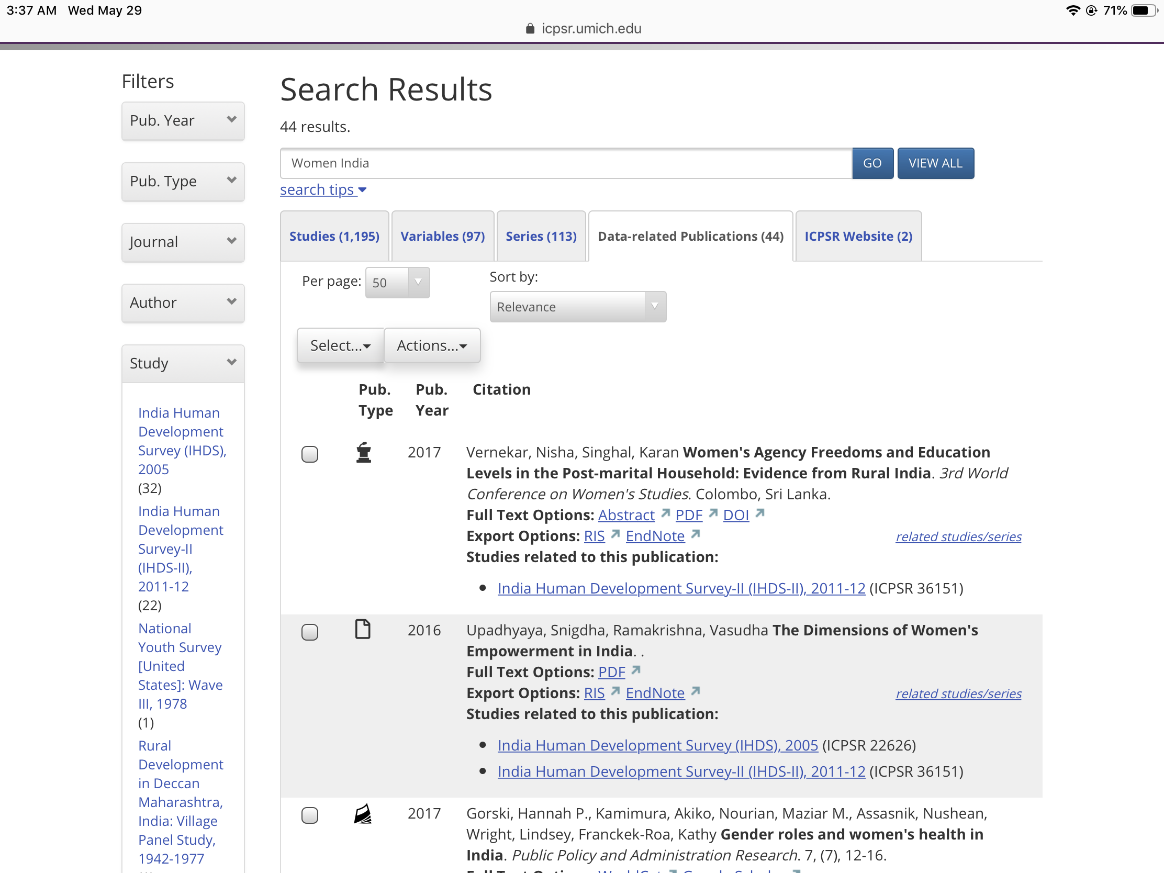
Notes:
You get a results list in the Data-related Publications tab that shows citations in the Bibliography that have matching terms (women and India) in their citation metadata.
You can choose to link out to the full text, or link to the studies we have associated with the publication.
You can also filter by Study to see all the studies in the catalog that are associated with one of the publications about women and India.

Slide 9
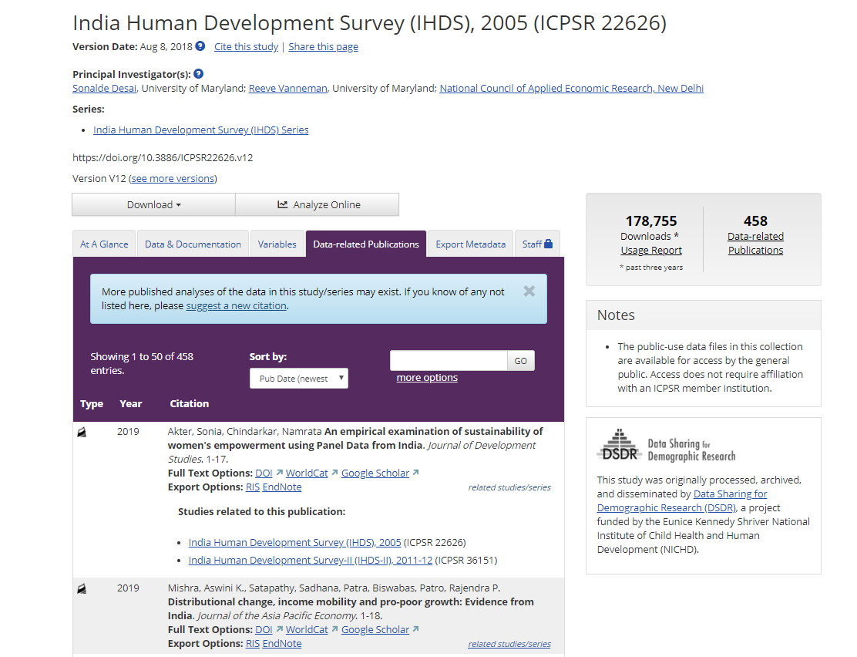
Notes:
Each study home page also has a Data-related Publications tab where all citations linked to that study in the Bibliography are displayed, with links out to full text, as well as links to any other studies found to be related to each citation.

Slide 10
Benefits data depositors, users, and funders
Enables the discovery and re-use of data . . . via the data-related literature, which can be less intimidating and more accessible than the raw data and documentation.
Helps users decide what data will fit their needs . . . by reading how others used the data, identifying cross-disciplinary implications and uses of the data, and avoiding duplicating analysis that has already been done.
Points to key research areas . . . allowing ICPSR to point to trending topics being addressed with data in the literature.
Encourages best practice . . . by attempting to make visible all published data use, both cited with a DOI and informally cited, to ensure credit is given and to promote transparency.
Notes:
The Bibliography benefits data depositors, users, and funders…
ICPSR can detect trends in the literature, identifying data of value to researchers.

Slide 11
Dodd, S. A. (1979), Bibliographic references for numeric social science data files: Suggested guidelines. J. Am. Soc. Inf. Sci., 30: 77–82. doi: 10.1002/asi.4630300203
  “Conclusion:
  Standardized procedures for bibliographic citations are designed to provide accurate and complete references, which in turn will be helpful to investigators and readers alike. It is hoped that guidelines or examples similar to the ones presented in this article will soon appear in the “authors’ guide” section of the social science journals and will eventually be included in such works as the Chicago A Manual of Style and Kate L. Turabian’s A Manual for Writers, etc. The ultimate goal would be to pave the way for social science data files to be included in printed bibliographies, end-of-work references, and indexing and abstracting works such as the Social Science Citation Index.”
Notes:
Tracking data citations was envisioned decades ago by our very own IASSIST colleagues, including Sue Dodd. In 1979, two years after my own birth, she envisioned including standardized data citations in end-of-work references.

Slide 12
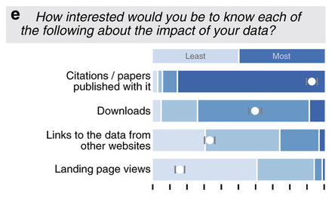
Researchers (n=247) were asked:
“How interested would you be to know each
of the following about the impact of your data?
*White dots show the mean on a scale of one-to-four.
J Kratz and C Strasser. 2015. Making data count. Nature Scientific Data 2: 150039. dx.doi.org/10.1038/sdata.2015.39
Notes:
Data citations are now seen as “the coin of the academic realm” – the most valuable of usage metrics, and more valuable than page views or downloads.
*All error bars depict 95% confidence intervals calculated by basic bootstrap with 10,000 resamplings.

Slide 13
Downloads: Download counts, on the other hand, are both highly valuable and practical to collect. Downloads were a resounding second-choice metric for researchers and 85% of repositories already track them.
Citations: Citations are the coin of the academic realm. They were by far the most interesting metric to both researchers and data managers. Unfortunately, citations are much more difficult than download counts to work with, and relatively few repositories track them. Beyond technical complexity, the biggest challenge is cultural: data citation practices are inconsistent at best, and formal data citation is rare. Despite the difficulty, the value of citations is too high to ignore, even in the short term.
https://datapub.cdlib.org/2015/08/04/2334/
Notes:
Data citations are now seen as “the coin of the academic realm” – the most valuable of usage metrics.

Slide 14
Challenges of tracking informal data citation
Notes:
ICPSR has a large collection and user base…

Slide 15
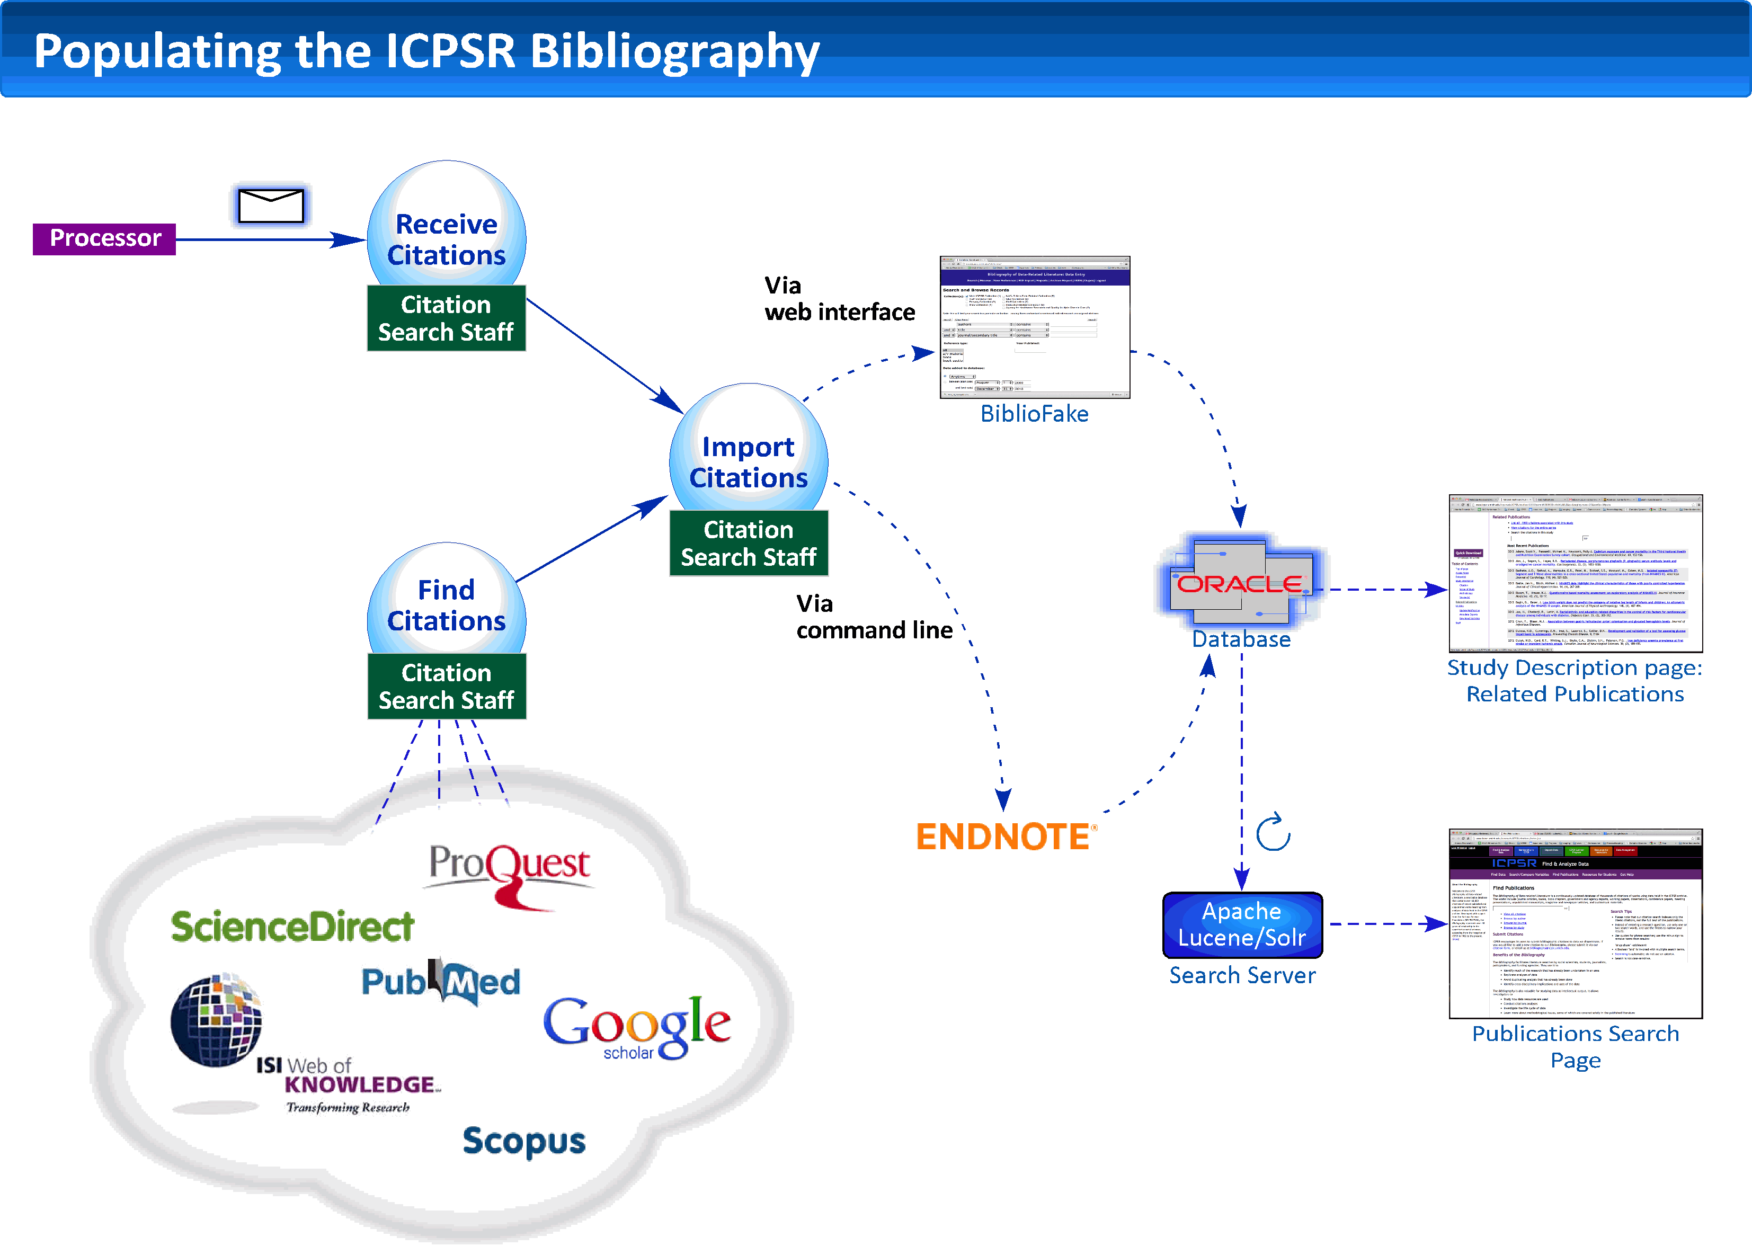
Notes:
While we do get related publications submitted by PIs at the time of deposit, and some secondary users send us citations using ICPSR data, and those who receive restricted data include lists of related publications in an annual report . . . the majority items we have found is by searching the literature ourselves.

Slide 16
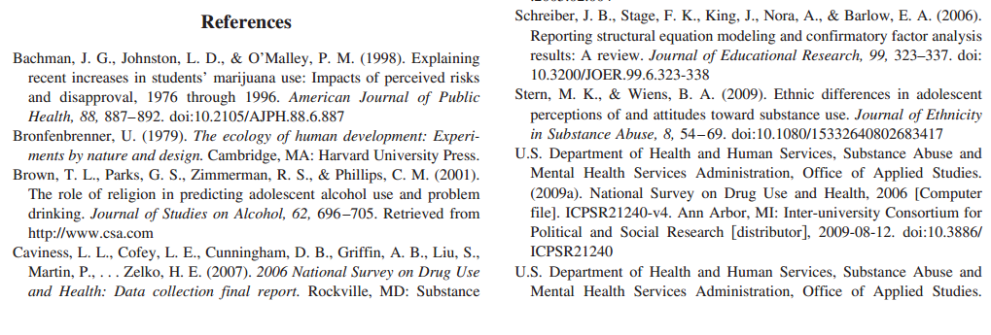
doi:10.3886/ICPSR21240
Notes:
When authors use the data citations we provide to cite the data formally, in the references, entities larger than the individual repository can do this work for us.
They can automate the tracking of data reuse, on a large scale.

Slide 17
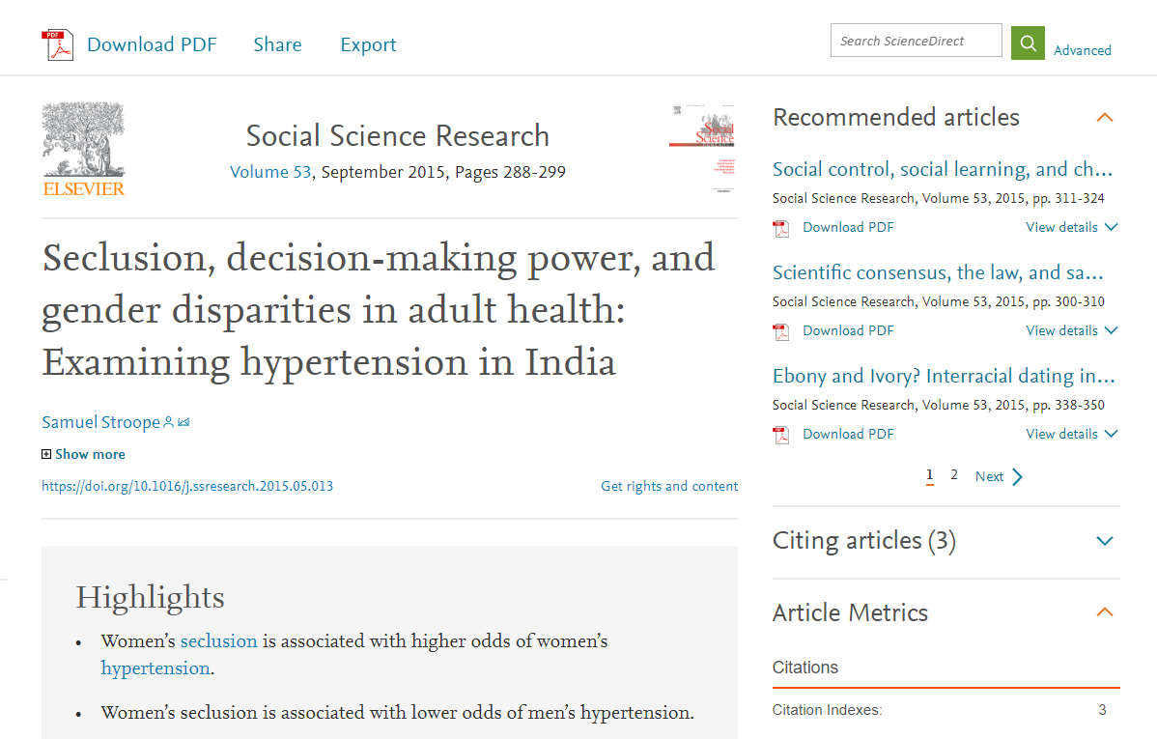
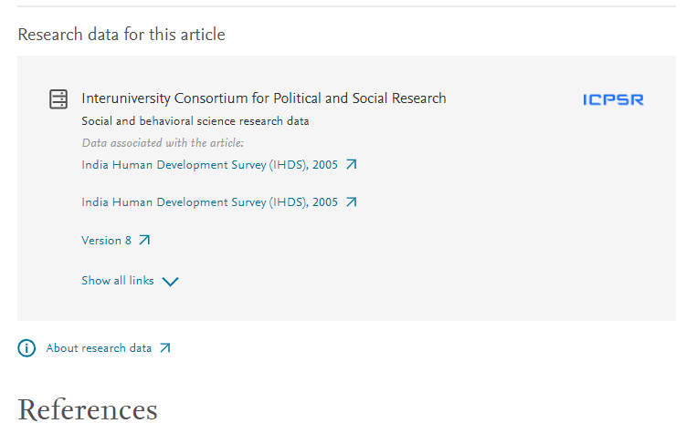

In ScienceDirect
Notes:
Here is just one example of a Science Direct article that takes advantage of an automated service built to connect literature to data. They use an implementation of the Scholix framework that was developed by and RDA/WDS-ICSU working group. DataCite, CrossRef, and repositories contribute links.
But the focus is on the type of data use that machines can detect by finding PIDs like DOIs.

Slide 18
But . . . tracking data use remains primarily a manual process
Most authors do not include formal data citations with machine-readable, persistent identifiers.
A 2018 study of biomedical literature by Park, You, and Wolfram found that “because only 62 of 513 observed instances of initial data reuse were included in the reference section of the examined articles, fewer than 20% of these citations are likely to be indexed in citation databases.”
We risk not counting or linking 80% of data use if we do not track informal data citation.
Notes:
But . . .
Our experience conforms with what Katz & Strasser found: “Data citation practices are inconsistent at best and formal data citation is rare. But despite the difficulty, the value of citations is too high to ignore, even in the short term.”
Park, H., You, S., & Wolfram, D. (2018). Informal data citation for data sharing and reuse is more common than formal data citation in biomedical fields. Journal of the Association for Information Science and Technology, 69(11), 1346–1354. https://doi.org/10.1002/asi.24049

Slide 19
How ICPSR finds and collects informally cited data-related publications
Notes:
But . . .

Slide 20
Challenge 1 (Humans):
Authors don’t “cite data right”
We must create queries using the study name and other metadata. Limiting our collection to only those publications in which ICPSR DOIs were cited would mean most data use would go unlinked and uncounted.
Imprecise by nature, these queries can bring back what we consider to be bad hits. We do not collect data mentioned in passing. ICPSR only collects publications in which the data were analyzed, so distinguishing this must be done with human judgment.
Bad hits=time wasted. Each hit needs to be evaluated, in multiple locations, e.g., the abstract, methods, acknowledgements, footnotes, references, etc.
Notes:
And the

Slide 21
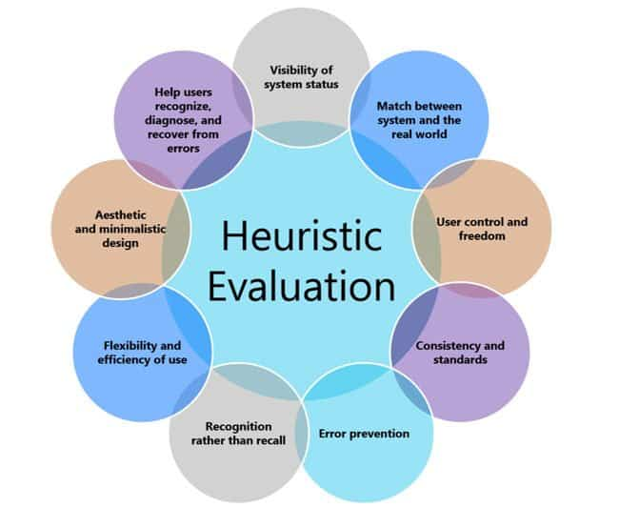
1. Is this already in the Bibliography? If no . . .
6. Did author use something in a series, but didn’t say which specific study? Collect for series.
2. Were the data formally cited in the references? If no . . .
5. Was any year/wave/phase clearly analyzed but not cited in the references? Add those.
Heuristic to evaluate publications for data use
3. Where does query string appear in text? (tables, footnotes, methods, supplement, acknowledgements?)
6. Collect citation and associate with study numbers from ICPSR catalog.
4. If a good “hit” (data analyzed) –5. If a bad “hit” (just mentioned or pub cited)—5a.
If 5a, find cited pubs & check for #1--#5.
If 5. Does ICPSR catalog have same years, waves, panel, sample?
Notes:
Immediate challenges evident:
Why it’s not easy for non-content experts to find citations
It’s manual and time consuming
We’re not mind readers—if the author didn’t clearly tell us, we can only use our best educated guess as to what data were used.

Slide 22
Challenge 2 (Automation):
No Adequate Tools Exist
Data repositories do not have the resources. Manual searching is burdensome for any large and growing collection. In ICPSR’s case, we grow by over a hundred new studies a year.
New automated linking tools are for PIDs only. Publishers and CrossRef/DataCite collaborate only on connecting PIDs together, not informally cited objects.
No good solution for automation at scale. Currently APIs can make comparisons, collection to collection, but that is not enough to be efficient, i.e., high precision with high recall.
Notes:
Repositories feel the impact of informal data citation. Because there are no adequate tools to do this work efficiently.

Slide 23
Challenge 2, cont’d:
No Adequate Tools Exist
You can automate targeted searching at scale, but not evaluation at scale. ICPSR could use APIs to search at scale already. Potential matches based upon narrow identifier criteria (DOI, grant number, ICPSR study number), or a broad textual query (combinations of study title, investigator name, time period, geography, etc.) would act as a filter to avoid, for instance, evaluating every article in ScienceDirect against every ICPSR study. But this would just leave a lot more hits to be evaluated.

Slide 24
Specific types of informal data citation in current use
Notes:
This is what we currently encounter in the social and behavioral science literature.

Slide 25
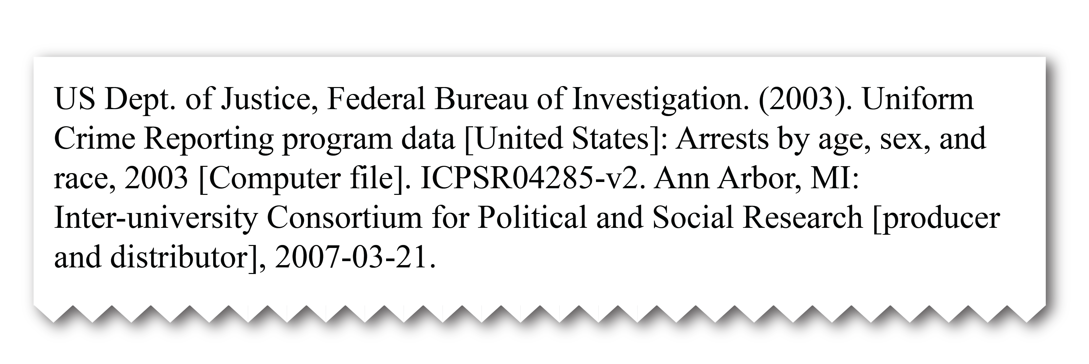
Almost complete
Data are formally cited in the references, but the PID is not included, which would have enabled machine-actionable detection and linking.

Slide 26
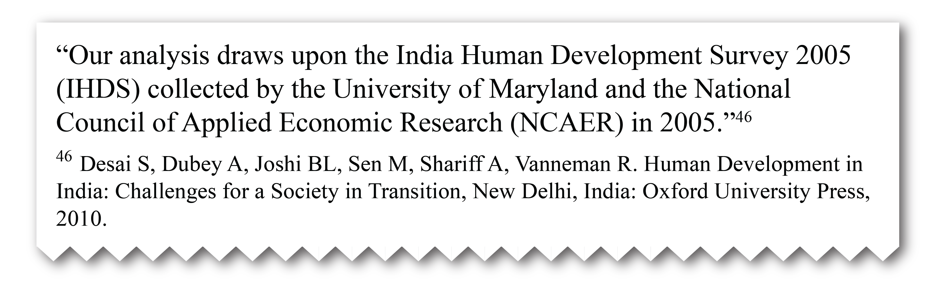
Indirect
A title and year of the data are mentioned in the methods, so it is clear data were used and even named, but no formal reference is made to the data or where they may be accessed. Often, the reference provided is to another publication and not directly to the data.

Slide 27
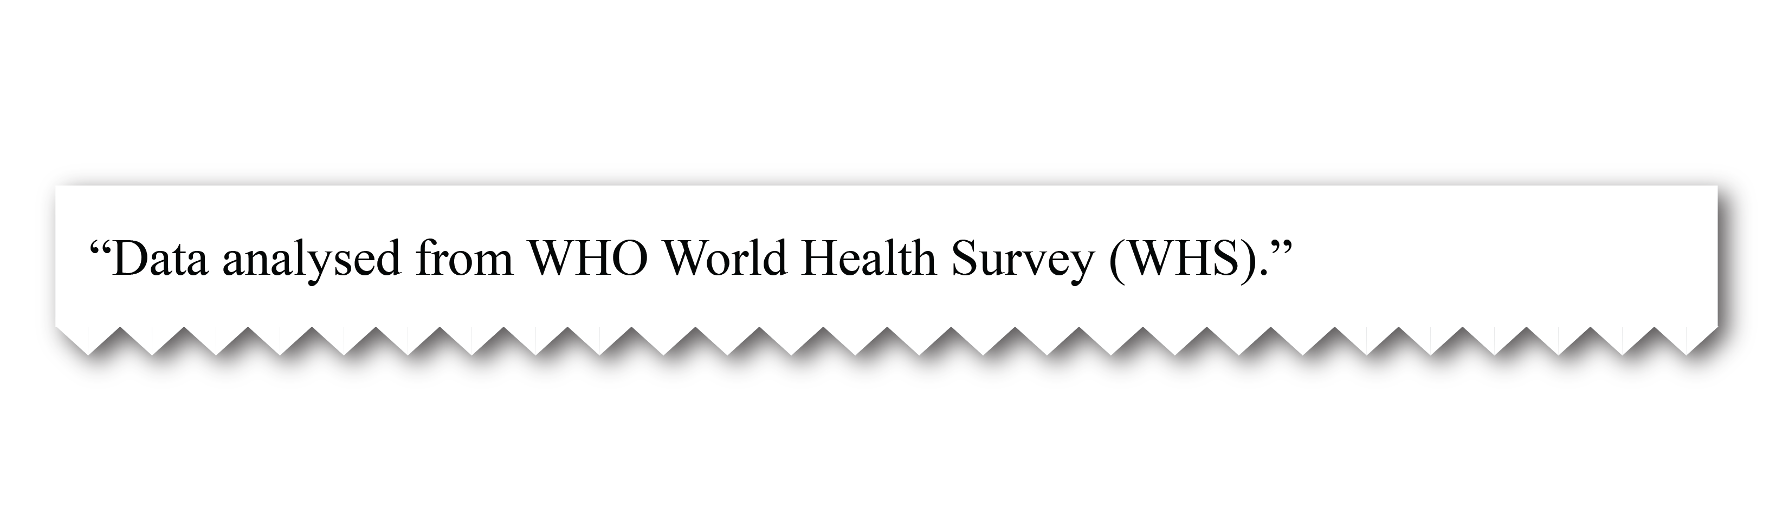
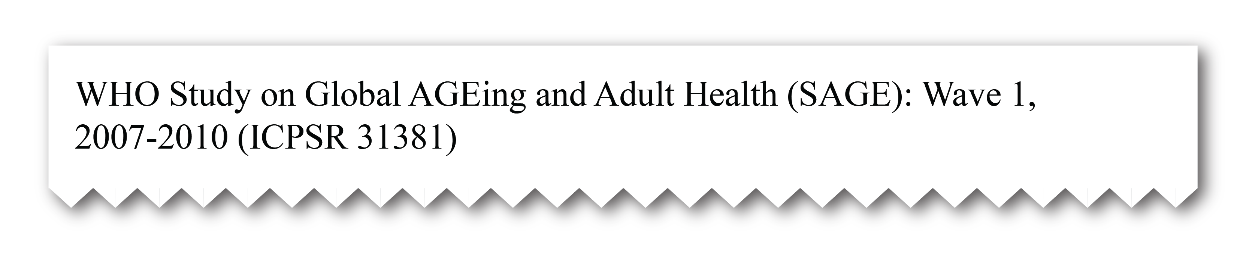
Mismatched
When the data are archived, the title may differ from the title used in publications prior to archiving.
You see it in the literature this way:
Title used when archived:

Slide 28

Barely there
Authors may mention the name of a data collection, and may even provide the specific years analyzed. But they do not include the PID provided by the archive, let alone the version number. Not enough information is provided to know exactly where the author got the data.

Slide 29
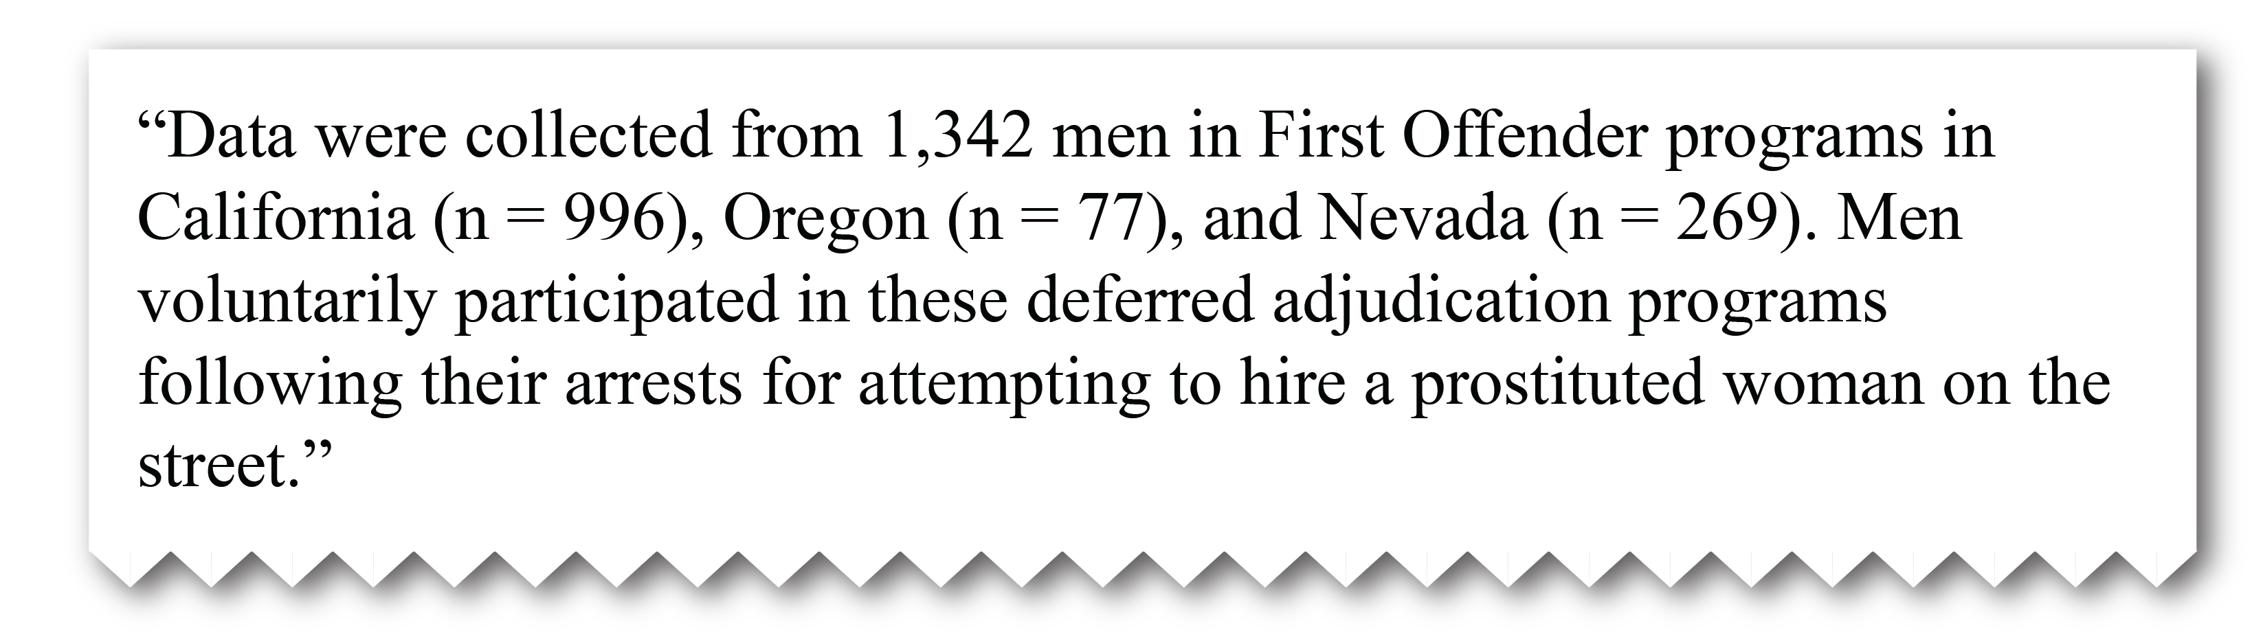
Vaguely described by necessity
The investigator writes about her own data well before having a citation and registered PID.
Or, sometimes, in sensitive areas of research, authors tend to say as little as possible about identifying characteristics of the data, even in broad terms.

Slide 30

Deducible with inside information
In some cases, even though no formal citation is used, an informed reader may know where the data were mandated to be deposited.
In other cases, authors acknowledge assistance from a repository. Or, only a staff member with knowledge of some aspect of the data would be aware of an identifying characteristic.

Slide 31

https://tuffpuppy.fandom.com/wiki/Mind_Reading_Helmet

Slide 32
Suggested improvements
Notes:
Suggestions for reducing effort and expense [Jared]
Changing author behavior
AI
Not be so anal about forcing citation -- the perfect is the enemy of the good.
Rethinking how we educate about data citation
Better incentives
Journal submission requirements

Slide 33
Educate authors

Slide 34
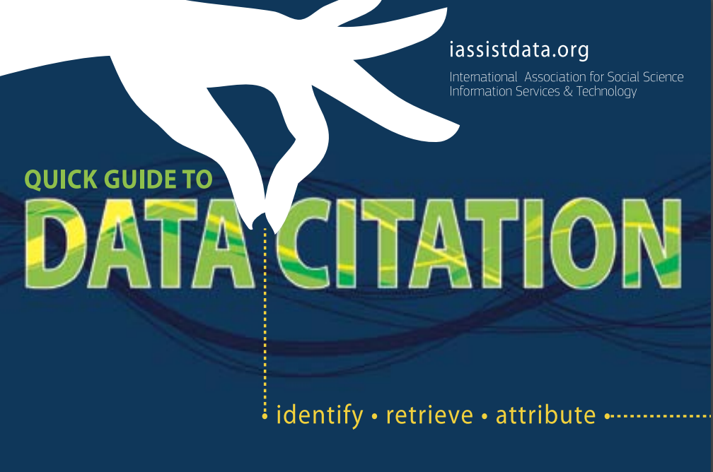
https://iassistdata.org/community/data-citation-ig/data-citation-resources
Notes:
https://iassistdata.org/community/data-citation-ig/data-citation-resources

Slide 35
Most authors do not include formal data citations with machine-readable, persistent identifiers.
A 2018 study of biomedical literature by Park, You, and Wolfram found that “because only 62 of 513 observed instances of initial data reuse were included in the reference section of the examined articles, fewer than 20% of these citations are likely to be indexed in citation databases.”
We risk not counting or linking 80% of data use if we do not track informal data citation.
Notes:
But . . .
Our experience conforms with what Katz & Strasser found: “Data citation practices are inconsistent at best and formal data citation is rare. But despite the difficulty, the value of citations is too high to ignore, even in the short term.”
Park, H., You, S., & Wolfram, D. (2018). Informal data citation for data sharing and reuse is more common than formal data citation in biomedical fields. Journal of the Association for Information Science and Technology, 69(11), 1346–1354. https://doi.org/10.1002/asi.24049
Park, You, & Wolfram (Informal Data Citation...)
low percentage of formal data citation in their sample
PIs formally cite their data (data sharing) even less than re-users

Slide 36
Rethink education about data citation
Many authors don’t know they are supposed to cite data. Failing to give credit to data creators has not been considered plagiarism, nor is there any ethical standard that is uniformly handed down across the social sciences in codified pedagogy.
Many authors still don’t know how to cite data. Until recently, there has been no universally accepted standard way to do so, little support for it in the major style guides, and often journals’ author instructions do not require that data be given attribution, let alone in the references.
Notes:
The author/PI published about her data long before depositing with ICPSR, so she didn’t even have a citation to use, let alone a DOI, when submitting the paper.

Slide 37
Rethink education about data citation
  The author was taught to acknowledge data by citing a report or other written primary works, not the dataset, itself.
  “…authors (and journals) are confused by being asked to cite their own data in their references. You don’t cite your figures or tables, so why would you cite your data? Unless publishers and journals can re-educate the research community into always citing their own datasets, this approach seems unlikely to succeed.”
https://scholarlykitchen.sspnet.org/2018/05/28/whats-up-with-data-citations/

Slide 38
Emphasize use of DOIs
The author did cite the data in the references section, but either was prevented from using a DOI by the journal’s style guide, or did not realize there was one to use.

Slide 39
Change publisher practices

Slide 40
Publishers invest in citation tagging
Devote extra resources at the typesetting phase to get the data citations right.
Publishers pushing for the inclusion of data citations in the references, and tagging them appropriately at typesetting stage.
In-text and data availability statements references to dataset DOIs being tagged as well, so that linkages between articles and their datasets are visible to Crossref, and authors can receive credit for the deposition of their data
https://scholarlykitchen.sspnet.org/2018/05/28/whats-up-with-data-citations/
Notes:
Citations to a publisher’s journals boost Impact Factors, and hence eventual revenue, so having typesetters carefully curate article citations has a commercial incentive.

Slide 41
Incentivize publishers to
require data citations
“Citations to a publisher’s journals boost Impact Factors, and hence eventual revenue, so having typesetters carefully curate article citations has a commercial incentive…. no such incentive exists for open data – having excellent connections between datasets and articles doesn’t have a clear path to future revenue. ”
https://scholarlykitchen.sspnet.org/2018/05/28/whats-up-with-data-citations/

Slide 42
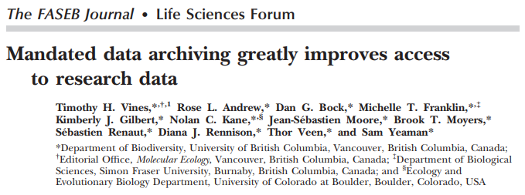
https://doi.org/10.1096/fj.12-218164

Slide 43
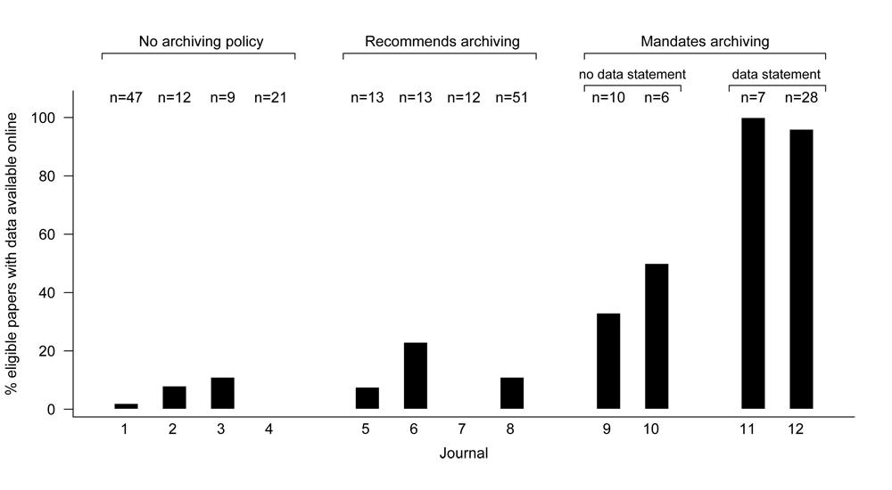
https://doi.org/10.1096/fj.12-218164

Slide 44
Automation: Machine learning
What we need is a tool that can evaluate (via scoring) whether a given article is likely citing (formally or informally) ICPSR study(s).
An evaluative algorithm would be:
  modular in nature (something we would install on our systems)
  able to accept dataset metadata as one input, and the full text of the article as the other input, and return some sort of numeric score that reflects the accuracy of the match.

Slide 45
An evaluative algorithm would be, cont’d:
agnostic, i.e., a repository’s developers could write crawlers that comb through other collections of articles (subscribed to by their institutions) and point those matches at the evaluative algorithm.
flexible, enabling a repository to set and modify thresholds for inclusion/exclusion (to control the volume of hits inherent in at-scale queries), e.g.:
  >90% automatically retain;
  60-90% flag for evaluation;
  <59% ignore entirely, though retain record so it doesn’t pop in future searches

Slide 46
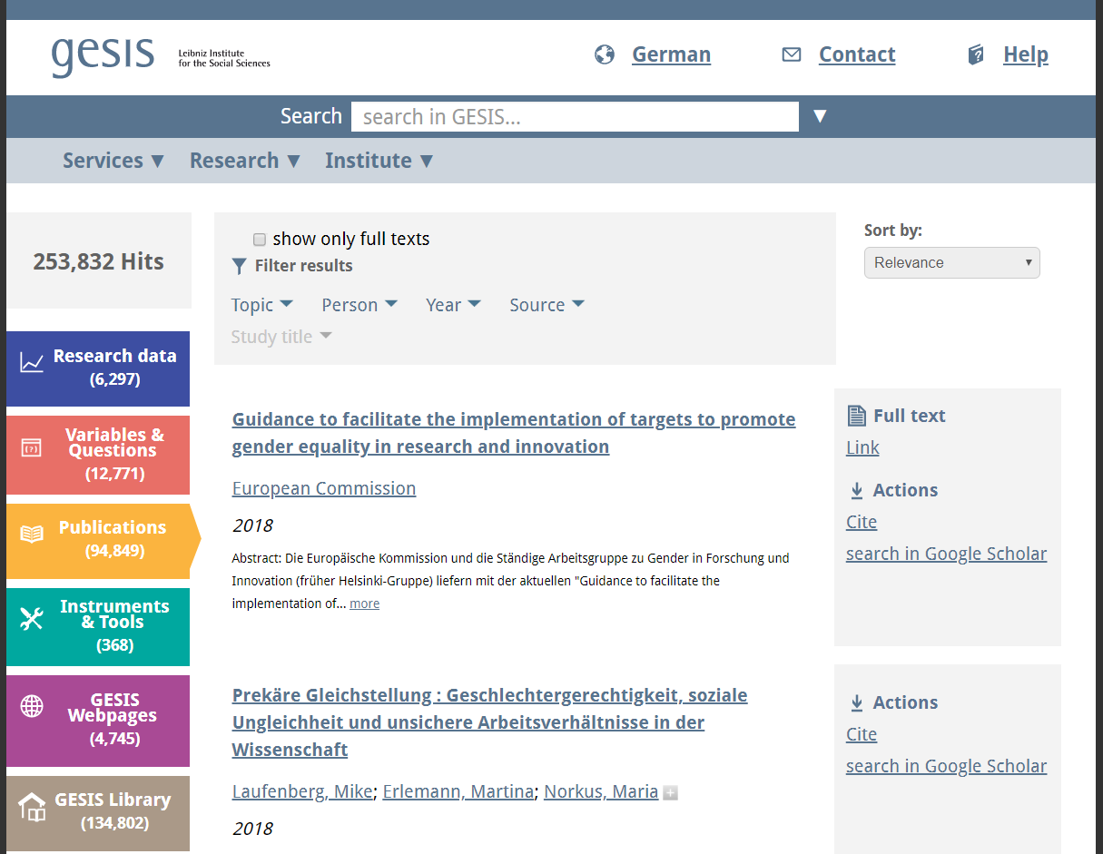
Collaboration
Notes:
Other repositories are tracking data use manually since we don’t have the perfect automated solution…yet. Can we use IASSIST to bring these organizations together to improve practice and help repositories do the manual labor effectively. Pool understanding and resources.

Slide 47
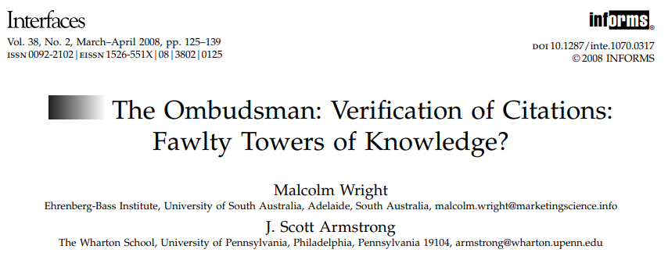
Don’t worry…change takes time
https://pubsonline.informs.org/doi/pdf/10.1287/inte.1070.0317
Notes:
Bad or incomplete citations aren’t unique to the data world. Even after hundreds of years of developing citation practice, citations to literature can be spotty. Wright and Armstrong found that authors often overlook relevant research (omissions) or include incorrect references.
Eichorn and Yankauer (1987) found that 31 percent of the references in public health journals contained errors, and three percent of these were so severe that the referenced material could not be located. Doms (1989) found that 42 percent of references in dental journals were inaccurate—30 percent of these were major errors, such as incorrect journal titles, article titles, or authors. Evans et al. (1990) studied 150 randomly selected references cited in three medical journals and found a 48 percent error rate.

Slide 48
Suggestions?

Slide 49


Slide 50
Thank you!
eammoss@umich.edu
lyle@umich.edu

