Slide 1
ICPSR and CoreTrustSeal:
Repository Certification
Experiences and Opportunities
Jared Lyle
IASSIST
Sydney, NSW, Australia
May 29, 2019
Notes:
For my presentation, I’m going to be discussing the experiences and lessons learned from going through repository self-assessments and formal certifications.

Slide 2
Outline
Overview of ICPSR
Why assessment is important
ICPSR’s experience with assessment, including effort and resources needed
Benefits from assessment
Opportunities to improve the process
Notes:
This is the outline of my presentation this afternoon….

Slide 3
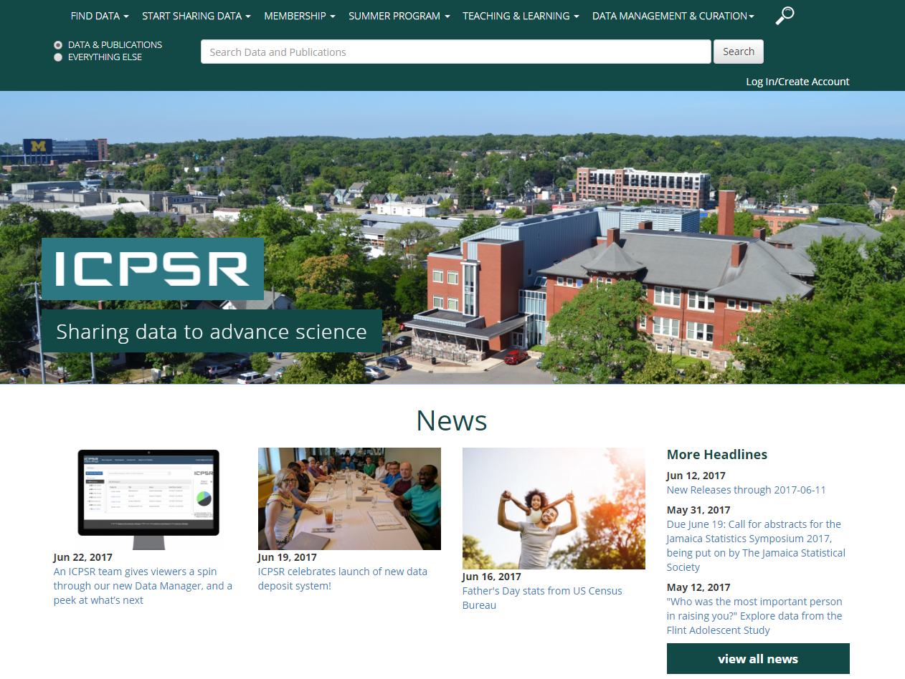
http://www.icpsr.umich.edu
Notes:
First, let me give some background on where I work, ICPSR.

Slide 4
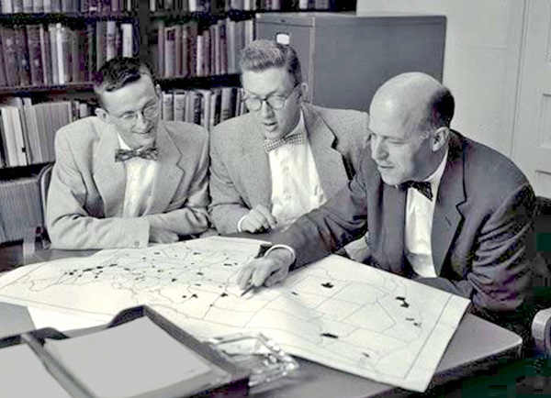
ICPSR
Established 1962
Originally 22 Members, now consortium of 776 world-wide
Originally Political Science, now all social and behavioral sciences
Philip Converse, Warren Miller, and Angus Campbell
Source: http://www.icpsr.umich.edu/icpsrweb/content/membership/history/timeline.html
Notes:
ICPSR stands for the Inter-university Consortium for Political and Social Research (ICPSR)…

Slide 5
ICPSR
Current holdings
  10,000+ studies, quarter million files
  1500+ are restricted studies, almost always to protect confidentiality
  Bibliography of Data-related Literature with 80,000 citations
Approximately 60,000 active MyData (“shopping cart”) accounts
Thematic collections of data about addiction and HIV, aging, arts and culture, child care and early education, criminal justice, demography, health and medical care, and minorities
Notes:
ICPSR has a large collection and user base…

Slide 6
Why Assessment is Important
Notes:
So why should we assess data repositories?

Slide 7
Provide transparent view into the repository
Improve processes and procedures
Measure against a community standard
Show the benefits of domain repositories
Promote trust by funding agencies, data producers, and data users that data will be available for the long term
Dillo, I., & de Leeuw, L. (2018). CoreTrustSeal. Communications of the Association of Austrian Librarians, 71(1), 162-170. https://doi.org/10.31263/voebm.v71i1.1981
Notes:
Assessment is important for several reasons…
These aren’t in the original order as specified by the authors. I’ve placed the internal benefits first.]

Slide 8
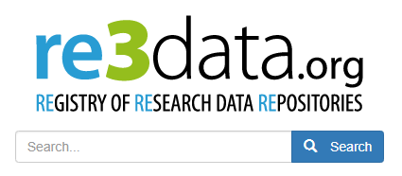
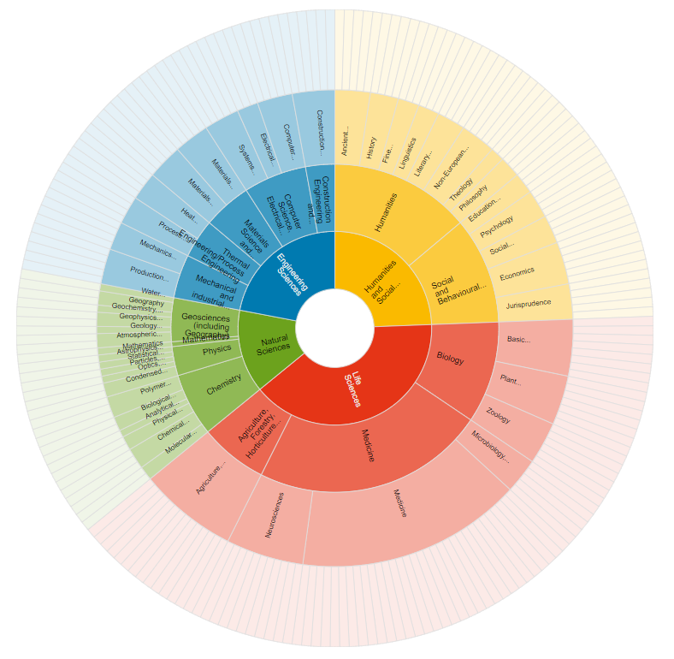
Notes:
There are now thousands of data repositories around the world. re3share is a registry of data repositories. Over 2,000 repositories are indexed. There are probably thousands more ‘in the wild.’

Slide 9
Forever!
Guaranteed!
We promise!
Notes:
Most repositories claim they will store data for the long term, using terms like these.
But can we trust what they say? Can we trust but also verify?

Slide 10
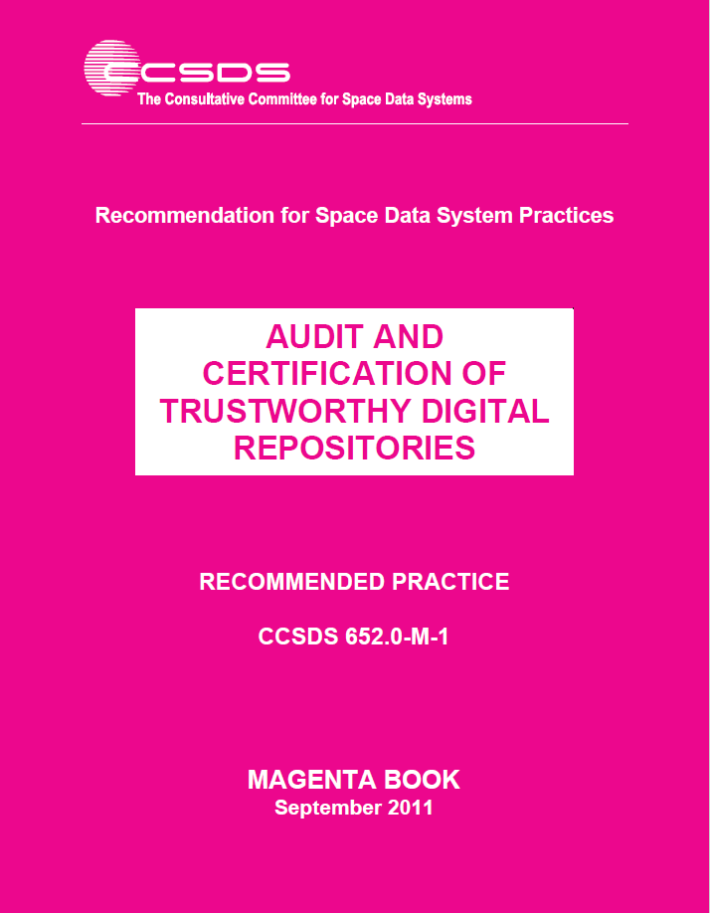
“Claims of trustworthiness are easy to make but are thus far difficult to justify or objectively prove.”

Slide 11
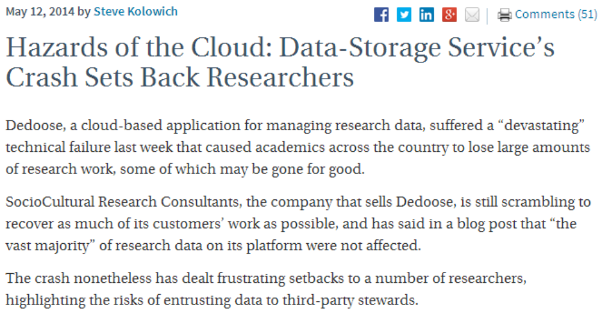
http://chronicle.com/blogs/wiredcampus/hazards-of-the-cloud-data-storage-services-crash-sets-back-researchers/52571
Notes:
This is especially important given examples of repository failures…

Slide 12
If we want to be able to share data, we need to store them in a trustworthy data repository. Data created and used by scientists should be managed, curated, and archived in such a way to preserve the initial investment in collecting them. Researchers must be certain that data held in archives remain useful and meaningful into the future.
“An Introduction to the Core Trustworthy Data Repositories Requirements”
https://www.coretrustseal.org/wp-content/uploads/2017/01/Intro_To_Core_Trustworthy_Data_Repositories_Requirements_2016-11.pdf
Notes:
This quote from “An Introduction to the Core Trustworthy Data Repositories Requirements” provides a good foundation for why repository assessment and certification is important…

Slide 13
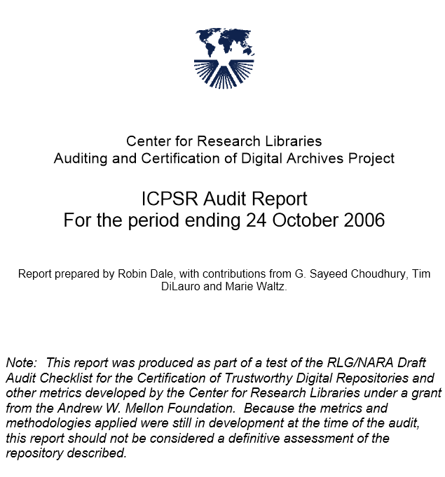
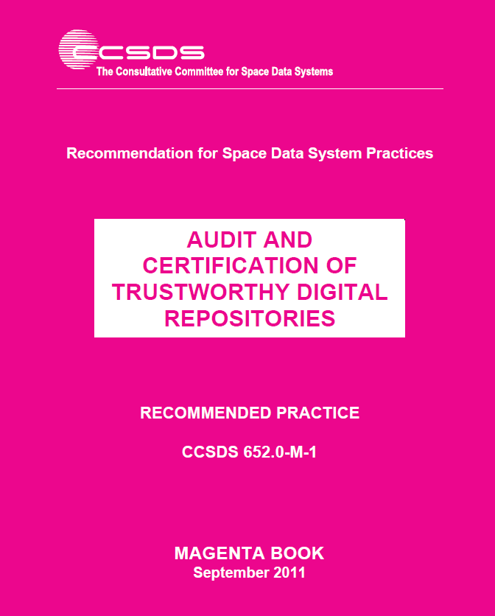



ICPSR Assessment Experience
2005-2006 CRL test audit (TRAC checklist)
2010-2012 TRAC/ISO 16363 self-assessment
2009-2010 Data Seal of Approval certification
2013 Data Seal of Approval (update)
2013 World Data System certification
2018-2019 CoreTrustSeal
Notes:
ICPSR has experience going participating in many of the assessment options. Let me tell you about these, including the effort and resources required, the assessment findings, and the changes we made as a result of the findings.
I’ve also included links to the assessment documentation we completed for each assessment – for your reference.

Slide 14
Common Elements of Assessment
The Organization and its Framework
  Governance, staffing, policies, finances, etc.
Technical Infrastructure
  System design, security, etc.
Treatment of the Data
  Access, integrity, process, preservation, etc.

Slide 15
CRL Test Audit, 2005-2006
Test methodology based on RLG-NARA Checklist for the Certification of Trusted Digital Repositories
Assessment performed by an external agency (CRL)
Precursor to current TRAC audit/certification
ICPSR Test Audit Report: http://www.crl.edu/sites/default/files/attachments/pages/ICPSR_final.pdf
Notes:
Center for Research Libraries

Slide 16
Effort and Resources Required
Completion of Audit Checklist
Gathering of large amounts of data about the organization – staffing, finances, digital assets, process, technology, security, redundancy, etc.
Weeks of staff time to do the above
Hosting of audit group for two and a half days with interviews and meetings
Remediation of problems discovered

Slide 17
Findings
Positive review overall:
Taken as a whole, ICPSR appears to provide responsible stewardship of the valuable research resources in its custody. Depositors of data to the ICPSR data archives and users of those archives can be confident about the state of its operation, and the processes, procedures, technologies, and technical infrastructure employed by the organization.

Slide 18
Findings
Positive review overall, but…
Succession and disaster plans needed
Funding uncertainty (grants)
Acquisition of preservation rights from depositors
Need for more process and procedural documentation related to preservation
Machine-room issues noted

Slide 19
Changes Made
Hired a Digital Preservation Officer
Created policies, including Digital Preservation Policy Framework, Access Policy Framework, and Disaster Plan
Changed deposit process to be explicit about ICPSR’s right to preserve content
Continued to diversify funding (ongoing)
Made changes to machine room

Slide 20
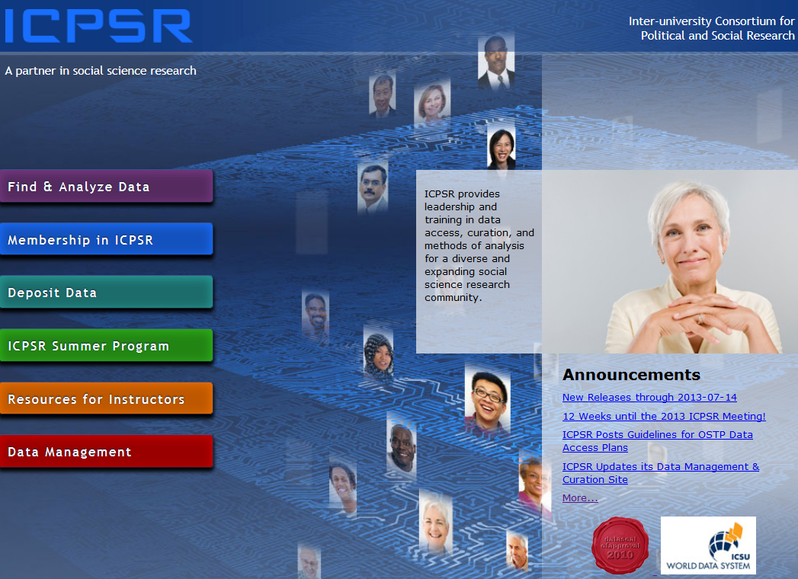
DSA Self-Assessment, 2009-2010
http://assessment.datasealofapproval.org/assessment_78/seal/pdf
http://hdl.handle.net/2027.42/144318

Slide 21
Data Seal of Approval
Started by DANS in 2009
The objectives of the DSA are to “safeguard data, to ensure high quality and to guide reliable management of data for the future without requiring the implementation of new standards, regulations, or high costs.”
http://www.datasealofapproval.org/en/information/about/
Notes:
In 2013, about 20 repositories had been certified.

Slide 22
Data Seal of Approval
16 guidelines – 3 target the data producer, 3 the data consumer, and 10 the repository
Example guideline: (7) The data repository has a plan for long-term preservation of its digital assets.
Self-assessments are done online with ratings and then peer-reviewed by a DSA Board member
Notes:
In 2013, about 20 repositories had been certified.

Slide 23
Procedures Followed
Digital Preservation Officer and Director of Collection Delivery conducted self-assessment, assembled evidence, completed application
Provided a URL for each guideline

Slide 24
Effort and Resources Required
Mainly time of the Digital Preservation Officer and Director of Collection Delivery
Would estimate two days at most
Less time required to recertify every two years

Slide 25
Findings and Changes Made
Recognized need to make policies more public – e.g., static and linkable Terms of Use (previously only dynamic)
Reinforced work on succession planning – now integrated into Data-PASS partnership agreement
Underscored need to comply with OAIS –building a new system based on it

Slide 26
CoreTrustSeal, 2018-2019

Slide 27
CoreTrustSeal
Developed by the DSA-WDS Partnership Working Group on Repository Audit and Certification, a Working Group of the Research Data Alliance
Merging of the Data Seal of Approval certification and the World Data System certification
16 criteria (guidelines)

Slide 28
Requirements
16 criteria (guidelines):
  Organizational Infrastructure (6)
  Digital Object Management (8)
  Technology (2)

Slide 29
Example of Evidence – R5
Guideline Text: R5. The repository has adequate funding and sufficient numbers of qualified staff managed through a clear system of governance to effectively carry out the mission

Slide 30
Example of Evidence – R5
Guidance: The range and depth of expertise of both the organization and its staff, including any relevant affiliations (e.g., national or international bodies), is appropriate to the mission.

Slide 31
ICPSR Response: R5 (one part)
A 12-person Council whose members are elected by the ICPSR membership provides guidance and oversight to ICPSR. Members serve four-year terms, and six new members are elected every two years. The Council acts on administrative, budgetary, and organizational issues on behalf of all the members of ICPSR. [6]
ICPSR’s staff of over 100 perform a variety of functions to support ICPSR’s archival and training missions. The staff include data curators and managers, librarians, Web developers, communications specialists, user support specialists, administrative staff, and a small team of researchers, as well as software developers, programmers, system administrators, and desktop support specialists. Staff have expertise in digital archiving, data preservation, usability testing, Section 508 review for ADA Section 8 compliance, DOI registration, web traffic analytics, search engine optimization, storage and dissemination of sensitive data, restricted-use data agreements, and researcher credentialing. All staff are required to complete ongoing training related to data security and disclosure risk. [7]

Slide 32
ICPSR Response: R5 (references)
References:
[1] ICPSR Web site, About the Organization: https://www.icpsr.umich.edu/icpsrweb/content/about/index.html (accessed 2018-10-04)
[2] ICPSR 2016-2017 Annual Report, Financial Reports: https://www.icpsr.umich.edu/files/ICPSR/about/annualreport/2016-2017.pdf (accessed 2018-11-08)
[3] ICPSR Web site, Thematic Data Collections: https://www.icpsr.umich.edu/icpsrweb/content/about/thematic-collections.html (accessed 2018-10-04)
[4] ICPSR Web site, List of Member Institutions and Subscribers: https://www.icpsr.umich.edu/icpsrweb/membership/administration/institutions (accessed 2018-11-06)
…

Slide 33
Effort and Resources Required
3-5 days of time by the Director of Metadata and Preservation
Less time required to certify every 3 years

Slide 34
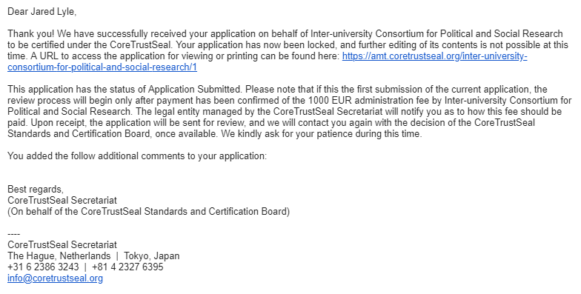

Slide 35
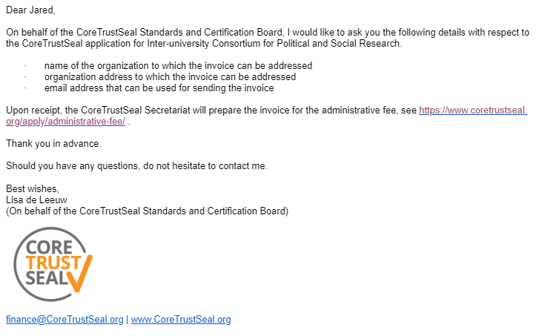

Slide 36
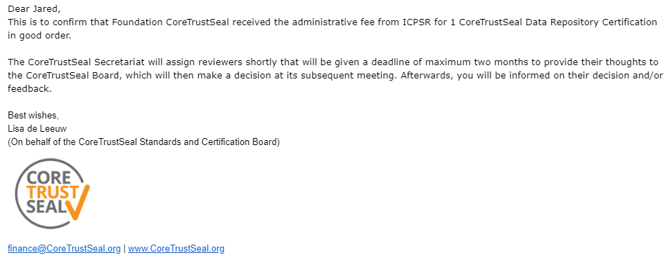

Slide 37
Still in progress
All areas marked by reviewers as
  4 – The guideline has been fully implemented in the repository
Reviewer feedback:
“This is a well-structured, written and evidenced application. The only suggestion is to briefly review self-assessment statement related to external evidence links to ensure they clarify which aspect of the evidence is relevant. It would also be helpful to clarify which parts of the linked evidence is relevant in the case of longer documents.”

Slide 38
Findings and Changes Made
Ancillary fine-tuning:
  R13. The repository enables users to discover the data and refer to them in a persistent way through proper citation.
  Making older versions of collections available
  File-level persistent identifiers and citations
Other fine-tuning:
  R3. The repository has a continuity plan to ensure ongoing access to and preservation of its holdings.

Slide 39
Comparison of Assessments – Effort and Resources
Test audit was the most labor- and time-intensive
TRAC self-assessment involved the time of more people
CoreTrustSeal (Data Seal of Approval and World Data System) certification least costly
Notes:
Additional observations:
-Try not to integrate details about technology that may change
-Schedule regular reviews of policies included in the assessments

Slide 40
Comparison of Assessments – Benefits
What did we learn and did the results justify the work required?
  Test audit was first experience – resulted in greatest number of changes, greatest increase in awareness
  Fewer changes made as a result of CoreTrustSeal (DSA and WDS); also not as detailed
  TRAC assessment has surfaced additional issues to address

Slide 41
Benefits continued
Difficult to quantify
  Trust of stakeholders
  Transparency
  Teaching opportunity for new staff
  Improvements in processes and procedures
  Use of community standards and alignment across domains

Slide 42
Other comparisons
Support by leadership
Organization-wide involvement
Interest from community

Slide 43
More opportunities
IASSIST community of practice for social science CoreTrustSeal applicants and recipients
Machine-actionable documentation

Slide 44
Thank you!
lyle@umich.edu

