Slide 1


What difference does curation make?
Introducing MICA: Measuring the Impacts of Curatorial Actions
Libby Hemphill
Director, Resource Center for Minority Data
Associate Professor

Slide 2
What’s ICPSR?
Founded in 1962 by 22 universities, now consortium of 800 institutions world-wide
Focus on social and behavioral science data, broadly defined
10K studies, 250K files
1500 are restricted studies, almost always to protect confidentiality
Bibliography of Data-related Literature with 75,000 citations
Approximately 60,000 active MyData (“shopping cart”) accounts

Slide 3
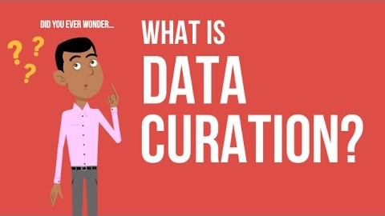
What’s data curation at ICPSR?

Slide 4
What’s MICA?

Slide 5
Develop curatorial metrics to evaluate the impact and efficacy of
specific data curation processes.

Slide 6


Funders
IMLS Award #LG-37-19-0134-19
NSF Award #1930645

Slide 7
The Team
Libby Hemphill | ICPSR, UMSI
Andrea Thomer | UMSI
Dharma Akmon | ICPSR
Elizabeth Yakel | UMSI
Amy Pienta | ICPSR
David Bleckley | ICPSR
Elizabeth Moss | ICPSR
Faculty Research Fellow | ICPSR
Membership and Communication Team | ICPSR

Slide 8
Research Questions
What impacts do specific curatorial actions have on research data’s impact or reuse?
How should we prioritize curatorial actions to achieve impact and return on investment?

Slide 9
Project Activities
Activity | Method
Understanding values, priorities, and curatorial actions | semi-structured interviews, content analysis
Measuring reuse and impact | multivariate regression, structural equation modeling
Generating curatorial metrics | structural equation modeling, path analysis

Slide 10
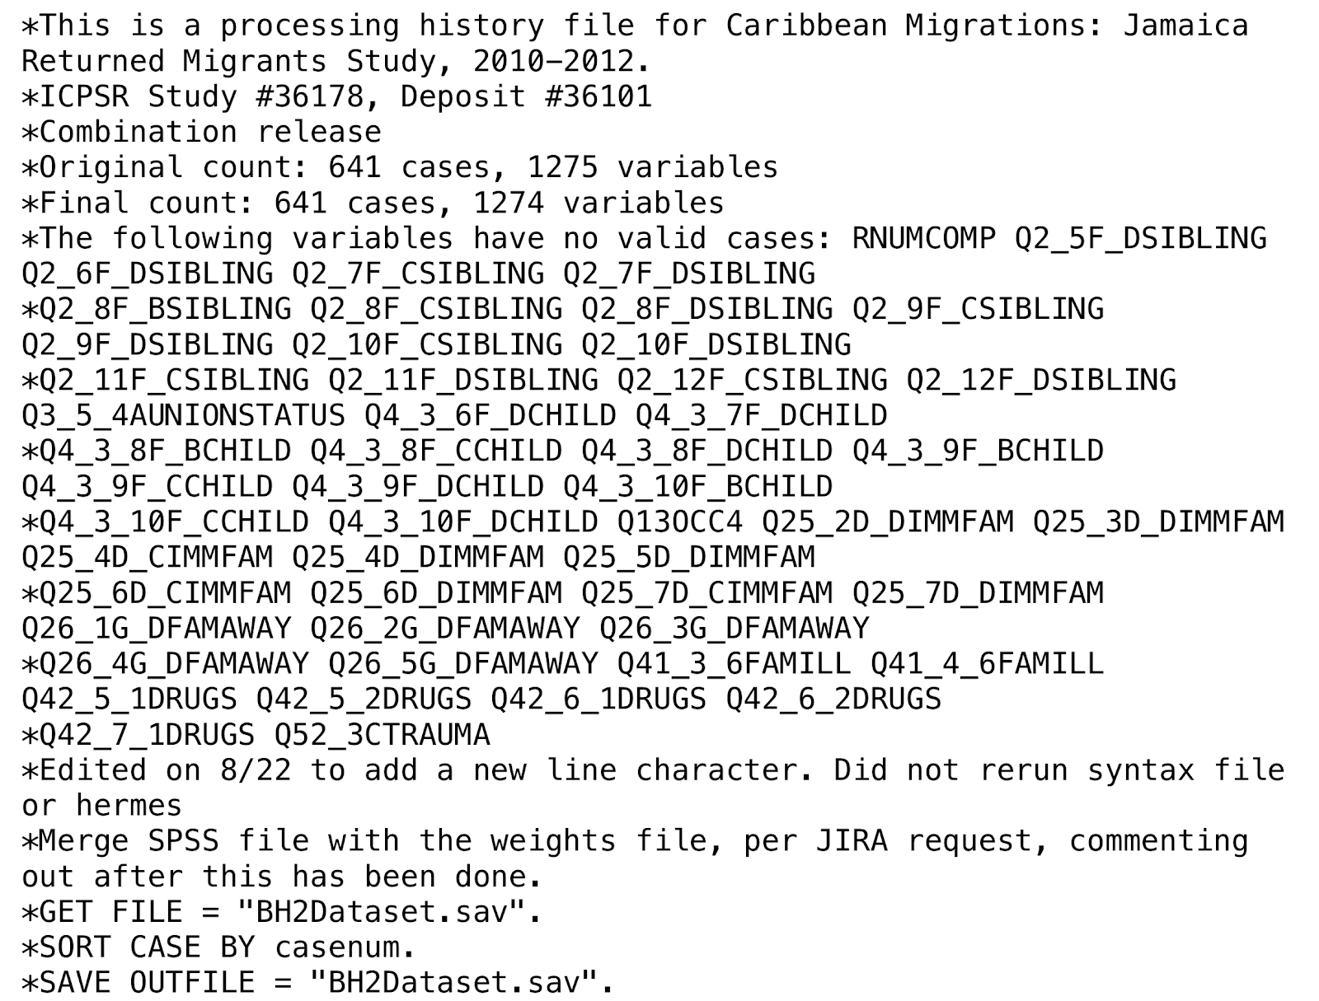
Understanding Curatorial Actions

Slide 11
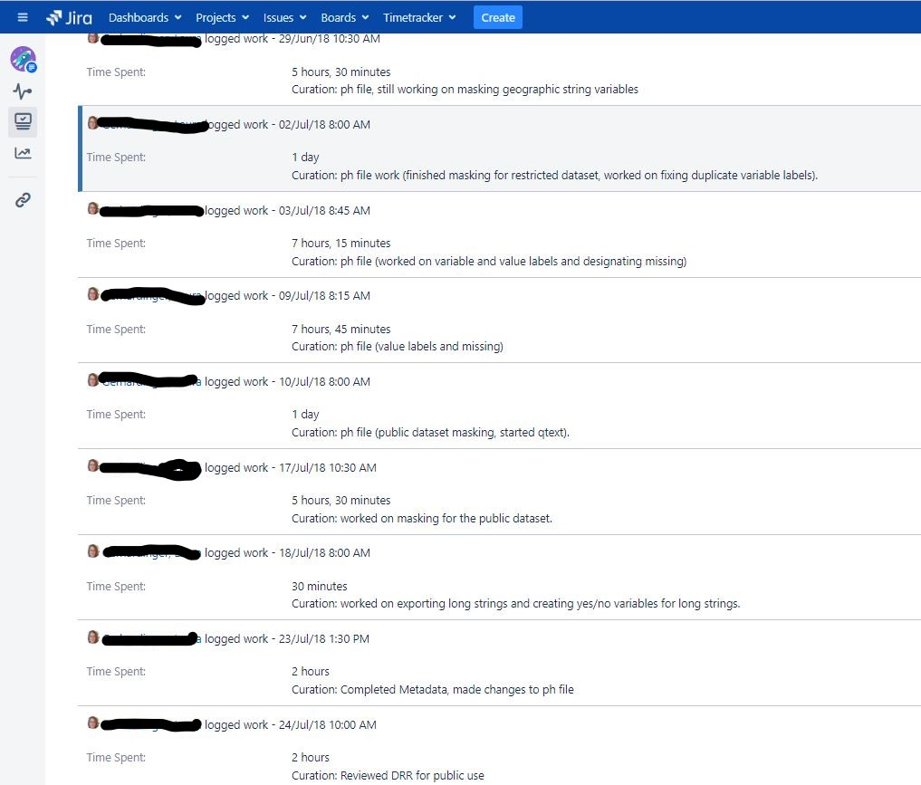
Understanding Curatorial Actions

Slide 12
Measuring Reuse and Impact
Secondary impact: how many times studies that reuse a particular dataset are cited
Diversity: breadth of disciplines that use the data

Slide 13
Dependency: Complete Bibliography
Almost complete: the data are formally cited in the references, but the DOI or identifier is not included
Indirect: the data are referred to by name, or another publication associated with data is cited

Slide 14
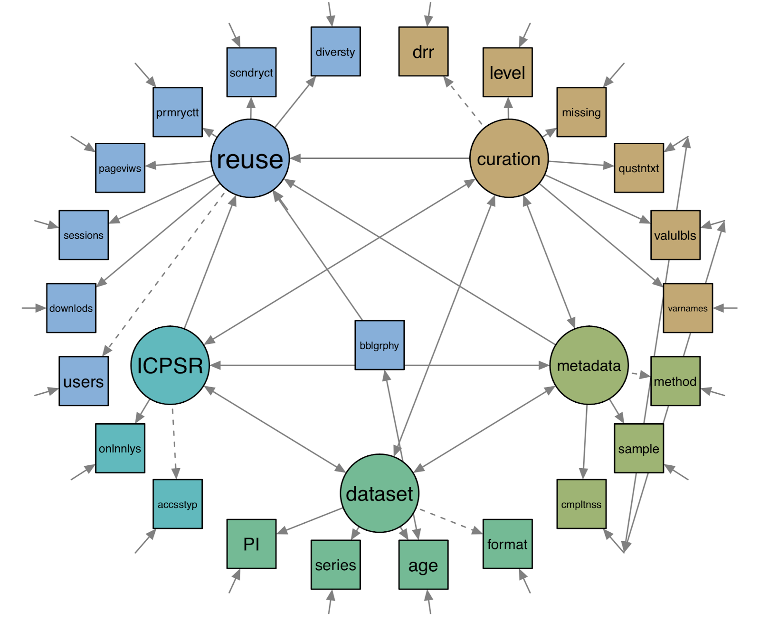
Generating Curatorial Metrics

Slide 15
Pilot: What Impacts Data Downloads?
Year of Release | # Studies Released | Percent (n=2,225)
2006 | 173 | 7.78
2007 | 202 | 9.08
2008 | 270 | 12.13
2009 | 210 | 9.44
2010 | 196 | 8.81
2011 | 217 | 9.75
2012 | 177 | 7.96
2013 | 275 | 12.36
2014 | 224 | 10.07
2015 | 281 | 12.63
Notes:
All releases 2006-2015

Slide 16
Pilot: What Impacts Data Downloads?
 |  | Model 1 | Model 2 | Model 3
Study Properties
 | Series (0 = No; 1 = Yes) | -0.55*** | -0.52*** | -0.70***
 | Variables (0 = 0-199; 1 = 200+) |  | 0.93*** | 0.61***
 | Single PI (0 = No; 1 = Yes) |  |  | -0.15*
Curation Activity
 | Sponsored (0 = No; 1 = Yes) |  |  | 0.87***
 | Intense curation (0 = No; 1 = Yes) |  |  | 0.60***
 | N metadata terms |  |  | 0.01*
Notes:
being part a series and having a single PI correlate with fewer downloads, and all other factors correlate with more. Curation activities, especially archive sponsorship and intense curation, likely increase downloads.

Slide 17
Pilot: What Impacts Data Downloads?
Predictions | Result
Curation activity will increase downloads. | Support
Which curation activities will have the most impact? | Sponsorship and intense curation
Bigger studies will receive more downloads. | Supported
Series will receive more downloads | Not supported

Slide 18
Thank you!
Main Goal
Develop curatorial metrics to evaluate the impact and efficacy of specific data curation processes.
Award Info
IMLS Award #LG-37-19-0134-19
NSF Award #1930645
Contact
Libby Hemphill
libbyh@umich.edu
@libbyh

