Slide 1
Resources for Gerontological and Social Science Researchers from NACDA
NACDA Data Project Manager Kathryn Lavender
December 11, 2019

Slide 2
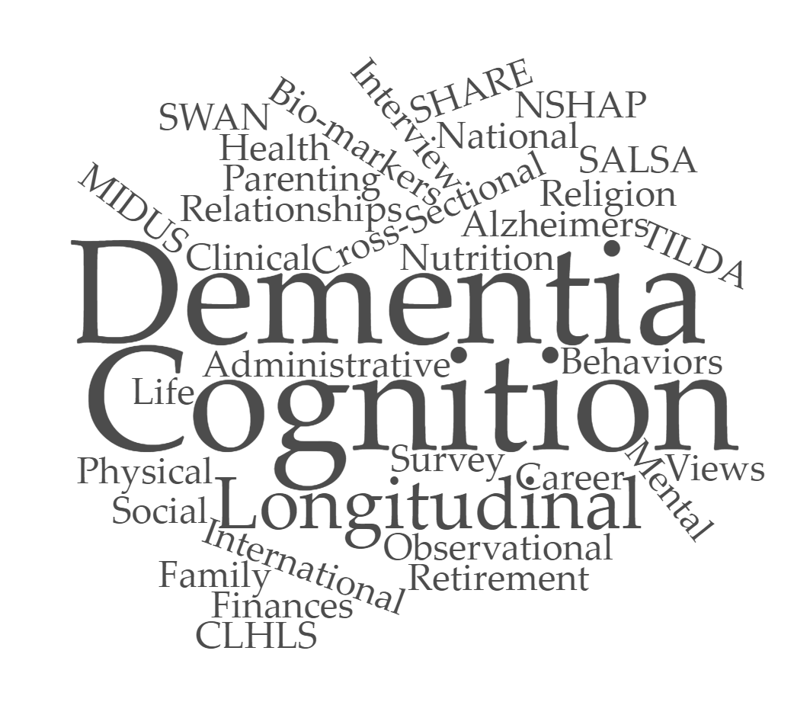
Plan
About us
Popular Studies
Accessing the data
Deposit data
Colectica Portal and Additional Resources
Ask questions

Slide 3
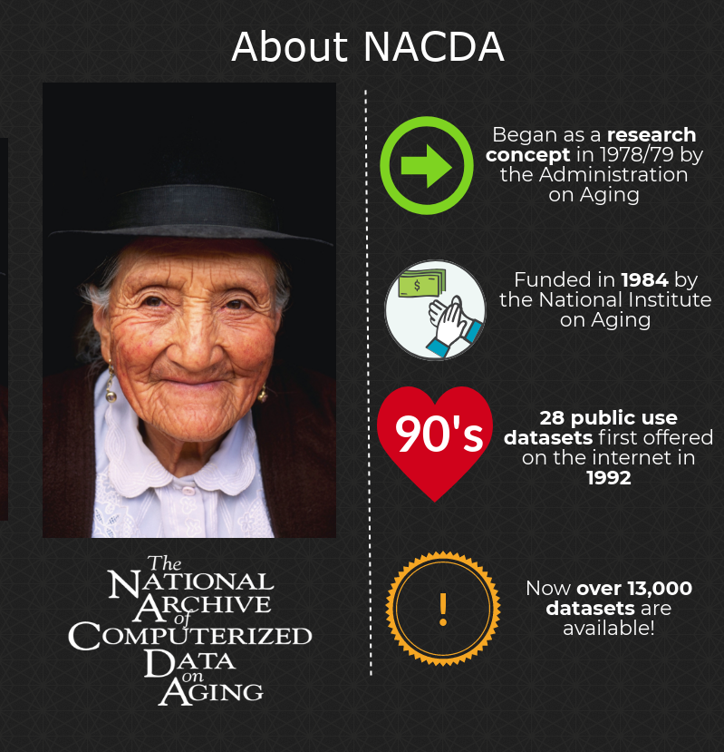


We
preserve
and
share
data on aging
Notes:
NACDA:
funded by the National Institute on Aging
part of ICPSR
acquires and preserves data relevant to gerontological research

Slide 4
Steering Committee
The Charge of the Steering Committee from Archiving and Sharing of Longitudinal Data Resources on Aging (U24) FOA:
A Steering Committee will serve as the main governing board for the collaborative agreement funded to support the FACTORS in Aging application.
(Chair) Ken Ferraro, Ph.D. – Committee Chair
Director of Center on Aging and the Life Course at Purdue University
Jennifer Ailshire, Ph.D.
Assistant Professor of Gerontology and Sociology at USC Leonard Davis
Margaret Gatz, Ph.D.
Professor of Psychology, Gerontology and Preventive Medicine at the University of Southern California
Louise Hawkley, Ph.D.
Senior Research Scientist at NORC
Peter A. Lichtenberg, Ph.D.
Director of the Institute of Gerontology and the Merrill Palmer Skillman Institute at Wayne State University
Barry Radler, Ph.D.
Researcher, Institute on Aging at the University of Wisconsin-Madison
George Rebok, Ph.D.
Professor, Johns Hopkins University
Notes:
The Steering Committee meets twice a year to help us define goals, discuss progress and provide feedback, and discuss the needs of the gerontological research community.

Slide 5

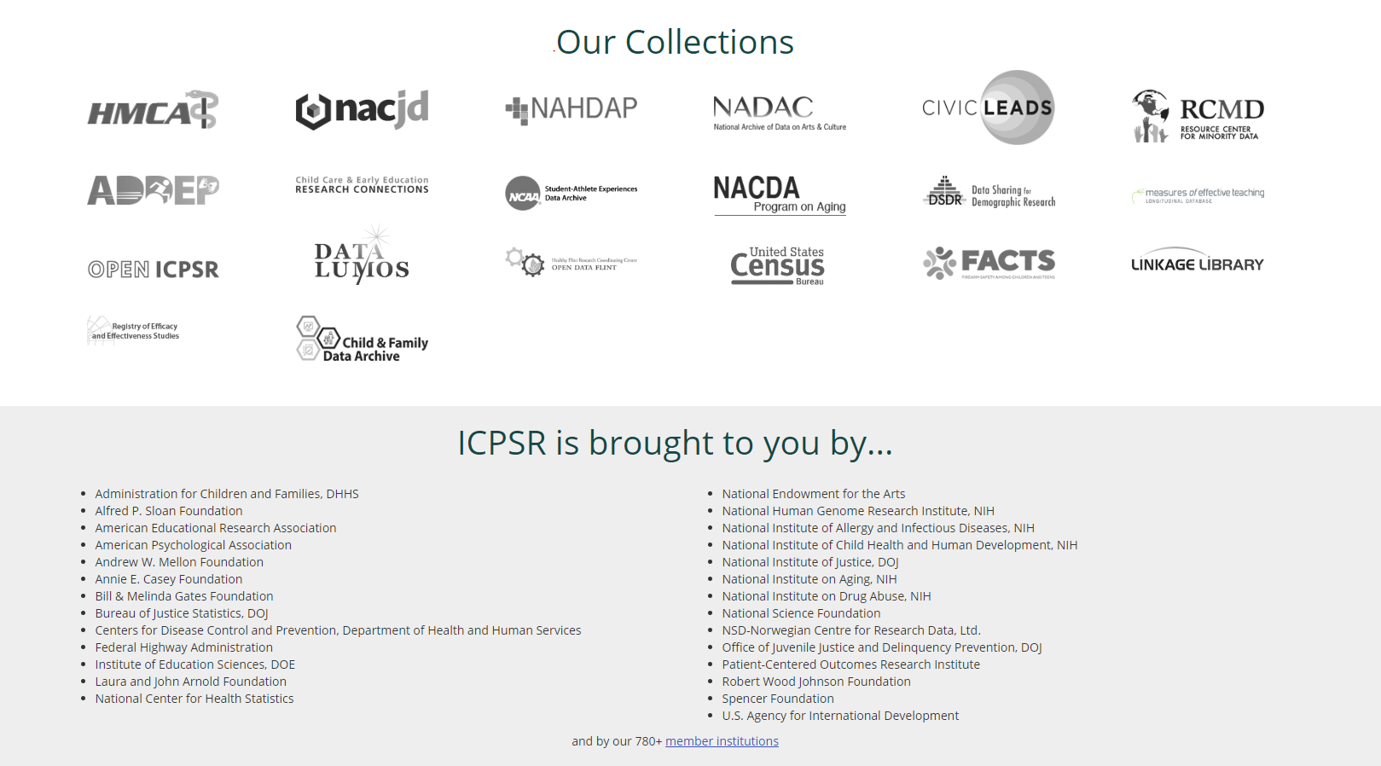
Notes:
We are part of ICPSR – if you go to the ICPSR home page and scroll down, you will see all of the wonderful data archives that make ICPSR what it is today.

Slide 6
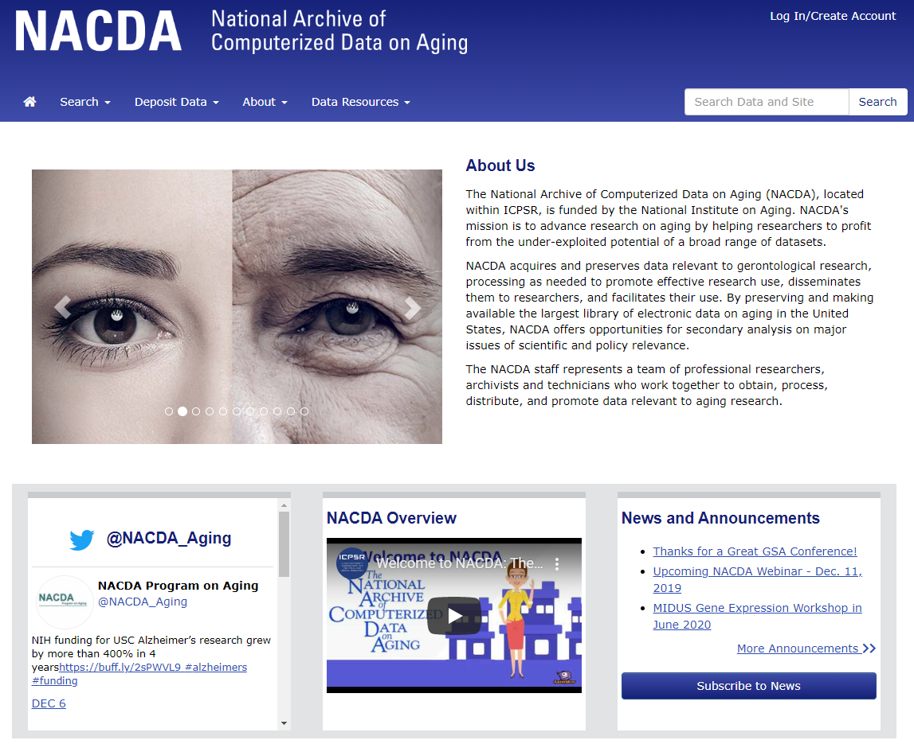
Go to our site!
Notes:
You might get to our page and wonder – where do I start?
Do you have a research topic in mind? - start with searching?
Do you already know of a dataset you need? Start with searching for that.
Do you have no idea what we do and want a quick explanation – watch that video in the middle.

Slide 7
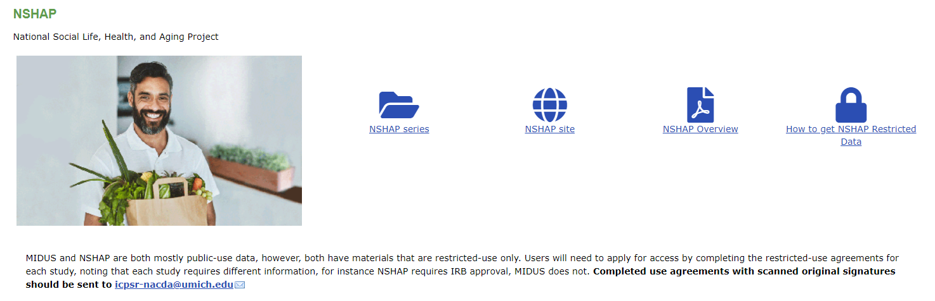
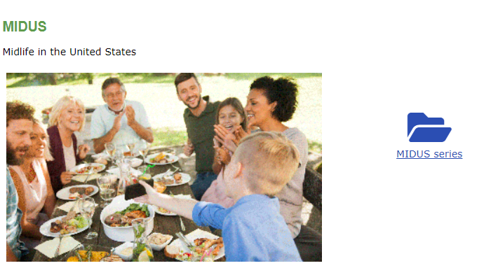



Popular Studies We Share
Notes:
NIA funded data primarily, but we accept any data on gerontological research.
MIDUS
NSHAP
SWAN
TILDA
Add Health Parent Study
HEPESE

Slide 8
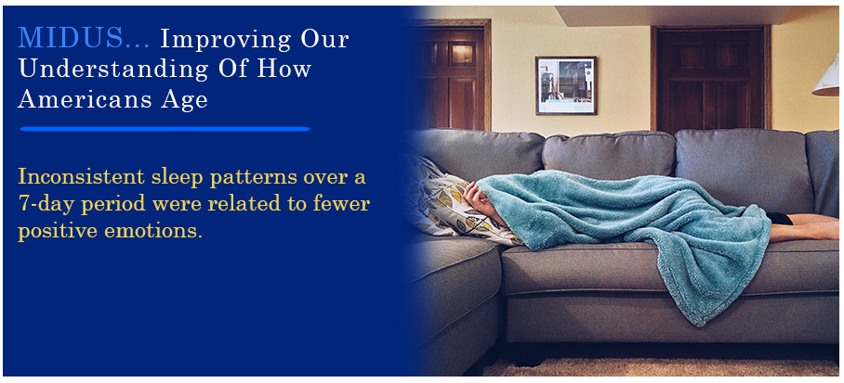
MIDUS
From the Institute on Aging at the University of Wisconsin-Madison
25 Studies in the MIDUS series
Mostly public use
MIDJA – Japanese sample
Longitudinal - M1; M2; M3
Refresher (new cohort)
Sample of African Americans from Milwaukee
Notes:
Has data on psychological factors (e.g., personality traits, well-being, positive and negative affect, sense of control, goal commitments), marital status, family structure, socioeconomic standing, social participation, social support, employment status, health status, health care utilization).

Slide 9

NSHAP
The NSHAP Wave 1 (National Social Life, Health, and Aging Project)
Over 200 “partner” variables
Over 200 “relationship” variables
From NORC at the University of Chicago
Longitudinal - 3 Waves of Data
Mixed public and restricted use
150 “sex” variables
Notes:
Integrates physical, psychological, sensory, functional, cognitive, and especially social dimensions, including social networks and intimate relationships.
My director likes to say this is one of the few studies on aging adults that actually treats them like adults.

Slide 10

Accessing Data

Slide 11
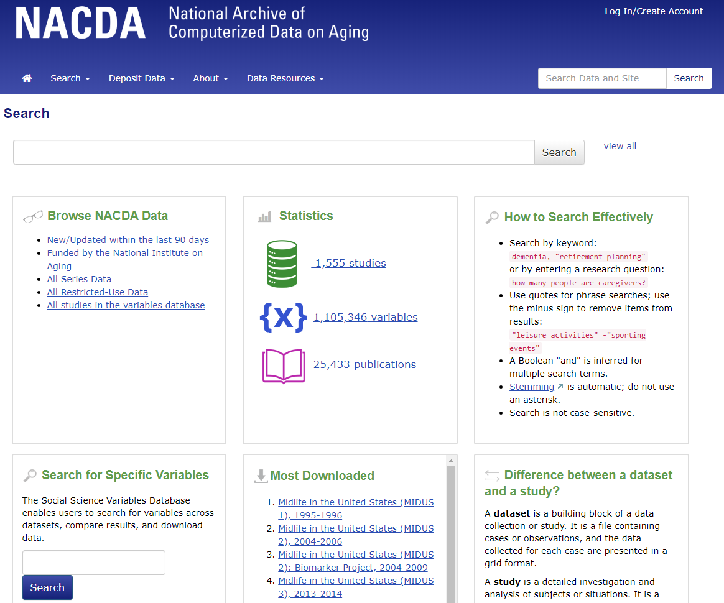
Searching for
Data
Notes:
There’s a persistent search box, helpful tips on how to search, and quick links to popular datasets. They all search the same holdings.
There are lots of options to search by – keyword, the features you see here on the search page, but my favorite way to search is by variable.

Slide 12
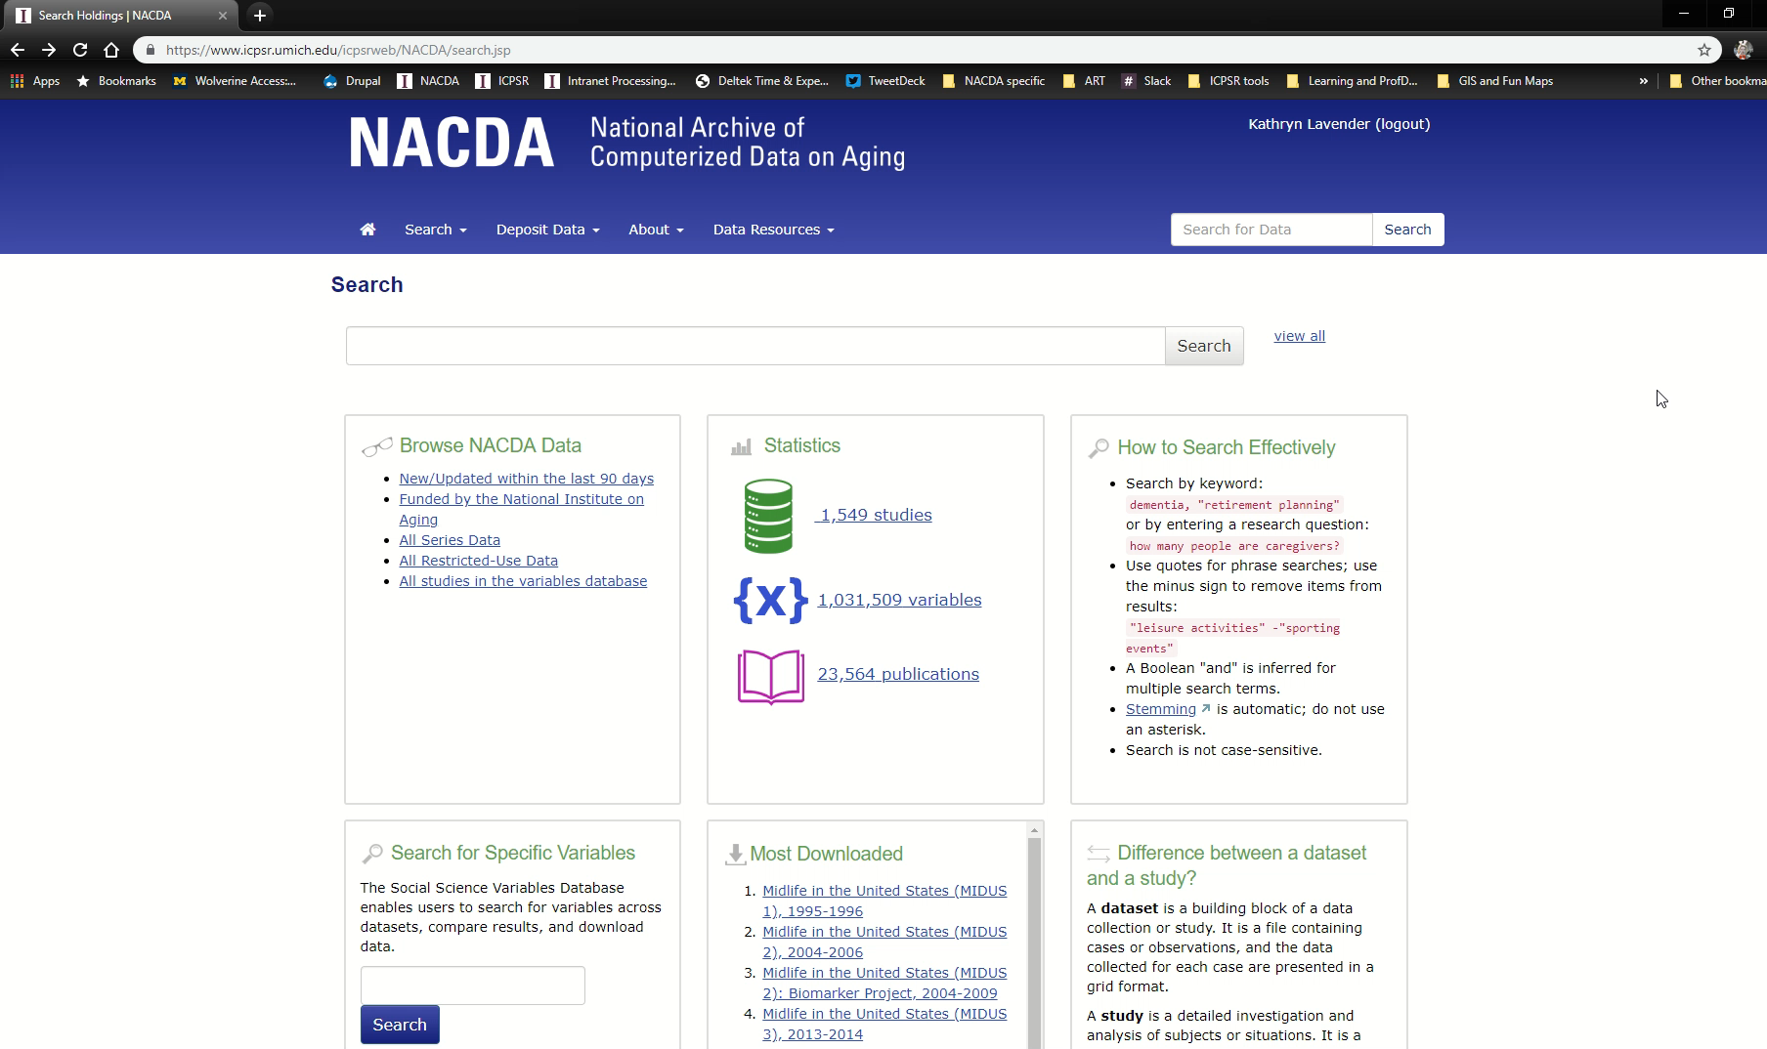
Search by Variable
Users can search variables within studies, across series, or across topics. We also have a comparison tool.

Slide 13

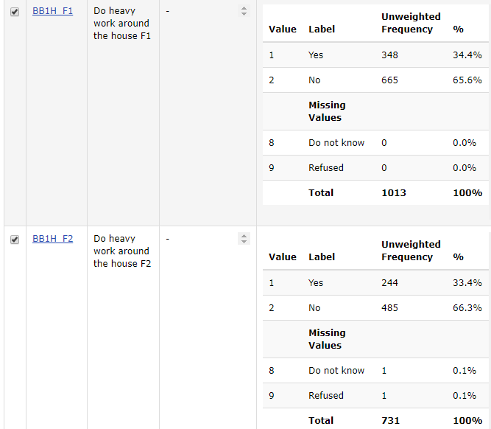
Mexican Americans aged 70+ years living in the Southwestern U.S.
Our variable comparison tool!
Taken from ICPSR 36231 - Hispanic Established Populations for Epidemiologic Studies of the Elderly (EPESE) Frailty Study: 2006-2009
Notes:
Found using “work around the house”

Slide 14
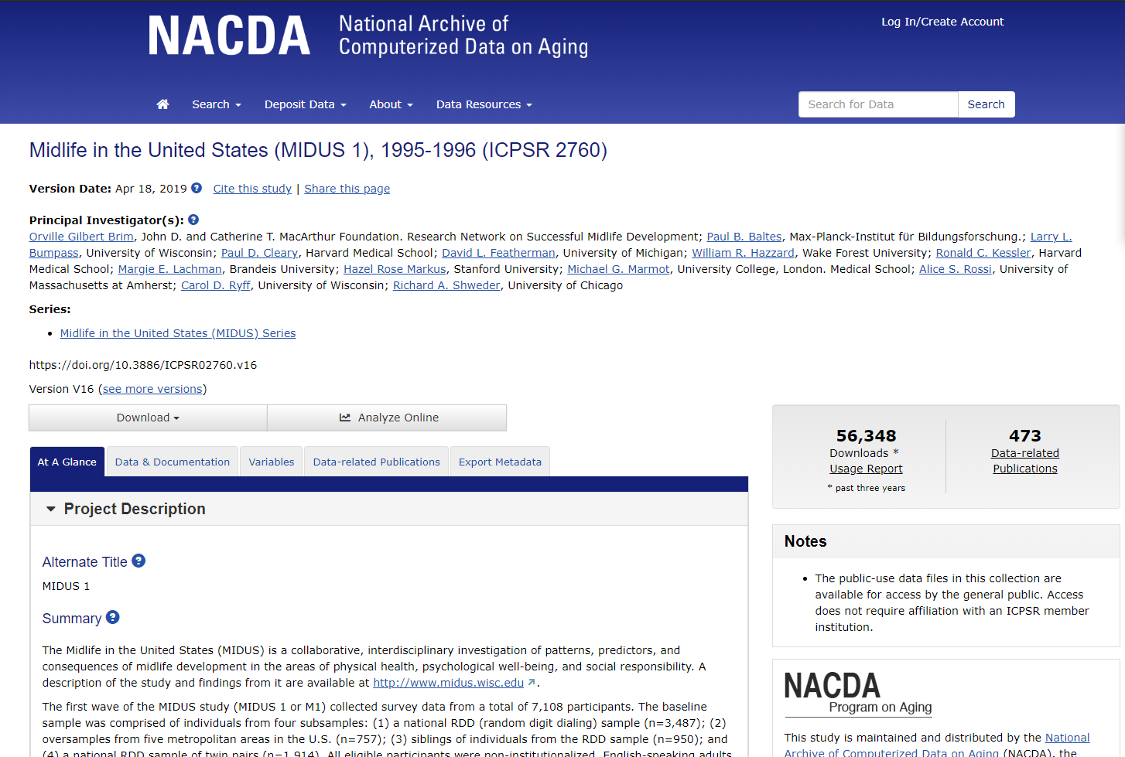
Study Pages – At a Glance Tab
The Study Page begins with the “At a Glance” tab. In this area, you can read the summary and other study-level information.

Slide 15
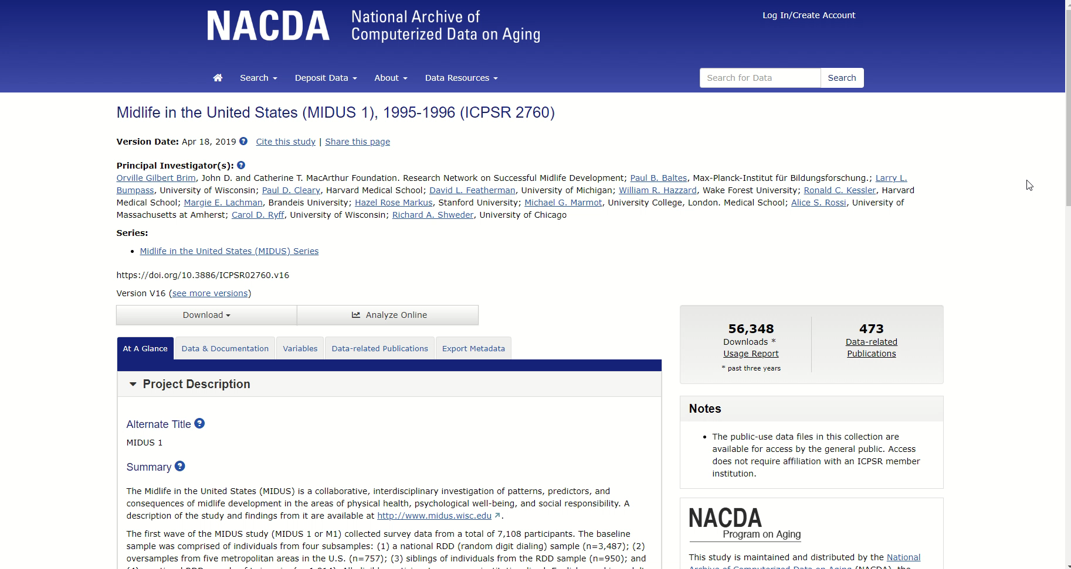
At a Glance page – make sure to scroll and click!
Notes:
This is where you can find info about the version/history of changes, important notes, sampling information, etc.

Slide 16
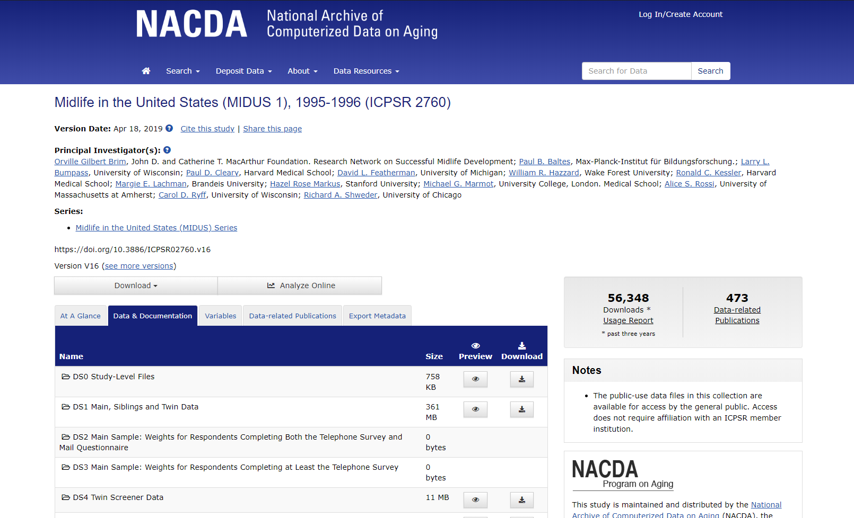
Study Pages – Data & Documentation
To look at the files that are available, select the “Data & Documentation” tab. Files are listed by dataset.
Notes:
There are a few different ways to download – the main download button allows you to download a lot of files at once – for instance, all of the SPSS files together.
The download features from the data and documentation tab allow you to download by dataset/fileset.

Slide 17
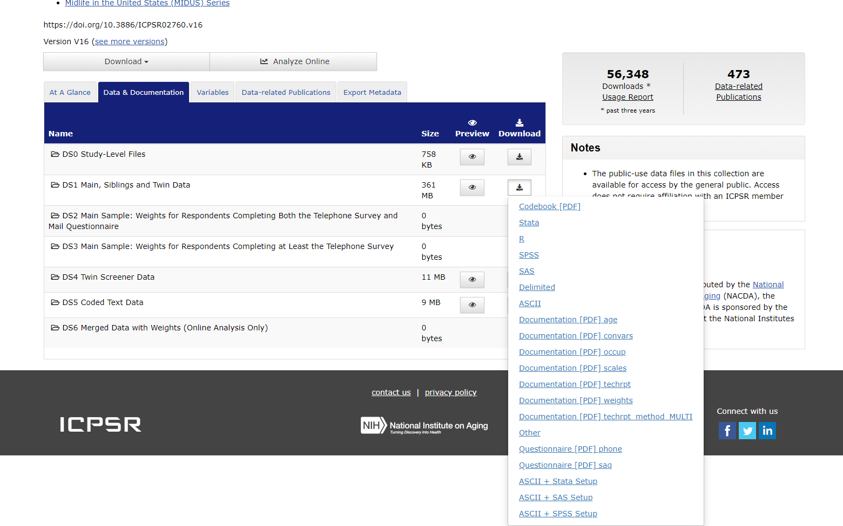
Study Pages – Data & Documentation
To Download files specific to any dataset within a study, select the “Download” button to the right of the Dataset (DS) name – a list of files will appear.
Notes:
The download button in the upper left of the page is how a user might download all of a certain type of file across the whole study. The download buttons to the right of the filesets is how a user might download any file for a specific dataset within a study.

Slide 18
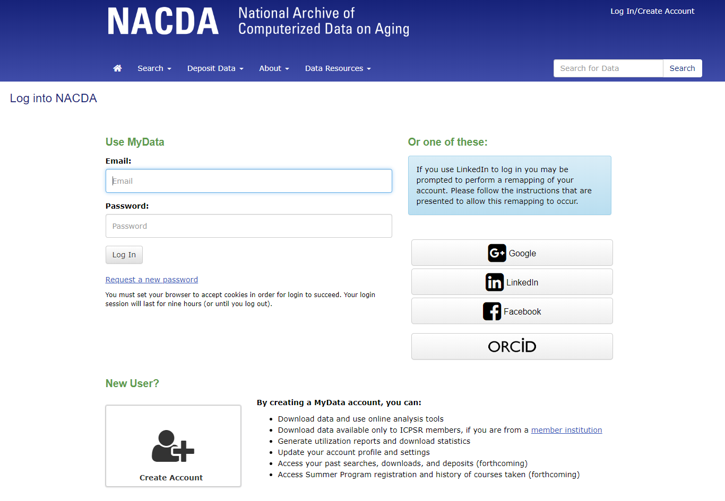
You Need to Register to Download
It’s free
Very little info is needed
We do not spam you or sell your data

Slide 19

Why Does It Come in a Zipped Package?
Internal Infrastructure
  We need to support both single and multi dataset studies
Metadata reasons

Slide 20
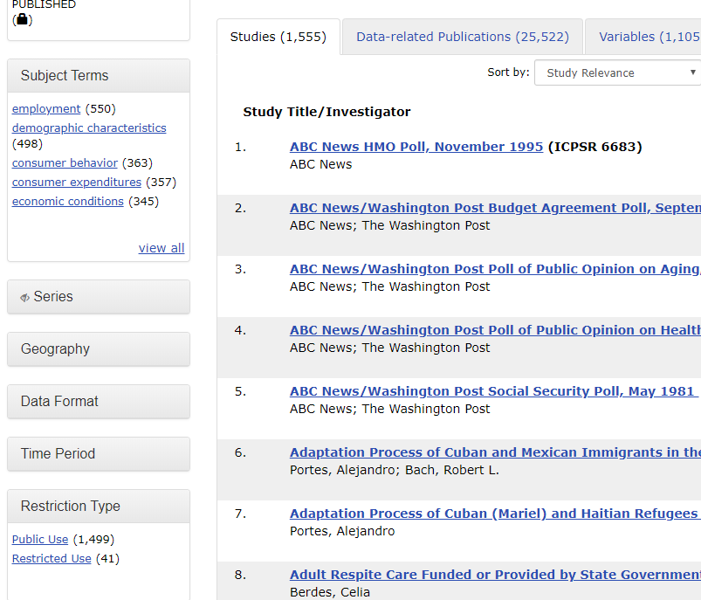
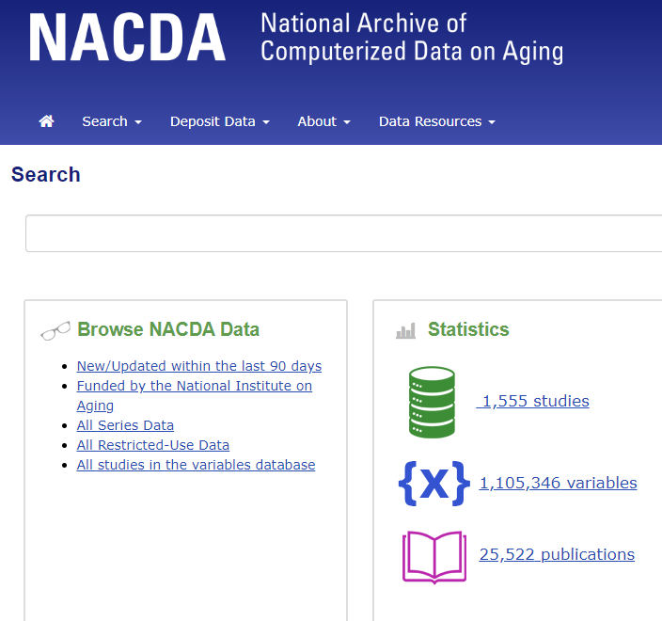
Public and Restricted Data
Notes:
Most of our data is public use – since we are federally funded, we are required to make the data completely open and free to the public. These data are available for immediate download from our site.
Some data are restricted – they contain sensitive information or may focus on a specific population and require additional care in order to ensure they will be used for ethical research purposes.

Slide 21
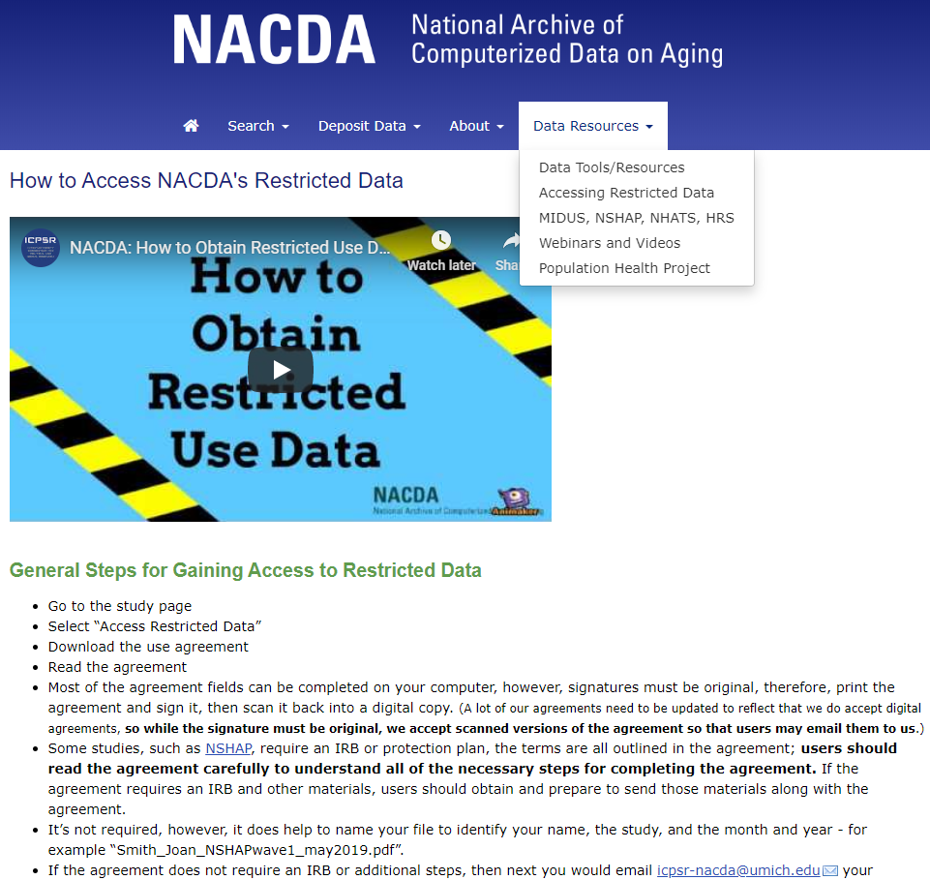
Restricted Data
Check out our video about accessing restricted data!
Popular restricted data collections:
NSHAP
MIDUS Milwaukee Sample
National Long Term Care Survey (NLTCS)
Notes:
Don’t worry, the video is short – about 2min.
We also have a page on our site that provides the details.

Slide 22
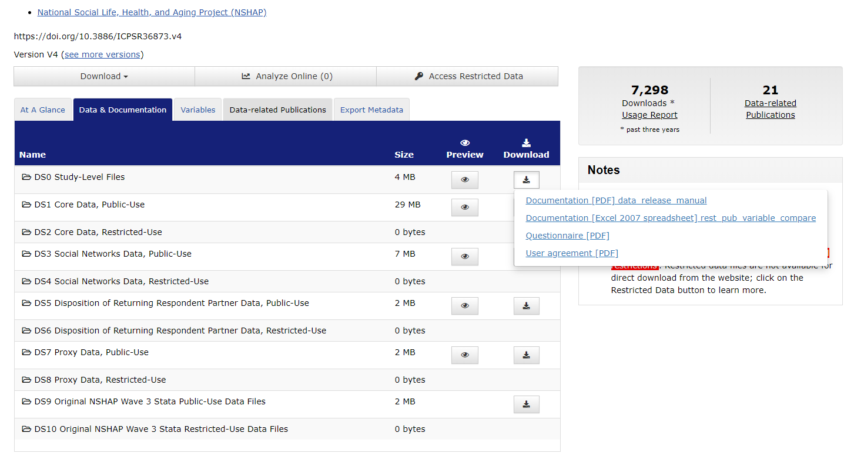
Study Pages with Restricted Data
Studies with restricted data may have helpful files such as comparisons and crosswalks

Slide 23

So You Want to Share Your Data
Why deposit your data with us?
To fulfill grant obligations
To broaden research potential of the data
It’s free
It will be preserved
Track usage
Need help with a data management plan? We have resources!

Slide 24
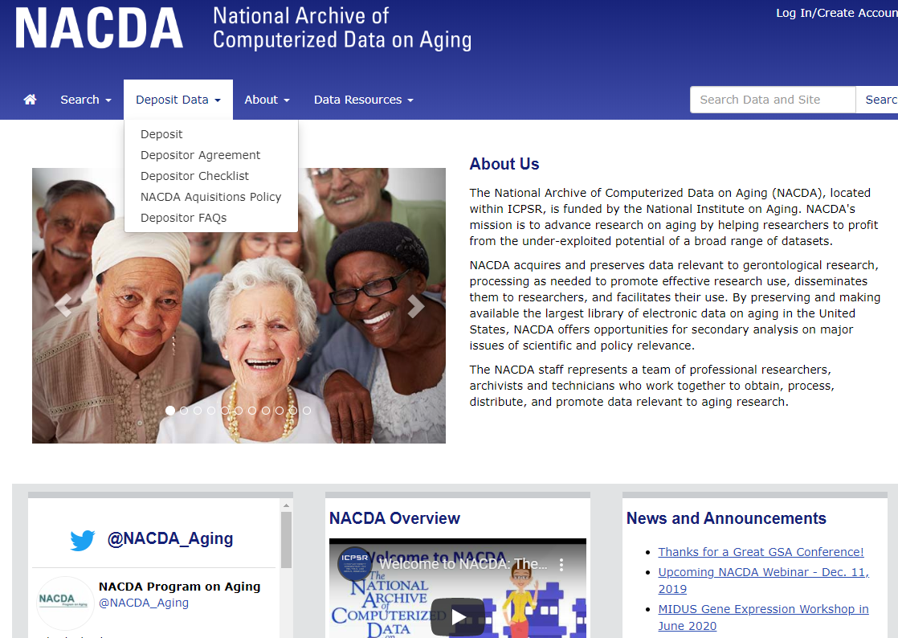
Deposit Data
Prepare to provide:
Title
PI
Description
Data Files
Codebook
Questionnaire
Relevant Syntax
Methodology Info
User Guide
Anytime you need help depositing, email us:
icpsr-nacda@umich.edu
Notes:
Value of public use data; we couldn’t have secondary access or analysis without a place to store and share everything first. It all starts with sharing data.

Slide 25
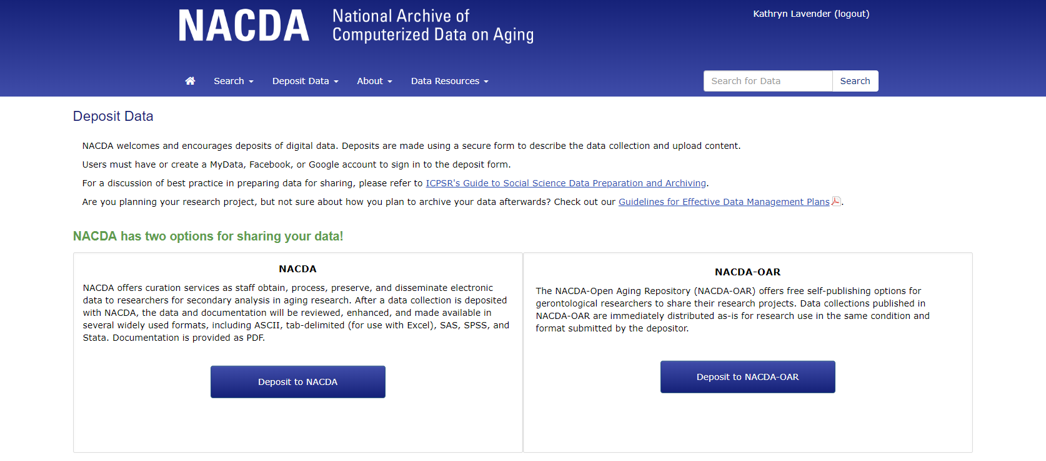
NACDA and NACDA-OAR
We now have 2 options for depositing
Main archive - curated
New, open archive – self published
Notes:
There are two options to depositing with NACDA.

Slide 26
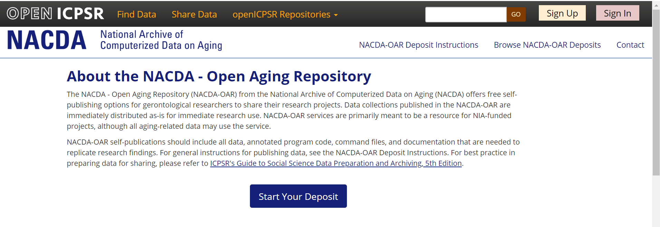
Why Self-Publish Your Data?
Makes your data discoverable
Fulfills your NIH Data Sharing Requirements
Rapid turnover and release
We track the use of your data
Notes:
Most of the same benefits as depositing to the main archive.

Slide 27
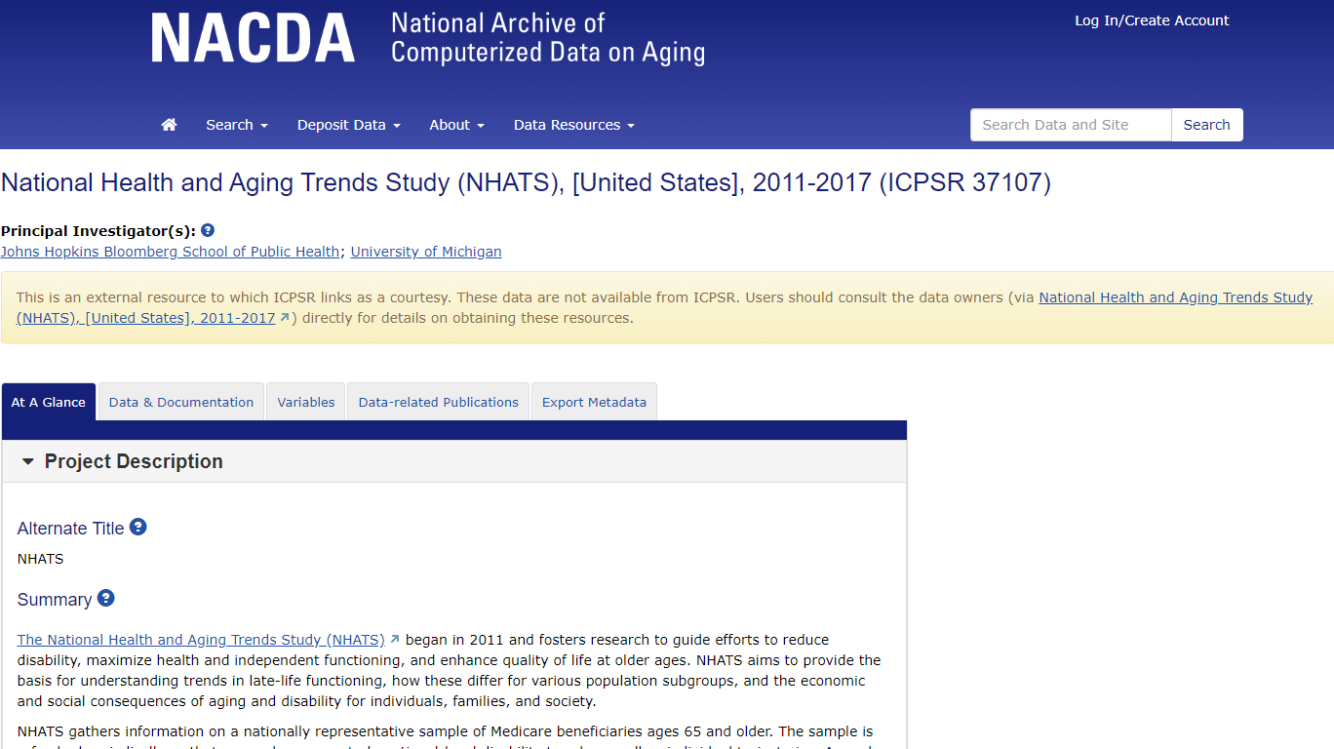
Making Data on Aging Discoverable
Notes:
We also help make data discoverable that we do not house – its about helping the research community.

Slide 28
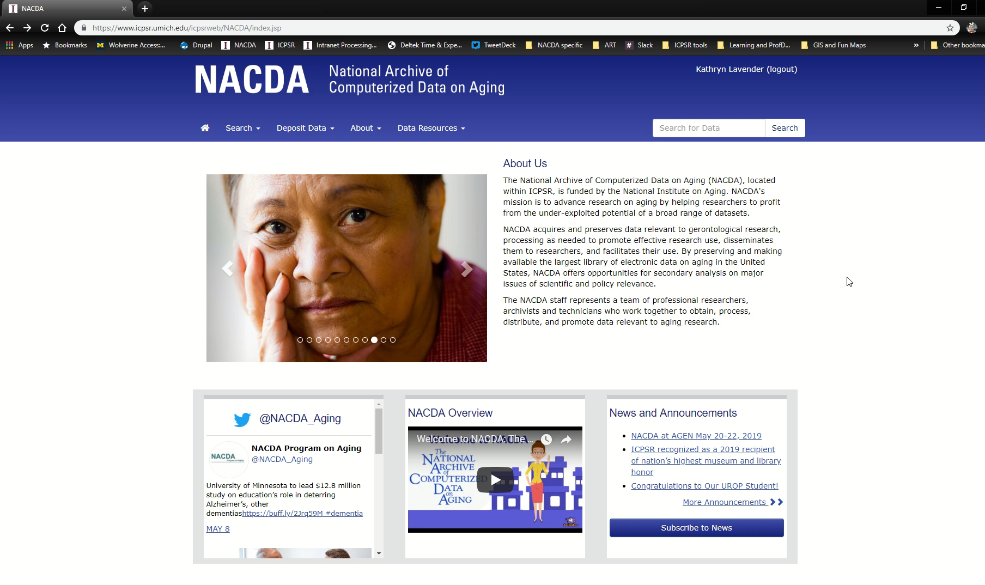
How to Track Use
View usage based on :
Publications
Data Downloads
Doc Downloads
Institution
Unique or return users

Slide 29
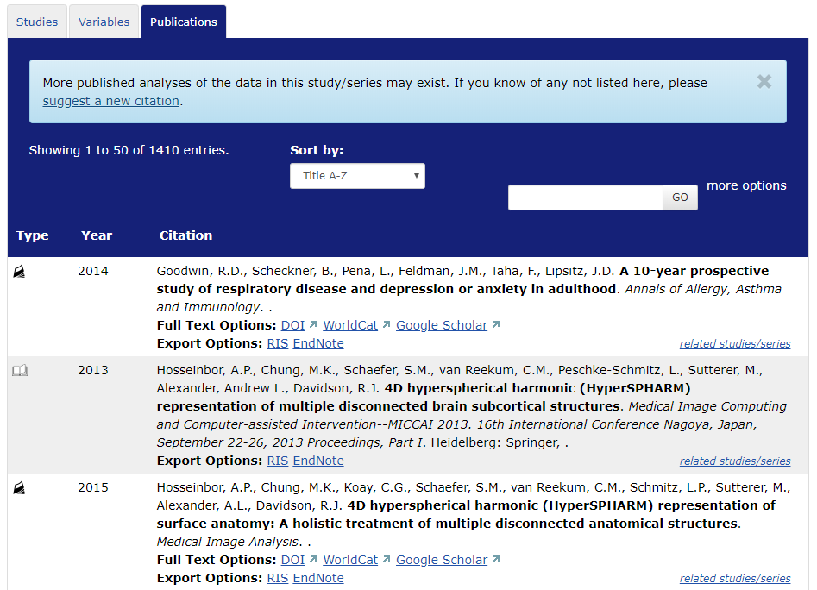
Related Publications
Did you use NACDA data in your research paper?
Let us know!
Email us at icpsr-nacda@umich.edu or use this ICPSR form that provides the citation directly to our bibliography team:
https://www.icpsr.umich.edu/icpsrweb/ICPSR/citations/submit.jsp
Notes:
This image shows the related publications for MIDUS from the MIDUS series page.
https://www.icpsr.umich.edu/icpsrweb/ICPSR/citations/

Slide 30
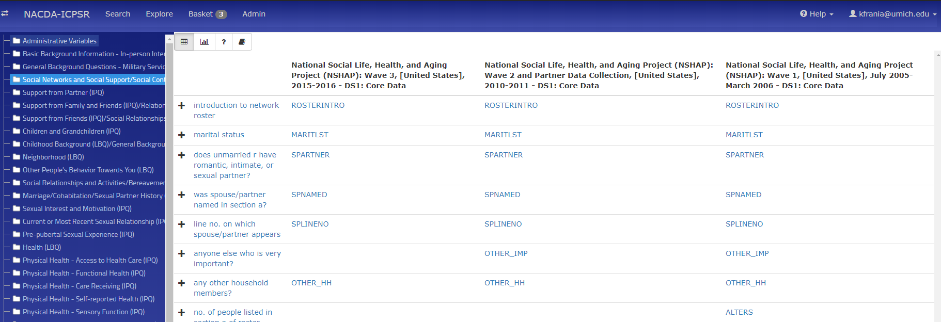
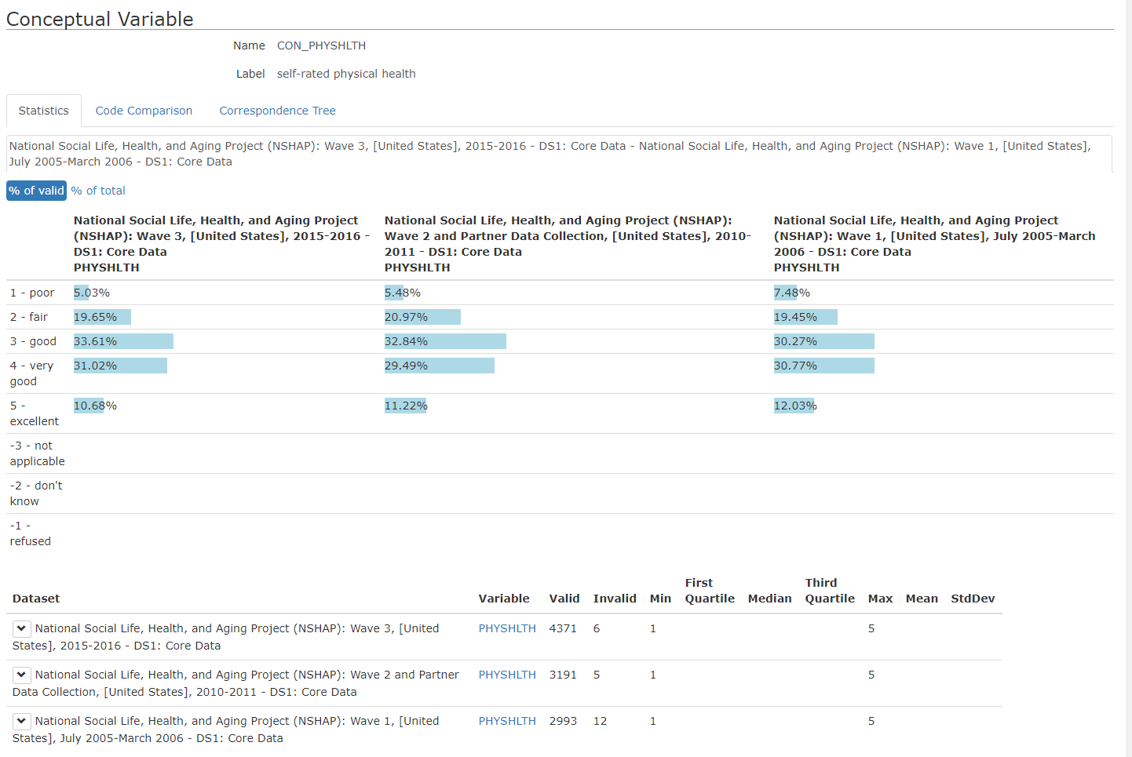
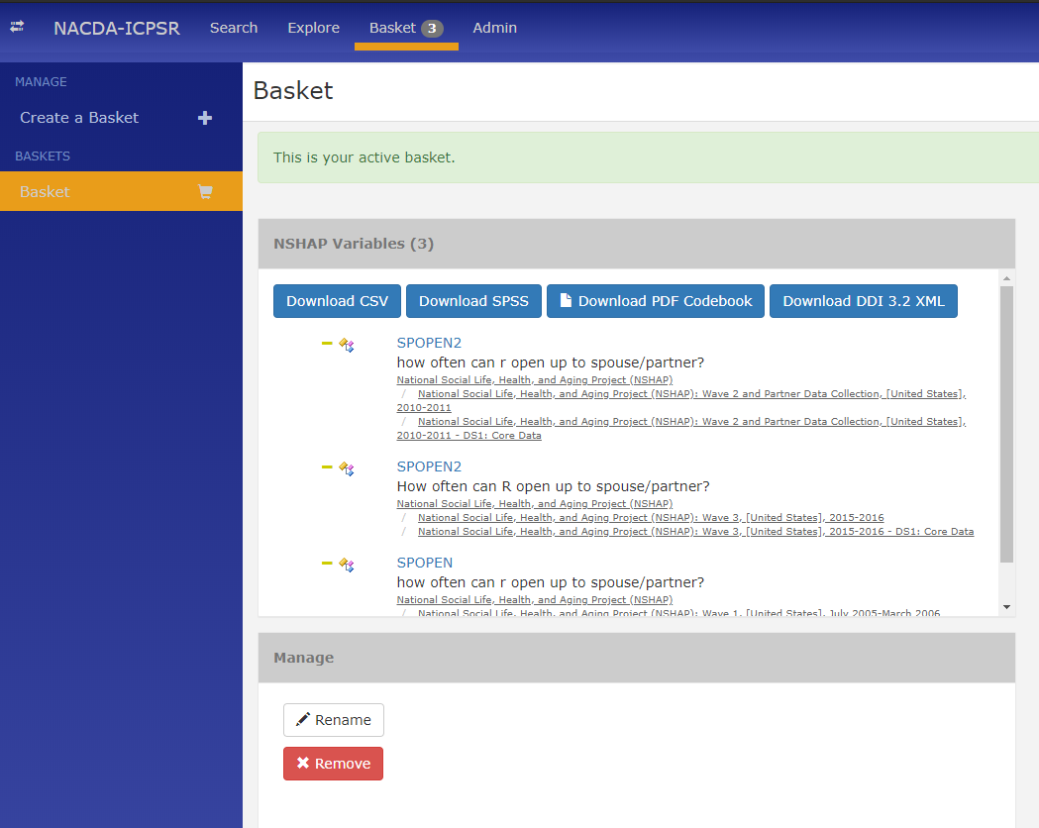
Colectica Portal
Notes:
Colectica is based in DDI and is a valuable tool for longitudinal and repeat measure data.
We love preserving and sharing the NSHAP data, and we wanted to take sharing a step further to enable users to create custom data extracts and browse variables across waves, side-by-side.
We worked with ICPSR staff with knowledge of DDI and with the Colectica team to create a portal to facilitate access to variables from a longitudinal approach.
The NACDA-ICPSR Portal facilitates efficient comparisons of longitudinal data. The Portal is based on the DDI metadata standard and is powered by Colectica software.
Within the Portal, you can:
Search across all datasets in the Portal, by variable name, label, question text, or topic/concept. Search results provide all variable-level metadata and descriptive statistics.
Browse the publicly available studies by concept, variable, and question:
Click on (“Explore”) concepts to browse the portal for variables, questions, and other metadata about that topic. Click on variables to view details, including detailed description, summary statistics, and source materials.
Download custom variable subsets. Variables can be added to a download “basket” by clicking on the shopping cart icon next to it.

Slide 31




NIA Funded Longitudinal Data Resources with Colectica Portals:
Notes:
We are working on identifying and mapping out overlapping concepts and variables between NSHAP and NHATS and hope to debut that work in the Colectica portal sometime next year.

Slide 32
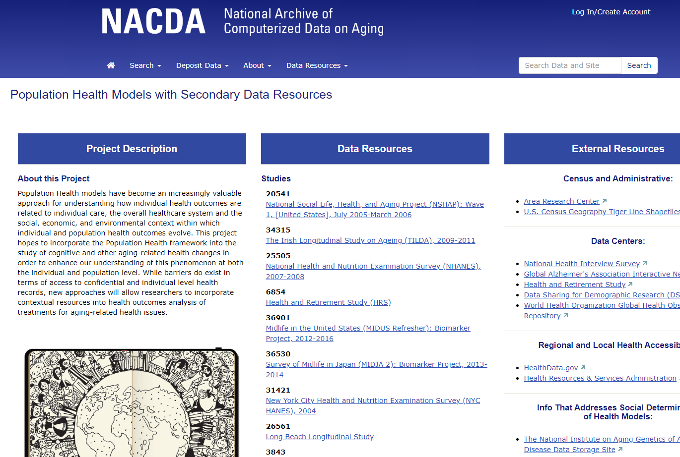
Supporting Gerontological Research
We want to highlight data resources for gerontological research and make it easier for data users to find what they need.
Notes:
Part of our mission is to help data users understand the research potential of our secondary data resources, so that they can go onto affect policy and better their communities for aging populations.
This is one example where we scraped our resources and put them all in one place to make it easier for our data users to find what they need.

Slide 33
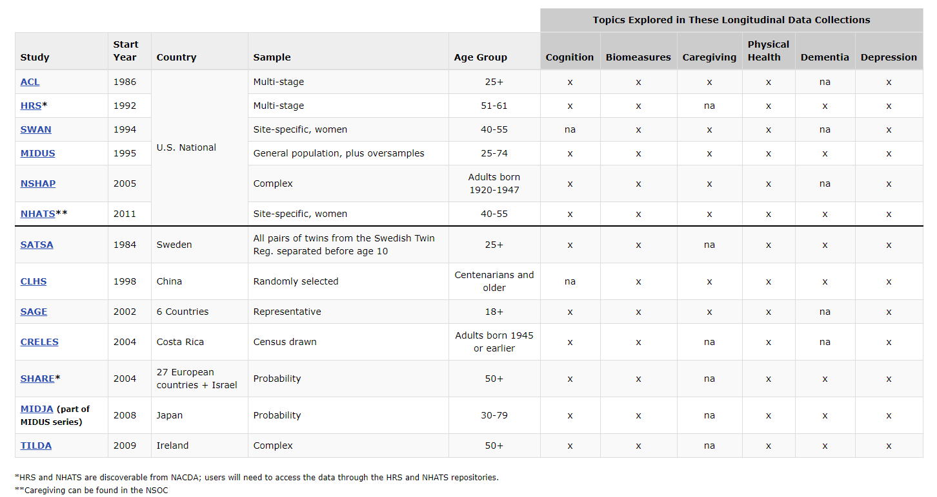
Cross-Study Conceptual Crosswalk
Notes:
We have so many great resources on our site! This chart shows some of our most downloaded studies, a bit about them, and whether they have variables that fall within certain search terms or concepts.

Slide 34
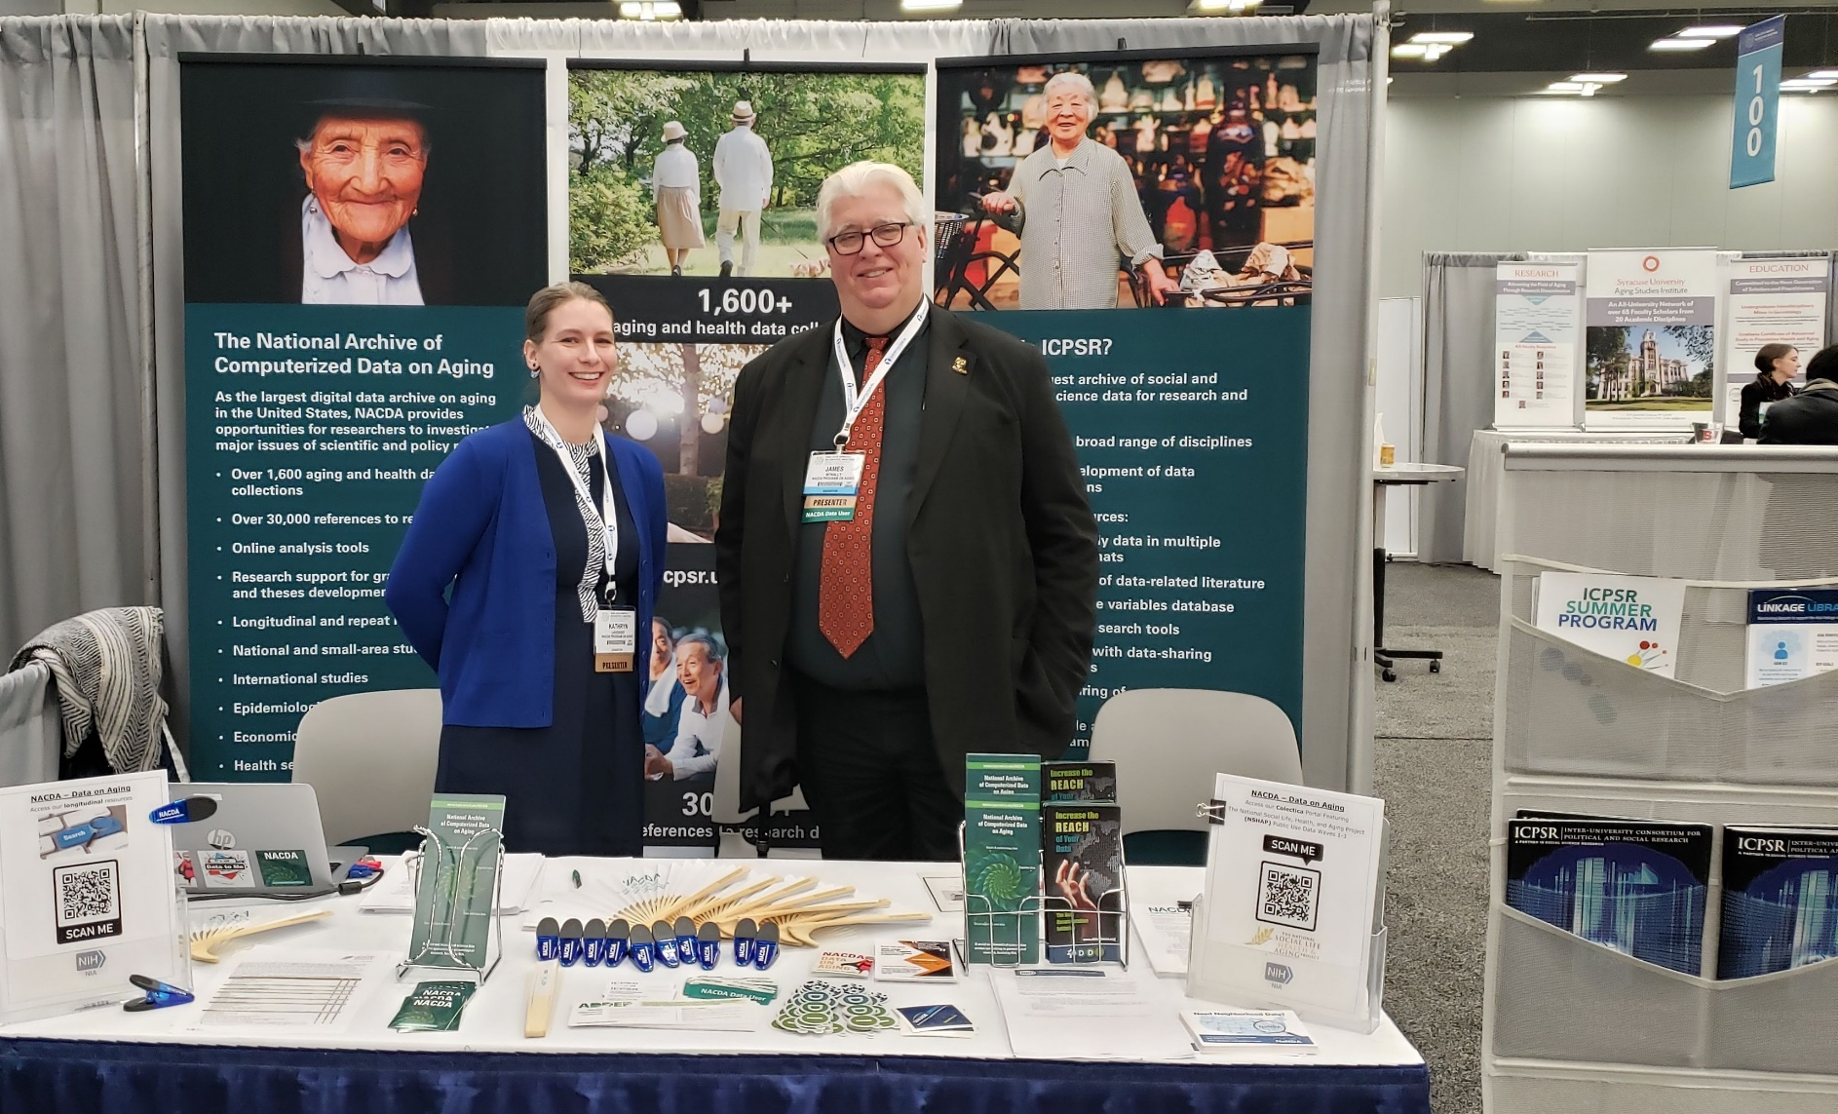
Outreach
Conferences
Social Media
Announcements and Newsletter
User Support

Slide 35
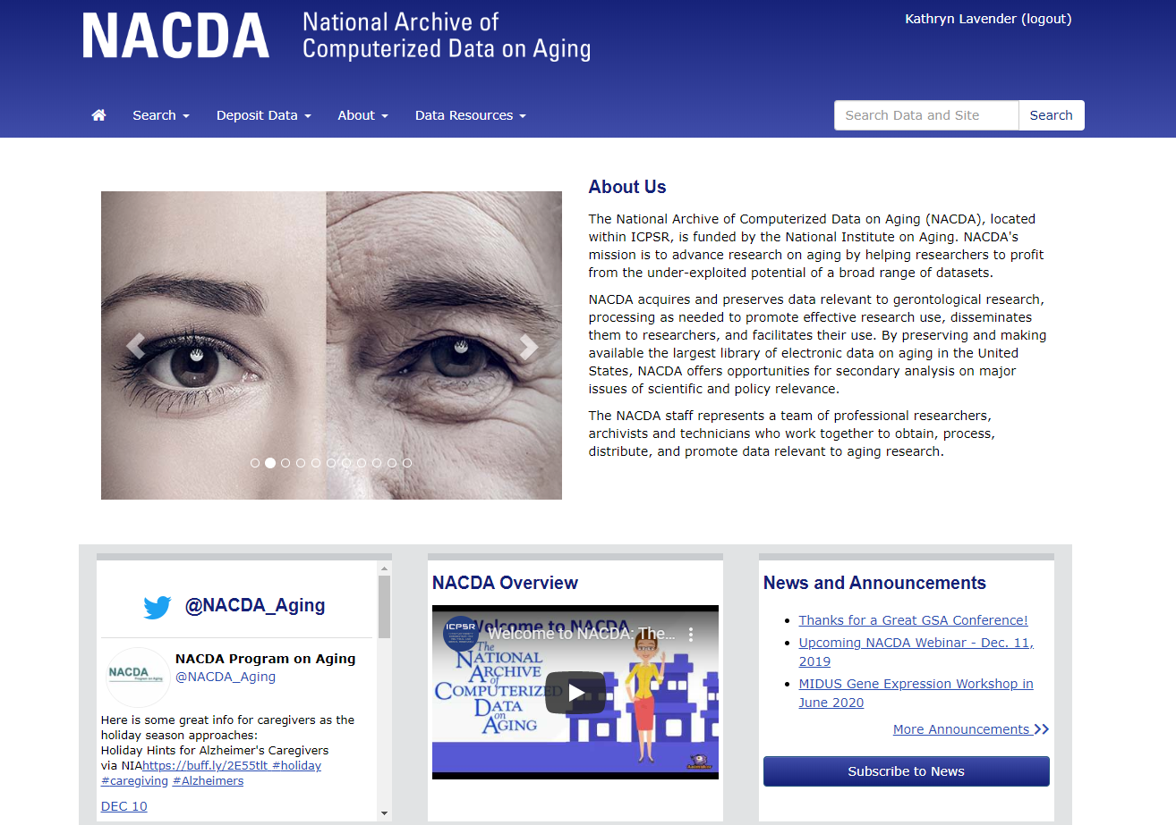
Stay in the know!

Slide 36

User Support
Contact User Support at
ICPSR-help@umich.edu
OR contact us at NACDA directly by emailing icpsr-nacda@umich.edu
Notes:
If you have a question about data you are interested in, data you have downloaded from our site, or if you find an error, reach out to us!

Slide 37

Shameless Promotions
Check out the MIDUS Gene Expression Workshop
Instructed by Steve Cole, PhD! June 9th – 10th, 2020
Apply by Sunday, March 1st, 2020.
Asian Conference on Aging and Gerontology (AGEN) Conference
March 27-29, 2020 in Tokyo, Japan
Final Abstract Submission Deadline: January 10, 2020
Population Association of America (PAA) Annual Meeting
April 22-25, 2020 in Washington, DC

Slide 38
Stay Connected!

Slide 39

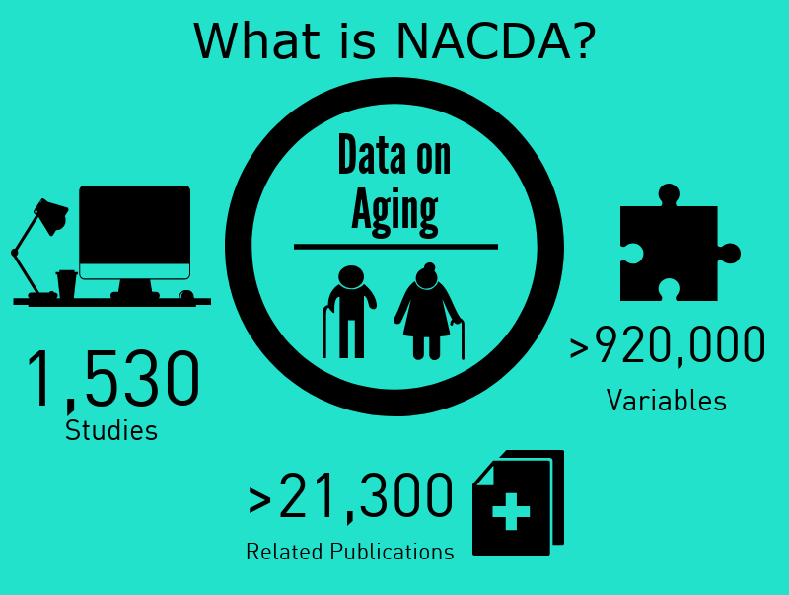
Thank You!
Look for these slides on our announcements page!

