Slide 1
The Ethereal Library: Our Experience in Library Futures at the Kresge Library
International Conference on Next Generation Libraries – 2019
National Institute of Technology – Rourkela
Rourkela, Odisha, India
December 12-14, 2019
Corey Seeman, University of Michigan

Slide 2
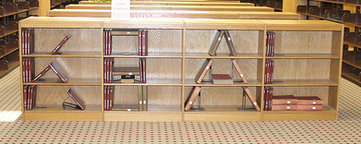
Presentation Outline & Objectives
2020 Vision – Change & Libraries
Two Places of the Library
Ross Construction Project 2013-2019
Future Challenges for Libraries
Lessons Learned at Kresge

Slide 3

Presentation Outline & Objectives
Want to show how we moved into becoming a ‘library of the future.’
Showcase some of the ‘thought process’ that went into this journey.
Show some of the problems and opportunities.

Slide 4
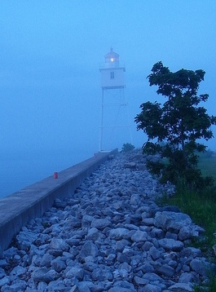
2020 Vision – Change & Libraries
We live at a time of great change in almost all fields.
The expansion of online education is fundamentally changing higher education.
In the United States – enrollment in higher education is stagnant with fewer International students seeking a US education.
This will impact the need of a physical library on each campus.
This will impact the roles that librarians play on campus.

Slide 5
2020 Vision – Change & Libraries
"Business has always been subject to uncertainties and change. It is affected by the elements, by wars, by mass movements, by changes in the wants and desires of consumers and by government regulation. Above all, competition tends continually to modify the business structure. New methods, new products and new processes introduce new elements that undermine the supremacy of one industry or firm or even a whole system of doing business. And the trend toward increasing regulation of business by governmental bodies here and abroad must not be ignored. In short, one generalization that truly applies to all business is: Change is continuous and inevitable."

Slide 6
2020 Vision – Change & Libraries
Quote is from: Coman, Edwin T. Sources of Business Information. New York: Prentice-Hall, 1949.
It is very easy to think about change only in our world.
However, we have been subjected to change for years and years…and will be subjected to change for years hence.

Slide 7

2020 Vision – Change & Libraries
NOT a library problem of the 21st century.
Changes in the last 50 years:
  Copy cataloging
  Local online catalogs & shared systems
  Expanded access (TOC, more subject headings)
  Shared catalogs
  Discovery layers
  Working papers management → digital repositories
  Coffee and food in the library
  Diminished roles (overall) of departmental libraries
How many staff are checking in serials? And while we are here – what are serials?

Slide 8

2020 Vision – Change & Libraries
Librarians are fantastic about envisioning change when they are leading the way.
We have done a good job of embracing the new electronic environment in a hybrid fashion with traditional print volumes and physical media.
These incremental changes can add up when pieced together…
HOWEVER, we are likely still behind where our patrons are and where they likely WISH we are.
Because we collect for the ‘long term,’ we are likely far more conservative than we should be.
Is our library supporting a world where I can present to India from COLD Michigan!

Slide 9
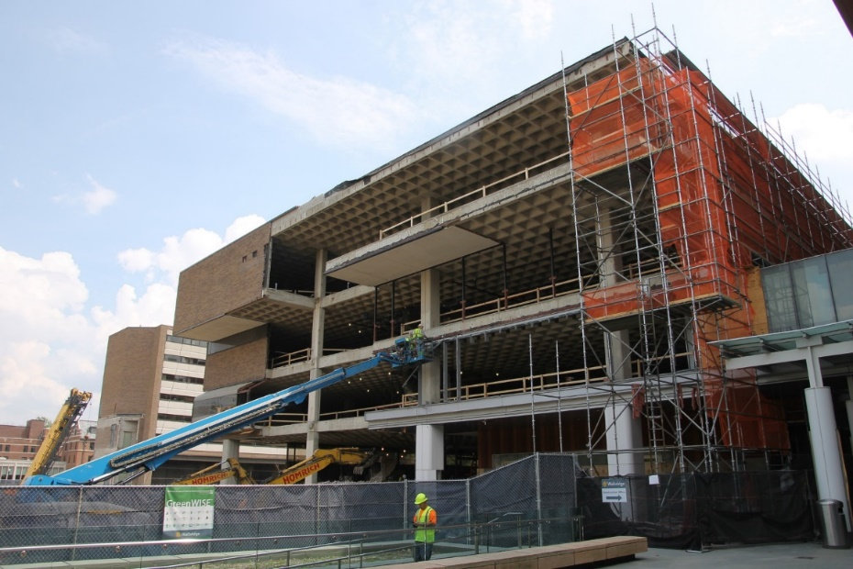
2020 Vision – Change & Libraries
Change in libraries will more likely be a change that is thrust upon us.
Are we ready to manage through real change?
Are we ready to give up services and resources our space will no longer accommodate?
Are we ready to embrace the change being asked – or demanded of us?

Slide 10
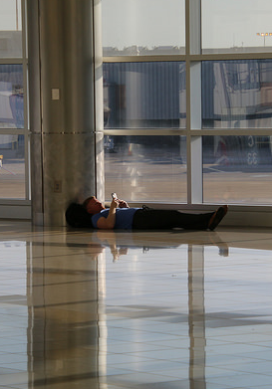
2020 Vision – Change & Libraries
For many of our patrons, libraries are nothing more than waiting rooms where they can be productive.
They want a place to…
  charge electronics
  study or do work
  relax
  sit
  Collaborate
They are typically very malleable
Waiting for a flight at Hartsfield-Jackson Atlanta International Airport – November 6, 2017

Slide 11

2020 Vision – Change & Libraries
We have often considered change in our field (publishers, software/ILS firms and resource vendors) and how that impacts libraries.
The factors that will demand change across higher education (and within the library) may include:
  Space demands
  Mergers or ceased operations
  Funding of new priorities
  Online education expansion
Change may be a dual edged sword – vibrant schools will demand more changes than stagnant ones.

Slide 12

2020 Vision – Change & Libraries
The next generation of libraries must look and feel different.
We will likely need to modify:
  Services
  Collections
  Expectations
  Abilities
Our world is changing, we cannot deliver the same services and expect our communities to benefit in the same way.

Slide 13
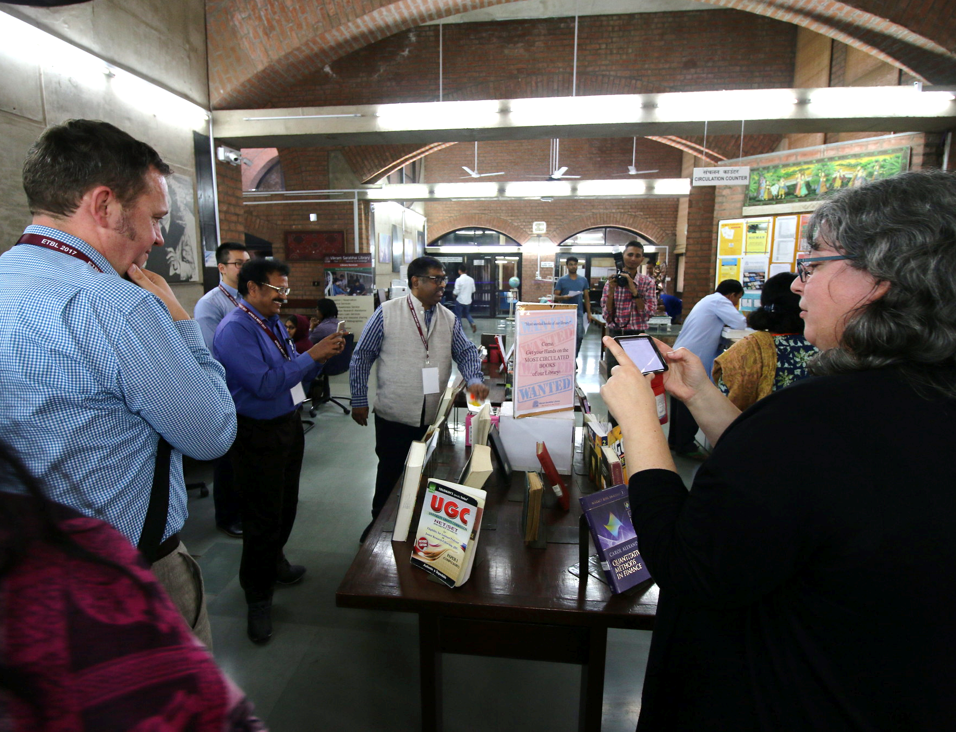
The Two Spaces of the Library
In Library as Space Program in 2013 (Michigan Library Association) – I shared the notion that the Library had two spaces:
  A physical space
  An ethereal space
They each provide distinct functions and benefits to the communities we serve.
Both can be critical for the members of the communities served by a library.
Vikram Sarabhai Library at Indian Institute of Management Ahmedabad (Gujarat, India - November 20, 2017)

Slide 14
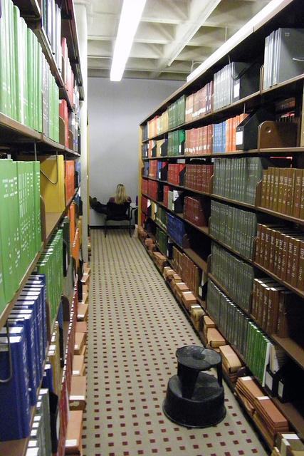
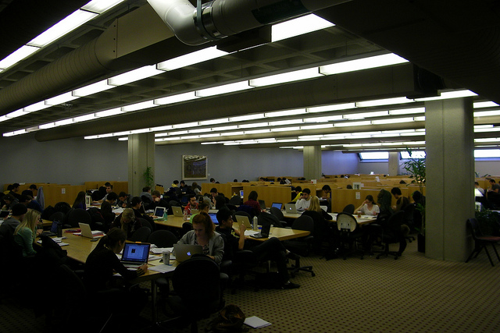
The Two Spaces of the Library
Physical space is used for:
  Study
  Print Materials
  Interaction Spaces
  Walk-in Access
For many functions - a physical space can be managed just as well by others.
Print collections might be 2% (or less)of the usage – but 75% (or more) of the perception of the library

Slide 15

The Two Spaces of the Library
The Ethereal space is used for service.
  This is where we connect with our community.
  This is where we provide clarity to a complicated information universe.
  This is where we contribute as a “Value-Add.”
  This is where we SHINE!

Slide 16
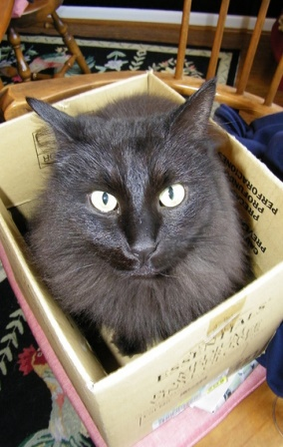
The Two Spaces of the Library
Space is a luxury on academic campuses – and with that – we lost ours.
There may actually be a move to decentralize a campus – creating the opposite problem – no need for a physical campus.
Are libraries ready for either future? Likely not.

Slide 17
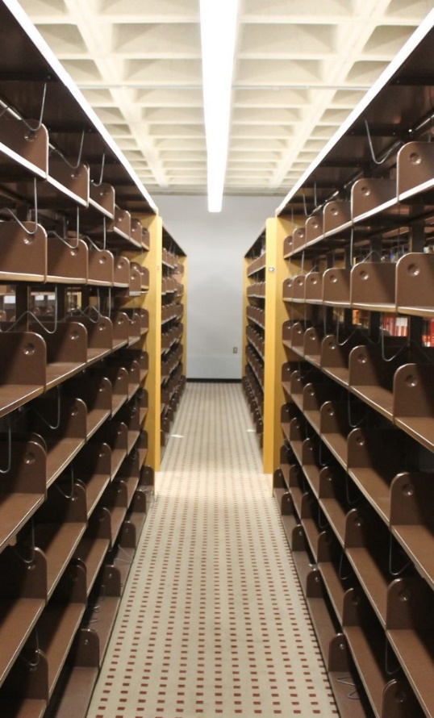
Two Spaces of the Library
Let’s think about our current library…
And take away your print volumes
Now, take away your book stacks
Finally, lets move student space out of a library
What do you have left?
Empty Shelves at Kresge Library After the Books Left

Slide 18
Ross Construction Project 2013-2019
Built in mid 1980s to serve the research and curricular needs of the Ross School of Business
We are open 108 hours during the Fall and Winter Terms.
Seating for nearly 700 students.
Very visible, located in the center of the Ross Complex (27K square feet).
We have a collection of almost 150,000 volumes in Ann Arbor and Flint (where they are stored at the University of Michigan-Flint)
Constant state of “Library Erosion”

Slide 19
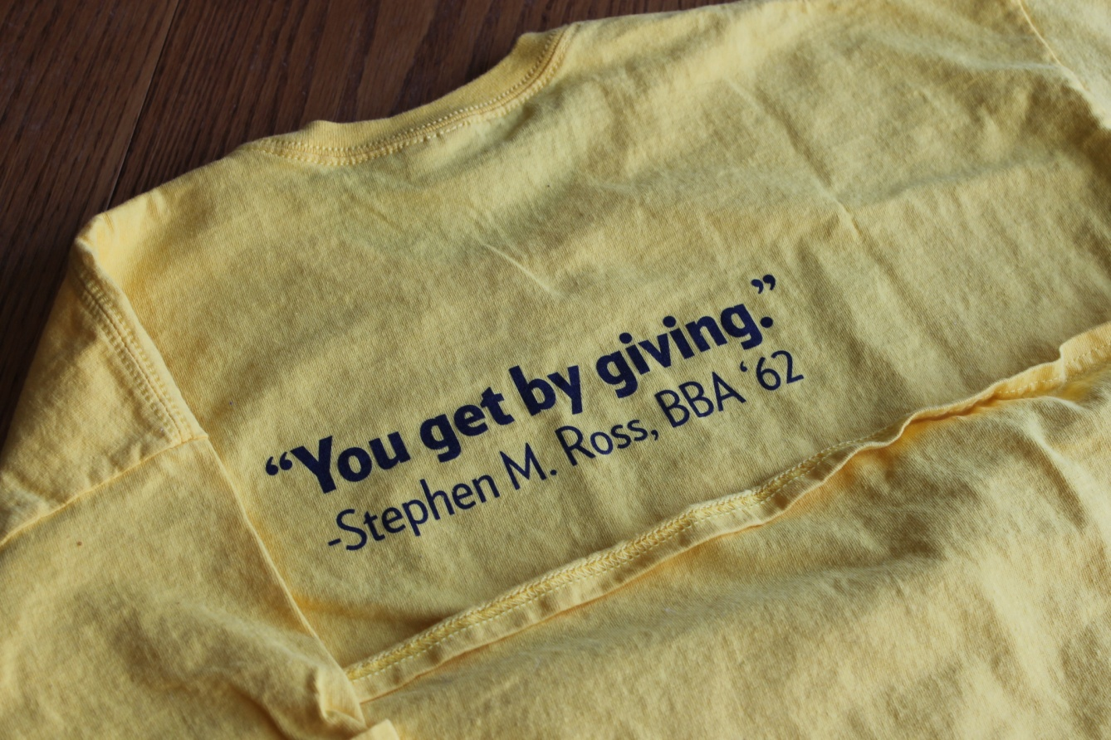

Ross Construction Project 2013-2019
Summer 2013 – Scope of plans shared*
September 2013 – Gift announced
Early 2014 – Plans developed
End of Winter Term – Started vacating the building
June 2014 – Moved to MOtown
July 2014 – Print moved out
Fall 2014 – Rebuilding Kresge Library Services

Slide 20

Ross Construction Project 2013-2019
Fall 2014 – Rebuilding Kresge Library Services
Winter 2015 – Kresge Value Proposition Meetings Started
Summer/Fall 2016 – Expected completion and move in to the new space
January 2017 – Opening of the new building to the school

Slide 21
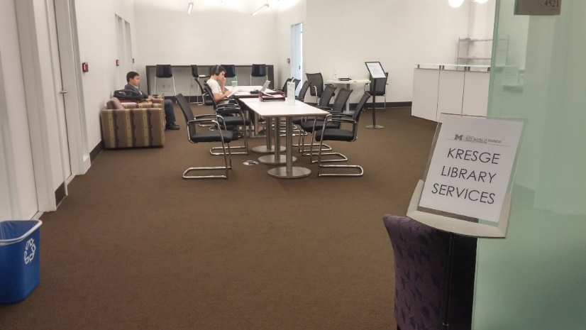
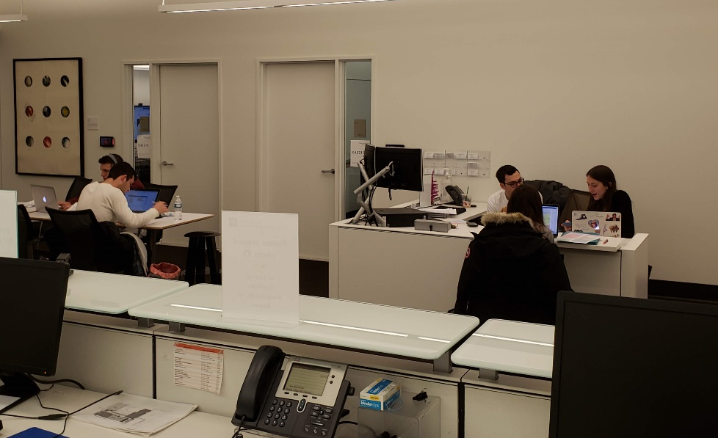
Ross Construction Project 2013-2019
2017 – Assessment of Course Reserves abilities
2018 – Reconfiguration of the reference desk at Kresge
2019 – Reconfiguration of the work space to accommodate new Digital Education Staff
2019-2020 – Greater demand for Study Space

Slide 22

Ross Construction Project 2013-2019
We expect there to be continued changes as space needs evolve on campus.
Our ability to work anywhere could lead to remote location for staff.
Not being tethered to a print collection has been mostly good – especially during bad weather.
We need to demonstrate flexibility and adaptability.

Slide 23

Future Challenges for Libraries
Are libraries well situated to address the future information needs of our communities?
Where are we looking for the solutions we implement?
Are academic libraries in sync with the organizations that they serve?

Slide 24
Future Challenges for Libraries
Where did the books go?

Slide 25
Future Challenges for Libraries
This is my vision of collection building in libraries – we need to find the balance between these needs.
Future Use
This is where Libraries have traditionally bought for (and many still do)
Community Needs
Community Aspirations & Desires
This is where our campuses really want us to be working. This might be where the turnaways come from.
Current Use

Slide 26
Future Challenges for Libraries
Library challenge is that we have multiple stakeholders and they have different needs – especially for business.
Faculty needs – scholarly journals, articles, books , datasets
Student needs – articles, company & industry information, market reports
Community – Mostly similar to student needs
Student
Community
Faculty

Slide 27

Lessons Learned at Kresge
6 Key terms to guide our libraries:
  Inevitability
  Rapidity
  Flexibility
  Hospitality
  Accountability
  Empathy

Slide 28
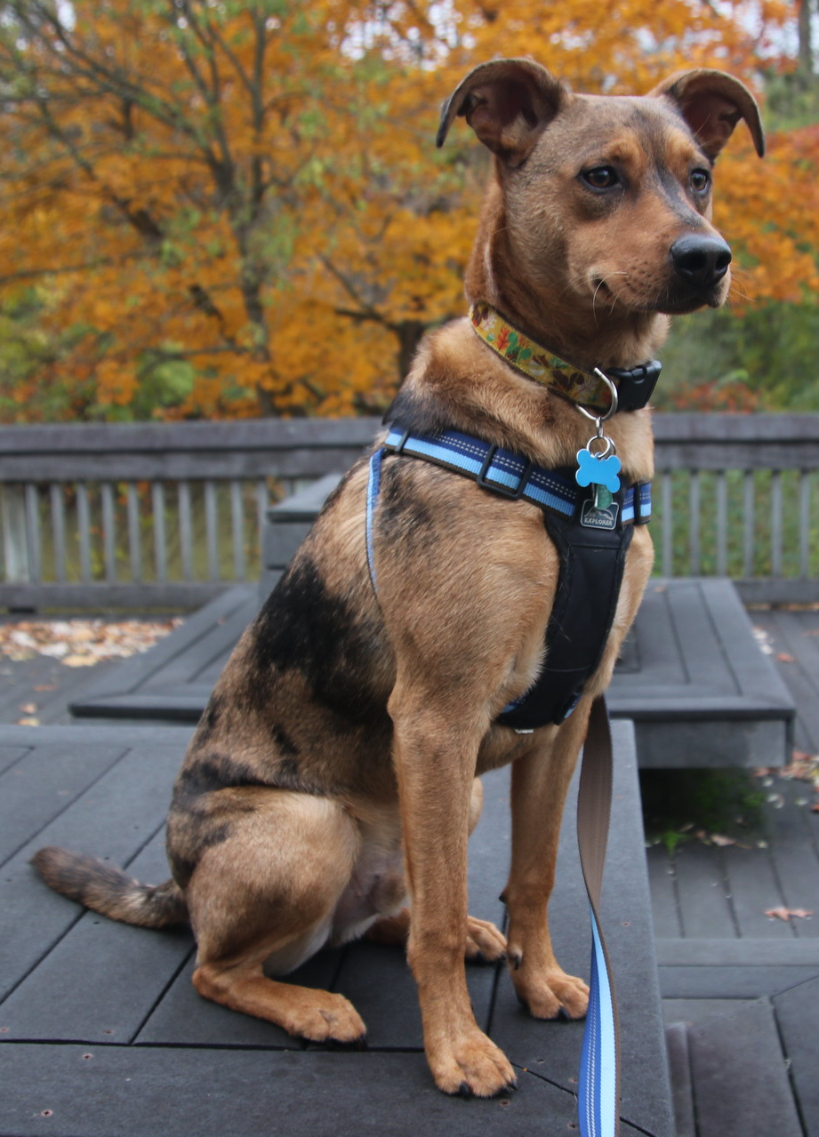
Lessons Learned at Kresge
Embrace the Change.
You need to be flexible and deal with change as it comes.
“A completely re-thought Kresge Library Services, transitions from a collection of physical reference materials to a full suite of information resources and research services, guided by expert staff.” – Ross Dividend, Fall 2016 (Ross Alumni Magazine)
The library did not close, but become virtually unrecognizable.
You do not always choose your path, but how you respond to the challenges.

Slide 29
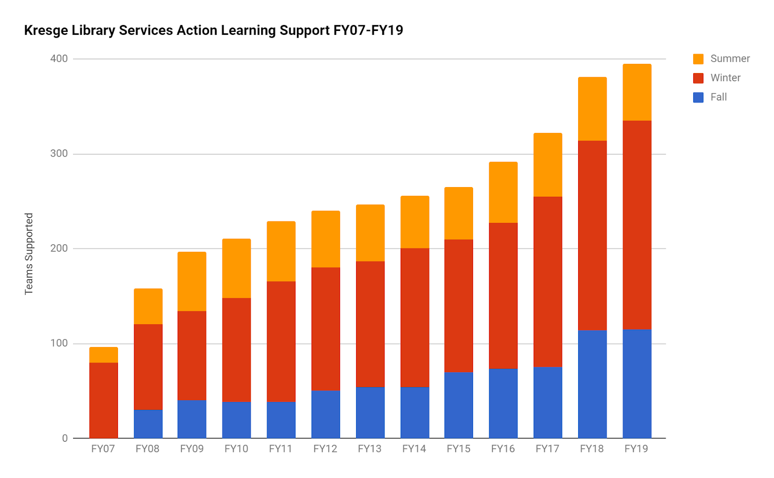
Lessons Learned at Kresge
Focus on what is working.
Action learning support at Kresge Library is widely accepted as aThe educational opportunities we provide need to mirror the world of business
We need to teach students how to manage through Ambiguity and Complexity
We do this through experiential learning programs
This is a great opportunity for the Kresge Library

Slide 30

Lessons Learned at Kresge
There are also some actual positives about not having a public space.
No longer have to worry about evenings and weekends in bad Michigan weather…
Create a flexible work environment to expand your reach by enabling remote work.

Slide 31
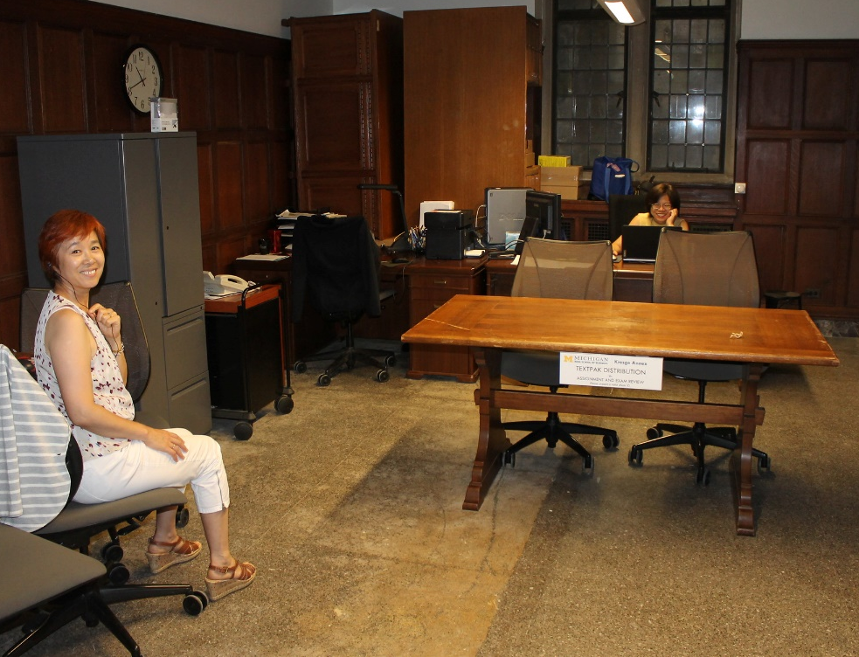
Lessons Learned at Kresge
Seek out new opportunities.
Exam and Assignment Program.
Responding to a need at the school – we were able to redeploy staff who were managing print resources to support this program.
Provided a value for the school and retained jobs.

Slide 32
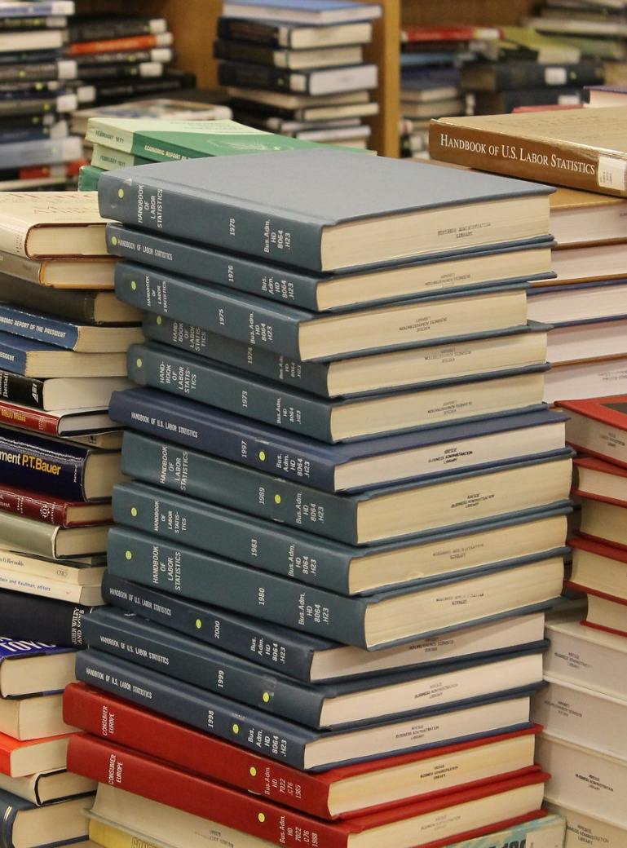
Lessons Learned at Kresge
Seek out new opportunities.
Expanded support for Data accounts
We provide administrative oversight for Nielsen data (Kilts Center – Chicago Booth) and WRDS (Wharton Research Data Services) for the University of Michigan.
Good role for our information management skills and attention.

Slide 33
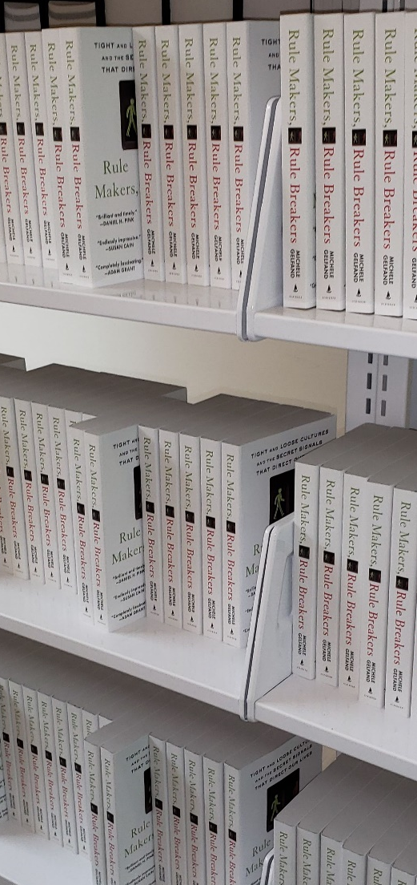
Lessons Learned at Kresge
Let the ‘bottle neck’ guide you to better solutions.
Even though we do not buy print, we bought physical copies of a work for everyone in a class because the cost for digital access was almost five times what the print copies were.
We need to be creative to figure out our unique problems.

Slide 34

Lessons Learned at Kresge
At Kresge, the “Ethereal Library’s” value proposition is:
  Live within the restrictions of virtually no collection space.
  Figure out new collaboration mechanisms to serve our community.
  Do not measure your success in what other libraries are doing.
  Focus on what we can do vs. what we have done.
  Forget the dead, take care of the living!

Slide 35
Thank you & Questions
Corey Seeman
Director, Kresge Library Services
(Ross School of Business)
University of Michigan
cseeman@umich.edu

