Slide 1
Intrauterine Devices (IUD) - Part II
Lia Tadesse gebremehdin, Md, mha
Program director, cirht

Slide 2
Objectives
Describe the appropriate timing of IUD insertion
Differentiate interval IUD from postpartum IUD
Describe the steps in insertion of IUD
Discuss the adverse effects of IUD
Suggest management options for adverse effects of IUD

Slide 3
Timing: When can a woman have a copper IUD insertion?
Within first 7 days of the cycle
Any time it is reasonably certain that she is not pregnant (rule out pregnancy if after 7 days of her cycle)
Post-partum
Post-abortion: immediately
Switching from another method
For emergency contraception: within120 hours
Notes:
To increase reliability of excluding pregnancy, the pregnancy test should be obtained two or more weeks after her last episode of unprotected intercourse.

Slide 4
Postpartum IUD
 | Postpartum IUD | Interval IUD
Timing | -Post-placental: Within 10 minutes post-delivery of placenta: - Pre-discharge After 10 minutes but within 48 hours of delivery Trans-caesarean | After 6 weeks postpartum
Expulsion rate | Higher | Lower
Counseling | Initiating during ANC is important | Postpartum counselling is feasible
https://goanimate.com/videos/0ldTPq5jtX94?utm_source=linkshare&utm_medium=linkshare&utm_campaign=usercontent
Notes:
Favorable time: women are motivated, setting convenient (within health institution), risk of unintended pregnancy is high, pregnancy is excluded

Slide 5
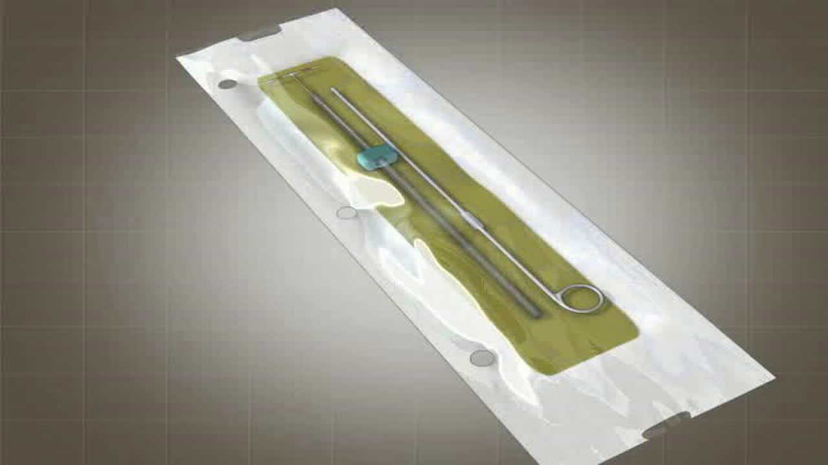
Insertion and Removal techniques for interval IUD

Slide 6
Adverse Events of IUDs and their Management

Slide 7
Adverse Events of IUDs
Expulsion
Malposition
Missing string
Method Failure
Perforation
Infection
Pain
Partner feeling the string

Slide 8
Case: Pregnancy with IUD
25-year-old, para II woman presents to your clinic
6 weeks amenorrhea and positive pregnancy test
Has had a copper IUD in place for 3 years and can feel the strings herself
Experienced light cramping but no bleeding
On examination, the IUD string is present at the external cervical os.
While the pregnancy is unplanned, the patient desires that it continues.

Slide 9
Case: Pregnancy with IUD
25-year-old, para II woman presents to your clinic
6 weeks amenorrhea and positive pregnancy test
Has had a copper IUD in place for 3 years and can feel the strings herself
Experienced light cramping but no bleeding
On examination, the IUD string is present at the external cervical os.
While the pregnancy is unplanned, the patient desires that it continues.
Should you remove the IUD?

Slide 10
Management of adverse events of IUD
Expulsion
More in the first year (3-10%)
Risk Factors: Prior expulsion, multi-parous, menorrhagia, severe dysmenorrhea and insertion immediately after a second trimester abortion or postpartum
Symptoms: Cramping, intermenstrual or post-coital bleeding, male or female dyspareunia, or lengthened/absent strings or asymptomatic
Management:
Prevention: Check their IUD strings periodically
Ultrasound, followed by x-ray
Partial expulsion: Remove and don’t reinsert
New insertion if no contraindication

Slide 11
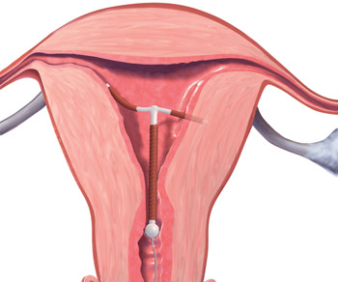
Management of adverse events of IUD
Malposition
If any part of it extends into the myometrium or endocervical canal
Asymptomatic or cramping, heavy menstrual bleeding, or inter-menstrual bleeding/spotting
Management:
If in lower uterine segment - leave it
If below the internal cervical os - removal
Notes:
If below the internal cervical os - removal because expulsion may follow and efficacy could decrease
Image Source: http://www.obgmanagement.com/fileadmin/obg_archive/images/2408/2408OBG_BraatenGoldberg-fig4.jpg

Slide 12
Management of adverse events of IUD
Missing string
IUD is in situ, but the strings are curled and retracted or broken.
  Uterine enlargement: Fibroids or pregnancy
  Rotation of the IUD
IUD has been expelled
IUD has perforated the uterus and is in the myometrium or abdomen

Slide 13
Management of adverse events of IUD
Management of missing string
Exclude pregnancy
If Pregnant:
  Confirm it is intrauterine
  If IUD strings are visible on speculum examination, remove
  Not visible: remove using forceps with ultrasound guidance
  If difficult, leave in-situ
  If termination desired, IUD removal and termination can be done at the same time
Notes:
Risk of adverse events in pregnancy with retained IUD is higher: Spontaneous abortion (50%), placental abruption, preterm delivery and chorioamnionitis

Slide 14
Management of adverse events of IUD
Management of missing string (con’t)
Pregnancy excluded:
  Backup contraceptives
  Probe strings with cytobrush or forceps
  IUD not located, do ultrasound: In cavity, leave it unless the woman wants to discontinue
  If removal is chosen, ultrasound guided removal or dilate cervix and remove
  If not visible on ultrasound, do abdominal and pelvic x-ray (AP and lateral): not visible, confirm expulsion
  If x-ray shows the IUD is located outside the uterine cavity, a perforation has occurred

Slide 15
Management of adverse events of IUD
Perforation
Occurs during IUD insertion in 1/1000 or less
Risk factors: Clinician inexperience, a retroverted uterus, breastfeeding, and the presence of a myometrial defect (by procedure or a pre-existing)
Usually not recognized immediately
Sign and Symptoms: shortening/missing string, mild abdominal pain and/or bleeding
Dx: Ultrasound, if not visible, X-ray
Management:
Removal by laparoscopy or laparotomy
If embedded in myometrium: hysterescopic removal

Slide 16
Management of adverse events of IUD
Infection
Greatest risk in the first 20 days after insertion (Contamination)
Existing STI at time of insertion: Risk of PID
Management:
Initiate treatment with the IUD in place,
If no response in 72 hrs or other complications like tubo-ovarian abscess is suspected: Remove IUD
Notes:
Routine antibiotics prophylaxis or routine STI screening before insertion of IUD is not recommended

Slide 17
Management of adverse events of IUD
Pain: New severe cramping or abdominal tenderness evaluate for pelvic inflammatory disease, ectopic pregnancy, threatened or incomplete abortion, and IUD expulsion or perforation.
Dysmenorrhea: worse in the first few cycles after insertion: can mostly be treated with NSAIDs.
Partner feeling the string: If strings are cut too short. Should be 3 to 4cm from the os: counseling

Slide 18
Summary
IUDs are:
  Highly effective
  Long term but reversible
  Very safe
  Broad eligibility
  Effective emergency contraceptive (Cu IUD)
Dispelling myths is needed
Immediate postpartum and post-abortion insertion possible and favorable

Slide 19
Thank you

