Slide 1
Short-term hormonal contraception
Woubishet GirmA, MD assistant professor, Jimma university
Obstetrics and GYNECOLOGY

Slide 2
Outline
Objectives
Depo medroxy progesterone acetate (DMPA)
Combination oral contraceptives
Progestin only oral contraceptives
Combined contraceptive patch and vaginal ring

Slide 3
Objectives
Describe short-term hormonal contraceptives
Explain mechanism of action of short-term hormonal contraceptives
Identify advantages and disadvantages of short-term hormonal contraceptives
Describe non-contraceptive benefits of short-term hormonal contraceptives

Slide 4
Case Study
A 23 year-old nulliparous woman named Tigist recently got married, she does not want to get pregnant in the next 6 months
What short-term hormonal contraceptive methods do you counsel her on?
Notes:
Before we begin the session, let us take a while and you reflect the case first. When you are done, click the next slide
I hope you have at least mentioned DMPA, COC, POP,

Slide 5
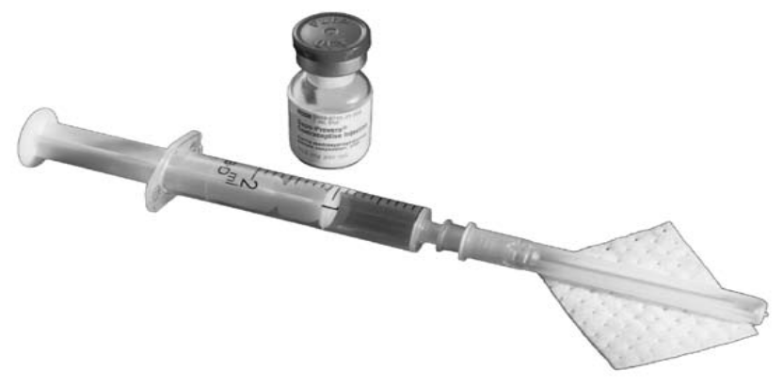
Depo Medroxy Progesterone Acetate (DMPA)
Suspension of microcrystals of a synthetic progestin injected intramuscularly (IM)
Active levels achieved within 24 hours after injection
Serum concentrations of 1 ng/mL maintained for 3 months
Single doses of 150 mg suppress ovulation in most women for as long as 14 weeks
Regimen consists of 1 dose every 3 months
New: Depo-sub Q provera delivers a lower dose of MPA (104 mg vs 150 mg)
Notes:
During the fifth or sixth month after injection, the levels decrease to 0.2 ng/mL, and they become undetectable by 7-9 months after injection
Inhibition of ovulation with the suppression of follicle-stimulating hormone (FSH) and LH (luteinizing hormone)levels and eliminates the LH surge
Thicken cervical mucous
render the endometrium less suitable for implantation
Hinder the rate of ovum transport.
A subcutaneous version of the drug is now available (depo-subQ provera 104) and delivers a lower dose of medroxyprogesterone acetate (MPA) (104 mg vs 150 mg)

Slide 6
Efficacy of DMPA
An extremely effective contraceptive option
Within the first year of use, the failure rate is 0.3%
Weight and use of concurrent medications does not alter efficacy
Notes:
An extremely effective contraceptive option
Neither varying weight nor use of concurrent medications has been noted to alter efficacy
Within the first year of use, the failure rate is 0.3%

Slide 7
Advantages of DMPA
No serious adverse effects of estrogen
Diminished anemia
Dysmenorrhea is decreased
Risks of endometrial and ovarian cancer decreased
Suitable for women who cannot take estrogen products
Safe for breastfeeding mothers
Notes:
No serious adverse effects of estrogen, such as thromboembolism

Slide 8

Disadvantages of DMPA
Amenorrhea in 50% of women within the first year
Persistent irregular bleeding
Delayed fertility
70% conceive within 12 months, and 90% do within 24 months
A "black-box" warning, stating that bone loss may not be completely reversible even after stopping the drug
Women should not use DMPA on a long-term basis unless all other methods were inadequate
IM route of injection, which requires an office visit every 12-14 weeks for administration
Notes:
Disruption of the menstrual cycle to eventual amenorrhea occurs in 50% of women within the first year
Persistent irregular bleeding can be treated by administering the subsequent dose earlier or by prescribing temporary low-dose estrogen therapy
Approximately 70% of former users desiring pregnancy conceive within 12 months, and 90% of former users conceive within 24 months because DMPA persists in the body for several months in women who have used it on a long-term basis,
Similar to the delay in fertility after discontinuation of DMPA, other adverse effects, such as weight gain, depression, and menstrual irregularities, may continue for as long as 1 year after the last injection
The main limitation, from the patient's point of view, has been the intramuscular (IM) route of injection, which requires an office visit every 12-14 weeks for administration
The subcutaneous route opens the possibility for home self-injections
the lower dose could decrease suppression of pituitary function and ovarian estradiol production.
It is the strongest warning that the FDA requires, and signifies that medical studies indicate that the drug carries a significant risk of serious or even life-threatening adverse effects.
Most users of DMPA are teens at a crucial age for the building of bone density; about 10% of American females aged 15-19 years who use birth control use Depo-Provera, compared with 3% of women in the United States overall.
Studies have contradicted the FDA warning.
Women who stopped using DMPA experienced an average bone gain of 1.34% at the hip versus a loss of 0.19% for women who never took the drug. Spine density increased 2.86% for women who stopped using the drug, compared with an increase of 1.32% for nonusers. Furthermore, teens regained their bone density faster than older women using Depo-Provera.^{[6]}
The FDA issued a "black-box" warning in November 2004, stating that bone loss from using Depo-Provera "may not be completely reversible" even after stopping the drug
The warning urged women not to use Depo-Provera on a long-term basis unless all other methods were inadequate

Slide 9
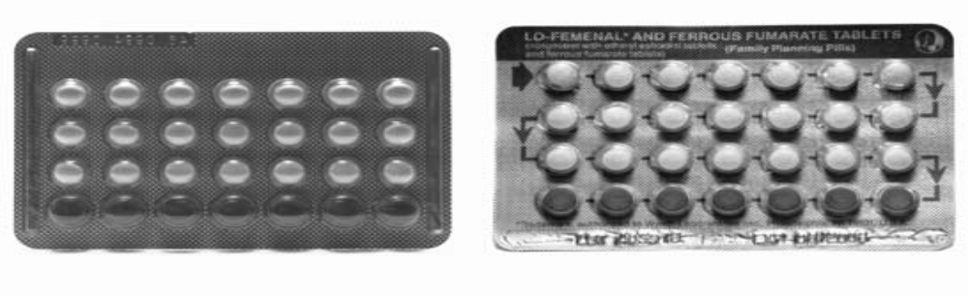
Combination Oral Contraceptives (COCs)
Pills that contain low doses of progestin and an estrogen
Ethinyl estradiol is used in all preparations containing ≤35 mcg
Recently low dose ethinyl estradiol (20 mcg) is available
Lower doses are associated with a decrease in the incidence of estrogen-related adverse effects
Progestin: norethindrone and levonorgestrel
New progestin: drospirenone
Notes:
Pills that contain low doses of 2 hormones—a progestin and an estrogen—like the natural hormones progesterone and estrogen in a woman’s body
Today, ethinyl estradiol is used in all preparations containing 35 mcg or less of estrogen in the United States
Lower doses are associated with a decrease in the incidence of estrogen-related adverse effects, such as weight gain, breast tenderness, and nausea
The major drive for this change is to improve the safety and reduce adverse effects
The progestin component consists of norethindrone, levonorgestrel, norgestrel, norethindrone acetate, ethynodioldiacetate, norgestimate, and desogestrel
The most recent addition to the progestin group is the addition of drospirenone, found in Yasmin birth control pills
The dose of sex steroids has declined significantly in the past 40 years
Prior to 1992, the estrogenic component of oral contraceptives consisted of either ethinyl estradiol or mestranol
The other major development is the reduction in the dosage of ethinyl estradiol to 20 mcg
However, few data exist to indicate whether reduction of the estrogen dose is associated with a decreased risk of serious sequelae

Slide 10
COCs (cont’d)
Monophasic: Constant dose of both estrogen and progestin in each of the active pills
Phasic combinations can alter either one or both hormonal components
Multiphasic: Biphasic, triphasic pills
Most of the formulations have 21 hormonally active pills followed by 7 placebo pills
This facilitates consistent daily pill intake
Notes:
Monophasic oral contraceptives have a constant dose of both estrogen and progestin in each of the hormonally active pills
Phasic combinations can alter either or both hormonal components
Multiphasic: Biphasic, Triphasic pills
Most of the formulations have 21 hormonally active pills followed by 7 placebo pills
This facilitates consistent daily pill intake
Another recent development is the release of a combined oral contraceptive pill to raise folate serum levels.
Beyaz contains the same progestin and estrogen contents as Yaz (drospirenone 3 mg/ethinyl estradiol 20 mcg) plus 0.451 mg levomefolate calcium (folic acid metabolite).

Slide 11
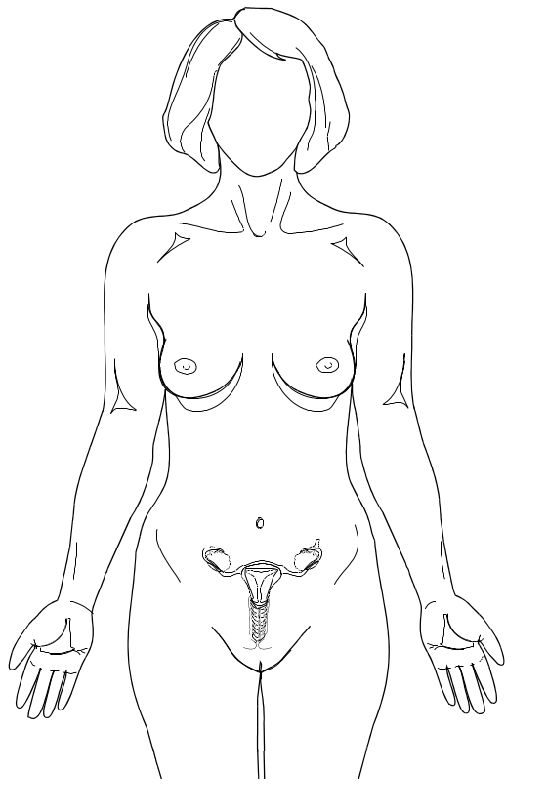
Mechanisms of Actions
Inhibit ovulation
Decrease tubal motility
Change endometrial lining (thinning)
Thicken cervical mucus (prevent sperm penetration)
Notes:
Ovulation can be inhibited by estrogen or by progestin alone.
Pharmacologic synergism is exhibited when the two hormones are combined and ovulation is suppressed at a much lower dose of each agent.
They also alter the consistency of cervical mucus, affect the endometrial lining, and alter tubal transport

Slide 12
When can a woman start COCs?
During first day of menstrual cycle
Amenorrhea
Breast feeding
Switching from another method
After abortion
Notes:
Remember the case study mentioned earlier regarding Tigist, if she has chosen COC, when should she begin using ?
should be initiated either on the first day of the menses or the first Sunday after menses has begun

Slide 13
Missed Pill(s)
Misses 1 or 2 pill(s)
  Take 1 pill as soon as she remembers
  Take 1 pill daily until coverage of the missed pill(s) is achieved
If more than 2 consecutive pills are missed
  Use a back-up method
  Finish up the packet of pills until next menses
Notes:
Tigist forgot to take her pills on Sunday, what do you tell her to do?
Either estrogen or progesterone alone is capable of inhibiting both FSH and LH sufficiently to prevent ovulation

Slide 14
Efficacy of COCs
Effectiveness depends on the user
Efficacy rates range from 0.1% with perfect use to 8% with typical use
Notes:
Failure rates are correlated to individual compliance.
Risk of pregnancy is greatest when a woman starts a new pill pack 3 or more days late, or misses 3 or more pills near the beginning or end of a pill pack

Slide 15
Health Benefits of COCs
Treatment for menstrual irregularity
Reduction and sometimes elimination of Mittelschmerz (mid-cycle pain after ovulation)
Reduced iron deficiency anemia
Less dysmenorrhea
Less severe pre-menstrual symptoms
Manipulates the cycle to avoid menses during certain events
Notes:
because menses is more regular and predictable
Functional cysts are reduced by the suppression of stimulation of the ovaries by FSH and LH

Slide 16
Health Benefits of COCs (cont’d)
Prevents benign conditions, such as benign breast disease, pelvic inflammatory disease (PID), and functional cysts
Ectopic pregnancies are prevented
Prevents epithelial ovarian and endometrial carcinomas
Notes:
Studies have noted an approximate 40% reduced risk of malignant and borderline ovarian epithelial cancer
Use of oral contraceptives is associated with a 50% reduction of risk of endometrial adenocarcinoma
Protection appears to last for at least 15 years following discontinuation of use and increases with duration of use

Slide 17
Disadvantages of COCs
Does not provide protection from STDs
Daily administration is necessary
Inconsistent use may increase the failure rate
Delay of normal ovulatory cycles upon discontinuation
Notes:
Women who continue to have amenorrhea after a discontinuation period of 6 months require a full evaluation.

Slide 18
Adverse Effects
Nausea, breast tenderness, breakthrough bleeding, amenorrhea, and headaches
Venous thrombosis
Hypertension
Atherogenesis and stroke
Hepatocellular adenoma
Breast cancer in young women (controversial)
Cervical cancer (controversial)
Notes:
When Tigist is counseled on COCs- what should be covered regarding certain medical conditions?
The estrogen component of oral contraceptives has the capability of activating the blood clotting mechanism. Use of low-estrogen oral contraceptives is associated with a lower risk of thromboembolism than use of oral contraceptives with higher levels of estrogen.
Oral contraceptives have a dose-related effect on blood pressure. With the older, high-dose pills, as many as 5% of patients could expect to have blood pressure elevations of 140/90 mm Hg or higher.
Although androgens and a few of the progestins actually may increase low-density lipoproteins and decrease high-density lipoproteins, past use of oral contraceptives does not increase the risk of cardiovascular disease
Current thought is that oral contraceptive use may be a cofactor that can interact with another primary cause to stimulate breast cancer

Slide 19
Contraindications to COCs
Cerebrovascular disease or coronary artery disease
History of deep vein thrombosis, pulmonary embolism, or congestive heart failure
Untreated hypertension
Diabetes with vascular complications
Undiagnosed abnormal vaginal bleeding
Active liver disease
A woman who is older than 35 years and smokes cigarettes
Notes:
Again, with Tigist, what are the contraindications?
Potassium levels should be checked during the first month of use, especially if drospirenone is taken daily with drugs that can increase potassium levels (eg, nonsteroidal anti-inflammatory drugs, ACE inhibitors).

Slide 20
Progestin-Only Oral Contraceptives
Also known as minipills
Indications:
  Women who are breastfeeding
  Women with contraindications to estrogen use
Two formulations are available, both have lower doses of progestin than COCs
One formulation contains 75 mcg of norgestrel and the other has 350 mcg of norethindrone
Notes:
Progestin-only oral contraceptives
are not used widely in the United States
Less than 1% of users of oral contraceptives use them as their sole method of contraception.

Slide 21
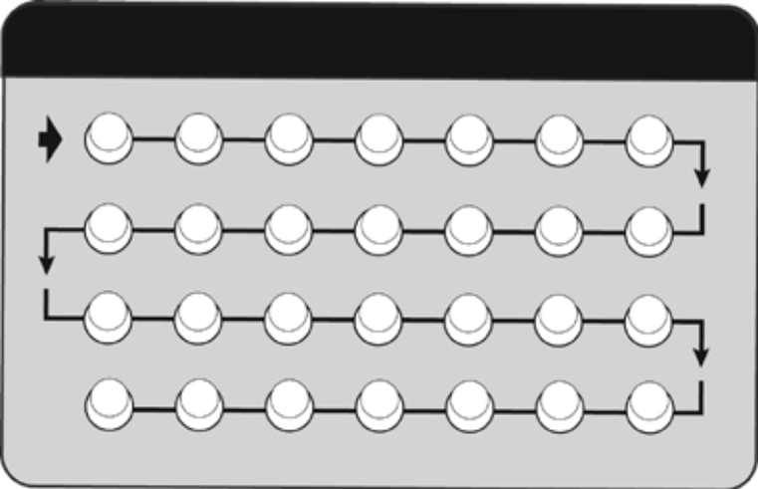
Mechanisms of Action
Suppression of ovulation
An increase in cervical mucus viscosity
An atrophic endometrium
A reduction in cilia motility in the fallopian tube
Notes:
Prevention of conception involves a combination of mechanisms similar to, but not as efficacious as, combination oral contraceptives
Suppression of ovulation (not uniformly in all cycles); (2) a variable dampening effect on the midcycle peaks of LH and FSH; (3) an increase in cervical mucus viscosity by a reduction in its volume and an alteration of its structure; (4) a reduction in the number and size of endometrial glands, leading to an atrophic endometrium not suitable for ovum implantation; and (5) a reduction in cilia motility in the fallopian tube, thus slowing the rate of ovum transport

Slide 22
Efficacy
Serum levels peak approximately 2 hours after administration
Returns to baseline with in 24 hours
Greater efficacy is achieved with consistent administration
Failure rates with typical use 8% in the first year and increased with inconsistent use

Slide 23
Advantages
Evidence of serious complication like thromboembolism is minimal
Non-contraceptive benefits include decreased dysmenorrhea, menstrual blood loss, and pre-menstrual symptoms
Unlike DMPA, fertility immediately reestablished after the cessation
Notes:
The advantages are similar to DMPA
Due to the lack of estrogen, evidence of serious complications to which estrogen can contribute (ie, thromboembolism) is minimal

Slide 24
Disadvantages and Adverse Effects
Disadvantages
Need for compliance with usage
Need to be counseled on a back-up method
Unscheduled bleeding and spotting
Adverse effects
Nausea
Breast tenderness
Headache
Amenorrhea
Notes:
The most significant disadvantage is the continuous need for compliance with usage
Users need to be counseled on the need for a backup method of contraception if a pill is missed or taken late
A pill is considered late if ingestion occurs 3 hours after the established time of administration
If a pill is missed, it should be taken as soon as possible; the next pill should be taken at the scheduled time
Backup contraception should be used for the next 48 hours
Unscheduled bleeding and spotting are common even with correct use
Other adverse effects include nausea, breast tenderness, headache, and amenorrhea

Slide 25

Combination Patch Contraceptive
Transdermal patch releases estrogen and progesterone directly into the skin
Releases a sustained low daily dose of steroids equivalent to the lowest-dose oral contraceptive
Greater compliance and decreased adverse effects
Less effective for women who weigh more than 90kg
Each patch contains a 1-week supply of hormones
Notes:
A small, thin, square of flexible plastic worn on the body
the contraceptive transdermal patch releases estrogen and progesterone directly into the skin (Ortho Evra, Ortho-McNeil Pharmaceutical; Raritan, NJ)
Must be replaced every week
It releases a sustained low daily dose of steroids equivalent to the lowest-dose oral contraceptive
A failure rate for the patch of 1 pregnancy per 100 women per year, similar to that of other combination methods
In August 2002, the FDA listed

Slide 26

Contraceptive Vaginal Ring
A flexible ring placed in the vagina
Releases progestin and an estrogen
Easily inserted and removed by the woman herself
Absorbed through the vagina directly into the bloodstream
Kept in place for 3 weeks, removed on the fourth week
The hepatic first-pass metabolism of progestin is prevented
Lowest dose of ethinyl estradiol compared with other COCs
Notes:
A flexible ring placed in the vagina is a non biodegradable, flexible, colorless ring made up of a polymer of ethylene vinyl acetate and magnesium stearate
Continuously releases 2 hormones—a progestin and an estrogen, like the natural hormones progesterone and estrogen in a woman’s body—from
inside the ring.
The outer diameter of the ring is 54 mm and the cross-sectional diameter is 4 mm
The ring contains 11.7 mg of etonogestrel and 2.7 mg of ethinyl estradiol
It releases 120 mcg of etonogestrel and 15 mcg of ethinyl estradiol each day
Hormones are absorbed through the wall of the vagina directly into the bloodstream.
The ring is kept in place for 3 weeks, then removed for the fourth week.
During this fourth week the woman will have monthly bleeding.
Also called NuvaRing.
Works primarily by preventing the release of eggs from the ovaries
(ovulation).

Slide 27
Summary
Short-term hormonal contraceptives primarily act through inhibiting ovulation
DMPA is most common short-term hormonal method and known for delaying return of fertility
COCs with low dose estrogen are safe and have to be taken consistently
POP is preferred for lactating women
Their effectiveness depends on compliance of user

