Slide 1
BARRIER METHODS USED IN FAMILY PLANNING PROGRAM
JUSTINE BAGIRISANO, RM, BScNM, BPH

Slide 2
What will be discussed:
Barrier contraceptive methods
    Introduction to available methods
    Counselling
    Emphasis on male condom

Slide 3

Learning Outcomes
Barrier contraceptive methods
  Discuss
    effectiveness,
    risks,
    indication and contra indication
    advantages and disadvantages
    side effects/complications
  Teach the condom use
What else do you expect from this session?

Slide 4
Barrier Methods
To prevent pregnancy: block ovum and sperm from meeting
Barrier methods may have failure rates due to design and human error

Slide 5
Barrier Contraceptive Methods
MECANICAL METHODS | CHEMICAL METHOD | BOTH
Condoms- Male/Female | Spermicides in form: mousses (Delfen*), gel, crèmes (Koromex*), ovules, comprimés moussants (Conceptrol*) | IUD (Copper or Melena) & Diaphragm Cervical Cap Sponge Cervical ring

Slide 6
Family Planning Counselling for Barrier Use
During the first visit:
Ensure privacy
Tell to the client to come before finishing all condoms
Ask if she/he is satisfied of services delivered to her/him
Encourage the client to ask/respond to questions for clarification
Provide condoms when requested
Remind her/him that condoms are also provided by CHWs
Thank the client, accompany him/her, and say "goodbye"

Slide 7

Family Planning Counselling for Barrier Use
During the second and other following:
Ensure privacy
Ask to client if she/he is satisfied about using condoms
Ask if she/he wants to use condom again
If not, help the client to choose another method

Slide 8
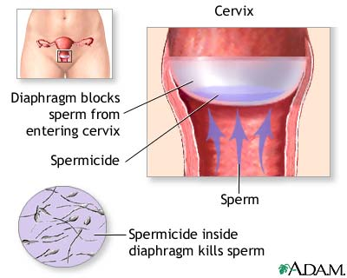
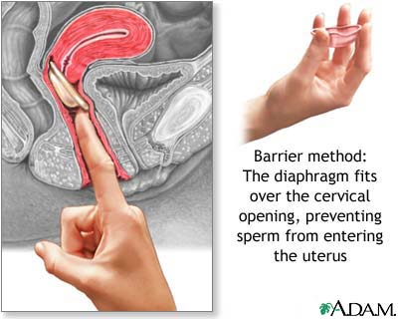
Diaphragm

Slide 9
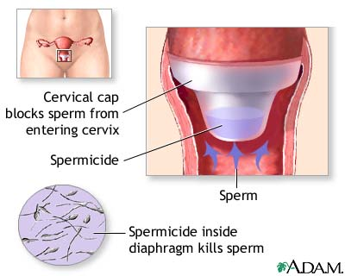
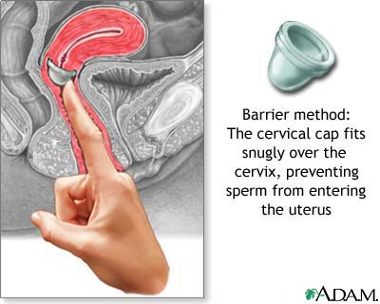
Cervical Cap

Slide 10
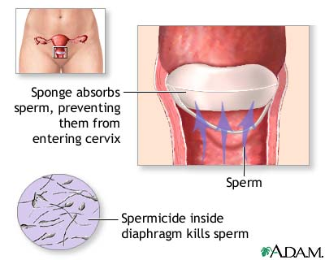
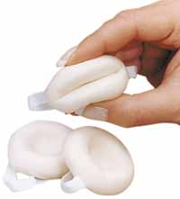
Sponge

Slide 11
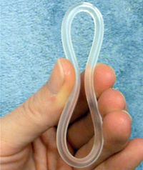
Vaginal Ring (NUVARING)
Effective: 95-99%
Does not require prescription
can make periods more regular and less painful,
no pill to take daily,
ability to become pregnant returns quickly when use is stopped.

Slide 12
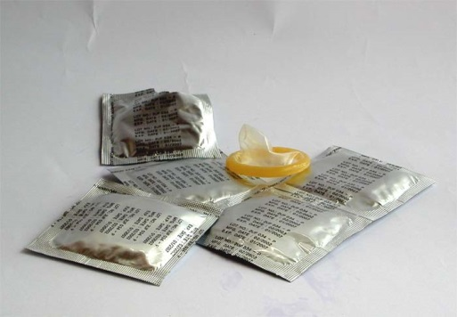
Male Condom
Latex and Polyurethane
Water or oil based lubricants
No prescription is needed

Slide 13
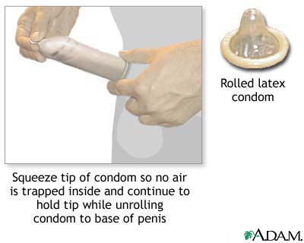
Male Condom
Prevention: pregnancy and spread of STD’s/HIV
86-97 % effective

Slide 14
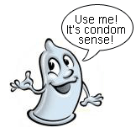
Male Condom
Combining condoms with spermicides raises effectiveness levels to 99%

Slide 15
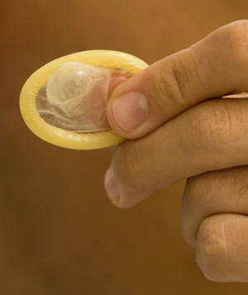
Advantages and Disadvantages
Advantages | Disadvantages
No medical prescription Cheap Easy to teach/use Can be used while waiting to use another method Men participation in FP program No systematic side effects Can prevent premature ejaculation | Require partner motivation Possibility of condom damage Interfere with sexual intercourse

Slide 16
Advantages and Disadvantages
Advantages | Disadvantages
Does not interfere with Breastfeeding The only reversible method for men Is integrated in Community-Based Provision program | Interrupt the prelude of intercourse (Must immediately be available) Possibility of allergy on latex The couple may stop use it or forget

Slide 17
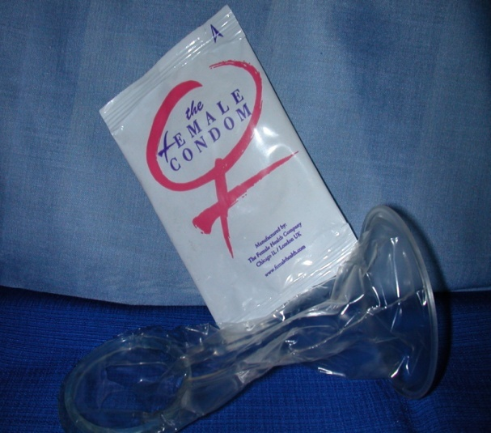
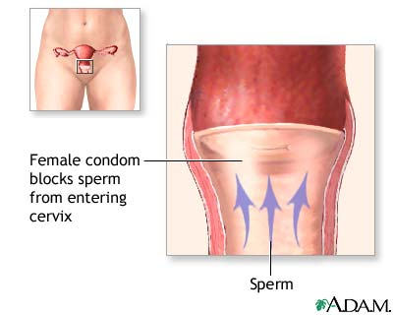
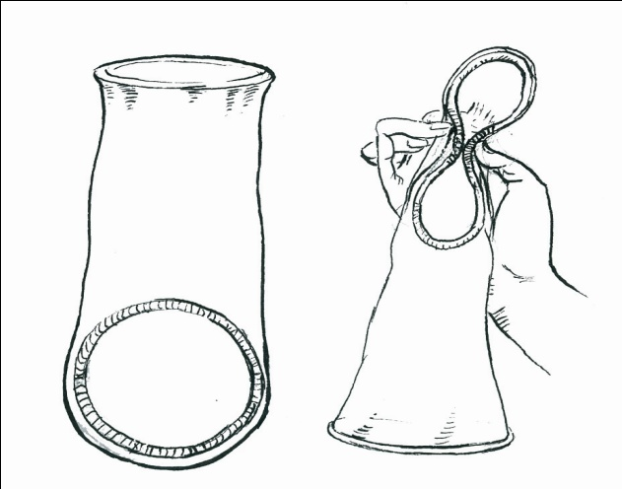
Female Condom
Alternative to male condoms
Lubricated polyurethane sheath
Physically inserted in the vagina
79-95% effective
No prescription

Slide 18
Advantages and Disadvantages
Advantages | Disadvantages
Prevent: HIV/STIs and pregnancy No side effect (only when dammaged or poor hygiene) | Expensive (around 1 USD) Cultural BARRIER Must be immediately available Uncomfortable when insert some women: no orgasm Misused: side effects (STIs, Pregnancy)

Slide 19
Indication and Contraindication Male & Female Condom
Indications | Contraindication
Choice of the couple Occasional sexual intercourse Discordant couple For anyone | Allergic to latex Impossible to maintain erection Not long term method

Slide 20
Instructions for Clients
Availability of condoms all the time
Combine condom and spermicides for maximum effectiveness
Never open the condom envelop with teeth, knife, scissors or other sharp instruments
Don’t use the condom if the envelop is damaged
Do not add other types of oil to increase the lubrication to avoid damage
Condoms are single use
Note the expiry date

Slide 21
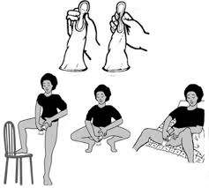
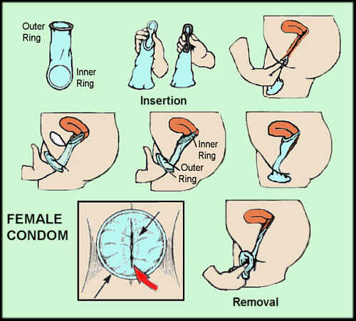
Female Condom

Slide 22
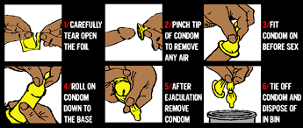
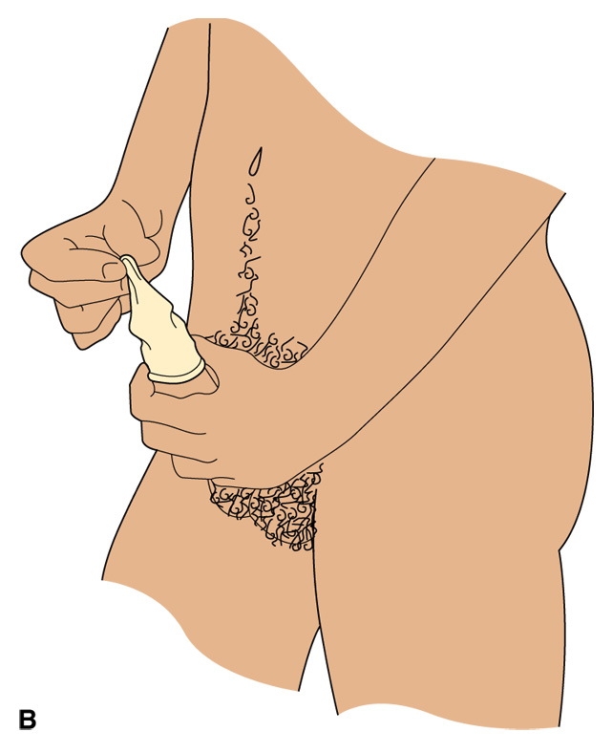
Male Condom

Slide 23

Summary
Do you feel confident to be able to explain how to use male and female condom use?
Types of barrier methods
Advantages and Disadvantages
Effectiveness
Instructions for use

