Slide 1
COMPREHENSIVE ABORTION CARE
PART II - Methods of termination of pregnancy
YONAS GETACHEW, MD
CLINICAL ADVISOR, CIRHT
ASS’T PROFESSOR, OB-GYN, ADDIS ABABA UNIVERSITY

Slide 2
Objectives
Outline methods in first trimester pregnancy terminations
Describe medical methods in first trimester pregnancy terminations
Describe surgical methods in first trimester pregnancy terminations
Outline management of complication of first trimester pregnancy terminations

Slide 3
Outline
Methods in first trimester pregnancy terminations
  Medical
  Surgical
Management of complication of first trimester pregnancy terminations

Slide 4
Methods of termination
Medical, pharmacologic
Surgical

Slide 5
Methods of termination
First trimester: Medical, MVA
Second trimester: Medical (repeated doses of misoprostol), D&E

Slide 6
Choice depends on:
Gestational
Clinical condition
Patient choice
Skill
Availability

Slide 7
Medical
Oxytocin, cytotoxic drugs
Prostaglandins
Anti progesterone: Mifepristone, epostane
Hyper osmolar solutions: 20% saline, 30% urea

Slide 8
Surgical
Vacuum aspirations: MVA, EVA
Sharp curettage: D&C, E&C
Evacuation: D&E, D&X
Balloons, Laminarrie
Amniotomy
Hysterotomy (no more)
Hysterectomy (no more except only in case of complications)

Slide 9
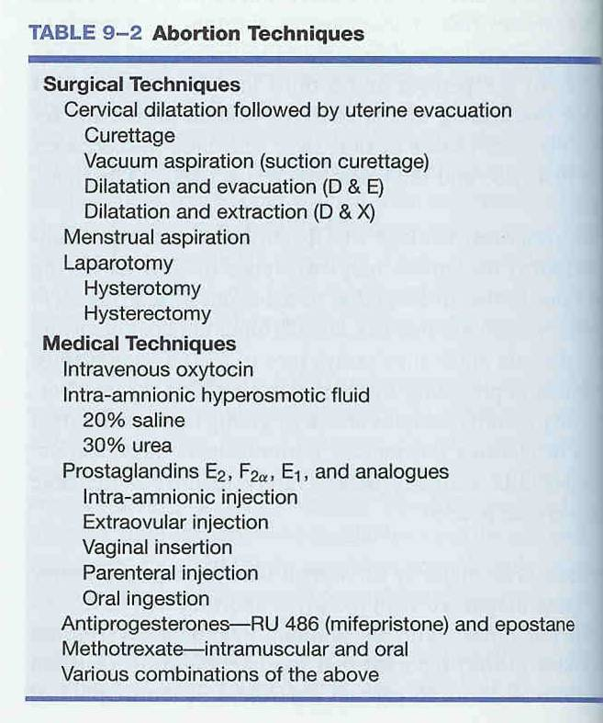
Methods of Termination

Slide 10
Medical methods

Slide 11
Medical methods
Medication abortion is termination of pregnancy using drugs
The most commonly used MA agents are mifepristone and misoprostol

Slide 12
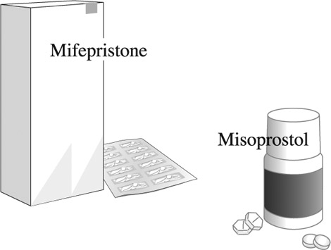
Medication - Abortion Pills

Slide 13


The Drugs
Notes:
Talking Points
In September 2000, the FDA approved mifepristone for use in the United States. With the availability of very sensitive pregnancy tests, women now theoretically can choose to terminate a pregnancy either with medication or vacuum aspiration as early as the pregnancy can be diagnosed.
In European countries, such as France, Great Britain, and Sweden, the widespread availability of mifepristone has not been associated with any increase in the number or rate of abortions; however, it has been associated with a rise in the proportion of abortions performed at earlier gestational ages (Jones and Henshaw 2002).
Reference
Jones RK, Henshaw SK. Mifepristone for early medical abortion: experiences in France, Great Britain and Sweden. Perspect Sex Reprod Health. 2002;34:154–61.
- - -
Original content for this slide submitted by the ARHP Clinical Advisory Committee for the Manual Vacuum Aspiration Education Partnership Project in December 2004. Original funding received from Ipas and the John Merck Fund through an unrestricted educational grant. Last reviewed/updated by the ARHP Clinical Advisory Committee for the Manual Vacuum Aspiration Education Partnership Project in October 2007. This slide is available at www.arhp.org/core.

Slide 14
Mifepristone
Synthetic anti-progesterone
Developed as RU-486
Leads to detachment of the pregnancy from the uterine wall; it also dilates the cervix
Teratogenic if pregnancy continues after use
Given orally: 200mg

Slide 15
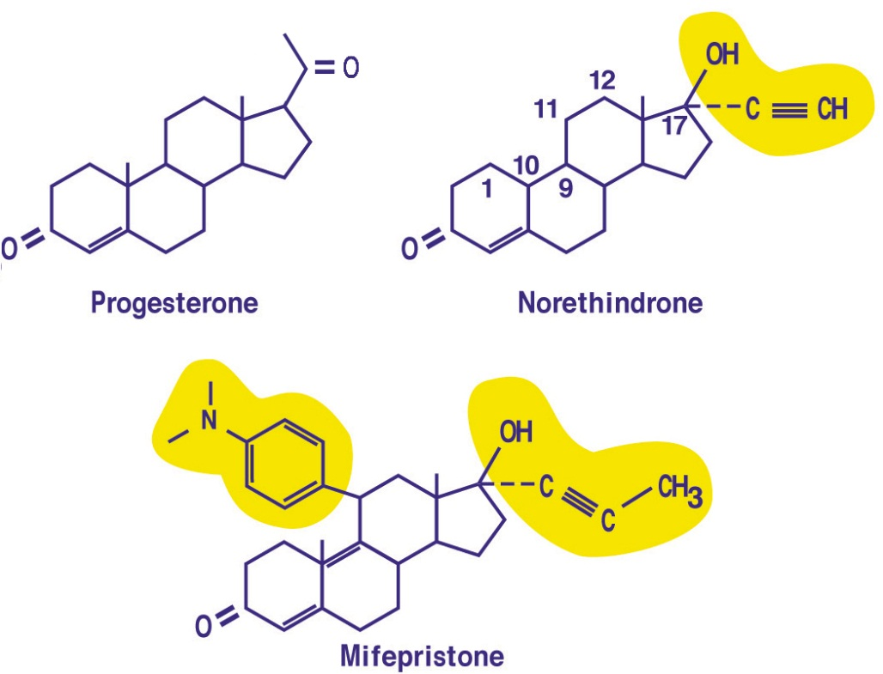
Mifepristone - mechanism of action
Progesterone during pregnancy:
  Inhibits contractility of myometrium
  Inhibits secretion of prostaglandins in endometrium
  Maintains closed cervix

Slide 16
Misoprostol
Prostaglandin E analogue
Originally manufactured for treatment of PUD
Works by causing uterine contraction and cervical dilatation
Can be used for prevention and/or treatment of PPH
Given in different routes (oral, vaginal, buccal, sublingual)

Slide 17
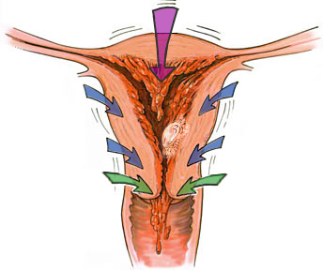
Mechanism of Action:
Mifepristone + Misoprostol
Progesterone Blockade
Decidual
Necrosis
Rhythmic
Uterine
Contractions
Cervical
Ripening
Detachment
Expulsion
Abortion
© Lisa Penalver
Source: NAF
Notes:
Mifepristone: blocks progesterone
➔binds to its receptors without activating them.
➔trophoblast separates from the decidua and releases prostaglandins.
➔cervical ripening.
Misoprostol, a prostaglandin or PGE1,
Uterine contractions—expulsion
Mife + miso = higher success
Miso alone = high enough to be appropriate

Slide 18
Indications: MA in first trimester
Pregnancy less than nine weeks since the LMP
(confirm that the woman is pregnant!)
NB: For gestational age >9wks to 12 wks DO MVA

Slide 19
Contraindications
Allergy for the medications
Hemorrhagic disorder or concurrent anticoagulant therapy
Suspected or confirmed Ectopic pregnancy
Inherited porphyria

Slide 20
Precautions
Intrauterine device inside the uterine cavity (can remove prior to medical abortion)
Clinically unstable
Severe anemia
Poorly controlled asthma
Chronic adrenal failure

Slide 21
Special conditions
Asthma
STI
HIV
Breast feeding
Obese
Multiple pregnancy

Slide 22
Regimen: dose, route
Combination regimen is recommended
Mifepristone is given 200mg oral
Misoprostol can be given orally, buccal or sublingually or vaginal

Slide 23
Dose: less than 7 weeks
Day 1: Mifepristone - 200mg (1 tab) orally
Day 3: Misoprostol - 400 (2 tabs) micro gram oral

Slide 24
Dose: less than 9 weeks
Day 1: Mifepristone - 200mg (1 tab) orally
Day 3: Misoprostol - 800 (4 tabs) micro gram vaginal

Slide 25
Dose: 9-12 weeks
Mifepristone 200mg per os
followed 36-48h later by misoprostol 800 mcg vaginally
then misoprostol 400mcg vaginal or sublingual every 3h hours for a total of four doses

Slide 26
Dose: 13 to 24 weeks
Mifepristone 200mg per os,
followed 36-48h later by misoprostol 800 mcg vaginally or 400mcg oral
then misoprostol 400mcg vaginal or sublingual every 3h hours for a total of four doses

Slide 27
Misoprostol for missed abortion
800 mcg vaginally
Administered at home or in clinic
Success rates: 80-90%
But➔ diagnosis of “missed” abortion depends on access to ultrasound

Slide 28
Misoprostol for Incomplete Abortion
Regimen | Efficacy (through 12 weeks by uterine size)
600 μg orally | 96.3% Range: 80-90%
400 μg sublingually | Limited evidence reports it to be equally effective
Notes:
28
Notes are directly clipped from FLASOG Miso manual, 2nd edition:
Misoprostol for treatment of incomplete abortion is becoming increasingly popular because it is easy to use, affordable, and convenient. Since misoprostol stimulates the myometrium at any gestational age and is broadly available, it offers the possibility of achieving a complete abortion using drugs only.
Misoprostol has the potential to improve access to treatment of incomplete abortion. Further, it can significantly reduce the burden at tertiary care facilities, currently overloaded with numerous cases of incomplete abortion that could have been resolved with misoprostol at the first care level. Thus, misoprostol use could substantially reduce service costs, allow women to remain with their family, and prevent the complications associated with surgical evacuation.
[In the past few years], numerous studies have become available and thus new recommendations can be made. Since the publication in 1993 of the first study on misoprostol for the treatment of incomplete abortion,17 several studies have explored a wide variety of regimens, routes of administration, and intervals.18,19 More recent research has allowed us to conclude that a 600 μg dose of oral misoprostol is almost as efficacious as MVA for incomplete abortion.20-23
Over a longer period (8 weeks), the results of expectant management are similar to those of misoprostol for incomplete abortion. With misoprostol, however, bleeding time and time to completion are shorter.14,24

Slide 29
Effectiveness of MA
Combination of two drugs more effective than either used alone.
Combined regimen is 92-98% effective in pregnancies ≤ 9 weeks since LMP (Von Hertzen et al., 2003).
Miso alone = 85-90% effective

Slide 30
Expected side effects following MA
Pain
Bleeding
Fever, chills, sweating
Nausea, vomiting
Dizziness
Diarrhea
Skin rashes
Headache

Slide 31
Complications
Heavy bleeding
Ongoing pregnancy
Incomplete abortion
Infection

Slide 32
Bleeding
Heavier than normal menstrual bleeding
Usually begins within 3-4 hours of misoprostole administration
Average duration: 13 days (from 1 to 60 days)
Total amount of blood loss related to gestational age
Keep patient well-informed of expected amount of bleeding

Slide 33
Heavy bleeding management
Aspiration (MVA) to stop bleeding (0.4 - 2%)
Transfusion required in approximately 0.2% cases
  For early surgical abortion ~ 0.1%
No reports of hysterectomy for hemostasis after MA reported

Slide 34
Infection
Is rare after MA
Broad spectrum antibiotics
MVA in case of retained products of conception

Slide 35
Incomplete abortion
Persistence of gestational sac or retention in about 2-5% of MA cases
Clinical signs: Vaginal bleeding or spotting with uterine sub-involution and/or cervical opening
Investigation
  Urine HCG and Ultrasound

Slide 36
Incomplete abortion management
Depends on patient condition and preferences
If patient clinically stable (no signs of infection, heavy bleeding):
  Provide reassurance, clinical exam and re-evaluate following next menstrual cycle
  Additional doses of misoprostole (as PAC)
  MVA
  Antibiotics
If bleeding heavy or detection of infection:
  Emergency aspiration with MVA/EVA

Slide 37
Ongoing pregnancy (Failed MA)
Incidence is 1-2%; varies by GA and regimen
Diagnosis:
  Clinical examination
    Little or no spotting after MA
    Presence of pregnancy symptoms
    Enlarged uterus upon clinical examination during check-up visit 2 weeks after Misoprostole
  Ultrasound (if available)
  Urine HCG
Management: MVA

Slide 38
What to do in suspected/diagnosed ectopic pregnancy
Always refer suspected ectopic pregnancies to hospitals where there is operative facility.

Slide 39
Surgical methods

Slide 40
Surgical: MVA
Vacuum aspiration is evacuation of content of the uterus using a flexible cannula and syringe.

Slide 41
MVA: three parts
MVA Cylinder
Valve
Cannulae
NB: 1 & 2 in combination are called MVA aspirator

Slide 42
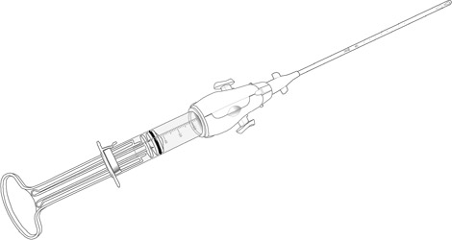
Ipas MVA Plus® with Ipas EasyGrip® Cannula

Slide 43
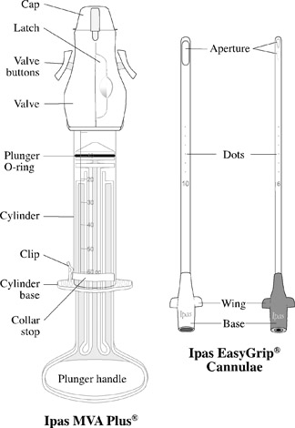
Parts Assembled

Slide 44
Cylinder contains:
O-ring
Collar stop
Plunger
Barrel

Slide 45
Cannulae selection depends upon:
Gestational age
Cervical dilatation

Slide 46
Cannulae based on GA
  Uterine size 4–6 weeks LMP: suggest 4–7mm
  Uterine size 7–9 weeks LMP: suggest 5–10mm
  Uterine size 9–12 weeks LMP: suggest 8–12mm

Slide 47
MVA - indications
Menstrual regulation
Abortion in first trimester
Diagnostic procedures

Slide 48
Diagnostic use of MVA
MVA is not only used for abortion but also as a diagnostic procedure for:
Infertility
Abnormal uterine bleeding
Amenorrhea
Screening for endometrial infections
Screening for endometrial cancer

Slide 49
Steps of the MVA procedure
  1. Prepare instruments
  2. Prepare the woman
  Perform cervical antiseptic prep
  Dilate cervix
  Insert cannula
  Suction uterine contents
  Inspect tissue
  Perform any concurrent procedures
  Process instruments

Slide 50
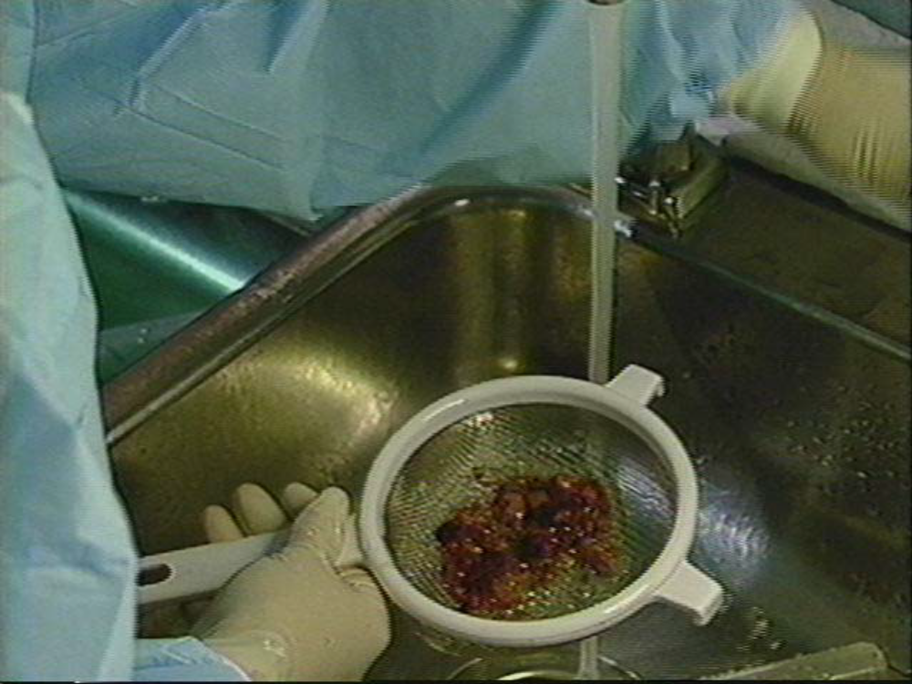
POC examination

Slide 51
Why POC examination?
Ensures pregnancy was inside the uterus
Gives provider feedback on pre-procedure evaluation
Helps provider decide if aspiration was successful
Helps provider plan for follow-up
Increases abortion safety
Notes:
Possible answers – evidence doesn’t necessarily support – no studies where POC checks are NOT done.

Slide 52
Signs of complete evacuation
Red or pink foam without tissue passing through cannula
Gritty sensation over surface of uterus
Uterus contracting around cannula
Increased uterine cramping

Slide 53
Adverse events
Vagal reaction
Incomplete evacuation
Uterine/cervical injury
Pelvic infection
Acute hematometra

Slide 54
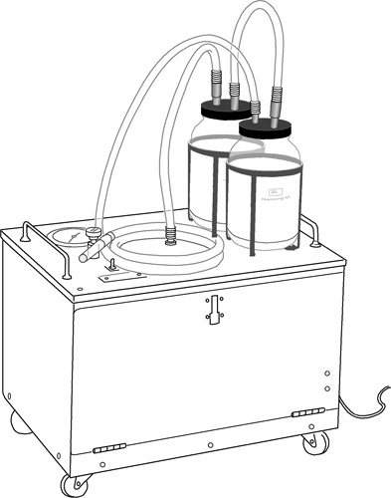
EVA machine

Slide 55
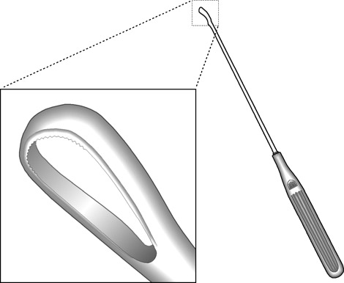
Sharp metal curette - D&C, E&C

Slide 56
Sharp metals - E&C and D&C
Complications
Duration
Pain, bleeding
Skill
Post procedure stay

Slide 57
Sharp curate
Is no longer recommended
High risk of complications - bleeding, perforation
Only in a place where there is no MVA

Slide 58
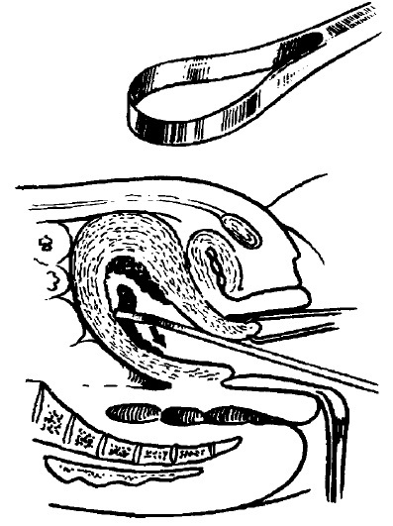
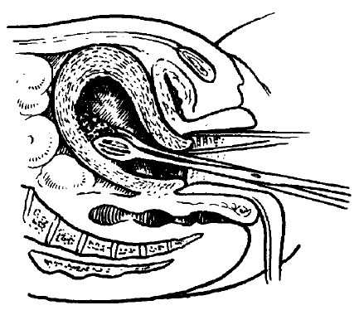
Ovum Forceps
Curette

Slide 59
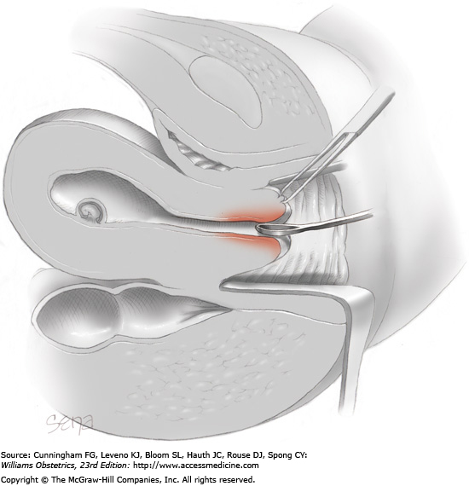

Slide 60
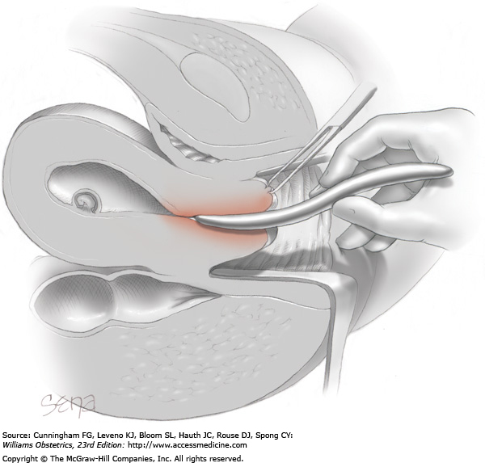

Slide 61
Dilatation and evacuation: D&E
Dilatation and Evacuation (D&E) – A surgical method of abortion using a combination of cervical dilatation, suction aspiration and specialized forceps to assist in tissue evacuation.

Slide 62
Appropriate technology – WHO, 2012
First - MVA and MA
Second - D&E and MA

Slide 63
Complications
Methods
Early complications: perforation, sepsis ,acute hematometra, bowel injury bleeding, death
Delayed/late complications: preterm labor, chronic pelvic pain, infertility, recurrent abortion

Slide 64
References
WHO, “Safe Abortion: Technical and policy guidance for health systems,” second edition, 2012
Ipas, “Clinical updates in reproductive health,” January 2016
FMOH, “Technical and procedural guideline for safe abortion service in Ethiopia,” second edition, June 2014
Reproductive Health Matters, “Second trimester abortion,” vol 16, no 31 supplement, May 2008
Standard text books

Slide 65
Thank You

