Slide 1
COMPREHENSIVE ABORTION CARE
PART I - INTRODUCTION
YONAS GETACHEW, MD
CLINICAL ADVISOR, CIRHT
ASS’T PROFESSOR, OB-GYN, ADDIS ABABA UNIVERSITY

Slide 2
Part I
Introduction

Slide 3
Objectives
Define abortion
Describe global, regional and national picture
Identify etiologies of abortion
Describe the different clinical categories of spontaneous abortion
Evaluation of clients with abortion
Describe induced abortion and post-abortion care (PAC)
Describe Ethiopian Law

Slide 4
Outline
Definitions
Overview
Classifications
Spontaneous abortion, etiology, clinical types
Induced abortion and PAC
Abortion laws

Slide 5
Abortion
Pregnancy (gestation) is the maternal condition of having a developing fetus in the body
Every pregnancy has a risk
Also referred to as “miscarriage, early fetal loss”
Can happen spontaneously or intentionally

Slide 6
Definitions
Abortion is termination of pregnancy before viability
Viability means is the gestational age (GA) at which the fetus is sufficiently developed to survive extra uterine life
In most countries, the GA for viability is 20 weeks or birth weight of ≥500gm

Slide 7
Definitions
In USA, abortion sometimes defined as termination of pregnancy at GA of less than 20 weeks or a birth weight of less than 500gm
Most Countries abortion is defined as termination of pregnancy before GA 28 weeks or birth weight of less than 1000gm

Slide 8
Definitions
WHO:
Abortion is referred as termination of pregnancy before or at GA of 22 weeks or weight less than 500gm (WHO, 2003)
Viability, no upper GA limits, which depends on various factors in each country (WHO, 2012)

Slide 9
Definitions
Ethiopia:
Abortion is the termination of pregnancy before fetal viability, which is to be less than 28 weeks from the last menstrual period (LMP). If the LMP is not known, a birth weight of less than 1000gm is considered abortion. (TPGL, page 5)

Slide 10
Global
208 million pregnancies annually
123m (59%) planned, 85 (41%) unplanned
22m (49%) unsafe abortion
47,000 deaths related to abortion
5m disabilities associated with unsafe abortion

Slide 11
Ethiopia
4 million pregnancies annually
500,000 induced abortions
One of the common indications for all gynecological admissions
7% of maternal deaths (MOH report, 2014)
One of the five major causes of maternal death

Slide 12
Classifications
WHO: “safe” or “unsafe”
GA: first or second trimester
Cause: spontaneous or induced
Clinical (spontaneous): threatened, inevitable, complete, incomplete or missed
Law: legal, therapeutic or criminal

Slide 13
WHO
“Unsafe” abortion
Procedure for terminating unwanted pregnancy by:
persons lacking the necessary skills
in an environment lacking minimal medical standards
or both

Slide 14
Cause
Spontaneous abortion (miscarriage) occurs not as a result of medical or mechanical intervention
Induced abortion is intentional termination of pregnancy for medical or other indications

Slide 15
Spontaneous abortion

Slide 16
Spontaneous abortion
Abortion occurring without medical or mechanical means to empty the uterus
Commonly called “miscarriage” or “early fetal loss”
Some cases are not detected clinically
80% occur in the first trimester
Difficult to know the exact incidence because of pre clinical abortion

Slide 17
Pathology
Hemorrhage in to the decidua basalis
Necrosis of tissues
Ovum detachment, fetal death
Uterine contraction, cervical dilatation
Fetal expulsion: complete or incomplete
Blighted ovum (sac with no embryo)

Slide 18
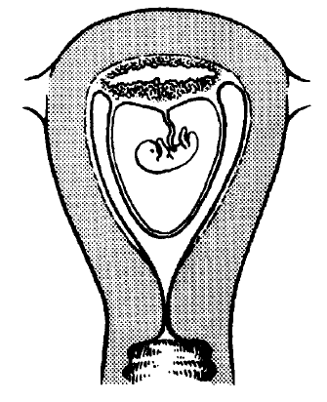
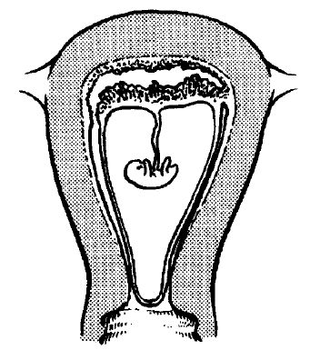
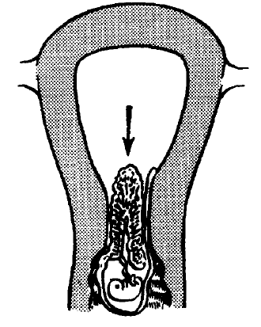
Pathology
Hemorrhage occurs in the decidua basalis leading to local necrosis and inflammation.
The POC, partly or wholly detached, acts as a foreign body and initiates uterine contractions. The cervix begins to dilate.
Expulsion complete. The decidua is shed during the next few days in the lochial flow.

Slide 19
Late pregnancy
Maceration: retained dead fetus, degenerated internal organs, skin softens and easily peels off
Fetal compresses: no amniotic fluid, fetus compressed and desiccated
Fetal papyraceous: dry compressed fetus resembling parchment

Slide 20
Etiology
Exact cause of spontaneous abortion are not always clear
Half are due to chromosomal anomalies
The incidence of chromosomal anomaly is less in late gestations

Slide 21
Risk factors
Advanced maternal age (over 40)
Advanced paternal age
Higher parity
Prior spontaneous abortions
Inter pregnancy interval of less than 3 months

Slide 22
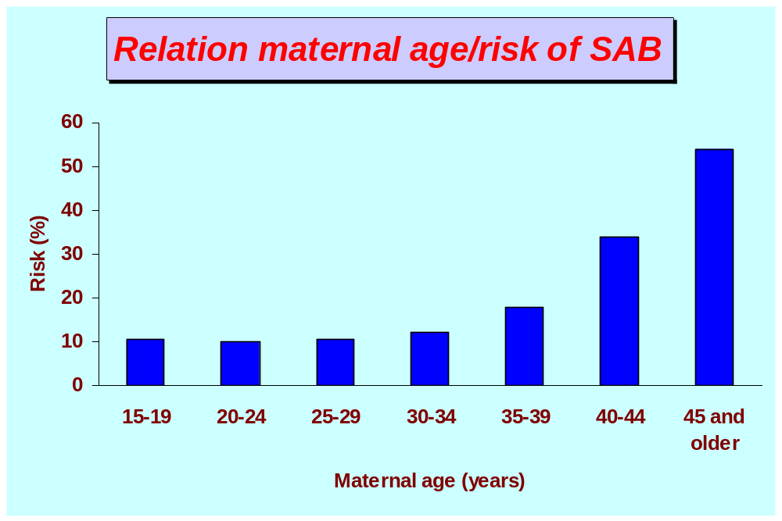
Risk factors – maternal age

Slide 23
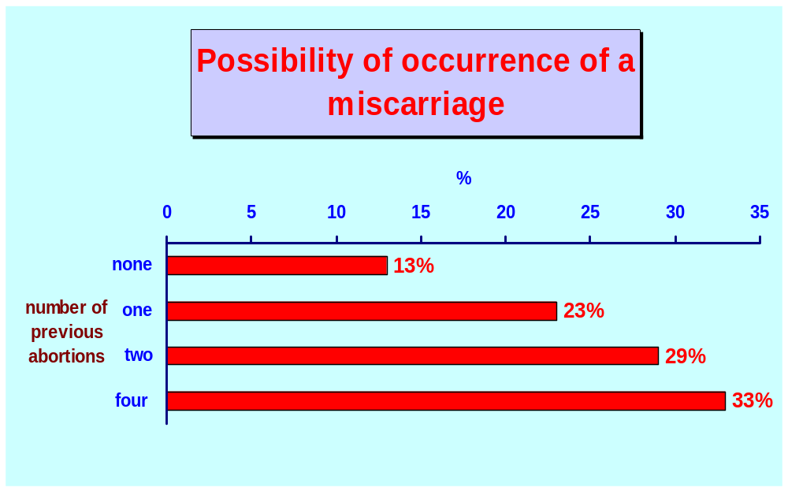
Risk factors – previous abortions

Slide 24
Major causes of abortion
Fetal: embryo, fertilization, implantation
Maternal
Paternal

Slide 25
Fetal factors
Abnormal zygote development (zygote, embryo, early fetus or placenta )
40% of spontaneous abortion in less than 20 weeks have morphologic abnormality

Slide 26
Fetal factors: Aneuploidy
Autosomal trisomy
Monosomy
Polyploidy
Chromosomal structural abnormalities

Slide 27
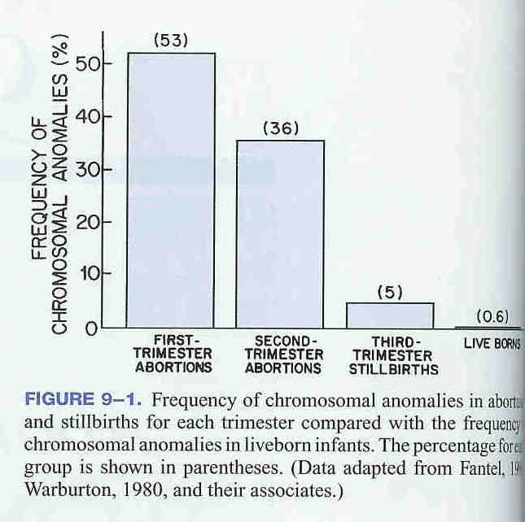
Aneuploidy

Slide 28
Fetal factors: Autosomal trisomy
Most common chromosomal anomaly in early pregnancy loss
75% occur in less than 8 weeks
Most trisomies result from isolated non disjunction
13, 16, 18, 21, 22 autosom

Slide 29
Fetal factors: Monosomy X
Second most common chromosomal anomaly
Cause late abortion
It is not compatible with life

Slide 30
Fetal factors: Polyploidy
Triploidy: associated with hydatidiform (molar pregnancy)
Tetraploidy: rare but may be born alive

Slide 31
Fetal factors: Euploidy
Cause late abortion
Peak gestational age is 13 weeks
Incidence increases with maternal age above 35 years

Slide 32
Maternal factors: Infections
Can cause abortion or congenital anomaly
Listeria monocytogenes
Chlamydia trachomatis
Mycoplasma hominis
Ureaplasma urealyticum
Toxoplasma gondii

Slide 33
Maternal factors: Chronic illness
Chronic debilitating diseases
Tuberculosis
Cancer
Celiac sprue

Slide 34
Maternal factors: Endocrine
  Hypothyroidism
  Diabetes mellitus
  Progesterone deficiency: luteal phase defect
  POC

Slide 35
Maternal factors: Immunologic
Auto immune antibody
Antiphospholipid antibodies
Prostacyclines
Thromboxane A2
Anticardiolipin AB

Slide 36
Maternal factors: Environmental
Tobacco: 14 cigarettes per day - 2x
Alcohol: three x per week - alcohol fetal syndrome - 3x
Coffee: four coffee cups per day - slightly increased
Radiation
Drugs

Slide 37
Maternal factors: Uterine defects
Congenital: septeted, unicornate, bicornate
Acquired: uterine synechie, Asherman syndrome, incompetent cervix, Myoma
NB: Myoma rarely causes abortion

Slide 38
Maternal factors: Other
Physical trauma
Psychological problems
Advanced age
Malnutrition
Surgery - Laparatomy
Stress
Contraception - IUCD

Slide 39
Paternal factors
Little is known in the genetics of spontaneous abortion
Defective gametogenesis is seen in 5% of cases
Chromosomal translocations in sperm can lead to spontaneous abortions

Slide 40
Stages of spontaneous abortion
Threatened
Inevitable
Incomplete
Complete
Missed
Septic
Recurrent/habitual

Slide 41
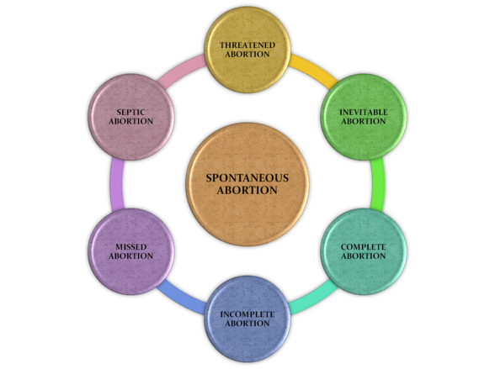
Stages of spontaneous abortion

Slide 42
Threatened abortion
Characterized by lower cramp and vaginal spotting
The pregnancy can continue till term

Slide 43
Threatened abortion
Sign and Symptoms
Minimal vaginal bleeding
Minimal lower abdominal cramp
Stable vital sign
Cervix closed
Symptoms resolve in a few days

Slide 44
Threatened abortion
Management
Almost 50% ends in abortion
High risk of preterm labor and birth
No effective treatment
Bed rest, analgesia, sedation, avoid sex, avoid douche, heavy activities
Serial beta HCG, progesterone, US, U/A, CBC, BG RH, culture and sensitivity

Slide 45
Inevitable abortion
Continuous bleeding and cramp leading to cervical dilatation and effacement but no expulsion of fetus or placenta
Pregnancy is unlikely to continue

Slide 46
Inevitable abortion
Sign, symptoms
Bleeding for more than three days
Lower abdominal pain of more than seven days
Cervical dilatation of more than 3 cm
Effacement more than 80%
Membranes may be ruptured

Slide 47
Inevitable abortion
Management
Proper clinical assessment
Hg, beta HCG, WBC, US
Manage emergency conditions
Evacuate
  medical
  surgical

Slide 48
Incomplete abortion
Passage of some products of conception or placental tissue from the uterine cavity
Typically present with bleeding that can produce hemodynamic instability
Usually there is no viable conceptus

Slide 49
Complete abortion
All products of conception have been expelled.
Once all products of conception have passed, pain and bleeding soon cease.

Slide 50
Missed abortion
Fetal death without expulsion of any fetal or maternal tissue for at least 4 weeks thereafter.
There may or may not be vaginal bleeding .
Pregnancy symptoms regress

Slide 51
Missed abortion
Ammenoric, dark bleeding
Regression of pregnancy symptoms
Negative gestational age discrepancy with LNMP
Can be expelled spontaneously
Can cause coagulation defect

Slide 52
Septic abortion
Any type of abortion that is accompanied by uterine infection.
Endometritis is the most common manifestation
  parametritis
  peritonitis
Septicemia and shock may occur if the local infection is left untreated.

Slide 53
Clinical assessment
History: amenorrhea, bleeding, pain
Physical examinations: pelvic, bimanual, speculum
Investigations: blood, urine, ultrasonography

Slide 54
Differential diagnoses
Ectopic pregnancy
Gestational trophoblastic disease (GTD)
Appendicitis
Cervicitis
UTI, vaginities
Dysfunctional uterine bleeding
Ovarian cyst

Slide 55
Management
Expectant
Medical evacuation
Surgical evacuation

Slide 56
Management
Pre procedure: Counseling, prophylactic antibiotics
Intra procedure care: pain management
Post procedure care: pain, discharge instructions, PAFP, follow up

Slide 57
Three Sources of Pain
Psychological pain due to anxiety, fear, apprehension
Physical pain due to cervical dilatation
Uterine cramping due to manipulation or contraction of uterus

Slide 58
Non-pharmacological methods for relieving psychological pain
Gentle, respectful interaction and communication
Verbal support and reassurance
Gentle, smooth operative technique

Slide 59
Pharmacological Means of Addressing Psychological Pain
NSAIDs (diclofenac, ibuprofen) can effectively relieve pain effectively
Narcotic analgesia
Anesthetic: paracervical block using lidocaine
General anesthesia should be reserved for extreme cases

Slide 60
Administering paracervical block
Inject 1–2mL of lidocaine where tenaculum will be placed
Place tenaculum
Apply slight traction to move cervix, exposing transition from cervical to vaginal tissue
Slowly inject 2–5mL of lidocaine into this tissue to depth of 1–1.5 inches at 3, 5, 7 and 9 o’clock

Slide 61
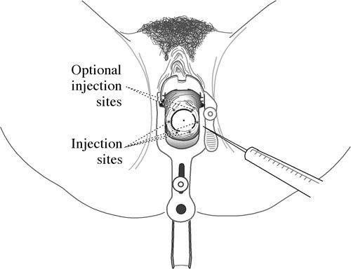
Paracervical Block

Slide 62
Recurrent abortion

Slide 63
Recurrent abortion
Occurrence of three or more consecutive spontaneous abortions
The prognosis depends on the cause
Types
  Primary: no prior child
  Secondary: at least one prior child

Slide 64
Causes of recurrent abortion
Parental chromosomal abnormalities
Structural Uterine Defects
Immunological Factors
  Autoimmune Factors
    Lupus erythematosus
    Antiphospholipid syndrome
Endocrinological Factors
  Luteal phase defect
  Polycystic Ovarian Syndrome
  Diabetes Mellitus
Thrombophilic Disorders

Slide 65
Incompetent Cervix
Pregnancy loss by painless cervical dilatation in the second trimester
    Prolapse of membranes into the vagina
    Expulsion of an immature fetus
This sequence may repeat in future pregnancies

Slide 66
Incompetent Cervix
Etiology
The cause of cervical incompetence is obscure.
In utero DES exposure
Trauma to the cervix
  D&C
  Conization
  Cauterization
  Amputation of the cervix

Slide 67
Incompetent Cervix
Diagnosis
US
Hysterogram
Balloon catheter
Treatment
Prophylactic cerclage
  McDonald
  Modified Shirodkar

Slide 68
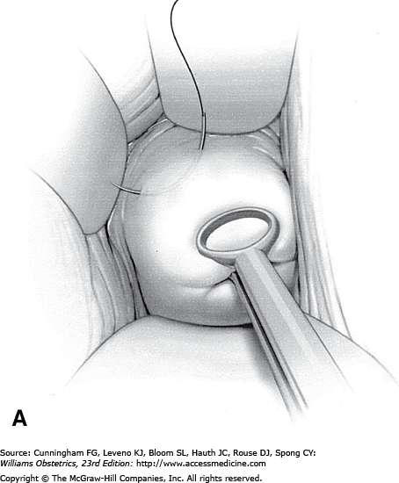
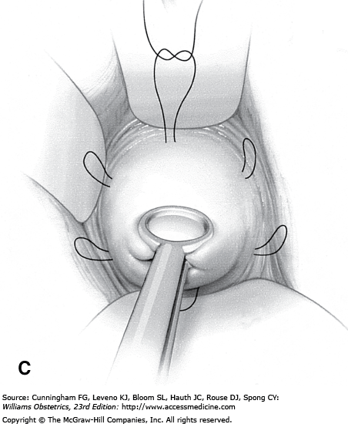
Incompetent Cervix
Treatment: Elective cerclage generally is performed between 12 and 16 weeks

Slide 69
Uterine synechie / Asherman syndrome
Partial or complete adhesion of uterine cavity
Etiology: Curettage
Diagnosis: US, hysterogram, multiple filling defect
Treatment: hysteroscopy, lysis
  IUCD
  Endometrial proliferation
  Estrogen

Slide 70
Post abortion care (PAC)

Slide 71
PAC
Post abortion care is a medical service and related interventions designed to manage incomplete, unsafe abortions and their complications
Include management of complications, PAFP and other RH problems

Slide 72
Elements of PAC
Treatment of abortion and abortion related compilations
Counseling
Contraceptive and family planning services
Reproductive and other health services
Community and service provider partnership

Slide 73
Induced abortion

Slide 74
Induced abortion
Intentional medical or surgical termination of pregnancy
Elective/voluntary abortion; done by the will of the woman

Slide 75


Guidelines

Slide 76
Ethiopian law: penal code
TOP by a recognized medical institution with in the period permitted by the profession is not punishable where:
The pregnancy is the result of rape or incest
Pregnancy endangers the life of the mother or the child or the health of the mother, or where the birth of the child is a risk to the life or health of the mother
Fetal Deformity
Unable to raise child due to physical and mental disability or being a minor

Slide 77
Thank You

Slide 78
COMPREHENSIVE ABORTION CARE
PART I - INTRODUCTION
YONAS GETACHEW, MD
CLINICAL ADVISOR, CIRHT
ASS’T PROFESSOR, OB-GYN, ADDIS ABABA UNIVERSITY

