Slide 1
COMPREHENSIVE ABORTION CARE
Dr. Diomede NTASUMBUMUYANGE
Senior Lecturer
UR/CMHS

Slide 2
Session Objectives
Define abortion
Explain magnitude of abortion
Discuss legality of abortion for safe abortion in Rwanda
Identify causes/risk factor
Classify abortion
Identify differential diagnosis of abortion
Manage abortion based on its classification
Identify uterine evacuation methods
Provide post abortal care

Slide 3
Definitions
• Abortion (Miscarriage) is termination of pregnancy before viability
In USA, abortion sometimes defined as termination of pregnancy at GA of less than 20 weeks or a birth weight of less than 500gm
In most Developing Countries abortion is defined as termination of pregnancy before GA 28 weeks or birth weight of less than1000gm
In Rwanda?
Notes:
Viability means the gestational age (GA) at which the fetus is sufficiently developed to survive extra uterine life.

Slide 4
WHO Definition
• Abortion is referred as termination of pregnancy before or at GA of 22 weeks or weight less than 500gm (WHO, 2003)
• Viability depends on various factors in each country (WHO, 2012)

Slide 5
Magnitude
Globally, 213 million pregnancy annually (>40% unplanned: 85 Million)
Currently, an estimated 55.9 million abortions occur each year—49.3 million in developing regions and 6.6 million in developed regions ( Singh, Remez, Sedgh Kwok &Onda, 2017)

Slide 6
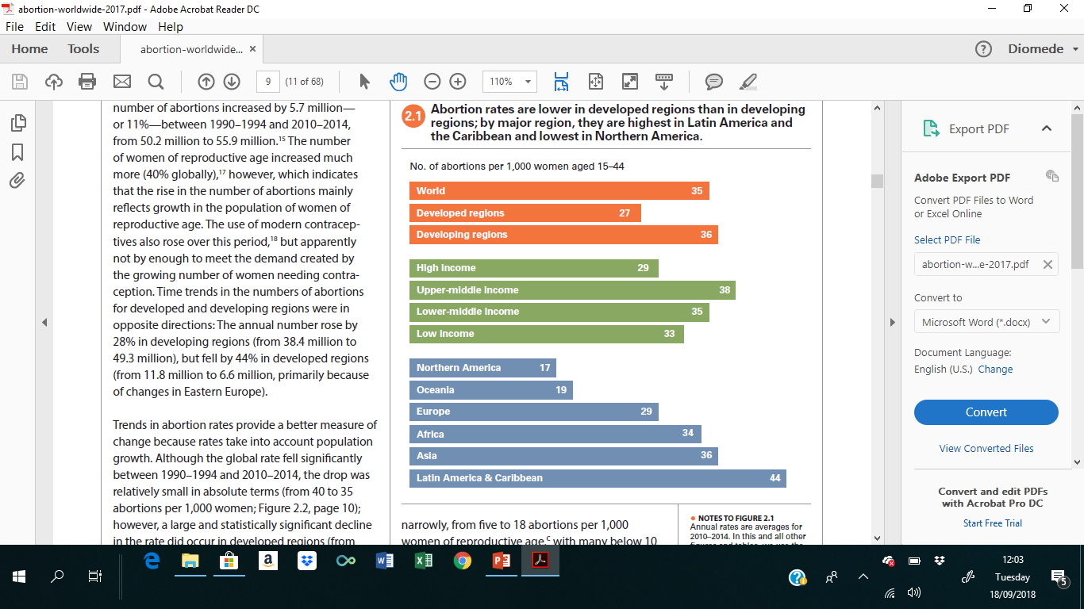
Abortion rate

Slide 7
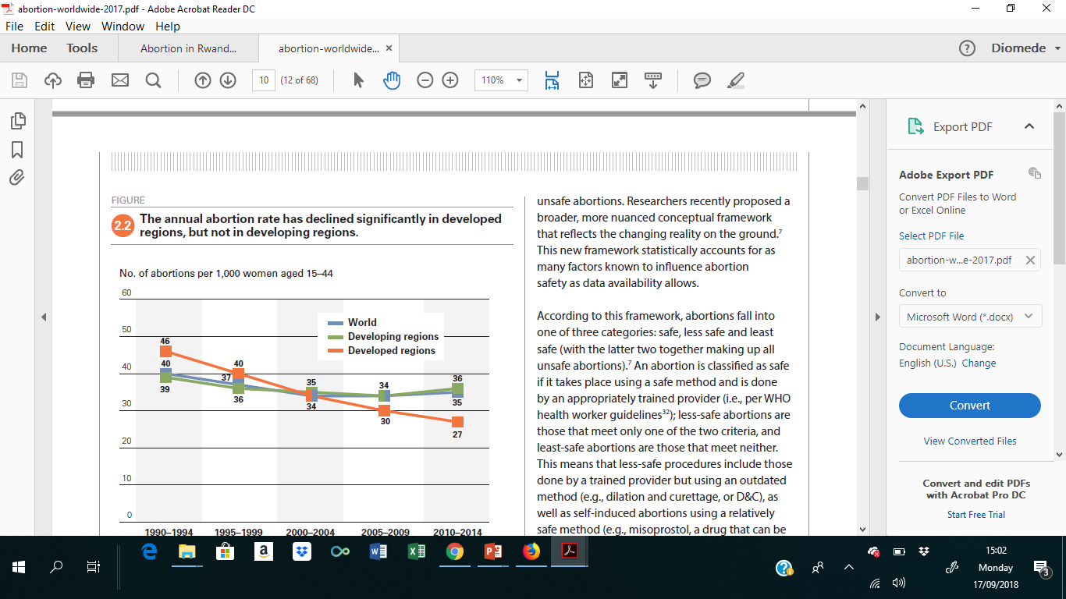
Abortion rate

Slide 8
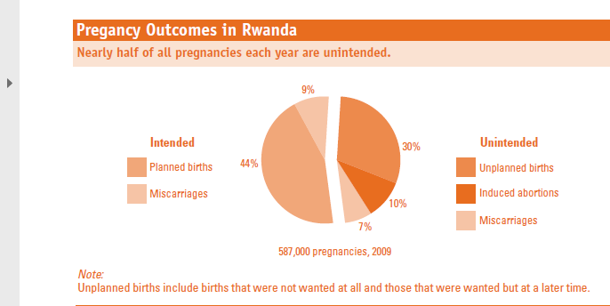
Abortion rate

Slide 9
Legality of Abortion in Rwanda
Abortion in Rwanda is governed by organic Law 01/2012/OL of 02/05/2012
Exemptions from criminal liability for abortion were specified in articles 162 through 167 of the Penal Code:
        Rape
        Incest
        Forced marriage
        Risk to the health of the woman or the fetus

Slide 10
Classification of Abortion
WHO classification
Safe abortion
Unsafe abortion
  “Less safe”
  “Least safe”
Based on gestational age
First trimester abortion
Second trimester abortion

Slide 11
Classification (con’d)
Based on occurrence
  Spontaneous
  Induced
Based on clinical stages
  Threatened
  Inevitable
  Incomplete
  Complete
  Missed
  Anembryonic pregnancy
  Septic
  Recurrent

Slide 12
Spontaneous Abortion
Definition: Abortion occurring without any medical or surgical means to empty the uterus
Incidence:
At least 15% of clinically evident pregnancies end up in spontaneous abortion
80% of spontaneous abortion occur before 12 weeks

Slide 13
Etiology/Risk factor of spontaneous abortion
Fetal factors:
Chromosomal abnormalities (60%)
  Aneuploidy(Monosomy X )
  Autosomal Trisomies (T-16 )
  Polyploidy
Defective implantation
Defects in the placenta or embryo
Accidental injuries to the fetus
Aging of the gametes
Failure of hormonal mechanisms
Exposure of the embryo to various viruses, chemicals or irradiation

Slide 14
Etiologies (con’d)
Maternal factors:
Infections (Bacterial, Viral, protozoal )
Endocrine disorders (Hypothyroidism, DM)
Cardiovascular disorders (HTN, Renal disease)
Malnutrition

Slide 15
Etiologies (con’d)
Drugs
  Tobacco
  Alcohol
  Caffeine
  Radiation
Paternal factors?
Environmental toxins
Immunologic factors
Thrombophilias
Maternal surgery
Trauma
Uterine defects

Slide 16
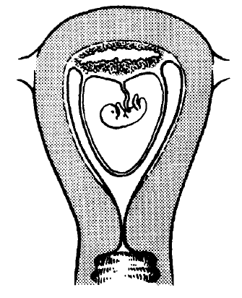
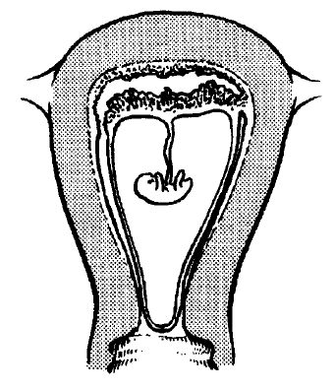
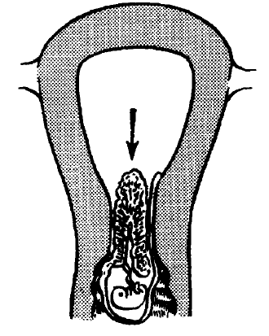
Mechanism of Abortion
Hemorrhage occurs in the decidua basalis leading to local necrosis and inflammation.
The POC, partly or wholly detached, acts as a foreign body and initiates uterine contractions. The cervix begins to dilate.
Expulsion complete. The decidua is shed during the next few days in the lochial flow.

Slide 17
Differential Diagnosis
Ectopic pregnancy
Molar pregnancy
Local lesions
Polyps

Slide 18
Management
Threatened abortion
Medical treatment usually not necessary.
Advise woman to avoid strenuous activity and sexual intercourse; bed rest not necessary.
If bleeding stops, follow up in antenatal clinic.
Reassess if bleeding recurs.
If bleeding persists, assess for fetal viability (pregnancy test/ultrasound) or ectopic pregnancy (ultrasound).
Persistent bleeding, esp. in the presence of uterus larger than expected may indicate twins or molar pregnancy.
Treat if anaemia or in hypovolemic shock.

Slide 19
Management of Inevitable Abortion
  Mild to sever vaginal bleeding with no expulsion of products of conception
  Crampy abdominal pain
  Effacement & dilatation of cx
  Rupture of membrane

Slide 20
Management of Inevitable Abortion
If pregnancy is less than 12 weeks, plan for evacuation of uterine contents. If evacuation not immediately possible:
  misoprostol 400 mcg by mouth (repeated once after 4 hours if necessary);
  Arrange for evacuation as soon as possible.
Ensure follow-up after treatment.

Slide 21
Management of Inevitable Abortion
If pregnancy is greater than 12 weeks:
  Await spontaneous expulsion of products of conception and then evacuate uterus to remove any remaining products of conception
  If necessary, infuse oxytocin 40 units in 1 L IV fluids at 40 drops/min to help expulsion of products of conception

Slide 22
Incomplete Abortion
The expulsion of some but not all of the products of conception.
Symptoms & sign
  Placental tissue is in uterine cavity
  Cervix is open & visible or palpable RPC
  Pain with profuse vaginal bleeding

Slide 23
Management of Incomplete Abortion
Less than 12 weeks:
If bleeding light to moderate, use fingers or ring (or sponge) forceps to remove products of conception protruding through cervix.
If bleeding heavy, evacuate uterus:
  Manual vacuum aspiration (MVA) is preferred method.
  EVA should only be done if MVA not available
  Ensure follow-up of the woman after treatment.

Slide 24


Slide 25
Management of Incomplete Abortion
Greater than 12 weeks:
Infuse oxytocin 40 units in 1 L IV fluids at 40 drops/min. until expulsion of POC occurs
Evacuate any remaining products of conception from uterus by evacuation and curettage
If necessary, give misoprostol 200 mcg vaginally every 4 hours until expulsion, but do not administer more than 800 mcg.
Antibiotic therapy.
Ensure follow-up of the woman after treatment.

Slide 27
Mifepristone Misoprostol Protocol
 | FDA regimen 2016 Buccal Misoprostol | Alternative: Vaginal Msoprostol
Maximum GA | 70 days from LMP | 70 days from LMP
Mifepristone dose/location | 200 mg orally. Dispensed in office | 200 mg orally
Misoprostol dose/route | 800 mcg buccally (4 tablets) | 800 mcg buccally (4 tablets)
Misoprostol timing | 24-48 hours after Mifepristone | 6-72 hours after mifepristone
Misoprostol | Home | Home

Slide 28
Complete Abortion
Definition: The whole products of conception is expelled.
Symptoms & Sign:
    The uterus is small and well contracted,
    Closed cervix,
    Scant vaginal bleeding,
    and only mild cramping

Slide 29
Management of Complete Abortion
Evacuation of the uterus usually not necessary
Observe for heavy bleeding
Ensure follow-up of woman after treatment

Slide 30
Missed Abortion
Definition: Retention of dead products of conception in utero for several weeks
Signs and symptoms:
    Regression of symptoms and signs of pregnancy
    Persistent amenorrhea, brownish vaginal discharge
    Uterine size regress & cervix is closed
Management:
    Counseling for uterine evacuation
    Clotting profile
    Post abortion care

Slide 31
Septic Abortion
Definition: any of the types of abortion complicated by pelvic infection.
Etiology: Polymicrobial
Symptoms & Sign
  Fever, shivering
  Restlessness
  Abdominal pain
  Malodorous vaginal discharge
  Low BP
  Tachypnea & tachycardia
  Guarding & rebound tenderness
  Cervical motion tenderness
  Peritonitis

Slide 32
Management of Septic Abortion
Fluid resuscitation
Broad spectrum Antibiotics
Consider uterine evacuation
Follow up of treatment

Slide 33
Which Method Is Best?
Use of a certain method depends on:
  Safety, efficacy and cost
  Staff skills
  Equipment, supplies, drugs available
  Woman’s clinical condition
  Woman’s personal preference

Slide 34
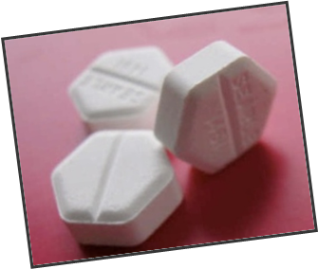
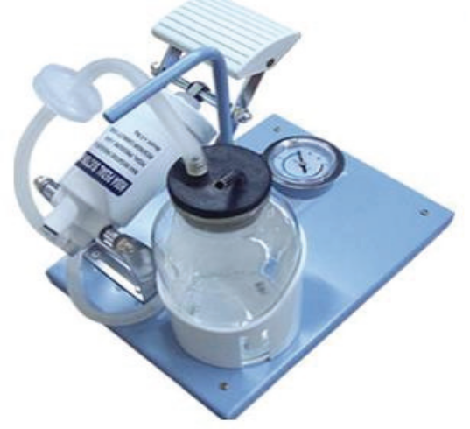
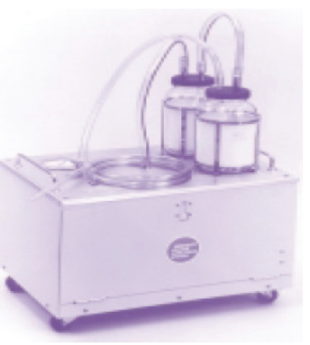
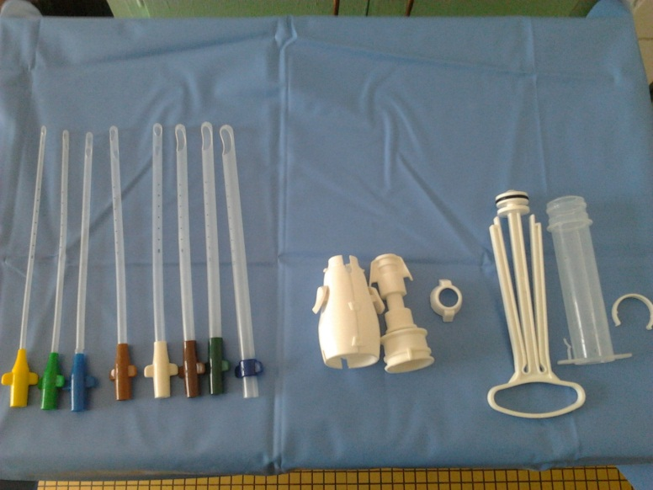
Methods of uterine evacuation
Medication methods
Foot pump
Electric vacuum aspiration
MVA
Notes:
Do it in the safest way

Slide 35
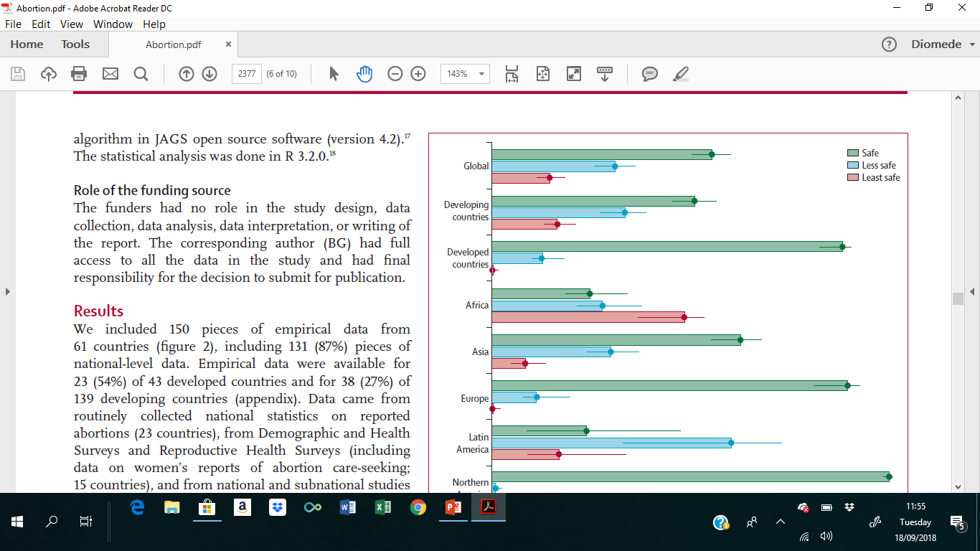
Distribution of abortion safety categories worldwide and by region
Notes:
Define what is safe, less safe and least safe

Slide 36
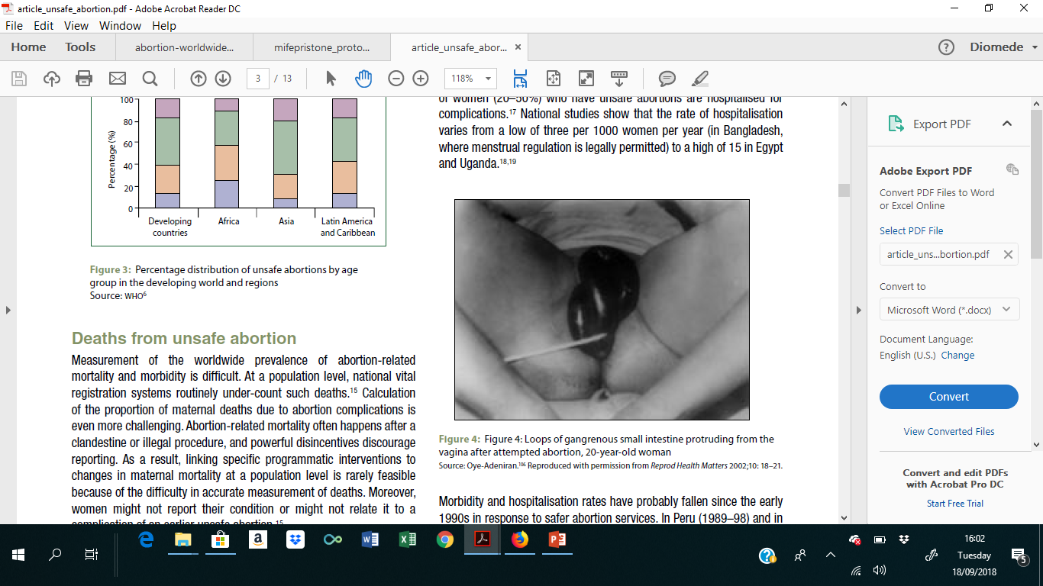
Unsafe Abortion consequences
Every year, 68 000 women die ,about eight per hour
Unsafe abortions when performed under least safe conditions can lead to:
Incomplete abortion
Heavy bleeding
Infection
uterine perforation
Damage to the genital tract and internal organs.
Death

Slide 37

Effective CAC Counselling
Explores feelings, coping, decisions
Identifies special needs
Improves woman-provider relationships
Facilitates less painful procedure
Creates greater satisfaction

Slide 38
Decision to Terminate
Confidentiality of care
Length of pregnancy
Abortion methods available
Pain medications available
Any other tests that may be done
If applicable, fetal anomalies or other medical indications detected
Permission to treat a complication if necessary

Slide 39
Procedure Choice
Explain differences between methods
What will be done during and after the procedure
What she is likely to experience
How long it will take
Side-effects, risks and potential complications
Aftercare and follow-up

Slide 40
SUMMARY: Post Abortion Care
Treatment of incomplete abortion
Use safe and effective treatment methods
Family planning services
Counseling
Identify and respond to women’s emotional and physical health needs
Help women prevent an unwanted pregnancy or practice birth spacing
Reproductive and other health services
Preferably provided on site or via referrals to other accessible facilities
Community and service provider partnerships
To prevent unwanted pregnancies and unsafe abortion, mobilize women to help receive care for complications from unsafe abortion, and ensure health services meet needs

Slide 41
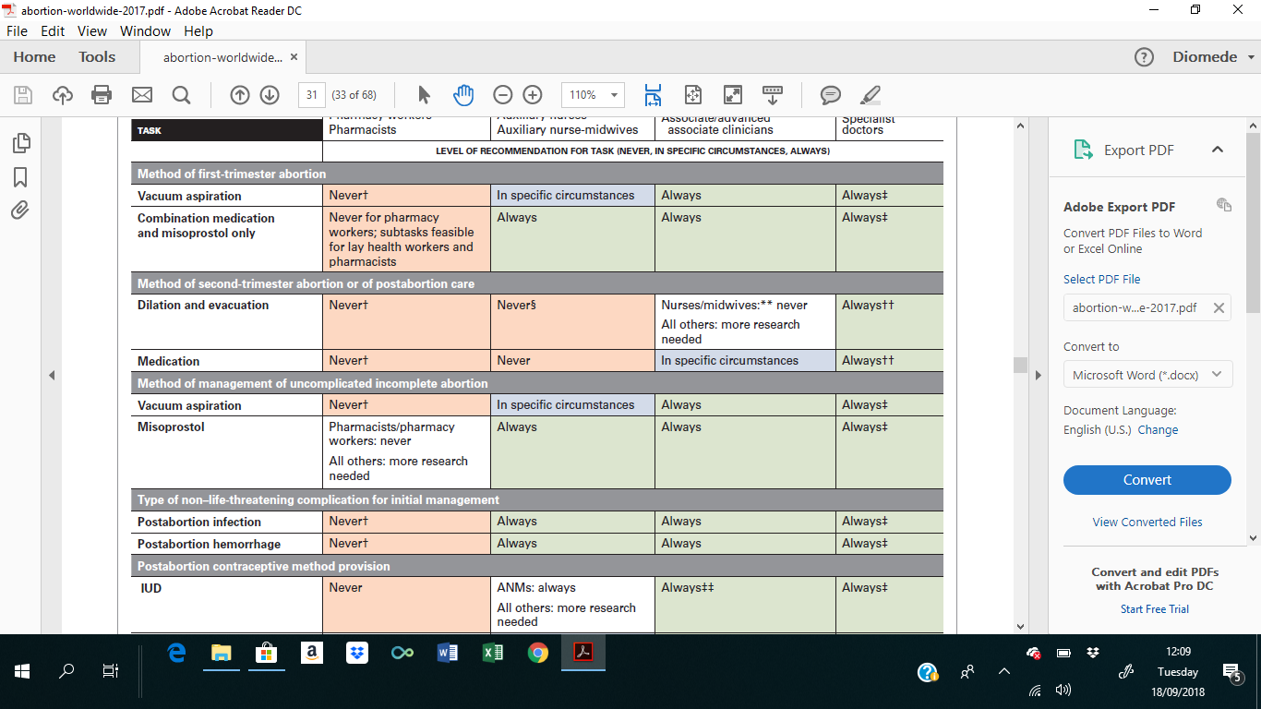
Summary (cont’d)

Slide 42
Thank You

