Slide 1
Understanding Abortion Stigma
Stigma 101

Slide 2
Agenda
Key definitions and ideas of stigma (lecture)
Effects of stigma on women’s wellbeing (lecture)
Stigma and abortion providers (lecture)
Locating stigma in our physical space (group discussion)
Providers as stigmatizers (small group discussion)
Case vignettes (small group discussion)

Slide 3
Definitions of Stigma
An attribute that is “deeply discrediting”
“Whole and usual” person becomes “damaged,” “tainted,” and “discounted” person
    Erving Goffman, 1963
Stigma is a social process and requires a stigmatizer
Stigmatized work = “dirty work”
    Gravediggers, garbage collectors, abortion providers

Slide 4
Abortion stigma
Why is abortion stigmatized?
  Illegal/restricted in many parts of the world
  Seen as equivalent to killing
  Deviates from beliefs about traditional gender roles and idealized notions of femininity and womanhood
  A way to express disapproval of women’s sexual behavior
Notes:
In Ethiopia, Nineteen percent of women seeking postabortion care in 2014 suffered complications severe enough to require hospitalization; the proportion in 2008 was 23%. In 2005, Ethiopia expanded its abortion law, which had previously allowed the procedure only to save the life of a woman or protect her physical health. Before 2005 Ethiopia has Restrictive abortion law and due to these legal barriers and cultural stigma, many women, for fear of public exposure, seek unsafe abortion and may be persecuted and imprisoned for their actions.

Slide 5
Reflections on Stigma
Has abortion-related stigma always existed?
How does it differ across time and location? Does it differ in settings where abortion laws are liberal versus where abortion laws are more restrictive?
How does stigma emerge across the various reasons women have abortion?

Slide 6
Levels of Abortion Stigma
INSTITUTIONAL/
ORGANIZATIONAL
DISCOURSE & MEDIA
INDIVIDUAL
COMMUNITY
LAW AND POLICY
“The E.R. docs will invariably say some crap about ‘the jokers over at the abortion clinic’… There is this implied stereotype that doctors who do abortions are hacks [who] can’t do any other part of medicine”
“I could see this bumper sticker and it just said ‘abortion’ on the top. I was dying to see what it said underneath…what it said was, ‘abortion: one dead, one wounded’. And I thought, why, why? That is so unfair. Why, why do I have to take this?”
“It can be very hard to work at a clinic like this. There’s a lot of guilt. A lot of paranoia and fear that you have to live with that you don’t really think about.”
“…if something bad goes wrong here and everybody in the world knows that I am an abortion doctor, will I be able to go to church?”
“We have to fear breaking the law when doing our job”
Notes:
[These examples should correspond to local context]
Abortion stigma exists on multiple levels as the diagram below depicts:
In order to work toward de-stigmatization:
Need to examine multiple levels of creation and how they work together to reinforce and/or contradict one another
Need to understand how each level manifests stigma and discrimination
Need to understand and create new ways of de-constructing the stigma that is produced at each level and test whether interventions at just one level will affect the others or if multi-level interventions are needed.
At level of framing discourses: murderer vs. saving women’s lives; abortion vs. menstrual regulation
At level of government: national laws and policies, and global policies incl. Gag Rule
At level of organizations: separation of abortion services from other health services, PAC policies, policies of reporting to police in case of induced abortion
At level of community: abortion not just a woman’s issues but a social, community

Slide 7
The stigma-silence vicious cycle
Stigma
Silence

Slide 8
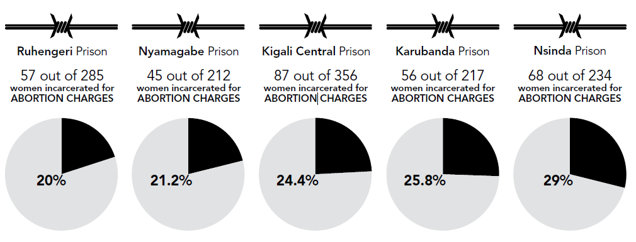
Effects of Stigma on Women
  Shame, guilt, disgrace
  Social isolation, loss of relationships
  Violence
  Criminal punishment
  Maternal mortality
Figure 1. Ipas, 2014
Notes:
This figure shows us statistics from Rwanda, where nearly 1 in 4 incarcerated women are charged with abortion-related crimes.

Slide 9
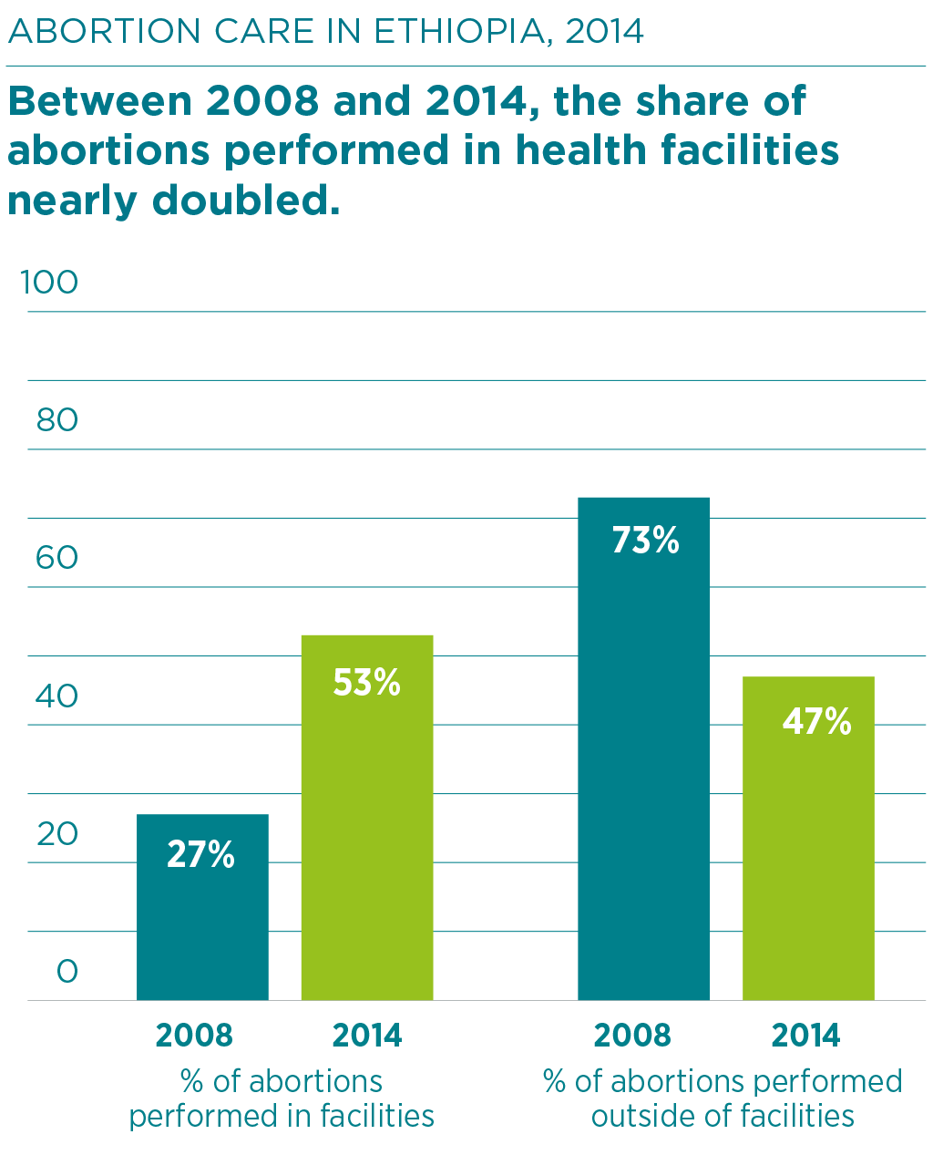
Stigma and Abortion Complications
Ethiopian health professionals estimate that 40% of women who have an abortion outside of a health facility experience serious complications and that 74% of these women receive treatment for their complications.
Hard to know how many women die from unsafe abortion complications, but contributes to an estimated 17% of all maternal deaths in East Africa
Notes:
While a greater number of abortion care takes place in hospitals now, compared to 2008, women still experience severe complications from seeking postabortion care.

Slide 10
Stigma-Complications Vicious Cycle
Complications
Stigma

Slide 11
Why consider stigma and complications together?
Stigma hurts women
Leads to unsafe abortion even in settings in which legal and safe abortion is available
A matter of public health and maternal mortality
Can cause complications even when abortion is not provided
Notes:
Those who mobilize stigma as a way to stop abortion are only ultimately hurting women, even if their stated agenda is to help them.
Legal reform – while vital – is not enough. Stigma leads to unsafe abortion even in settings in which legal and safe abortion is available.
We need to make clear that stigma really matters to women’s lives and the lives of their families. Stigma is not simply conceptual; it is a serious public health and maternal mortality issue. Through this lens, abortion stigma reduction and elimination are urgent matters, needing to be addressed by anyone who wishes to reduce global maternal mortality.
Abortion stigma causes complications even when an abortion never happens. Sometimes a complication happens when abortion is not provided. When a provider is not able to offer the care requested – because of legal restriction or institutional policy--they often experience immense conflict and distress. For patients, the inability to get needed care is not only distressing but also sometimes fatal.

Slide 12
Kelly’s Story
“Kelly was 18 years old when she was arrested and imprisoned in June 2013. She was 17 years old when she became pregnant. Under Rwandan law, anyone under 18 is considered a minor and presumed unable to consent to sex. She explains what happened: ‘I was a student. A guy requested me to pay him a visit, and then he made me pregnant. I went back to school but he told me that he would look for someone to assist me to have an abortion. After two months, he brought me a tablet. After giving it to me, he disappeared. I swallowed the tablet and got a miscarriage.’
Kelly took the pills in the school bathroom. When she began suffering from complications, the school administration intervened and reported her to the police. Kelly had no legal representation during her trial and pleaded guilty in order to get a reduced sentence. Given that Kelly was 17 at the time she got pregnant, and this is considered rape under Rwandan law, she was legally exempted from prosecution. However, because she did not report the rape, she could not use this as defense for her actions. Kelly was sentenced to one year in prison” (Kane, 2015).
Notes:
What are some of your reactions to this story? In what ways has abortion stigma influenced this case?

Slide 13
Stigma and pathways to complications
Stigma impacts our ability to cope with and recover from complications
Stigma can turn safe care into unsafe care
Safe setting
Abortion decision
Complication
Treatment
Recovery
Unsafe setting
Stigma makes managing complications difficult
Stigma causes women to seek unsafe care
All of these sites involve relationships which are impacted by stigma

Slide 14
Relationship dynamics
Poverty
Sex
Contraceptive use
Unintended pregnancy
Safe setting
Abortion decision
Complication
Treatment
Recovery
Unsafe setting

Slide 15
Stigma and pathways to complications
Stigma impacts our ability to cope with and recover from complications
Stigma can turn safe care into unsafe care
Safe setting
Abortion decision
Complication
Treatment
Recovery
Unsafe setting
Stigma makes managing complications difficult
Stigma causes women to seek unsafe care
All of these sites involve relationships which are impacted by stigma

Slide 16
Effects of Stigma on Providers
Negative Consequences
Positive Outcomes
  Shame, guilt, disgrace
  Social isolation, loss of relationships
  Additional consequences for providers:
    Threats of violence
    Harassment
    Criminal prosecution
    Extortion
Motivation, pride, and purpose for work
Resiliency and strength
Could strengthen abortion-providing workforce by focusing on positive aspects of stigma

Slide 17
Why stigmatize abortion providers?
  Deviates from lifesaving ideals of medical profession
  Association with criminal activity

Slide 18
Dirty Work
Stigmatized work = “Dirty Work”
  Physical taint
  Social taint
  Moral taint
Notes:
This dirty work is associated with three types of taint: physical taint (blood, fetal parts); social taint (contact with stigmatized patients); and moral taint (ambiguous fetal moral status).

Slide 19
Examples of labeling and stereotyping
A person who performs an abortion:
Is a bad person
Lacks morals
Is a “hack” with poor skills
Is committing a crime and/or a sin
Is doing it just for money
Doesn’t care about women

Slide 20
“Legitimacy Paradox”
Providers fear further devaluation/ violence if their abortion work is known
Providers don’t speak about abortion work
Providers are depicted stereotypical incompetent “butchers”
Doctors experience marginalization/
devaluation/ harassment
A social norm is perpetuated that abortion providers are incompetent or dangerous or deviant

Slide 21
Stigma Mapping
How do we experience these levels of abortion stigma here?
Insert image of clinic/hospital floorplan or other relevant community space

Slide 22
Debrief Questions
How did you feel throughout this activity?
Did anything in this discussion surprise you?
How does it feel to discover ways in which stigma is evident in the practices and structures of our clinics and community?
What are the ways that we can mediate the effects of stigma in these spaces?
Notes:
A break is suggested between this activity and the following discussions, as the content will move more towards personal reflections and small group discussions.
Now we will be moving into a reflective period of our work. We will ask you to consider some questions that are deeply personal and require you to negotiate your own comfort with disclosure. The following questions will help us to explore our own attitudes, biases, and experiences as providers, in relation to abortion work and stigma. You may have direct experience related to these questions or it may be in anticipation of your future work. Due to the personal and sensitive nature of the following discussion, it is important to respect the privacy and confidentiality of your peers as each of you share your thoughts.

Slide 23
Providers as Stigmatizers:
Impact on patient care
How does discomfort with and even judgment about the reasons some women have sex, experience unintended pregnancies, and seek abortions affect our work as providers?
How might our discomfort and/or judgment impact quality of our care?

Slide 24
Providers as Stigmatizers
Think about examples of patients that make you angry (e.g. women who need second trimester abortions, women with little money to pay for their procedure, women who have multiple abortions).
Do you see this particular example as problematic? Why or why not?
How do these attitudes contribute to or perpetuate abortion stigma?

Slide 25
Case Vignettes: Complications
Questions for case vignettes:
What are your reactions to these cases?
In what ways is abortion stigma apparent and influential in the reactions of all participants and outcomes of these cases?
How would these cases been different had abortion stigma not been present?
What/who needs to change to reduce abortion stigma in these cases?
How does this influence your work as a provider?

Slide 26
Case Vignettes: Disclosure
Questions for case vignettes:
What are your reactions to these cases?
Have you experienced any similar situations regarding disclosing your work?
How would you have negotiated these decisions of disclosure?
How does this influence your work as a provider?

