Slide 1

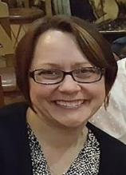

Workshop: Creating an Instructional Plan for Simulation-based Education
SPHMMC Visit
March 2019
Deborah Rooney PhD
Asst. Professor, Department of Learning Health Sciences
Director of Education and Research
Clinical Simulation Center
Division of Professional Education
Notes:
SLIDE TIME=0:40
TOTAL TALK TIME:
43 minutes talking time, not including 3 exercises
Exercise 1= 5-7 min. (SLIDES 9-10)
Exercise 2= 10 min (SLIDES 16-17)
Exercise 3= 10-12 min. (SLIDE 31)
TOTAL TIME = 1 hr. 15 min
Not including extended discussion.

Slide 2
Agenda (aka Instructional Objectives)
During this workshop, we will:
Review the primary components of an instructional plan
Examine special considerations while writing an instructional plan
Develop an instructional plan using 3 exercises based on goals, learning objectives, learning activities, and assessment plan
Notes:
TIME= 0:33

Slide 3
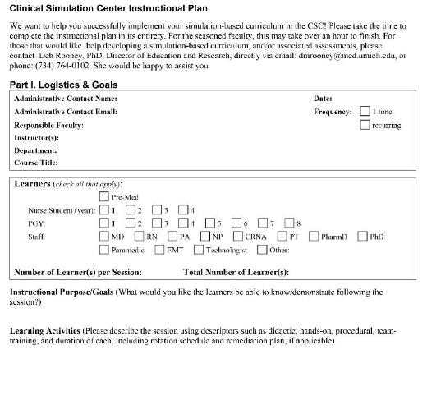
Your Instructional Plan
Logistics(*)
Instructional Purpose
  (aka Goals)
Learning Objectives
Learning Activities
Assessment Plan
white handout- *see CSSC Activity Planning form
Notes:
TIME= 1:09
Everyone has some form that describes critical components of a curriculum
-Portable, share with colleagues at own place (other instructors teaching for you), or other institutions, even

Slide 4


Goal v. Learning Objective
Goal
Learning Objective
  Represents demonstrable learner behaviors
  Must be
    measurable,
    attainable with the curriculum time frame
Goal
  Broad statement of general intentions that describe what the learner will gain from instruction/ course
Learning Objective
Notes:
TIME=0:48
QUESTIONS? Let’s do a warm-up

Slide 5
Warm-up: Goal v. Learning Objective?
A. Following the Pulmonary Critical Care Session, critical care nurse orientees will properly demonstrate the steps required to assess breath sounds on a simulated patient.
B. The Critical Care Course will prepare critical care nurse orientees to manage ICU patients in respiratory distress.
C. The Critical Care Course provides critical care nurse orientees opportunity to practice patient management of moderately complex patients in simulated environment where instructors will give feedback during small group setting.
Notes:
TIME=0:16
WHICH IS GOAL?

Slide 6
Warm-up: Goal v. Learning Objective?
A. Following the Pulmonary Critical Care Session, critical care nurse orientees will properly demonstrate the steps required to assess breath sounds on a simulated patient.
B. The Critical Care Course will prepare critical care nurse orientees to manage ICU patients in respiratory distress.
C. The Critical Care Course provides critical care nurse orientees opportunity to practice patient management of moderately complex patients in simulated environment where instructors will give feedback during small group setting.
Goal
Notes:
TIME=0:10
B is GOAL.
How ‘bout LO?

Slide 7
Warm-up: Goal v. Learning Objective?
Learning Objective
A. Following the Pulmonary Critical Care Session, critical care nurse orientees will properly demonstrate the steps required to assess breath sounds on a simulated patient.
B. The Critical Care Course will prepare critical care nurse orientees to manage ICU patients in respiratory distress.
C. The Critical Care Course provides critical care nurse orientees opportunity to practice patient management of moderately complex patients in simulated environment where instructors will give feedback during small group setting.
Notes:
TIME=0:22
A is learning objective.
ANYONE KNOW WHAT C IS?

Slide 8
Warm-up: Goal v. Learning Objective?
A. Following the Pulmonary Critical Care Session, critical care nurse orientees will properly demonstrate the steps required to assess breath sounds on a simulated patient.
B. The Critical Care Course will prepare critical care nurse orientees to manage ICU patients in respiratory distress.
C. The Critical Care Course provides critical care nurse orientees opportunity to practice patient management of moderately complex patients in simulated environment where instructors will give feedback during small group setting.
Instructional Purpose
Notes:
TIME=0:25
C. Is Instructional Purpose
PAGE 1 BOTH APPROPRIATE → INSTRUCTIONAL PURPOSE/GOAL
→ EXERCISE 1: Next slide

Slide 9
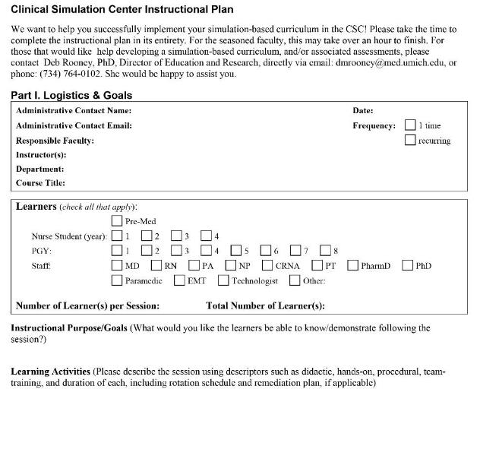
Goals: Exercise 1
Notes:
TIME=0:23
REFER TO EXERCISE WORKSHEET- WHITE HAND OUT
<C>
“Instructional Purpose/Goal”
Use Handout to write overarching goals.

Slide 10
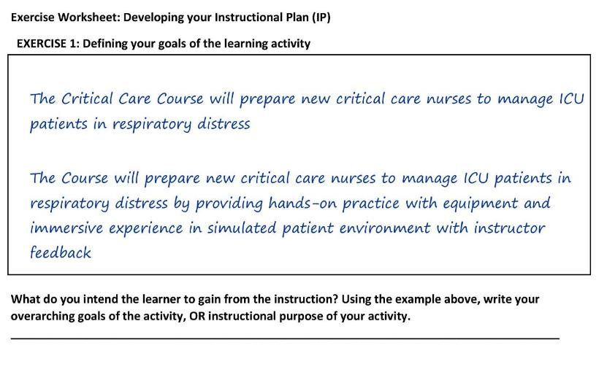
Goals: Exercise 1
Example: Goal
Example: Instructional Purpose
Notes:
TIME=0:35
EXERCISE
5 MINUTES

Slide 11
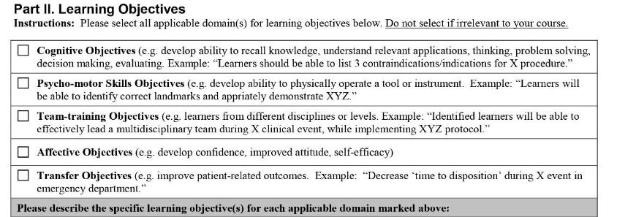
Foundation of Learning Objectives
Domains
Notes:
TIME=1:04
Instructional Plan Handout

Slide 12
Foundation of Learning Objectives
Bloom's Taxonomy of Learning
Cognitive = Knowledge K
Psychomotor = Skills S
Affective = Attitude A
Bloom B. S. (1956). Taxonomy of Educational Objectives, Handbook : The Cognitive Domain. New York: David McKay Co Inc.
Notes:
TIME=0:24

Slide 13
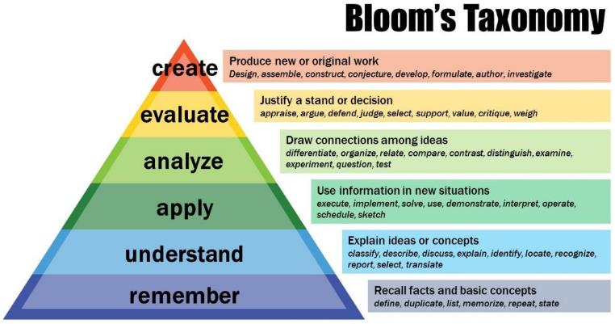
Foundation of Learning Objectives
Anderson, L. W., & Krathwohl, D. R. (2001). A Taxonomy for Learning, Teaching and Assessing: A Revision of Bloom’s Taxonomy of Educational Objectives: Complete Edition. New York: Longman.
Notes:
TIME=1:56

Slide 14
3 Components of a Learning Objective*
^
Well written
Objective Part | Description | Example
Behavior | Describes learner capability within context of learning domain-observable | “will describe the steps in…” “will be able to perform the steps in…” “will rate their comfort toward performing the steps “
Conditions | -Equipment/ tools involved -Environmental | “with instruments supplied” “during simulated scenario representing adult presenting in respiratory distress”
Standard of Performance | Degree-standard for acceptable performance (time, accuracy, quality, etc) | “without error” “without prompting” “within 60 seconds”
*blue handout
Notes:
TIME=1:54
Refer to BLUE HO
Standard= “Independently” is a standard used more often
Talk about issue of obs/measureable. How do we ensure that?

Slide 15
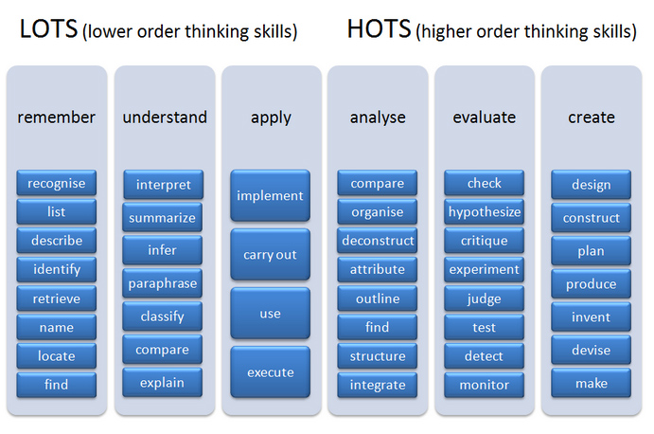
How to make learning objectives measureable?
http://www.maxvibrant.com/bloom-s-taxonomy/bloom-s-taxonomy
Notes:
TIME=1:25
(BACK-SAME BLUE HO)

Slide 16
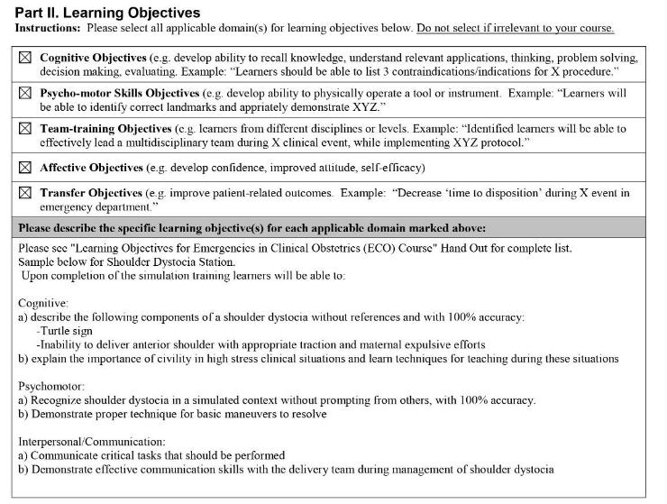
Notes:
TIME=1:05
Instructional Plan Handout
→ EXERCISE 2 NEXT PAGE

Slide 17
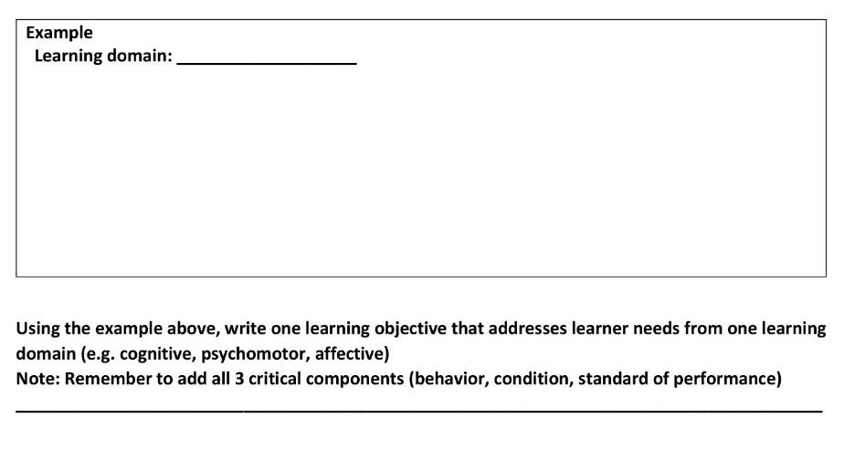
Learning Objectives: Exercise 2
psychomotor
Trainees will demonstrate proper dressing change on the simulated patient while maintaining sterile technique.
Condition
Standard of performance
Measurable behavior
Notes:
TIME=1:30
USING THIS FORMAT AND VERB SHEET AS GUIDE,
Take a few minutes to write a learning objective on sheet (EXERCISE 2)
5 min. DONE
SHARING? QUESTIONS? 5 min

Slide 18
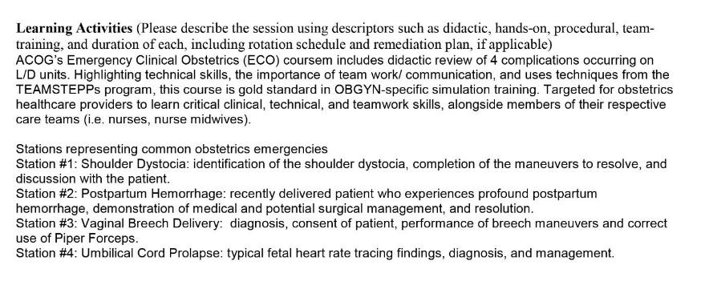
Learning Activities
Notes:
TIME=0:43
Once we know LOs, NOW develop educational strategies, we call them learning activities on IP
<C>
Instructional Plan Handout

Slide 19
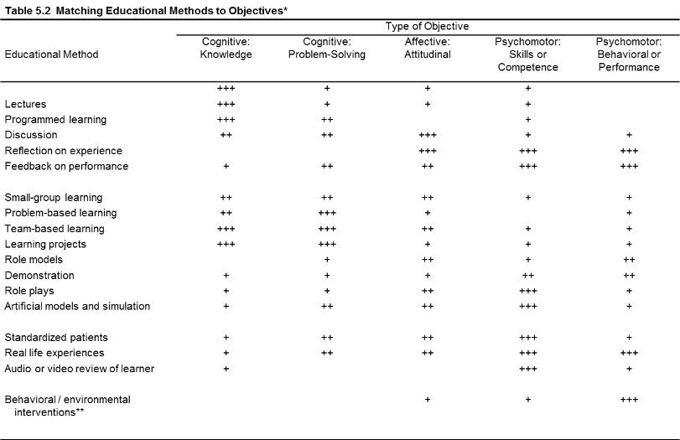
Learning Activities (educational methods)
*Kern et al. Curriculum Development for Medical Education: A six-step Approach. Johns Hopkins University School of
Medicine, Baltimore, MD.
Notes:
TIME=1:22

Slide 20
Simulation-based learning activities
Group size (L:I) | Pros | Cons
Large Grp (>8:1) (Didactic, task training, passive scenario) | More learners/session | -Less-targeted training -Generalized FB -Limited assessment
Small Grp ≤4:1) (task training, engaged scenario) | -Individualized instruction, with guided FB -More assessment options | -Requires more resources -increased requirement for time/sessions/ human support
Individual (1:1) (same, remediation) | -Extremely targeted -Best assessment | -Even more time intensive -Not sustainable
Individual (1:0) (self-directed, flipped class) | -Efficient -Learner-directed -Good K, some PM assessment | -Not effective if learners not motivated -Assessment scope is limited
Notes:
TIME=2:29

Slide 21
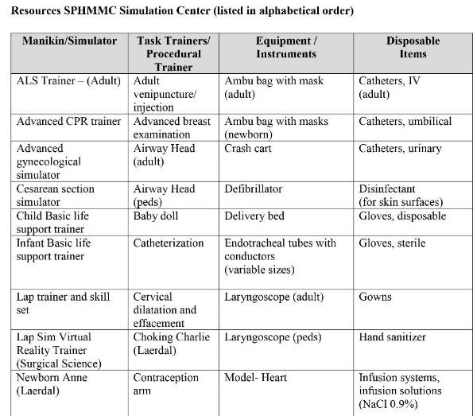
Activities &
Resources
Notes:
TIME=1:11
HANDOUT-RESOURCES-GREEN SHEET
WHEN HAVE IDEA OF RESOURCES< CAN PLAN ACTIVITIES. What does it look like written?

Slide 22

Learning Activities: example
Instructor describes each practice station and goals for session.
Participants break into groups to receive instructional presentations, hands-on demonstration and return demonstration at each station. Each station has an instructor, and participants individually complete required activity for the station (1:4 instructor: participant ratio).
Groups rotate through all stations of the simulation session. The learned critical behaviors are assessed in the case scenario simulated environment.
Notes:
TIME=1:40
EXAMPLE- NO EXERCISE.
Instructional Plan Handout- One example here, one on HO
QUESTIONS? What have we not talked about yet? Assessment?

Slide 23
Assessment: What to measure?
What should be assessed?
  Any part of curriculum considered essential and/or has significant designated teaching time
  Demonstrable behavior that differentiates “low” from “high” performers
  Should be consistent with established learning objectives
Notes:
TIME=1:35
PASS OUT HANDOUTS

Slide 24
learning objectives → assessment plan
Objective Part | Description | Example
Behavior | Describes learner capability within context of learning domain-observable | “will describe the steps in…” “will be able to perform the steps in…” “will rate their comfort toward performing the steps “
Conditions | -Equipment/ tools involved -Environmental conditions | “with instruments supplied” “during simulated scenario representing adult presenting in respiratory distress”
Standard of Performance | Degree-standard for acceptable performance (time, accuracy, quality, etc) | “without error” “without prompting” “within 60 seconds”
Notes:
TIME=1:06
GOING BACK TO BLUE HANDOUT
Purpose of LO→ support assessment

Slide 25
Determine your assessment purpose
  Formative (typically norm-based)
    Gather information during course to give feedback of learners’ strengths/weaknesses with respect to learning objectives
    Consequences are typically low- “Low stakes”
  Summative (typically criteria-based)
    Measure learner’s achievement at end of learning cycle, and compare to standard/benchmark
    “Moderate” to “high stakes”
  Administrative / Compliance
    Gather data to evaluate gap / needs assessment (not associated with education)
Notes:
TIME=2:32
Reporting, Program Evaluation

Slide 26
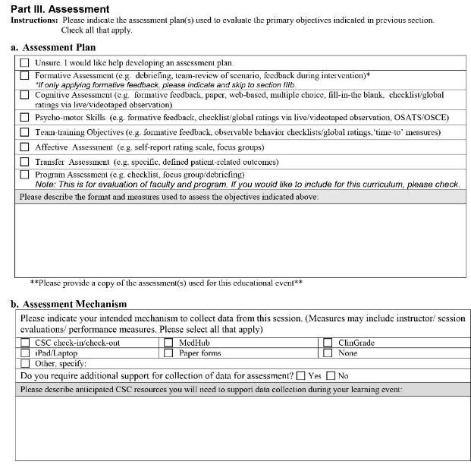
Assessment*
*Program Evaluation
Notes:
TIME=2:20
Here’s section on Instructional Plan Handout

Slide 27

Commonly Used Assessment Tools
Survey
(affect)
Written, multiple choice examinations
(knowledge)
Direct observation Checklist/Global rating
(knowledge, psychomotor)
Individual or 360-degree assessment
(affect, knowledge, psychomotor)
Notes:
TIME=2:08

Slide 28




Direct Observation tools
Reflect observable behaviors
Objective (as much as possible)
  Particularly true for Y/N responses
Can also measure quality, degree
  Rating scales
Can measure other metrics
  “time to”
  demographics
Notes:
TIME=1:23

Slide 29
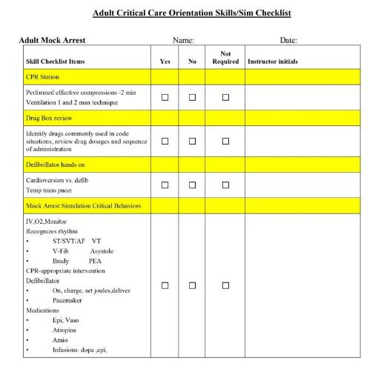
Direct Observation tools: Checklist
Lists critical components for KSAs, and required observable behaviors
Pro: Most objective, require little advanced rater training
Con: No way to indicate sequencing or quality of performance (dichotomously scored)
Notes:
TIME=2:00

Slide 30
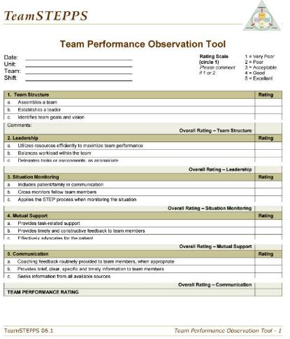
Direct Observation tools: Global rating
Overall impression over broad domains
Scored on 5-point scale
(1=v. poor, 5=excellent)
5 domains
  Team Structure
  Leadership
  Situation Monitoring
  Mutual Support
  Communication
Clancy CM, Tornberg DN (2007). TeamSTEPPS: assuring optimal teamwork in clinical settings. Am J Med Qual 22:214–217.
Notes:
TIME=1:31
→ EXERCISE 3 (FINAL EXERCISE) NEXT SLIDE

Slide 31
checklist development steps
Develop learning objectives
Align learning objectives with assessment
plan
Notes:
Do an exercise

Slide 32
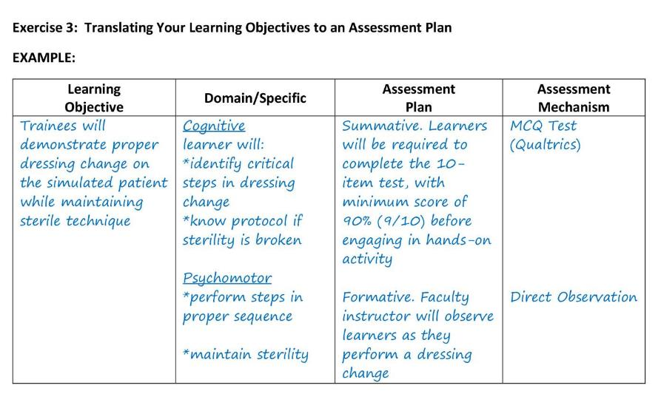
Creating an assessment Plan: Exercise 3
Notes:
TIME=4:09
EXERCISE 3= 10 min
SHARING?
QUESTIONS?

Slide 33
checklist development steps
Develop learning objectives
Align learning objectives with assessment plan
Determine practicality of training/ assessment
Revise as needed

Slide 34
Nitty gritty: checklist development steps
Write all steps (CTA)
<<< Find available resources
Disseminate to colleagues to review using a
documented process
See Content Validity Form
Notes:
First assessment handout

Slide 35
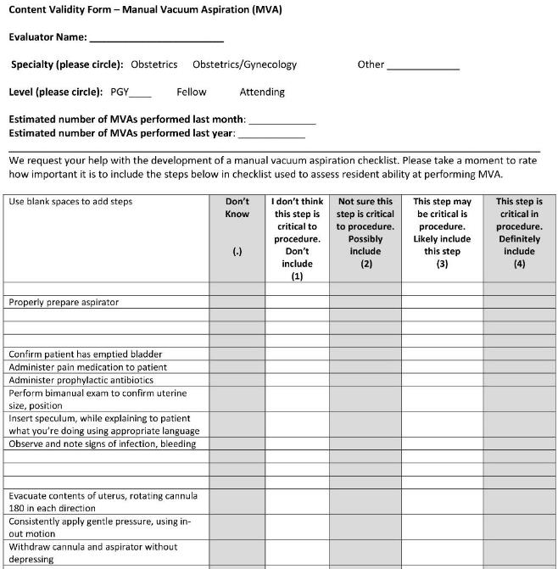
Notes:
Content validity: Exercise.
Ind. Review, then we’ll talk to add items as a group

Slide 36
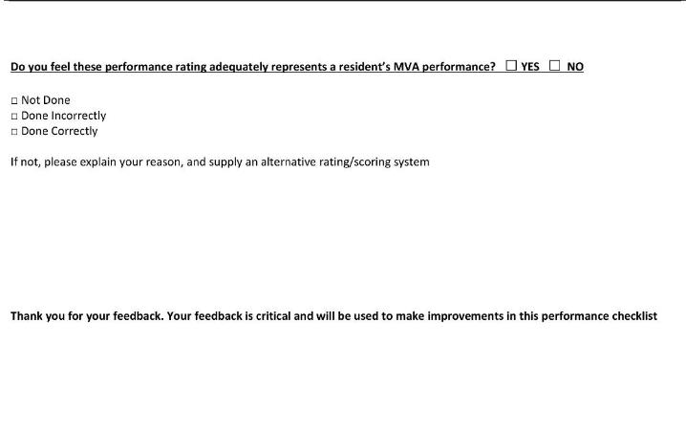
Don’t forget the response options!

Slide 37
checklist development steps
Write all steps (CTA)
Find available resources
Disseminate to colleagues to review using a
documented process
4. Collect, review responses. Revise, as needed
5.Recreate new content validity form
6. Disseminate
7. Focus group
8. Compile final items, metrics
9. Finalize form

Slide 38
checklist development steps use your other experts…
10. Have education/ assessment specialist review
a) clarity
b) ensure items are discrete unless required
11. Have sim specialist review to ensure checklist items
align with resources needed in simulated setting
Revise as needed, and review again
******DOCUMENT EVERYTHING**********

Slide 39
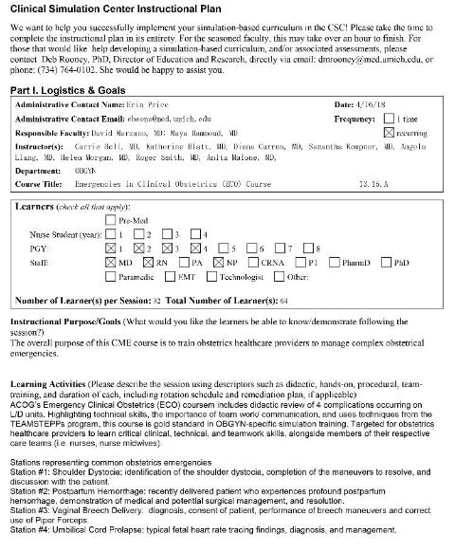
Putting it all together!
SUCCESS!
Goals, learning objectives, learning activities, and assessment tools/ methods should align
Consider long-term feasibility, with “big picture” goals in mind
Use your resources!
Notes:
TIME=1:26
Thank you, and reference slides to follow

Slide 40
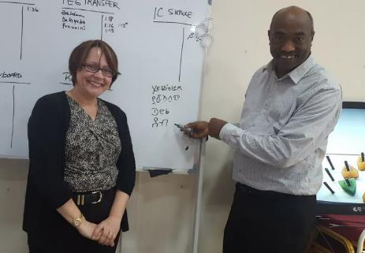
Thank you
Deborah Rooney, PhD
dmrooney@umich.edu

Slide 41
References / Resources
Bloom B. S. (1956). Taxonomy of Educational Objectives, Handbook : The Cognitive Domain. New York: David McKay Co Inc.
Dave R. H. (1975). Developing and Writing Behavioral Objectives. (R J Armstrong, ed.) Educational Innovators Press.
Guidelines for Writing Learning Objectives. American Academy of Family Physicians. Website. http://www.aafp.org/dam/AAFP/documents/cme/faculty_development/LearningObjectivesGuidelines.pdf Accessed November 15, 2018.
Krathwohl, D.R., Bloom, B.S., and Masia, B.B. (1964). Taxonomy of educational objectives: Handbook II: Affective domain. New York: David McKay Co.
Webb EM, Naeger DM, Fulton TB, Straus CM. Learning objectives in radiology education: why you need them and how to write them. Academic Radiology, 2013 Mar;20(3):358-63. doi: 10.1016/j.acra.2012.10.003.
UMCSC Instructional Plan. https://medicine.umich.edu/dept/csc/about-us/policies/instructional-plans Accessed November 15, 2018.

