Slide 1
Contraceptive Implants
Eyaya Misgan, MD
Head, Department of Obstetrics and Gynecology
Bahir Dar University

Slide 2
Skill Lab Assignment
Practice Implant Insertion Methods

Slide 3
Skill Lab Assignment
Practice Implant Removal Methods

Slide 4
Outline
Objectives
Types of Implants
Mechanism of action
Advantages and disadvantages
Eligible candidates
Timing of insertion
Insertion procedure
Complications
Summary

Slide 5
Objectives
Describe the characteristics of implants
Apply medical eligibility criteria for implants
Explain the insertion, removal, and follow-up procedures
Describe when to initiate use of Implants
Detect and manage side effects

Slide 6
Case Study
Almaz is 28 years old and has two children
She is a first year postgraduate student at the University of Gondar
She wants you to advise her on the most suitable contraceptive method
She explained to you that she is worried
  About the side-effects
  Wants more children in the future
    What is the most suitable contraceptive for Almaz ?

Slide 7
Introduction
Contraceptive implants are
  Progestin-based
  Highly effective
  Rapidly reversible
Have been used for more than 25 years
Consist of flexible tubes or rods of match stick size
Provide 3 to 7 years of continuous protection
Ethiopia: the second most common in utilization
Notes:
It consists of
ﬂexible tubes or rods, each about the size of a match stick, inserted under the
skin of a woman’s upper arm by a trained professional. Implants can give
continuous protection for three to seven years, depending on the number of
rods inserted. This method of contraception has been used for more than 25
years.

Slide 8
Types of Implants
Based on
  The number of tubes or rods
  The type of progestin that each releases
  Radio-opacity
Name | Progesterone | Number of rods | Duration of use in years
Norplant | 36mg levonogestrel | 6 | 5
Jadelle | 75mg levonogestrel | 2 | 5
Sino-implant (II) | 75mg levonogestrel | 2 | 4
Implanon | 68mg etonogestrel | 1 | 3
Nexplanon | 68mg etonogestrel | 1 | 4
Notes:
Norplant: 6 capsules, each containing 36 mg of levonorgestrel. Labeled for 5 years of use. (Large
studies have found it is effective for 7 years.)
Implanon and Nexplanon are bioequivalents
They are different
Nexplanon is radio-opaque and

Slide 9
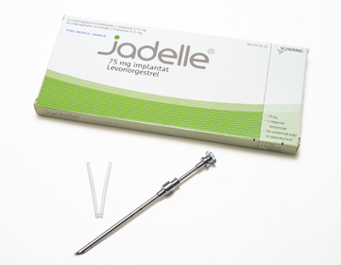
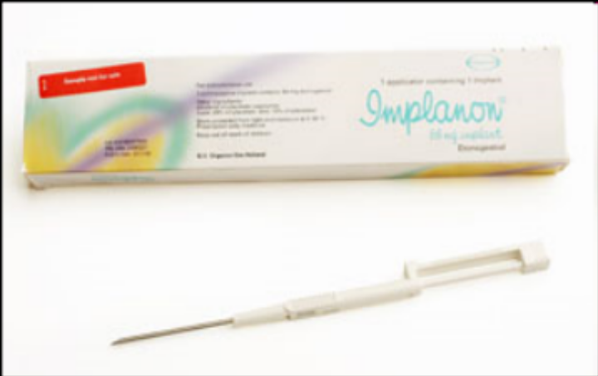

Slide 10

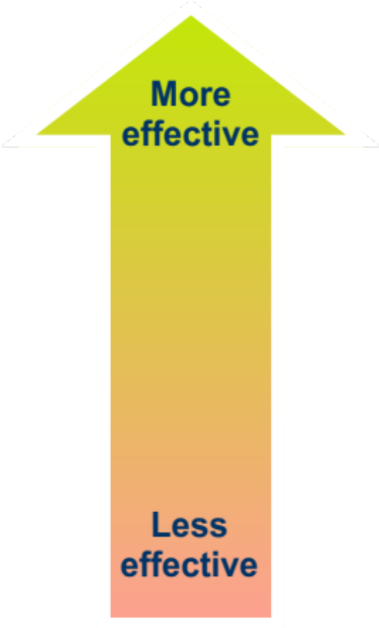
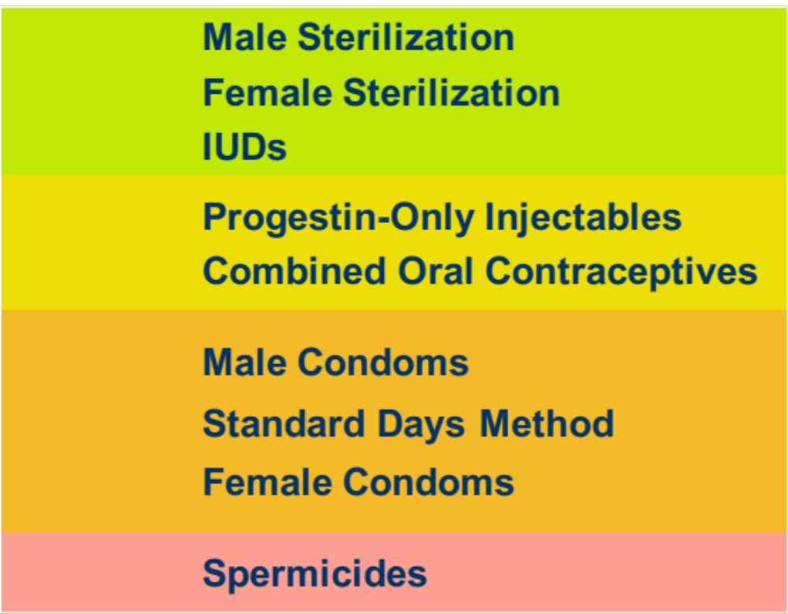
Effectiveness of Implants

Slide 11

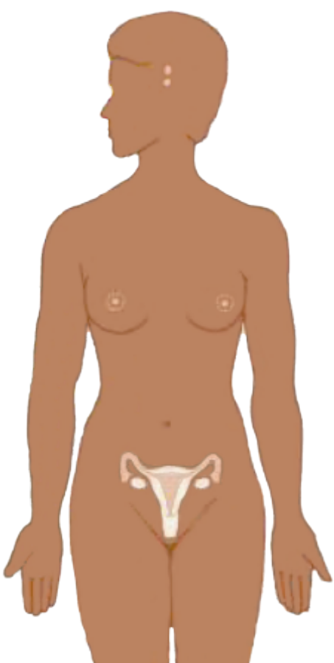
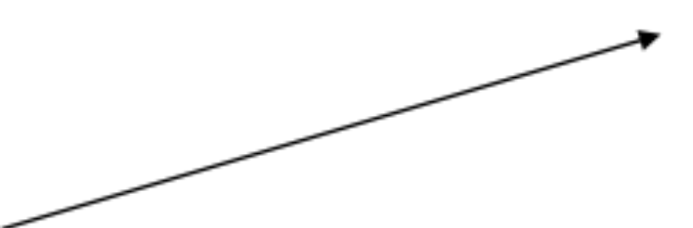
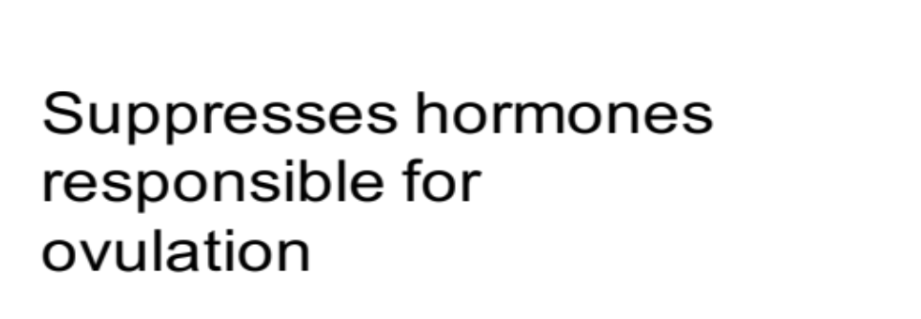


Mechanism of Action
Notes:
Thicken cervical mucus ...this is due to antiestrognic effect of progesterones....mucus becomes, scanty thich and impenetratable by sperm
Such level of progesterone will inhibit follicular maturation and hence ovulation will be suppressed

Slide 12
Advantages and Disadvantages
Advantages
  Very safe
  Highly effective (99.95%)
  Easy to use
  Immediate return of fertility
  Can be used by breastfeeding women
  Offer health benefits
Disadvantages
  Side effects
  Require minor surgery to insert and remove
  Need provider’s help
  Provide no protection from STIs/HIV
Notes:
Immediate return of fertility returns without delay when removed

Slide 13
Health Benefits
Reduced risk of
  Symptomatic pelvic inflammatory disease (PID)
  Iron-deficiency
  Ectopic pregnancy
    6 per 100,000 in Implant users
    650 per 100,000 in women using no contraception

Slide 14
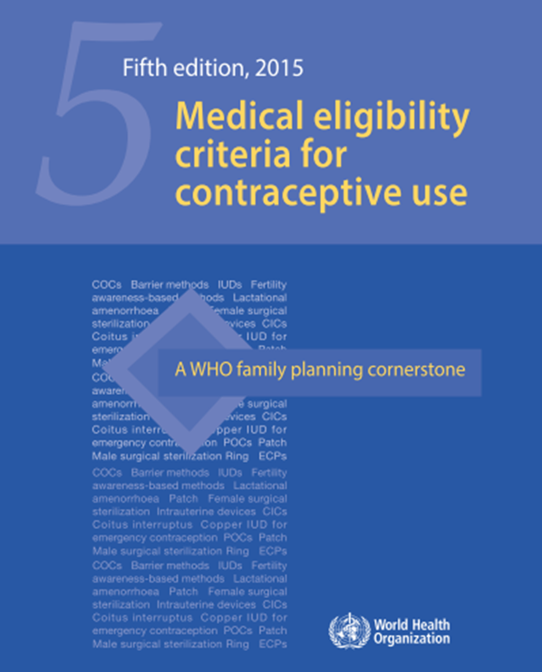
Eligible candidates for implantable contraception
Most women can use Implants safely
Most health conditions do not affect safe and effective use
Many women who cannot use methods that contain estrogen can safely use
Base on WHO Medical eligibility criteria (MEC)
Notes:
CANDIDATES WILL BE SLECTED BASED ON THE WHO/MEC

Slide 15
WHO/MEC (cont’d)
Category 1 | no restriction for the use of the contraceptive method
Category 2 | advantages of using the method generally outweigh the theoretical or proven risks
Category 3 | the theoretical or proven risks usually outweigh the advantages of using the method
Category 4 | an unacceptable health risk if the contraceptive method is used

Slide 16
Examples
Category 1 and 2
  Adolescent girls
  Postpartum
  Post abortion
  Blood pressure > 160/100 mmHg
Category 3 and 4
  Pulmonary thromboembolism
  History of breast cancer
  Current breast cancer

Slide 17
Timing
First 7 days of menstrual cycle (5 days for Implanon)
After 7th day of menstrual cycle (5th for Implanon), rule out pregnancy and use backup method for 7 days
Postpartum: immediately
Post abortion: immediately

Slide 18
Timing (cont’d)
Switching from other method:
  Immediately if a hormonal method was used
  With in the reinjection window for injectable users
After using emergency contraceptive pills:
  Insert within 7 days after start of next menstrual period
  Provide with backup method during interim
Notes:
If the chosen method is Implanon insert with in five days after the start of the next menstrual period

Slide 19
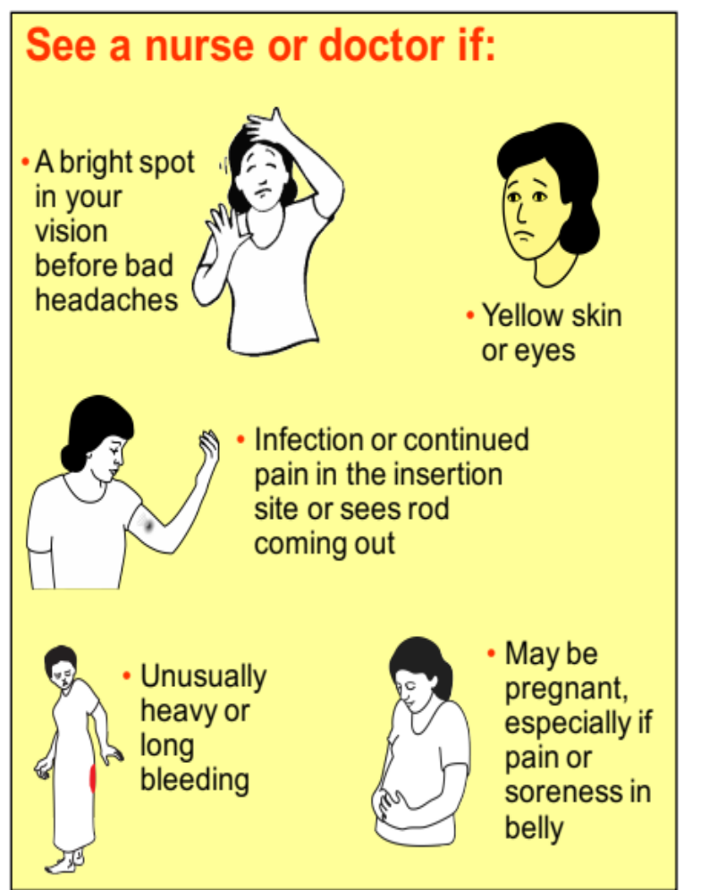
What to Remember after Implant insertion
Keep the insertion area dry for 4 days
Expect a bit of soreness and bruise
Side effects are common but rarely harmful
Come back any time for any problems or concern or want to get pregnant

Slide 20

Insertion Video (Jadelle)

Slide 21
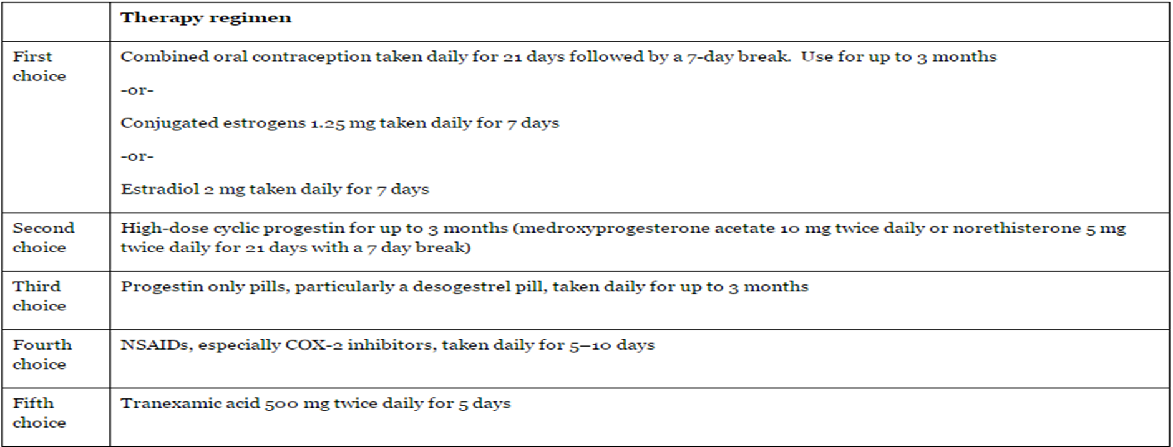
Case study 2
You inserted Jadelle for Almaz, she called you after two months that she has vaginal bleeding which comes at irregular intervals
What is Almaz’s diagnosis?
What do you do for her problem ?

Slide 22
Side effects of Implants
First several months
  Lighter bleeding and fewer days of bleeding
  Irregular bleeding
  Infrequent bleeding
  No monthly bleeding
After about one year
  Lighter bleeding and fewer days of bleeding
  Irregular bleeding
  Infrequent bleeding
Notes:
Implanon users are more likely to have no monthly bleeding than irregular bleeding

Slide 23

Management of unscheduled bleeding
Notes:
Observation
Treatment with
Consuder iron tablets if bleeding is heavy to prevent anemia

Slide 24
Problems that may require switching from implants
Unexplained vaginal bleeding
Migraine headache
Coagulopathy
Ischemic heart disease
Suspected pregnancy

Slide 25
Complications and management
Infection at insertion site
Expulsions
Difficult removal
Notes:
Complications are rare from implants but clients may have
Infection at insertion site
If occurs, most likely within the first 2 months
Difficult removal
Rare if inserted properly and removed by a trained provider
Expulsions
Rare; most occur within the first 4 months

Slide 26
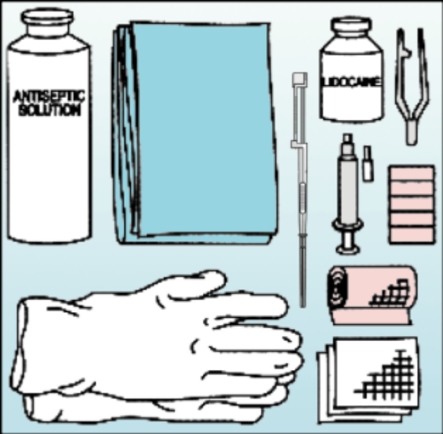
Prior to Implant Insertion or Removal
Getting ready
  Have the client wash her arm
  Cover the procedure table
  Prepare a clean instrument tray
  Open the sterile instrument pack
Before insertion/removal
  Wash hands thoroughly and put
  on gloves
  Clean the insertion/removal site
  Use a sterile drape with a hole over the site
  Use a new disposable syringe and needle

Slide 27

Implant removal (Jadelle)

Slide 28
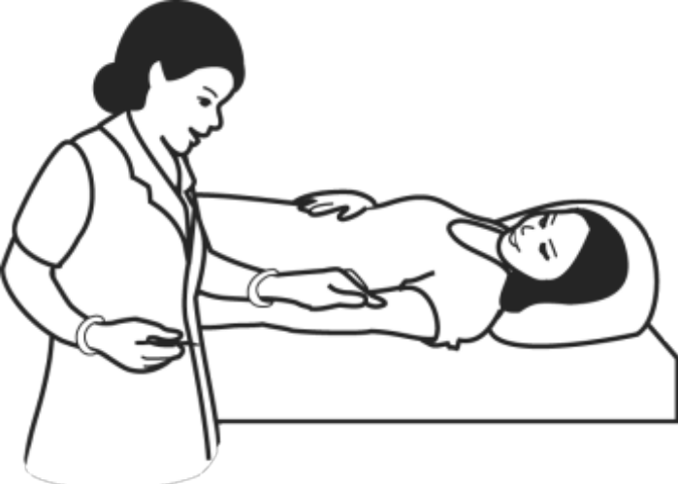
After Implant Insertion or Removal
Stop any bleeding with gauze and clean the insertion/removal site
Apply a sterile adhesive bandage
Place sharps in a safety container
Decontaminate instruments
Dispose of contaminated objects
Decontaminate all surfaces
Wash hands with soap

Slide 29
Summary
Provide long-term protection
Highly effective and readily reversible
Appropriate for most women, including young and nulliparous
Irregular bleeding patterns may be a problem for some women
Thorough counseling is essential

