Slide 1
EMERGENCY CONTRACEPTION
SHumi Negesse, MD
Assistant
Professor, Adama hospital medical college
Department of OBSTETRICS AND GYNECOLOGY

Slide 2
Outline
Objectives
Introduction of emergency contraceptives
Types of emergency contraceptives
When to prescribe emergency contraceptives
Side effects of emergency contraceptive pills (ECPs) and management
Effectiveness of ECPs
Discussion of future contraception options
Summary of the presentation

Slide 3
Objectives
  Define emergency contraceptive
  List types of emergency contraceptives
  Identify candidates for emergency contraceptives
  Discuss mechanisms of action
  Explain common side effects of emergency contraceptive pills

Slide 4
Definition
Use of drugs or a device as an emergency measure to prevent pregnancy
ECPs are also called: “Morning After Pill” or post-coital contraceptives

Slide 5
Pills or Devices for Emergency Contraceptive
Special ECPs with
  the progestin (levonorgestrel)
  estrogen and levonorgestrel
Progestin-only pills with levonorgestrel or norgestrel
Combined oral contraceptives with an estrogen and a progestin
  levonorgestrel
  norgestrel or norethindrone
Intrauterine contraceptive device (IUCD)

Slide 6
When to take Emergency contraceptives?
As soon as possible after unprotected sex
Any time up to 5 days after unprotected sex
Notes:
The sooner emergency contraceptive are taken after unprotected sex, the better they prevent pregnancy.

Slide 7
Emergency Contraceptive Pills
    Who is a candidate for ECPs?
    All women can use ECPs safely and effectively
      Unprotected sex
      Condom rupture, slippage
      Missed pills, 3 or more doses
      Sexual assault
No known medical conditions make ECPs unsafe for any woman

Slide 8
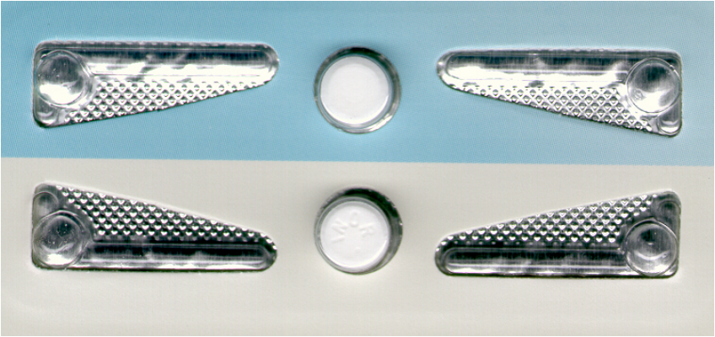
Dose(s) of Emergency Contraceptive Pills
Progesterone only dedicated product(post pill)
  1.5 mg of levonorgestrel in a single dose or
  0.75 mg levonorgestrel (follow with same dose 12 hours later)
  Most recommended ECPs

Slide 9
Dose(s) of Emergency Contraceptive Pills (cont’d)
Estrogen progestin dedicated product
  0.1 mg ethinyl estradiol + 0.5 mg levonorgestrel (follow with same dose 12 hours later)
Progestin-only pills with levonorgestrel or norgestrel
  Levonorgestrel pills 1.5 mg in a single dose
  Norgestrel pills 3 mg in a single dose

Slide 10
Dose(s) of Emergency Contraceptive Pills (cont’d)
Combined oral contraceptives
  0.1 mg ethinyl estradiol + 0.5 mg levonorgestrel (follow with same dose 12 hours later)
  0.1 mg ethinyl estradiol + 1 mg norgestrel (follow with same dose 12 hours later)
  0.1 mg ethinyl estradiol + 2 mg norethindrone (follow with same dose 12 hours later)
Notes:
Remember that many pills may be taken if progesterone only or combined oral contraceptive are used as ECPs

Slide 11
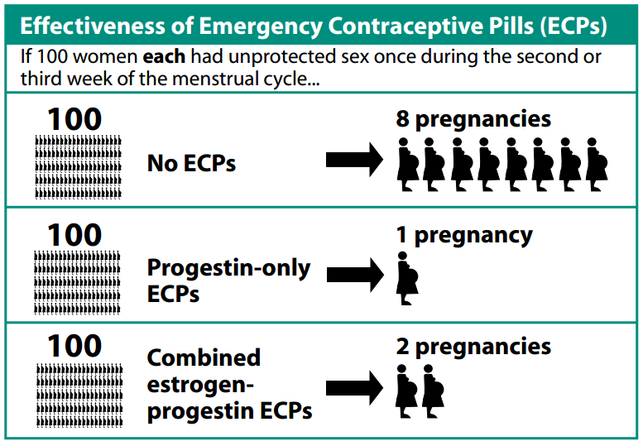
Effectiveness of ECPs

Slide 12
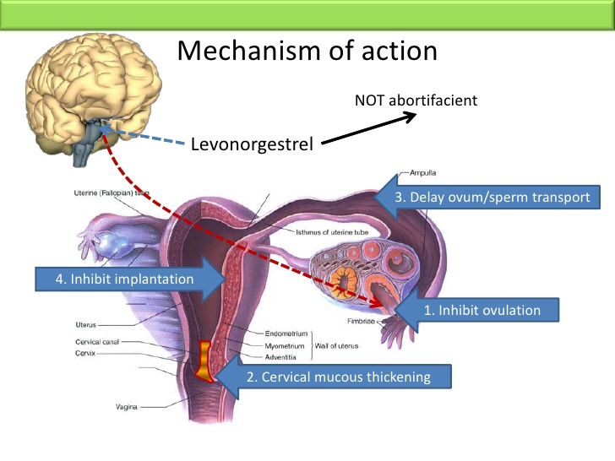

Slide 13
Facts About ECPs
Emergency contraceptive pills:
  Do not cause abortion
  Do not cause birth defects if pregnancy occurs
  Are not dangerous to a woman’s health
  Do not promote risky sexual behavior
  Do not make women infertile

Slide 14
Side Effects of ECPs and Management
Changes in bleeding patterns may include:
  Slight irregular bleeding for 1–2 days after taking ECPs
  Monthly bleeding that starts earlier or later than expected
Nausea
  Routine use of anti-nausea medications not recommended
  Give anti-nausea medication for clients with
    previous ECPs use
    first dose of a 2-dose regimen
Vomiting: If within 2 hours after taking ECPs give another dose

Slide 15
Side Effects of ECPs and Management (cont’d)
No routine return visit is required
However, a woman should seek follow-up care if:
    She thinks she might be pregnant
    She has no monthly bleeding
    Or her next menses is delayed by more than one week

Slide 16
Planning Future Contraception
  ECPs does not protect from pregnancy
  If she does not want to start a contraceptive method now
    give condoms
    oral contraceptives
  Invite her to come back anytime
  If possible, give her more ECPs (for future use)

Slide 17
Planning Future Contraception (cont’d)
Should women use ECPs as a regular method of contraception?
No
Nearly all other contraceptive methods are more effective in preventing pregnancy
Women who use ECPs regularly are at high risk to have unintended pregnancy

Slide 18
IUCD (Copper IUCD)
  Should be inserted within 120 hours
  Highly effective
  Can remain in place for up to 10 years
  Good option for long-term contraception

Slide 19
Some Contraindications for IUCD
Uterine abnormalities/anomalies
Acute pelvic inflammatory disease or in the past 3 months
Pelvic malignancies: Cervical cancer and endometrial cancer
Undiagnosed abnormal vaginal bleeding
Allergies to copper

Slide 20
Other Types of Emergency Contraceptive
Ulipristal acetate
  Highly effective and well-tolerated
  Can be taken up to 5 days after unprotected sex
  Believed to be more effective than levonorgestrel ECPs
Mifepristone
  Highly effective, with few side-effects
Both are not included in our guideline
Notes:
Ulipristal acetate available United States (sold as ella) and Europe (sold as ellaOne)
This type of emergency contraceptive pill is currently available only in China, Vietnam, Armenia and Russia.

Slide 21
Case Study
20 year old female college student
Unprotected sex 12 hours back
Last normal menses was 2 weeks back
Unmarried, with no immediate plan for children
On antibiotics for pelvic inflammatory disease
Which of the emergency contraceptive do you recommend based on Ethiopian Ministry of Health family planning guideline?

Slide 22
Case Study (cont’d)
Levonorgestrel-only dedicated pills
or
Postpill

Slide 23
Summary
Levonorgestrel-only dedicated is the most recommended type of ECPs
Emergency contraceptives prevent pregnancy when taken up to 5 days after unprotected sex
Emergency contraceptives do not disrupt an existing pregnancy
ECPs are safe for all women
ECPs are not recommended as regular contraceptive methods

