Slide 1
Where is the Hospitality in Your Library?
Salem-South Lyon District Library
Friday March 6th, 2020
URL: http://tinyurl.com/cgs2020ssldl
Corey Seeman
Kresge Library Services
Ross School of Business (University of Michigan)

Slide 2
Presentation Overview
Introduction
Hospitality & Service
Two Spaces of a Library
Hospitality at Kresge Library
Becoming Kresge Library Services
Patron-Driven Services and the Power of Yes
Closing Thoughts

Slide 3
Introduction
My Diverse Employment Background
  Spent 3 weeks and 1 day working in the JC Penney Manager Training Program….
  Worked at Special Libraries, Archives and Academic Libraries
  Worked for a Library Software Company (Innovative)
  Been in Technical Services and Systems
  Moved to Collections and Administration
  Always have been able to keep close with the patrons or end-users

Slide 4
Introduction
Some presentation goals -
  This is my approach and my philosophy about libraries and library services.
  Libraries are not all the same – they have different funding, staffing, student/faculty/community needs.
  What works at one, may not work at another.
  How can we frame problems and opportunities to ensure that we are meeting the needs of our patrons.
  Great libraries are not designed by architects – but by librarians & library staff.

Slide 5

Introduction
The view of an iconoclast.
Borrowed this line from Pirates of Penzance:
  Frederic (to his fellow pirates): Individually, I love you all with affection unspeakable; but, collectively, I look upon you with a disgust that amounts to absolute detestation.
From Gilbert and Sullivan’s Pirates of Penzance (or The Slave of Duty), 1879
From: http://math.boisestate.edu/gas/pirates/pirates_lib.pdf

Slide 6
Hospitality & Service
Hospitality, n. The virtue which induces us to feed and lodge certain persons who are not in need of food and lodging.
    ~Ambrose Bierce, The Devil's Dictionary, 1911
Hospitality is making your guests feel at home, even though you wish they were.
    ~ Unknown
Share with God's people who are in need. Practice hospitality.
    ~Romans 12:13

Slide 7
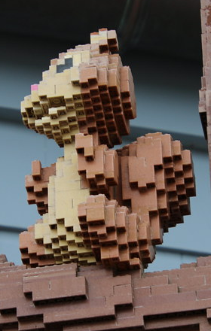
Hospitality & Service
Disney Model
  Excellent customer service
  Excellent attention to detail
  Things just run beautifully smooth
  You really feel like they care about every person
  You really feel that they care about YOU!

Slide 8
Hospitality & Service
Nordstrom Model
  Employee Handbook is one card
  “Our number one goal is to provide outstanding customer service”
  Our only rule: “Use good judgment in all situations”
  See Spector’s The Nordstrom Way to Customer Service Excellence, 2005

Slide 9
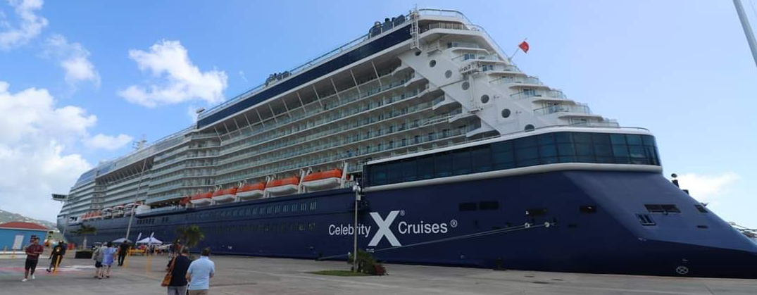
Hospitality & Service
Cruise Ship Model
  Managing a huge number of people at every given time.
  Things within and beyond your control (weather, health concerns, civil unrest, natural disasters).
  Hospitality and flexibility are intertwined.

Slide 10
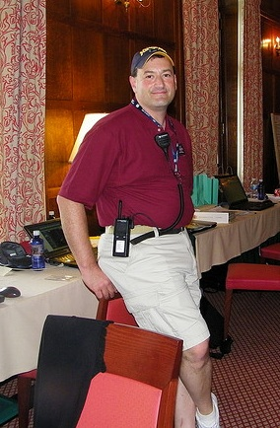
Hospitality & Service
Hall of Fame Hospitality Desk.
  Over Hall of Fame Weekend, the “Hospitality Desk” manages all events
  Used to be called Information Desk
  Name was changed to the Hospitality Desk and Crew instill a culture of taking care of people
  The goal is to make things right

Slide 11
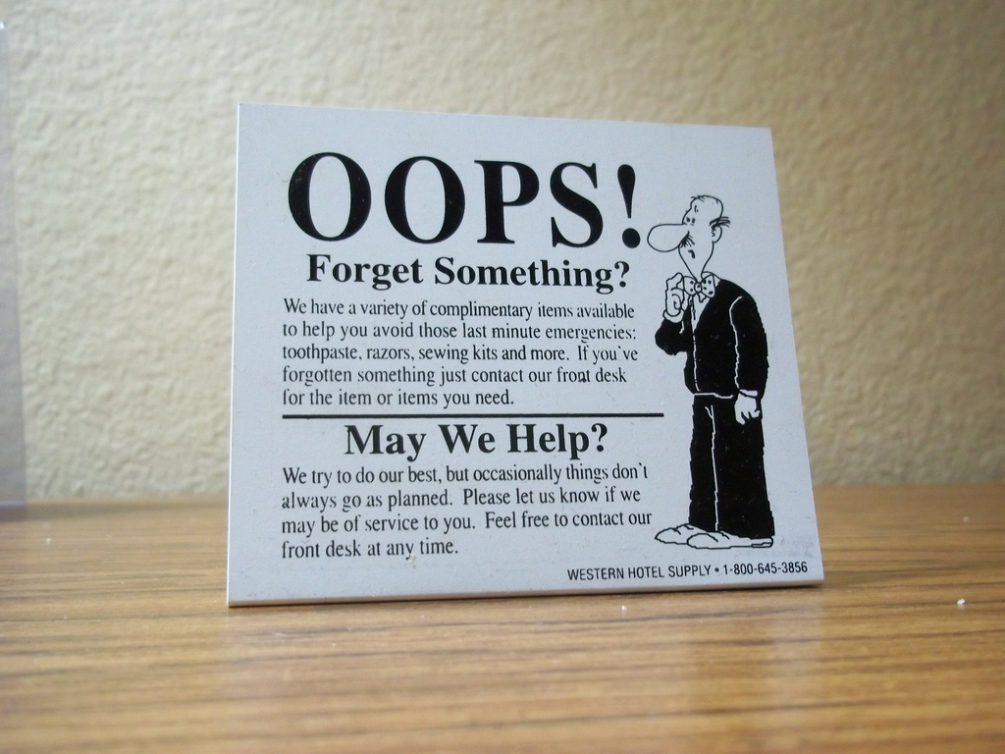
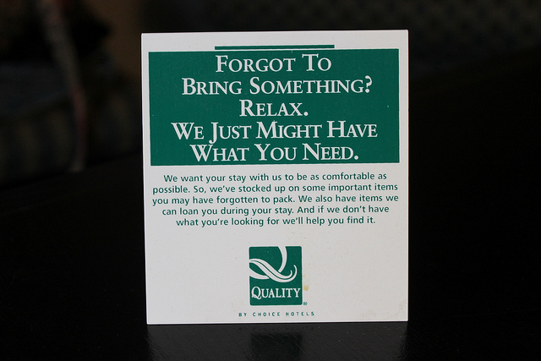
Hospitality & Service
Hospitality can be modest and still be appreciated and useful

Slide 12
Hospitality & Service
In general, Hospitality is…
  It is being available and visible
  It allows you to change what your patrons can expect from the library
  It is treating your users like customers (no matter what we call them)
  It is treating your users like the way you would want to be treated
  It is treating people well, even before you know who they are
  It is not simply luxury or excess

Slide 13
Hospitality & Service
Librarians & library staff are amazing at providing service
In many academic settings, the libraries are the element that people are most fond of in reviews and surveys
In communities, libraries are often considered one of the most commonly cited benefit of a city or town
In many ways, libraries are well suited to focus on hospitality

Slide 14
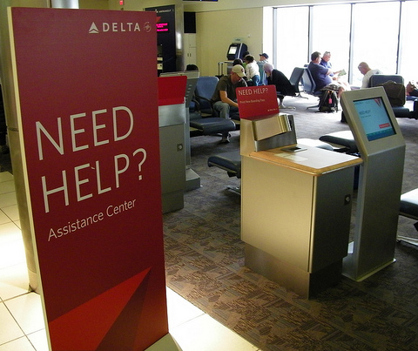
Hospitality & Service
With the advent of electronic resources and discovery layers – we have worked very hard to make the library mostly self-service
We have to be very careful – because we could be leading to…
ATL Airport – July 11th, 2012

Slide 15
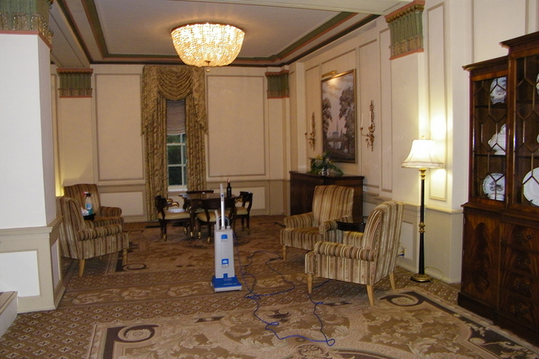
Hospitality & Service
Or Maybe a Self-Service Hotel…

Slide 16
Hospitality & Self-Service
Self-service has a great role in librarianship
That is great when patrons know what they want
This is not great when people don’t know what they need
We have seen a change in services and removal of the reference desk (among others)
This is when we have a problem…and an opportunity

Slide 17
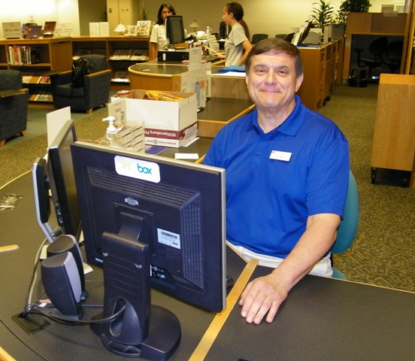
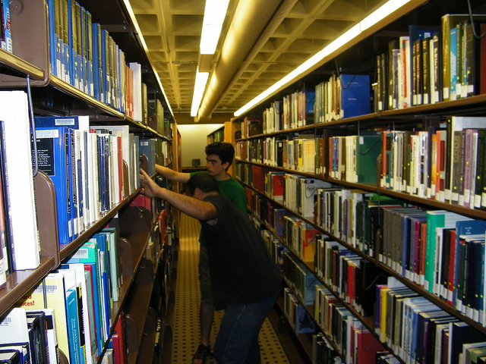
Two Spaces of a Library
How do they see us?
Storage or Service?

Slide 18
Two Spaces of a Library
There are two distinct spaces in a modern library:
  The Physical Space
  The Ethereal Space
Both are critical for our work and for libraries everywhere
Both are critical for considering outreach activities with our collections (esp. in business)

Slide 19
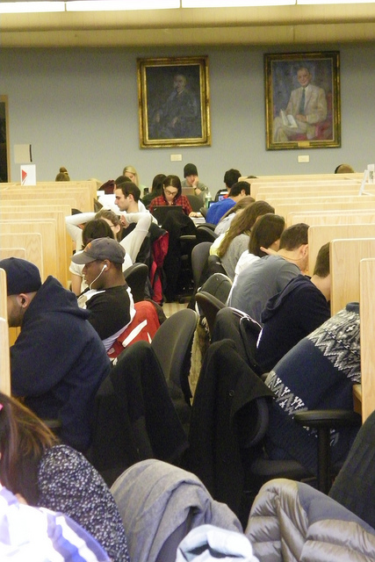
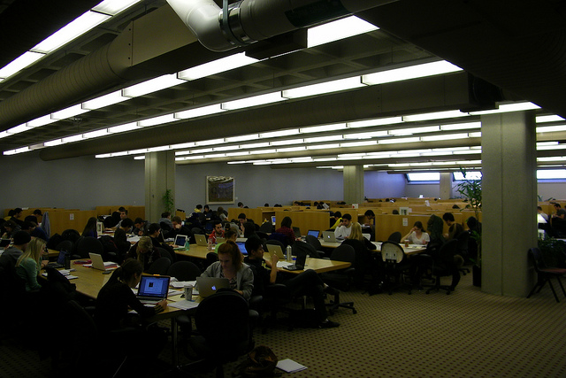
Two Spaces of a Library
The Physical space of the library is used for quiet study and contemplation

Slide 20
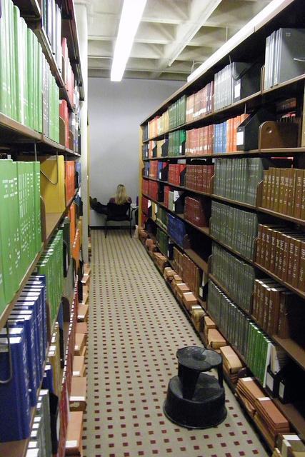
Two Spaces of a Library
The Physical space of the library is used for managing printed collections…
Which ARE STILL RELEVANT and USEFUL (though we may not be able to keep all we want)
But its not the biggest priority with building projects.
In many ways – we focus heavily on the physical space.
Study space can be managed by anyone on a campus!

Slide 21
Two Spaces of a Library
The Ethereal Space of the Library is where
  We connect with users
  We provide outreach
  We showcase our value to communities
  We make sense of “it all”
  We become the “Shell Answer Man”
  We SHINE

Slide 22

Two Spaces of a Library
The Ethereal Space is boundaryless
  12 Natural Laws of Building a Great Business
  #9 – Success Means You Get Better Problems (p.54)

Slide 23
Hospitality at Kresge Library
Kresge Library: Independent Library at University of Michigan - Ross School of Business (3700 FTE)
Formerly staff of 20 FT people (8 librarians, 10 staff) with 4.5 FTE of temporary staff
Open 108 service hours a week during the Fall and Winter terms***

Slide 24
Hospitality at Kresge Library
Joined the library in 2005 and became the director in 2006
My goal as director has been to create the library I would want to use
I am more concerned about what our students and faculty need than what libraries are doing elsewhere (instead of keeping up with other ABLD libraries)

Slide 25
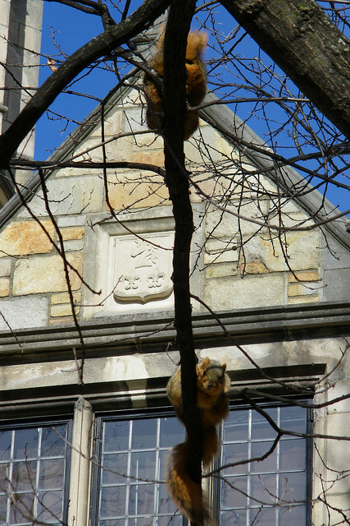
Hospitality at Kresge Library
Hospitality and Empathy are KEY TERMS for me
Empathy has to work both ways – in balance
  More empathetic towards patrons – more work for staff
  More empathetic towards staff – maybe less services for patrons
Without empathy, we cannot truly connect with our users.

Slide 26
Hospitality at Kresge Library
We are a very different academic library
Very strong proponent of the Nordstom Way
Always encourage staff to take care of the problem as best we can and sort out details later
We want to be the service champions at the Ross School
Draw examples from everywhere, not just our type of library
DON’T RON JOHNSON YOUR LIBRARY (former CEO of JC Penney)!

Slide 27
Hospitality at Kresge Library
It is a 100% service orientation for the library
We are flexible to take care of the immediate needs of the school
A student’s perception of Kresge might be equally influenced by interaction with me, a reference librarian, a staff member or a student temp
Very important to share values – even with different roles at the Library

Slide 28

Hospitality at Kresge Library
Is there a cost associated with being a hospitable library?
  Some are possible because of our size and budget
  Some have relatively modest cost with a good return
  Some have virtually no cost and a good return

Slide 29
Hospitality at Kresge Library
Embedded Librarians for MAP & Action-Based Learning
  This is not one of my ideas – but it grew as the school developed
  Action-based Learning programs like MAP involve student groups working with corporate, governmental and nonprofit organizations
  They often need very specialized research assistance
  We assign librarians to each group to make it easier for the teams
  We get a lot of “return business” after MAP is over

Slide 30
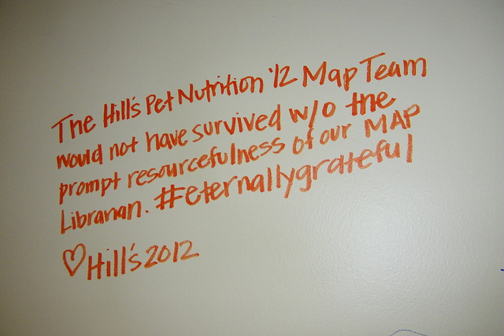
Hospitality at Kresge Library
From the MBA surveys:
  “Access to a dedicated librarian during MAP was AWESOME”
  I had no idea until MAP how awesome the staff at Kresge is

Slide 31

Hospitality at Kresge Library
Some have a modest or no cost associated with them.
Need Supplies?
Similar to many hotels that provide toothbrushes, etc. to travels who forget items
We provide office supplies (name tents, envelopes, paper (for case interviews), pens, earplugs)
We used to charge (cost recovery) – but it was more work to track the money

Slide 32
Hospitality at Kresge Library
Being hospitable and flexible with staff
Corey’s theory
  If I am flexible with you, please be flexible with our patrons
  If I am not flexible with you, then you will not be expected to be flexible with our patrons
Balancing Empathy between all staff and patrons
Ties to Positive Organizational Scholarship
Important for Modeling Good Behavior!

Slide 33
Hospitality at Kresge Library
The most important element of hospitality is our demeanor
  We smile
  We wear name tags when working in the public
  To a person at Kresge, we reach out to patrons who look like they need help
  This is fairly unique at Ross
  So much has to do with the little things (Zombieland Rule #32 – Enjoy the Little Things)

Slide 34
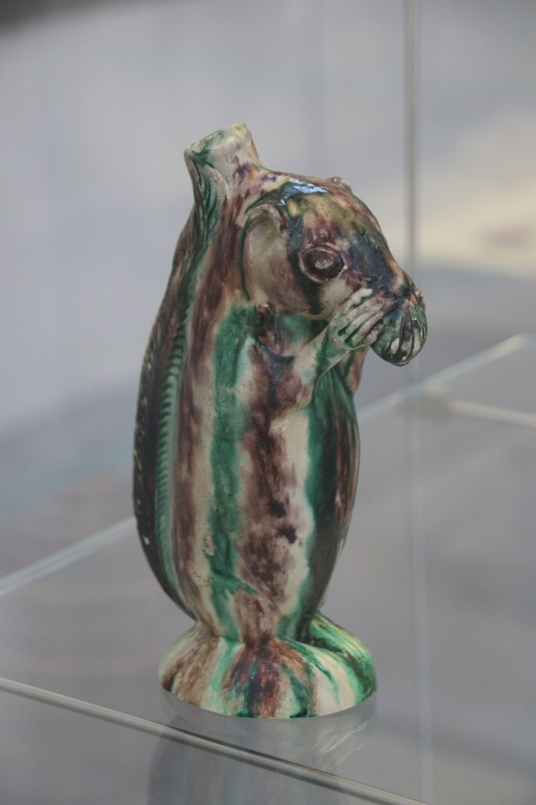

Hospitality at Kresge Library
Helping visitors and patrons.
Squirrels at the Met (NYC)
Bottle from Salem, NC - ca. 1790–1805.
Snuffbox from Germany (Schrezheim manufactory), ca. 1761-1770. In Gallery 538 – closed the day I went.
Two decorative squirrels in the collection of the Metropolitan Museum of Art, New York City

Slide 35
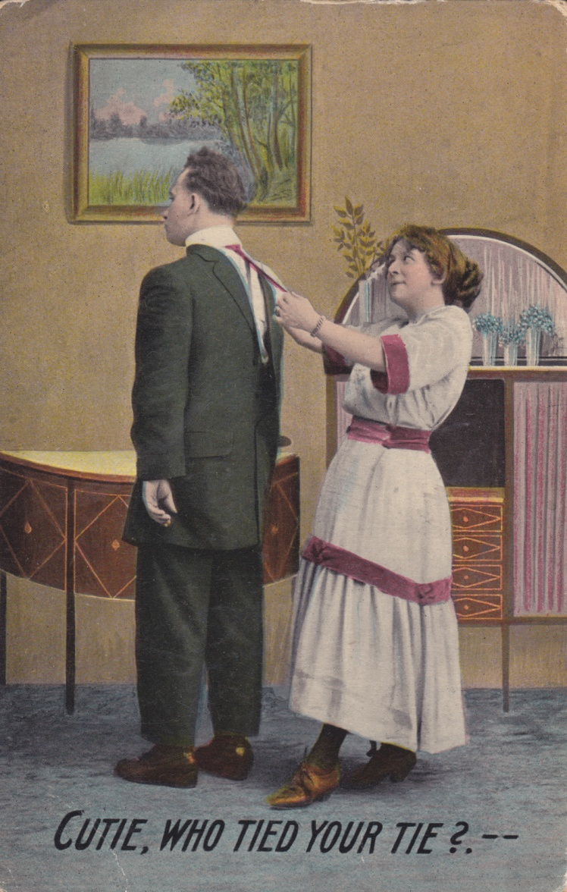
Hospitality at Kresge Library
Some things were tried and discontinued
Maybe they were not popular…or too popular to support
“Do not get married to the results” – Bernard Seeman (many times)
Do not start with artificial metrics for success.
We really have to trust ourselves to know if it is working or not.

Slide 36
Hospitality at Kresge Library
In Summary….
  Make all people feel welcome at your library
  Treat patrons the way that you would like to be treated (Golden Rule)
  “Point with your feet, not with your arm”
  Create the library you would want to use!
  When times are hard and resources (space, budget and personnel) are tight…being hospitable can be difficult
  We cannot always control how we are treated and what resources we are given…but we can control how we respond
  Yep…it’s a cliché…but it works

Slide 37
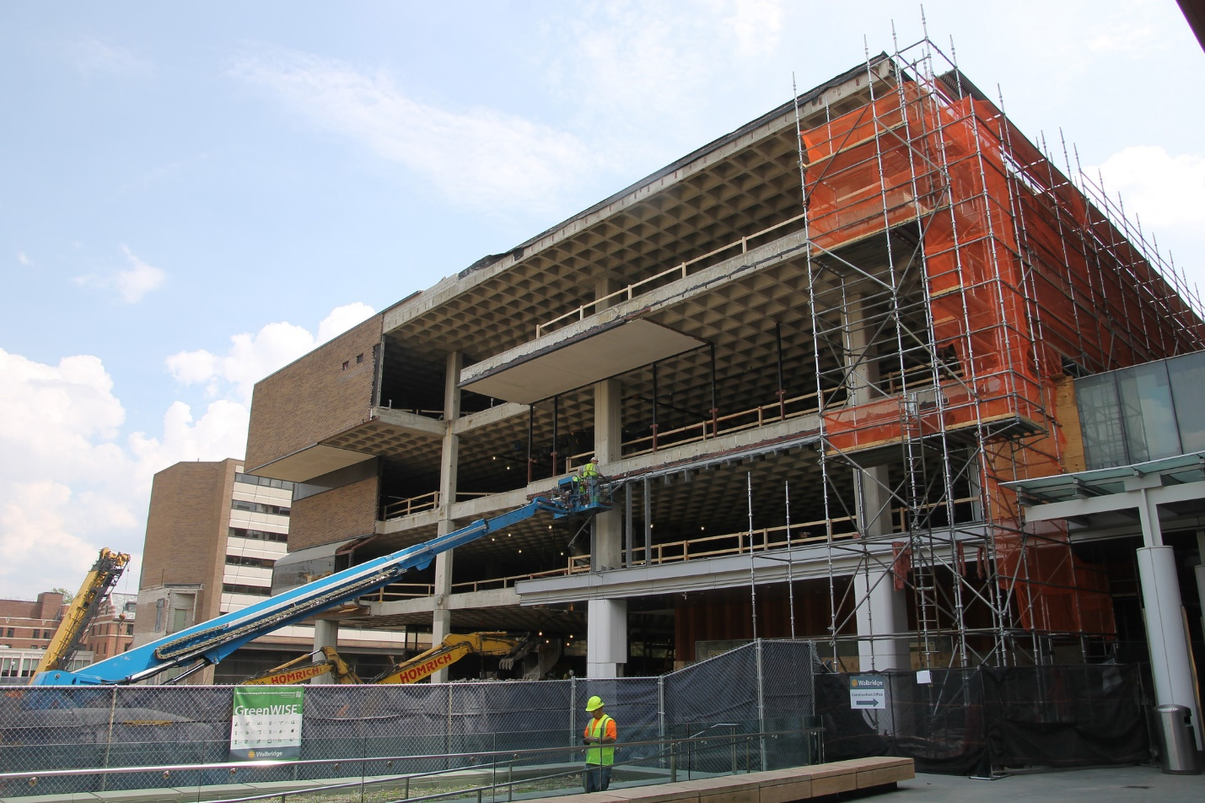
Becoming Kresge Library Services
So why did we change our name in 2014 to “Kresge Library Services?”
Major construction project at Ross saw our space reduced from 27K square feet to 5K.
Collection space reduced from 70K vol to 200.

Slide 38
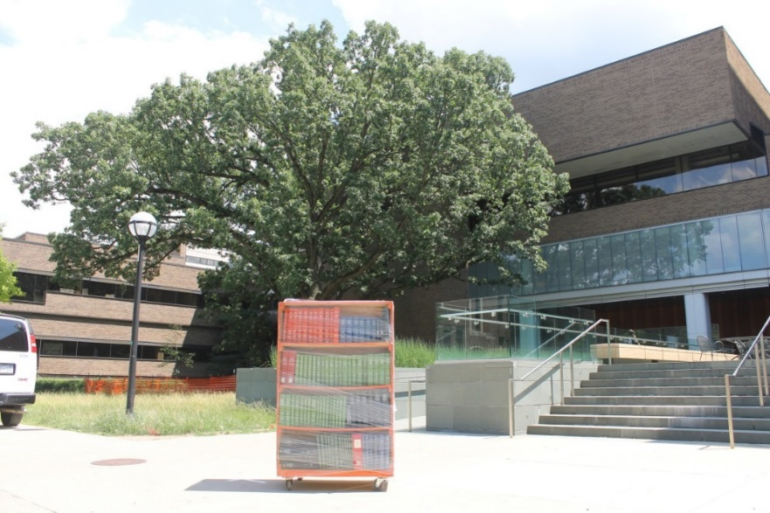

Becoming Kresge Library Services
Shifting from library as place to library as service.
Creating an “ethereal library”
Entrepreneurial Thinking involves:
  New approach to a new (or old) problem
  New market opportunity
  Creative thinking
  Empathetic focus (Design Thinking)
  Willingness to fail
Entrepreneurial Libraries do not have an exit strategy!

Slide 39
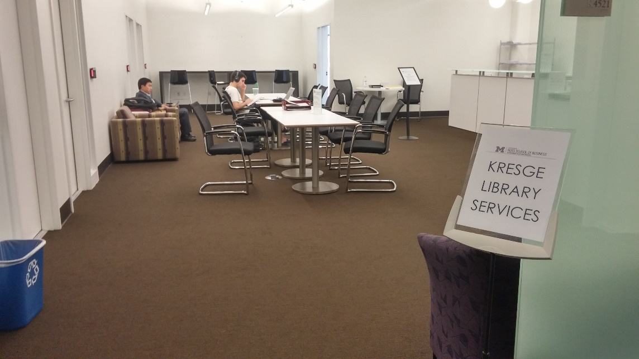
Becoming Kresge Library Services
“A completely re-thought Kresge Library Services, transitions from a collection of physical reference materials to a full suite of information resources and research services, guided by expert staff.” – Ross Dividend, Fall 2016 (Ross Alumni Magazine)
The library did not close, but become virtually unrecognizable.
You do not always choose your path, but how you respond.
The NEW Kresge Library Services at the University of Michigan

Slide 40

Becoming Kresge Library Services
At Kresge, the “Ethereal Library’s” value proposition is:
  Live within the restrictions of virtually no collection space.
  Figure out new collaboration mechanisms to serve our community.
  Forget the dead, take care of the living!
If you are service-oriented, then you can survive these dramatic changes!
Squirrel at the University of Michigan, Ann Arbor

Slide 41

Becoming Kresge Library Services
Focus on what we can do vs. what we have done.
  Made decisions like not bringing back course reserves – do not have the space to manage it.
  Still have evening reference via chat and email – all done remotely.

Slide 42
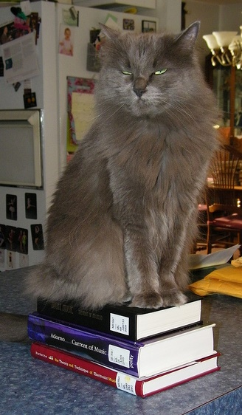
Becoming Kresge Library Services
Embrace the change
NOT a library problem of the 21st century.
Changes in the last 50 years:
  Copy cataloging
  Local online catalogs & shared systems
  Expanded access (TOC, more subject headings)
  Shared catalogs (MeLCat, etc.)
  Discovery layers
  Working papers management → digital repositories
  Coffee and food in the library
How many staff are checking in serials?
Change is the only constant!
Wanda Hates eBooks

Slide 43
Patron-Driven Services and the Power of Yes
Patron-Driven Services is a somewhat new way of thinking.
So much of the library literature has been focused on figuring out how to get patrons to use our services
Maybe…JUST MAYBE…we are providing the wrong service
Are we offering what they want?
Patron-Drive Acquisition is a very common theme among collection development librarians. Why buy books that have a 50% chance of NEVER being used (Academic problem) – instead let the patrons decide
Buy just in time resources vs. just in case

Slide 44
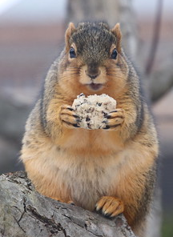
Patron-Driven Services and the Power of Yes
Patron-Driven Services (PDS) is the same model:
  Being more open to what our community needs
  Listening to what they are asking for
  Not fearing success (which brings more people to the library)
  Being viewed as a facilitator, not an obstacle
  Seeking out the ‘high-class’ problem (vs. the ‘low-class’ one).

Slide 45

Patron-Driven Services and the Power of Yes
Low-Class Problem questions:
  How do we get people to the Reference Desk?
  How do we get people to check out books (that we select)?
  How do we get people to use electronic resources that we select?
  How do we get people into our classes & programs?

Slide 46

Patron-Driven Services and the Power of Yes
High-Class Problem questions:
  How do we build capacity to meet our patron needs?
  How do we get expand the space to fit all the people into our library?
  What services might we stop doing to meet the reference needs of our patrons (embedded librarianship)?
  How do we embrace technology as our patrons use it?

Slide 47
Patron-Driven Services and the Power of Yes
Problem with “YES” can be that we lose ownership of the transaction
HOWEVER, what we lose in ownership, we gain in creating an advocate
With YES, we can create “Boosters and Ambassadors” for the library and the organization
  Has love (not like) for the service
  Has been able to get some unique service or interaction with the organization
  Has had an amazing experience that is worth sharing
  Has been told “Yes…we can do that”

Slide 48

Patron-Driven Services and the Power of Yes
Managing Expectations
“No organization has become great or maintained greatness by managing expectations” – me (lots of times)
No organization has ever developed passionate users by managing expectations
This is the time when poor customer service is winning!

Slide 49
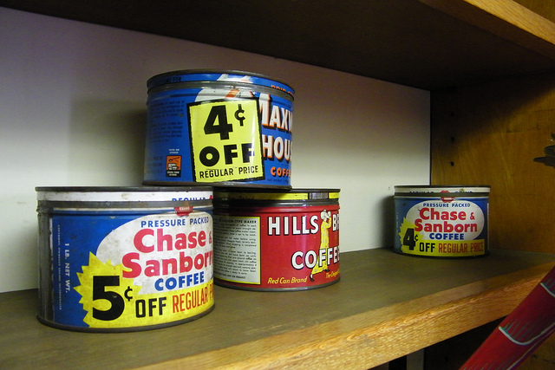
Patron-Driven Services and the Power of Yes
Heed the lessons from Chase and Sanborn!
An early market leader for home coffee, they instituted small changes to the product to reduce the cost.
The collective effect of these cuts was destroying the quality of the coffee
The Race to the Bottom!

Slide 50


Patron-Driven Services and the Power of Yes
What book do we want to model?
Graphics by Kelly Burr, University of Michigan

Slide 51
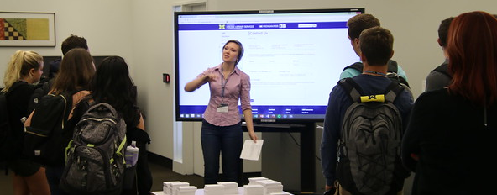
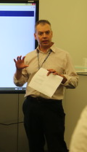
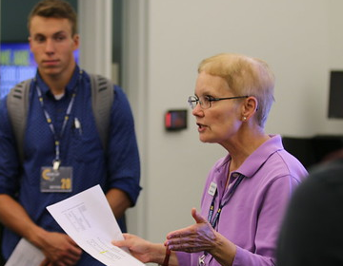
Patron-Driven Services and the Power of Yes
Power of Yes at Kresge Library has enabled us to be the customer service champs at Ross
Power of Yes has brought to us new projects and opportunities that we would not have gotten before
People WANT to work with us – not have to
And when the library morphed into a service unit – it kept us functioning!

Slide 52
Closing Thoughts
What does hospitality mean at Kresge?
  It means serving the students, faculty and other staff the best we can
  It means listening to their needs without considering what other libraries are doing
  It means not being bogged down with what other departments or libraries are doing
  It also means that we cannot take on everything – right now, that is finding students places to study.

Slide 53

Closing Thoughts
Factors beyond your control (especially space and budget) can easily thwart enthusiasm for providing service
However, we can never be expected to do more than our budget and space allow – Focus on what you CAN do!
Our world right now is fixated on Coronavirus (COVID-19). We do not know what is happening – but we have to be ready no matter what.

Slide 54
Closing Thoughts
It means that no one will EVER get in trouble helping our community
It means that the customer is always our first → “I am Third”
It also means that we cannot do all things for all people – but that cannot be a deterrent from doing anything!
“Do we provide a 4 star service when a 3 star service will do?” – Former dean at Ross School of Business

Slide 55
Closing Thoughts
*Note: On a scale from 1 (poor) to 7 (excellent) – 2017 scale to 5 (and adjusted)
2018 & 2019….don’t ask….

Slide 56
Closing Thoughts
Exit Survey Responses from MBA Grads
  “Another gem at Ross. Whenever I have asked Kresge for help (in person or remotely through Meebo), I have never been disappointed. They helped me greatly during my internship.
  "Best thing about Ross hands down.“
  "The librarians are amazingly responsive and supportive. I will miss them and their resources.“
  "Kresge Library staff is awesome! They answer to the e-mails promptly even during the weekend and they are very helpful. The chat is also very useful.“
  "Kresge library staff rocks! One of the best things about Ross.“
We did poorly in the survey during construction – where did the library go???

Slide 57
Closing Thoughts
Balancing Hospitality of our community and organizational change can be difficult.
It is difficult to be hospitable is you do not feel that you are treated well or fairly.
It is the manager’s role to ensure that staff have an opportunity to share thoughts and opinions about what is going on.
But it’s the manager’s role to ensure that the unit remains relevant and functioning.

Slide 58
Closing Thoughts
Be careful about Metrics & Dashboard indicators
Numbers are used (especially in politics) as props!
Numbers can mean so many different things
  Batting average of .406 is amazing!
  Winning percentage of .406 is not good – but maybe it is justified
  Fielding percentage of .406 is really awful!

Slide 59
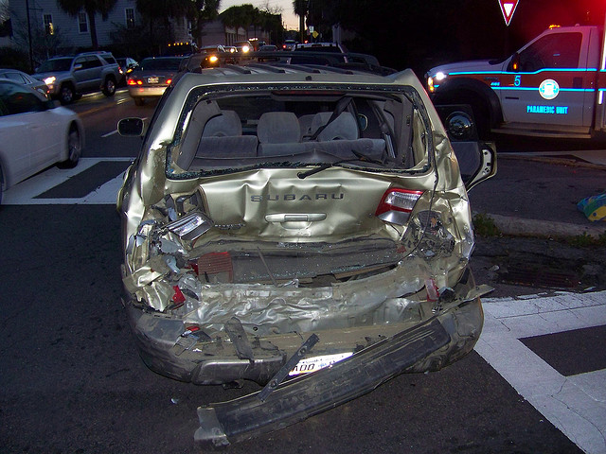
Closing Thoughts
Sometimes it does not matter what your dashboard shows….

Slide 60
Thank You
Questions?
Slides:
http://tinyurl.com/cgs2020ssldl
Corey Seeman
cseeman@umich.edu
http://www-personal.umich.edu/~cseeman/index.html

