Slide 1
Navigating Longitudinal Collections with Colectica Portals
NACDA Director Dr. James McNally, NACDA Project Manager Kathryn Lavender, and Co-Founders of Colectica, Jeremy Iverson and Dan Smith.
August 20, 2020

Slide 2



Today’s Agenda
About NACDA and Longitudinal Data
About Colectica
Explore the Portals
How to create customized datasets and codebooks
Benefits of using the portal vs benefits of downloading from NACDA site

Slide 3


About NACDA
Dr. James McNally, NACDA Director
Kathryn Lavender,
NACDA Data Project Manager
nacda-aging.org
Focus on archiving & sharing longitudinal gerontological research data
Part of ICPSR and ISR at the University of Michigan
35+ years of experience
Supported by the National Institute on Aging (NIA)

Slide 4

NACDA Program on Aging
NACDA has spent the past 40 years identifying, gathering and organizing data on aging and the aging life course so we can archive and share these resources with the research community.
NACDA currently supports approx. 1,600 individual studies on ageing and health and adds new studies to our collections each year.
NACDA is part of ICPSR
Twitter @NACDA_Aging

Slide 5
Why is Longitudinal Data Important?
They are effective in determining variable patterns over time.
They can provide high accuracy when observing changes.
They are very effective in doing research on developmental trends.
They are more powerful than cross-sectional studies.
They are highly flexible.
https://futureofworking.com/11-advantages-and-disadvantages-of-longitudinal-studies/

Slide 6
Why is Longitudinal Data the Way It Is?
Longitudinal data is often prepared and distributed in independent waves.
This approach adds considerable start up costs to researchers using these data.
History of Longitudinal Data:
The development of longitudinal data sharing is driven by past limitations that have hardened into habit.
  Computational limitations
  Analysis software limitations
The pressure to release waves quickly make it easier to release each wave independently.
More emphasis has been placed on releasing the data rather then on the development of essential documentation to encourage across wave use.

Slide 7
Efforts to Manage Longitudinal Data
Crosswalks - This approach is one of the earliest attempts to structure multi-wave data in a consistent manner; typically a static approach.
Question Concordance - This is dynamic refinement to a crosswalk.
Scripts - Prepared merging scripts have become less common with time. (https://support.sas.com/resources/papers/proceedings/proceedings/sugi31/140-31.pdf)
Special developmental project -
  RAND HRS - https://www.rand.org/well-being/social-and-behavioral-policy/centers/aging/dataprod/hrs-data.html
  GATEWAY TO GLOBAL AGING DATA - https://g2aging.org/

Slide 8

New Initiatives in Longitudinal Data
NIA has placed a new emphasis on the management of longitudinal data.
RFA-AG-17-016: Archiving and Sharing of Longitudinal Data Resources on Aging (U24) July 13, 2016
This RFA required that NACDA change its focus and mission to explicitly support the development of tools and approaches to facilitate the use of longitudinal data.
NACDA’s relationship with Colectica to establish DDI-Lifecycle capacities for high priority NIA is an example of this work.

Slide 9
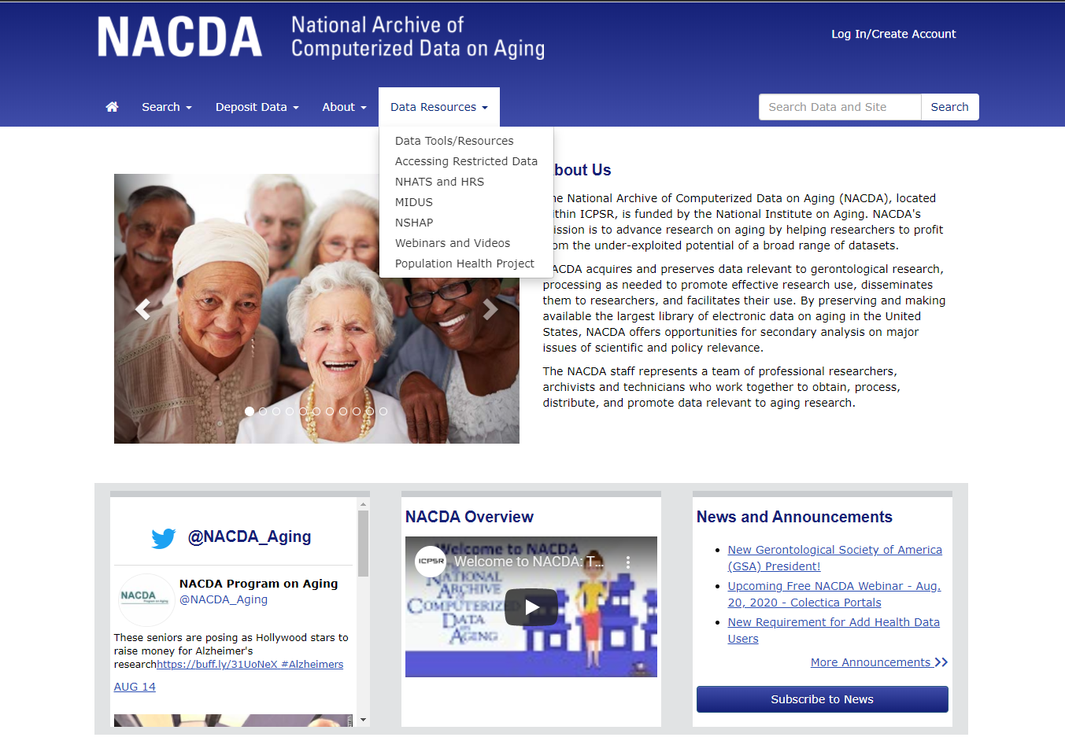
Check our site to find helpful info about longitudinal data, special collections, and more!
Notes:
Check out our site – go to the “Data Resources” tab and find helpful info about longitudinal data, special collections, and more!

Slide 10


About Colectica
Jeremy Iverson
Dan Smith
colectica.com
Statistical and survey data documentation software
Open standards
National statistics, longitudinal studies, research data

Slide 11
Data Publishers use Colectica to
Catalog longitudinal datasets
Document data
Publish interactive web portals, codebooks, data dictionaries

Slide 12
Goals
Let researchers discover data across datasets
Understand the data and its provenance
Allow the data to be more widely used and cited

Slide 13
The Colectica Platform
Colectica Desktop Tools
  Create, ingest, manage, and edit metadata
  Usable DDI 3 for end-users
Colectica Repository
  Centralized, authoritative, metadata store built on DDI 3, ISO 11179, and Web Service standards
Colectica Portal
  Search and browse metadata from Colectica Repository
Colectica SDK
  Allows programmers to work with DDI 3 and interact with Colectica Repository

Slide 14
Unique Features
Variable level documentation and lineage
Concordance, across time and across studies
Based on open standards
  DDI Lifecycle, GSIM, and more

Slide 15

NACDA Portal Demonstration
Single study concordance
Cross study concordance
Search
Basket
Data Extract

Slide 16
Metadata Preparation
1. Single study concordance for NHATS
2. Single study concordance for NSHAP
3. Create a common set of conceptual variables
4. Map NHATS and NSHAP conceptual variables to the common conceptual variables

Slide 17
Metadata Structure:
Single Study

Slide 18
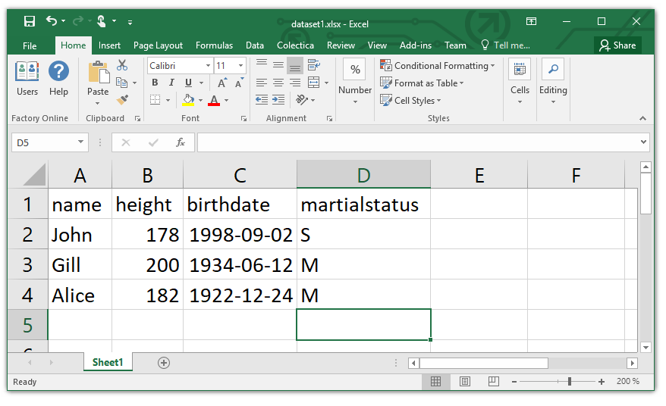
What is a variable?
Notes:
What is a variable In DDI?
We will start to look a a small example dataset in excel
18

Slide 19
Example: dataset1
name | height | birthdate | maritalstatus
John | 178 | 1998-09-02 | S
Gill | 200 | 1934-06-12 | M
Alice | 182 | 1922-12-24 | M
Notes:
The data is divied into columns where each represent a recorded value.
The whole purpose is to tie the variables together which are measuring a comparable topic.
Should we list what other domain use to describe a variable e.g. column in excel, relational database, attribute in object-oriented programing etc.
Start with a table of data- a variable is a column of data.
When people are approaching DDI they think of data as records of data
Are we missing info unless we explain why we have a rectangular file? How do you say that each row is related to the same column? Are we making an assumption– show an example and explain that we asked each people there marital status each row is a person.
We can visualise this as a table
Discuss as item type level in relation to other items rather than details about each.
Repeated measures in a column (not associated these measures with anything yet)
19

Slide 20
Different variable representation types
text | numeric | date | code
name | height | birthdate | maritalstatus
John | 178 | 1998-09-02 | S
Gill | 200 | 1934-06-12 | M
Alice | 182 | 1922-12-24 | M
Notes:
The variables have three obviously different types- text, numbers, dates and codes.
There are several more types, but in the following examples of a variable cascade we will use code, text and numreric
20

Slide 21
Variable with code representation
name | height | birthdate | maritalstatus
John | 178 | 1998-09-02 | S
Gill | 200 | 1934-06-12 | M
Alice | 182 | 1922-12-24 | M
Notes:
Maritalstatus have a coded representation
21

Slide 22
Variable - code representation
maritalstatus codes
code | category
S | Single
M | Married
maritalstatus
(variable)
Notes:
maritalstatus point to a code list with the enumerated value.
The variable have a code list:
S = Single
M = Married
22

Slide 23
Three similar datasets
dataset1
name | height | birthdate | maritalstatus
John | 178 | 1998-09-02 | S
Gill | 200 | 1934-06-12 | M
Alice | 182 | 1922-12-24 | M
dataset2
firstname | personheight | dateofbirth | maritalstatus2010
Bob | 70 | 1995-09-02 | S
Lars | 76 | 1954-06-21 | M
Gerald | 66 | 1972-11-23 | S
dataset3
firstname | imperialheight | dateofbirth | maritalstatus2018
Lisa | 69 | 1995-09-02 | S
Bart | 75 | 1954-06-21 | M
Homer | 68 | 1972-11-23 | D
Notes:
Three datasets with similar variables.
Note: some variable names are different and the values are a bit different
23

Slide 24
Three similar datasets - code representation
dataset1
name | height | birthdate | martialstatus
John | 178 | 1998-09-02 | S
Gill | 200 | 1934-06-12 | M
Alice | 182 | 1922-12-24 | M
dataset2
firstname | personheight | dateofbirth | maritalstatus2010
Bob | 70 | 1995-09-02 | S
Lars | 76 | 1954-06-21 | M
Gerald | 66 | 1972-11-23 | S
dataset3
firstname | imperialheight | dateofbirth | maritalstatus2018
Lisa | 69 | 1995-09-02 | S
Bart | 75 | 1954-06-21 | M
Homer | 68 | 1972-11-23 | D
Notes:
Two datasets sharing same code list and the third have a new code list.
They are related in some way, but how do we relate these together- the variable cascade helps us do this.
24

Slide 25
Variables re-using sets of codes
maritalstatus
(variable)
maritalstatus codes
code | category
S | Single
M | Married
maritalstatus2010
(variable)
maritalstatusplus codes
code | category
S | Single
M | Married
D | Divorced
maritalstatus2018
(variable)
Notes:
The first two datasets share the same codes while the third have its own sets of codes
25

Slide 26
Documenting comparabilities among variables
Conceptual variable
Common variable specification without a representation
maritalstatus
(conceptual variable)
Represented variable
Common variable specification with a code representation
maritalstatus
(represented variable)
maritalstatusplus
(represented variable)
Variable
Variable specification within a dataset context
maritalstatus
(variable)
maritalstatus2010
(variable)
maritalstatus2018
(variable)
Notes:
What is variable cascade?
Three Different (distinct) sets of data with a different variables all measuring marriage status.
Represented variables link variables which are directly comparable.
Same representation of the value domain. It doesn’t care about the question asked- only the value domain.
The represented variable is a way to measure marriage and so links to the marriage conceptual variable.
Represented variable means that they are not directly comparable but can be made to be comparable.
The third dataset has a different code list (i.e. value domain) and so it needs a new representative variable which then links to the conceptual variable.
Concept variable defines a measure without defining the measurement.
Value domain = Variable representation in DDI
26

Slide 27
Benefits of the variable cascade structure
Specify comparability across variables allows comparison across datasets
Structure for facilitating harmonization across datasets / studies
Variable names and representations can change
  Underlying, unique DDI ID to create explicit relationships
Documenting changes over time
Planning for future data collection to ensure comparability
Notes:
Benefits
Comparability and provenance.
Lineage of the data/provenance
Identify comparable data
Compare how the response values have changed over time or over different sources
Used to manage to change and comparability
Supports people working on harmonisation (gives you the structure to describe the variables and decide whether you can harmonise them or not)
Useful resources
Daniel Gillman EDDI 2017: The DDI-4 Variable Cascade and Datum-Centered Approach
Colectica docs site - https://docs.colectica.com/designer/manage-content/data/harmonize-variables/
Questions/answers
What level do we publish?
it depends on how you want to display the datasets.
All the variables could have the same variable name, but in DDI they will have a different identifier. It is up to you which you see.
We should always have the conceptual and represented in place, even if there is no change in the code value.
DDI separates the conceptual variables and representative variable is so that someone can query the relationships without having to look at every variable and value domain which is time consuming and also not reliant on a machine- as it is shows that person has decided that these are comparable.
Should there always be a new variable for each data collection- can they be the same variable?
It depends on how you describe the dataset- there is lots more info about a dataset then just its type e.g. who it’s measured about e.g. universe. If you have different datasets the people/household changes. If you have new dataset then it is usually a new instance variable. Specific to a datasets as the it contains other metadata e.g. time of collection. If you publish data every quarter the variable instance will be different each time.
If there is only one dataset- whey would you use represented and conceptual variables- If you want people to re-use it or to use with other study’s data then it is valuable to including the represented and conceptual variable.
Ideal world- create a concept then create a question for that. Which is linked to the represented and conceptual variable. – questions to be discussed elsewhere.
27

Slide 28
Metadata Structure:
Across Studies

Slide 29
Cross Study Concordance
Separate studies may have already mapped to separate sets of conceptual variables
Create common conceptual variables
  Allows third parties to perform concordance, without changing each study’s content
Map each study’s conceptual variables to the common conceptual variables
Notes:
Benefits
Comparability and provenance.
Lineage of the data/provenance
Identify comparable data
Compare how the response values have changed over time or over different sources
Used to manage to change and comparability
Supports people working on harmonisation (gives you the structure to describe the variables and decide whether you can harmonise them or not)
Useful resources
Daniel Gillman EDDI 2017: The DDI-4 Variable Cascade and Datum-Centered Approach
Colectica docs site - https://docs.colectica.com/designer/manage-content/data/harmonize-variables/
Questions/answers
What level do we publish?
it depends on how you want to display the datasets.
All the variables could have the same variable name, but in DDI they will have a different identifier. It is up to you which you see.
We should always have the conceptual and represented in place, even if there is no change in the code value.
DDI separates the conceptual variables and representative variable is so that someone can query the relationships without having to look at every variable and value domain which is time consuming and also not reliant on a machine- as it is shows that person has decided that these are comparable.
Should there always be a new variable for each data collection- can they be the same variable?
It depends on how you describe the dataset- there is lots more info about a dataset then just its type e.g. who it’s measured about e.g. universe. If you have different datasets the people/household changes. If you have new dataset then it is usually a new instance variable. Specific to a datasets as the it contains other metadata e.g. time of collection. If you publish data every quarter the variable instance will be different each time.
If there is only one dataset- whey would you use represented and conceptual variables- If you want people to re-use it or to use with other study’s data then it is valuable to including the represented and conceptual variable.
Ideal world- create a concept then create a question for that. Which is linked to the represented and conceptual variable. – questions to be discussed elsewhere.
29

Slide 30
One to one mapping
Common conceptual variable or group
maritalstatus
(conceptual variable)
Study conceptual variables
maritalstatus
(NHATS)
marstat
(NSHAP)
Study represented variables and variables
…
…
…
…
…
…
…
…
…
Notes:
What is variable cascade?
Three Different (distinct) sets of data with a different variables all measuring marriage status.
Represented variables link variables which are directly comparable.
Same representation of the value domain. It doesn’t care about the question asked- only the value domain.
The represented variable is a way to measure marriage and so links to the marriage conceptual variable.
Represented variable means that they are not directly comparable but can be made to be comparable.
The third dataset has a different code list (i.e. value domain) and so it needs a new representative variable which then links to the conceptual variable.
Concept variable defines a measure without defining the measurement.
Value domain = Variable representation in DDI
30

Slide 31
Many to one mapping
age
(conceptual variable or group)
Common conceptual variable or group
Study conceptual variables
age
(NHATS)
birthyear
(NSHAP)
birthmonth
(NSHAP)
Study represented variables and variables
…
…
…
…
…
…
…
…
…
Notes:
What is variable cascade?
Three Different (distinct) sets of data with a different variables all measuring marriage status.
Represented variables link variables which are directly comparable.
Same representation of the value domain. It doesn’t care about the question asked- only the value domain.
The represented variable is a way to measure marriage and so links to the marriage conceptual variable.
Represented variable means that they are not directly comparable but can be made to be comparable.
The third dataset has a different code list (i.e. value domain) and so it needs a new representative variable which then links to the conceptual variable.
Concept variable defines a measure without defining the measurement.
Value domain = Variable representation in DDI
31

Slide 32
Back to NACDA
harmonize.icpsr.umich.edu

Slide 33
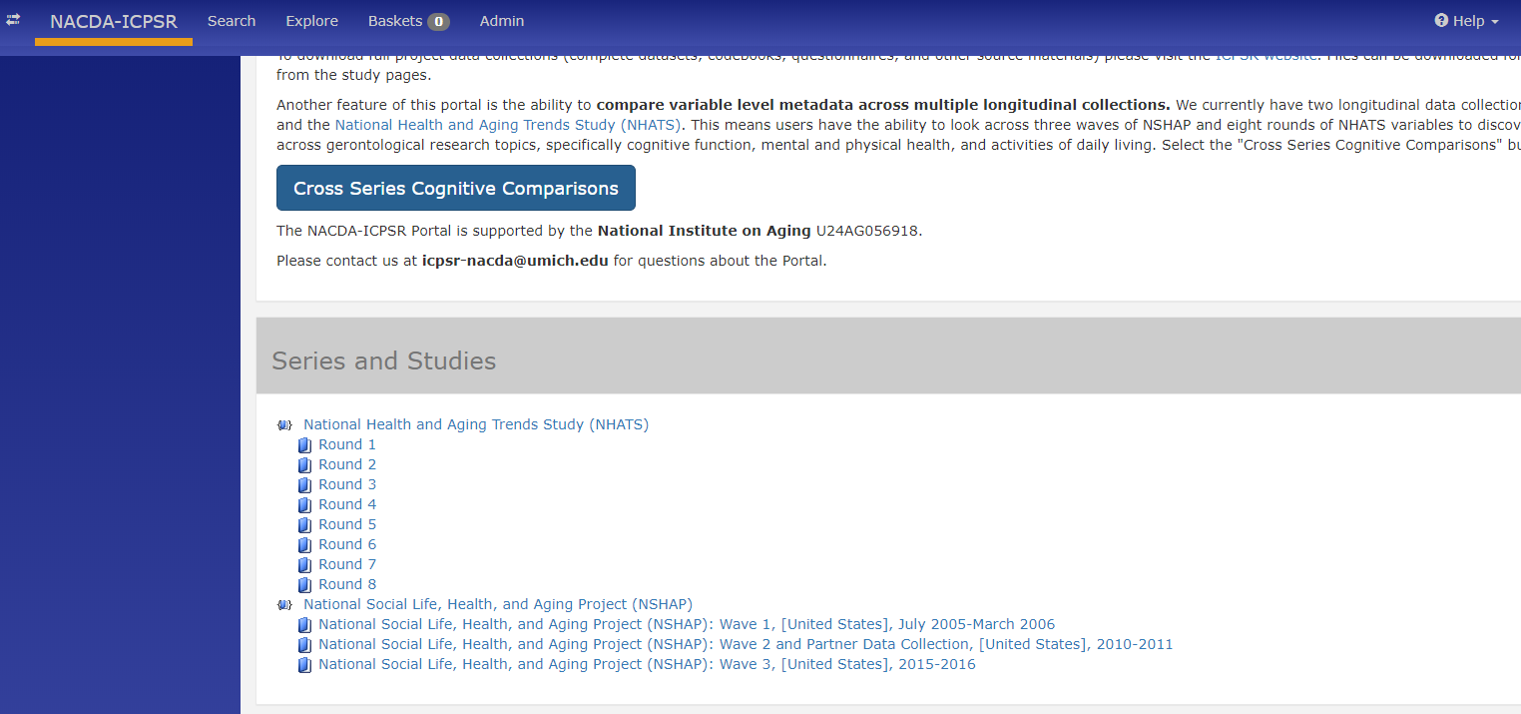
What Comes with the Portal Download?
Notes:
From the NACDA portal homepage – select the NSHAP series link .
The following variables will be included with any NSHAP custom extract:
WEIGHT_SEL - person-level weight (no non-response adjustment)
WEIGHT_ADJ - person-level weight (nonresponse adjusted)
STRATUM - (pseudo) sampling stratum
CLUSTER - (pseudo) PSU
INT_START - Interview Start Date
ID - Respondent ID
Survey Type

Slide 34
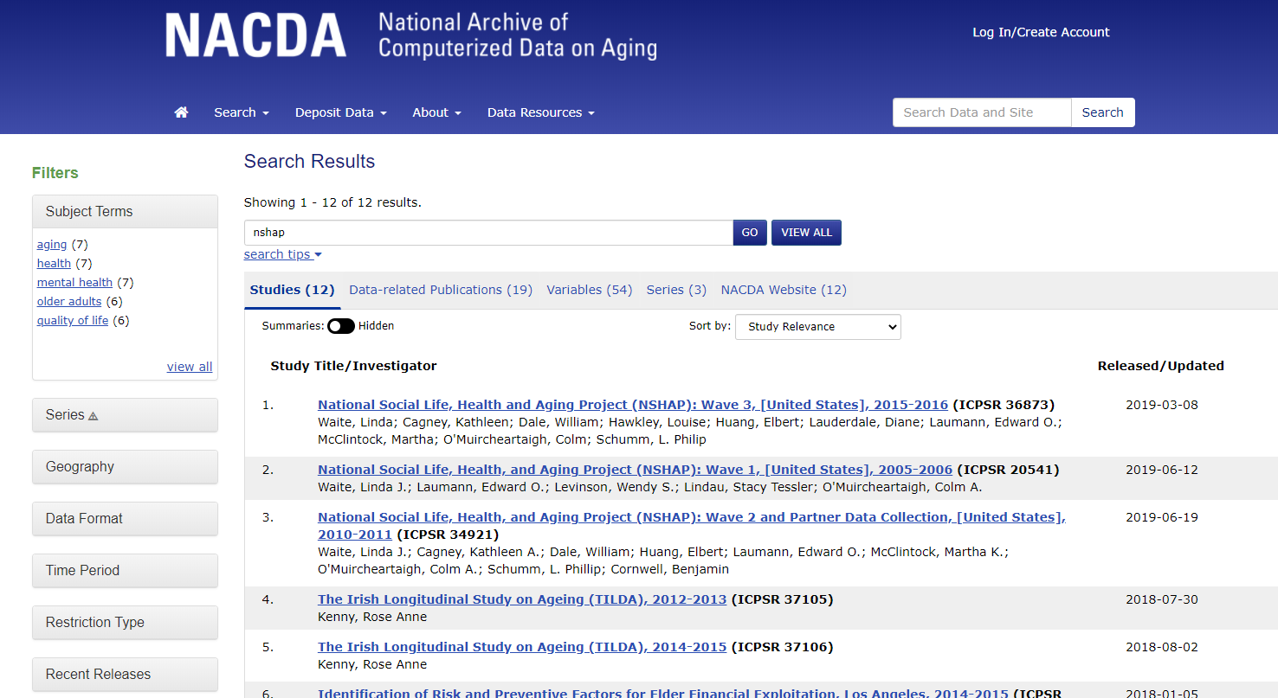
Notes:
Searching our site/accessing NSHAP from our site – you can search by keyword, view study results, variable results, related publications, and even our site announcements.

Slide 35
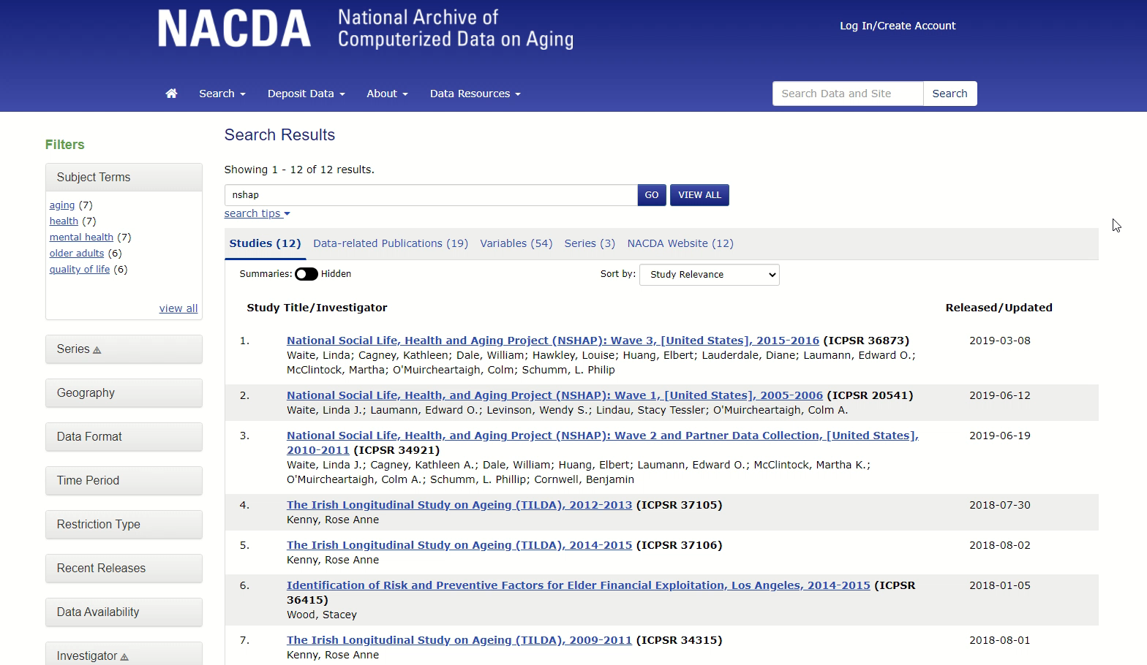
NACDA Portal – Series Description Page Variable Search
Notes:
Play recording

Slide 36
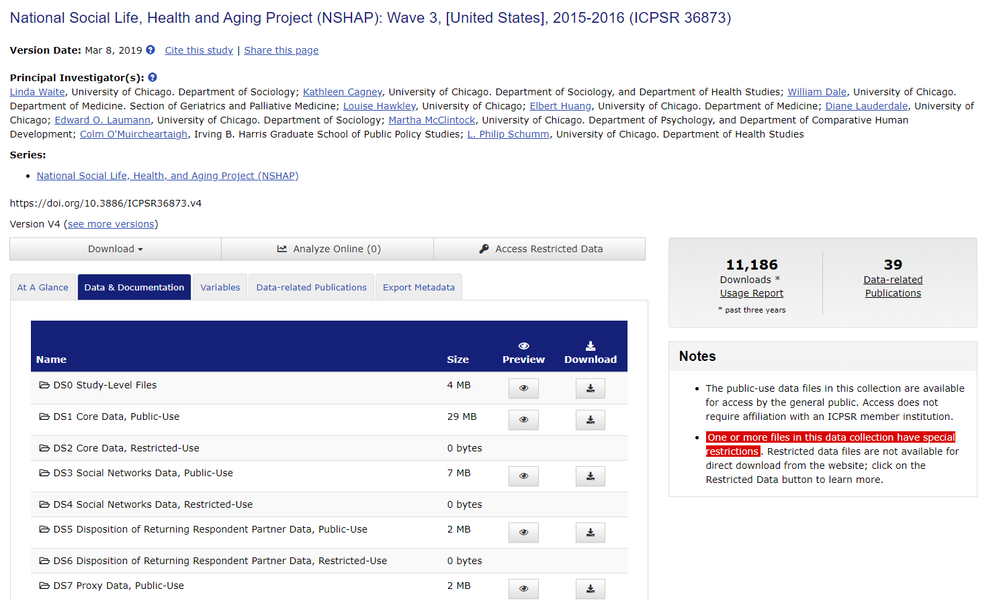
Downloading Data and Docs from NACDA
Go to the study page – you can download using the “Download” button on the left, or by going to the “Data & Documentation” tab and selecting specific datasets

Slide 37
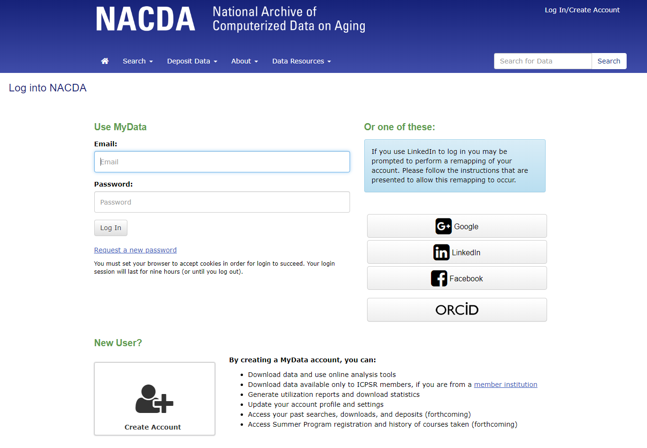
You Need to Register to Download
It’s free
Very little info is needed
We do not spam you or sell your data
Notes:
We have a video on our site about this, too.

Slide 38

Does my MyData Account get me access to the Portal?
No. Each longitudinal portal is hosted independently at this time, therefore, you must
register for each one.
https://giphy.com/gifs/robot-road-unlock-50OAJNulFBBrq

Slide 39

Why Does it Download as a Zipped Package?
Internal Infrastructure
  We need to support both single and multi dataset studies
Metadata reasons
  Important info in the docs
Notes:
Metadata reasons – we want to make sure you have the matching documentation to the data – it’s easy to lose track and get mixed up, especially if you are downloading multiple data collections.

Slide 40
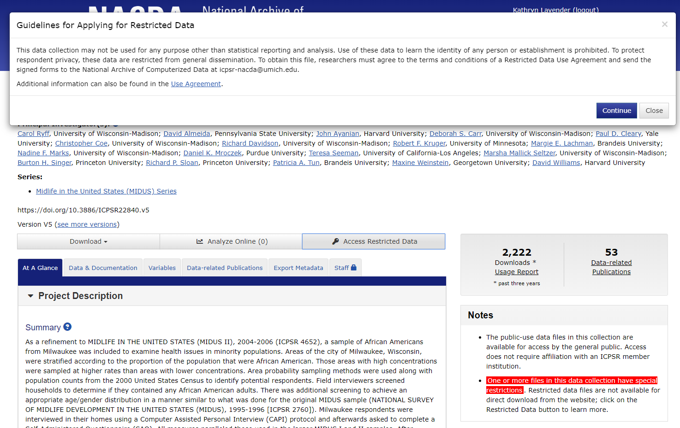
Accessing Restricted Data- Study Page View

Slide 41

Accessing Restricted Data - General
Download the agreement
Read it
Complete required fields
Provide additional documentation, as needed
Print
Sign it
Scan it
Email it to NACDA
Digital signatures are also acceptable with COVID related limitations in mind.
We also have a short video on our site about the process.

Slide 42
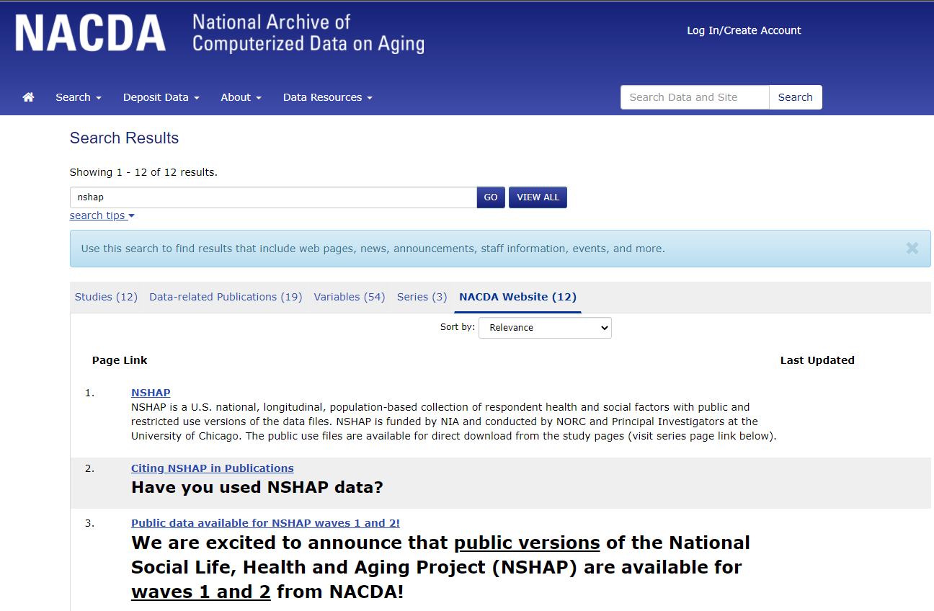
Check Our Announcements Page
And Subscribe to Our Newsletter!
Notes:
Searching our announcements for study/NSHAP related info

Slide 43
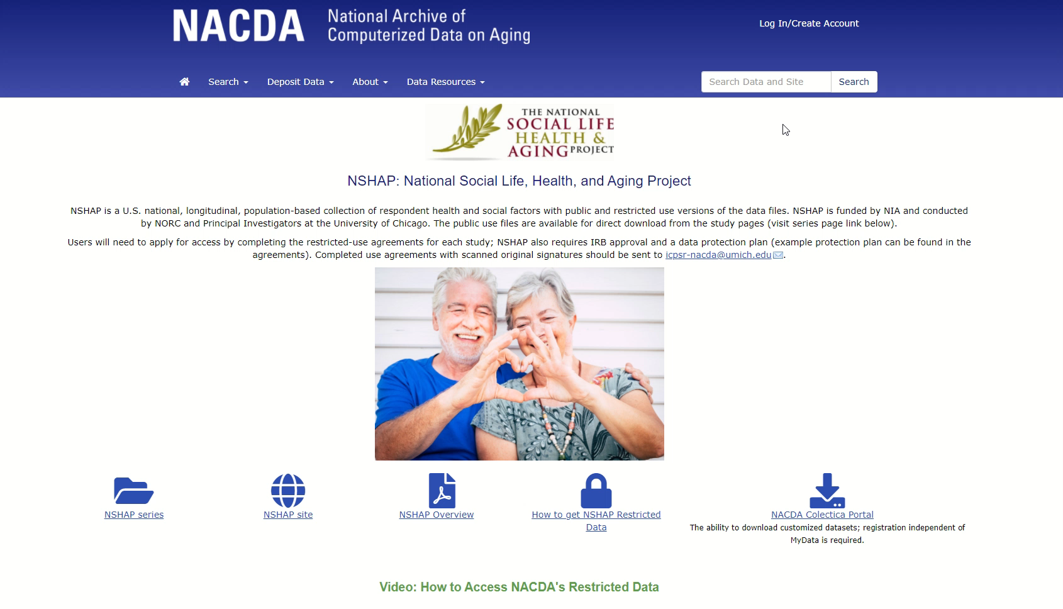
Go to Data Resources tab ->select NSHAP
Notes:
Play recording - NSHAP page from NACDA site – where to find all NSHAP resources; we also have one of these for MIDUS.

Slide 44
Recap
NACDA website takeaway:
NACDA is the source for whole MIDUS and NSHAP datasets, among thousands of other aging related data
  Download and merge whole data files and accompanying docs
Wide variety of file formats available
List-like variable display
Public and Restricted data available
Access relevant news and announcements
NACDA Colectica Portal takeaway:
Search and discover across longitudinal variables in a table-like display
Variable comparisons across multiple waves and studies (pending more!)
Customized data and documentation extracts
NHATS metadata comparison with NSHAP
Public data only
Notes:
Both include user support, both powered by DDI.

Slide 45
Thank you!!

