Slide 1
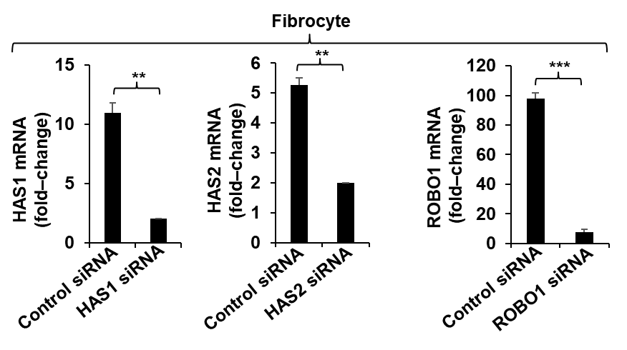
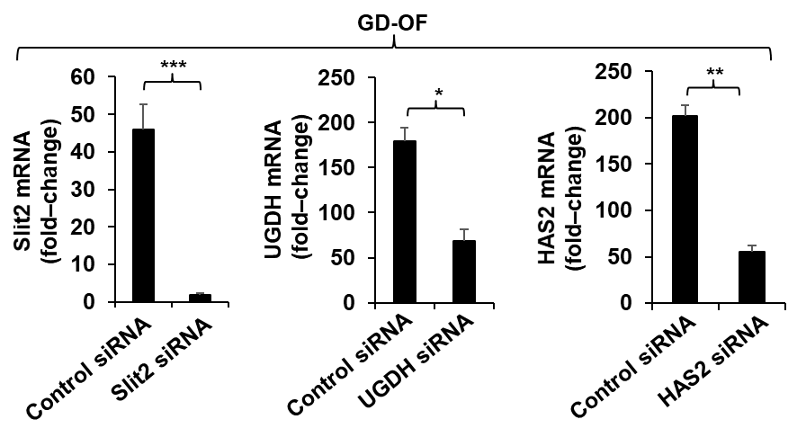
Sup Fig 1
(A)
(B)
(C)
(D)
(E)
(F)
Figure S1. Effectiveness of siRNAs knock down on targets HAS1, HAS2, UDPGD, ROBO1, and Slit2. Confluent fibrocyte and GD-OF cultures were transfected with control siRNA (3 µg) and respective target siRNA (3 μg) for 3 d using CD34⁺ neuclofection kit, with the U-033 program. RNA was extracted from monolayers, and reverse transcribed cDNA was subjected to RT-PCR for the target indicated. Data are expressed as mean + SD, n=3; *, p<0.05; **, p<0.01; ***, p<0.001. Three independent determinations were performed.

