Slide 1
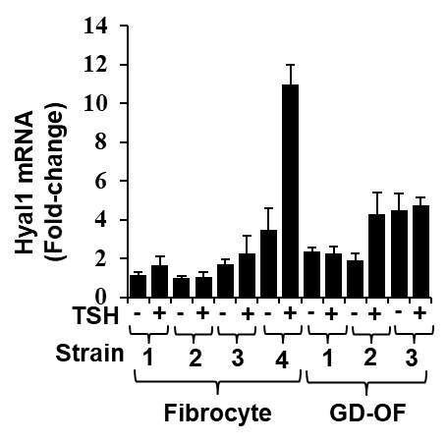
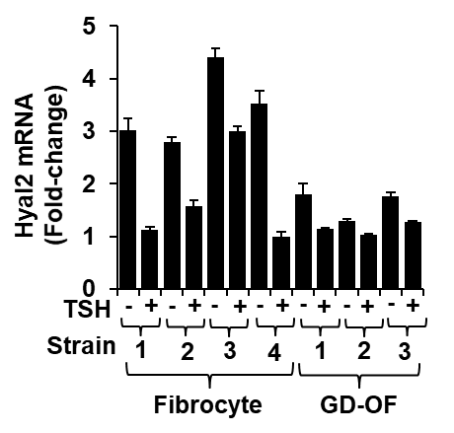
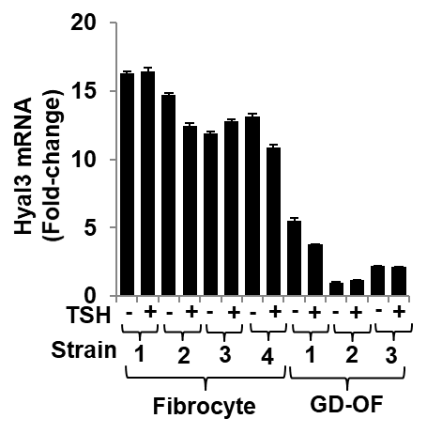
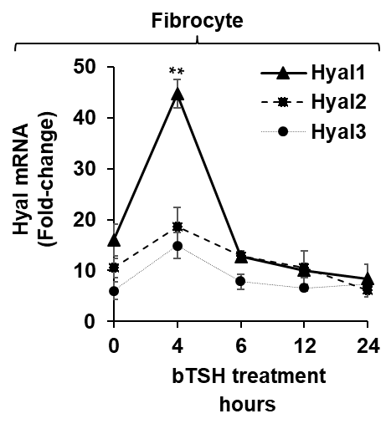
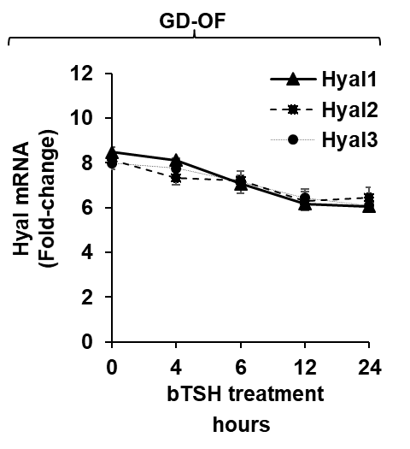
(A)
(B)
(C)
Sup Fig 2
(D)
(E)
Figure S2. Relative basal and bTSH-dependent expression of hyaluronidase (Hyal) isoenzymes in fibrocytes and GF-OF. (A-C) Confluent cultures were incubated with DMEM supplemented with 1% FBS for 18hr, and then were untreated or received bTSH (5 mIU/mL) for 6 h. (D,E) Cultures were treated with bTSH for the graded intervals indicated along the abscissas. RNA was extracted from monolayers, reversed-transcribed and subjected to RT-PCR for the targets indicated. Levels were normalized to respective GAPDH levels. Data are presented as mean ± SD of triplicate independent determinations from a single experiment, representative of three conducted. **, p<0.01.

