Slide 1
Where is That Picture of Aunt Cindy? Organizing, Protecting and Sharing Your Digital Images
Corey Seeman
University of Michigan
tinyurl.com/##
https://sites.google.com/view/squirrelman/
https://www.flickr.com/photos/cseeman/
Milan District Library
September 17, 2020

Slide 2
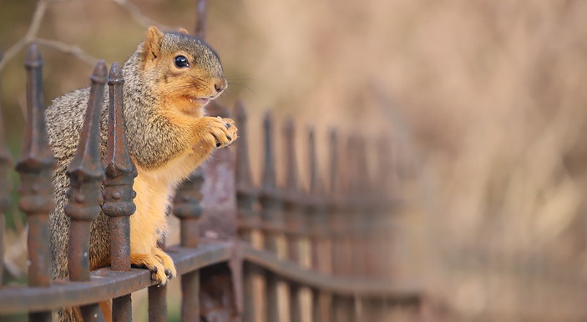
Presentation Overview
Introduction
Key Digital Library Services
Why flickr?
Three Key Things – Organize, Describe, Organize
Your Images – Your Rights
Additional resources

Slide 3
Presentation Overview
This program will introduce you to photo sharing services that are available from companies such as Google, Apple, facebook and flickr (among others) and how to organize them for easy retrieval. We will look at ways organize, backup and share pictures with friends and family. We will also explore how images are found by others (using tags or searchterms), if you want to share more broadly. This could be the perfect session if you want to do something with all those pictures on your phone or clogging up your SD card!
Key Takeaways
  Share my photography philosophy
  Understanding where to store photos on the cloud
  Best practices to make photos easy to find
  Best way to manage them for the long haul
  Better appreciation for squirrels!

Slide 4
Introduction
About Corey
Librarian at the University of Michigan (since 2005)
Formerly, an archivist at three institutions (including the National Baseball Hall of Fame & Chicago Historical Society).

Slide 5
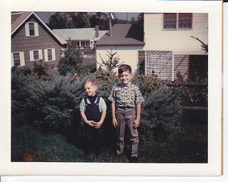
Introduction
Passionate photographer as a child.
Done in by the double cost of photography (film and developing).
Rekindled my passion for photography with my first digital camera back in 2007.
My older brother and me, in Matawan, NJ
(c. 1968)

Slide 6
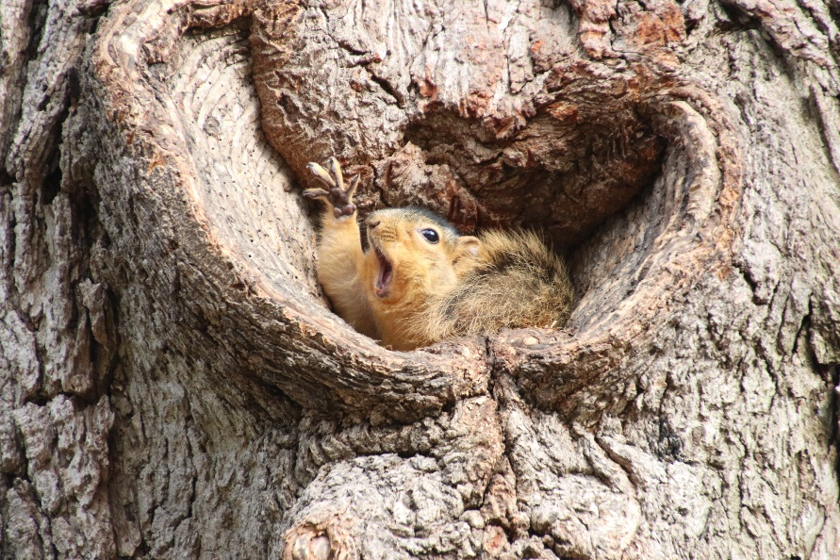
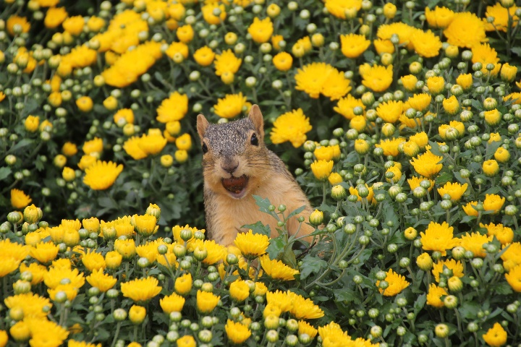
Introduction
Passionate amateur photographer
All about the squirrels
Comedy Wildlife Award Highly Commended (2019)
Washington Post Squirrel Week Contest 2nd place & Detroit News Celebrate Michigan winner

Slide 7
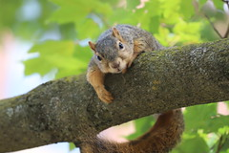
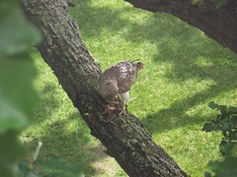
Introduction
Huge user on flickr
https://www.flickr.com/photos/cseeman
I have participated in Project365 (one photo every day) since June 12, 2008
Almost never without a camera!

Slide 8
Key Digital Library Services
flickr – flickr.com
SmugMug - Smugmug.com
Instagram - instagram.com
Imgur - imgur.com
Google Photos - photos.google.com/
facebook – facebook.com
Apple Photos - www.apple.com/ios/photos/
Amazon Photos - www.amazon.com/Amazon-Photos
Shutterfly & Snapfish (and other print/gift focus)
It’s a constantly changing environment!

Slide 9
Key Digital Library Services
Name | Cost (relative) | Benefit / Drawback
flickr | Free account; Pro account ($49.95/year) gives you more features & more than 1000 pictures. | Great community of photographers. Easy way to share and integrate into social media*
SmugMug | Primarily for professionals. Fee to use service. | Owners of flickr – good if you are interested in photography business.
Instagram | Free account. | Maybe the biggest name in photo sharing. Designed to work with your mobile device.
Imgur | Free basic account. | Can get lost among cat GIFs
Google | Free account, more storage needs costs per month. | Integrates with your Android phone/device; great backup (cloud).

Slide 10
Key Digital Library Services
Name | Cost (relative) | Benefit / Drawback
facebook | Free with account | Good for sharing with your network only.
Apple | iPhone/iPad users get 5GB free storage. Can upgrade from there. | Integrates with your Apple phone/device. Easy to share and edit. Typically great cameras on these devices. Like Google, you can find primarily your pictures. Backup all to the cloud if you can!
Amazon | Free with Prime account or pay per storage needs | Relative new entry among photo sharing.
Shutterfly Snapfish (etc) | Free with account | Easy printing, somewhat odd sharing (but possible)

Slide 11
Why flickr?
It is a community of photographers.
It is about as much your photos as it is for ones that are shared by others.
You can find a group (or groups) that is interested in just about anything.
Excellent sharing and findability.
Easy way to create albums and use tags to find pictures.

Slide 12

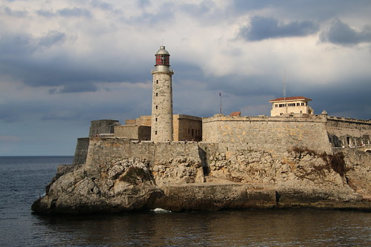
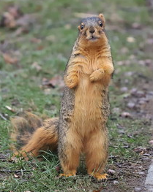
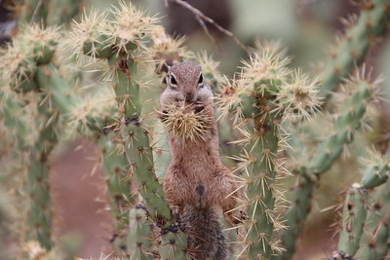
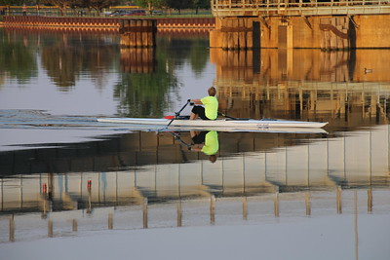
Why flickr?
  You can share any image on the site.
  Pictures I have taken

Slide 13
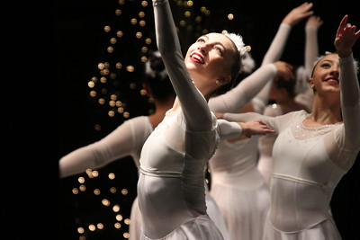
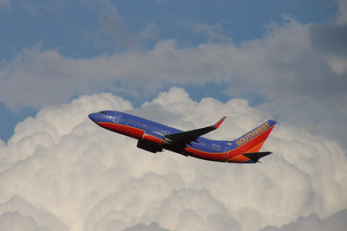
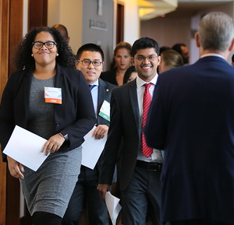
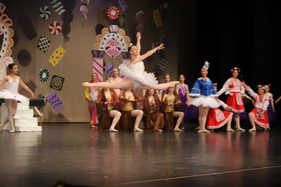
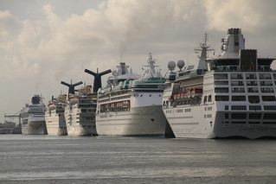
Why flickr?
  You can share any image on the site.
  Pictures I have taken

Slide 14

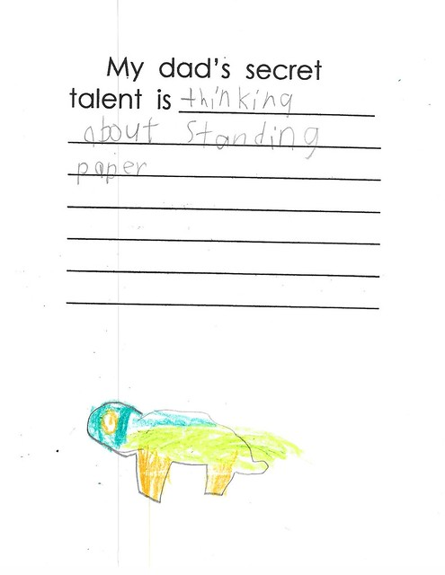

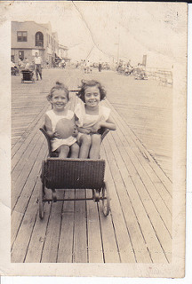
Why flickr?
  Pictures & Documents I have scanned

Slide 15
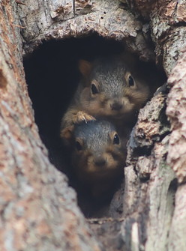
Why flickr?
Corey’s philosophy of photography
Take 50 more pictures than you think you need. Or more! #LaVitaDigital
Capture the beauty of everyday life.
Make things easy to find.
Only share good capture (especially when people are talking).
Share joy with others.
Every pictures tells a story and captures a moment in time.
January 7th, 2019
https://flic.kr/p/2e15qQY

Slide 16
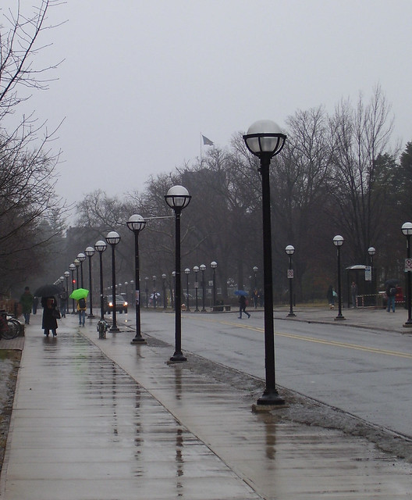
Why flickr?
Corey’s philosophy of photography
See what other people are doing - continually seek out ways to improve.
Always carry your camera - you never know what you will see!
Take the same picture at different times - seasons, light, opportunity
A great photo is a match of three things: Opportunity, Artistry, and Equipment
Shoot Cannon DSLRs (6D Mark II, 80D, 70D, T3)
March 18th, 2008
https://flic.kr/p/4zbYa3

Slide 17
Three Key Things
Organize (as you take them)
Describe (to make them findable)
Organize (so you may save them)
NOTE: I will be showing this with flickr and Google Photos. Apple Photos are nearly identical to Google.

Slide 18
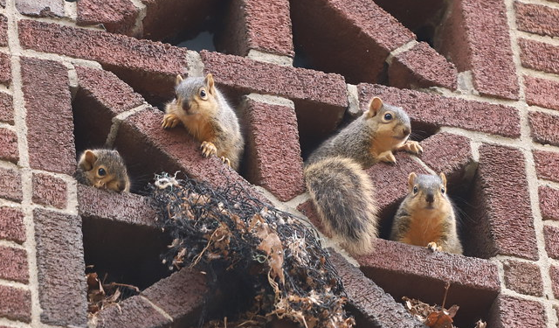
Organize (Three Key Things)
They key to finding anything is to keep it organized!

Slide 19
Organize (Three Key Things)
Natural way photographs are organized is by date taken.
Use folders and sub-folders to fine tune where pictures go.
In flickr, you can order your upload so the picture you want will show first.
Time spent here will make it easier to find items later.

Slide 20
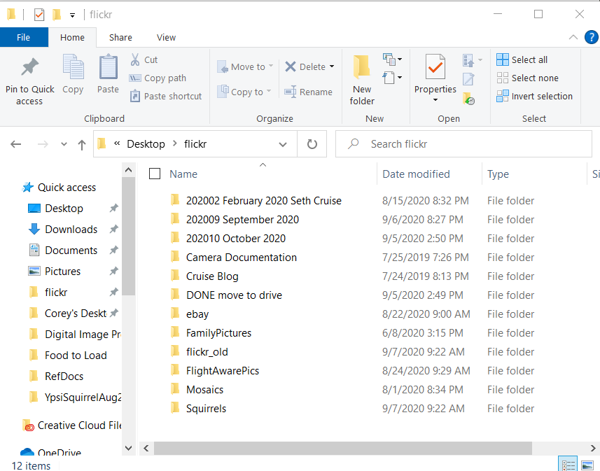
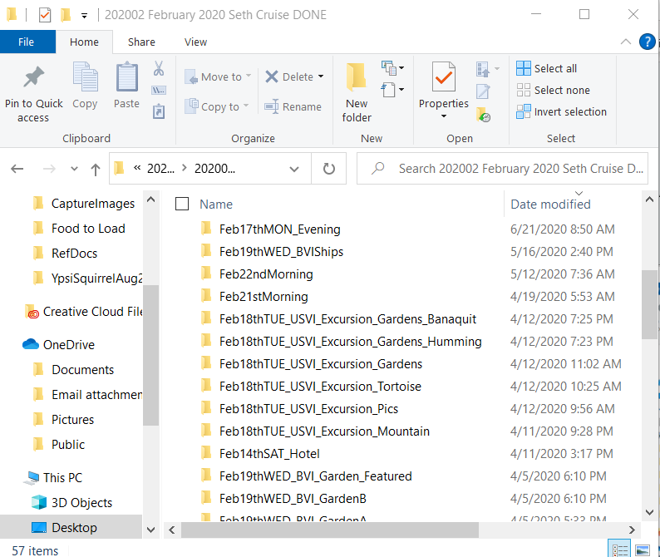
Organize (Three Key Things)
Use folders!

Slide 21
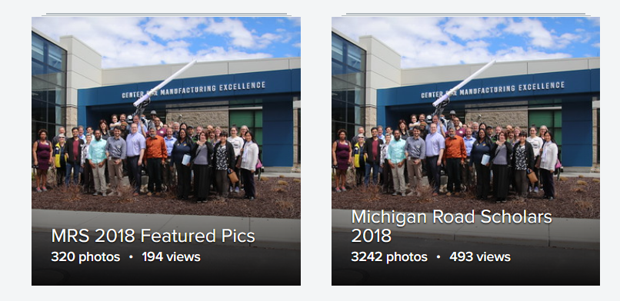
Organize (Three Key Things)
Use Albums – very common means of bringing similar items together.
Great for sharing and organizing.
Corey’s Albums on flickr - https://www.flickr.com/photos/cseeman/albums

Slide 22
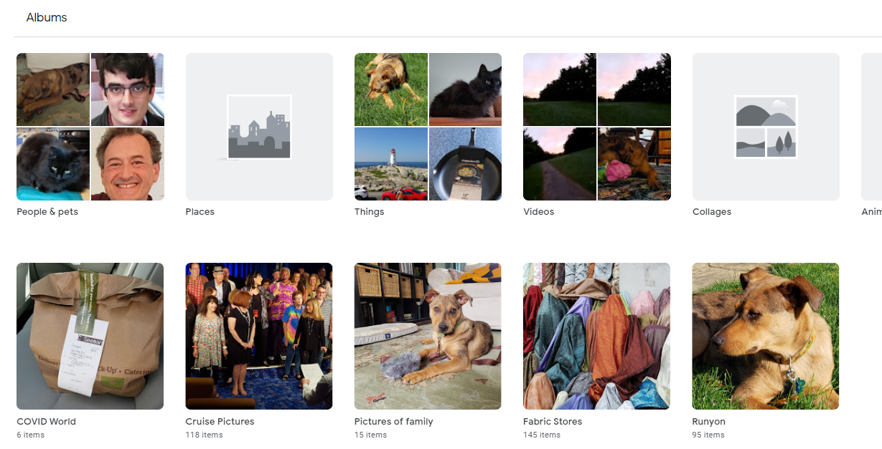
Organize (Three Key Things)
Google Photos enable albums – easy way to find items.

Slide 23
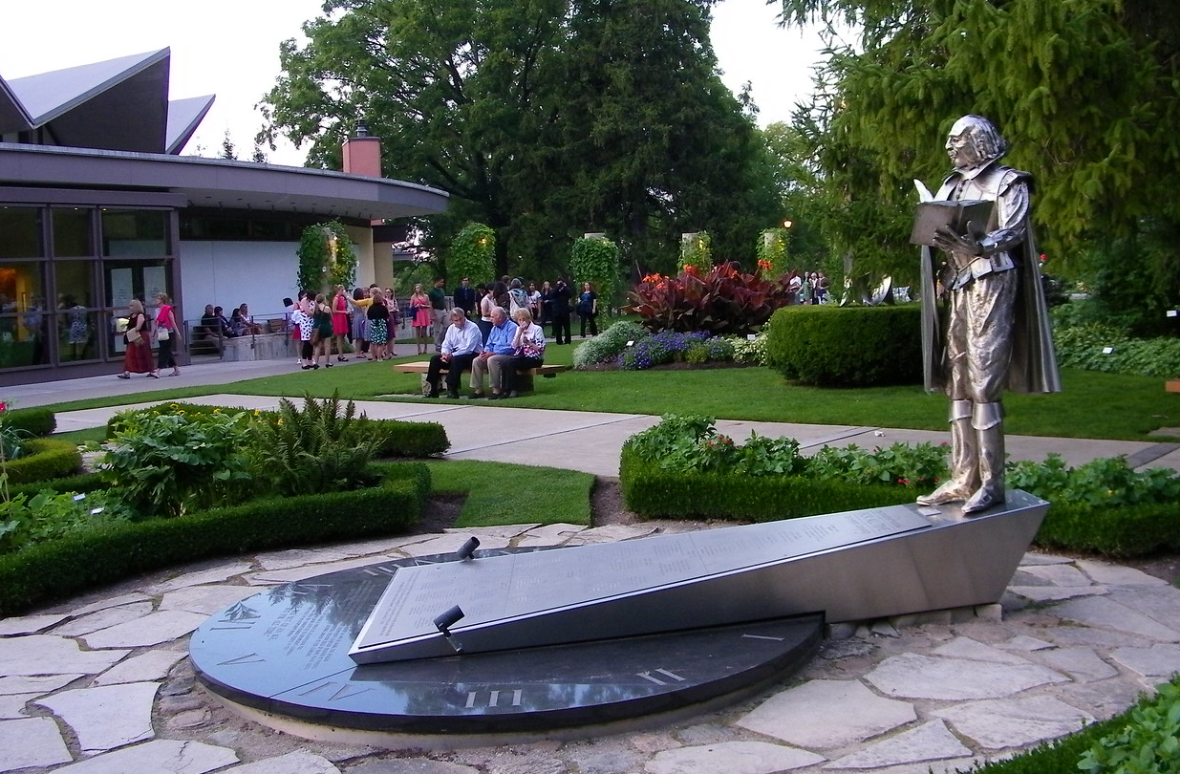
Describe (Three Key Things)
Words, Words, Words
  (Hamlet Act 2, Scene 2)

Slide 24
Describe (Three Key Things)
With flickr, you have a title, description and tags. Relatively few limits.
With Instagram, it is essentially all about the tags.
With Google (and Apple), you can add info (description), but they seem to be more based on AI to find items.

Slide 25
Describe (Three Key Things)
Tags are the best ways to have people find your images.
Create all sorts of tags to direct people to the items.
You can add tags after the fact.
You can also apply the same description to multiple items.
These become the search-terms in both flickr and search engines.

Slide 26
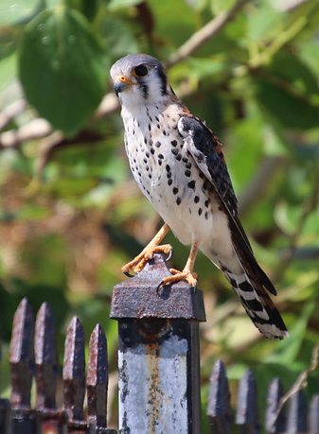
Describe (Three Key Things)
Your tags can have meaning only to you.
“Security by Obscurity” approach.
equinoxfeb152020tortola
Sometimes you need to reindex.
https://flic.kr/p/2iyBvW3

Slide 27
Describe (Three Key Things)
Tags can have external or internal meanings (they all live together).
Sometimes, the tags will not retrieve the image (HINT – you can make the image PRIVATE and then PUBLIC again to re-index – it takes 24 hours).
Images with no tags or only internal use tags will be virtually hidden.

Slide 28
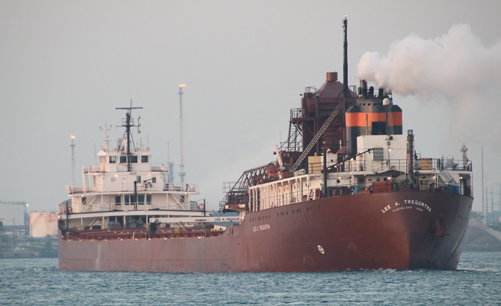
Describe (Three Key Things)
Title: Self-Unloader Lee A. Tregurtha Heading Downbound on the St. Clair River at Port Huron, Michigan and Sarnia, Ontario - September 1st, 2018
URL: https://flic.kr/p/2aDtme7
TAGS: Freighter "Lake Freighter" Ships "St. Clair River" Michigan River Water Canada "Port Huron" Boatnerd Sarnia Ontario Shipping "Self-Unloader Paul R. Tregurtha" "Freighter Lee A. Tregurtha" "Interlake Steamship Company" "Lee A. Tregurtha" "Port Huron Ship Watching" Overcast Morning 2018Project365CoreyS YearElevenProject365CoreyS Project365 P365CS092018 #356Project2018

Slide 29
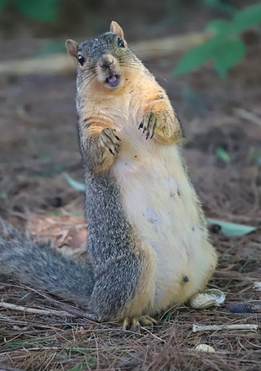
Describe (Three Key Things)
Title: Backyard Red & Fox Squirrels (Ypsilanti, Michigan)
URL: https://flic.kr/p/2jok8im
Description: Red squirrels and fox squirrels hanging out at our house in Ypsilanti, Michigan. Here are some pictures of my neighbors including my favorite - Tipsy - between July 17th, 2020 and July 20th, 2020.
TAGS: "American Red Squirrels" "Red Squirrels" "Fox Squirrels" "Eastern Fox Squirrels" Feeder "Bird Feeder" Perch Squirrel Squirrels Ypsilanti Michigan YpsiSquirrel YpsiSquirrelJuly20th2020 Hungry "Squirrel Feeder" Summer Backyard Juveniles "Juvenile Squirrels" "Juvenile Red Squirrels" 2020Project365CoreyS YearThirteenProject365CoreyS Project365 P365CS072020 #356Project2020

Slide 30
Describe (Three Key Things)
Groups (in flickr) are ways to share pictures on a topic with other users.
Michigan Libraries - https://www.flickr.com/groups/michiganlibraries/
Groups on nearly any topic…
Anyone can create a group!

Slide 31
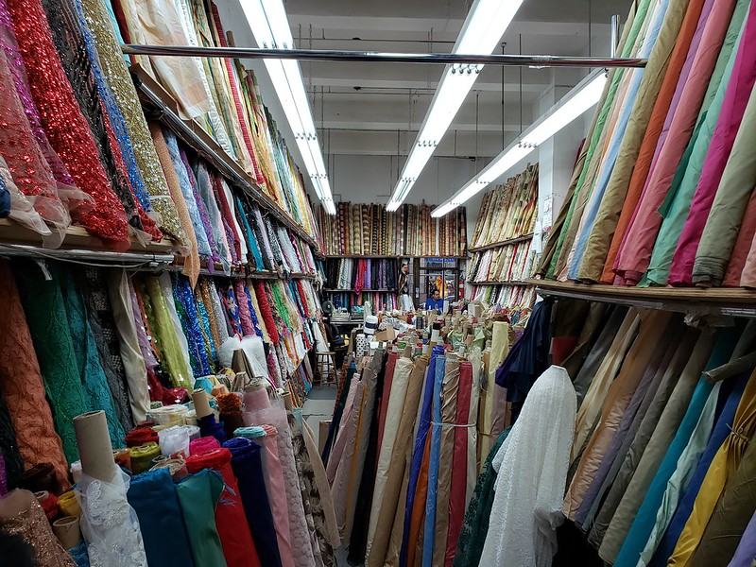
Organize Pt 2 (Three Key Things)
Just because they are online – you need a fallback position….

Slide 32
Organize Pt 2 (Three Key Things)
We cannot fully rely on any commercial service to be continually useful or practical for our purposes.
They might also go away or drop the service. Or institute a cap on the number of pictures you can have.
You need a backup system. Keep it organized.

Slide 33
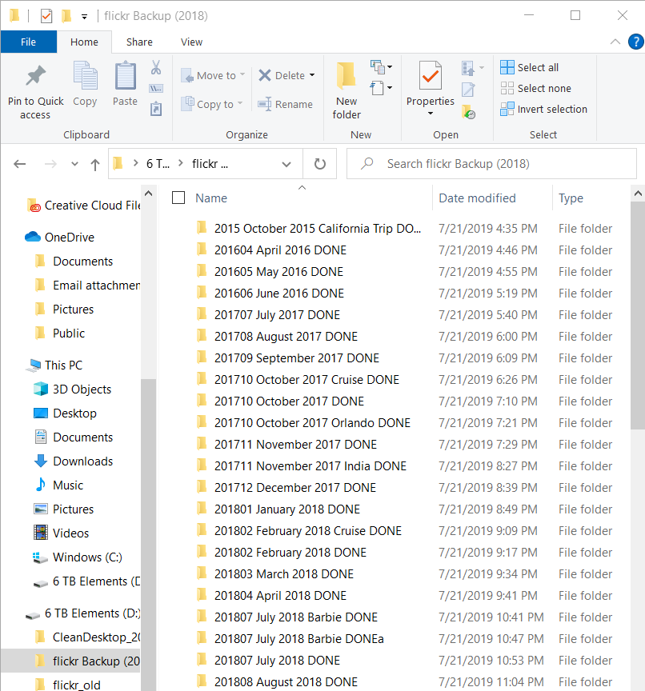
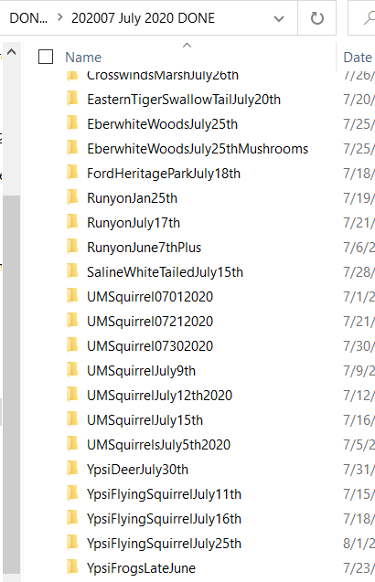
Organize Pt 2 (Three Key Things)
External hard drives are a good investment.

Slide 34
Your Images – Your Rights
You can limit who sees the pictures.
flickr has both public and private pictures.
This could be important for privacy or other reasons.
However, once they get out, it is hard to get them back in…

Slide 35
Your Images – Your Rights
Creative Commons
  https://creativecommons.org/
  https://creativecommons.org/licenses/
Creative Commons Pics on flickr
  https://www.flickr.com/creativecommons/
You can put restrictions on access and downloading if you want.

Slide 36
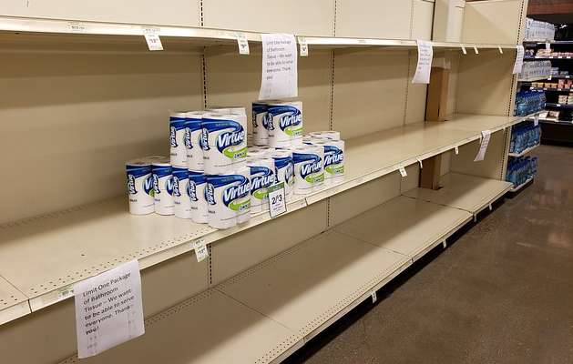
Your Images – Your Rights
Business Insider (September 12, 2020) - Photos submitted to be included in the Library of Congress' permanent collection show American life during the coronavirus pandemic
https://www.businessinsider.com/library-of-congress-crowd-sourcing-coronavirus-pandemic-photography-american-experience-2020-9
Busch’s (Saline) – March 22nd, 2020
https://www.flickr.com/photos/cseeman/49689283237/

Slide 37
Your Images – Your Rights
https://petapixel.com/2020/03/23/the-shoebox-negatives/
https://shoeboxnegs.com/
“In the late 1930s my father was just out of high school and an avid amateur photographer. Decades after he died at age 43 my mother handed me a shoebox stuffed with his film negatives, shot mostly in and around Chicago's Near West Side, and then developed in a makeshift darkroom.
I never had the chance to ask my dad about the people or situations captured in his photos. But this is the next best thing.”
Joan Tortorici Ruppert is a television writer, producer, and director. Professional site - https://jtrp.net/
Everyone might have a treasure like this!

Slide 38
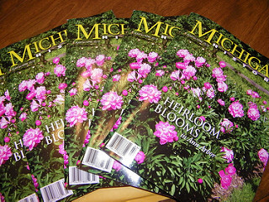
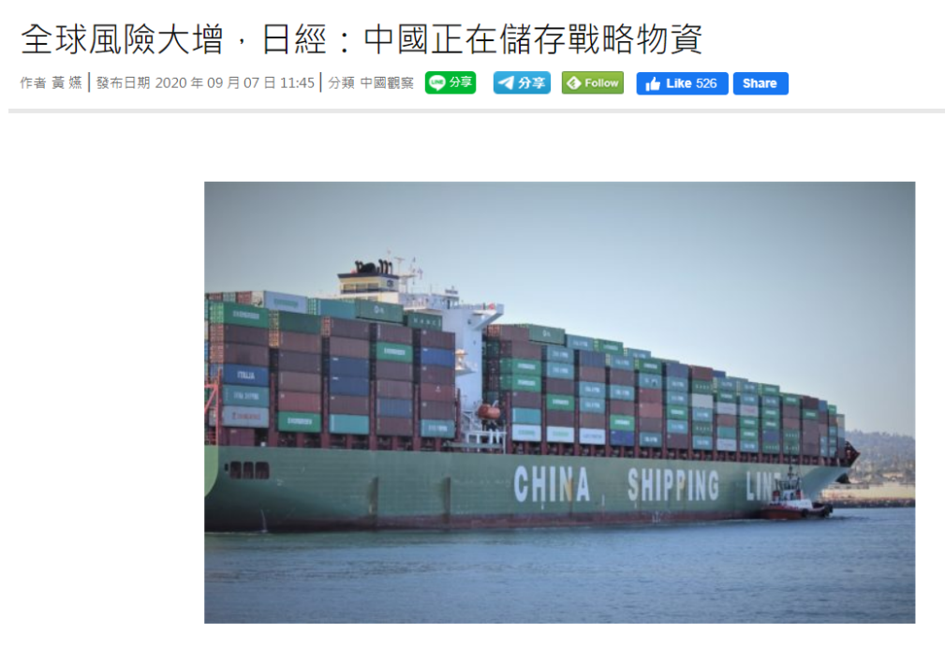
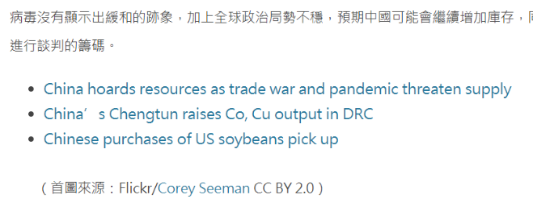
Your Images – Your Rights
If people can find it – they can use it

Slide 39
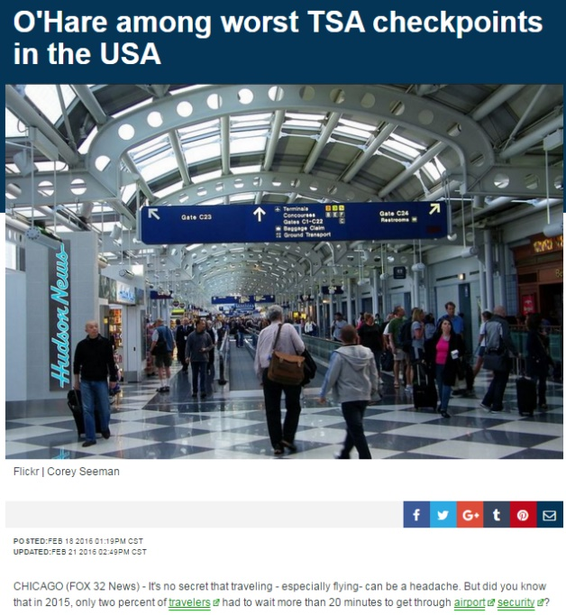
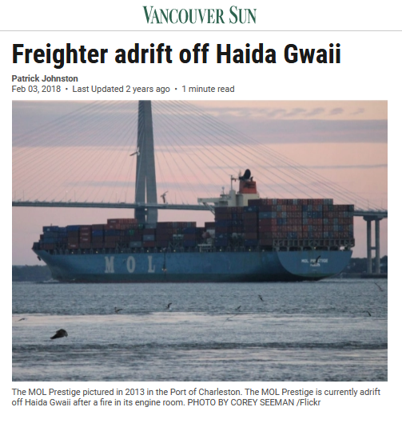
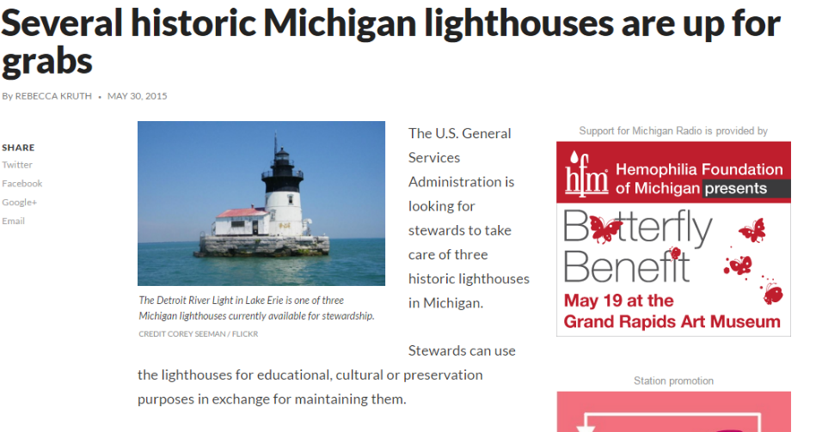
Your Images – Your Rights

Slide 40
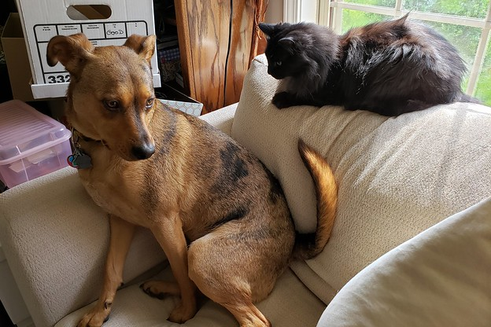
Questions & Thank You
Corey Seeman
University of Michigan
Email: cseeman@umich.edu
Web: https://sites.google.com/view/squirrelman/
Slides: ##
Corey’s flickr page: flickr.com/cseeman
More Resources follow this slide!

Slide 41
Resources - Favorite Sites
National Camera Shops –
B&H Explora - https://www.bhphotovideo.com/explora/
B&H Event Space - https://www.bhphotovideo.com/find/EventSpace.jsp
Adorama's 42 West - https://www.adorama.com/alc/
CameraMall (Ann Arbor) - https://cameramall.com/

Slide 42
Resources - Favorite Sites
Michigan Camera Shops
CameraMall (Ann Arbor) - https://cameramall.com/
PROCAM (Livonia and others) – https://procam.com/events
Woodward Camera (Birmingham) - https://woodwardcamera.com/
Midwest Camera Repair (Wyandotte) - http://www.midwestcamera.com/

Slide 43
Resources - Favorite Sites
PetaPixel - https://petapixel.com/
FroKnowsPhoto - https://froknowsphoto.com/
Digital Photography School - https://digital-photography-school.com/
Digital Photography Review - https://www.dpreview.com/

Slide 44
Resources – Digital Photo Platforms
flickr
URL: https://www.flickr.com/
Help URL: https://help.flickr.com/
SmugMug
URL: https://www.smugmug.com/
Instagram
URL: https://www.instagram.com/?hl=en
Imgur
URL: https://imgur.com/
Facebook
URL: https://www.facebook.com/

Slide 45
Resources – Digital Photo Platforms
Google
URL: https://photos.google.com/
Help URL: https://support.google.com/photos#topic=6128818
Apple
URL: https://www.apple.com/ios/photos/
Help URL: https://support.apple.com/photos
Organize and Find Your Photos - https://support.apple.com/en-us/HT207368
Amazon
URL: https://www.amazon.com/Amazon-Photos/b?ie=UTF8&node=13234696011
Help URL: https://www.amazon.com/gp/help/customer/display.html?nodeId=GDMHBWK3M5RAV5TY
Print Services
Shutterfly: https://www.shutterfly.com/
Snapfish: https://www.snapfish.com/home

Slide 46
Resources - Libraries on flickr
University of Michigan Library - https://www.flickr.com/photos/mlibrary
Michigan State University Main Library - https://www.flickr.com/photos/msumainlibrary
Library of Congress - https://www.flickr.com/photos/library_of_congress
flickr Commons: https://www.flickr.com/commons
flickr Commons Participating Institutions: https://www.flickr.com/commons/institutions/

