Slide 1
Change, Crisis & Counting: Thoughts on Library Assessment in Fluid Times
Reorienting Library Advocacy: Aligning our priorities & futures to meet the challenges universities face
Corey Seeman
Director, Kresge Library, University of Michigan
cseeman@umich.edu
Slides Link: https://tinyurl.com/CoreyCHS2020

Slide 2
Introduction & Overview
Abstract - offers the perspective of a library leader who dramatically transformed a full-service library with a 70,000 volume collection to one that is almost completely digital in 2013-14. What kind of data has Corey collected? How does he use it to demonstrate value and advocate for the library with campus stakeholders?

Slide 3
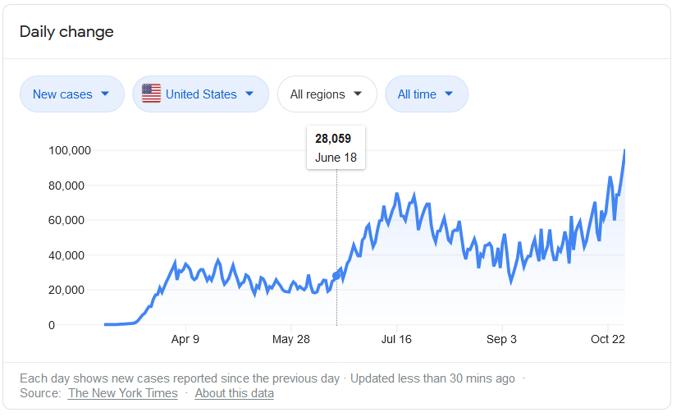
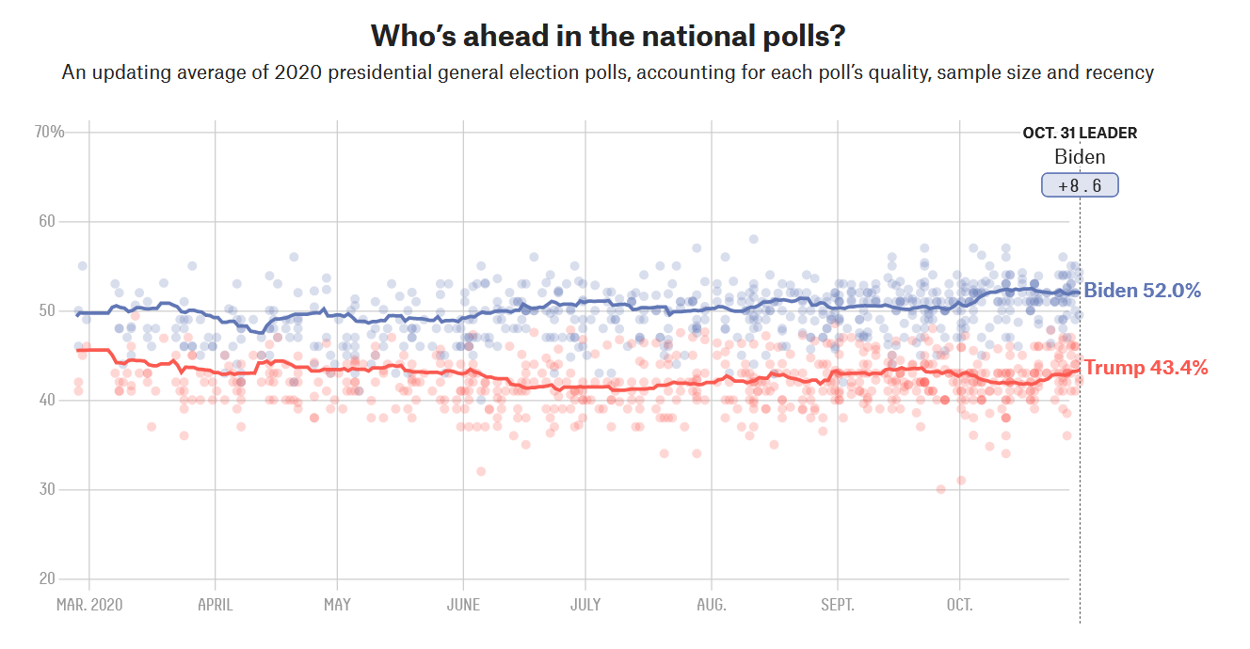
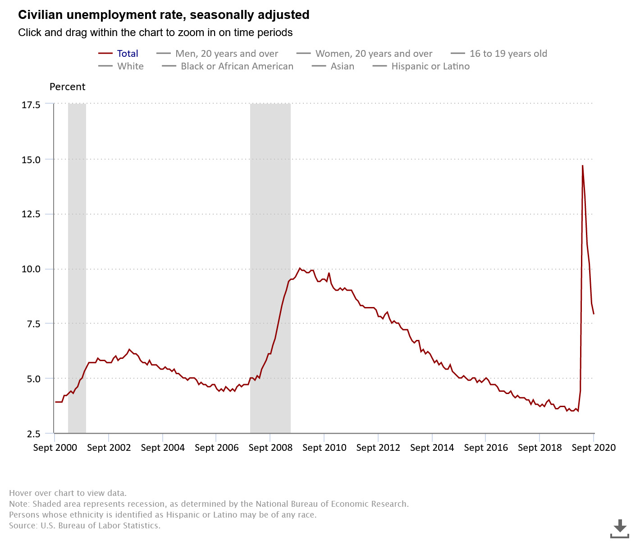
Metrics and Assessment
Since its 2020….
How similar is political polling and resources we buy for students and faculty?

Slide 4
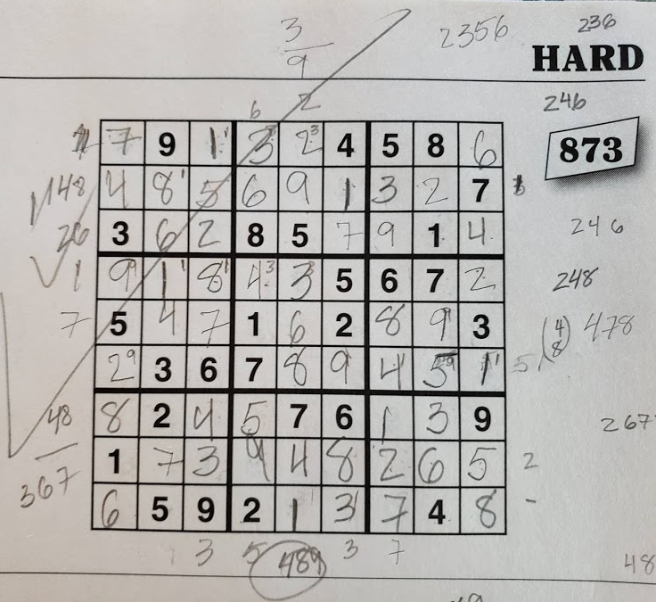
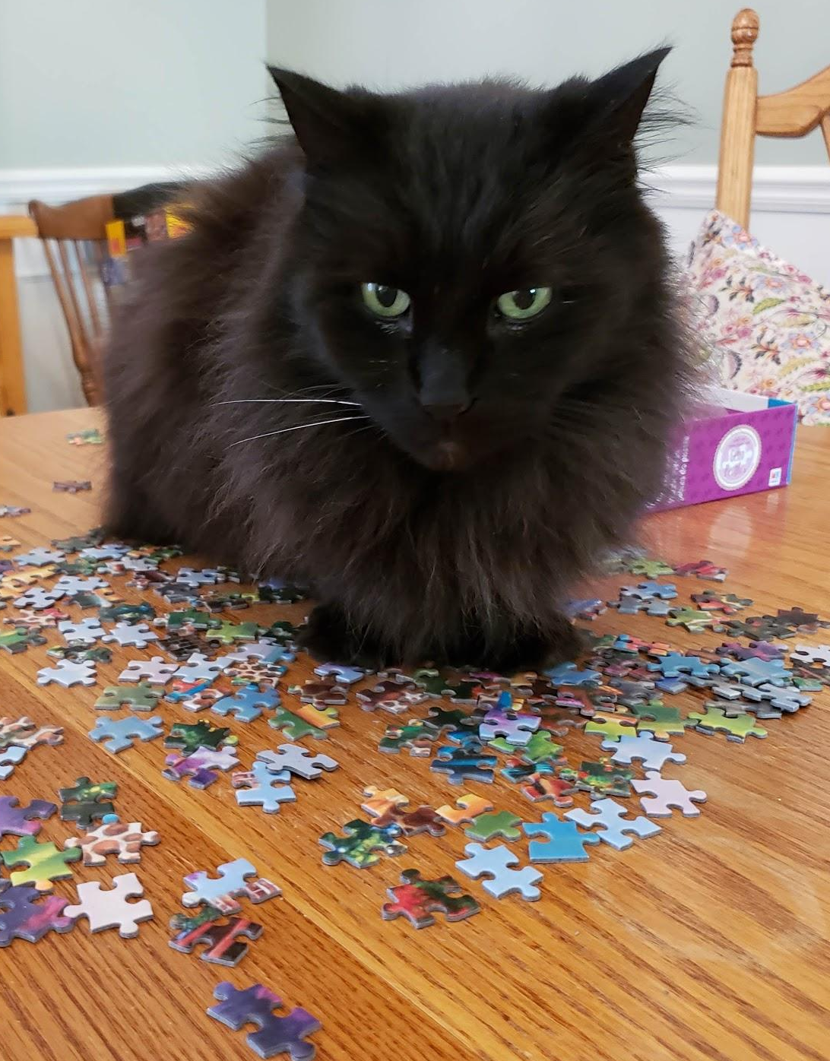

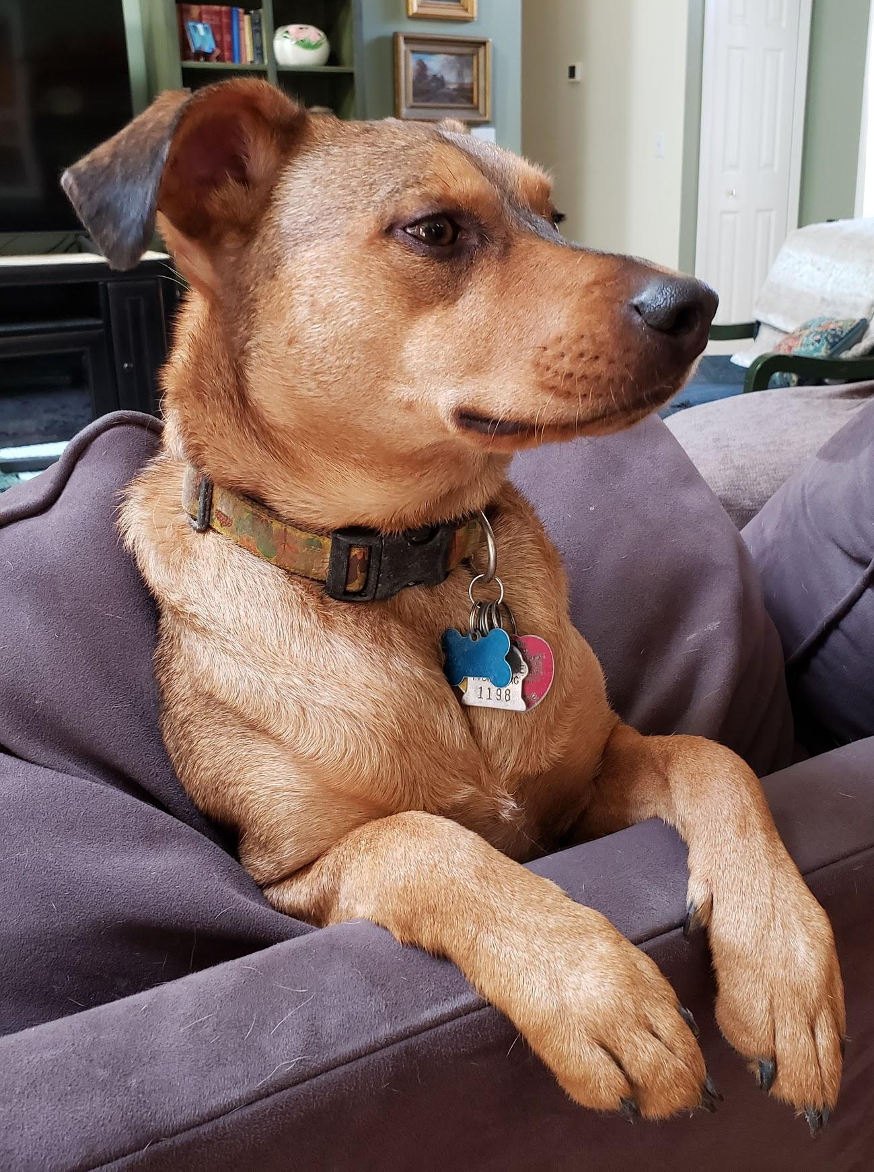
It’s a Puzzle: Sudoku or Jigsaw?
Assessment is a puzzle where we combine numbers and stories to show effectiveness.
Certainly, if there was a year when the numbers tell dramatically different stories, it is 2020.
Some problems only have one answer – like a Sudoku puzzle.
Other problems require more flexibility – like a jigsaw puzzle with missing pieces.
Your story is unique, as is your campus.

Slide 5
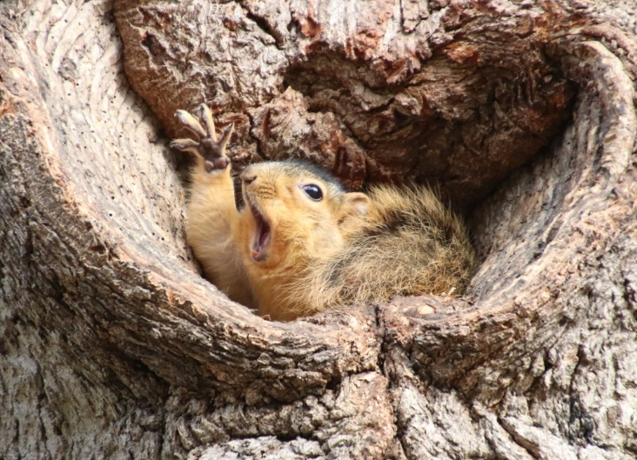
2020 Vision* – Change & Libraries
We live at a time of great change in almost all fields.
The expansion of online education is fundamentally changing higher education.
In the United States – enrollment in higher education is stagnant with fewer International students seeking a US education.
This will impact the need of a physical library on each campus.
This will impact the roles that librarians play on campus.
The factors that will demand change across higher education (and within the library) may include:
  Space demands
  Mergers or ceased operations
  Funding of new priorities
  Online education expansion
Change may be a dual edged sword – vibrant schools will demand more changes than stagnant ones.

Slide 6
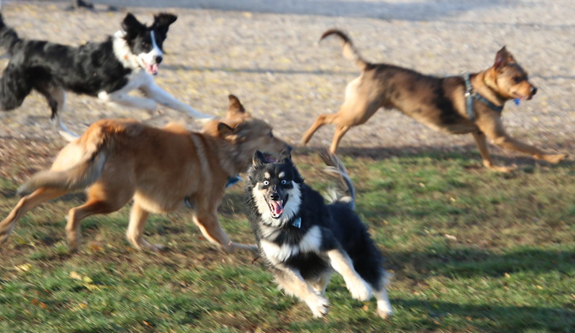
Going Your Own Way (Change in 2014)
Kresge Change in 2013-2014 (Mostly February-July 2014)
Move to a mostly electronic collection.
70K books to 200 (now less....)
Move away from a large traditional library.
Move towards an “Ethereal Library”
Shifting Jobs and Focus to what was possible – not what we used to do.
When we moved out of our space, we changed our name to Kresge Library Services.
In many ways, our timeline started over from scratch. That enabled us to build our own future.

Slide 7
Going Your Own Way (Change in 2014)
Where did the books go?

Slide 8
Going Your Own Way (Change in 2014)
This is my vision of collection building in libraries – we need to find the balance between these needs.
Future Use
This is where Libraries have traditionally bought for (and many still do)
Community Needs
Community Aspirations & Desires
This is where our campuses really want us to be working. This might be where the turnaways come from.
Current Use

Slide 9
Going Your Own Way (Change in 2014)
Library challenge is that we have multiple stakeholders and they have different needs – especially for business.
Faculty needs – scholarly journals, articles, books , datasets
Student needs – articles, company & industry information, market reports
Community – Mostly similar to student needs
Student
Community
Faculty

Slide 10
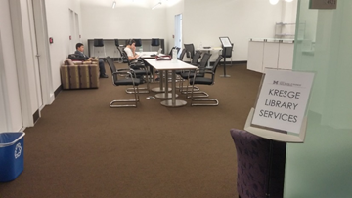
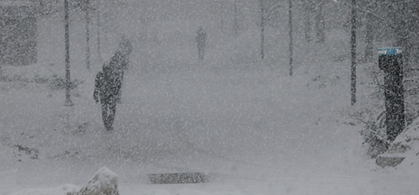
Going Your Own Way (Change in 2014)
We could do our work anywhere.
Previous challenges such as the polar vortex and closures during constructions.
We developed new services to redeploy staff capacity not working with print - Kresge Exam Service.
Our services were aligned to campus needs, not library norms.
We had to embrace a flexible mindset to manage this change.
Quickly adapted to a digital only services in March 2020.

Slide 11
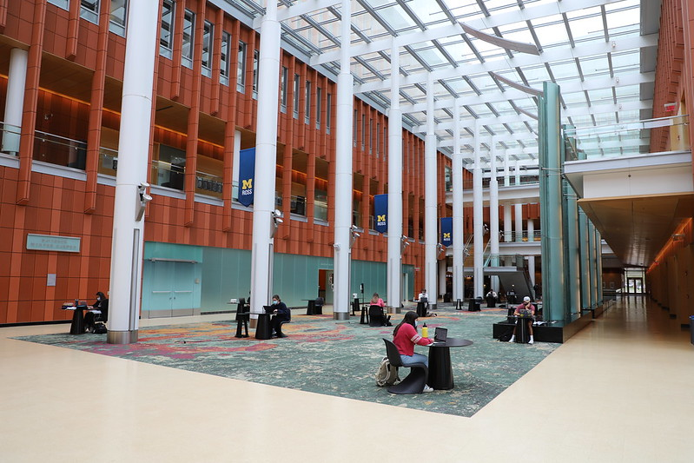
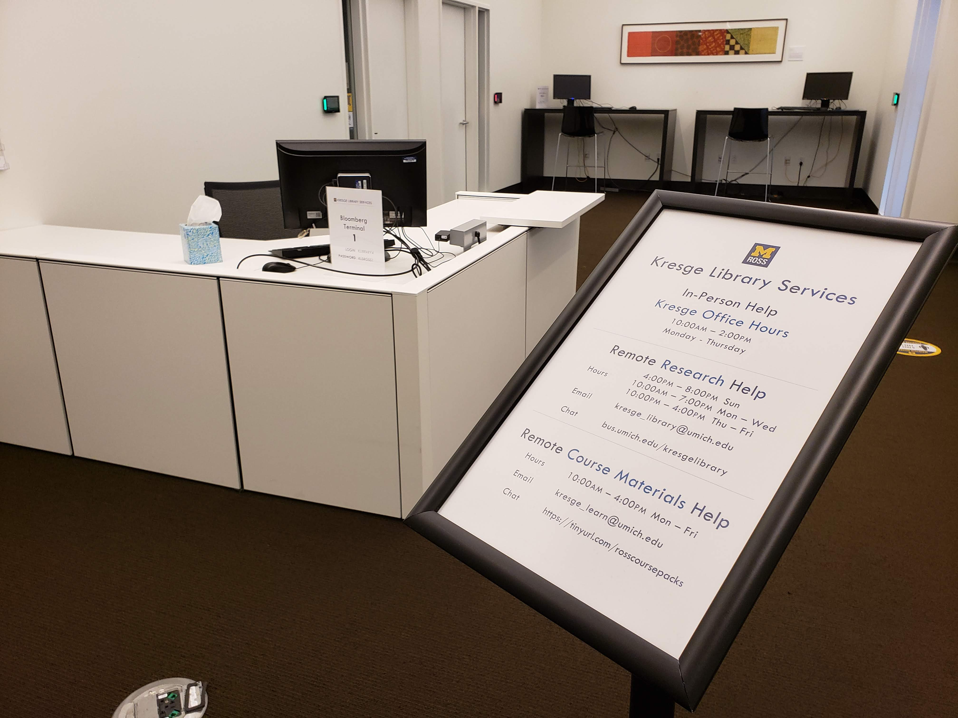
Going Your Own Way (Crisis in 2020)
With no student space and a 99.99% electronic collection, we were designed for a pandemic.
We did have in-person reference and desk services (Exam and Assignment Review as well as Textpack Pickup) and those were either moved online or cancelled.
Our planning for Fall Term was along the same lines for our hybrid term, but the Ross Leadership Team wanted something in person.

Slide 12
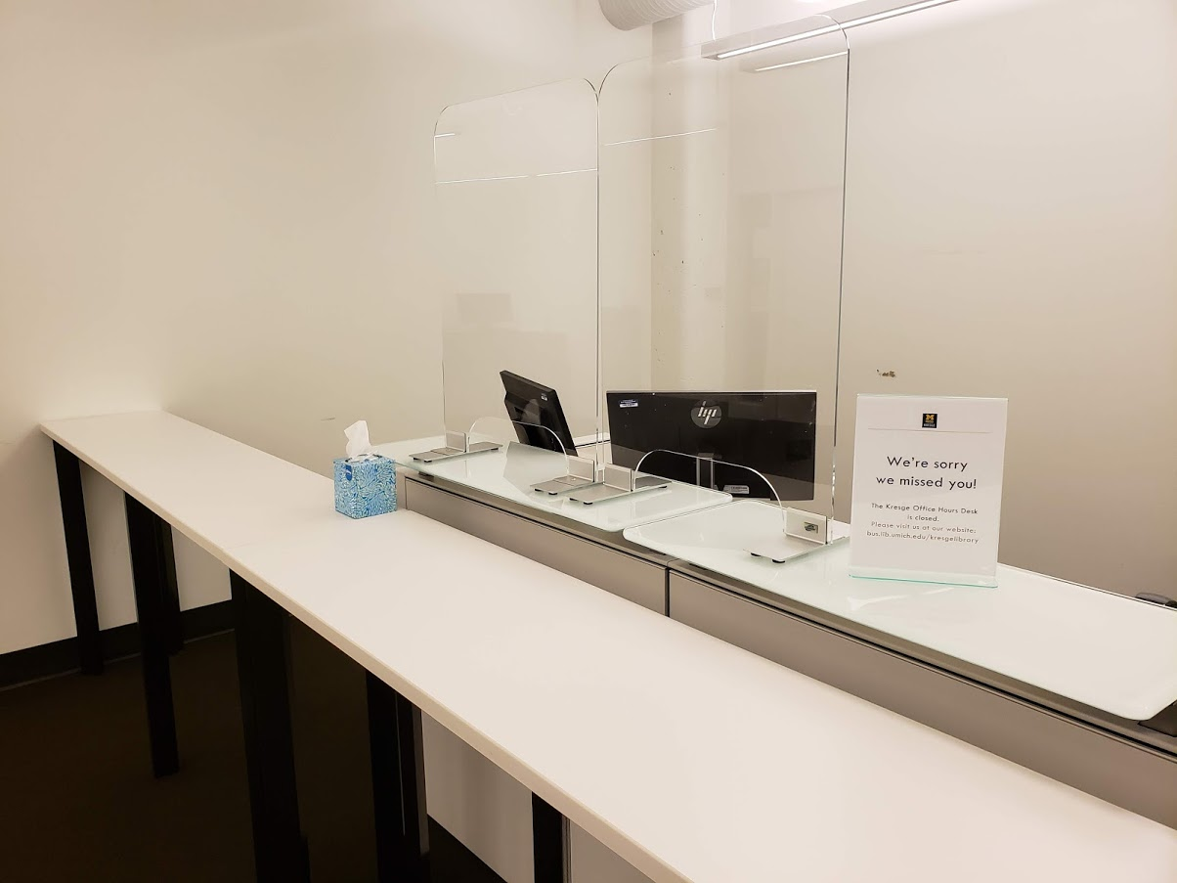
Going Your Own Way (Crisis in 2020)
A New Service – Kresge Office Hours
The goal from the Ross Leadership Team (LT) was to have some staff in the building if students would be there.
After we were told to rethink what it might look light, we reconnected as a group.
We have staff of 18 and about one-third were comfortable coming in.
We pitched (internally and to the LT) about staffing a desk for questions that students had.
The LT was enthusiastic, and we started this service on the first day of school.

Slide 13
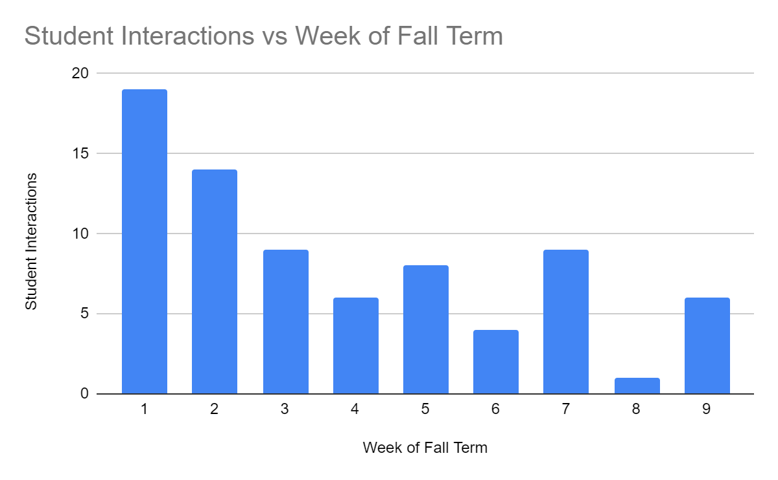
Going Your Own Way (Crisis in 2020)
A New Service – Kresge Office Hours
We staff the desk Monday through Thursday from 10am to 2pm.
ONE Library Question
Some Textpack Questions
Majority of Questions – Printing, Room Reservations, Supplies, General Help.
These numbers are very low, but they are appreciated by students and the LT.

Slide 14

Changes – Temporary & Permanent
We also added a new chat service in Fall 2020 for course materials.
An agile library needs to determine if a service or function can continue - especially if not everything is available.
When dealing with change, you have more a more gradient way to explore if something can continue being offered in the new environment.
Be creative - how can you find books that are print only?
When dealing with crisis management, you have fewer gradients - think more binary.
When dealing with change management, you have more gradients. What will our libraries look like on the other side?

Slide 15
For More Fun….
"The Ethereal Library: Our Experience in Library Futures at the Kresge Library." presentation to be given at the International Conference on Next Generation Libraries (NGL-2019) to be held December 12-14, 2019 at National Institute of Technology, Rourkela, India. Virtual participant at the meeting. Link
"History Has Its Eyes on You: Lighthouses and Libraries Weathering Storms of Change," Keynote for the Great Lakes Resource Sharing Conference, June 8-9, 2017 at Oak Brook, Illinois. Link
“Don’t Get Married to the Results: Managing Library Change in the Age of Metrics,” presentation at the 2015 Charleston (SC) Conference, November 2015. Link / Transcription of Talk
“Creating The Ethereal Library: Thinking Creatively When You Have No Space To Think,” presentation at the The 2014 Conference for Entrepreneurial Librarians, Wake Forest University, Winston-Salem, North Carolina on October 17, 2014. Link / Proceedings Link
Also visit - https://sites.google.com/view/squirrelman

Slide 16
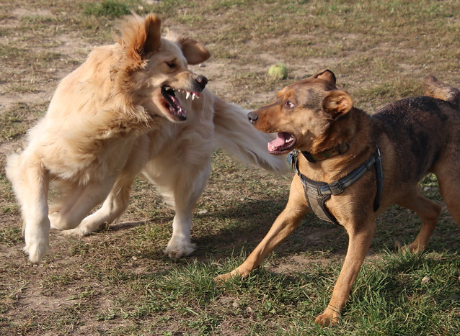
Closing Thoughts – Be Flexible
When you are at a dog park, you must always be flexible, especially with your knees.
That way, the dogs running around will not knock you over!
We might be done with COVID-19, but it is not done with us!
Don’t jump to conclusions about a picture.
Runyon and Rosie at Swift Run Dog Park, October 11th, 2020.

Slide 17
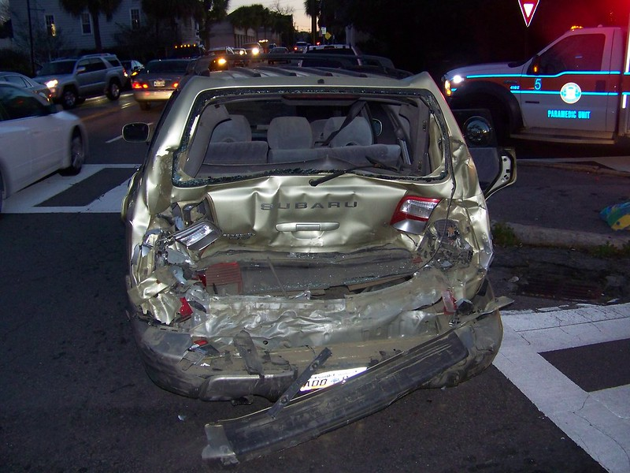
Closing Thoughts – Beware Dashboard Indicators
They will not tell you about the person behind you!
Thank you
Corey Seeman
cseeman@umich.edu
Slides Link: https://tinyurl.com/CoreyCHS2020

