Slide 1


Honors Capstone Project
Ziyang Ji
Dec 18, 2020

Slide 2
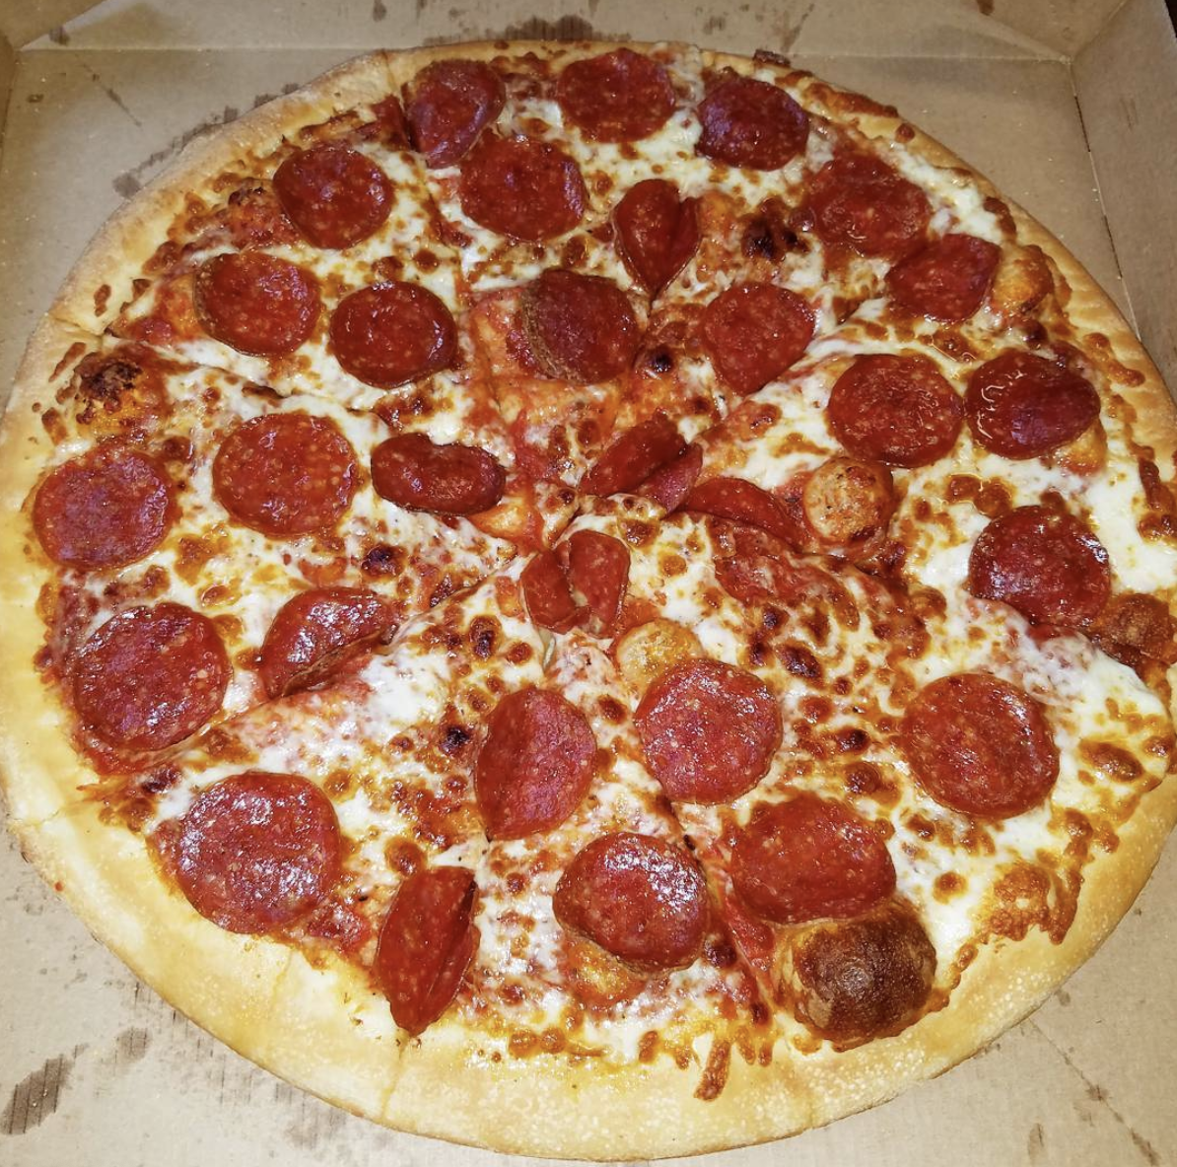
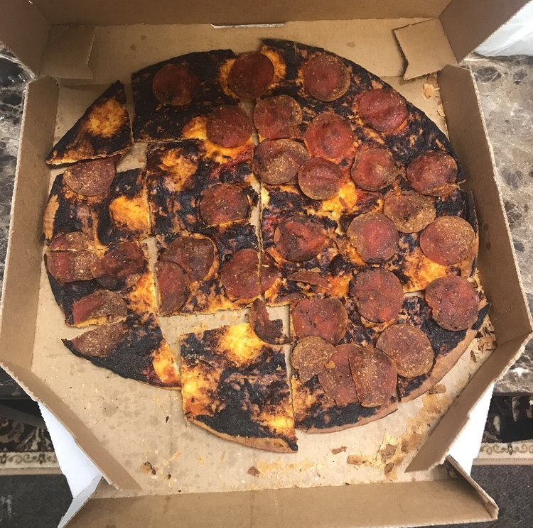
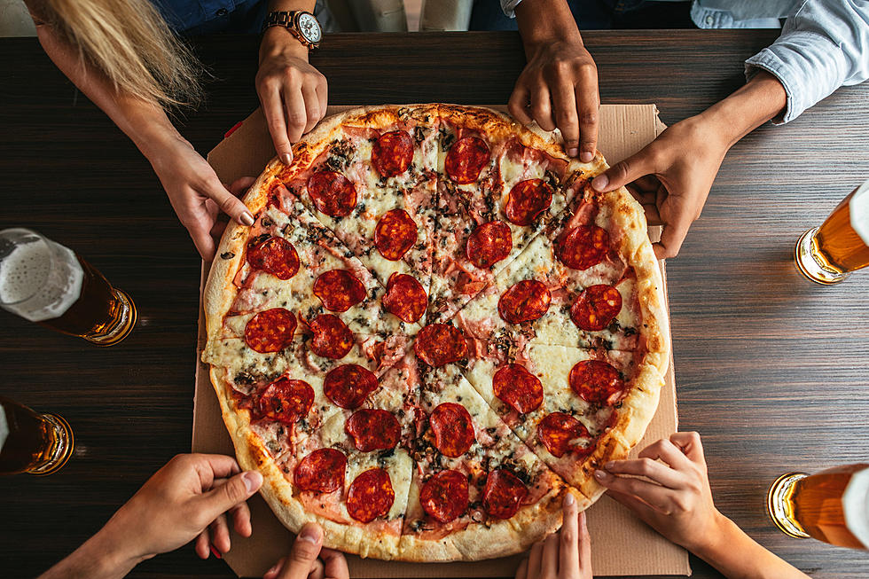

Little Caesars strives to make perfect pizza at every place and every time!

Slide 3
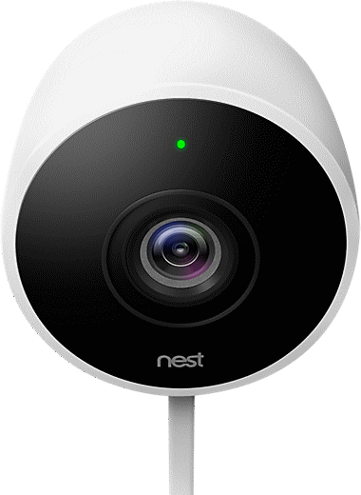
We use Computer Vision and Image Processing techniques to build an automated quality checking system
Upload Image
Run Image Analysis
Provide Feedback

Slide 4
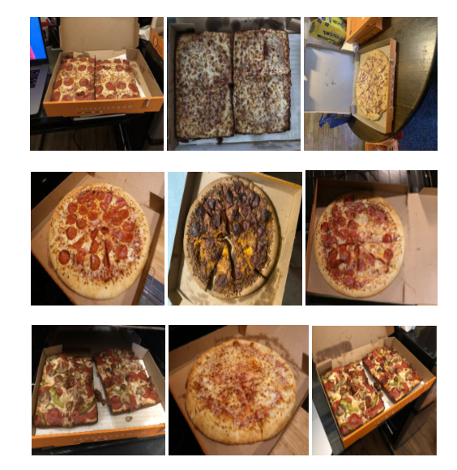
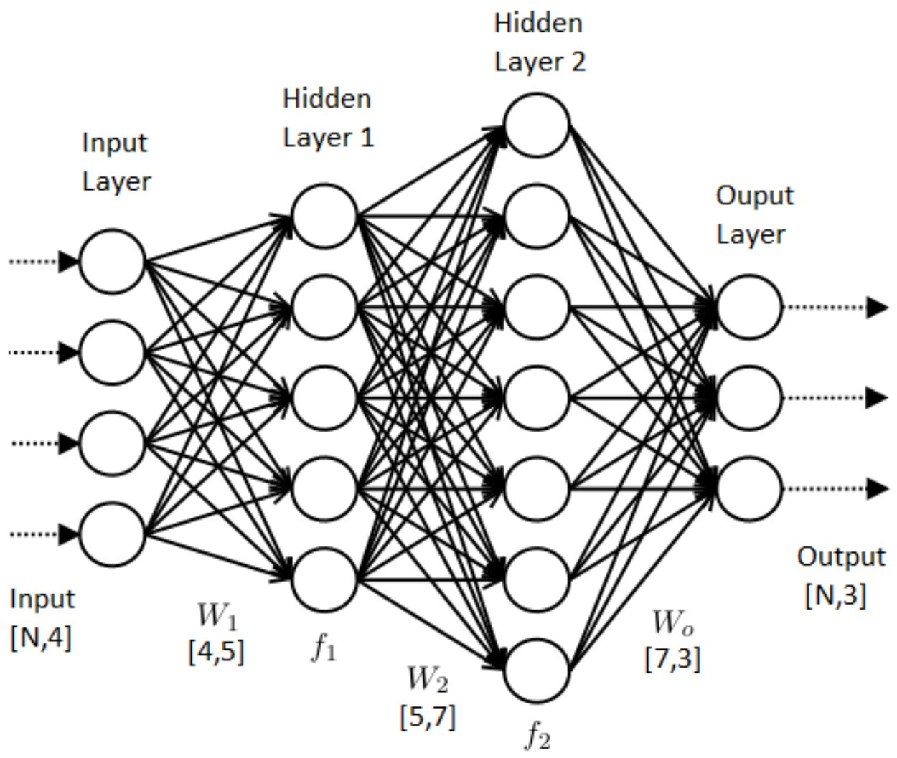

Our final accuracy is 85%!

Slide 5
What we learnt?
Understand sponsors' requirements
Communicate regularly within the team
Present results in an easier and more understandable way

Slide 6
Thank you!

