Slide 1
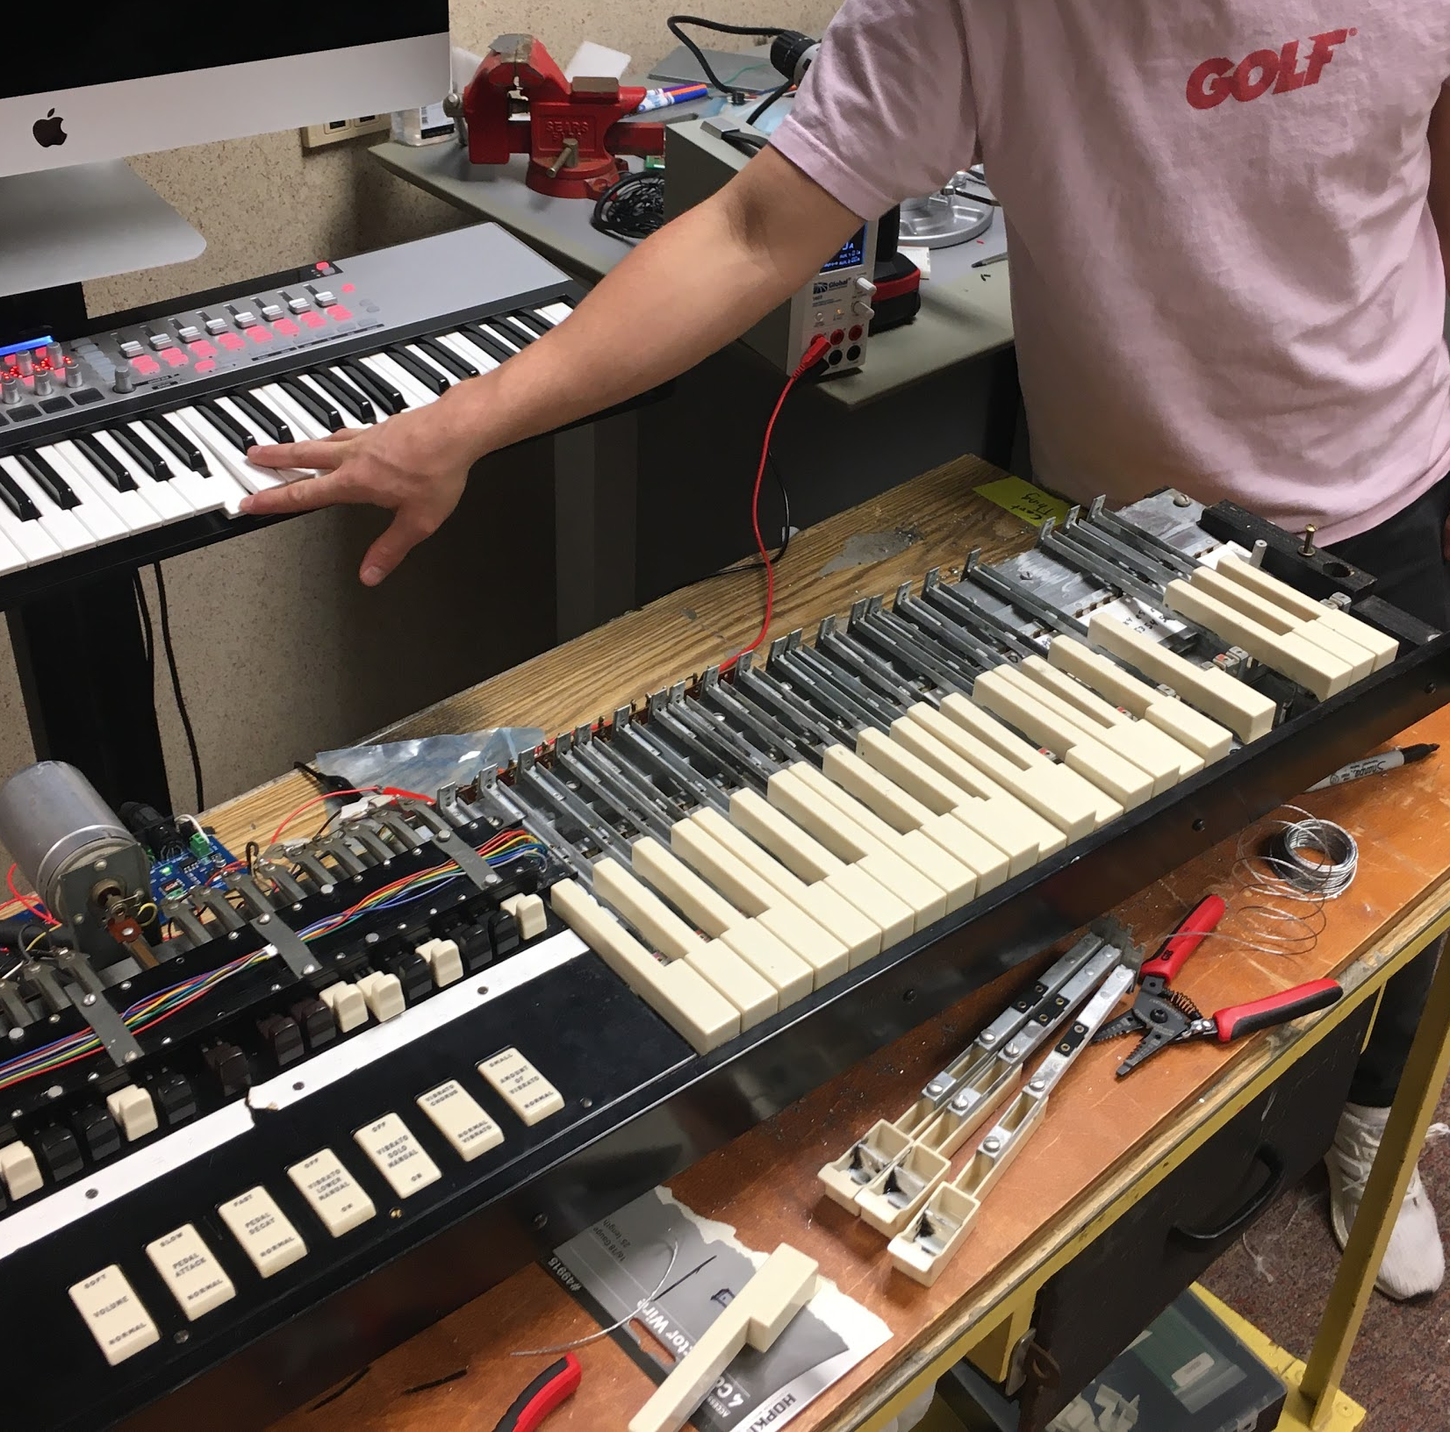
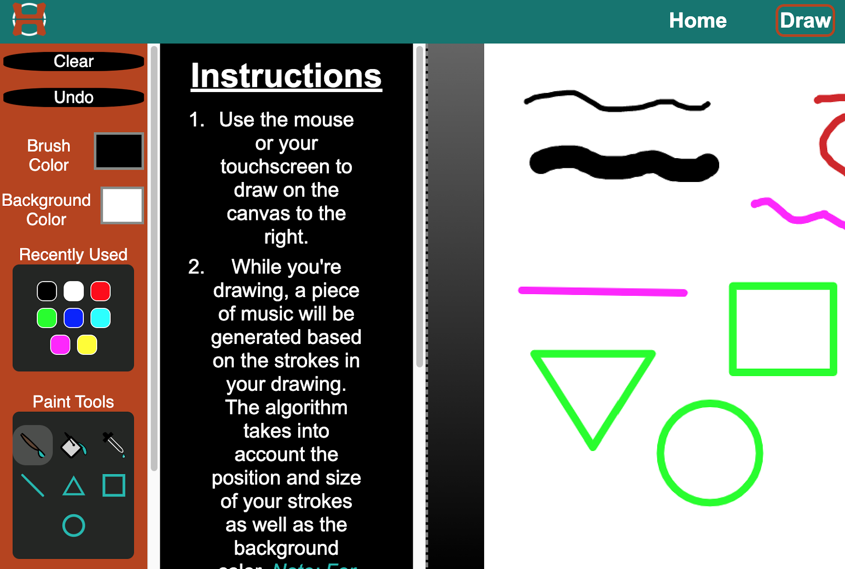
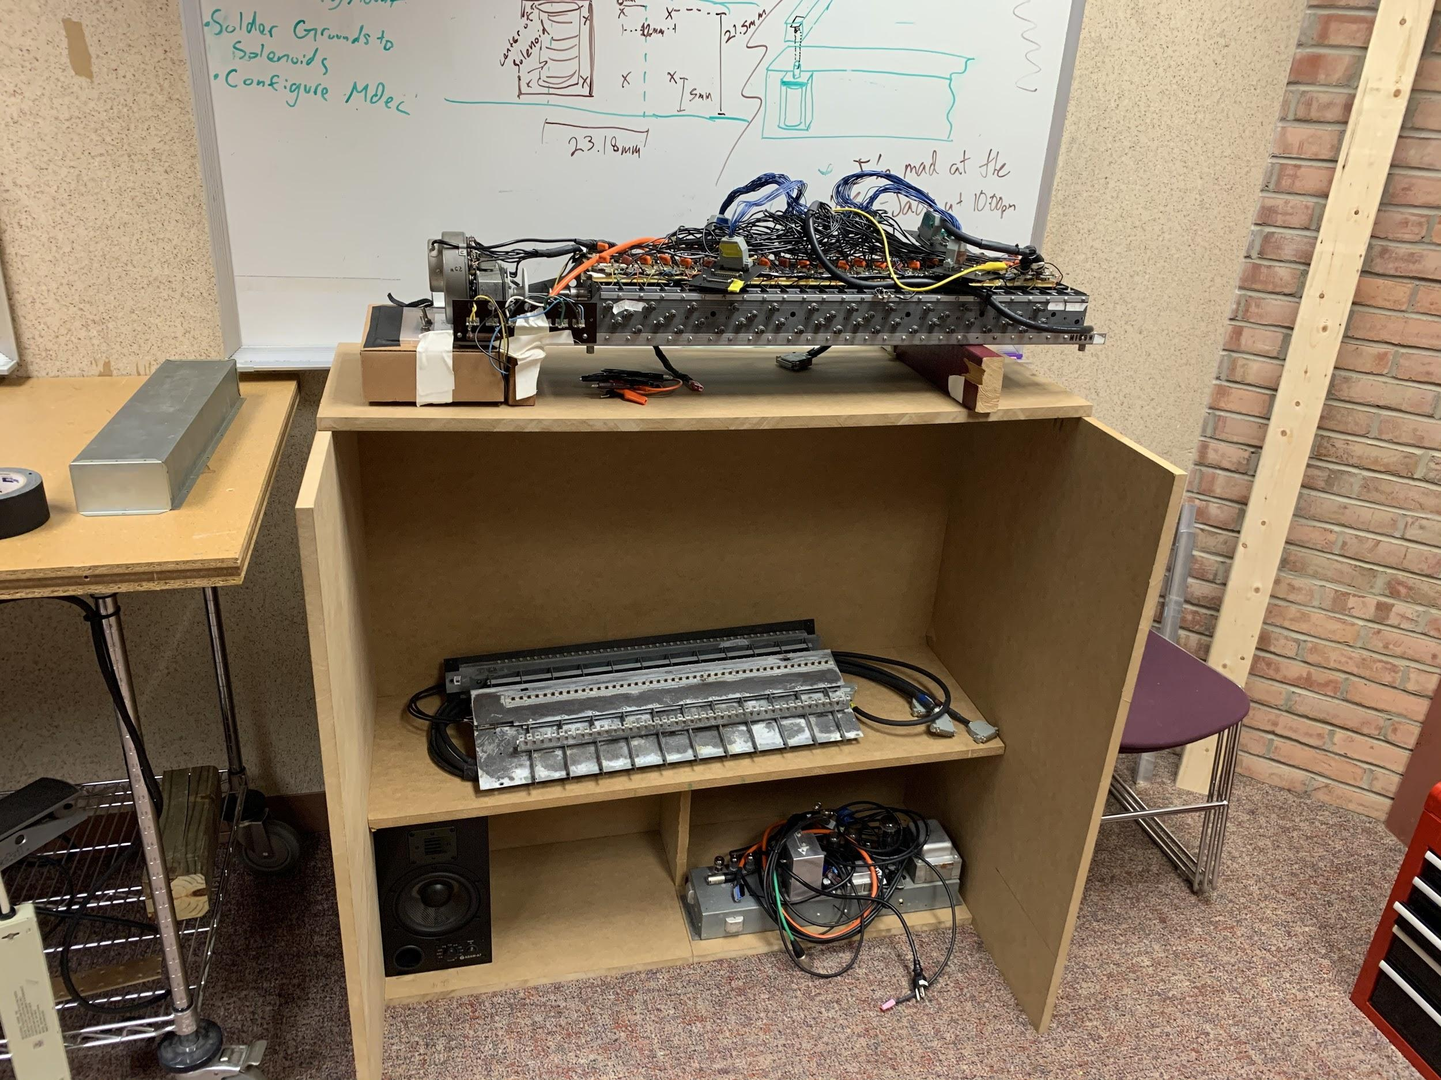
What did we do
Implemented a mechanical MIDI playback system
Coded a Drawing App that translates a user’s drawing into music
Built a test stand to determine required physical dimensions
Notes:
1st point - The hammond organ doesn’t have a sensing and playback system, so we implemented a sensing and playback system. As you can see in the photo, the player is pressing three keys and three matching keys are depressed on the organ.
2nd point - we created a web app to take drawing to make a midi file that can be played on the organ or in the browser
3rd point - test stand which allows teams to implement further dreams
solenoids
coded a drawing app which takes in the color and brush size that is then translated into music so anyone can play the organ by drawing
Compare original organ to the current system w/ our modifications

Slide 2

21st Century Hammond Organ Team
Sponsored by ArtsEngine
Mentored by Dave Greenspan and Kyle Snyder

Slide 3
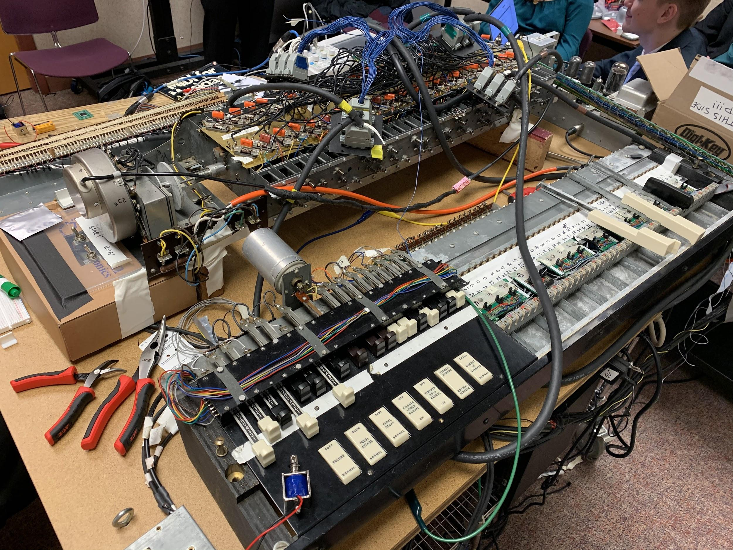
What is the problem?
Asked to bring the Hammond Organ into the 21st Century
What is the 21st Century Hammond?
Notes:
Arts engine team
our main problem was to bring the hammond organ into the 21st century organ
what does that mean
we decided we wanted it to be accessible and everyone could experience the organ (not all of us know how to mplay the organ)

Slide 4
What did we do?
Implemented a mechanical MIDI playback system
Coded a Drawing App that translates a user’s drawing into music
Built a test stand to determine required physical dimensions
Notes:
1st point - The hammond organ doesn’t have a sensing and playback system, so we implemented a sensing and playback system. As you can see in the photo, the player is pressing three keys and three matching keys are depressed on the organ.
2nd point - we created a web app to take drawing to make a midi file that can be played on the organ or in the browser
3rd point - test stand which allows teams to implement further dreams
solenoids
coded a drawing app which takes in the color and brush size that is then translated into music so anyone can play the organ by drawing
Compare original organ to the current system w/ our modifications

Slide 5
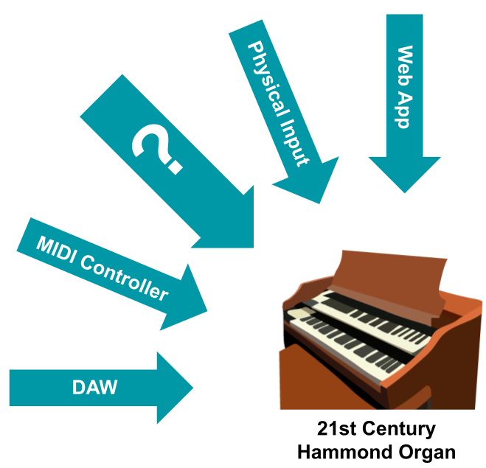
Why is it important?
Accepts MIDI input
Mechanical playback allows for future optimization
Provides an open-ended framework for future teams to work with
Notes:
Accepts Midi input in order to playback midi files generated by drawing or some other way.
You could use our app, a midi controller, a wii remote even? to capture midi through motion. in the future, teams could implement more ways to play the organ through midi signals. and possibly even bring the organ to Sophie’s place, a music therapy studio.
Possibilities or recommendations- finish implementing the solenoids, take it to sophie's place, build more alternative inputs with a sleek casing design.
“open ended framework for future teams to build on”

Slide 6
Prototyping process
Determine Design Parameters
Model known inputs
Interpret results to select best
Notes:
Accepts Midi input in order to playback midi files generated by drawing or some other way.
You could use our app, a midi controller, a wii remote even? to capture midi through motion. in the future, teams could implement more ways to play the organ through midi signals. and possibly even bring the organ to Sophie’s place, a music therapy studio.
Possibilities or recommendations- finish implementing the solenoids, take it to sophie's place, build more alternative inputs with a sleek casing design.
“open ended framework for future teams to build on”

Slide 7
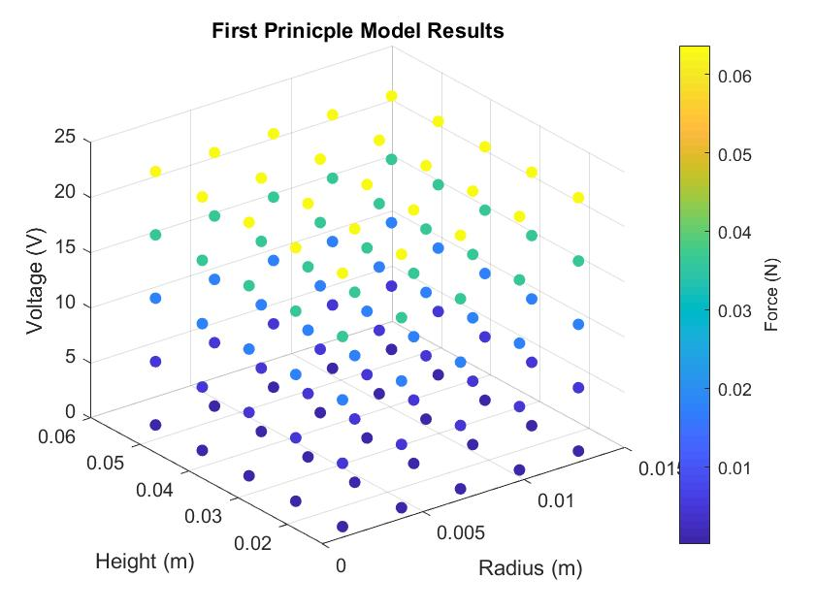
First Principle Modelling
Used math to predict results
Highlighted flaws in made assumptions
Possibility for future work, but not directly relevant to the team
Notes:
Accepts Midi input in order to playback midi files generated by drawing or some other way.
You could use our app, a midi controller, a wii remote even? to capture midi through motion. in the future, teams could implement more ways to play the organ through midi signals. and possibly even bring the organ to Sophie’s place, a music therapy studio.
Possibilities or recommendations- finish implementing the solenoids, take it to sophie's place, build more alternative inputs with a sleek casing design.
“open ended framework for future teams to build on”

Slide 8
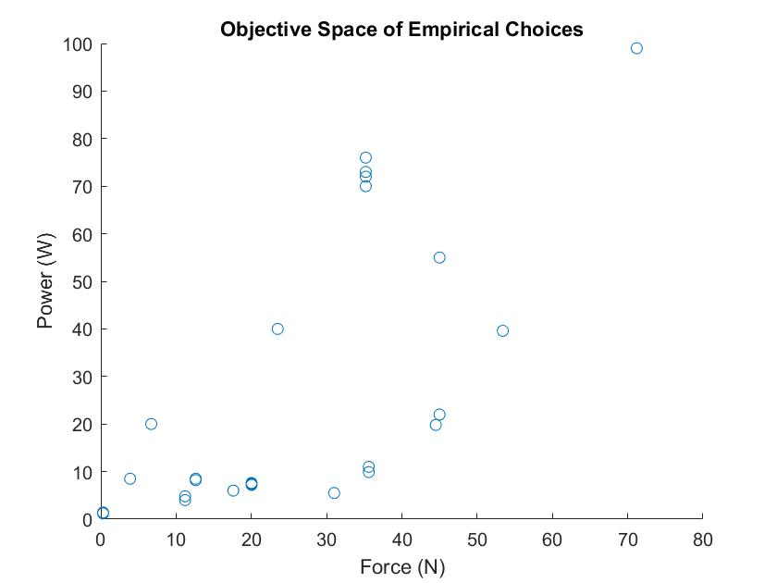
Empirical Modelling
Identified Pareto set
Reduces Decision Space
Opens Possibility of Trend in Design Space
Notes:
Accepts Midi input in order to playback midi files generated by drawing or some other way.
You could use our app, a midi controller, a wii remote even? to capture midi through motion. in the future, teams could implement more ways to play the organ through midi signals. and possibly even bring the organ to Sophie’s place, a music therapy studio.
Possibilities or recommendations- finish implementing the solenoids, take it to sophie's place, build more alternative inputs with a sleek casing design.
“open ended framework for future teams to build on”

Slide 9
Conclusion and Questions
Process Identified a best solenoid, though the team had already picked one that “worked”
Went to the MDP fair and saw what was interesting
Biggest Hurdle was the Virus, and the issues that introduced logistically
The Project will continue, next steps are to finalize the casing and otherwise polish the current work
Notes:
Accepts Midi input in order to playback midi files generated by drawing or some other way.
You could use our app, a midi controller, a wii remote even? to capture midi through motion. in the future, teams could implement more ways to play the organ through midi signals. and possibly even bring the organ to Sophie’s place, a music therapy studio.
Possibilities or recommendations- finish implementing the solenoids, take it to sophie's place, build more alternative inputs with a sleek casing design.
“open ended framework for future teams to build on”

