Slide 1
Generating Pop Songs through Machine Learning and Algorithms
Team Member: David Wang (Honors Capstone)
Advisor: Dr. Zeynep Özcan

Slide 2


My goal is to explore ways in which pop song melodies could be recreated through machine learning and hard-coded algorithms
Characteristics of Pop Songs:
Clear chord progression.
Repetition and modification of motifs.
Rhythm that could be easily sung.
Clear conclusion.

Slide 3
Method 1:
Machine Learning

Slide 4
Google’s Magenta offers models capable of generating long term structure.
Lookback RNN:
Looks back at events from 1 and 2 bars ago to determine next output.
Attention RNN:
Uses an “attention” mechanism to extract information from past decoder steps.

Slide 5
I experimented with different models and weights to see if their outputs show any characteristics of pop songs.
Models:
Lookback RNN
Attention RNN
Weights:
Magenta’s Default Weights
Weights from video game music.
Weights from 50 pop song vocal lines

Slide 6
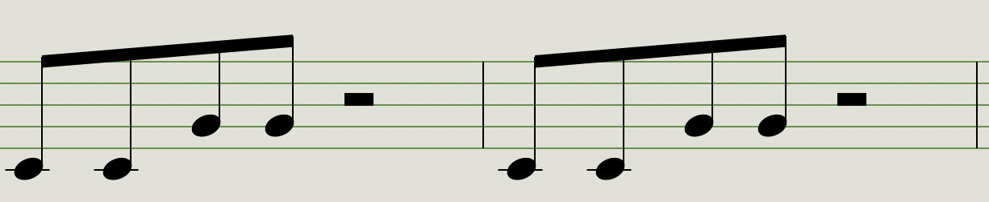
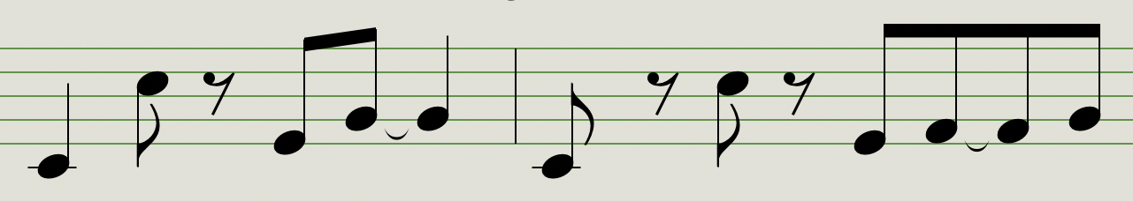
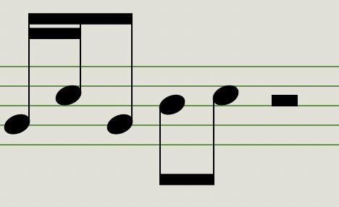
Magenta’s models tend to slowly modify pitches and rhythms over time, but never return to the same melody.
Repeat the input melody.
Elaborate on the melody.
Ends with a heavily modified version of the input melody.

Slide 7
A structural issue in Magenta’s models makes it incapable of repeating motifs
Pop music: Heavily reuses motifs and repeats previous bars.
Magenta’s music: Only capable of looking back at two bars at max.

Slide 8
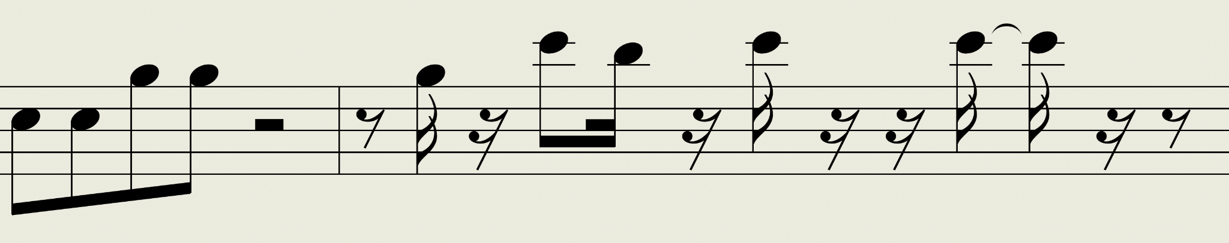
Magenta’s models are better suited for brainstorming and generating experimental music.

Slide 9

We would use two input melodies to display some characteristics of Magenta’s output.
Input 1: The first 4 notes of Twinkle Twinkle Little Star (input_1)
Input 2: The first two bars of Maroon 5’s Payphone (input_2)

Slide 10
Comparison 1
The complexity of the input melody, such as its pitch range and variation in note length, would be reflected in its continuation.
(comp_1_input_1)
(comp_1_input_2)

Slide 11
Comparison 2
Attention RNN seems to hold longer themes than Lookback RNN.
In the following example, Attention RNN could hold the same rhythm for 11 bars, while Lookback RNN changes rhythm every 2 bars.
(comp_2_lookback)
(comp_2_attention)

Slide 12
Comparison 3
Magenta’s output would take on characteristics of its training MIDI files. For instance, we would see rapid 16th notes if the model was trained using video game music.
(comp_3_video_game)
(comp_3_pop_vocal)

Slide 13
Method 2:
Hard-Coded Algorithm

Slide 14
I experimented with converting my rules of pop song writing into a hard-coded algorithm in Python.
Characteristics of Pop Songs:
Clear chord progression.
Repetition and modification of motifs.
Rhythm that could be easily sung.
Clear conclusion.

Slide 15
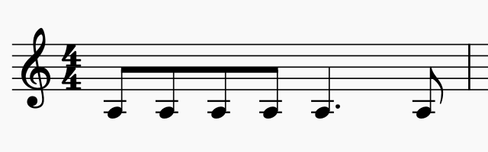
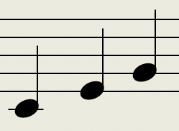
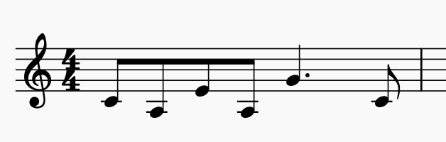
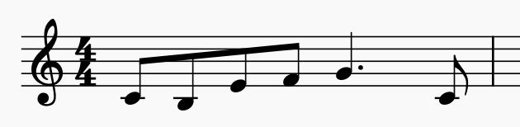
I was able to create chord progressions be fitting each bar to a specific chord.
1. Generate a random rhythm.
2. Decide on a chord.
3. Assign notes with chord tone.
4. Assign others with neighboring tones.

Slide 16
The repetition and modification of melodies could also be achieved through coding.
1. Generate a 4 bar sequence of melody.
2. Duplicate the sequence.
3. Modify parts of the second sequence
C | F | G | C
C | F | G | C
C | F | G | C
C | F | G | C
C | F | G | C

Slide 17
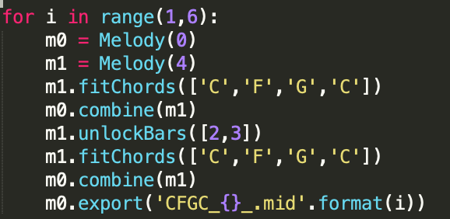
In the end, I wrote functions that help me generate rhythms, fit chords to rhythms, as well as duplicating and modifying them.

Slide 18
Examples
I’ve put some of my algorithm’s outputs on Google Drive for you to listen to.
(algorithm_{1~10})

Slide 19
Lessons I learned from my Capstone:
Never underestimate the time needed to pre-process your data. It was challenging for me to manually extract tracks I desired.
Both machine learning and hard-coded algorithms may not produce full-length pop songs on its own. Each has its own strengths and weaknesses.

Slide 20
Next Steps:
Write Python scripts that help with pre-processing raw MIDI data.
By integrating Magenta’s models with my functions, I may generate melodies with both logical continuations and repetitions.
Share my algorithm on GitHub to help those who are interested in continuing my project.

Slide 21
Sample Audio Clips:
Magenta’s output: (comp_2_lookback)
My algorithm’s output: (algorithm_2)

Slide 22
Thank you for Listening

