Slide 1
Pre-Figurative Structures for Social Connection
Bre Boersma, Waylon Richmond, Fikayo Olutomiwa (Honors Capstone)
Faculty Advisor: Nick Tobier
Notes:
Background info: I am part of a FEAST (Faculty Engineering/Arts Student Teams) project. Creating a physical experience that is tactile and connects across distance.
https://careerfairplus.whereby.com/ad73b475-c170-4669-ba32-14ce10615255?userAuth=off&emptyRoomInvitation=off

Slide 2
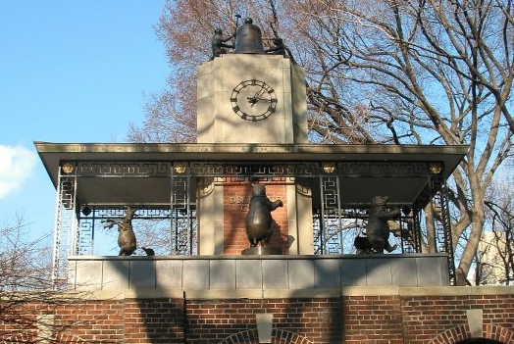
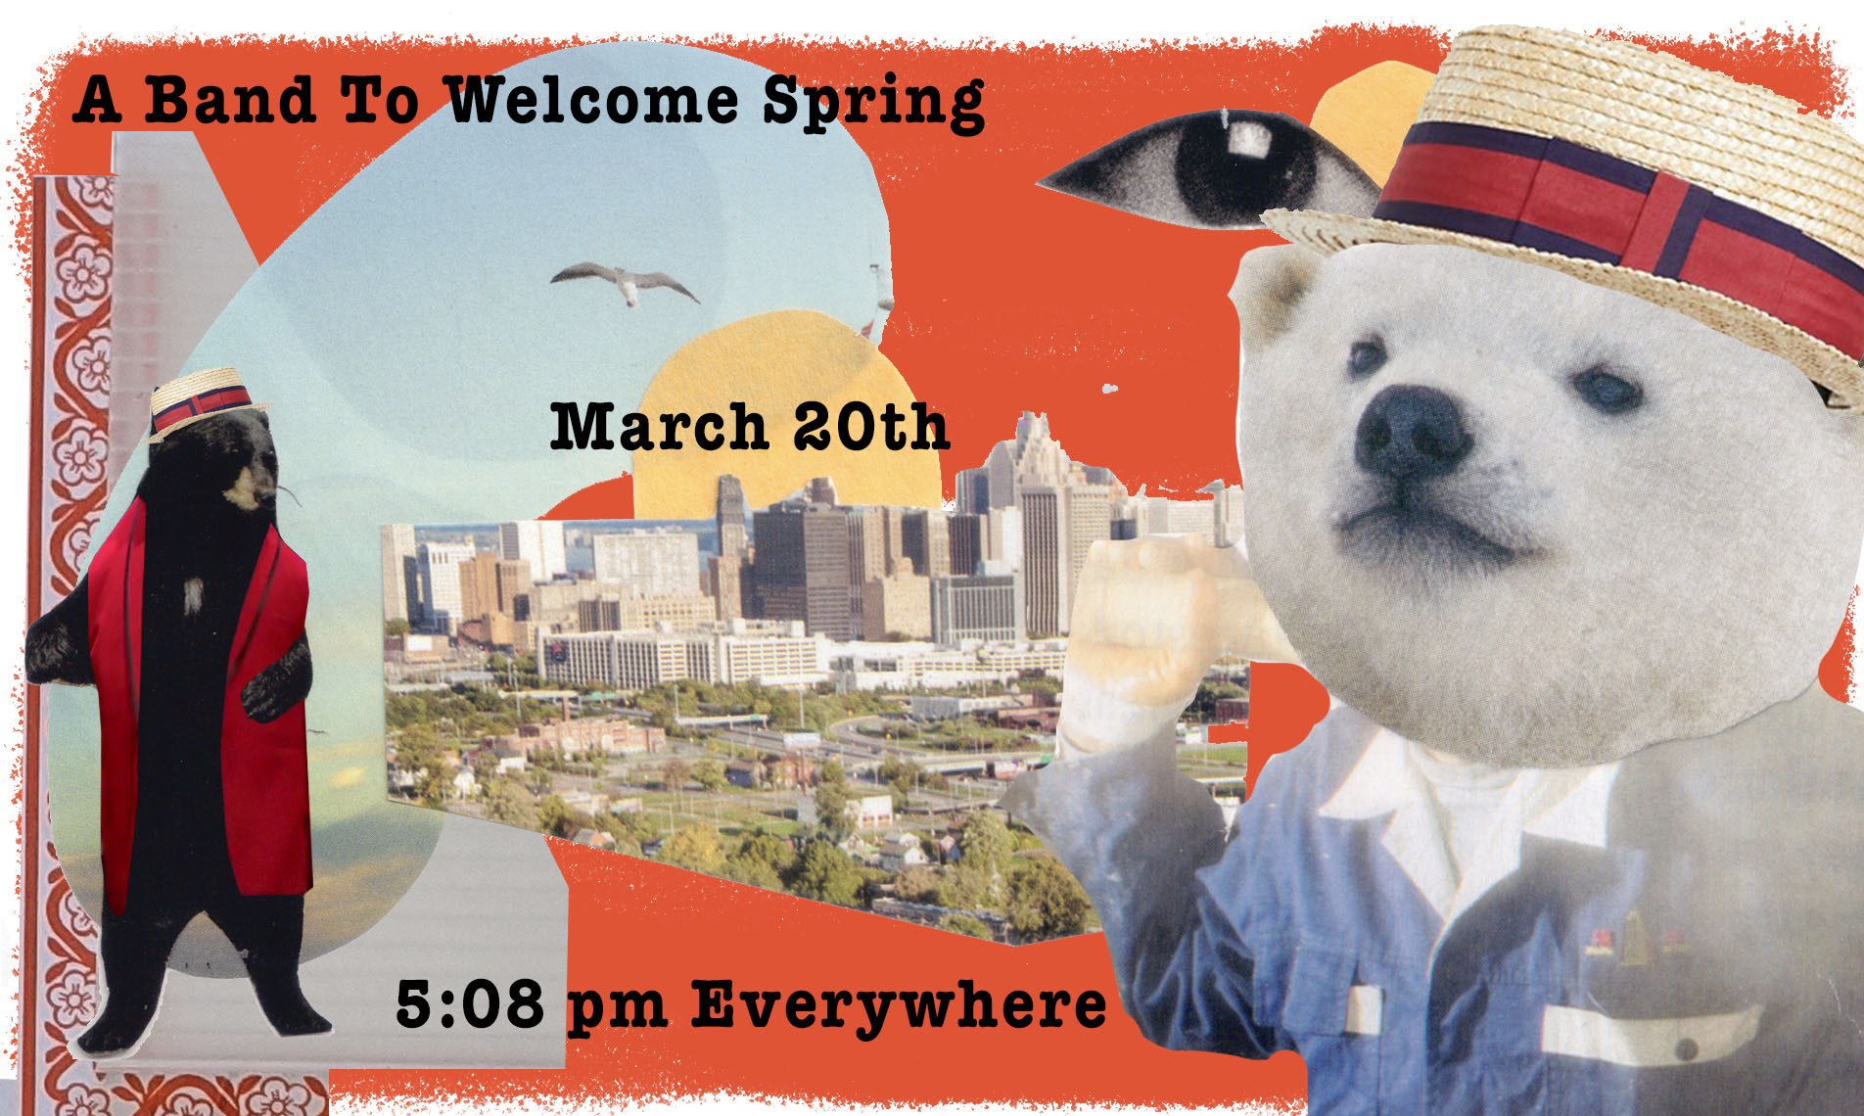
Band to Welcome Spring
Inspired by municipal clocks and bell towers
Celebrate the Vernal equinox
Create social connection and celebration in a world separated by the pandemic
Bre Boersma, Waylon Richmond, Fikayo Olutomiwa (Honors Capstone)
Faculty Advisor: Nick Tobier
Notes:
A Band to Welcome Spring is inspired by municipal clocks and bell towers that for centuries have been civic recognitions of the shared keeping and passage of time. A popular example of this is the Delacorte clock at the Central Park zoo in New York (where people stop to watch the animals play instruments at a certain time). *give umich bell tower example*
In this full pandemic year interest in and the need for social connection and celebration (while respecting physical distance ) feels especially needed.
The celebration time we chose was the vernal equinox (the coming of spring) which was on March 20th. We built a small structure to set up on a hill in Ann Arbor and were joined by 3 willing musicians and, among others: a wedding band in India that includes a horse in their ensemble, a custom-built island on Animal Crossing with animal musicians, a tuning fork in Vancouver, a slide whistle in Tokyo, a stand-up bass in Grand Rapids, a kazoo duo in Oregon, a dancing dog in DC, a string quartet in Central Park and a spinning disk in London.
So we were able to assemble music from all over the world to celebrate this one event.
bring people from around the world to celebrate spring together at the same time in different locations and time zones.

Slide 3
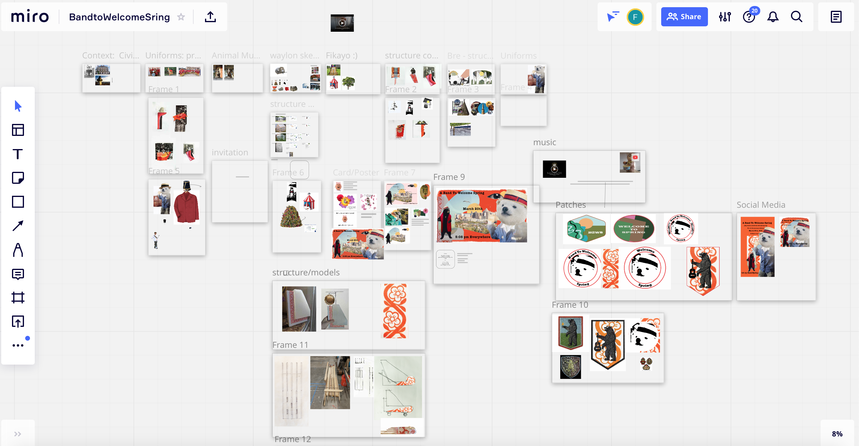
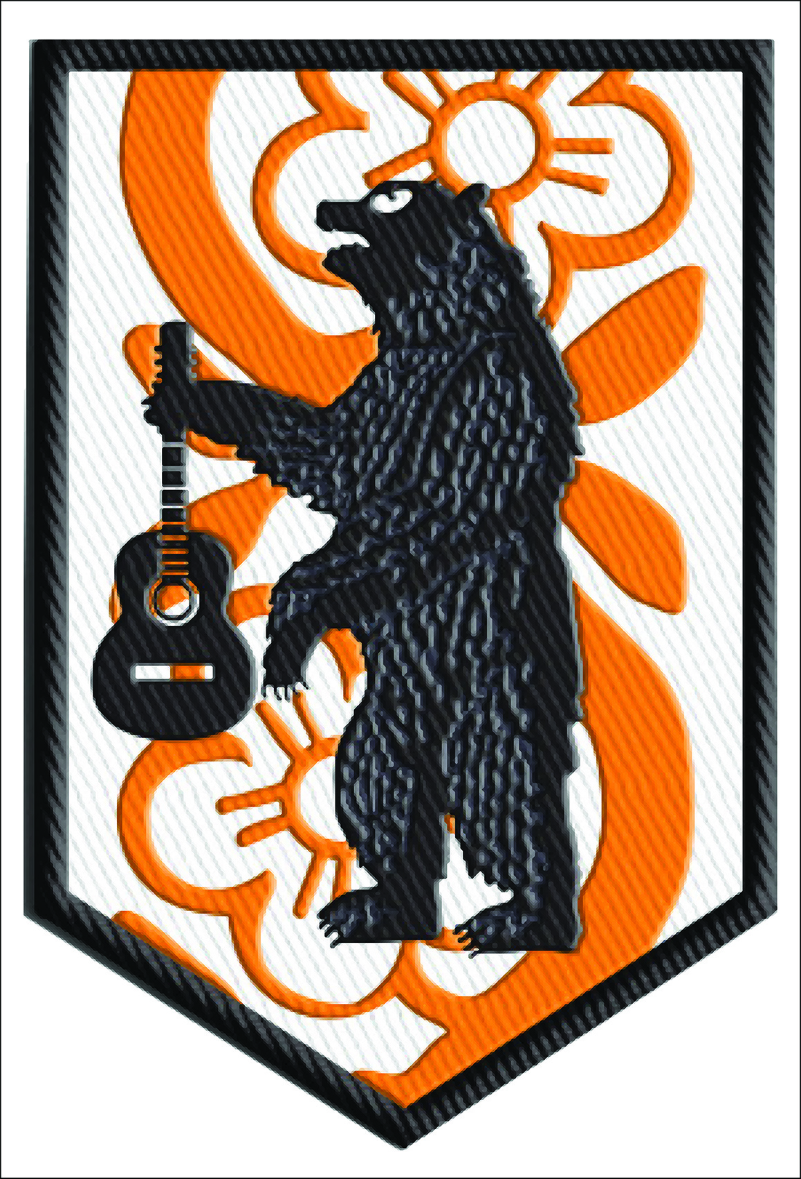
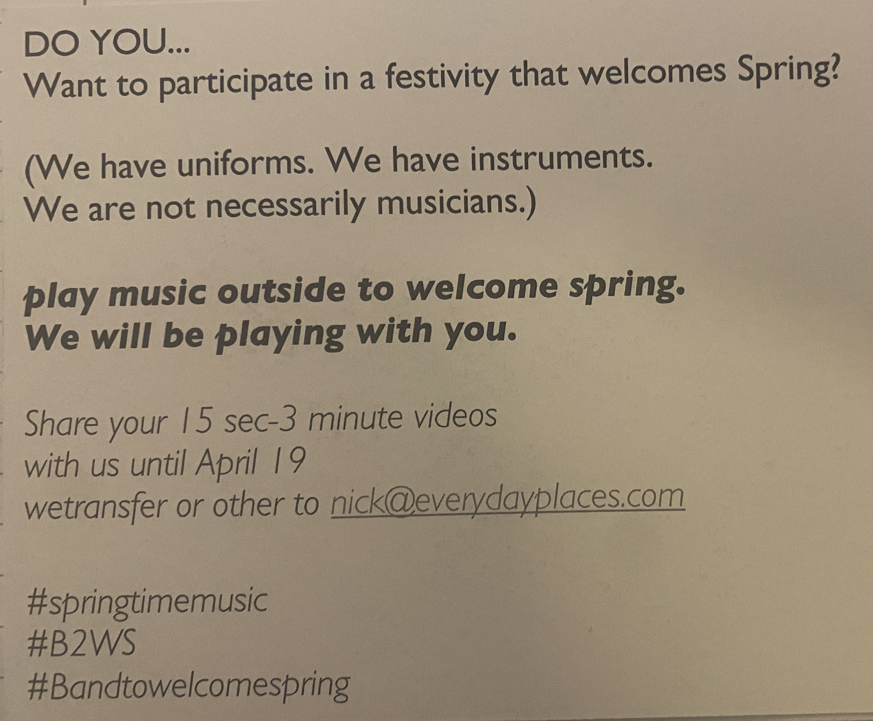
Creative Process
Structure/Hallmark
Uniforms
Poster
Bear Patch
Invitations (Postcards)
Bre Boersma, Waylon Richmond, Fikayo Olutomiwa (Honors Capstone)
Faculty Advisor: Nick Tobier
Notes:
We used a miro board to collect ideas and inspiration for the structure we made and for the invitations and sign for other people to use
Initial structure inspired by tiny restaurant tents for outdoor dining and then it changed to have a bobsled as its base design
Created Poster
Bear patch that was printed by other participants. to connect all the performances
*show postcard*

Slide 4
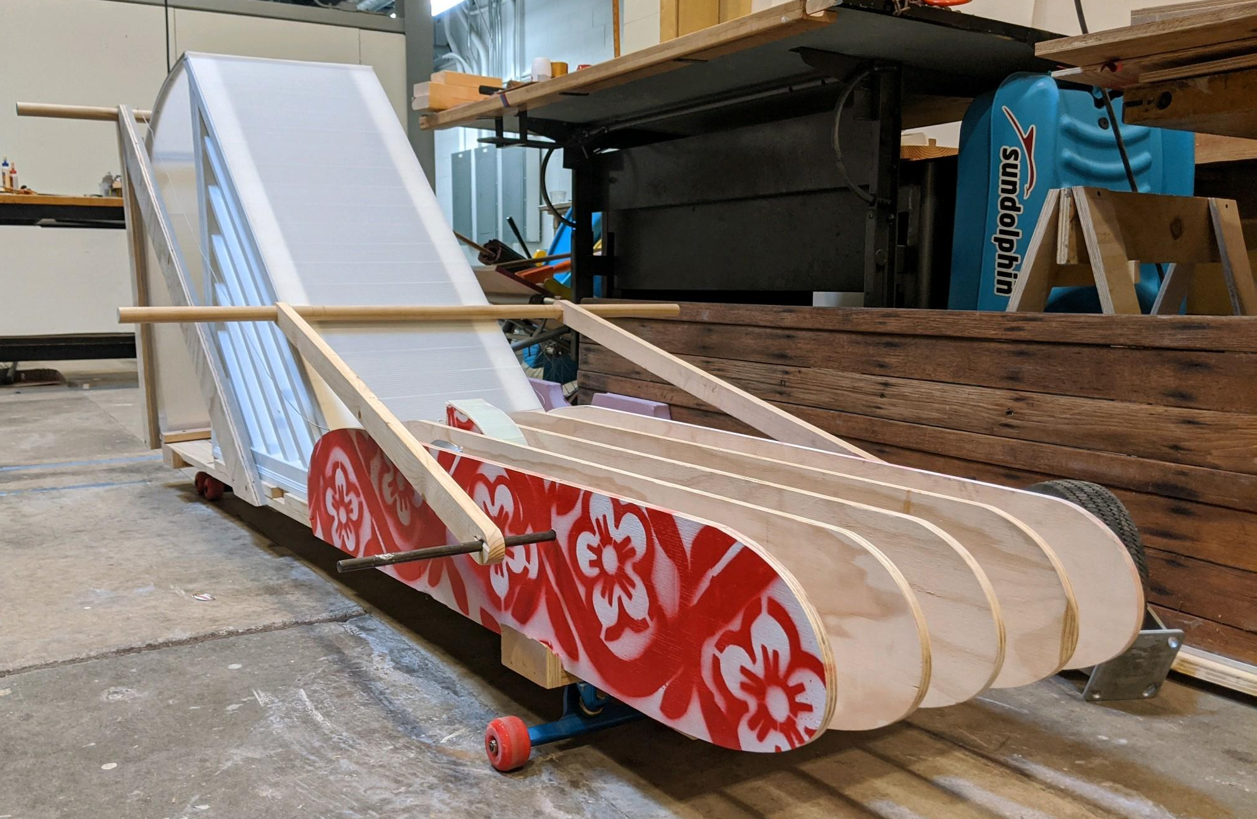
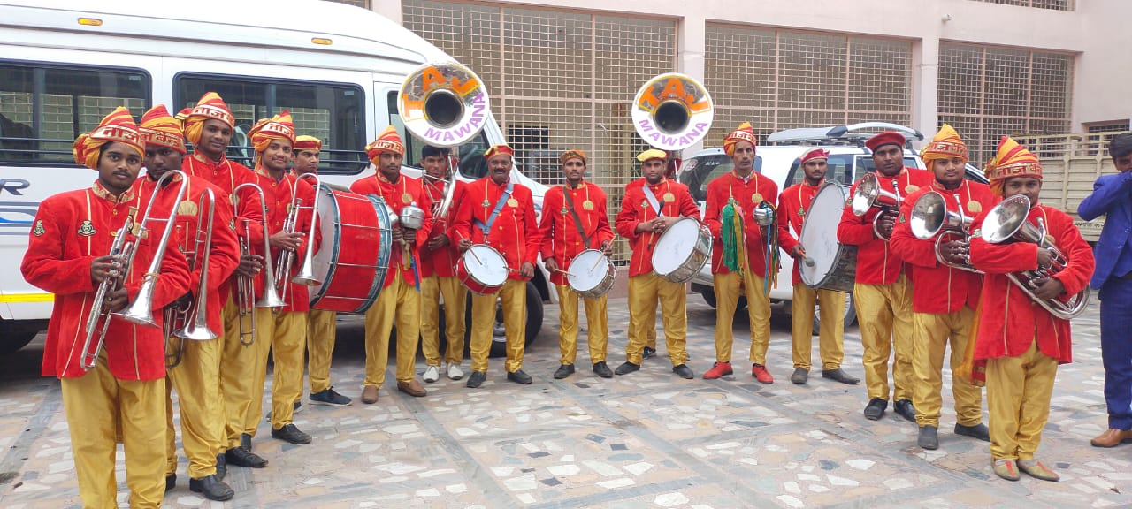
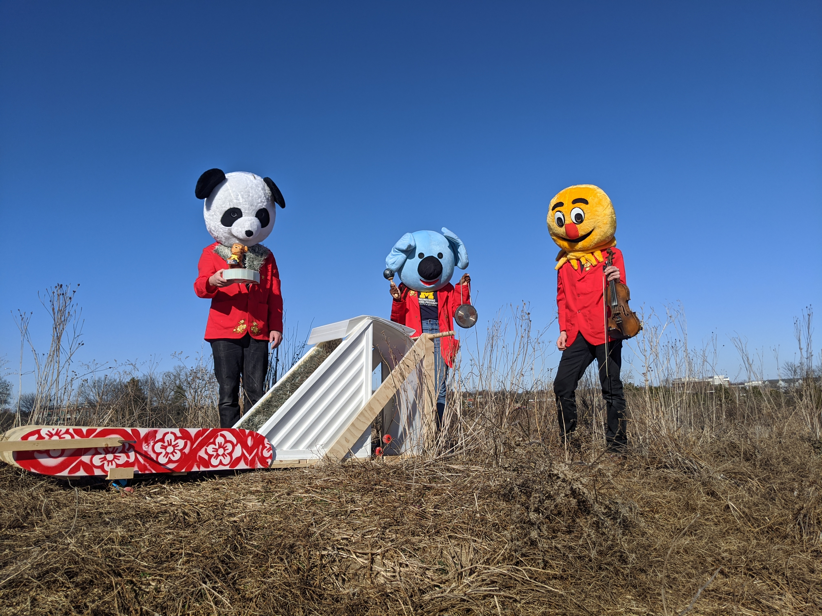
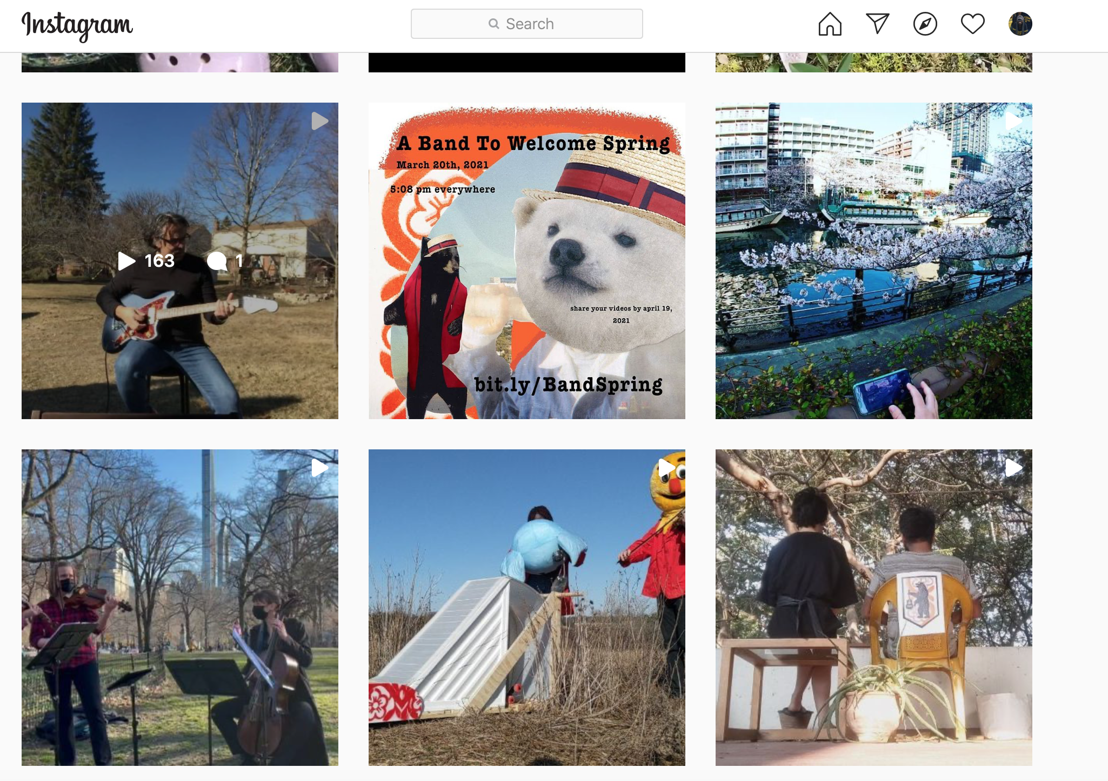
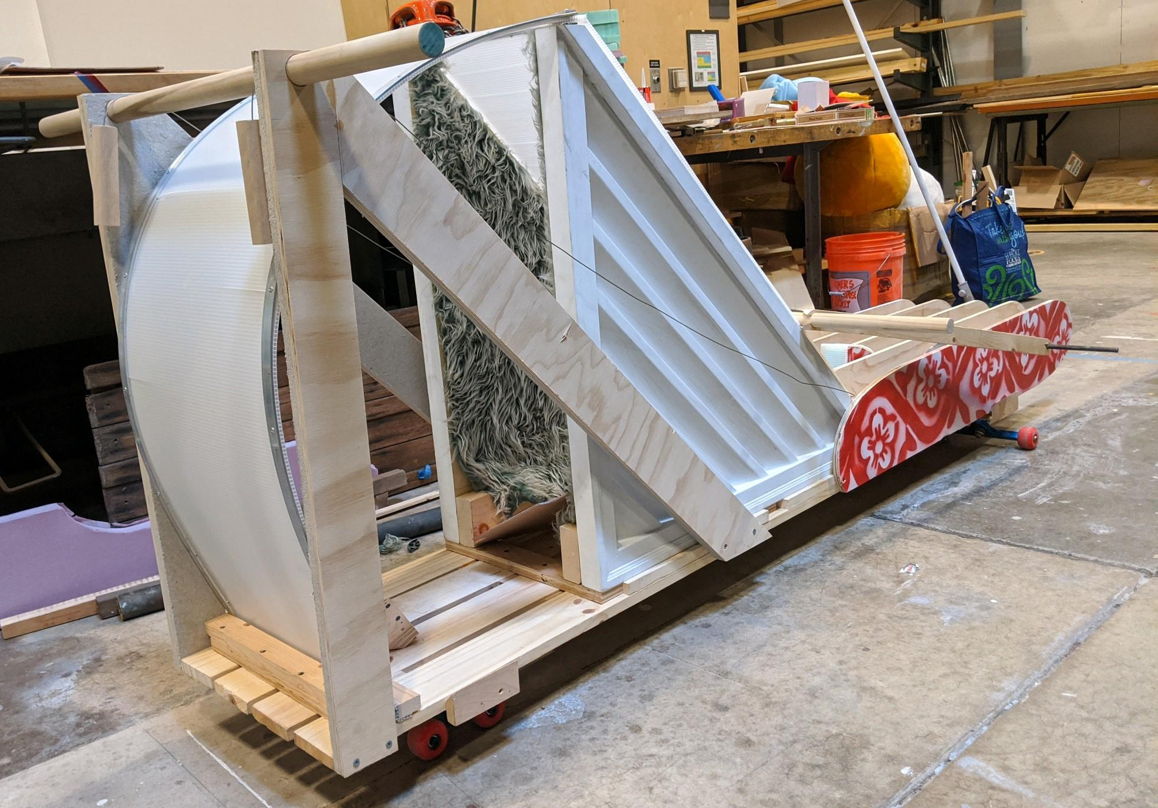
Final Structure and Performances
bit.ly/BandSpring
@nicktobier on IG
Structure
Bre Boersma, Waylon Richmond, Fikayo Olutomiwa (Honors Capstone)
Faculty Advisor: Nick Tobier
Notes:
Final structure base design was inspired by a seven foot toboggan which is associated with winter. We created a similar base using fresh lumber and added flower stencils to evoke the image of spring.
We had a performance on top of a hill with a fiddle playing

Slide 5
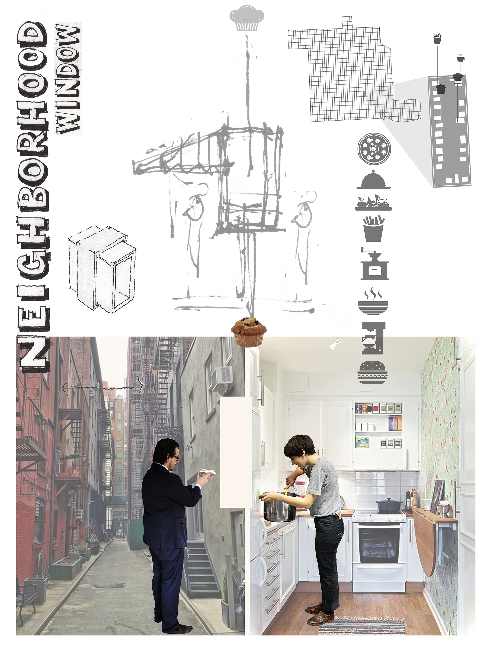
Further Work
Neighborhood Window
Emerging post pandemic
Bre Boersma, Waylon Richmond, Fikayo Olutomiwa (Honors Capstone)
Faculty Advisor: Nick Tobier
Notes:
Encourage collaboration within communities while maintaining separation of space

Slide 6
Thank You

