Slide 1
Electrooculography-controlled Cursor
University of Michigan Engineering Honors Capstone Winter 2021
EECS/BME 458 - Biomedical Instrumentation & Design
Professor Barry Belmont
Hardware: Samina Abdullah, Aidan Ahamparam
Software: Ellie Dulzo, Samy Ismail
Notes:
Samy

Slide 2
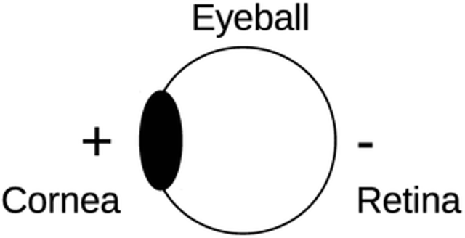
What is Electrooculography?
Electrooculography (EOG) is a technique for measuring the corneo-retinal standing potential that exists between the front and the back of the human eye.
Notes:
Samy

Slide 3
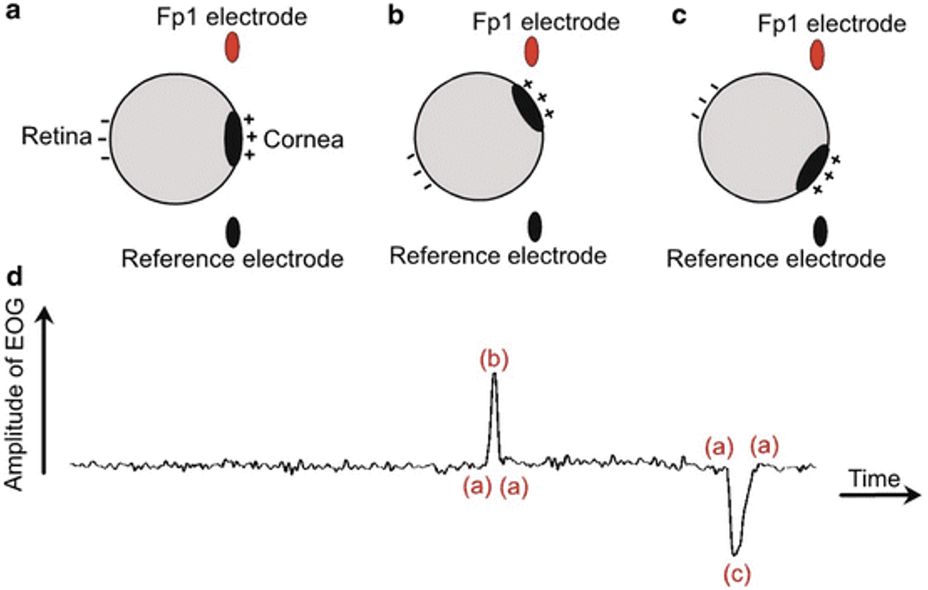
What is Electrooculography?
Notes:
Samy
Abbas S.N., Abo-Zahhad M. (2017) Eye Blinking EOG Signals as Biometrics. In: Jiang R., Al-maadeed S., Bouridane A., Crookes P., Beghdadi A. (eds) Biometric Security and Privacy. Signal Processing for Security Technologies. Springer, Cham. https://doi.org/10.1007/978-3-319-47301-7_5

Slide 4
Objective & Audience
Build a device that allow users to operate a computer via the movement of their right eye as opposed to hand motion
This technology would be particularly useful for amputees, quadriplegics, and any individual unable to operate a typical mouse
Notes:
Samy
Our goal build an EOG device that allows users to operate a computer cursor via the movement of their right eye as opposed to hand motion.
People with impaired motor function or dexterity are unable to or have difficulty controlling a computer’s cursor through its intended interface, which restricts their ability to use computers.
Being able to use a computer is a necessary life skill. Therefore, this technology would be particularly useful for amputees, quadriplegics, and any individual unable to operate a typical mouse.

Slide 5
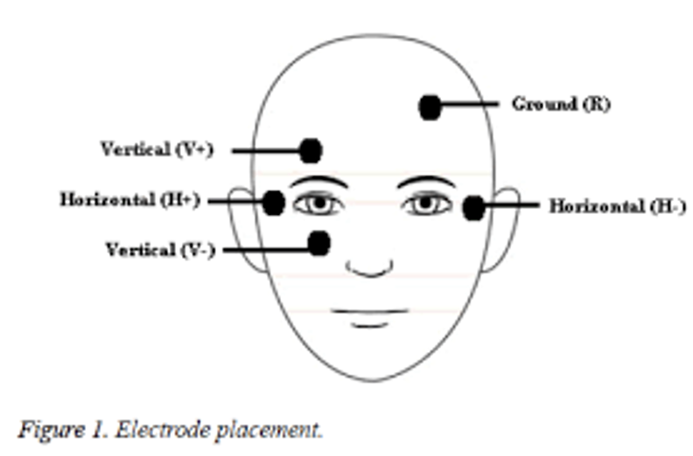
Electrode Placement

Slide 6
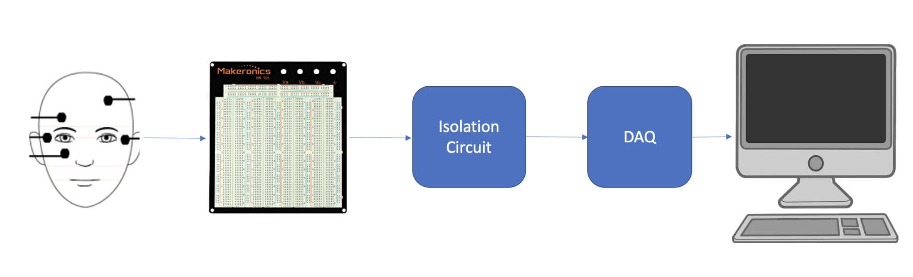
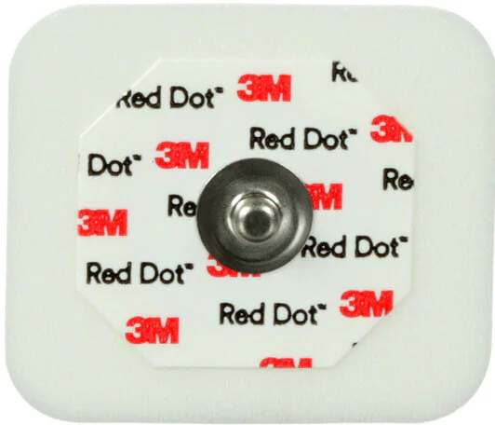
High-level Experimental Setup
Notes:
Samina

Slide 7
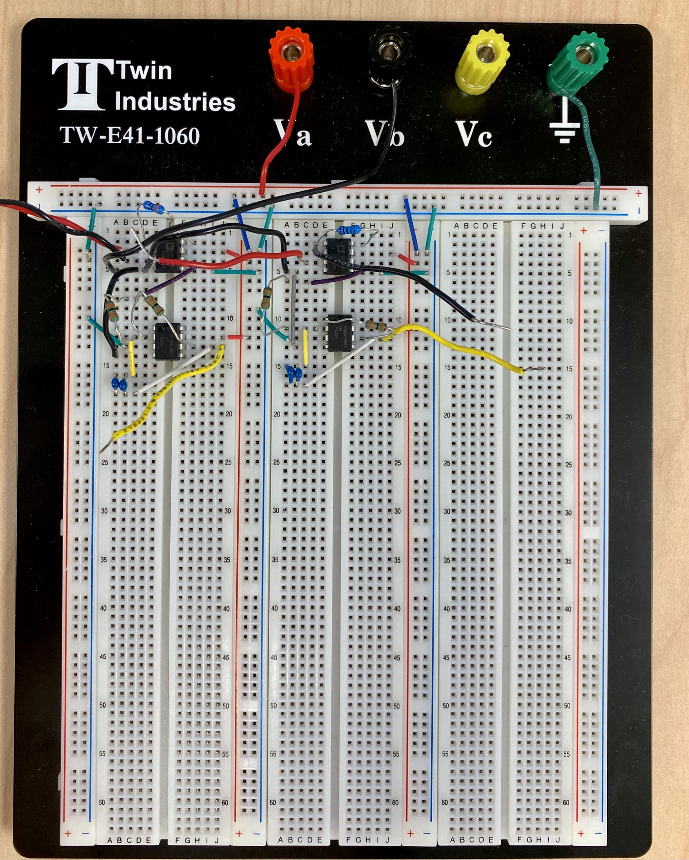
Breadboard

Slide 8
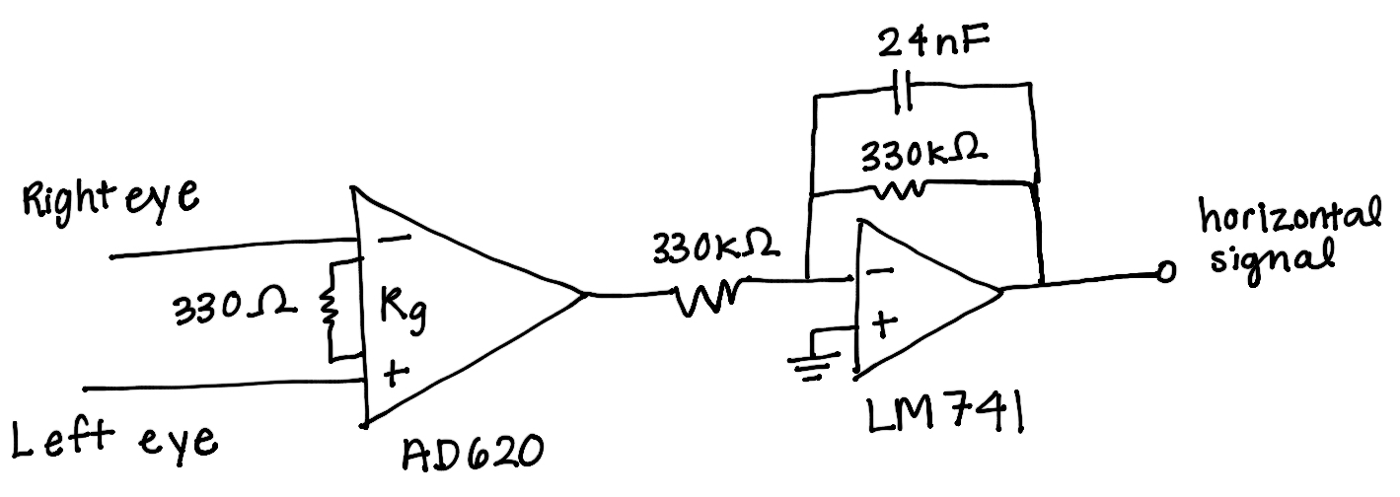
Hardware Schematic: Horizontal
Notes:
Samina

Slide 9
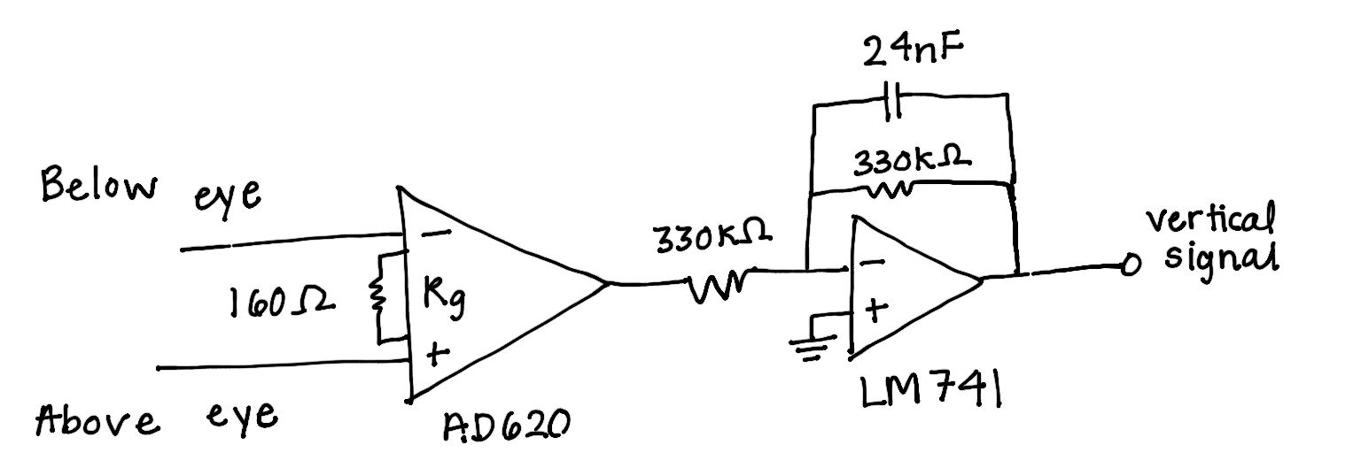
Hardware Schematic: Vertical
Notes:
Samina

Slide 10
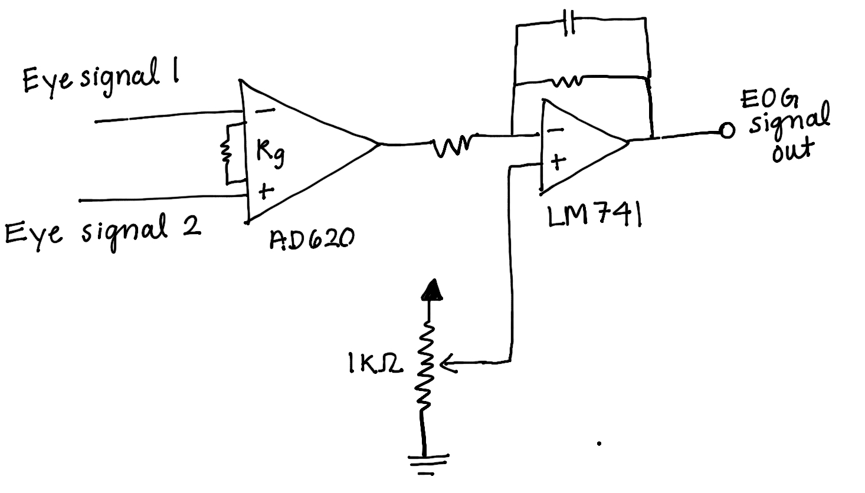
Hardware Considerations
Deciding to implement a LPF instead of BPF
Tuning gain value on each circuit
Potentiometer subtractor circuit
Notes:
Samina
Deciding to implement a LPF instead of a BPF
Saw many research paper that implemented BPF to eliminate the DC offset, but we decided to implement a LPF because we didn’t want to detect the differentiated signal which would only show peaks when the potential changed. We wanted the signal to be a constant value when looking in a specific direction
Tuning gain value on each circuit
We spent a lot of time trying out different resistors for the gain of the circuit that would take advantage of the full range of the DAQ without maxing the op-amp out
Potentiometer subtractor circuit for DC offset
Although we didn’t end up including this sub circuit in our final hardware, in efforts to separate the change in the signal from the DC offset and maximize this change through amplification, we implemented a subtractor circuit with a potentiometer tuned to the DC offset of the user’s eye. We had to tune the potentiometer manually and ended up having more issues when the circuit was added because we had to split the amplification into two stages since we had two op-amps and we ran into problems with maxing out our op-amps, so we decided to go with our one stage of amplification and LPF and ended up getting the best results with that hardware setup.

Slide 11
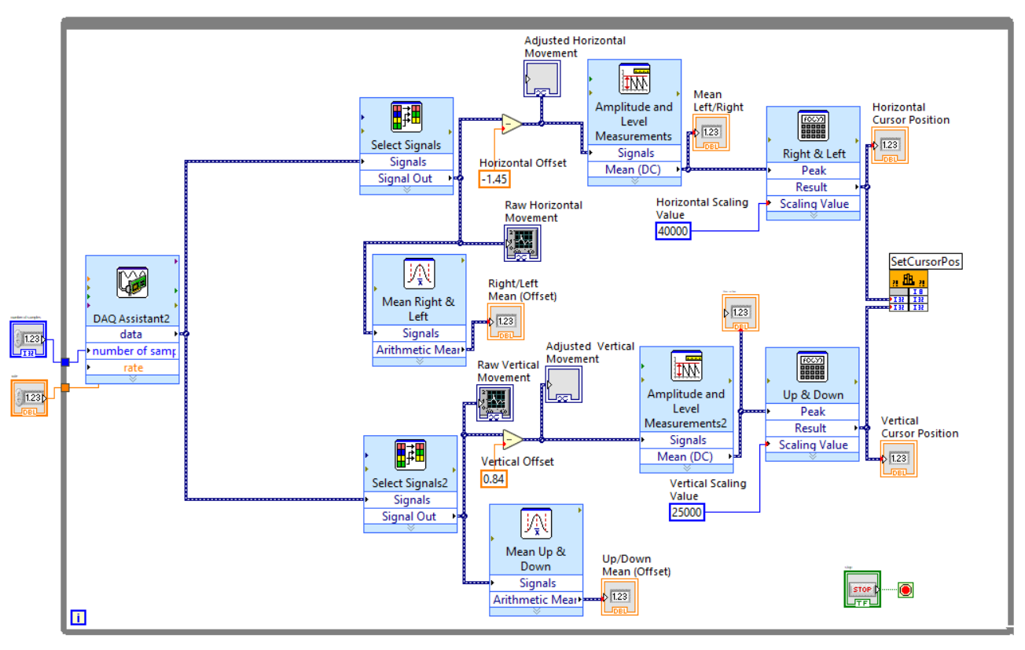
Software Block Diagram
Notes:
Ellie

Slide 12
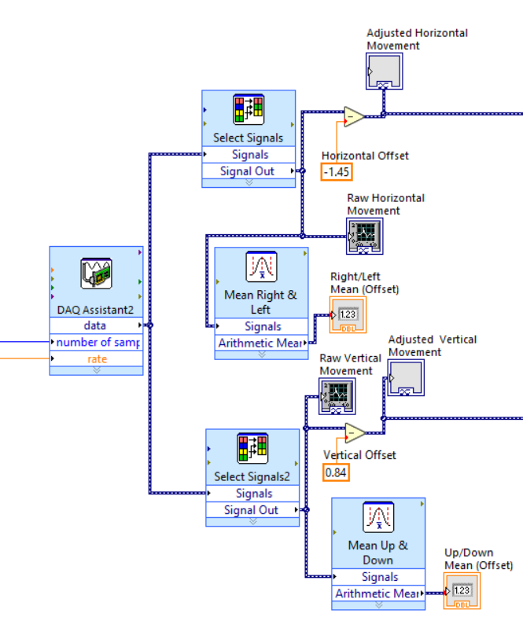
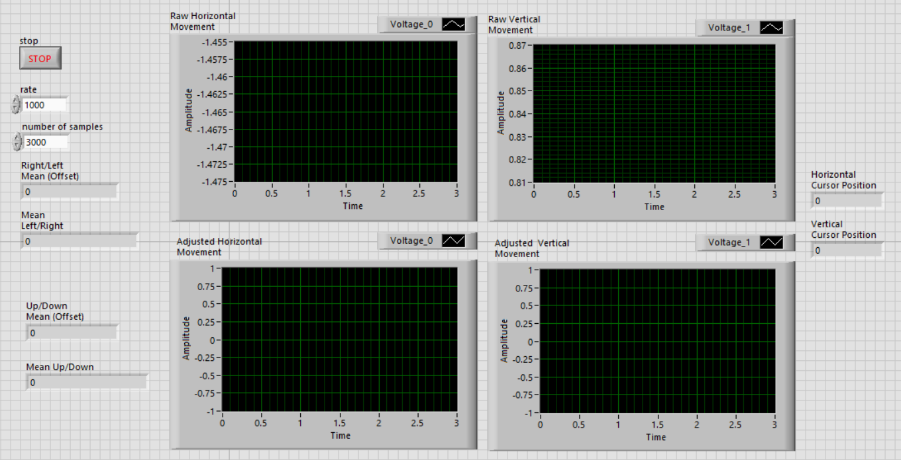
LabVIEW Data Analysis
Notes:
Ellie

Slide 13
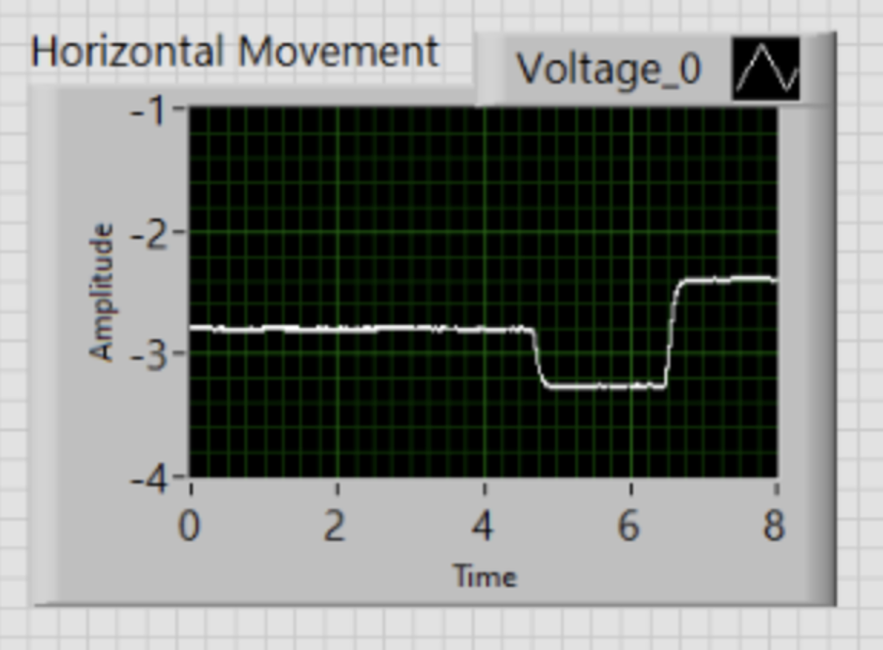
Horizontal Eye Movement Waveform

Slide 14
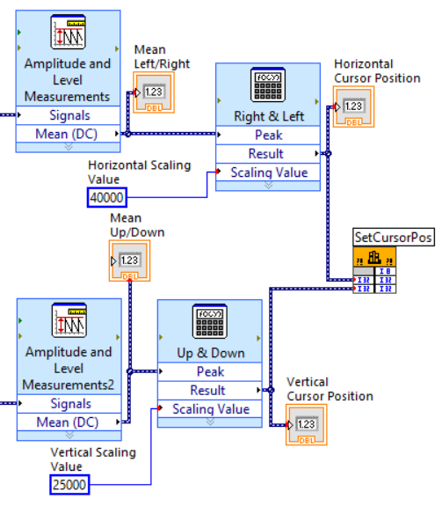
LabVIEW Data Analysis
Notes:
Ellie

Slide 15
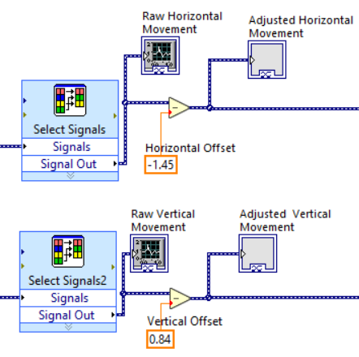

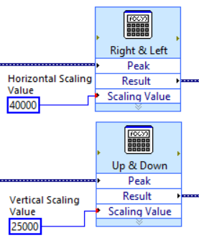
Calibration
Notes:
At the beginning of each trial we started by collecting some baseline values.
We asked the participant to look at the middle “X” while we identified the the horizontal and vertical offsets. We inputted these values into the software so that the adjusted signals would be centered at zero.
Then we asked the participant to look at the right “X”, left “X”, up “X”, and down “X” so that we could record the extreme measurements. These values were used to estimate starting the scaling values, although they were also adjusted slightly based on trial and error.

Slide 16
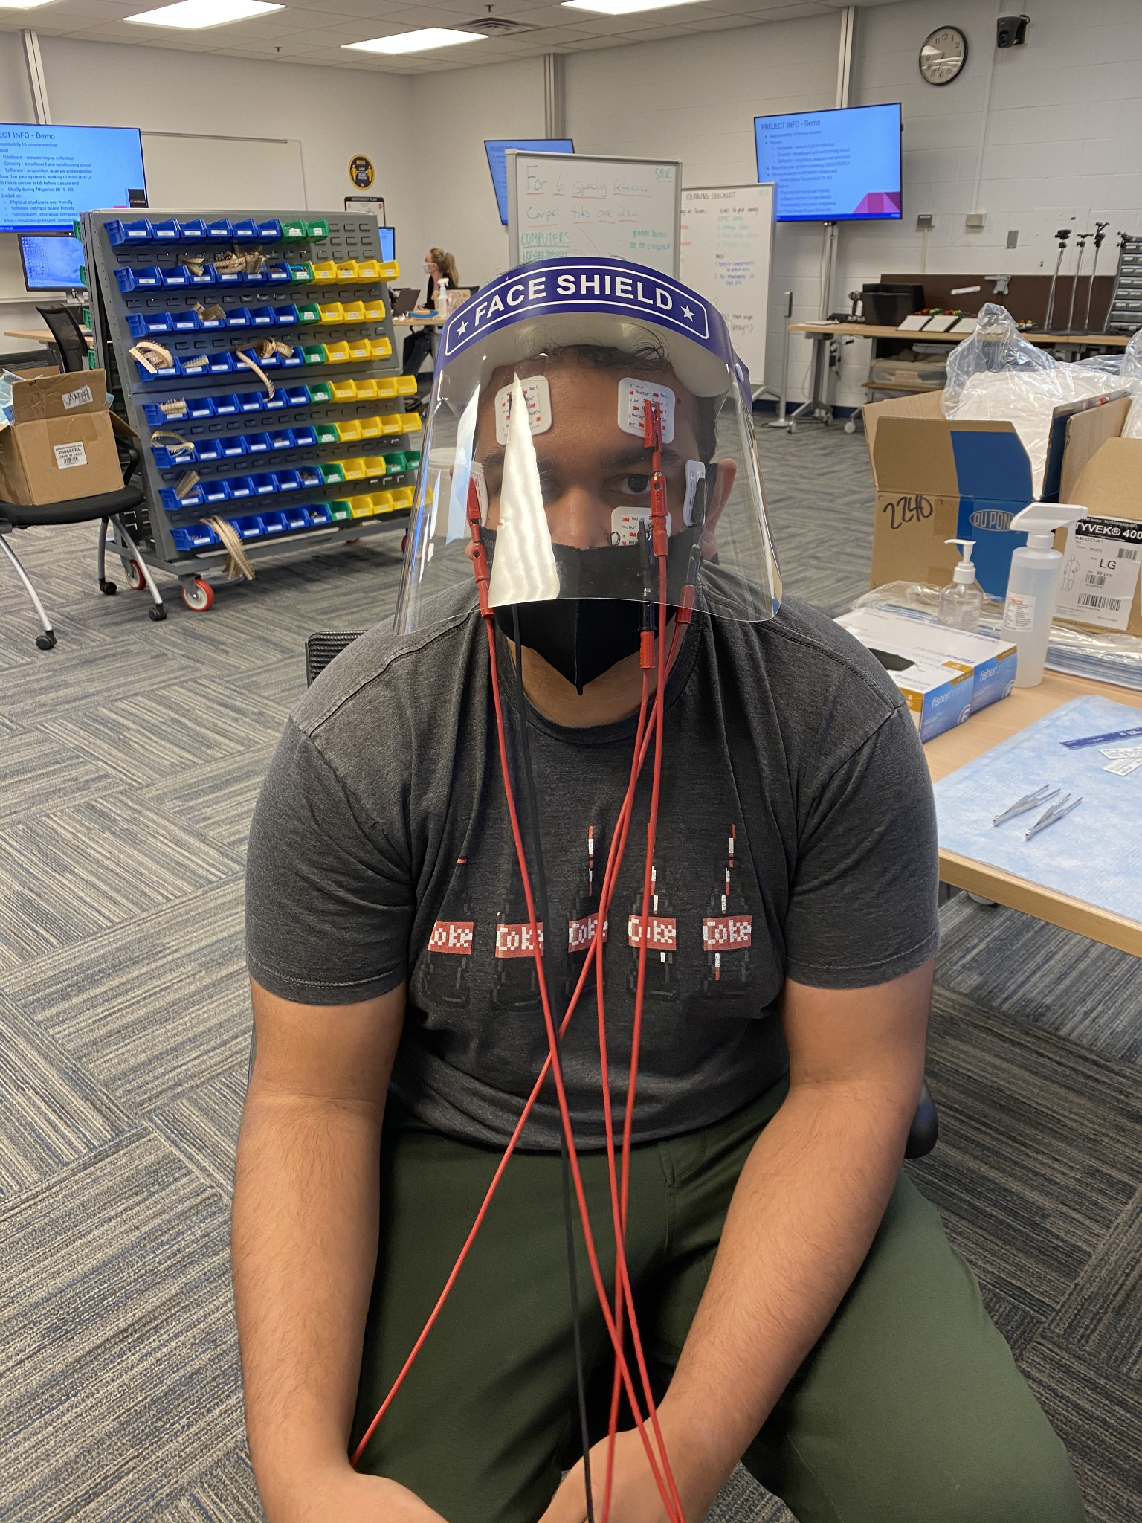
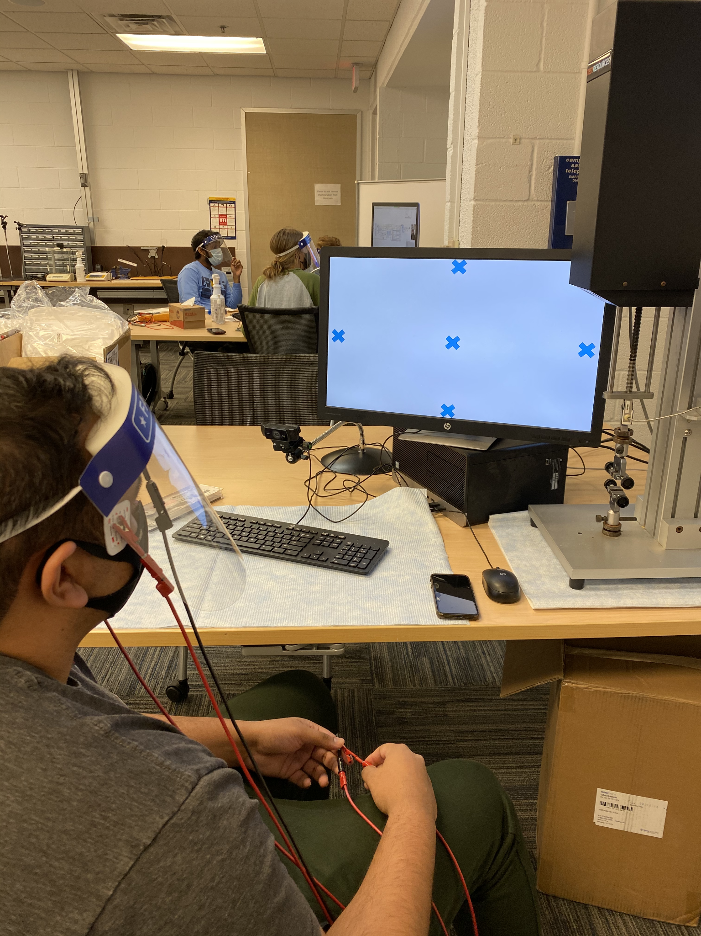
Testing

Slide 17

Video Demo: Horizontal Extremes and Intermediates
Notes:
Ellie

Slide 18
Video Demo: Four Corners
Notes:
Ellie

Slide 19
Obstacles & Challenges
Hardware Design
  Acquiring a vertical signal
  Tuning gain to appropriate sensitivity
  Balancing complexity and accuracy
Calibration
  Tuning scaling value
  Range of user offset and making time-varying adjustments
  User fatigue
Greatest Challenges: Acquiring a vertical signal and calibrating the user offset.
Notes:
Hardware Design
Acquiring a vertical signal → vertical “range of motion” is much smaller.
Tuning gain to appropriate sensitivity
Balancing complexity and accuracy
Calibration
Tuning scaling value → This value differed for each participant.
Range of user offset and making time-varying adjustments → This value differed for each trial and was constantly changing. It had to be updated frequently.

Slide 20
Results & Conclusion
Overall, we consider our project a success.
We were able to build a EOG device using hardware and software to identify vertical and horizontal potential differences and convert these values into a cursor location.
We were able to move the cursor to extreme and intermediate horizontal values as well as to the four corners of the screen.
However, our system still had some error as the cursor would often go to the general desired location but not the precise location.
Notes:
Ellie

Slide 21
Next Steps
Streamline the calibration process.
Calibrate using vocal commands
Add feature to turn off and run the system using vocal commands
Test and adapt to different screen sizes
Add a way to click the mouse
Notes:
Ellie
Would our system be more accurate with a larger screen?
Would our system be easier or harder to operate on a larger screen?
What is the ideal screen size for our system?

Slide 22
Questions?
Electrooculography-controlled Cursor
University of Michigan Engineering Honors Capstone Winter 2021
EECS/BME 458: Biomedical Instrumentation & Design
Contact info: Samina Abdullah, syabdul@umich.edu

Slide 23
Citations
Abbas S.N., Abo-Zahhad M. (2017) Eye Blinking EOG Signals as Biometrics. In: Jiang R., Al-maadeed S., Bouridane A., Crookes P., Beghdadi A. (eds) Biometric Security and Privacy. Signal Processing for Security Technologies. Springer, Cham. https://doi.org/10.1007/978-3-319-47301-7_5
Banerjee, Anwesha, et al. “Classifying Electrooculogram to Detect Directional Eye Movements.” Procedia Technology, vol. 10, 2013, pp. 67–75, www.sciencedirect.com/science/article/pii/S2212017313004921, 10.1016/j.protcy.2013.12.338. Accessed 16 Oct. 2019.
Creel, Donnell J. “The Electrooculogram.” Handbook of Clinical Neurology, vol. 160, 2019, pp. 495–499, pubmed.ncbi.nlm.nih.gov/31277871/, 10.1016/B978-0-444-64032-1.00033-3. Accessed 30 Mar. 2021.
“Electrooculogram.” EyeWiki, 23 June 2019, eyewiki.aao.org/Electrooculogram.
“Electrooculography - an Overview | ScienceDirect Topics.” Www.sciencedirect.com, www.sciencedirect.com/topics/neuroscience/electrooculography.
Huang, Eric Cole, Evan Mok and Alex, and Eric Cole Huang Evan Mok and Alex. EOG-Controlled Video Game. circuitcellar.com/research-design-hub/eog-controlled-video-game/. Accessed 23 Apr. 2021.
Z. Hossain, M. M. H. Shuvo and P. Sarker, "Hardware and software implementation of real time electrooculogram (EOG) acquisition system to control computer cursor with eyeball movement," 2017 4th International Conference on Advances in Electrical Engineering (ICAEE), 2017, pp. 132-137, doi: 10.1109/ICAEE.2017.8255341.

