Slide 1
Photo-assisted Flow Battery Charging
Wes Fermanich
B.S.E. Materials Science and Engineering (Honors Capstone)
Minor in Energy Science and Policy
Advisor: Prof. David Kwabi
Department of Mechanical Engineering

Slide 2
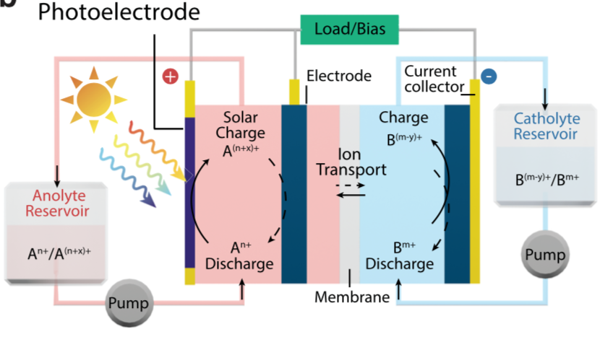
Background
Problem
Intermittency of solar energy requires coupling with energy storage systems
Coupling these systems causes efficiency loses and takes up greater space
Solar flow battery schematic
Solution
Integration of dye-sensitized solar cells (DSSCs) with redox flow batteries → solar flow batteries
Direct storage of solar-generated energy in battery, aiding the charging process
Li, W., & Jin, S. (2020). Design Principles and Developments of Integrated Solar Flow Batteries. Accounts of Chemical Research, 53(11), 2611-2621. doi:10.1021/acs.accounts.0c00373

Slide 3
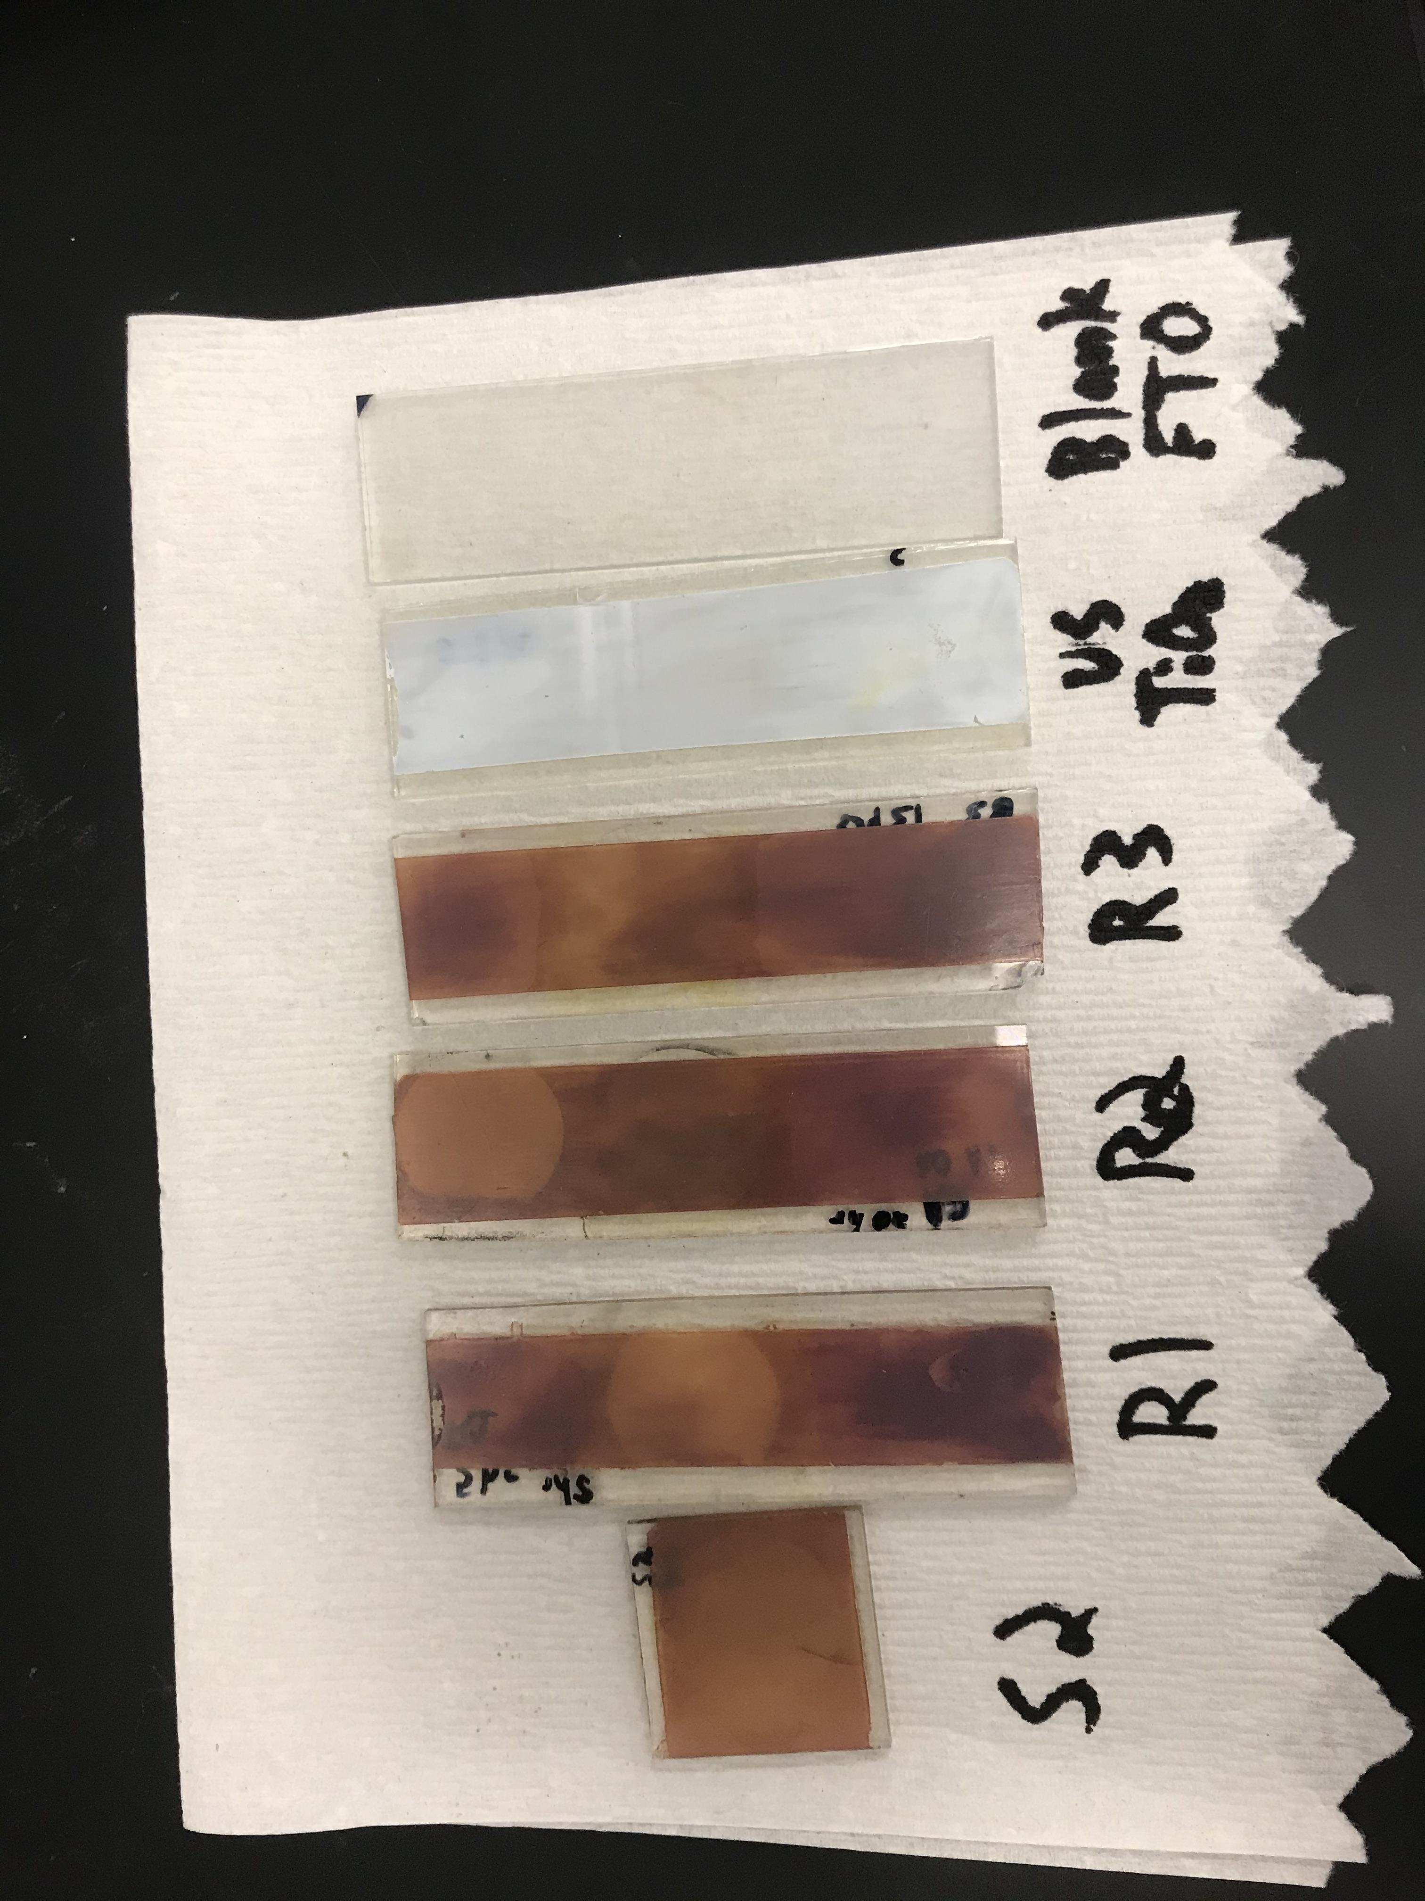
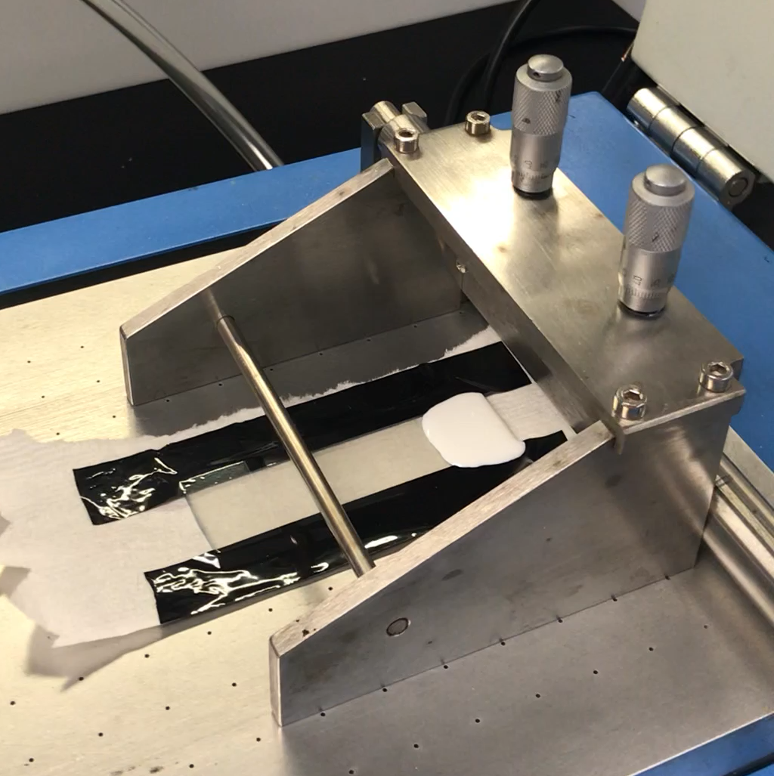
Work Completed
Photoanode Production
Paste formulation → paste dispersion → drying → dye-sensitization
Uncoated
Coated & dried
Photoanode Testing
Cyclic voltammetry: apply voltages to photoanode in electrolyte and measure current response
Sensitized samples for different amounts of time
Sensitized

Slide 4
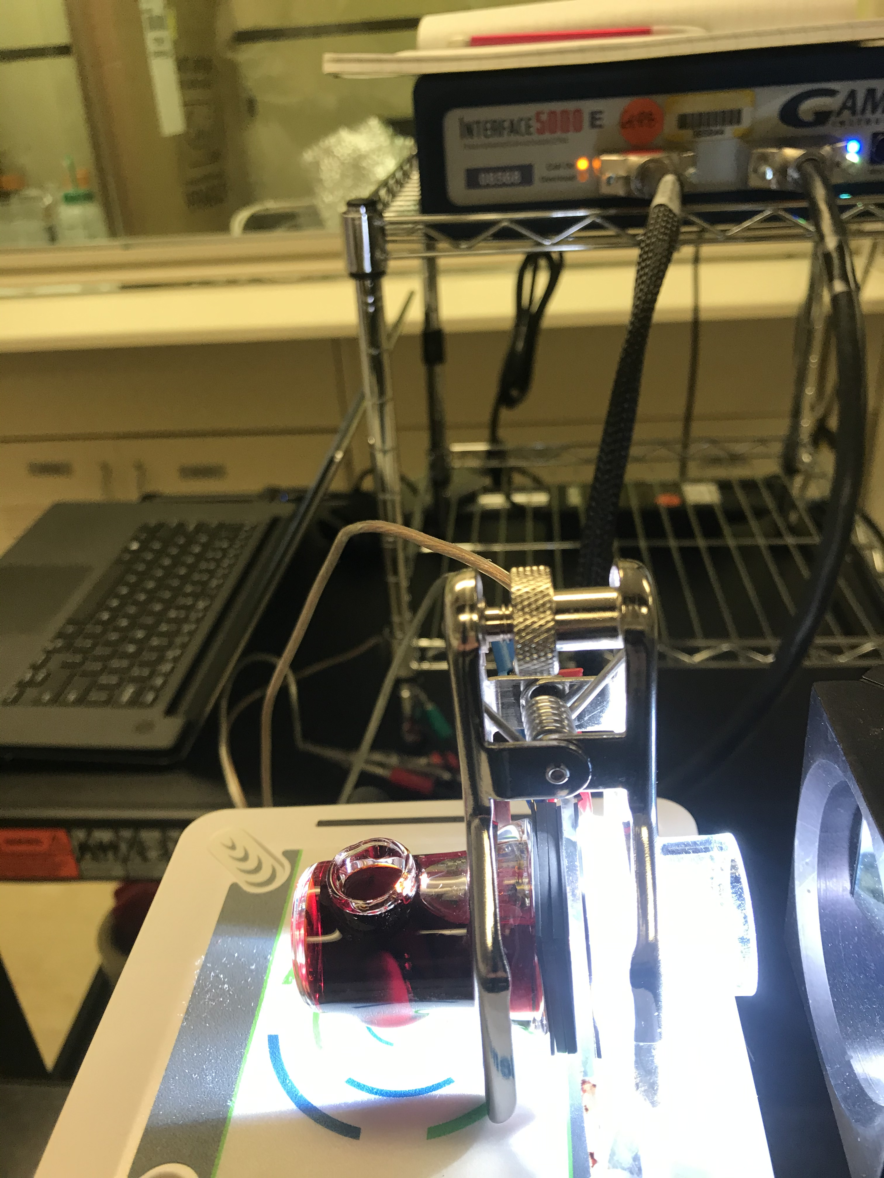
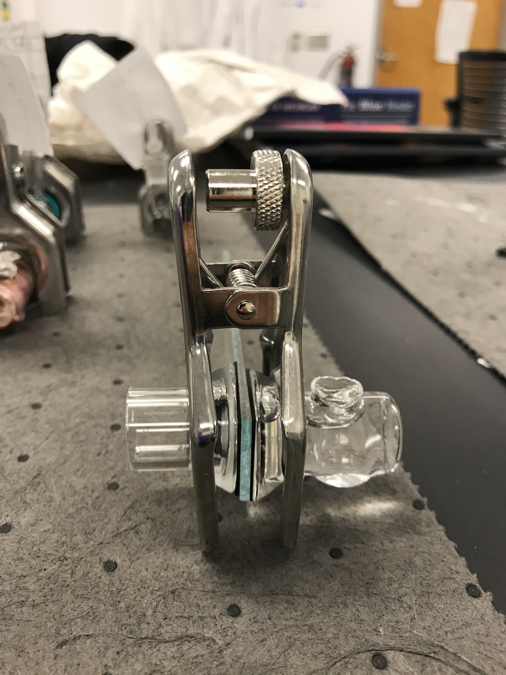
Photoanode Testing Set Up
20 hrs
13 hrs
0 hrs
5 hrs
~72 hrs
counter electrode
Electrolyte w/ stir bar
All anodes had an active area of roughly 2.5 cm² apart from S2 which had an active area of ~3.1 cm²
Gasket
Photoanode

Slide 5
Testing Results
Sample | Sensitization Time (hrs) | Max Power (mW)
R1 | 5 | 0.176
R2 | 20 | 0.226
R3 | 13 | 0.126
S2 | ~72 | 0.366
S2 norm | ~72 | 0.305

Slide 6
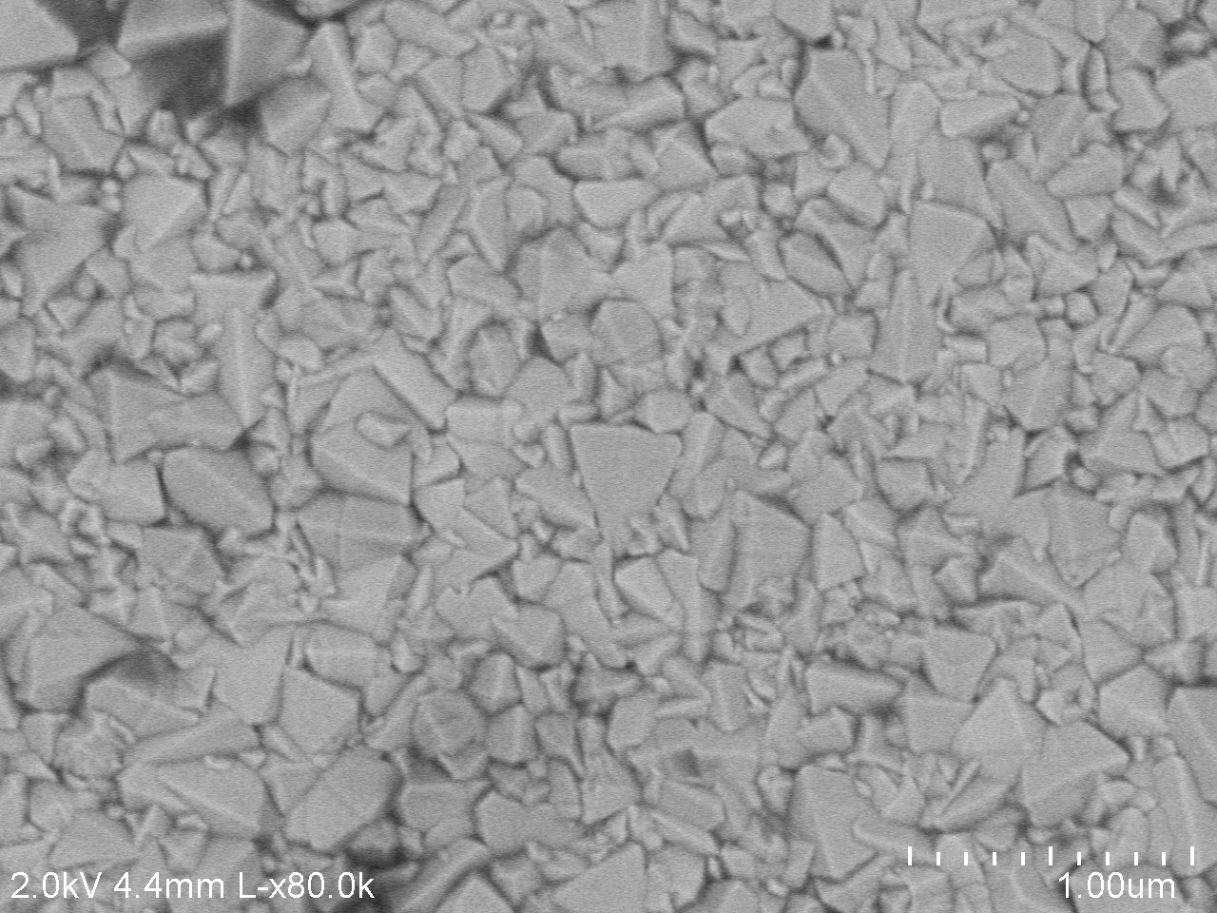
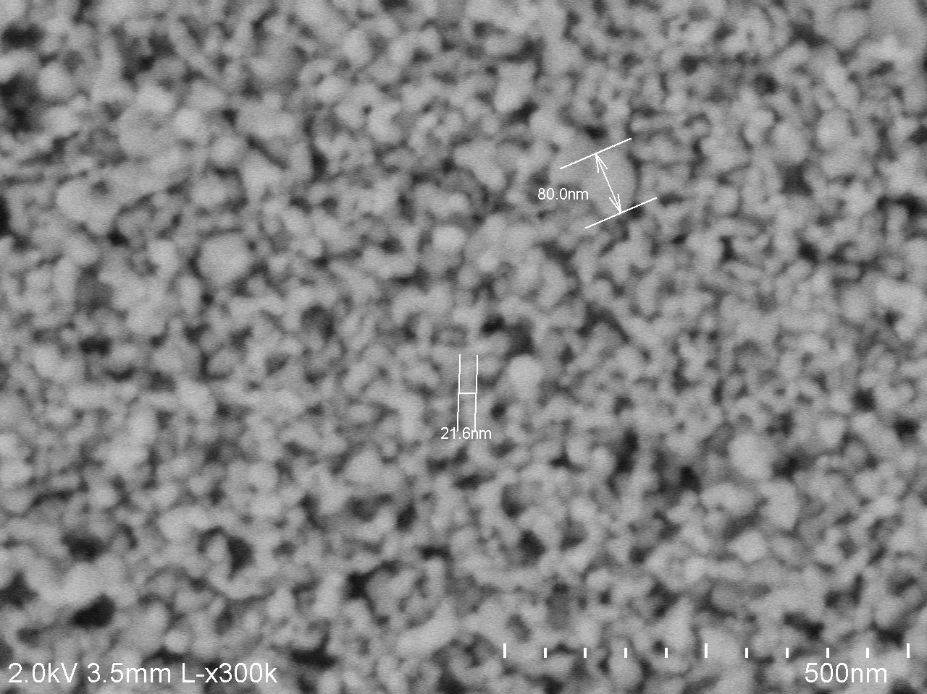
SEM Images
Air-dried, not heat treated
Heat treated and unsensitized

Slide 7
Looking Forward
Photoanode Production
Finalize paste formulation and dispersion
Determine parameters of interest for performance
Photoanode Characterization
Surface structure analysis
Electrical performance testing
Implement into Flow Cell
Test for full charging cycle under illumination
Test with other electrolytes

Slide 8
Acknowledgments
Professor David Kwabi
Sanat Modak
Cansu Doganay
Professor Zetian Mi
Yixin (Arthur) Xiao
Dr. Pilar Herrera-Fierro
CoE Engineering Honors Staff

Slide 9
Additional Slides

Slide 10
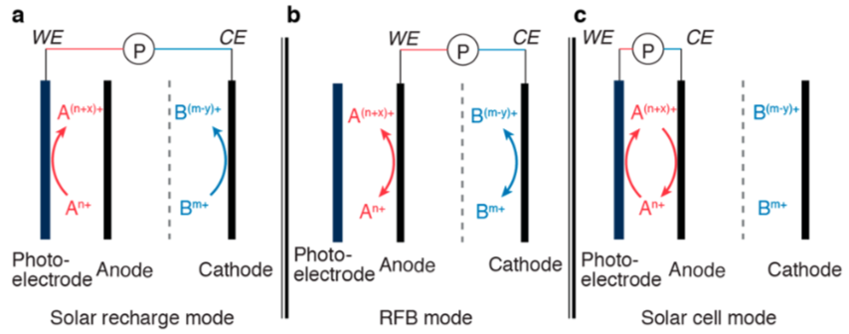
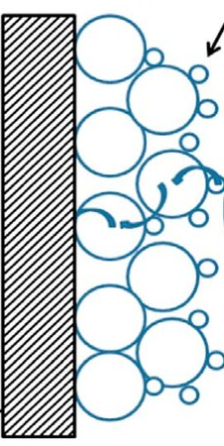

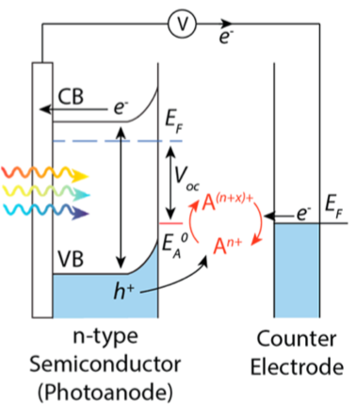
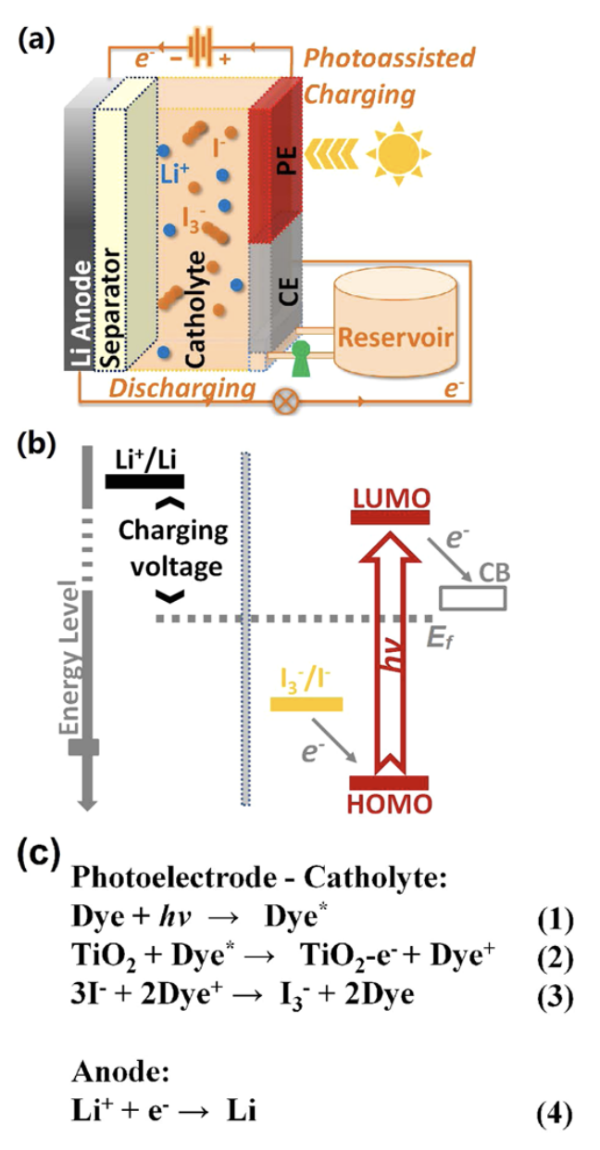
Photoanode Performance Theory
Z-907 dye
FTO
TiO₂

Slide 11
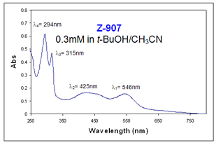
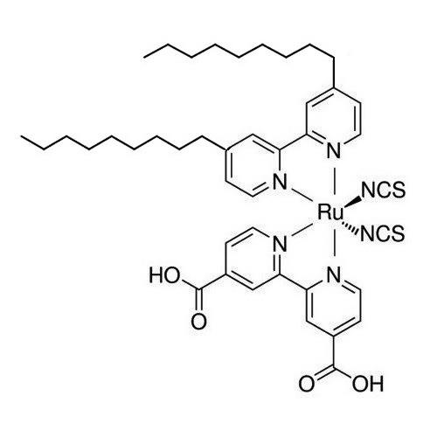
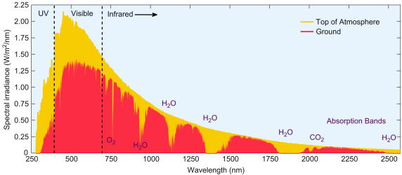
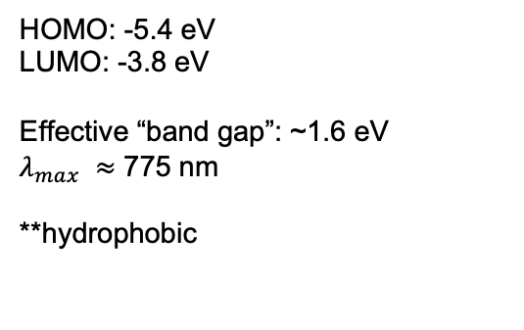
Z-907 Dye Structure & Properties
HOMO: -5.4 eV
LUMO: -3.8 eV
Effective “band gap”: ~1.6 eV
$λ_{max} ≈$ 775 nm
**hydrophobic
Z-907 dye
https://www.sciencedirect.com/topics/engineering/solar-spectrum

Slide 12
I-V Curves
Sample | Sensitization Time (hrs) | Open Circuit Voltage (mV) | Short Circuit Current (mA)
R1 | 5 | 243 | 1.83
R2 | 20 | 213 | 2.62
R3 | 13 | 210 | 1.56
S2 | ~72 | 304 | 3.99
S2 norm | ~72 | 304 | 3.32

Slide 13
Total Photoanode Testing Results
Sample | Sensitization Time (hrs) | Open Circuit Voltage (mV) | Short Circuit Current (mA) | Max Theoretical Power (mW) | Max Power (mW) | Fill Factor | Series Resistance (Ω)
R1 | 5 | 243 | 1.83 | 0.445 | 0.176 | 39.6% | 32.4
R2 | 20 | 213 | 2.62 | 0.558 | 0.226 | 40.5% | 29.0
R3 | 13 | 210 | 1.56 | 0.328 | 0.126 | 38.5% | 35.8
S2 | ~72 | 304 | 3.99 | 1.21 | 0.366 | 30.2% | 47.4
S2 norm | ~72 | 304 | 3.32 | 1.01 | 0.305 | 30.2% | -

