Slide 1


Final Presentation
Dylan Constantine | Joshua Goldstein | Miles Krasny | Parth Valecha

Slide 2

Agenda
Understanding of Farmacy Food
Project Scope and Context
Competitive Landscape
Research and Methodology
Success Stories
Smart-fridge Location Placement Analyses
Recommendations
Q&A

Slide 3
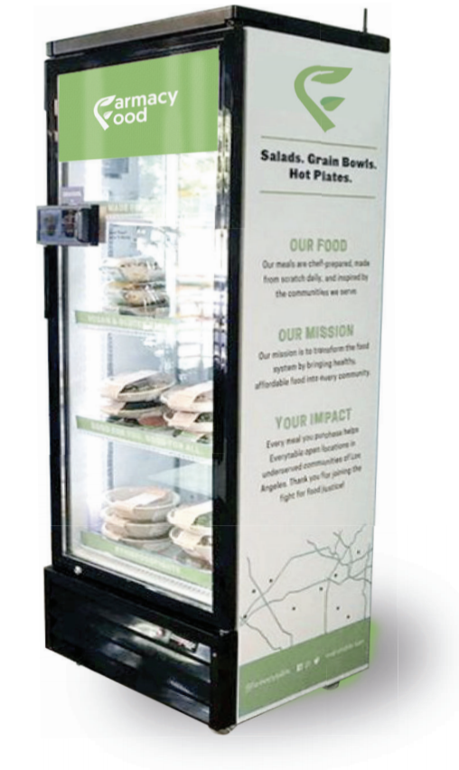
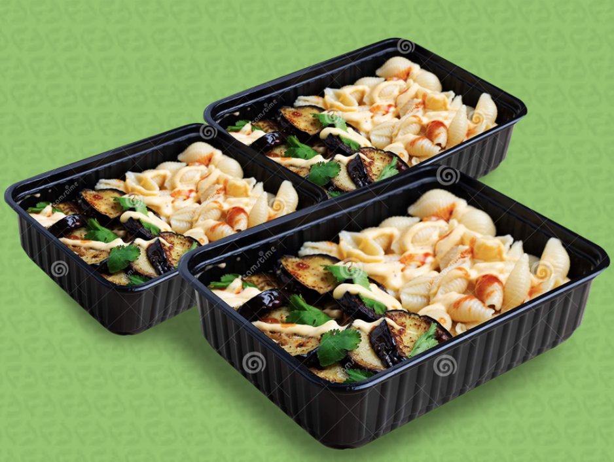
Farmacy Food Overview
Value Proposition:
Farmacy Food is a Detroit based fast-casual startup looking to provide the local community with healthy, organic, dietary minded food at an affordable price. At the core of its business, it wants to make healthy food a more accessible and convenient option.
Leverages 2 Business Models:
Smart-fridge Vending
Meal Subscription Service

Slide 4
Project Scope and Context
Focus: Smart-fridge Business Model
High potential for meaningful contribution to this business model
Relatively new and modern concept
Key differentiating factor from competitors locally and regionally
  Potential for sustainable competitive advantage
Pursuit of entrance into AA market
Semester Report and Findings
Outline the research and methodologies conducted and used in the analysis of the smart-fridge vending model
  Primary research conducted using personal interviews, surveys, and experience with AA smart-fridge placement
  Secondary research on competitive landscape, success stories, and location placement analyses
Final Recommendation on location placement focus, break-even analysis choices, and smart-fridge specifications

Slide 5






Competitive Landscape
Industry: Healthy Fast-casual Food
Marketwide effort to draw to customers away from unhealthy fast-food options by providing healthy, convenient food at an affordable price

Slide 6
Research and Methodology
Primary Research:
Student Interviews
  Conducted 18 in-person and zoom call interviews with friends/mutual friends (under/upperclassmen)
Student Surveys
  Surveyed 72 U of M students on frequency of eating out, purchasing considerations, price vs. convenience, and perceived health benefits of certain foods
Pilot Placement Experience
  Highlight steps and consistencies when getting in front of key decision makers in a variety of locational choices

Slide 7
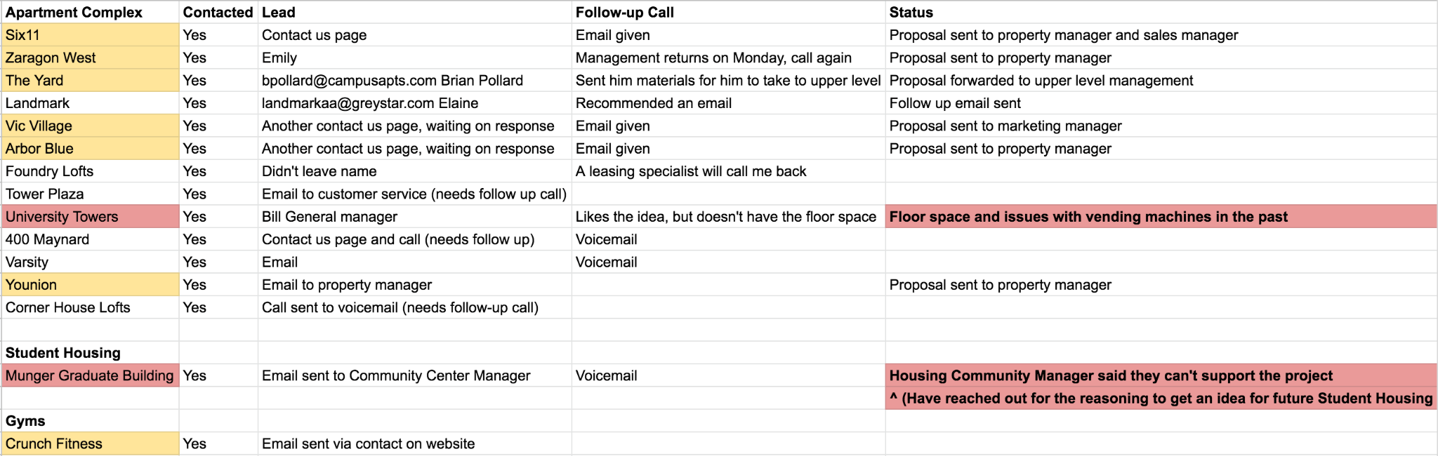
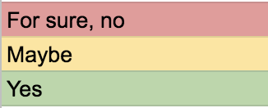
Research and Methodology
Locational Research:
University Buildings
  Identified potential for on-campus housing/dorms and study areas
  Reached out to 5 undergraduate dorms (via Student Housing Director), Munger Graduate Building, and two University libraries
Apartment Buildings
  Sales Pipeline
    Phone calls and emails to property managers
Gyms
  University: Intramural Sports Building, Central Campus Recreational Building, North Campus Recreational Building
Hospitals

Slide 8
Success Stories
This section aims to highlight the successful companies around the U.S. leveraging smart-fridges in their business model.

Slide 9

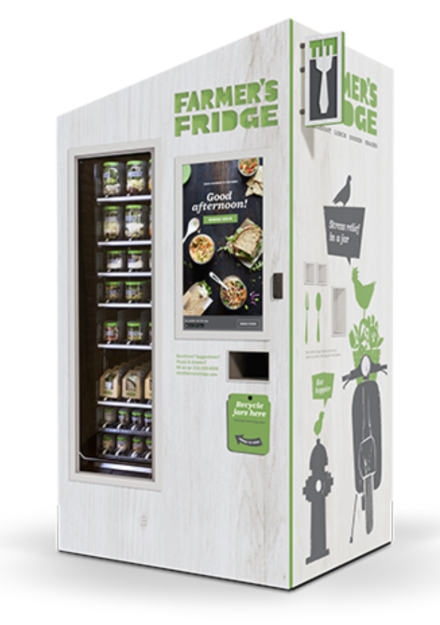
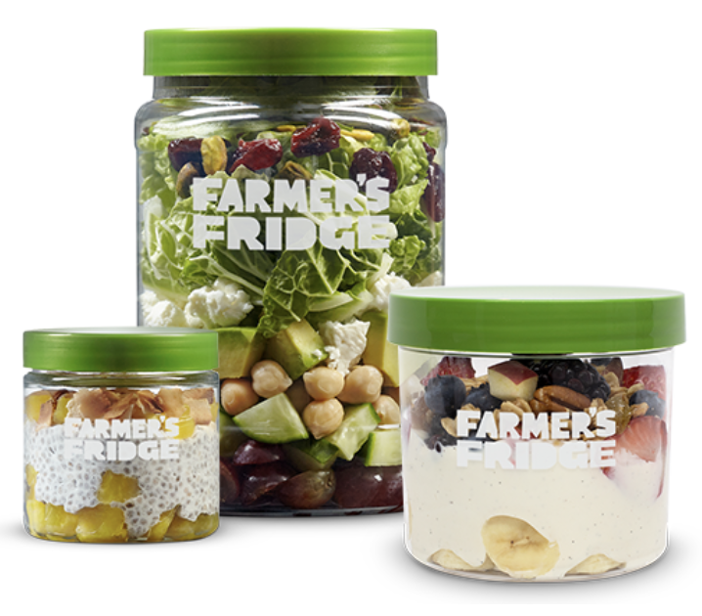
Farmer’s Fridge
Chicago, IL/Milwaukee, WI
Mission: “We make wholesome, delicious food simply accessible, so people can live a little happier.”
Story: Launched in 2013 as a vending provider; raised ~ $40M in investments by 2018.
Successes: Deployed “200 smart vending machines” and is selling “15,000 meals per day” (75 meals/day per machine). They use an “allocation algorithm” that boasts a 5% leftover rate and uses 100% recyclable jars in their machines.
Insights: The vending model is scalable and can attract investors. An allocation algorithm can greatly increase efficiency. Upwards trend toward recyclable products.

Slide 10


Coolgreens
Oklahoma City, OK
Mission: “Fuel healthy communities with fresh food through a chef-inspired menu.”
Story: Started as a fast-casual restaurant in 2009. First expanded in 2017 via franchising franchise, then expanded into fast-food vending, testing the smart-fridge concept in a hospital
Successes: Acquired valuable consumer data with a 6-month hospital pilot and landed 2 fridges in “multi-family” high rise apartments.
Insights: Hospitals are a strong target; 6-months the ideal pilot
&

Slide 11

Everytable
Los Angeles, CA
Mission: “We believe nutritious food is a human right. Every aspect of our business was designed to make fresh, delicious food available to everyone, every table.”
Story: Launched in 2015, utilize three business models: a brick and mortar grab-and-go style restaurant, a meal subscription service, and smart-fridge vending.
Successes: Smart-fridge vending service has been targeted to “schools, colleges and universities across Southern California.” Fundraising for franchises for people of color. Discriminatory pricing model that charges lower prices in underserved areas. *Numbers are non-disclosed*
Insights: Schools are a viable target. Upward trend toward social causes and positive discriminatory pricing

Slide 12
Analysis
This section will analyze our break-even analysis model and each potential smart-fridge location in the context of primary and secondary research and this model catered to each location.

Slide 13
Survey Analysis
Is food cooked this way less healthy than fresh?
42%
5.6%
30%
Microwave
Oven
Respondents with Dietary Restrictions

Slide 14

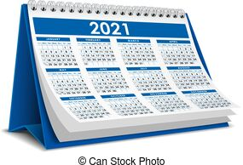
Break-even Analysis Overview
Using Mr. Osei’s numbers we:
Solved for break even times with different numbers of meals sold
Calculated break even times under different efficiencies

Slide 15
Break-even Analysis
75% Efficiency
87% Efficiency
6 months
4 months

Slide 16
Profitability Analysis
$3.65 > $3.40
Risk of Misjudging Efficiency is very high
Costs
Profit

Slide 17
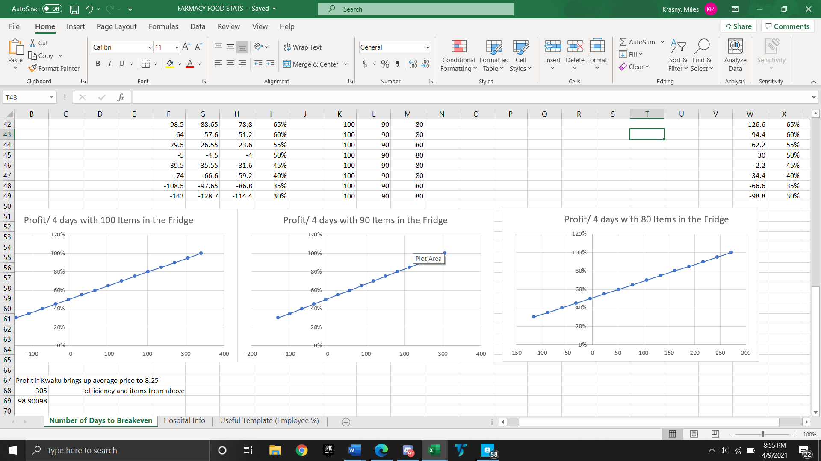
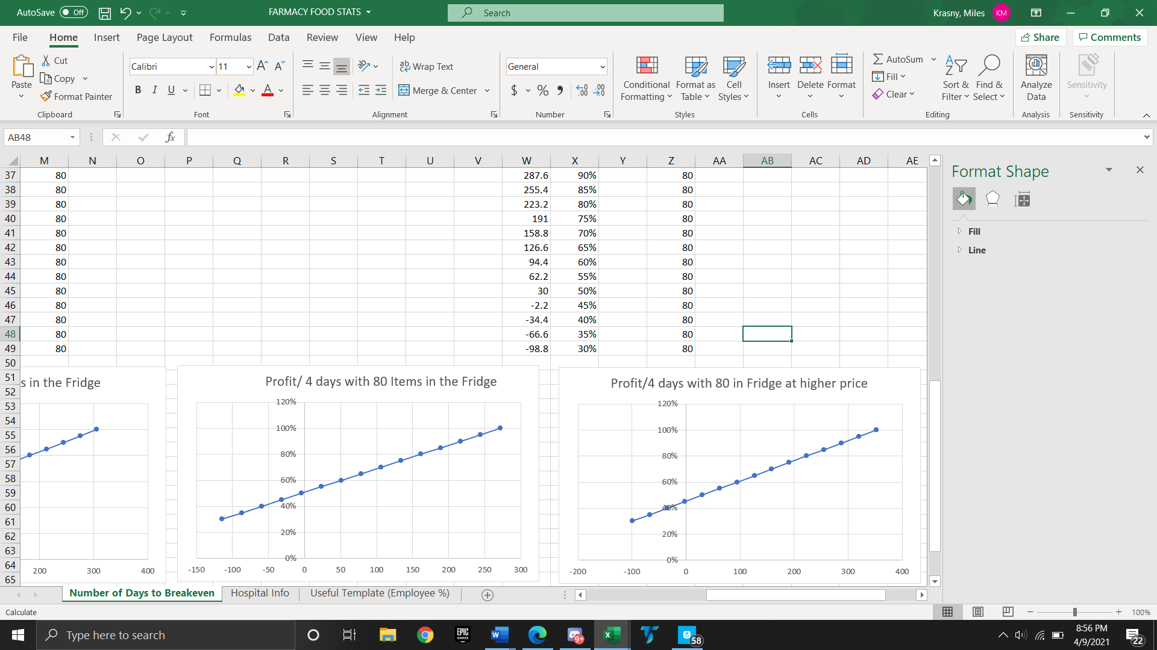
Break-even Analysis with New Price

Slide 18
Location Analysis
Features | Apartment Buildings | University Buildings | Gyms | Hospitals
Foot Traffic | High | Usually high, currently low | Low | High
Competition | High | Low | Low | Low
Convenience | High | High | High | High
Microwaves | Yes | Sometimes | No | Sometimes
Target Customer Base | Yes | Yes | Exclusively | Sometimes
Space for Multiple | Yes | Sometimes | No | Yes
Ease of Installation | Easy | Hard | Easy | Very Hard

Slide 19
Recommendations

Slide 20
Primary Targets
Secondary Target
Hospitals and Apartment Complexes that don’t have a restaurant
High foot traffic
High convenience/need
Space for multiple fridges
Low competition
Gyms - ideally high capacity and post-covid
Low competition
Targets health conscious consumers
Simple sales cycle

Slide 21
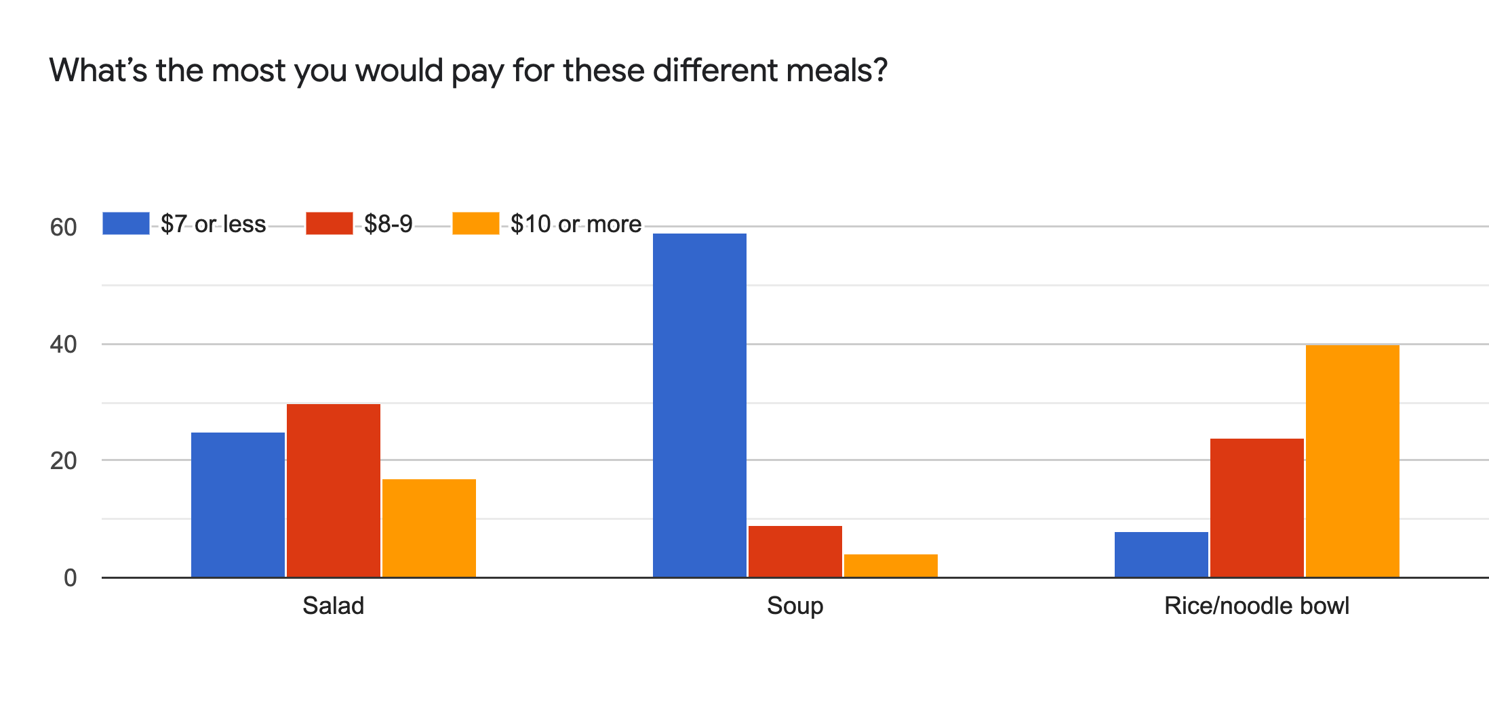
Increase price by $1
Most students willing to pay more than $7.25
Greatly reduces break even period
At 75% efficiency
6 Months
100 days

Slide 22
Smart-fridge specifications
Placement
High traffic areas of building
  Main floor/front desk
  By elevator
  In a shared space/central hub
In sight of security cameras
Aesthetic
Large glass pane
Bright white lights showcasing food

Slide 23
Questions

Slide 24
Appendices

Slide 25
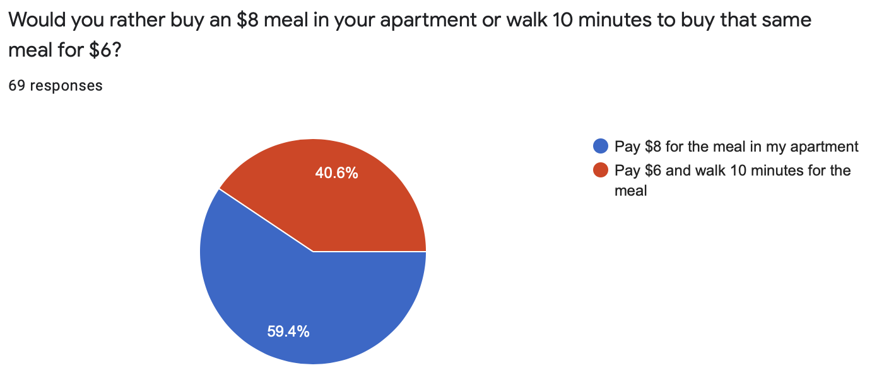
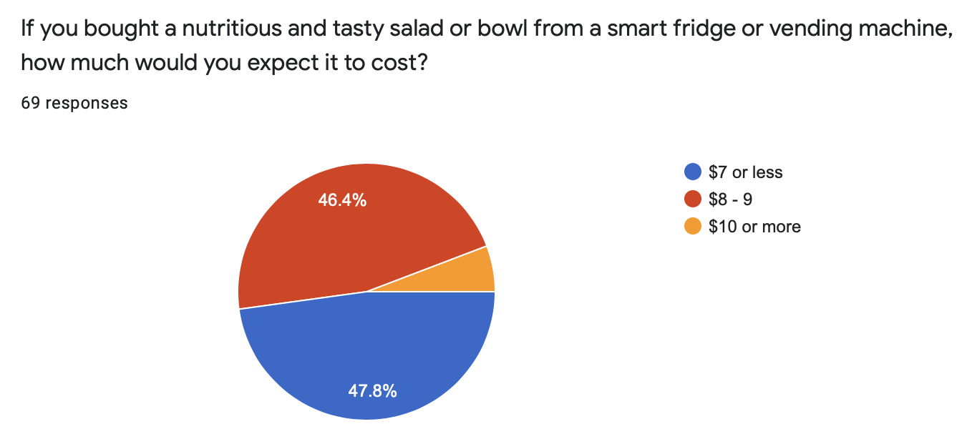
Survey Results

Slide 26
Interview Results
Preliminary in-depth interviews indicate great interest in convenient healthy options within the target demographics.
Current sample size is ~ 20 people.
Moving forward, we have created a standardized survey to gather a larger data pool with which we can create compelling arguments for high rise owners.

Slide 27
Methods of Execution
Phases 1 & 2 - determining value prop and target market
Interview potential customers
Conduct taste tests
Analyze ingredients, processing and sourcing
Phases 3 & 4 - choosing and implementing business model
Survey apartments, offices, coffee shops
Project potential traffic of different models
Examine competitive landscape

Slide 28
Break-even Analysis App.
Normal Price Point

Slide 29
Break-even Analysis App.
Higher Price Point

Slide 30
Objective
Deliverable
Hypotheses/ Assumptions
Activities/ Methods
Resources
Select a business model which works best with our identified target customer, propelling Farmacy Foods forward and establishing a stable customer base of X people.
Mid Point
Clarify the target customer/ market, what order is the value prop?
Their food tastes better than other healthy food
Taste tests, positive reviews, JJ app model
The food, a functional app
Customer cares most about convenience
Customer
Surveys
Google Forms / Survey Monkey
Customer views FF as healthier and values healthy food
Determine nutrition and health value of ingredients, surveys
Purchase receipts, grocery lists, gov’t info.
Final
Select and implement business model
Apartments/offices/coffee shops will have interest in including the fridges
Survey apartments/offices/coffee shops
Calls, emails, surveymonkey
Brick and mortar model provides best visibility
Investigate cost/benefit
Financial Information + contact info of R.E. agent. Industry info.
Farmacy Food will stand out on Doordash to get sales
Examine competition nearby on subscription food delivery services
Doordash website/ customer survey
3
Notes:
Mr. Osei wants customers who are pursuing a healthy option to discover that FF tastes better than unhealthy food, at a comparable price / convenience. We want to know if the customer shares this priority order, or if they, for example, prioritize maximum convenience or minimum price amongst competitors. What is our superlative? (Tastiest, healthiest, cheapest, fastest)

Slide 31
Research and Methodology
Locational Research:
University Buildings
  Identified potential for on-campus housing/dorms and study areas
  Reached out to 5 undergraduate dorms, Munger Graduate Building, and two libraries.
    Interest for product, but limited foot traffic due to pandemic and bureaucracy of working with University quickly emerged as roadblocks.
Apartment Buildings
  High foot traffic & frequency, return customers; competition with local restaurants
Gyms
  University and local
  Capture key target market, lower volume, fewer competition
Hospitals
  High foot traffic (employees and patients), unmet need with cafeteria closure and hours, convenience and health attractiveness

Slide 32
Increase price by $1
Most students willing to pay more than $7.25
  70%+ survey respondents willing to pay >$8 for a bowl or salad
Greatly reduces break even period
  75% efficiency goes from 6 months to 100 days

