Slide 1


Merging Subject Matter Expertise and Deep Convolutional Neural Network for State-Based Online Machine-Part Interaction Classification
Hao Wang, Yassine Qamsane, James Moyne, Kira Barton

Slide 2
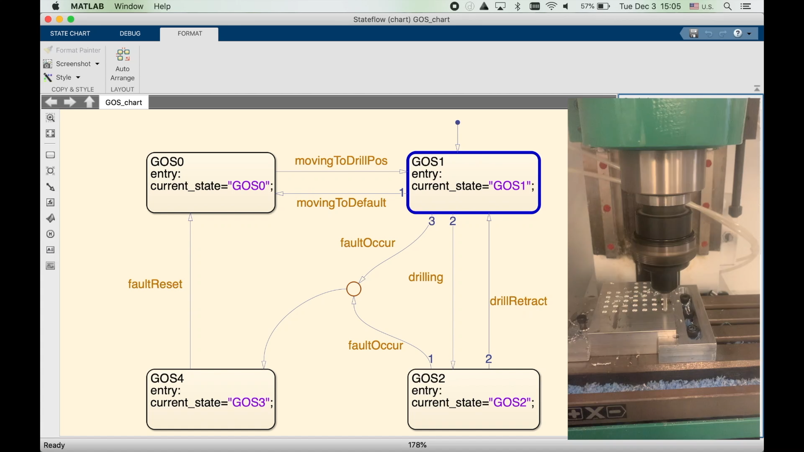
Project Overview
Motivation
  Machine-part interaction classification is a critical capability of Cyber-physical systems
  Machine-part interaction classification can help address fault detection, root cause analysis, and equipment performance evaluation
Notes:
Need to motivate the research
Explain what is CPS.
Why is CPS important
What is machine-part interaction
Why machine part interaction is important

Slide 3
Project Overview Cont.
Gaps in literature
  Current state of the art solutions only classify steady state behaviors without addressing transitions between steady states
    Transition detection is critical is manufacturing context
  Existing solutions do not incorporate Subject Matter Expert knowledge
    Deep learning-based solutions still need SME knowledge
Notes:
Explain gaps
Why transitions are important?
Why SME is important?

Slide 4
Project Overview Cont.
Contributions
  Framework for online machine-part interaction classification
    Steady state classification + transition detection
    Efficient architecture due to compact data representation
  Merging Subject Matter Expertise (SME) with data driven approach
    Error checking mechanism (Finite State Machine)
    Detailed description of SME incorporation into framework

Slide 5
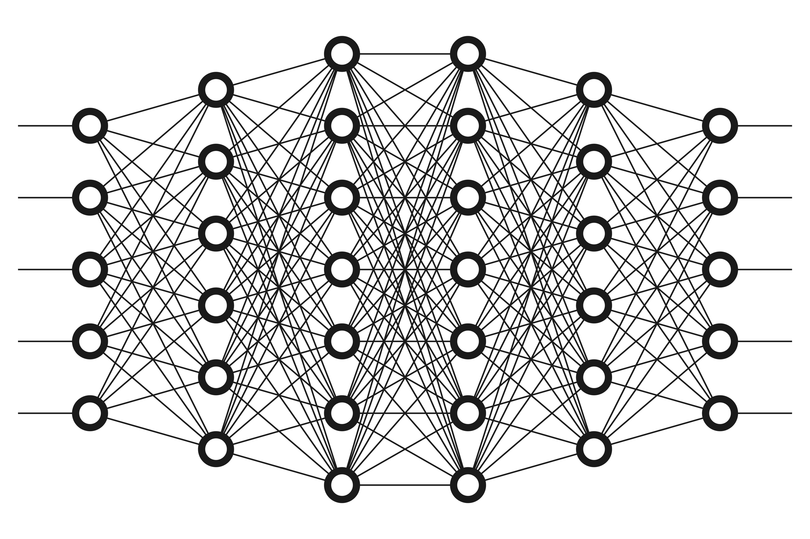
Background – Neural Networks
Stacks of layers of computational units (neurons)
Convolutional layer
  Filter moves across the input
  Captures local connectivity
Black box models

Slide 6
Background – Classification Systems
Primarily neural network-based solutions
Classify fixed length time series signal
Ignores transitions
Time Series Signal
Class Scores

Slide 7
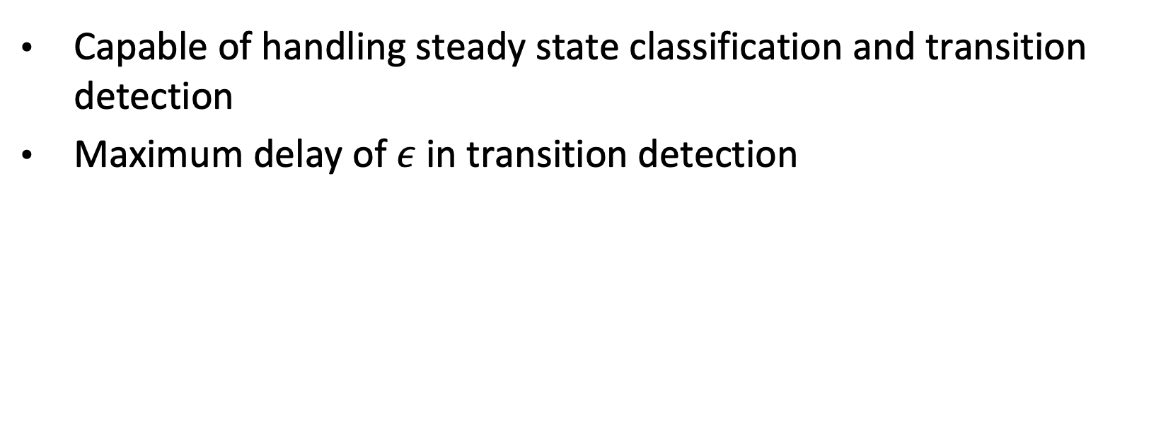
Solution Requirements
Capable of handling steady state classification and transition detection
Maximum delay of $ε$ in transition detection

Slide 8
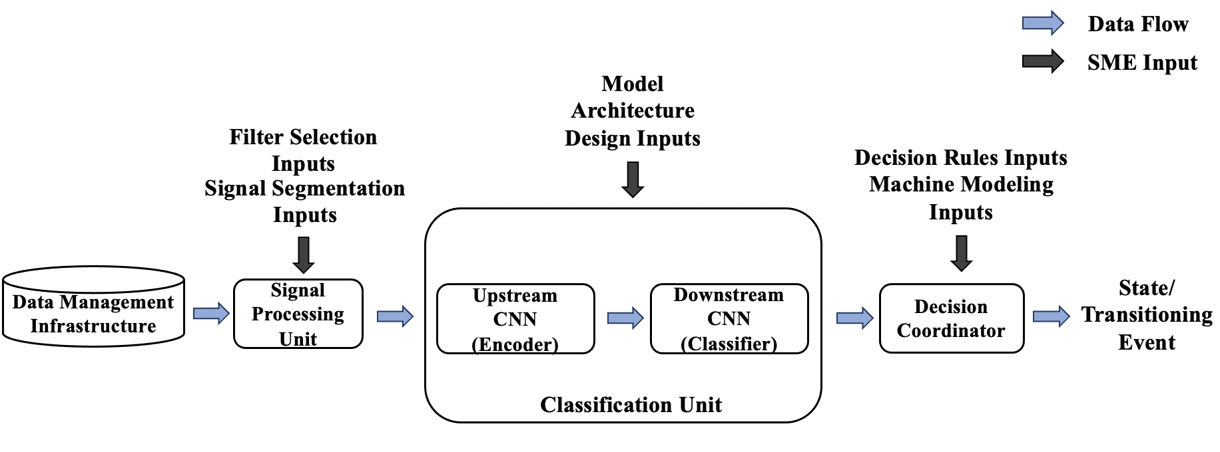
Methodology

Slide 9
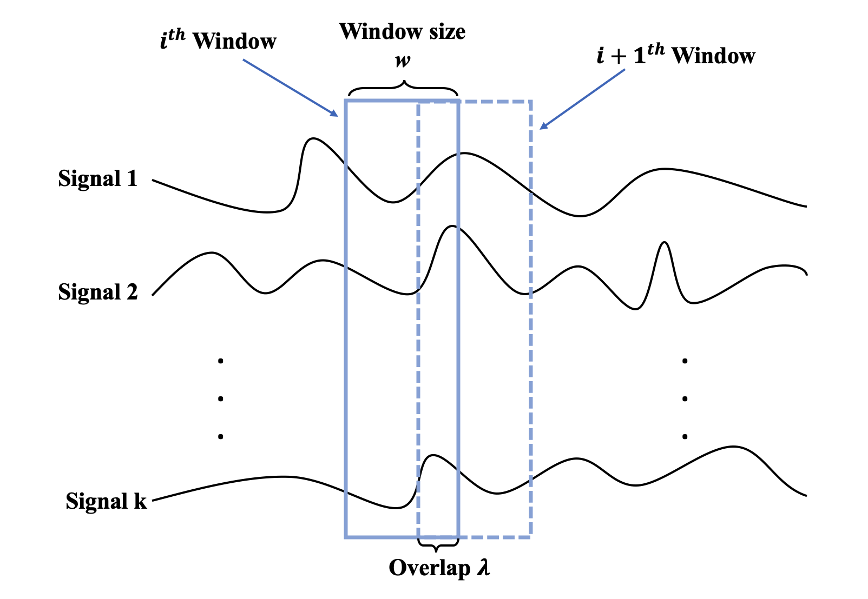
Methodology – Signal Processing Unit
Segment time-series input signals
  Sliding window technique
  Parameters: window size & overlap
Denoising operations
Notes:
Explain the role of window size
Larger window, generally better for classification because more context is given
Explain the role of overlap

Slide 10
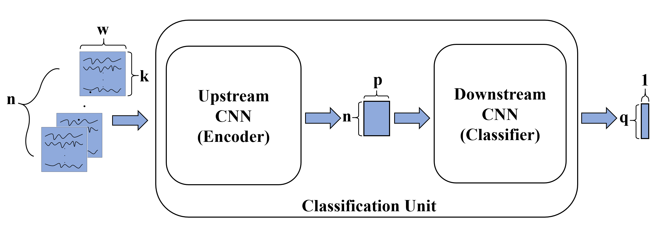
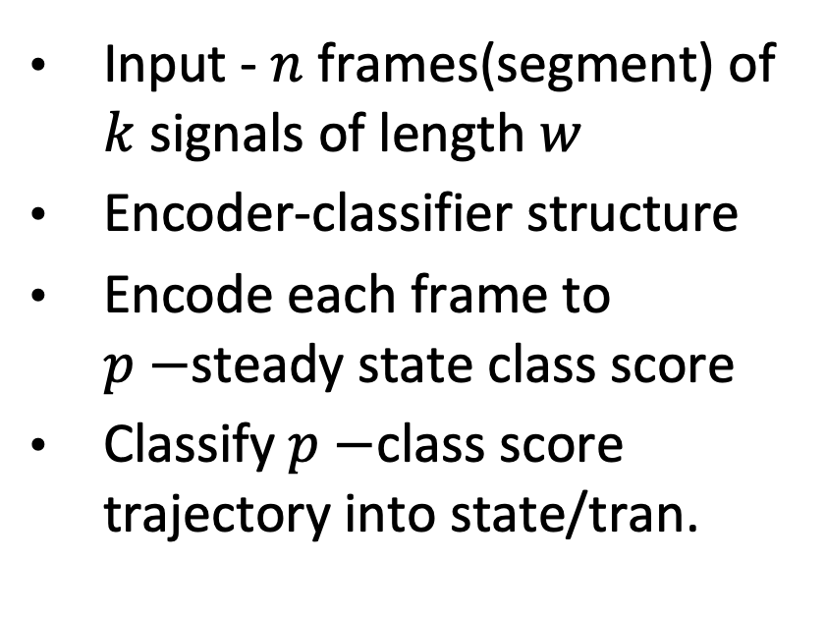
Methodology – Classification Unit
Input - $n$ frames(segment) of $k$ signals of length $w$
Encoder-classifier structure
Encode each frame to $p−$steady state class score
Classify $p−$class score trajectory into state/tran.
Notes:
Why need n frames to perform classification for time instance t?
Short answer: Incorporate past context into classification for time instance t (improve classification performance)
Long answer: it is very useful to include context from past when performing transition detection, so that the system can detect transition without too much delay, which leads to well defined state boundary
Encode each frame to a p-class score, where p is the number of steady state. Why p-class?
Changes of steady state class score can provide sufficient information for occurrence of transition
N frames provide n snapshots of class scores at n time instance, and the trajectory of the class score can tell us when the transition occur.

Slide 11
Decision Coordinator
Why?
  Feedforward NNs do not retain memory
  Inputs to this system is NOT i.i.d
  Current state depends on the past
Model the machine as a Finite State Machine
  Error checking

Slide 12
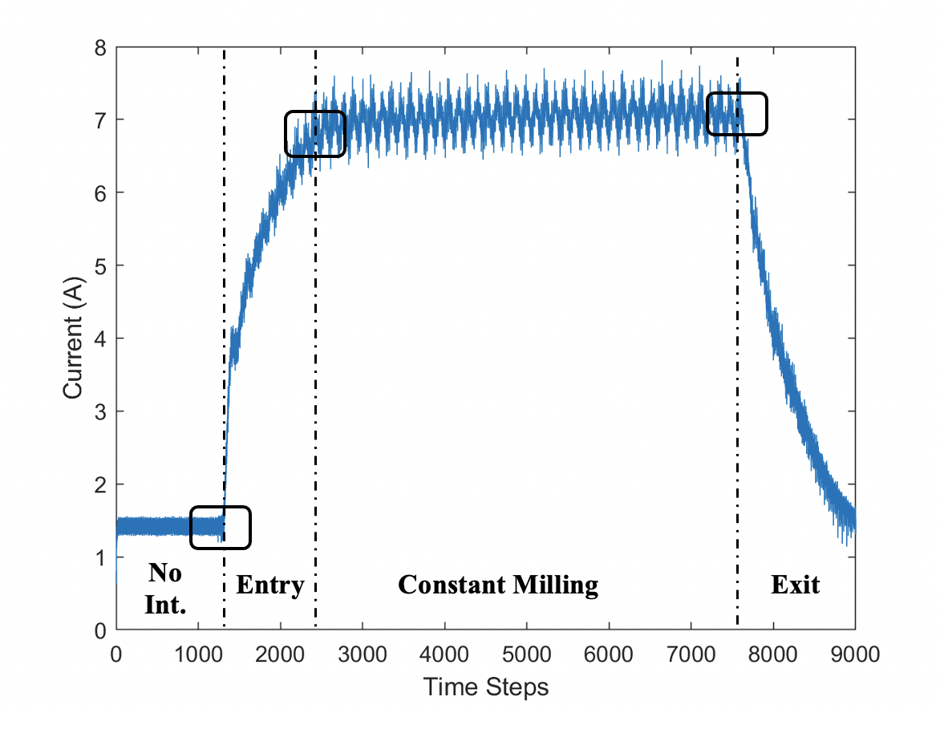
Case Study
NASA milling dataset[1]
4 steady states
3 transitions
Partition signals based on machine-part interaction

Slide 13
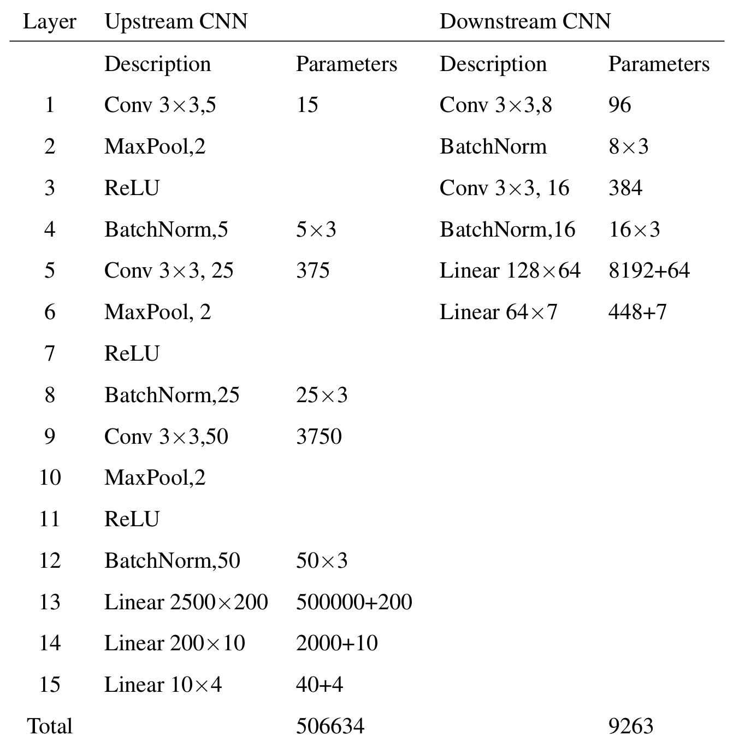
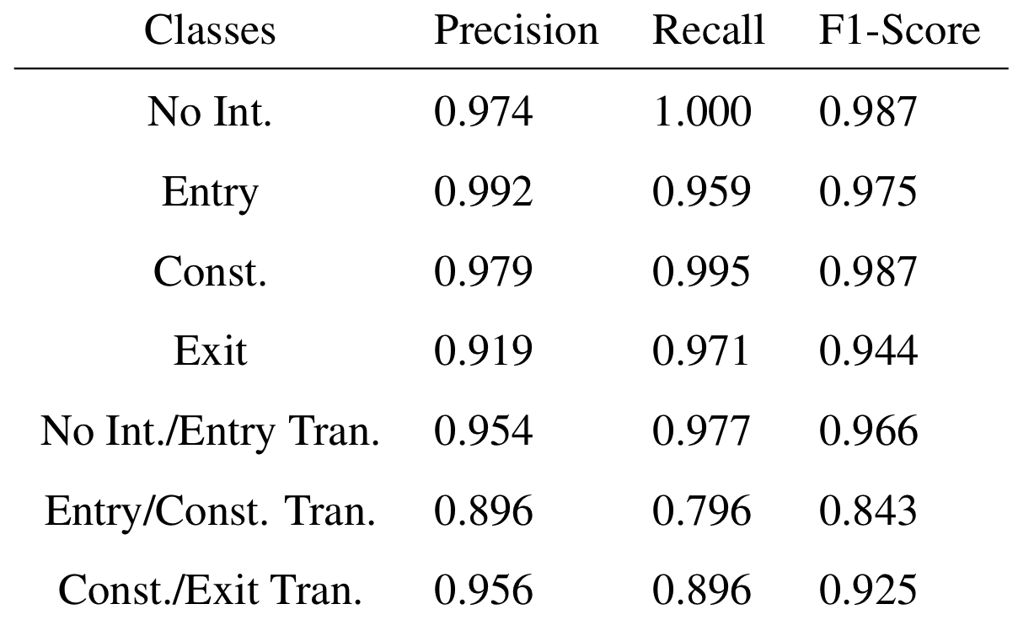
Architecture and Performance

Slide 14
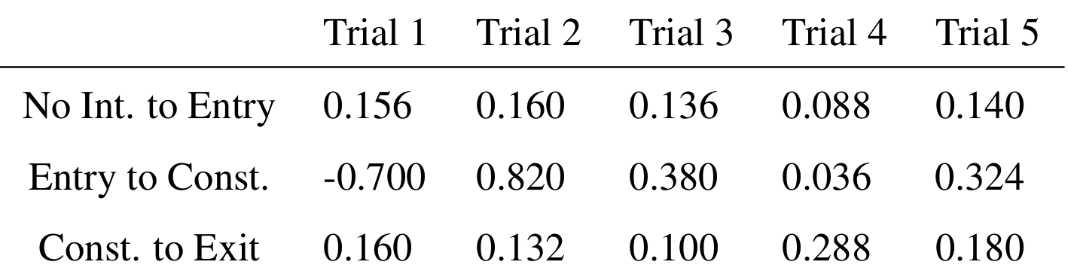
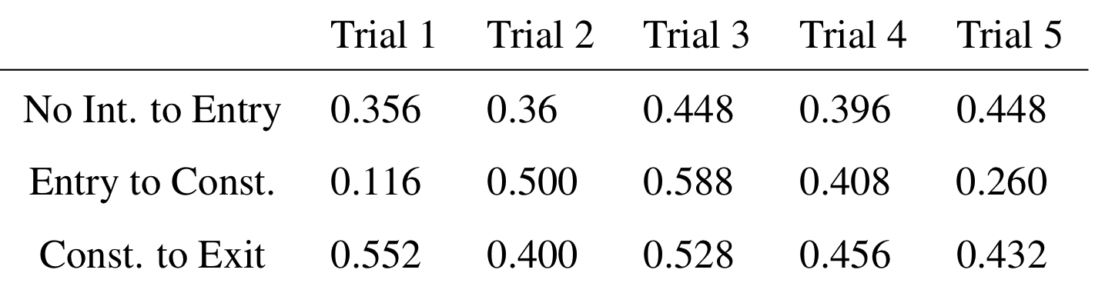
Deployment Simulations

Slide 15
Subject Matter Expertise Integration

Slide 16
Future Work
Delays in transition detection
Modeling formalism
RNN to encode time dependency

Slide 17
