Slide 1

Emergent Design Failure in Ship Design
Matt Georgy

Slide 2
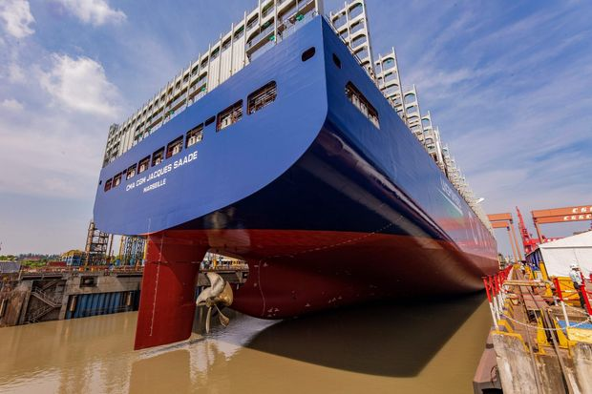

Slide 3
Capstone Project Goal
To understand emergence design failures through the evaluation of NA 470 senior ship design project
Emergent design failures are characterized by rework, design churn, or failure to integrate design

Slide 4
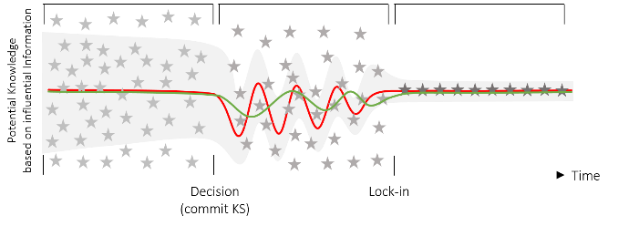
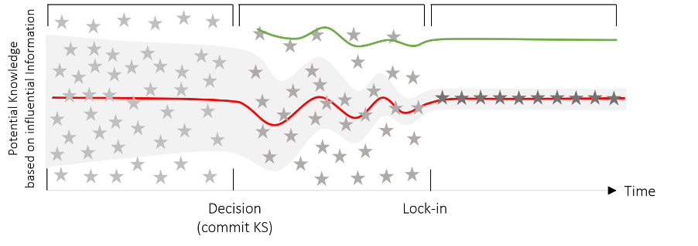
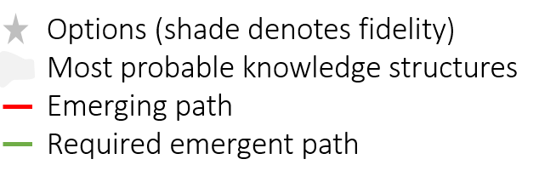
Emergent Design Failures Illustrated
Design Churn
“the total number of problems being solved (or progress being made) does not reduce (increase) monotonically as the project evolves over time" (Yassine et al. 2003)
Failure To Integrate
The inability to integrate a product (component/system) and knowledge required to define that product into the existing design, leading to the inability to continue with current design activities or infeasibility of the final design.
1. Yassine, A., Joglekar, N., Braha, D., Eppinger, S., & Whitney, D. (2003). Information hiding in product development: the design churn effect. Research in Engineering Design, (14), 145–161.
2. Goodrum, J. Conner. (2020). Conceptually Robust Knowledge Generation in Early Stage Complex Design. Department of Naval Architecture and Marine Engineering. University of Michigan.

Slide 5
Goal
Identify what aspects of the design failed
Determine why this issue occurred
Where the decision path began
Why this continued throughout the design
Identify which aspect of emergent design theory this was related to
Notes:
Go through capstone, determine failures, determine decision path failures

Slide 6
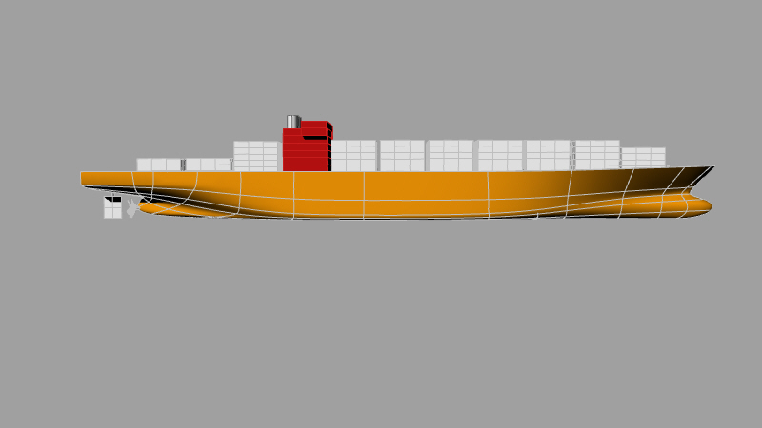
Steps Taken
(1) Learn about advanced design theory from Professor Singer
(2) Examine NA 470 design and determine what emergent design failures existed
(3) Evaluate what design decisions create the emergence and why they were made.

Slide 7
Design Failures Identified
Trim towards the stern a large amount.
Righting arm of the ship was low for intact stability
Righting arm failed to surpass regulations in damage stability

Slide 8
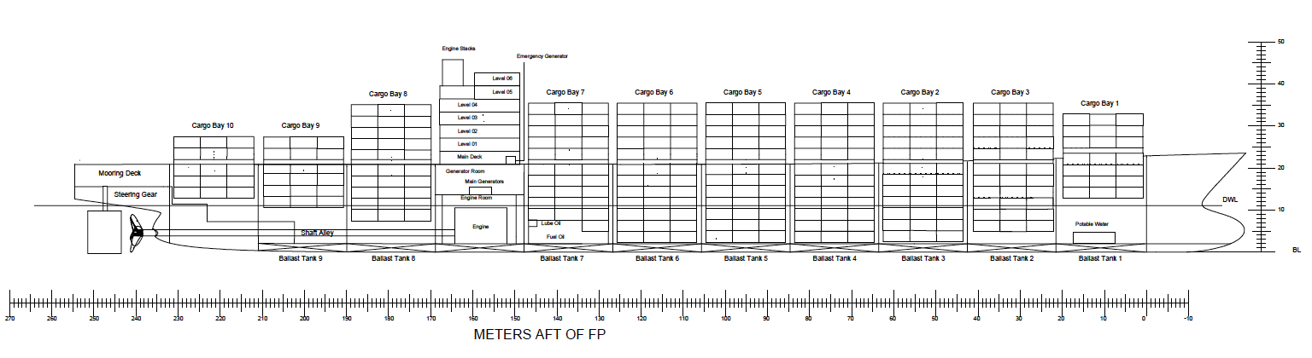
1). Bulkheads just placed with no input on reason they exist (FL)
2) The stern transformation resulted in a poorly designed hull (too much overhang and not enough buoyancy)

Slide 9
Emergent Design Failure
When making the positions for the bulkheads, floodable length was not considered.
This caused design churn because the bulkhead placements were not advised by the floodable length curve.
As a result, the ship failed when certain parallel bulkheads were flooded. They were less than 0.2, the USCG requirements for ships of this size.
This failure led to churning between container placement and height of containers. This only resulted in passing the most amount of test cases but not all of them.
High up
Cargo Hold Not Used

Slide 10
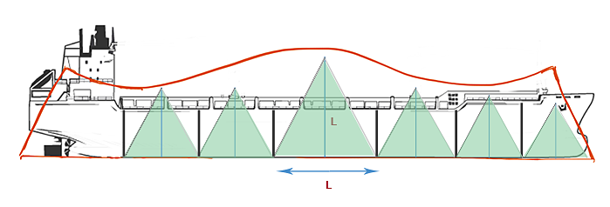

Slide 11
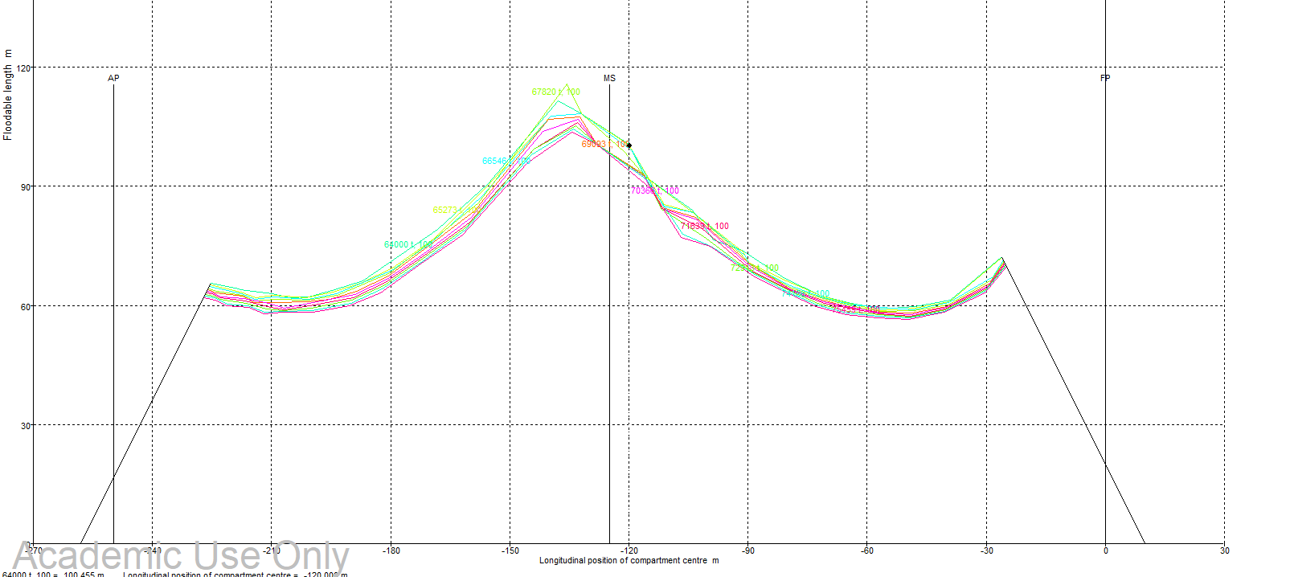

Slide 12
Hull Lines
Lines in the back of ship show a lack of buoyancy
Notes:
Draw line on transom

Slide 13
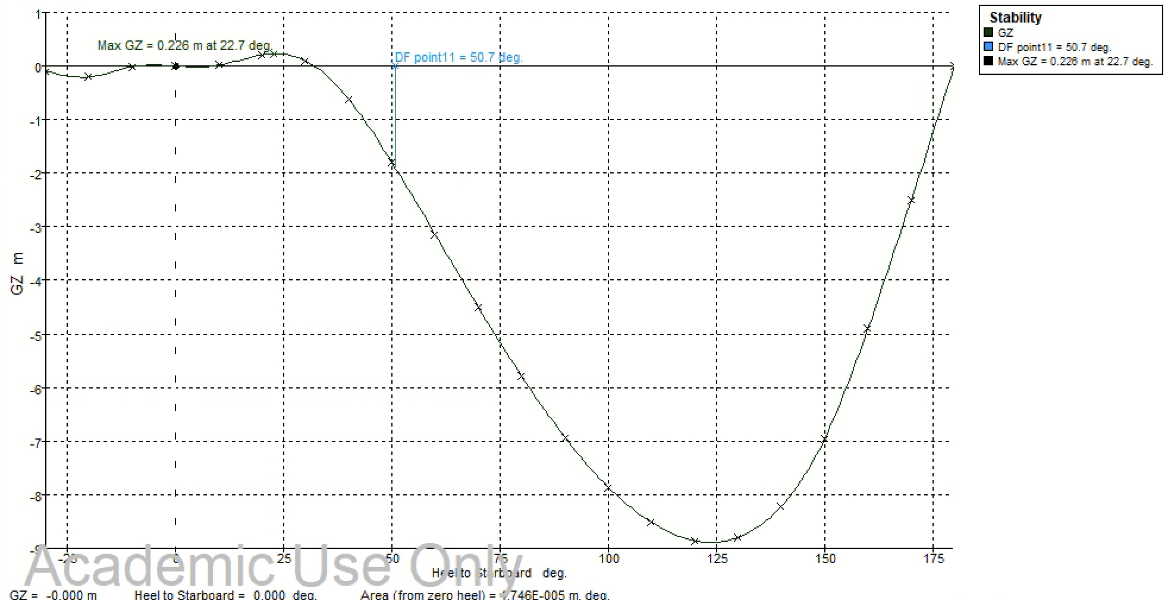
Damage Stability
Damage stability is the stability of the ship given a damaged water tight bulkhead.
The design failure in this case was a failure to integrate information, particularly the floodable length.

Slide 14
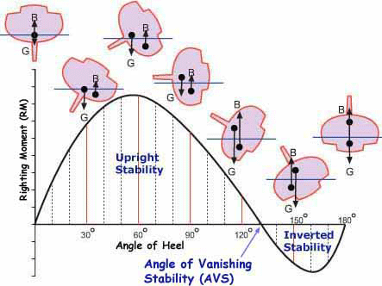

Slide 16
How These Could Have Been Avoided
Understanding the hull form was incorrect for this number of containers
Taken in to account the floodable length curves
Anticipated the change in damage stability

