Slide 1

Rules & Regulations and Reality: Rethinking Reference Work in the Library of the Future
Library of Congress Reference Forum
September 28, 2021
Corey Seeman, University of Michigan
cseeman@umich.edu

Slide 2

Presentation Outline & Objectives
Want to show how we moved into becoming a ‘library of the future.’
Showcase some of the ‘thought process’ that went into this journey.
Show some of the problems and opportunities.
Want you to (hopefully) find one nugget or idea that you can take away.

Slide 3
Presentation Outline & Objectives
About Kresge Library
Kresge Library and Change
New Library Rules & Laws
Questions
But first….a zoom poll…

Slide 4
Zoom Poll #1 - What is your SECOND favorite LC? (please choose one)
LC Greenwood
Lady Chatterley
Lake Charles (Louisiana)
Lake Champlain (New York, Vermont & Quebec)
Lemon Curd

Slide 5
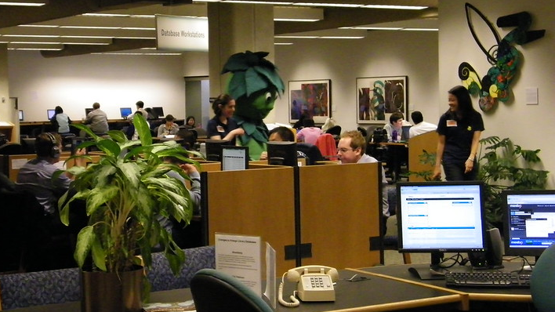
About Kresge Library
Kresge Library Services is an independent library service unit at the University of Michigan.
We receive funding from the Ross School of Business and work collaboratively with colleagues at the main and law libraries on campus.

Slide 6

About Kresge Library
We are JUST like the Library of Congress
We have patrons we love.
We have patrons who we don't love.
We hate when patrons are only looking for answers that confirm what they want to believe.
We do not have enough space.
We do not have enough money
Our aspirations and desires stretch beyond our means.
LC has 170 million items - we have around 17.
We have never been burned by the British - so we have that going for us.

Slide 7

About Kresge Library
Ikea “Dream Kitchen” ad c2013

Slide 8
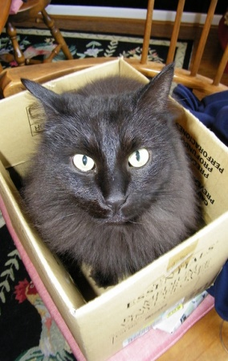
About Kresge Library
Kresge By the Numbers:
  Total Staff: 19 (9 librarians* & 10 staff)
  Total volumes: 15 (used to have 150K)
  Annual materials budget ($1.1m)
  Annual total budget ($2.4m)
  Reference transactions – around 3-4K/year
  Also support course materials (cases) and LMS for Ross.

Slide 9
About Kresge Library
Built in mid 1980s to serve the research and curricular needs of the Ross School of Business
Constant state of “Library Erosion”
September 2013 – Gift announced
July 2014 – Print moved out
Summer 2014-2016 – Kresge Staff in Modular Offices (MOTown)
Fall 2014 – Rebuilding Kresge Library Services
January 2017 – Opening of the new building to the school
Continued tweaking and changes to space.

Slide 10
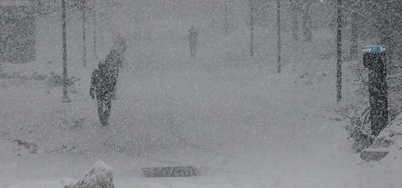
About Kresge Library
There are also some actual positives about not having a public space.
No longer have to worry about evenings and weekends in bad Michigan weather…
Create a flexible work environment to expand your reach by enabling remote work.
Pandemic-proof – for the most part!

Slide 11

About Kresge Library
Wrote this back in 2019…
We expect there to be continued changes as space needs evolve on campus.
Our ability to work anywhere could lead to remote location for staff.
Not being tethered to a print collection has been mostly good – especially during bad weather.
We need to demonstrate flexibility and adaptability.

Slide 12

About Kresge Library
When the pandemic hit – we flipped the switch and were able to jump into the new world order.
In-person services switched online.
In-person services that could not be turned virtual were shuttered.

Slide 13

About Kresge Library - Philosophy
Some of the philosophies that drive my decision making.
Some of it is making the best of a less than optimal situation.
We are continually evaluating and tweaking services to reflect changes at the school.
We try just about anything…

Slide 14
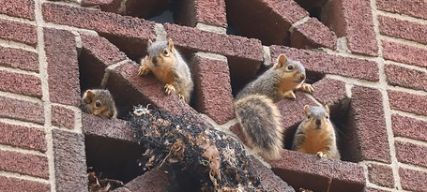
About Kresge Library - Philosophy
During our transformation to a virtual library, we sought to rebrand ourselves.
Changed name to “Kresge Library Services”
Developed and refined the notion of the “ethereal library” not tethered to space, but to service.

Slide 15
Zoom Poll #2 – What Time Period Has the Most Library Change?
1960s & 1970s
1980s & 1990s
2000s
2010s
2020s (now with MORE COVID-19)
All of the Above

Slide 16
Kresge Library and Change
"Business has always been subject to uncertainties and change. It is affected by the elements, by wars, by mass movements, by changes in the wants and desires of consumers and by government regulation. Above all, competition tends continually to modify the business structure. New methods, new products and new processes introduce new elements that undermine the supremacy of one industry or firm or even a whole system of doing business. And the trend toward increasing regulation of business by governmental bodies here and abroad must not be ignored. In short, one generalization that truly applies to all business is: Change is continuous and inevitable."
(bold added)

Slide 17
Kresge Library and Change
Quote is from: Coman, Edwin T. Sources of Business Information. New York: Prentice-Hall, 1949.
It is very easy to think about change only in our world
However, we have been subjected to change for years and years…and will be subjected to change for years hence

Slide 18

Kresge Library and Change
NOT a library problem of the 21st century.
Changes in the last 50 years:
  Copy cataloging
  Local online catalogs & shared systems
  Expanded access (TOC, more subject headings)
  Shared catalogs
  Discovery layers
  Working papers management → digital repositories
  Coffee and food in the library
  Diminished roles (overall) of departmental libraries
How many staff are checking in serials? And while here – what are serials?

Slide 19
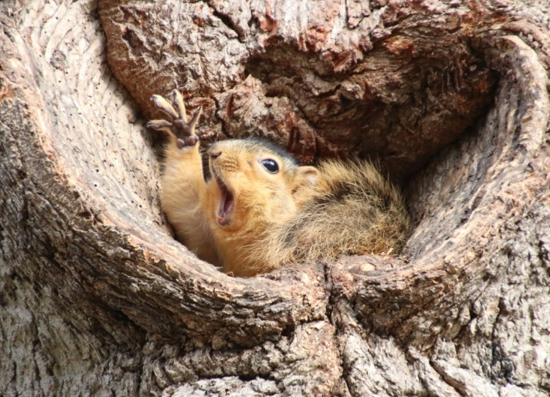
Kresge Library and Change
Librarians are fantastic about envisioning change when they are leading the way
We have done a good job of embracing the new electronic environment in a hybrid fashion with traditional print volumes and physical media
These incremental changes can add up when pieced together…
HOWEVER, we are likely still behind where our patrons are and where they likely WISH we are
Because we collect for the ‘long term,’ we are likely far more conservative than we should be

Slide 20
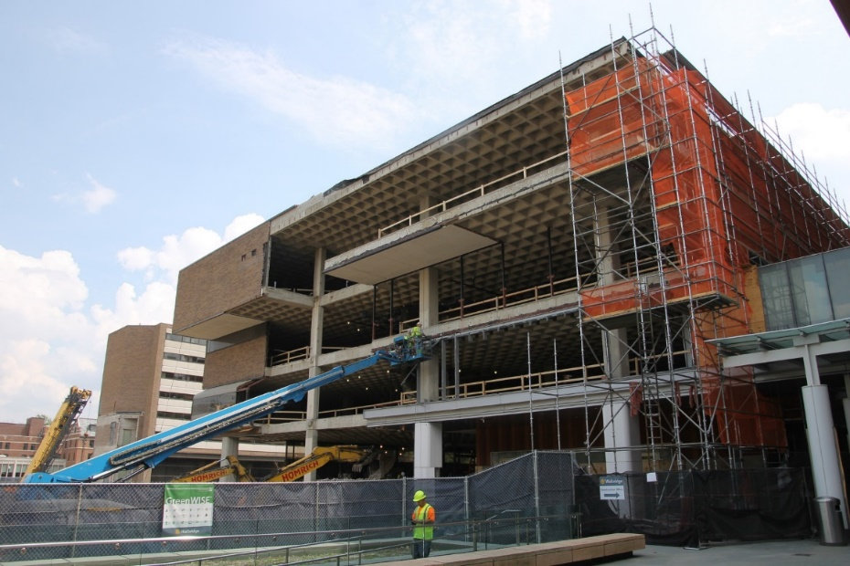
Kresge Library and Change
Change in libraries will more likely be a change that is thrust upon us
Are we ready to manage through real change?
Are we ready to give up services and resources our space will no longer accommodate?
Are we ready to embrace the change being asked – or demanded of us?
Change may be a dual edged sword – vibrant schools will demand more changes than stagnant ones.

Slide 21
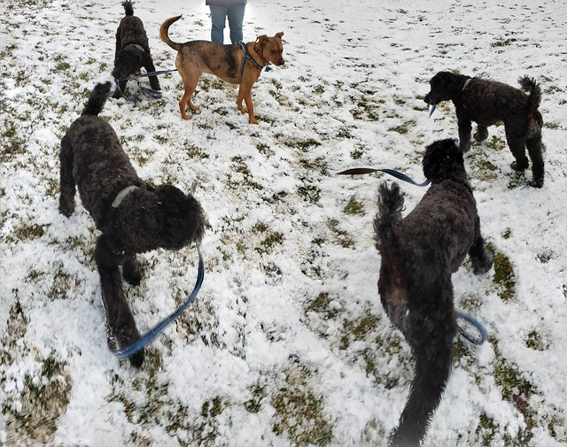
Kresge Library and Change
There is a strong desire to embrace elements like AI to help with our work.
Before we jump all in – lets look at where that technology is right now.
Runyon and the Riplies – Google Photos Panoramic.

Slide 22
Kresge Library and Change - Collection
This is my vision of collection building in libraries – we need to find the balance between these needs.
Future Use
This is where Libraries have traditionally bought for (and many still do)
Community Needs
Community Aspirations & Desires
This is where our campuses really want us to be working. This might be where the turnaways come from.
Current Use

Slide 23
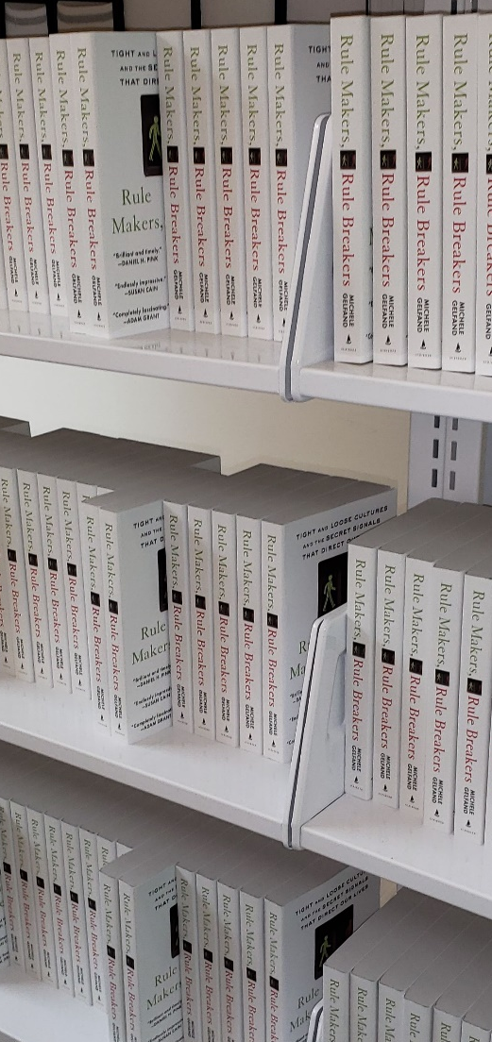
Kresge Library and Change - Collection
Let the ‘bottle neck’ guide you to better solutions.
Even though we do not buy print, we bought physical copies of a work for everyone in a class because the cost for digital access was almost five times what the print copies were.
We need to be creative to figure out our unique problems.
Not having a print collection really only impacted a few types of research.

Slide 24
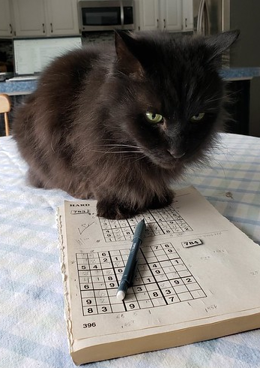
Kresge Library and Change - Reference
As librarians try to figure out reference, we often think there is one solution.
But the scope of the requests can vary tremendously.
Some have definitive answers (like Sudoku), some do not.
We are merely guides or Sherpas to help them learn about the terrain so they can understand what are their next steps.
Reference and research are a voyage.

Slide 25
Kresge Library and Change - Reference
Library challenge is that we have multiple stakeholders and they have different needs – especially for business.
Faculty needs – scholarly journals, articles, books , datasets
Student needs – articles, company & industry information, market reports
Community – Mostly similar to student needs
Student
Community
Faculty

Slide 26
Kresge Library and Change - Reference
Green line – the availability of information
Blue line – the need for assistance

Slide 27

Kresge Library and Change - Reference
In addition to clarity, our reference work really is driven by the appetite of our users & the scope of their research.
For many of us, there is not a great deal of information on our topic.
That is still an important part of the process.

Slide 28
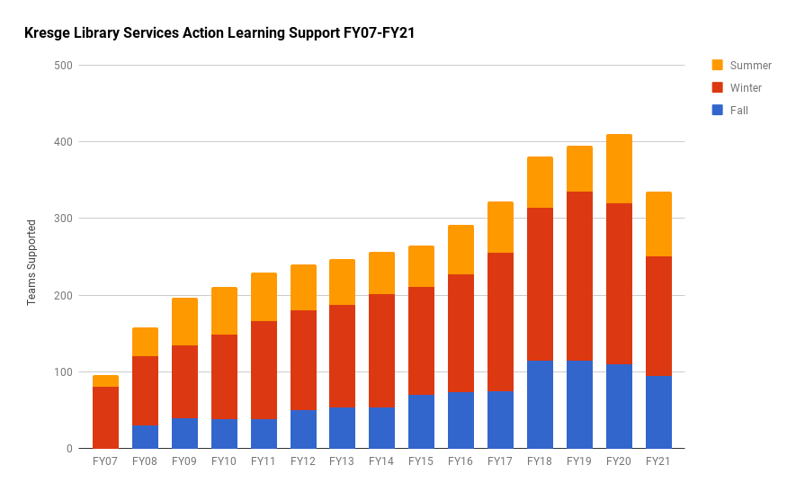
Kresge Library and Change - Reference
Action learning support at Kresge Library is widely accepted as our biggest contribution.
We need to teach students how to manage through Ambiguity and Complexity.
We do this through experiential learning programs.
This is a great opportunity for the Kresge Library.

Slide 29
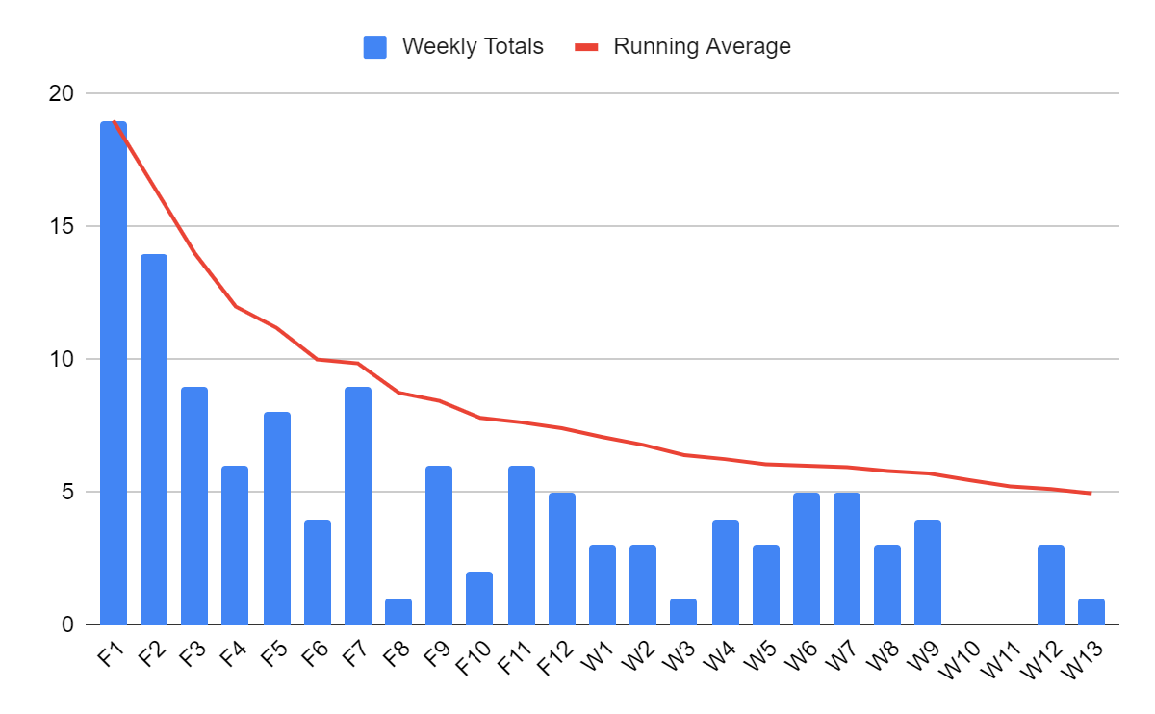
Kresge Library and Change - Services
We staff the desk Monday through Thursday from 10am to 2pm.
ONE Library Question
Some Textpack Questions
Majority of Questions – Printing, Room Reservations, Supplies, General Help.
Metrics that mattered – we were available.
We cancelled the service before the end of the term.

Slide 30

Kresge Library and Change - Services
Embrace the Change.
You need to be flexible and deal with change as it comes.
“A completely re-thought Kresge Library Services, transitions from a collection of physical reference materials to a full suite of information resources and research services, guided by expert staff.” – Ross Dividend, Fall 2016 (Ross Alumni Magazine)
The library did not close, but become virtually unrecognizable.
You do not always choose your path, but how you respond to the challenges.

Slide 31
Zoom Poll #3 - How do questions arrive at your "desk?" (click all that apply)
Phone call
Email
Reference desk
Carrier pigeon
Message in a bottle
Attached to a brick & thrown through your window
None of the above
All of the above
What's Reference?

Slide 32

New Library Rules & Laws
Lawrence of Arabia, 1962

Slide 33

New Library Rules & Laws
Librarianship is a rule bound profession
Important for people to explore different libraries and interoperability.
Could be a way that we drive a wedge between us and our users.

Slide 34

New Library Rules & Laws
Librarians fear failure
Even more, librarians fear success
Capacity and Bandwidth can be an issue.
Relevancy is huge in this modern age (you know – because all the books are online)….

Slide 35
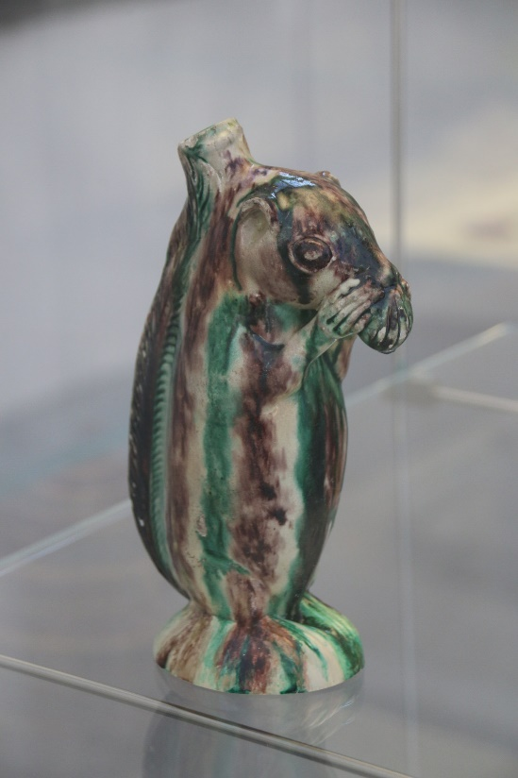

New Library Rules & Laws
Understand the difference between a known item search and an unknown item search.
Squirrels at the Met (NYC)
Bottle from Salem, NC - ca. 1790–1805.
Snuffbox from Germany (Schrezheim manufactory), ca. 1761-1770. In Gallery 538 – closed the day I went.
Two decorative squirrels in the collection of the Metropolitan Museum of Art, New York City

Slide 36
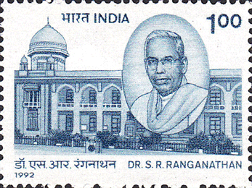
New Library Rules & Laws
Dr. Ranganathan’s Five Laws (1931)
  First Law: Books are for use
  Second Law: Every reader his / her book
  Third Law: Every book its reader
  Fourth Law: Save the time of the reader
  Fifth Law: The library is a growing organism
Image - http://www.stampsathi.in/php/public/stamps-gallery.php?page=171

Slide 37
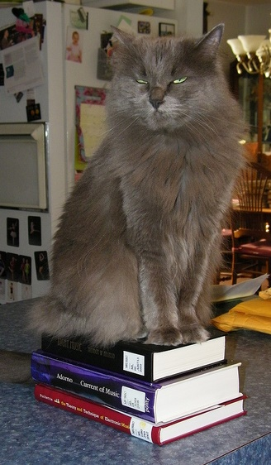
New Library Rules & Laws
Dr. Ranganathan’s Fourth Law - Save the time of the reader
This is the “technical services” law about cataloging in a closed stack environment.
Today, it can be a way we help provide clarity for people who are not as familiar with information resources like librarians.
Our work with Action Learning Teams is to support their research needs.

Slide 38

New Library Rules & Laws
One aspect that is challenging is when we are tasked to find resources that answer a specific problem in a specific way.
People are not doing research – but seeking to reaffirm what they already believe.
This is a huge problem with business research.
Sadly, it is also a problem with political research.

Slide 39
New Library Rules & Laws
Zombieland Rule #32 – Enjoy the Little Things
What I want to focus on is the simplicity of tagging as a means of findability.
If you are a creator of content, you will see and understand how information flows and how items are found.
This can be illustrated with my work in tagging on flickr.

Slide 40
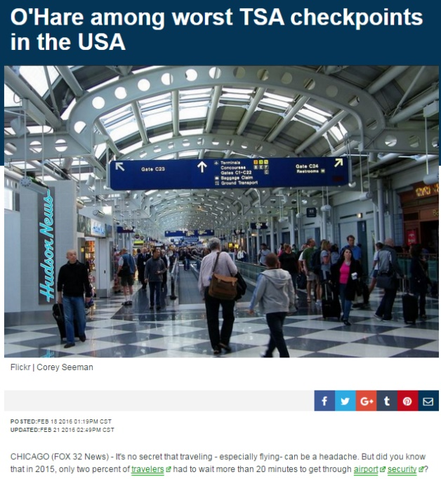
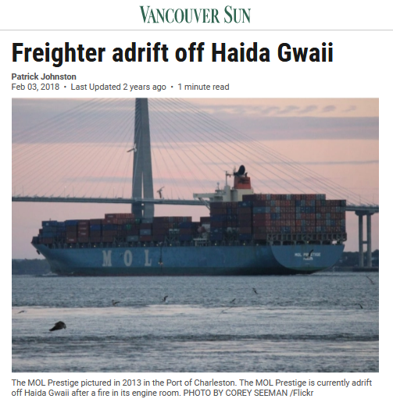
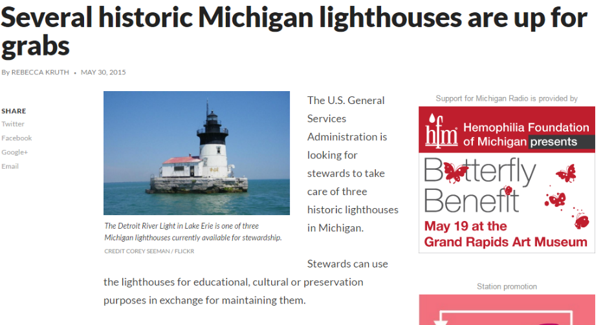
New Library Rules & Laws

Slide 41
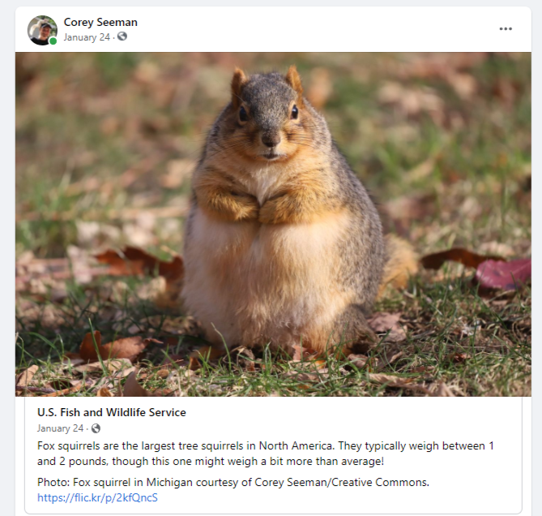
New Library Rules & Laws
While tagging can be sloppy, it is findable and very simple to manage.
Found by the US Fish and Wildlife Service and then by news services.
https://www.kansascity.com/news/nation-world/national/article248744280.html

Slide 42

New Library Rules & Laws
Zingerman's 12 Natural Laws of Business (Ari Weinzweig)
LAW #9 : Success means you get better problems.
We find this when we receive direct questions that come from researchers (faculty and students).
Success does not mean work goes away – it means you get more questions!

Slide 43
New Library Rules & Laws
“This one is a bit of a mind bend until you accept it. But as soon as you have, it becomes a belated glimpse of the obvious! If I asked you whether you can imagine a world/time/place that is free of all problems, you’d laugh at me, right? And yet, each of us, at least secretly, believes that when we get to that next stage, meet that next goal, life will become magically problem free. The truth is, you’ll just have different problems, and if the next stage or goal is getting you better problems, call it a win! Example : You obsess about customer service and are nationally recognized for it. Good Problem : You have lines out of the door and are getting customer complaints for the wait time. Less Good Problem : You don't obsess about customer service, you have no lines and no one complains about the wait.”
http://info.zingtrain.com/zingermans-12-natural-laws-of-business?_ga=2.237168901.402973041.1632699346-369966816.1632699346

Slide 44
New Library Rules & Laws
Nordstrom’s Only Rule
The Employee Handbook is one card
“Our number one goal is to provide outstanding customer service”
Our only rule: “Use good judgment in all situations”
See Spector’s The Nordstrom Way to Customer Service Excellence, 2005

Slide 45
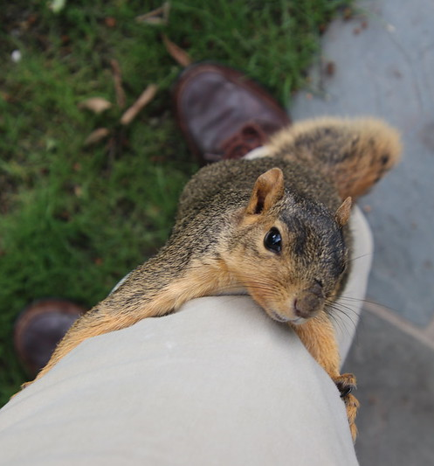
New Library Rules & Laws
At Kresge, everyone is empowered to make it right.
The expectation is to do something special when we can.
We can be a better library by looking at examples OUTSIDE other libraries.
Picture of a climber back in 2019.

Slide 46
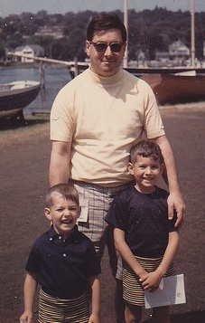
New Library Rules & Laws
Don’t Get Married to the Results
Something my father always said – he was a proponent of the importance of failure and risk-taking.
Do not start with predetermined measures of success.
Having the appearance of success does not mean you actually have it.
Attaining metrics might come at the expense of other important elements.
Do not let yourself be judged by what we did not accomplish – that is for the “customers”

Slide 47

Closing Thoughts – Be Flexible
At Kresge, the “Ethereal Library’s” value proposition is:
  Live within the restrictions of virtually no collection space.
  Figure out new collaboration mechanisms to serve our community.
  Focus on what we can do vs. what we have done.
  Forget the dead, take care of the living!
Squirrel at the University of Michigan, Ann Arbor

Slide 48

Closing Thoughts – Be Flexible
When you are at a dog park, you must always be flexible, especially with your knees.
That way, the dogs running around will not knock you over!
We might be done with COVID-19, but it is not done with us!
Don’t jump to conclusions about a picture.
Runyon and Rosie at Swift Run Dog Park, October 11th, 2020.

Slide 49
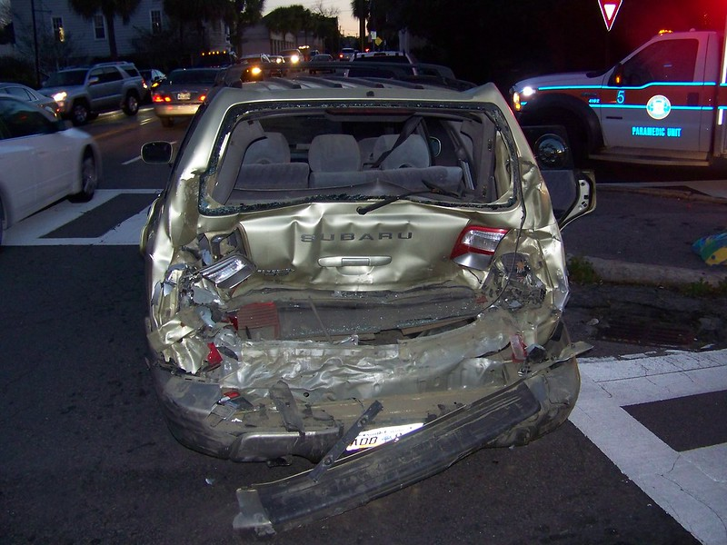
Closing Thoughts – Beware Dashboard Indicators
They will not tell you about the person behind you!
Thank you
Corey Seeman
cseeman@umich.edu
Corey - https://sites.google.com/view/squirrelman/home
Kresge - https://www.bus.umich.edu/Kresgelibrary/
Slides Link: tinyurl.com/SeemanLC21

Slide 50
For More Fun….
"The Ethereal Library: Our Experience in Library Futures at the Kresge Library." presentation to be given at the International Conference on Next Generation Libraries (NGL-2019) to be held December 12-14, 2019 at National Institute of Technology, Rourkela, India. Virtual participant at the meeting. Link
"History Has Its Eyes on You: Lighthouses and Libraries Weathering Storms of Change," Keynote for the Great Lakes Resource Sharing Conference, June 8-9, 2017 at Oak Brook, Illinois. Link
“Don’t Get Married to the Results: Managing Library Change in the Age of Metrics,” presentation at the 2015 Charleston (SC) Conference, November 2015. Link / Transcription of Talk
“Creating The Ethereal Library: Thinking Creatively When You Have No Space To Think,” presentation at the The 2014 Conference for Entrepreneurial Librarians, Wake Forest University, Winston-Salem, North Carolina on October 17, 2014. Link / Proceedings Link
Also visit - https://sites.google.com/view/squirrelman

