Slide 1
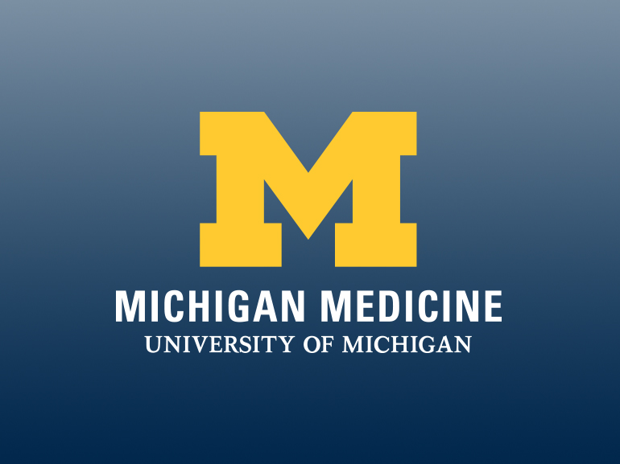

Becoming Healers: Improving Native American Interest and Access to Medical Training in Michigan
Nicole Honey, BS¹; Marilyn Roubidoux, MD²; Blair Richards, MPH³
¹University of Michigan Medical School, ²Michigan Medicine, ³University of Michigan, Michigan Institute for Clinical and Health Research
Abstract
There has been a significant increase in the number of medical students from groups now known as underrepresented minorities (URM) (Native Americans, African Americans, Mexican Americans, and mainland Puerto Ricans) since the 1960s when classes were only accepting one of these students every other year (3).
In a state like Michigan- where one of the state universities has a mascot named after a Native tribe, “Chippewa,” where public universities reside on indigenous land, and where a significant Native American population reside- it is imperative to understand how we can improve the health of our Native peoples. By digging deep into the number of medical student applicants and enrolled students who identify as American Indian/Alaska Native (AI/AN), we can understand if we are training a diverse group of people. By discovering if we need more applicants or enrolled trainees, we can dedicate resources to address where the pipeline narrows. The end coal will be to increase the number of Native American physicians who will have the option to practice in underserved communities in the state and improve patient satisfaction and outcomes among these communities.
Methods and Materials
Discussion
Purpose:
Health care disparities are prevalent in American Indian/Alaska Native (AI/AN) communities. One tactic to combat this inequity is to support providers who are more likely to practice in these communities. By understanding the proportion of AI/AN people who apply and enroll in medical schools in Michigan and nationally, we can start to discuss where we may better targets efforts to improve education for students. Then we may battle health disparities specific to the Native communities in state of Michigan.
Methods:
Univariable comparisons between the AI/AN and white racial groups were performed using chi-square tests and prevalence ratios with 95% confidence intervals. A 2-tailed p value of <0.05 was considered statistically significant.
Results:
Within the state of Michigan the prevalence of AI/NA people applying to medical school from 2015 to 2019 was 59% (95% CI = 39% to 89%) of that for white people (p=0.011). Nationally the prevalence of AI/AN people applying to medical school from 2015 to 2019 was 39% (95% CI = 36% to 42%) of that for white people (p<0.0001). The prevalence of AI/AN people enrolled nationally in medical school in 2019 was 75% (p<0.0001, 95% CI = 70% to 80%) of that for white people.
Conclusions:
Michigan medical schools are considerably diverse by admitting AI/AN students at a proportion that is not statistically different than the proportion of white students admitted. Nationally, there is a large shortage of AI/AN medical students enrolled. This is likely due to the low proportion of AI/AN students who are applying to medical school. Efforts must be placed earlier on, long before the application process, to recruit more diverse medical students.
The number of applicants from Michigan and nationally, as well as the number of enrolled medical students in the six medical schools in the state of Michigan and all medical schools nationally, was obtained through public data from the AAMC. The US Census was used to record the number of citizens in Michigan, as well as nationally, who identify as Native American or as white alone or in combination with another race.
For the applicant analysis, the number of AI/AN vs. white applicants from Michigan, and nationally, were compared to the total population in the areas, respectively. The period prevalence used the aggregate of applicants across years 2015 to 2019 and used the average population from 2015 to 2019.
For the enrollment analysis, the number of AI/AN vs. white enrolled medical students in Michigan, and nationally, in 2019 were compared to the total population in those areas respectively.
Univariable comparisons between the AI/AN and white racial groups were performed using chi-square tests and prevalence ratios with 95% confidence intervals. A 2-tailed p value of <0.05 was considered statistically significant. Microsoft Excel (2016) was used for all analyses.
This research was supported by funding from the National Center for Advancing Translational Sciences (grant number UL1TR002240).
Diversity is important in all aspects of life, but especially in medicine so that we can appropriately care for all persons. While Michigan medical schools are appropriately enrolling a proportion of American Indian/Alaska Native students not dissimilar to that of the proportion of white students, there is still a shortage of AI/AN medical student applicants from Michigan. This means that medical schools should make an effort to not only recruit applicants, but to reach back further into the pipeline to address why more AI/AN students are not applying in the first place. More research will need to be done to determine if the “pinch” in the pipeline occurs during college years, high school, or even prior to these years. This pinch is where medical schools need to place efforts into recruiting.
It is imperative to develop positive relationships with the tribes such that all parties are benefitted. A meeting was had with the Confederation of Michigan Tribal Education Directors to discuss options for this type of initiative.
Results
Within the state of Michigan, the prevalence of AI/NA people applying to medical school from 2015 to 2019 was 59% (95% CI = 39% to 89%) of that for white people (p=0.011). Nationally the prevalence of AI/AN people applying to medical school from 2015 to 2019 was 39% (95% CI = 36% to 42%) of that for white people (p<0.0001). The prevalence of AI/AN people enrolled for medical school in Michigan in 2019 did not significantly differ (p=0.80) from that for white people. The prevalence of AI/AN people enrolled nationally in medical school in 2019 was 75% (p<0.0001, 95% CI = 70% to 80%) of that for white people.
Introduction
Conclusions
It is well understood by now that the United States is an incredibly diverse country with healthcare disparities all over the map. In order to provide adequate healthcare to everyone, including those in underserved communities, we need to educate providers who are likely to practice in these communities. African American, Hispanic, and Native American physicians are much more likely than white physicians are to practice in underserved communities and to treat larger numbers of minority patients, irrespective of income (5). Patient satisfaction is also shown to increase when there is racial concordance between minority patient and provider (6). Therefore, the first steps to improving care in underserved communities is to promote medical training for young members within these communities.
Michigan medical schools are considerably diverse by admitting AI/AN students at a proportion that is not statistically different than the proportion of white students admitted. Nationally, there is a large shortage of AI/AN medical students enrolled. This is likely due to the statistical significantly low proportion of AI/AN students, within Michigan and nationally, who are applying to medical school. Efforts must be placed earlier on, long before the application process, to recruit more diverse medical students.
Discussions with the Confederation of Michigan Tribal Education Directors from the twelve tribes in Michigan will need to continue. This relationship will help to build programs for Native American students who are earlier on in their education, prior to the time applying to medical school.
Graph 1. Prevalence ratio of NA/AN vs. white residents residents who applied to medical school in Michigan and in the United States, aggregated from 2015-2019 (top). Prevalence ration of NA/AN vs. white residents who are enrolled in medical school in Michigan and in the United States in 2019 (bottom).
 | Enrolled / Population 2019 (%) | P Value
Enrolled in Med School in Michigan |  | 0.797
AI/AN | 42 / 147,802 (0.028%)
White | 2388 / 8074166 (0.030%)
Enrolled in Med School in United States |  | <0.0001
AI/AN | 923 / 5,642,996 (0.016%)
White | 53,362 / 244,544,307 (0.022%)
 | Applied / Average population 2015-2019 (%) | P Value
Applied to Med School in Michigan |  | 0.011
AI/AN | 23 / 53,016 (0.043%)
White | 5715 / 7,811,734 (0.073%)
Applied to Med School in United States |  | <0.001
AI/AN | 540 / 2,649,121 (0.020%)
White | 122,737 / 234,127,826 (0.052%)
Table 2. Frequency of AI/AN enrolled students vs. frequency of white enrolled students in 2019 in Michigan as well as in the United States.
Contact
References
Nicole Honey
University of Michigan Medical School
Email: nichoney@med.umich.edu
Table 1. Frequency of AI/AN applicants vs. frequency of white applicants from 2015-2019 in Michigan as well as in the United States.
AAMC 2015-2019 FACTS: Applicants and Matriculants Data. Table A-10.
AAMC 2015-2019 FACTS: Enrollment, Graduates, and MD-PhD Data. Table B-5.2.
Cohen, J. J., Gabriel, B. A., Terrell, C (2002). The Case for Diversity in the Health Care Workforce. Health Affairs 2002. 21:5, 90-102.
Current Trends in Medical Education (2015). AAMC List of Figures 2015.
Kington, R., Tisnado, D., & Carlisle, D. M (2001). Increasing racial and ethnic diversity among physicians: an intervention to address health disparities. The right thing to do, the smart thing to do: Enhancing diversity in the health professions, 57-75.
Saha, S., Komaromy, M., Koepsell, T. D., & Bindman, A. B. (1999). Patient-physician racial concordance and the perceived quality and use of health care. Archives of internal medicine, 159(9), 997-1004.
U.S. Census Bureau, Population Estimates Program (PEP). Updated annually.

