Slide 1
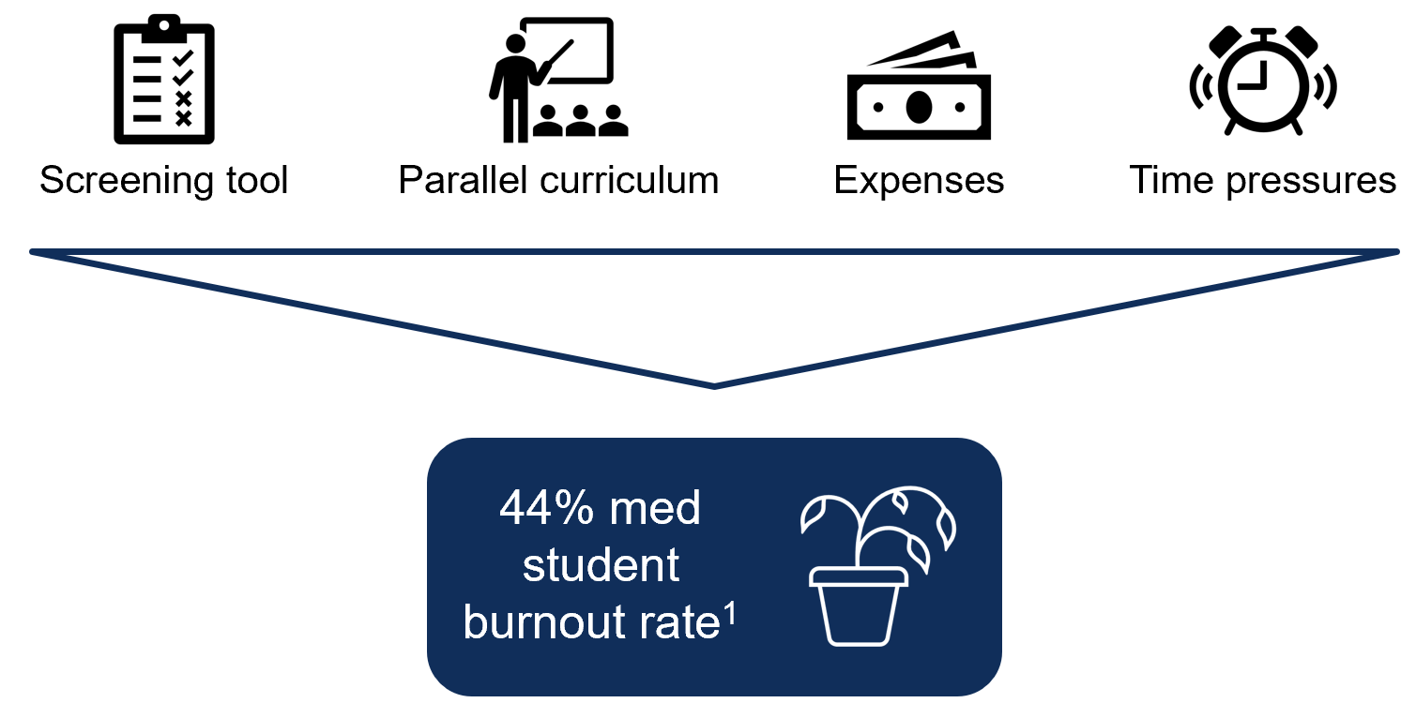
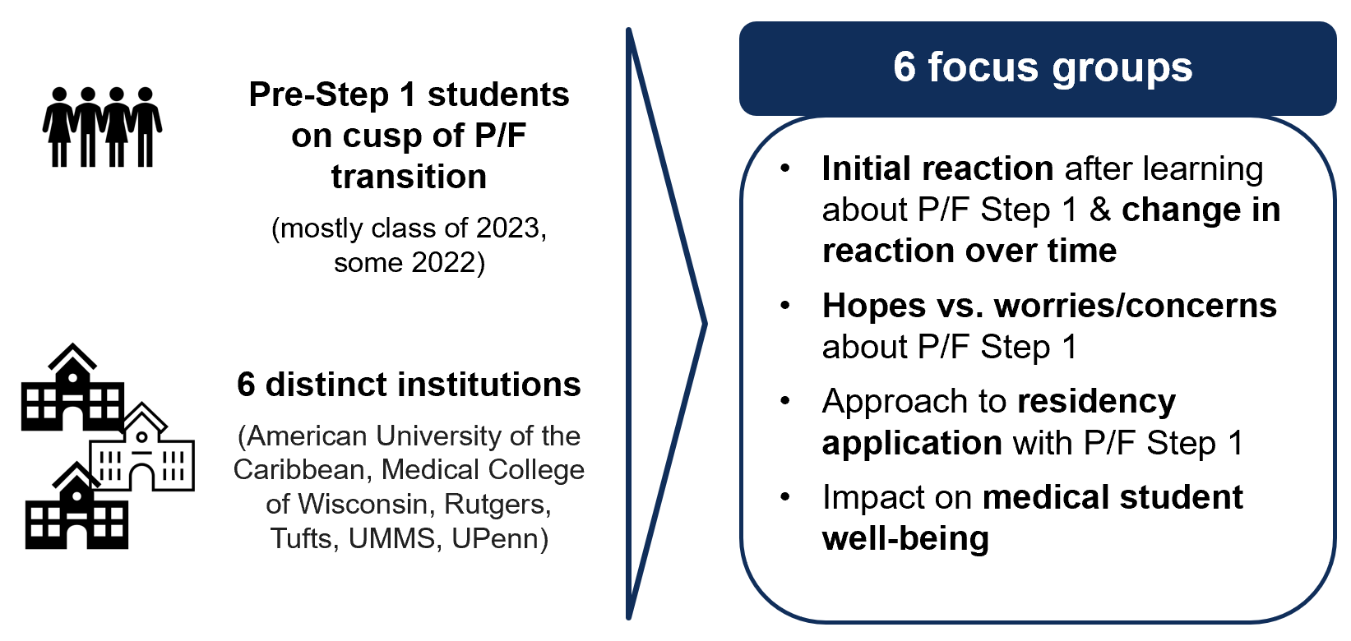
Exploring Students’ Perspectives on Well-being and the Change of United States Medical Licensing Examination Step 1 to Pass/Fail
Nicole Mott, BS¹; Jacquelyn Kercheval, BA¹; Michelle Daniel, MD, MPHE^{2,3}
¹University of Michigan Medical School, ²University of Michigan, Department of Emergency Medicine, ²University of Michigan, Department of Learning Health Sciences
Introduction
Results
In February 2020, the Federation of State Medical Boards and National Board of Medical Examiners announced that Step 1 of the United States Medical Licensing Examination would transition from a three-digit numerical score to a pass/fail outcome. While several opinion pieces have been authored on the potential implications of this change, no study has formally assessed the student voice. The purpose of this study is to explore medical students’ perspectives of a pass/fail Step 1, with an emphasis on how this transition will impact their well-being.
Participants included females (50%), males (47%), and one non-binary student. Mean age was 24 (range 21–29). The majority were Caucasian (57%), followed by Asian (27%) and African American (10%). Overall, students were confused regarding the decision to transition Step 1 to a pass/fail outcome. They expressed anxiety over the uncertainty of how a pass/fail Step 1 may impact future residency applications and pressure to re-allocate time and resources to other academic pursuits that would make them competitive. Students explicitly stated skepticism or disbelief that a pass/fail Step 1 would improve their well-being.
“…It just made it so much more uncertain with a process that already seemed so uncertain and out of our hands.” (P4)
“I think initially my class was really like excited about it, upon initial announcement, and then kind of once we started thinking about it more, it kind of turned into anxiety.” (P22)
“I think eventually that pressure will…shift towards like Step 2 around that same time that you’re going to be preparing for residency programs and stuff. So I don’t know exactly how much stress, um, will be reduced, I guess, in the end.” (P12)
“…It will increase competition for research spots, um, make things more cutthroat.” (P19)
“Our class gets along very well… and I don’t know that it would be that way if everybody was really clamoring for those leadership opportunities, you know, um, because they just wanted to be able to differentiate themselves on their application rather than finding something they’re passionate about and like just being a leader in that.” (P14)
Methods
“I wonder if, um, making it pass/fail would make time outside of dedicated like more stressful for me…I’d have to focus a lot more on other aspects of my application…and those types of things are more longitudinal…like research experiences…I can’t just say, ‘I’m going to go super hard for these two months….’All four years I’m going to be a little bit more rigid, say no to stuff so that I can enhance all these different aspects. My mental health would be suffering.” (P2)
We conducted virtual focus groups from May 2020 – June 2020 with first- and second-year medical students from six institutions (n = 30). We analyzed focus group content following the inductive and iterative constructivist approach to produce a thematic analysis.
“I think after a transition period it’s going to be really good for student well-being, but being in the transition period itself, I personally find the uncertainty very stressful with just the lack of clarity of how students will be evaluated when we apply for residency or how the residency process will change to accommodate a mixed pool.” (P25)
Conclusion
While the decision to make Step 1 pass/fail was in part intended to decrease stress associated with performance on a single high-stakes exam designed for licensing purposes, it has led to increased worries for students, and secondary, unanticipated consequences remain to be seen. In this new setting, it will be imperative to provide clarity regarding the metrics used to evaluate students and to incorporate their perspectives in future policy changes.
Contact
References
Nicole Mott
University of Michigan Medical School
Email: nmmott@umich.edu
Frajerman A, Morvan Y, Krebs MO, Gorwood P, Chaumette B. Burnout in medical students before residency: A systematic review and meta-analysis. Eur Psychiatry. 2019;55:36-42.

