Slide 1
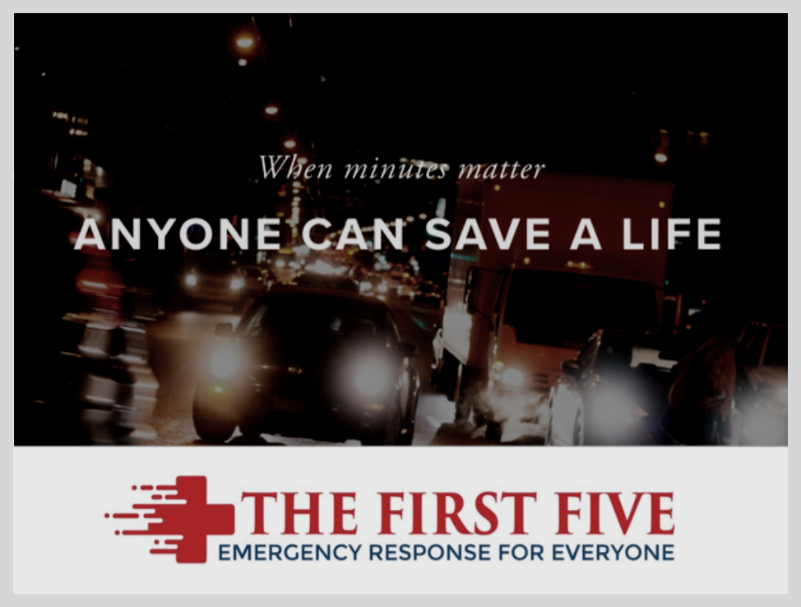

Slide 2

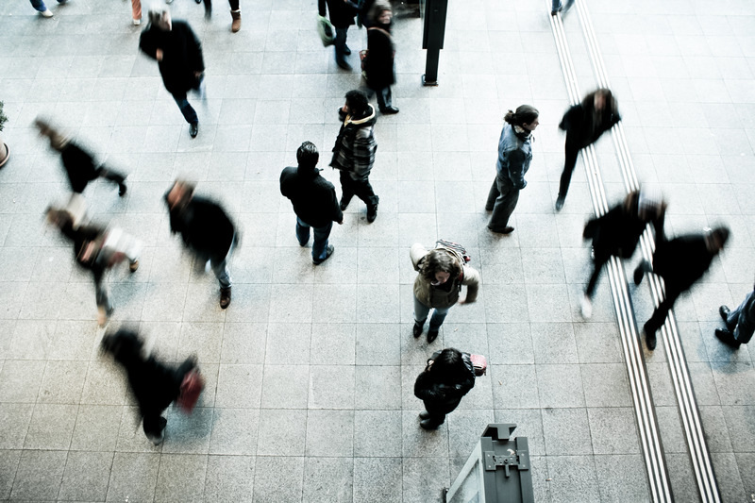

RELEVANCE
Trauma is the leading cause of death ages 1-43 with 200,000 deaths each year.
That's 1 every 3 minutes. 30% of these deaths are preventable.
Ambulance response time is ~5 minutes.
Are we prepared to act?
60,000 PREVENTABLE DEATHS

Slide 3


OBJECTIVE
Teach everyday people how to save a life
in the first five minutes of a medical emergency

Slide 4
COMMITMENT TO PROFESSIONALISM
Be present.
Ask questions.
Phones on silent & put away.
Take care of yourself first.

Slide 5
TAKE CARE OF YOURSELF FIRST
NOTE: WE WANT TO MAKE THIS A SAFE ENVIRONMENT TO LEARN.
IF YOU ARE UNCOMFORTABLE AT ANY POINT WITH ANY OF THE SCENARIOS, PLEASE FEEL SAFE TO SIT DOWN, LEAVE THE ROOM, OR LET US KNOW. THERE IS NO PRESSURE TO PARTICIPATE. WE COMPLETELY UNDERSTAND AND WANT TO BE AWARE OF VARIOUS LIFE EXPERIENCES.
IF YOU ARE UNCOMFORTABLE WITH PARTNERING UP FOR PHYSICAL SCENARIOS, PLEASE TAKE A STEP BACK FOR THAT PART SO WE ARE AWARE.
IF YOU HAVE HAD A TRAUMATIC EXPERIENCE IN THE PAST WITH YOURSELF, FAMILY MEMBERS OR OTHER LIFE EVENTS, FEEL FREE TO LET US KNOW OR EXIT THE ROOM FOR THAT PART OF TRAINING.
Notes:
Financial Disclaimer or Conflict of Interest

Slide 6
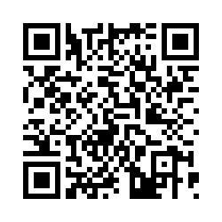
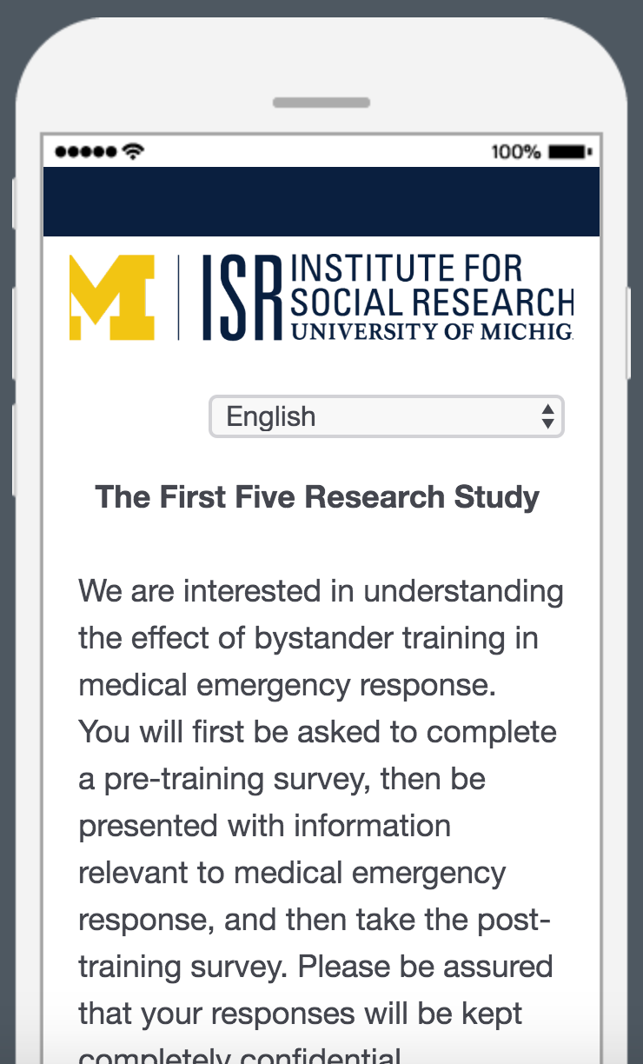

Slide 7



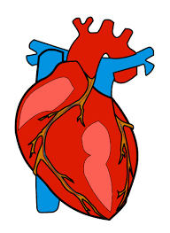
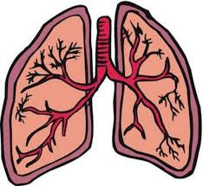
Safety
Protect yourself and others.
Call 911
Patient's injury and location.
Bleeding
Pressure to stop it immediately.
OVERVIEW OF TRAINING
Breathing
Positioning to keep airway open.
Heartbeat
Check pulse and CPR.

Slide 8
SAFETY
STOP! THINK! Then ACT!
● Protect yourself and others
● Bystander Effect
● Good Samaritan Law (Michigan)

Slide 9
CALL 911
● Make sure help is on the way!
● Call or specifically assign the roles.
● Communicate with EMS.

Slide 10
BLEEDING
Life threatening or not?
  Veins vs. Arteries
  Apply pressure
  Direct pressure with hands
  Tourniquet
  Improvise with t-shirt, scarf, tie, belt, etc.
Bottom Line: PRESSURE

Slide 11

BREATHING

Slide 12
BREATHING
1) Can they breathe?
  Talking or screaming in pain = Airway is open!
  Choking → abdominal thrust maneuver
  Position
    Roll to left side, head-tilt chin-lift, or jaw thrust
2) Is it adequate breathing?
  Both sides of the chest rise and fall
  Let patient breathe in their position of comfort

Slide 13

HEARTBEAT

Slide 14
HEARTBEAT
Check if they are responsive.
Check for a pulse.
Is there a heartbeat?
NO = Start CPR!
Someone calls 911.
Someone finds an AED during CPR.
Chest compressions are most important.

Slide 15
HEARTBEAT

Slide 16
OVERVIEW OF TRAINING
Safety Protect yourself and others.
Call 911 Patient's injury and location.
Bleeding Pressure to stop it immediately
Breathing Positioning to keep airway open.
Heartbeat Check pulse and CPR.

Slide 17

+
WHAT WILL YOU DO?

Slide 18
