Slide 1

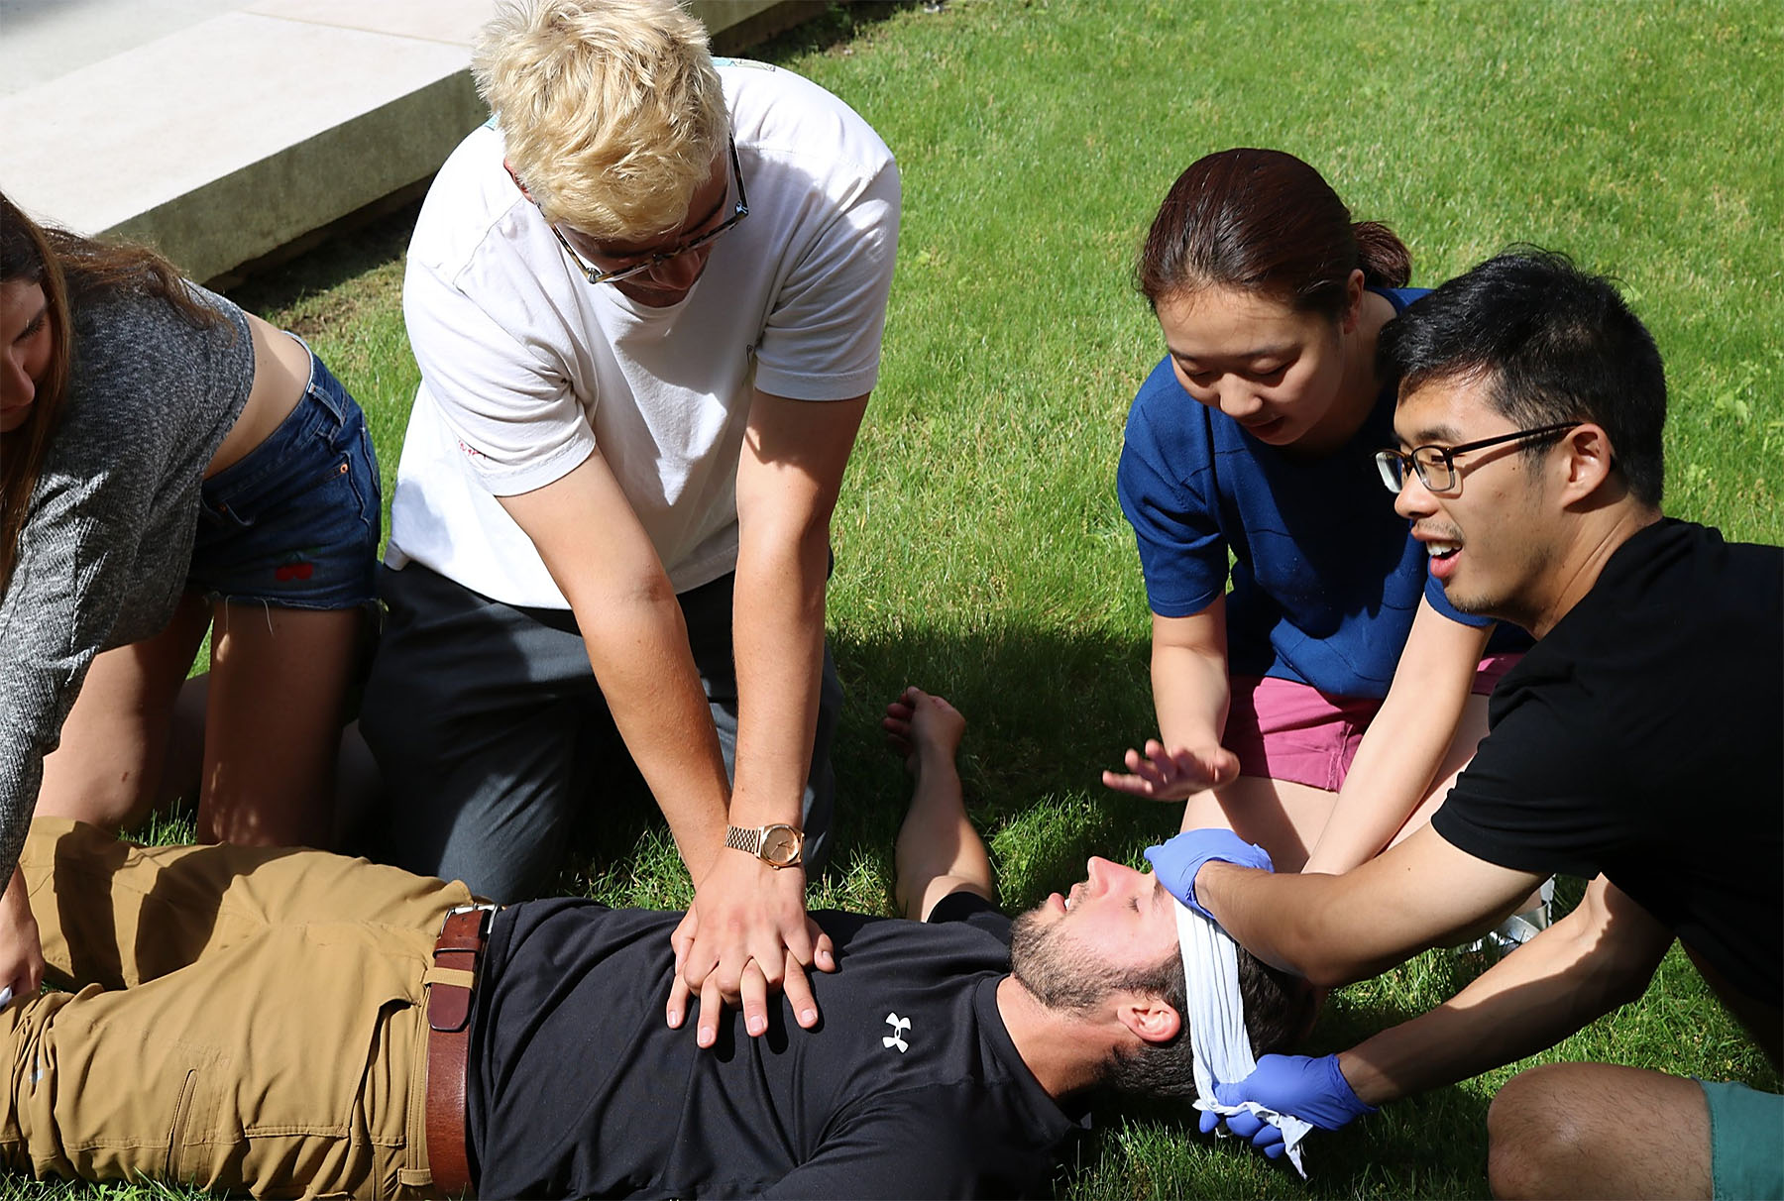
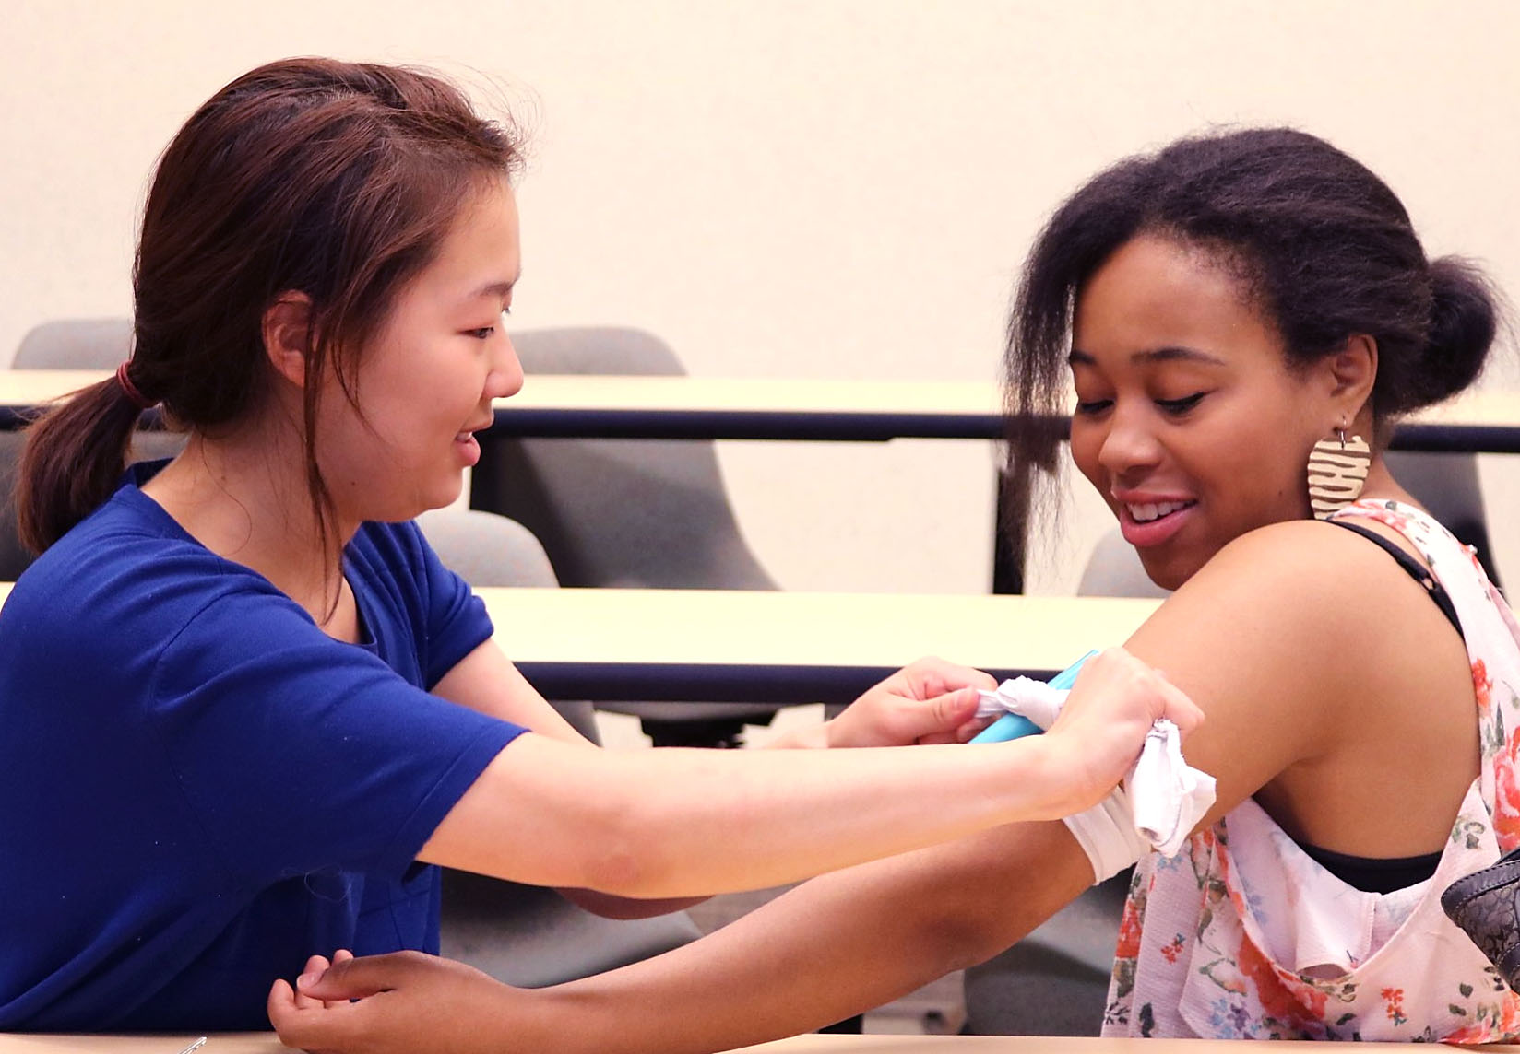
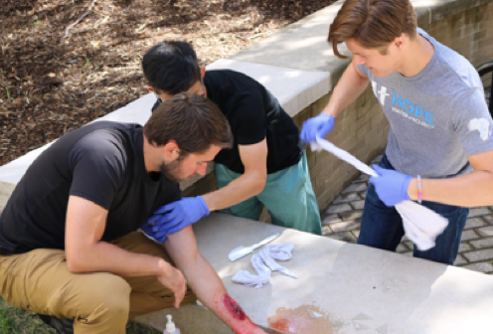



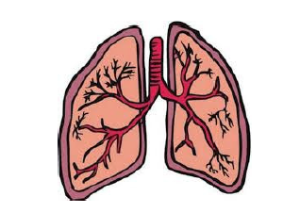
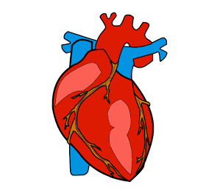

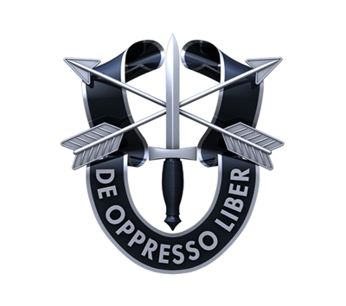
Introduction
Pilot Study Methodology
Discussion
The First Five trains bystanders how to respond in a medical emergency, emphasizing hands-on scenario-based training to provide critical lifesaving interventions within the first five minutes of injury. Just as Tactical Combat Casualty Care (TCCC) decreases the incidence of preventable deaths in combat, First Five training aims to increase survival from point of injury until emergency medical services or rescuers arrive.
Trauma is leading cause of death in US (ages 1-43; 200,000/year)
Up to 30% could have been prevented.
Over 60,000 unnecessary deaths/year.
Average person is not prepared to
respond to a medical emergency.
Sixteen students in University of Michigan’s post-baccalaureate pre-medical program received training on assessing scene safety, communicating with first responders, managing airway and breathing, and controlling bleeding. Thirteen pre- and post-training surveys asked respondents to self-assess the likelihood that they would respond to a medical emergency, their level of confidence in their ability to manage scenarios (1 = “not at all” to 5 = “very confident”) and tested their knowledge on appropriate actions to take.
Study results indicate that First Five training empowers bystanders to act with increased confidence and knowledge of lifesaving interventions during a medical emergency. Further application is needed within specific targeted communities (i.e. National Park Services, austere conditions, wilderness venues) to explore positive impact of widespread First Five training.
2018
University of Michigan in Ann Arbor
2019
Detroit metropolitan area
2020
Med student chapters across the country
2020+
Translate curriculum for global outreach
10 Team members 88 Total trained
Objectives
Results
Limitations
To train & prepare civilian outdoor enthusiasts in the principles of TCCC in order to improve health outcomes during emergencies in austere and wilderness medical environments.
Training for outdoor enthusiasts:
Easy-to-understand
Hands-on training workshops
Realistic scenarios
Taught by medical students
Limited sample size in this pilot study (N=13).
Study sample consists of students going into medical, with more baseline interest and knowledge than the general population.
Adequate follow-up is limited by constraints on time and resources.
Respondents who said they would “definitely” respond to a medical emergency increased from 53.3% to 93.3%. Students scored 58.5% higher on knowledge-based questions (6.31±2.17 before, 10.00±1.69 after training) a statistically significant improvement (p<0.001, CI99%). Students who responded as “confident” or “very confident” in their ability to stop major bleeding increased from 33.3% to 93.3%. Overall, trainees were significantly more confident in their ability to manage medical emergencies (p<0.001, CI99%), with level-of-confidence rising 3.54±0.37 to 4.66±0.18.
Overview of Training
Contact Information
Stephen Hobson, SSG
Special Forces Medical Sergeant
University of Michigan Medical School
40% increase
“definitely respond” in an emergency
58% higher scores
on knowledge-based questions
60% increase
“very confident” to stop bleeding
Safety → Protect yourself and others
Call 911 → Patient’s injury and location
Bleeding → Pressure to stop it immediately
Breathing → Position to keep airway open
Heartbeat → Pulse check and start CPR
firstfivemed@gmail.com
www.firstfivemed.com

