Slide 1


Slide 2


Capstone Seminar Template
Narrative Slide I: Briefly describe your interests that led you to this project.
(include any other details like how you found this project; what programming connected you to your project; did a faculty or advisor connect you to this project; did you do an internship that lead you to your project?)
Stephen Hobson, M.D. Candidate 2021, Special Forces Medical Sergeant
Notes:
Narrative Slide 1

Slide 3

Scientific Research
Narrative Slide: If you did any research that contributed to your project, discuss this briefly here, if not, toss the slide. List the advisor of this research.
Notes:
Problem

Slide 4

The rest of the following slides should focus on pitching your capstone project. You could include topics that you would see in a executive summary to develop your presentation. Any slides where titles are asterisked is required context and non-asterisked can be tossed or used if needed.
Please feel free to use less words and more pictures!
Notes:
Solution

Slide 5
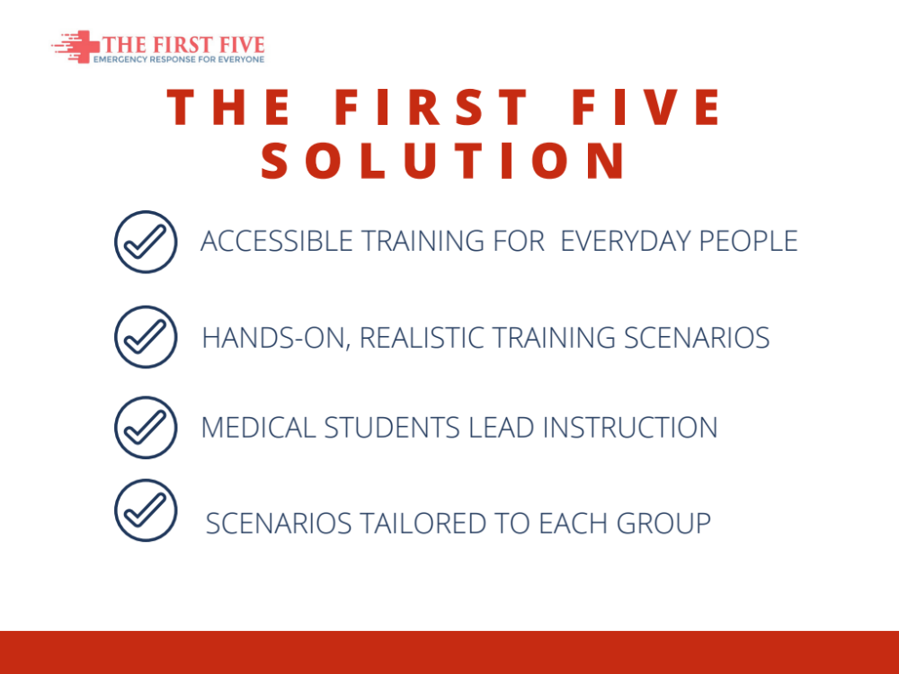
*Problem/Opportunity
Describe the problem or opportunity
What is the stakeholder pain or gain? What has been observed? Why is this a compelling time to act?
Replace blue text; 50 word limit
Notes:
Solution

Slide 6

*Solution
Describe the proposed solution
What is the solution? What is the general concept and key features?
Replace blue text; 50 word limit
Notes:
Stakeholders

Slide 7
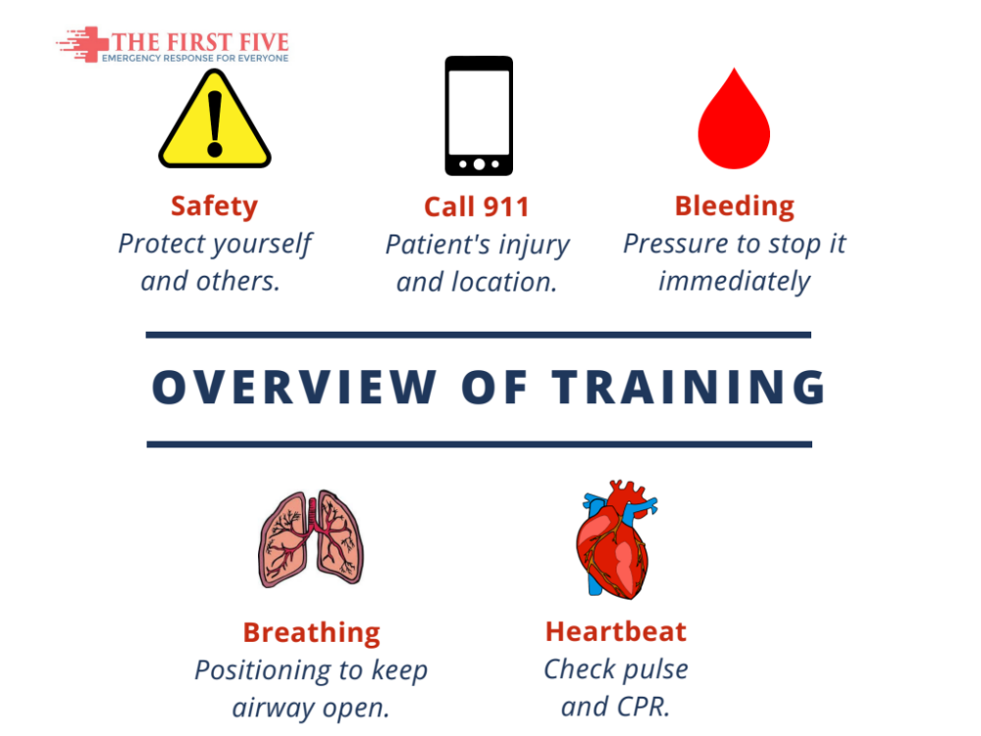
*Value Proposition
Summarize your value proposition
Customers (stakeholders) have a problem and the proposed solution is better than the alternatives resulting in compelling value.
Replace blue text; 75 word limit

Slide 8
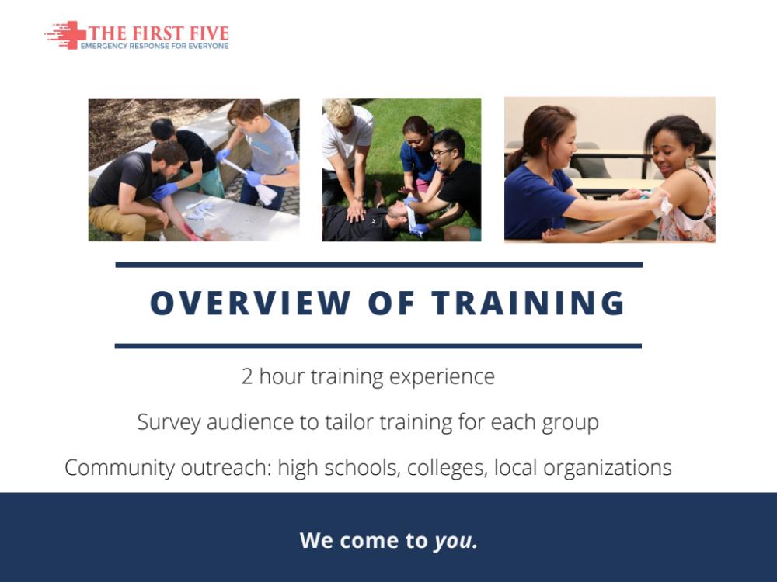
Ecosystem Map
Use your ecosystem map graphic if you have one
This could help describe how the problem influences multiple stakeholders or toss this if you feel you do not need to explain this.
Remove blue text; remove graphic

Slide 9
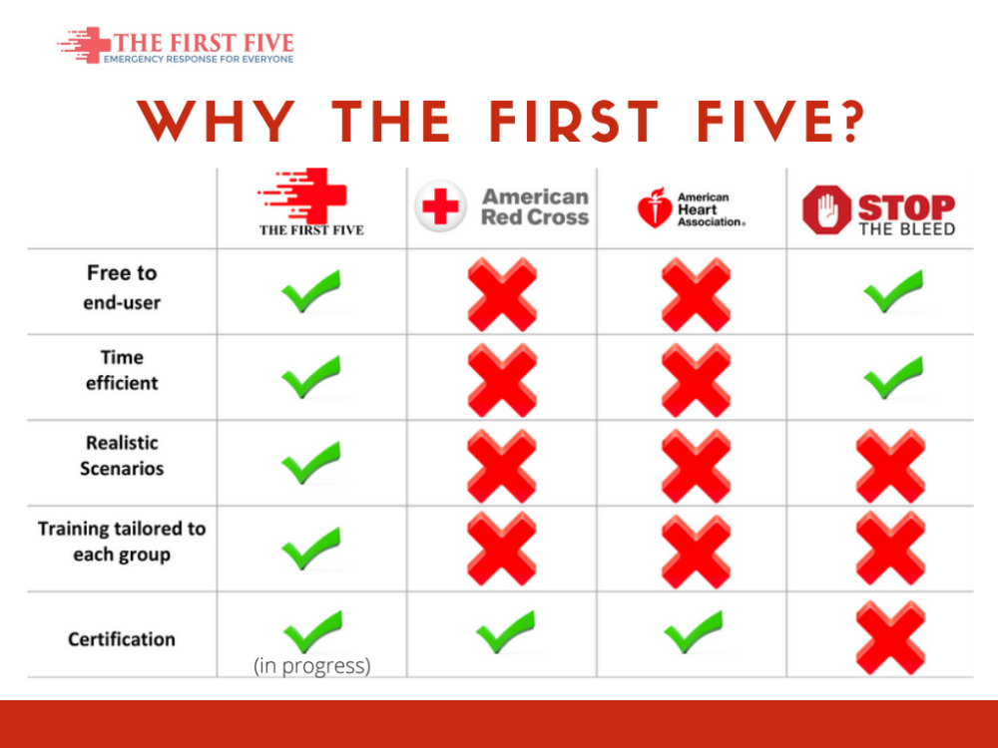
*Stakeholders
Identify your stakeholders
Summarize your list of critical stakeholders and the value provided.
(The chart can be used or tossed)
Stakeholder | Value Proposition
Example: Patient | Example: Decreased recovery time and improved outcomes
Remove blue text; replace text in table
Notes:
Value Proposition / Competitive Advantage

Slide 10
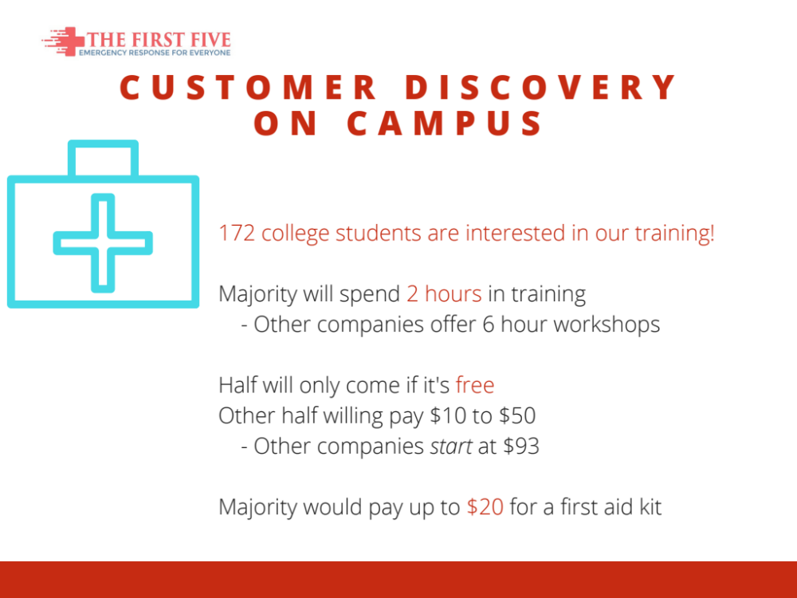
*Customer Discovery
Who did you interview and what did you learn?
Stakeholder | Interview Summary
Example: Patient, Diabetic | Does not mind needles Not comfortable taking insulin in pubic Finds current dosing easy to understand
[Name, Position, Company] | Key insight Key insight Key insight
[Name, Position, Company] | Key insight Key insight Key insight
Remove blue text; replace text in table
Notes:
Customer Discovery

Slide 11
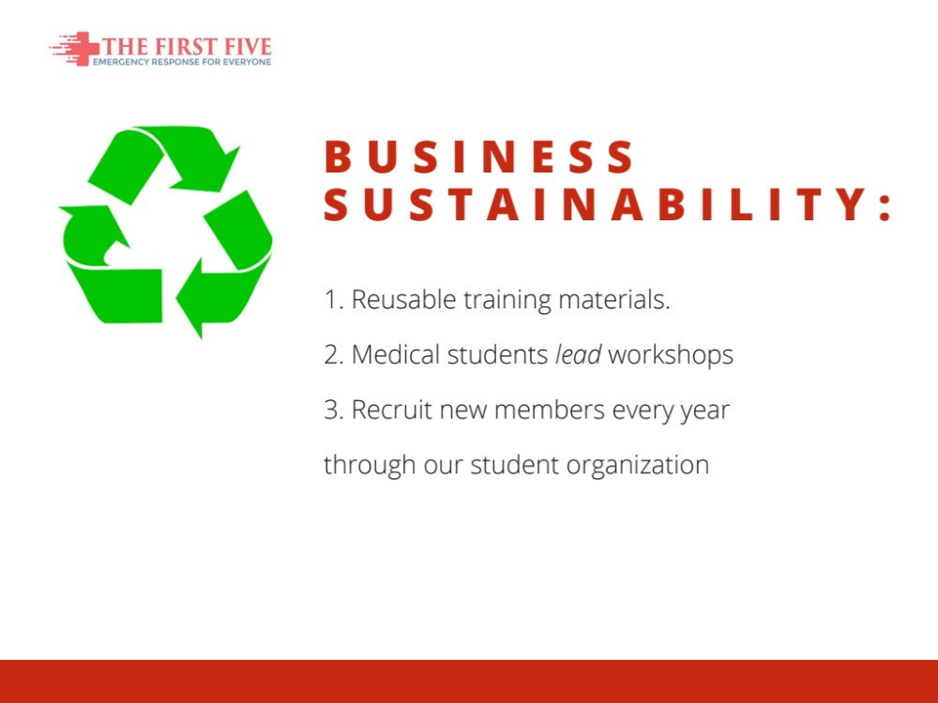
Competitive Advantage
(if needed)

Slide 12

Market Size
(if needed)

Slide 13
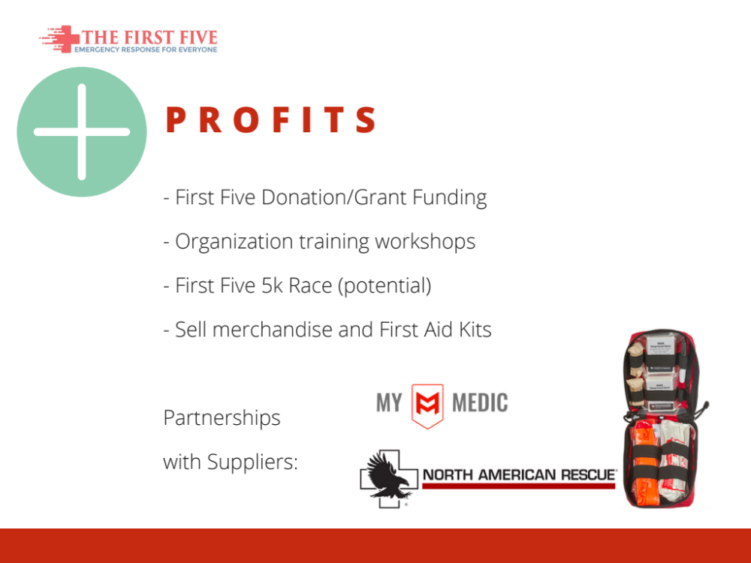
Intellectual Property
(if needed)

Slide 14
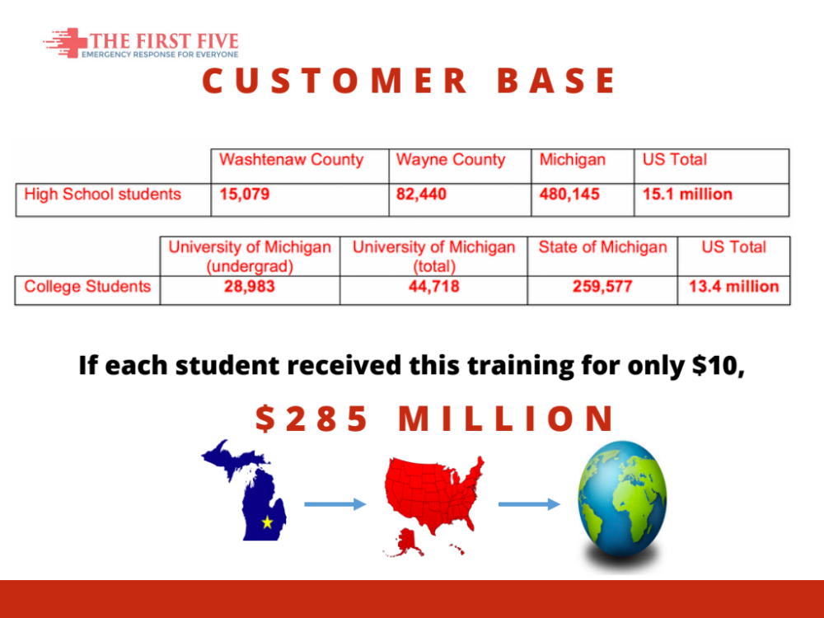
Notes:
Market Size / Financial Analysis

Slide 15

Regulatory Approval
(if needed)

Slide 16

Milestone & Analysis
(if needed)
Notes:
Ecosystem Map

Slide 17
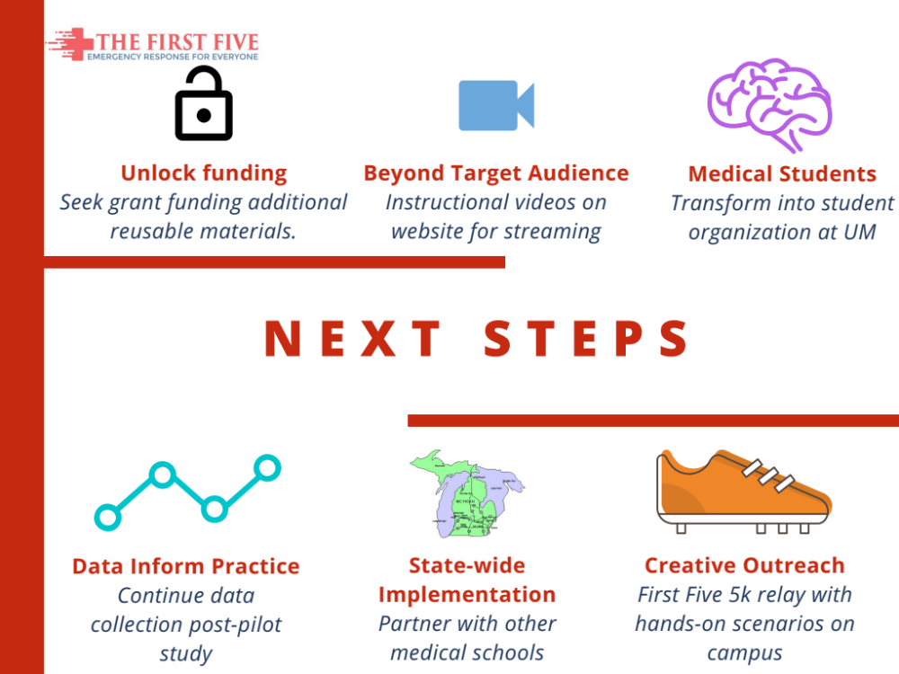
Financial Projections
(if needed)

Slide 18
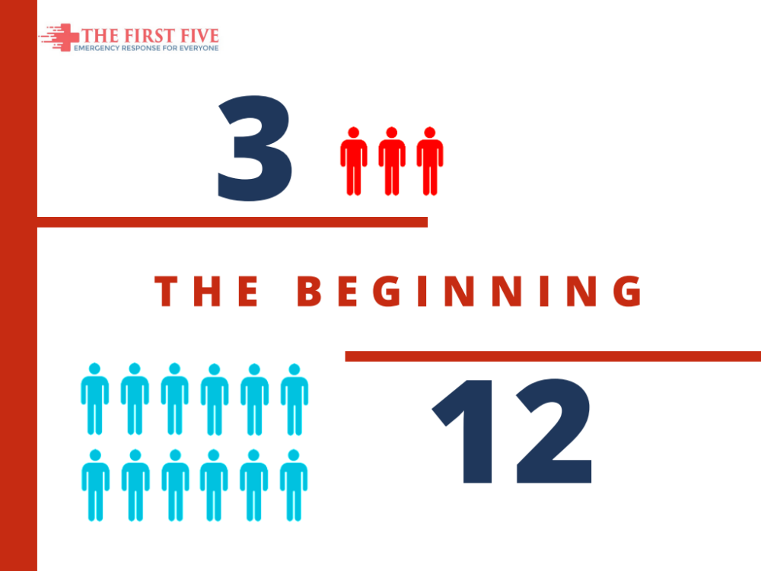

Slide 19
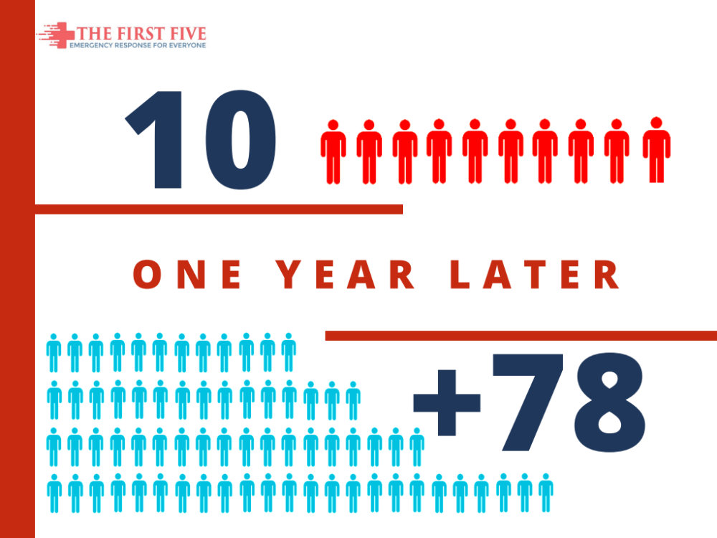
Notes:
Milestones & Analysis

Slide 20
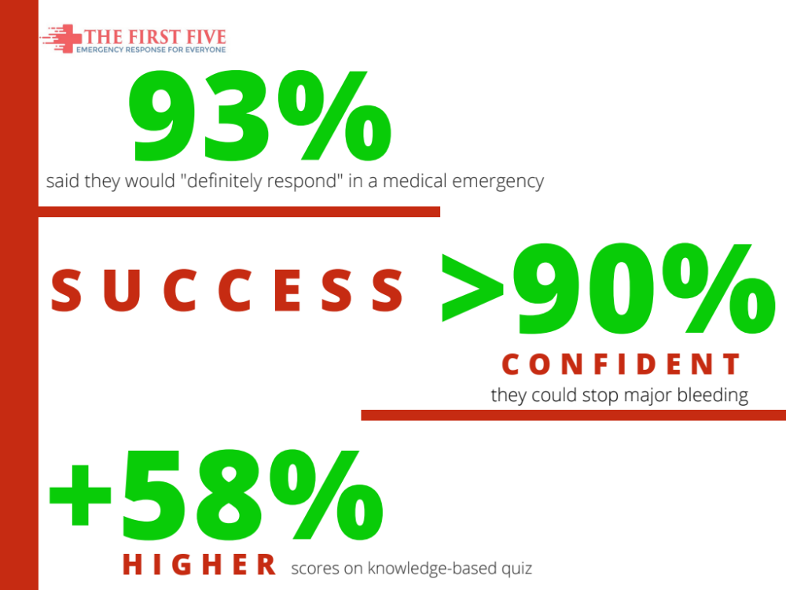
Notes:
Milestones & Analysis

Slide 21
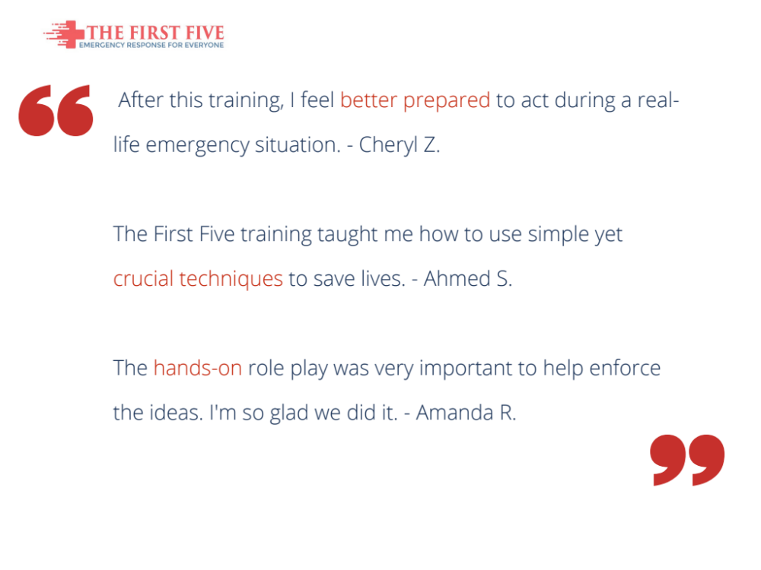
Notes:
Milestones & Analysis

Slide 22

Exit Strategy
(if needed)
Notes:
optiMize, Innovation in Action, IME conference, WMS conference
Narrative Slide II: What did you learn? What is still unknown?
Narrative Slide III: How has your project influenced your career decisions, how as I&E influenced your project and career? What are your next steps for your career and your project?

Slide 23

Notes:
Narrative Slide II: What did you learn? What is still unknown?
Narrative Slide III: How has your project influenced your career decisions, how as I&E influenced your project and career? What are your next steps for your career and your project?

