Slide 1


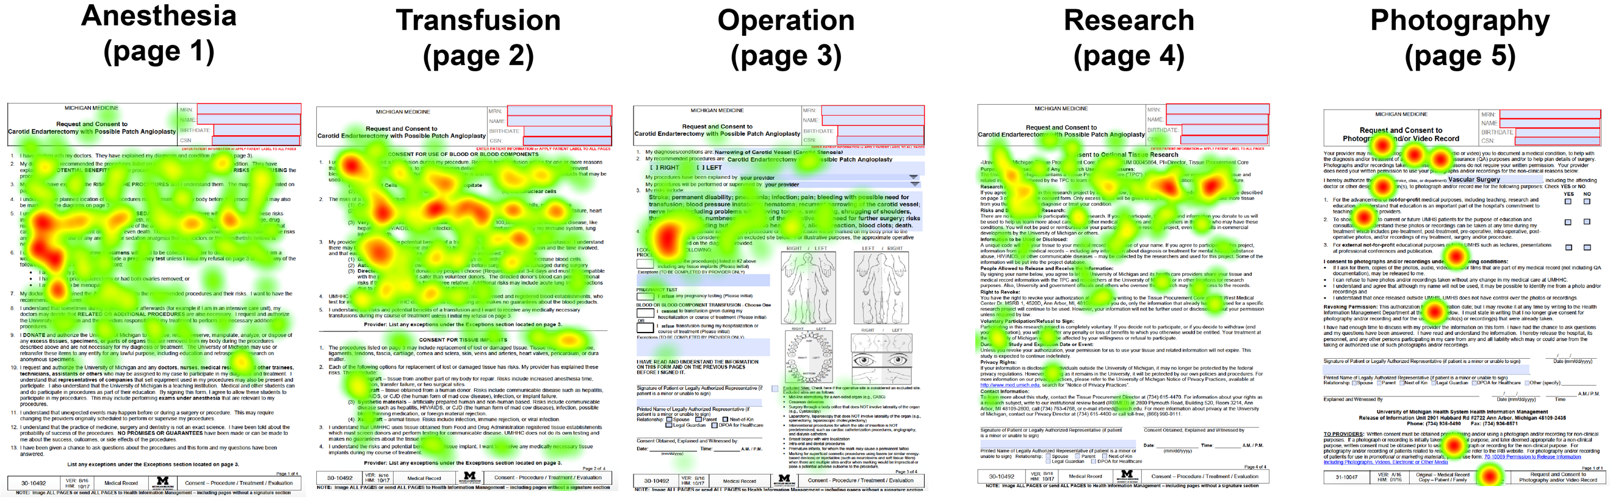
Evaluating Patient Review of Informed Consent Documents for Vascular Surgery Procedures through Eye Tracking
TR Wood; L Batrow; AG Shuman, MD; MA Corriere, MD, MS
Department of Surgery, Section of Vascular Surgery, University of Michigan, Ann Arbor, MI, USA
OBJECTIVE
RESULTS
CONCLUSIONS
Informed surgical consent documents contain descriptions related to anesthesia, transfusions, operations, research, and photography.
These documents are required for elective procedures, but little is known about how patients process the information (including what they do or do not read).
We studied patients’ review of procedure-specific informed consent documents during preoperative history and physical (H&P) visits where informed consent was planned the same visit.
Review of the five-page informed consent document took between 5-6 minutes.
Mean reading time was 64.2 + 20.9 seconds per page.
On a per-page basis, participants spent longer reviewing the case description (page 3, 87 seconds) and research (page 4, 86 seconds) and less time reading the anesthesia (page 1, 43 seconds), transfusion (page 2, 48 seconds) and video (page 5, 57 seconds) pages.
Heat maps indicated non-attendance to content positioned on the bottom of each page and progressively greater proportions of non-attendance compared with ROI and quick reading (Figure).
Detailed reading, identified as contiguous heat map overlay of an entire sentence or paragraph, diminished progressively from page 1 to page 5
Images were generally regions of non-attendance.
The last page (research consent) had a random ROI pattern more consistent with browsing or staling than detailed reading.
Surgical consent documents are incompletely reviewed by patients before procedures.
Key content should be strategically placed on the top of the page and on the first page, and operative and research details prompt more detailed review of content.
Patients are likely to skip or not read content positioned near the bottom of the page or latter pages of multi-page documents.
These considerations can inform strategic redesign of consents to facilitate review of key content.
METHODS
Patients were recruited from outpatient preop H&P visits for vascular procedures.
Eye tracking was performed using a screen-mounted 120Hz camera illuminator system combined dark and bright pupil methods to calculate gaze position while patients reviewed a procedure-specific surgical consent form.
Gaze points were combined with screen videos to generate heat maps and gaze plots used to identify key regions of interest (ROI).
Post-completion interviews further characterized ROI and non-attendance.
Participants also completed version of the Standardized User Experience Percentile Rank Questionnaire to assess consent usability and user experience.
FUTURE WORK
Prioritizing consent content from most to least important based on patient and clinician input
Document redesign based on study findings
Evaluation of informational and financial documents using similar approach
CONTACT INFORMATION
Taylor R Wood: woodta@med.umich.edu
Matthew A Corriere: mcorrier@med.umich.edu
www.corriere.lab.medicine.umich.edu
Authors have no relevant conflicts to disclose

