Slide 1

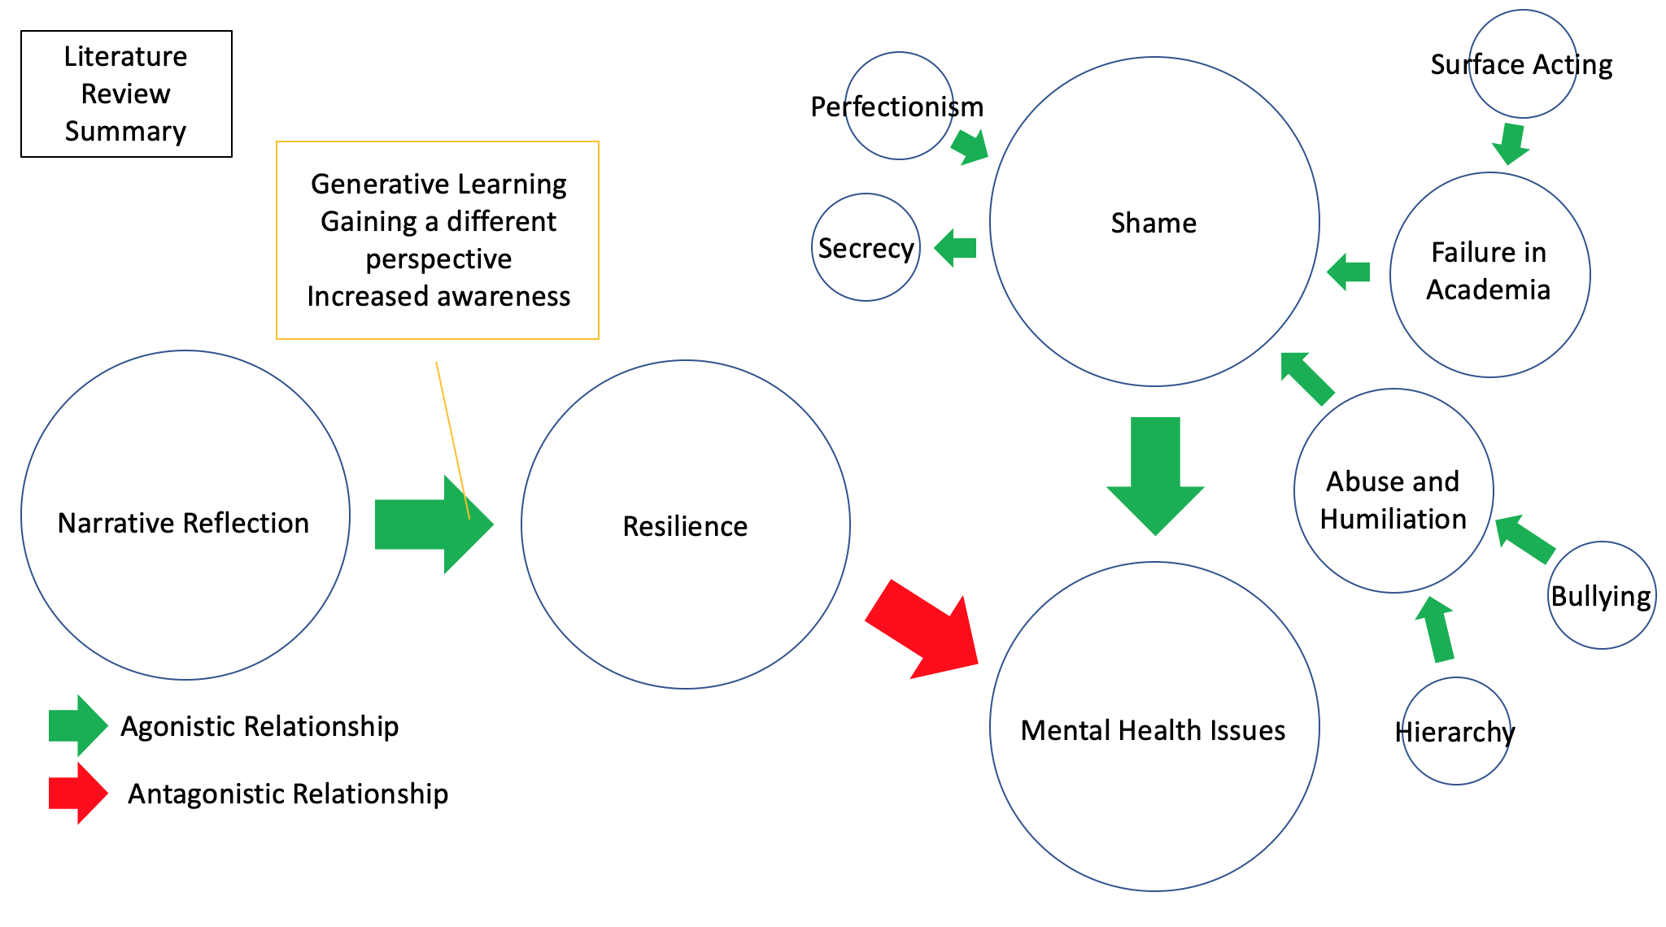
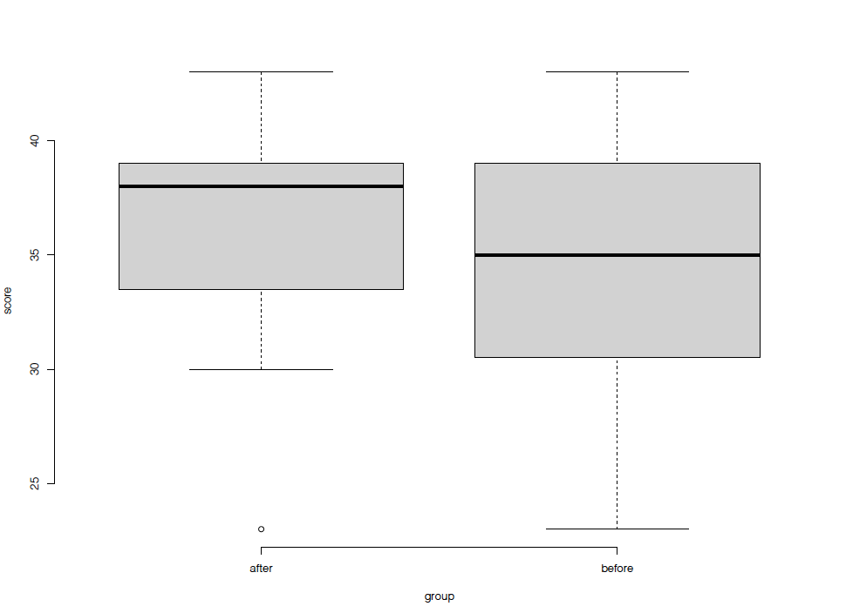
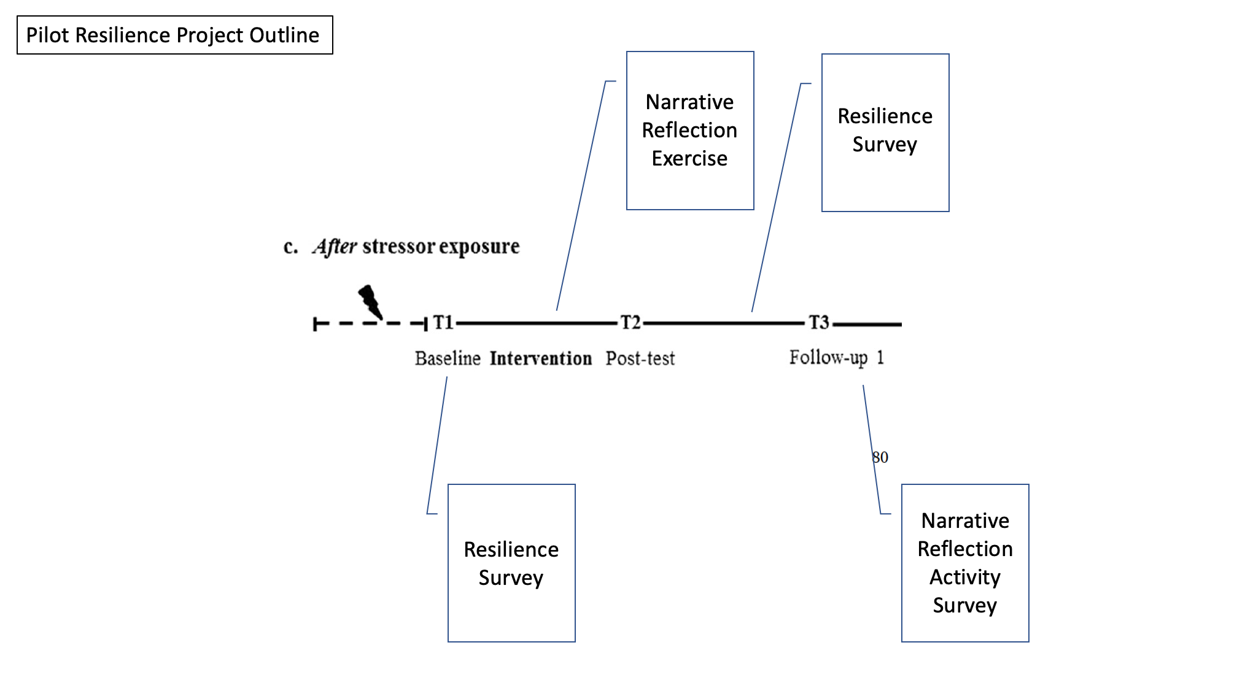
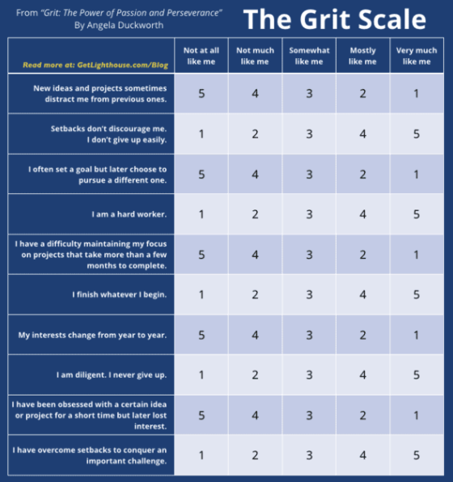
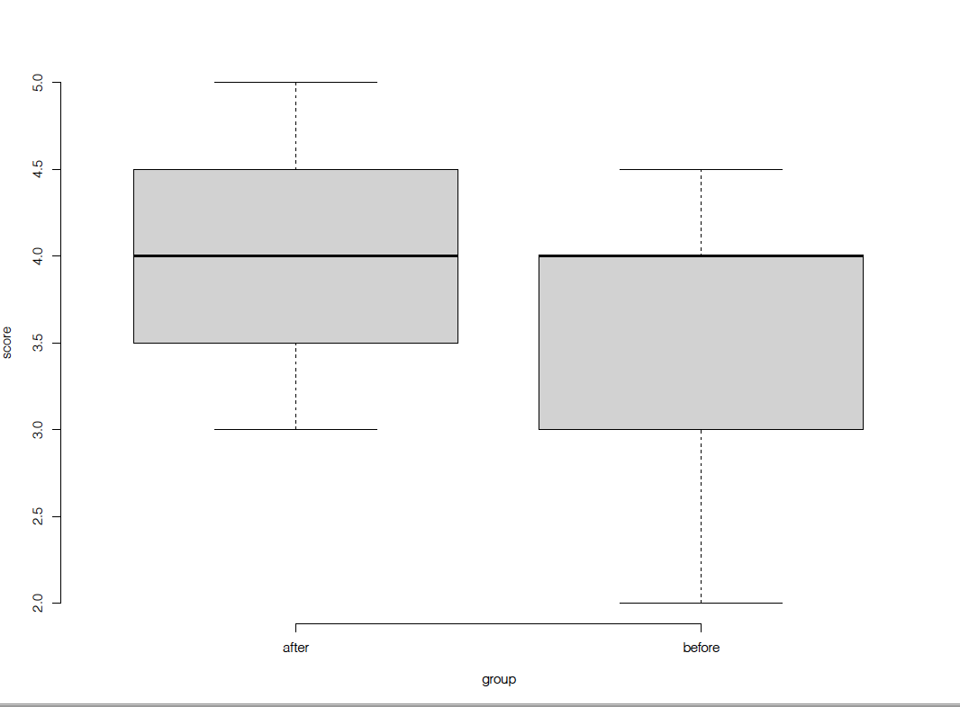
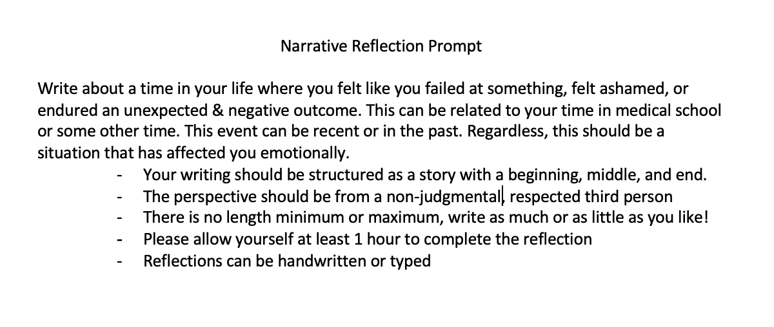
Developing Resilience through Narrative Reflection
Katarina Alajbegovic, BS¹; James Richardson, MD¹
¹University of Michigan
Introduction
Results
Results Continued
Resilience is defined as the “capacity to rebound or bounce back from adversity, conflict, failure, or even positive events, progress, and increased responsibility” (Lafuente et al., 2019).
As outlined in Figure 1, narrative reflection is an established tool found to help minimize shame, and in turn help individuals develop resilience.
Writing through a past trauma, professional or personal, can grant us some space and perspective that we would not otherwise be granted if we carried on otherwise.
Results of paired t-test analysis for the mean of average scores pre- and post-reflection (Graph 1) as well as for questions 2, 4, and 10 were not significant (p >0.05). N=11
There was a significant increase in participant scores after the intervention for Question 8 (Graph 2) with a p= 0.04226.
Results of activity survey are illustrated in Chart 1
Objective
Figure 1. Literature Review Summary
I hypothesized that student’s resilience scores through the Angela Duckworth Grit Scale will increased after completing the narrative reflection exercise.
Methods and Materials
11 M4 Students were recruited over email.
As outlined in Figure 3 students completed Angela Duckworth’s Grit Scale (Figure 4) prior to and after completing the narrative reflection (Figure 2).
Students also completed an activity survey to illicit general experiences at the end of the exercise.
Questions 2, 4, 8, and 10 were analyzed with paired t-testing
Figure 3. Resilience Project Outline
Graph 1. Mean Grit Scale Scores
Chart 1. Activity Survey Responses
Conclusions
There was only a significant increase in scoring for Question 8 of the Grit Scale.
Repeat experiments with a greater participant pool of at least 30 participants should be completed to better understand if narrative reflection is effective in improving student Grit scores
Activity survey data was overwhelmingly positive, and students expressed that they would consider employing narrative reflection in the future when faced with obstacles.
The use of narrative reflection to improve resilience should be explored in the medical education setting.
Figure 2. Narrative Reflection Prompt
Figure 4. Angela Duckworth Grit Scale²
Graph 2. Question 8 Grit Scale Score
Contact
References
Katarina Alajbegovic
University of Michigan Medical School
alajbkat@umich.edu
1. Lafuente, E., Vaillant, Y., Vendrell-Herrero, F., & Gomes, E. (2019). Bouncing Back from Failure: Entrepreneurial Resilience and the Internationalisation of Subsequent Ventures Created by Serial Entrepreneurs. Applied Psychology, 68(4), 658–694. https://doi.org/10.1111/apps.121753
2. Evanish, Jason. “Angela Duckworth Grit Scale.” Lighthouse: A Blog about Leadership and Management Advice, 2017, getlighthouse.com/blog/grit-skill-interview-for-how-to-look-for-it/.

