Slide 1
Literature Review Summary
Surface Acting
Perfectionism
Generative Learning
Gaining a different perspective
Increased awareness
Shame
Secrecy
Failure in Academia
Abuse and Humiliation
Narrative Reflection
Resilience
Bullying
Agonistic Relationship
Mental Health Issues
Hierarchy
Antagonistic Relationship

Slide 2
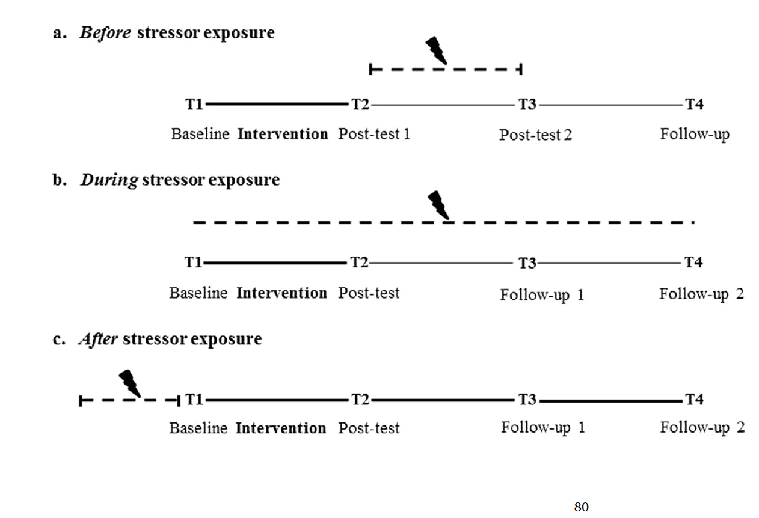
Pilot Resilience Project Outline
Narrative Reflection Exercise
Narrative Reflection Activity Survey
Resilience Survey
Resilience Survey

Slide 3
