Slide 1
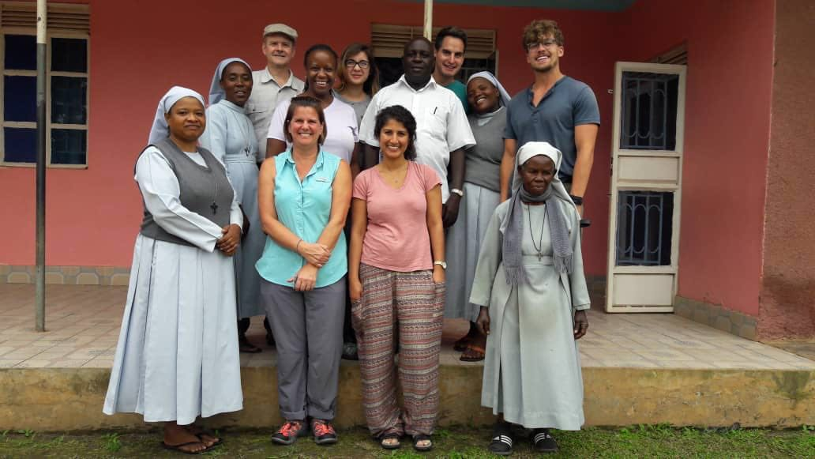
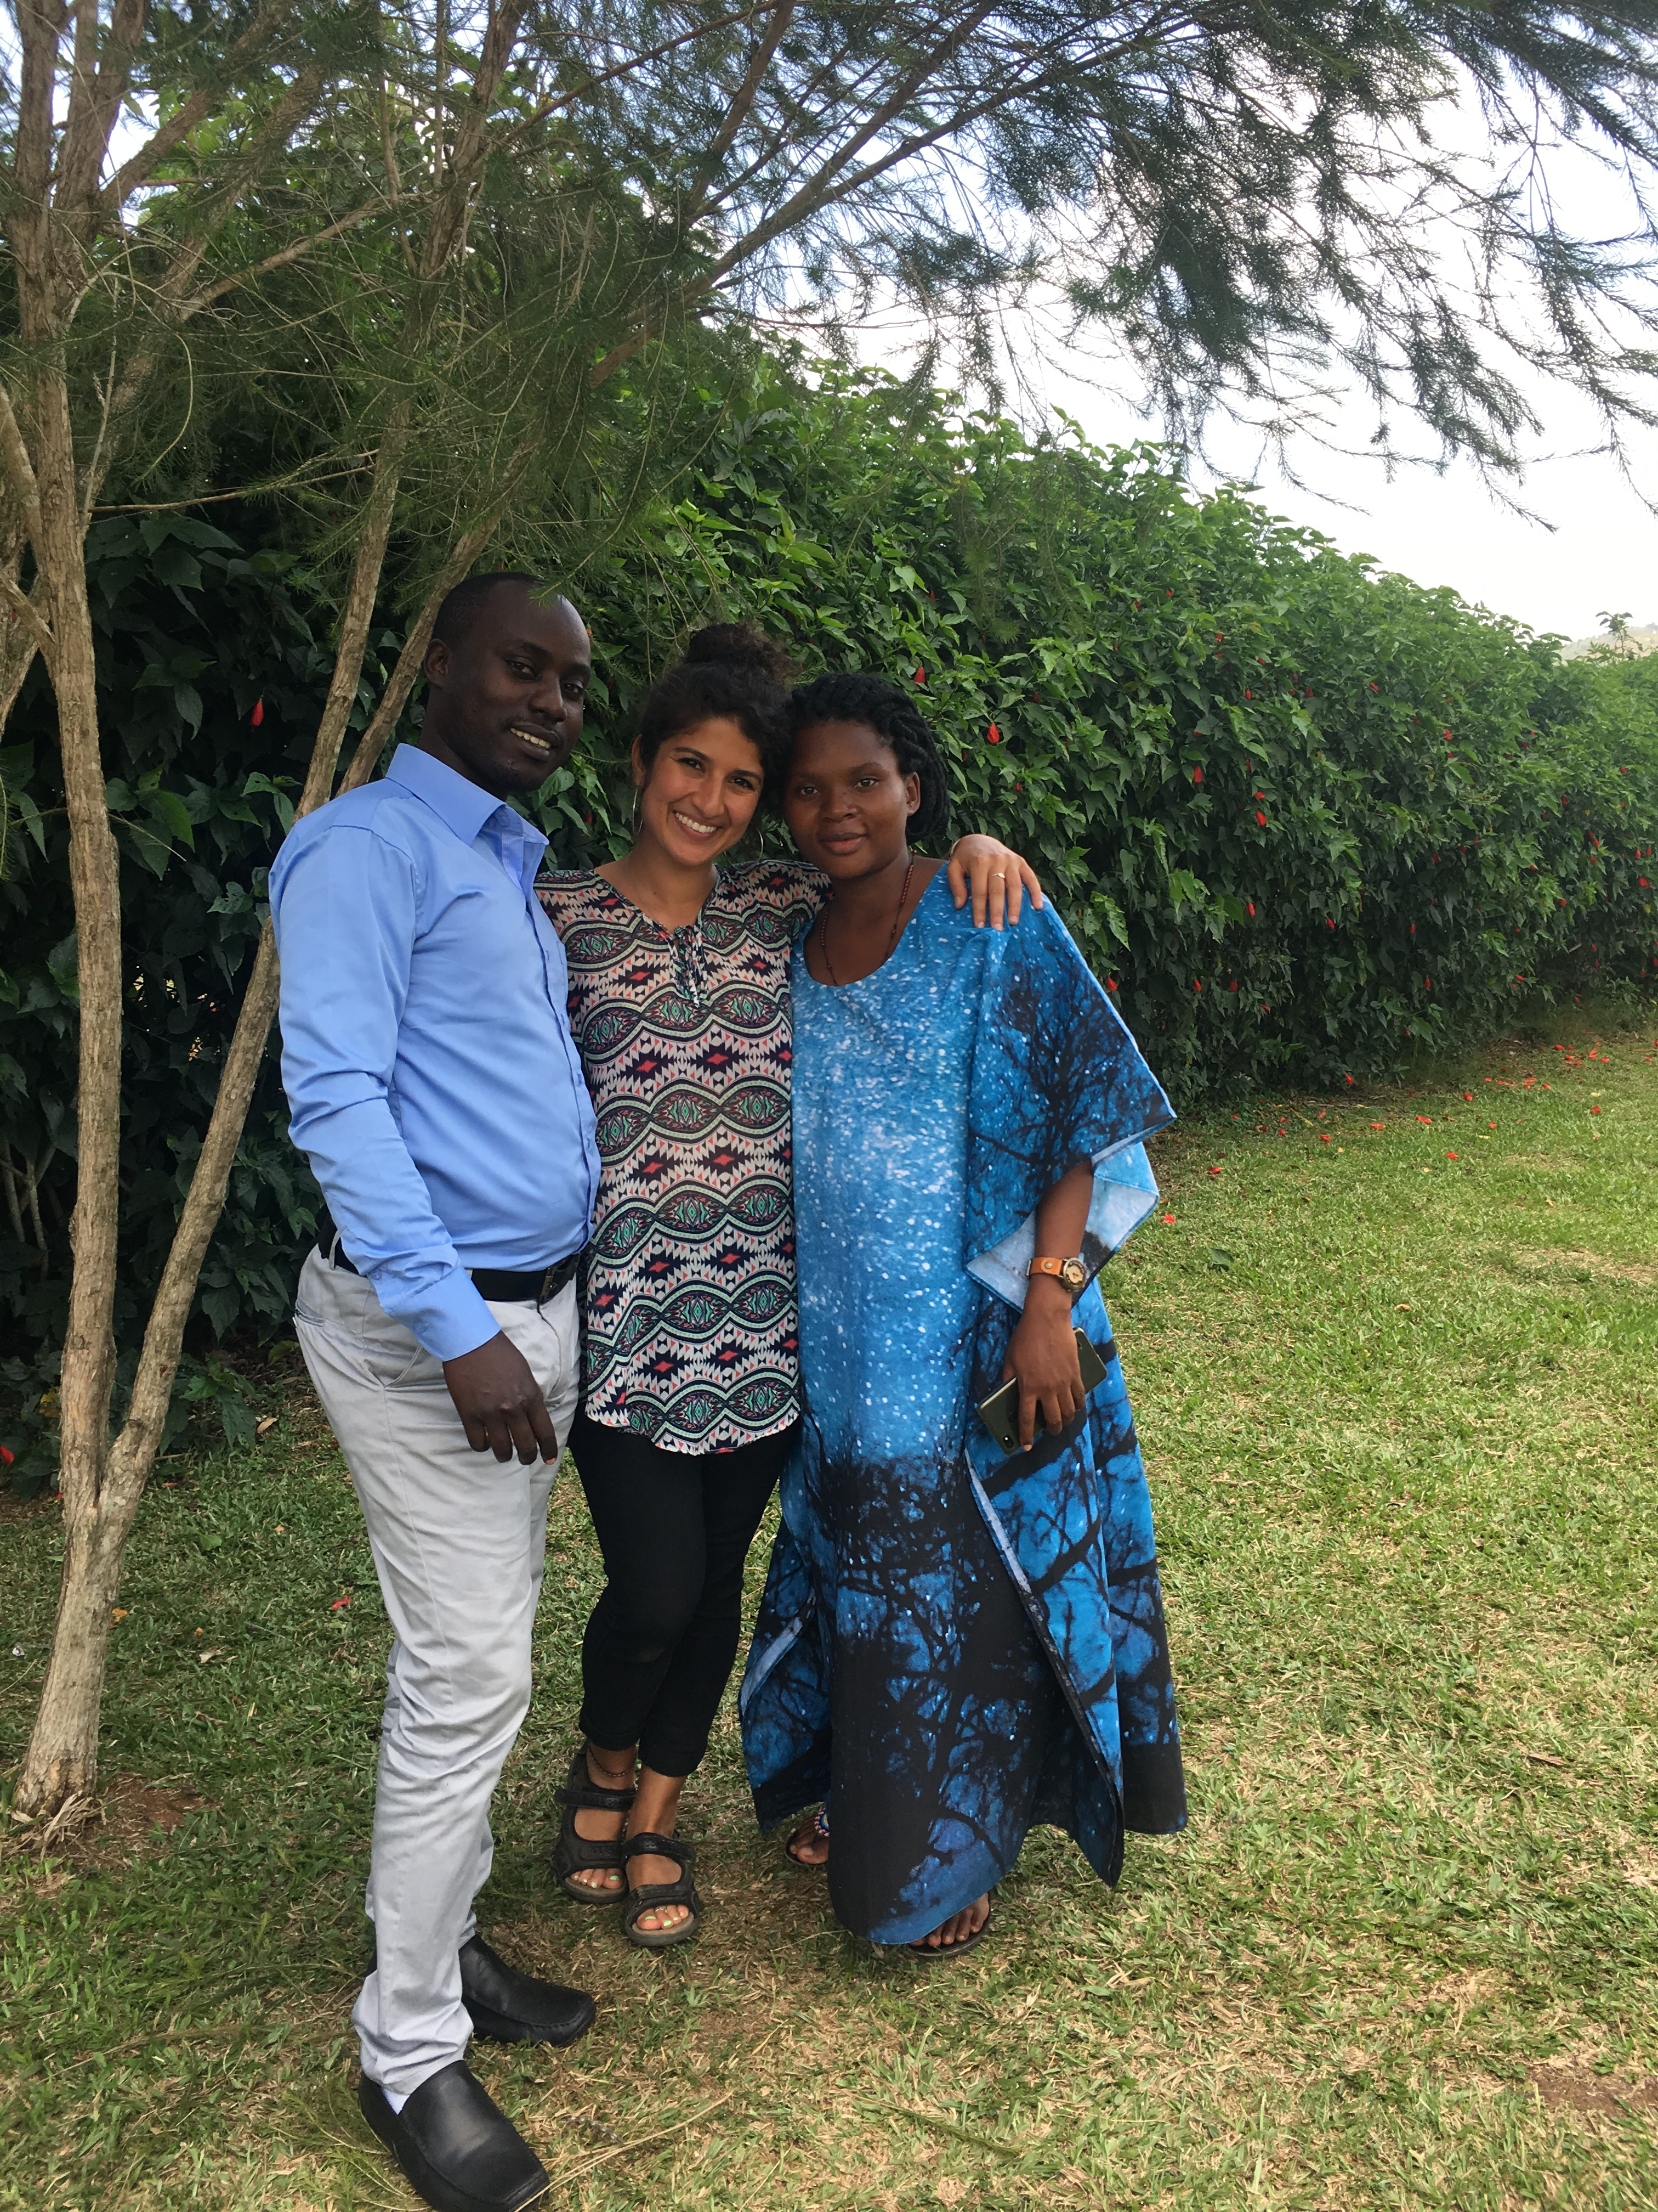
The Impact of Expanded Healthcare Insurance on Maternal Health in Rwibaale, Uganda
Some of the initial analysis completed:
Watsi is a nonprofit organization that developed a community-based health coverage platform in Rwibaale, Uganda, in collaboration with the community, clinic, government, and local partners, allowing them to enroll 5,880 people in the program
We digitalized 6 months worth of data documented at prenatal visits in the year 2017 (patient age, gestational age at 1st antenatal visit, total number of antenatal visits, gravida/parity, HIV status of the mother, HIV status of partner, on ARV treatment or not, syphilis status of mother and partner, and any previous complications) post Watsi implementation to enable simple analysis of these metrics

