Slide 1
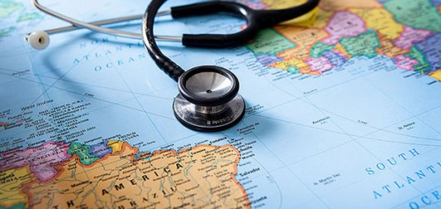
Global Health & The University of Michigan Medical School
Yalda Toofan
24 September 2018

Slide 2


My Journey…
Notes:
I’m an Iranian American with a very large Iranian family—and looking back it was definitely my parents that really sparked my love for global health
Summers I would volunteer at a family member’s health clinic and at a young age was exposed to health disparities
College I joined a group called MEDLIFE that focused on improving healthcare access and health education through mobile clinics and spent some time in Ecuador as a part of this group
Pursue masters at UCSF
1 year program that gave us an overview of the foundations of global health alongside a 1 year international capstone project
My experience at UCSF was truly enriched by the capstone project as I had the opportunity to design and implement a research project in Gulu, Uganda

Slide 3
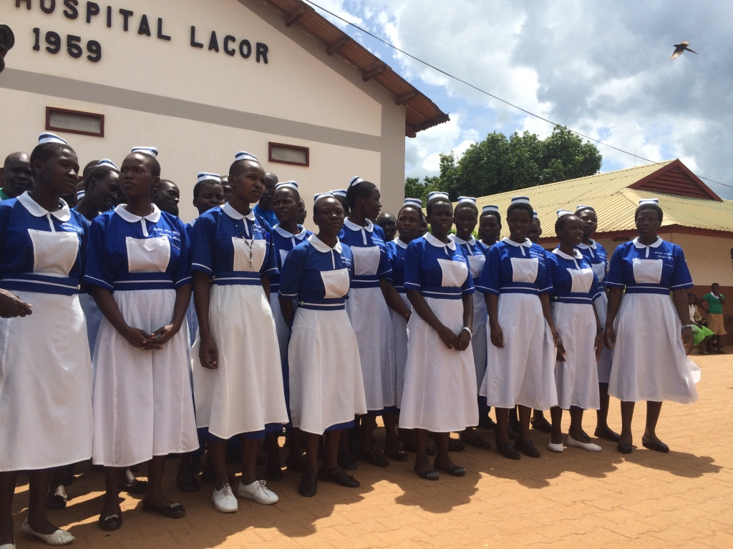
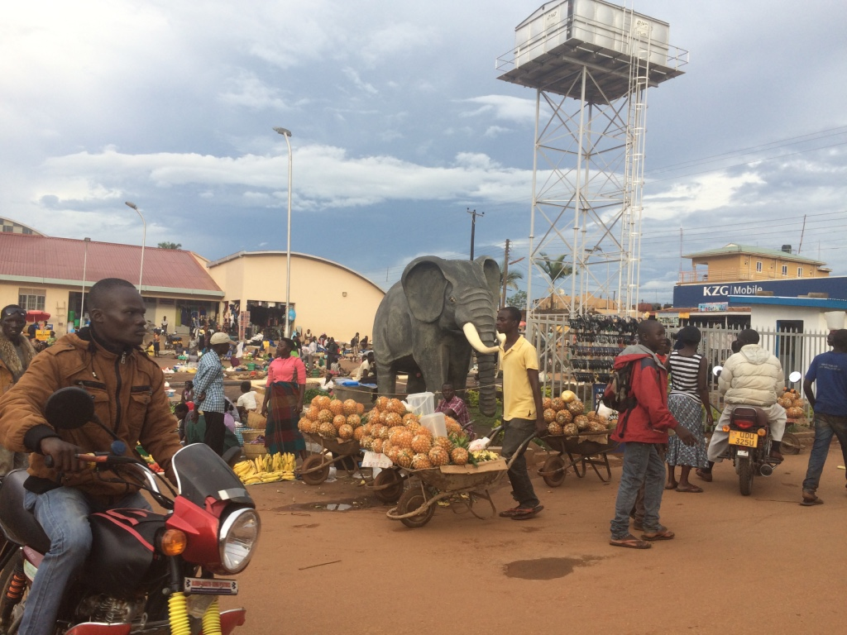
The Impact of Visiting International Surgical Mission Trips on Lacor Hospital in Gulu, Uganda: A Qualitative Study
Notes:
Throughout my masters I realized that there was a synergistic relationship between global health and medicine and an opportunity to have an immensely positive impact on an individual’s and community’s health
Having worked in diverse settings not only reinforced my aspirations to become a physician but it made it important for me to attend a medical school that combined academic rigor with a unique breadth of opportunities to intertwine the realms of medicine and social service
A medical school that would equip me with the tools and vision necessary to marry my passions for global health and medicine

Slide 4

Notes:
In choosing a medical school I was looking for more than just learning about the pathophysiology of pancreatitis or learning about the krebs cycle for the umpteenth time, I knew I was going to get the same medical education no matter where I went but it was michigan’s
investment in their student’s other passions, empowering their students to be the voice of change in healthcare, believing in their students to make impactful differences in their communities that made michigan different
As Dr. Kolars mentioned I’ve only been here for 13 months and I’ve already had a number of opportunities to weave global health into my medical education
3 things I’ve been involved with:
Global health and disparties pathway
Leadership team for the sujal symposium

Slide 5
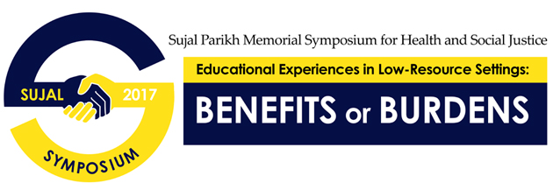
Global Health and Disparities Pathway
Sujal Symposium
Experiential Learning:
Domestic & Global
Notes:
We have something called pathways which are tracks that we can get involved in as medical students that allow you to explore their side passions, we have one for health policy, for medical ethics but I happen to be involved in the most popular pathway, global health and disparities—of the 180 students here there are about 80 in this pathway
They offer seminars which lay the foundations of global health and also have local leaders in global health come share their research and impactful work
A unique opportunity of this pathway offers is the chance to partner with a local organization to address a pressing health issue
For example we partnered with the Regional Alliance for Healthy Schools to improve STI testing and contraceptive access amongst adolescents in Flint
I am also on the leadership team for the Sujal Symposium: a symposium focused on global health and social justice issues. I presented at this symposium just the year before, and now wanted to be part of a team that organized the very conference that brought together such wonderful work both locally and abroad
160 students---25 posters

Slide 6
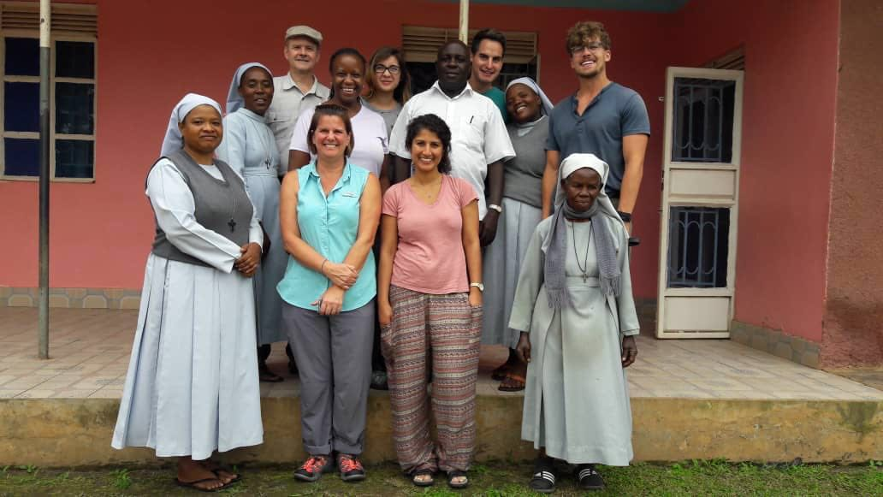
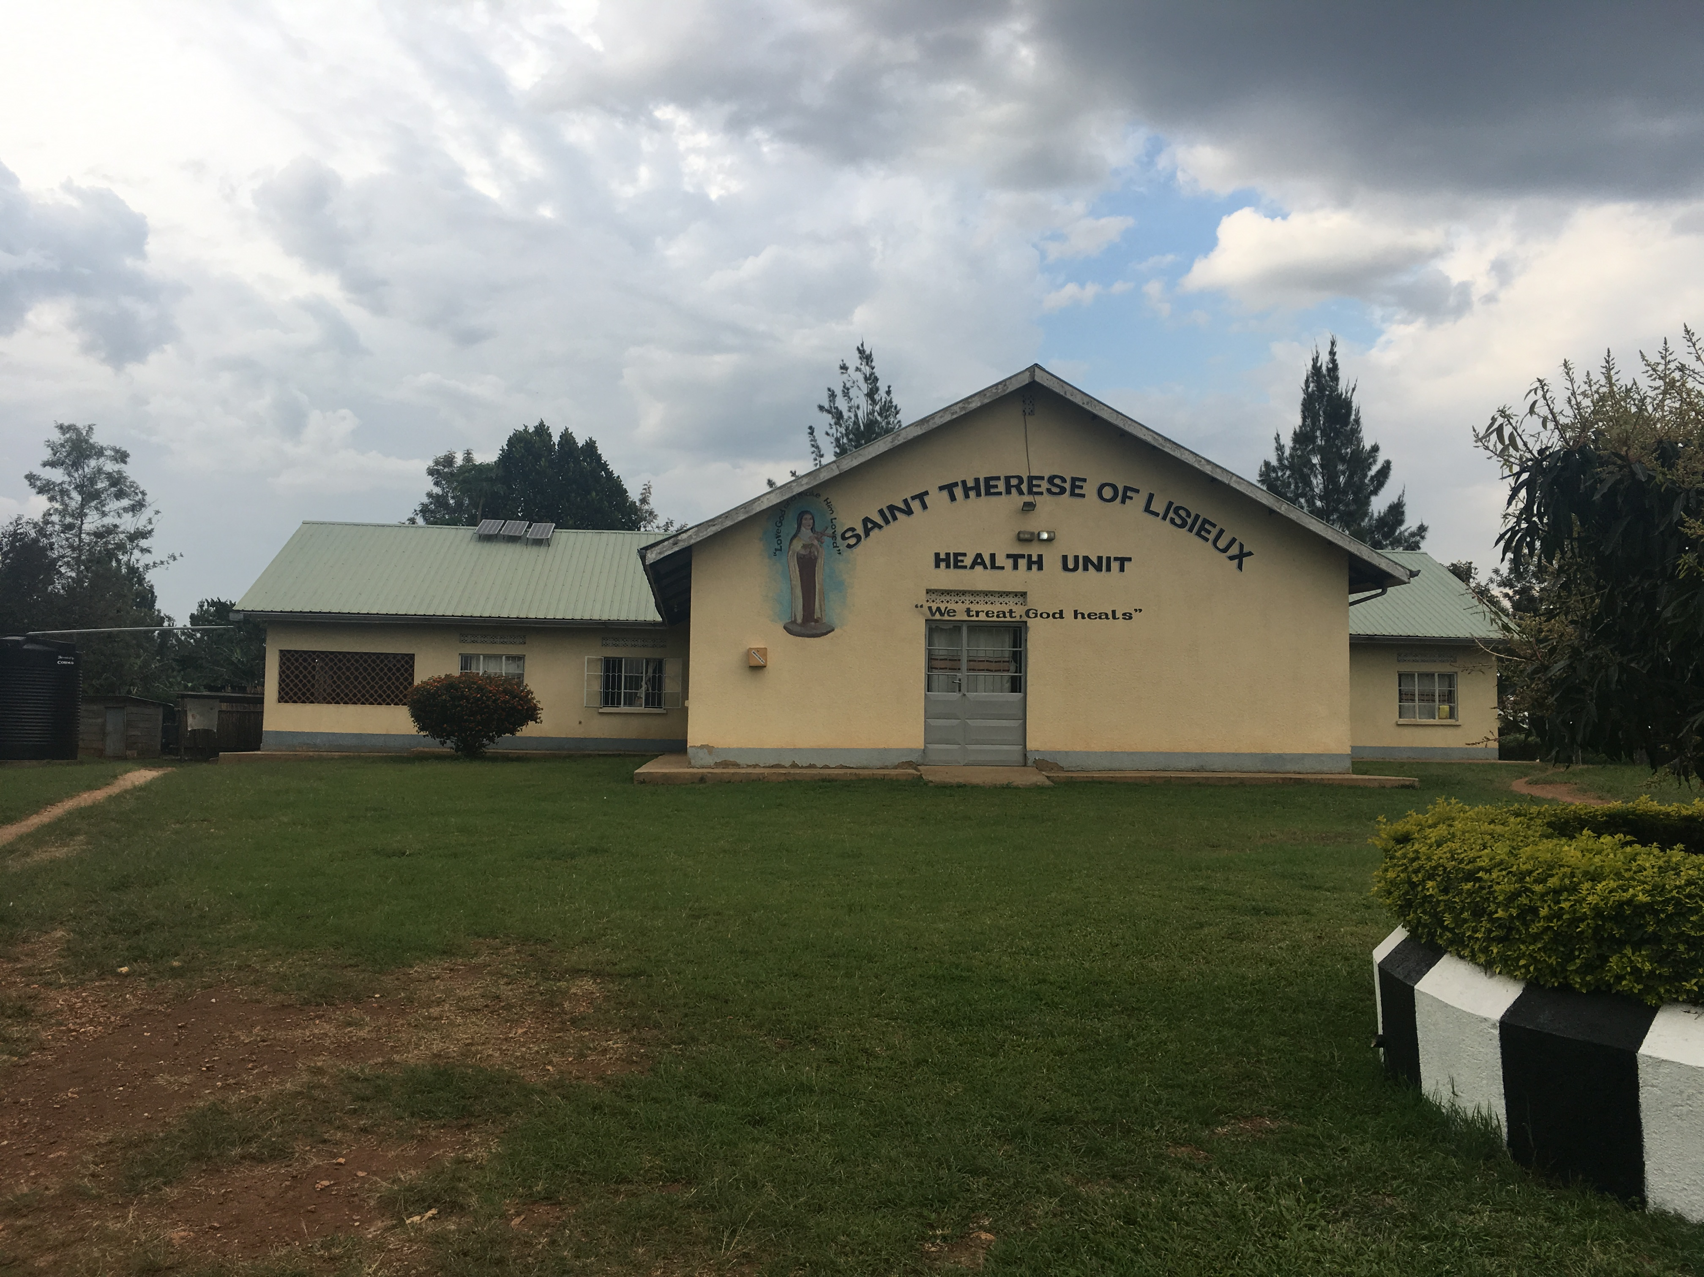
Western Uganda Interprofessional Initiative:
Rwibaale
Notes:
One of the most recent opportunities Michigan has afforded me is to be a part of the travel team in the Western Uganda Interprofessional Initiative.
In this picture you will see a nursing student, a social work student, a nurse practitioner amongst our ugandan colleagues where our purpose was to go into low resource settings in a collaborative fashion and address health issues together as a team.
Given rwibaale uganda is a very rural village in western uganda with limited resources we were intimately exposed to various social determinants of health

Slide 7
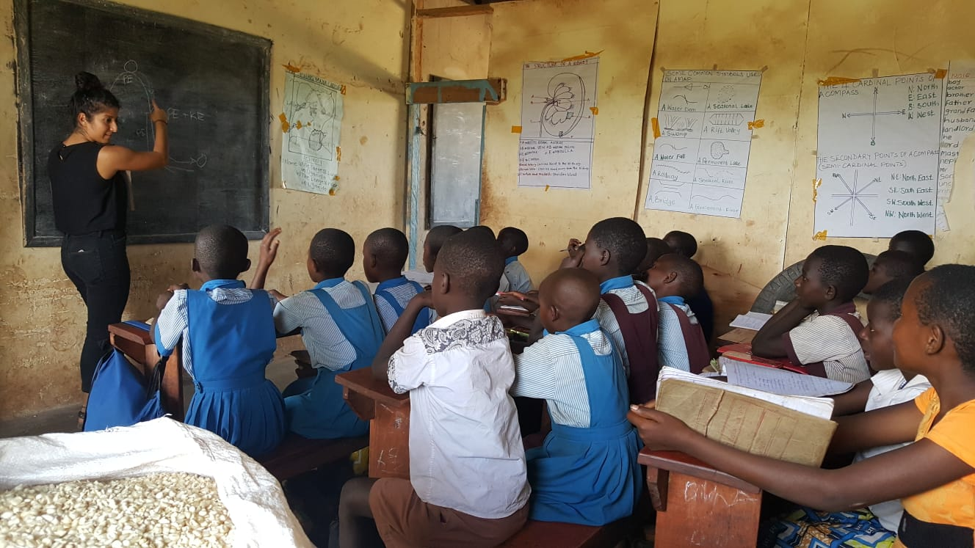
Notes:
One thing I was interested in was the social determinants of health as it pertained to education and so I had the opportunity to teach general science classes at a primary school the days that I was there.

Slide 8
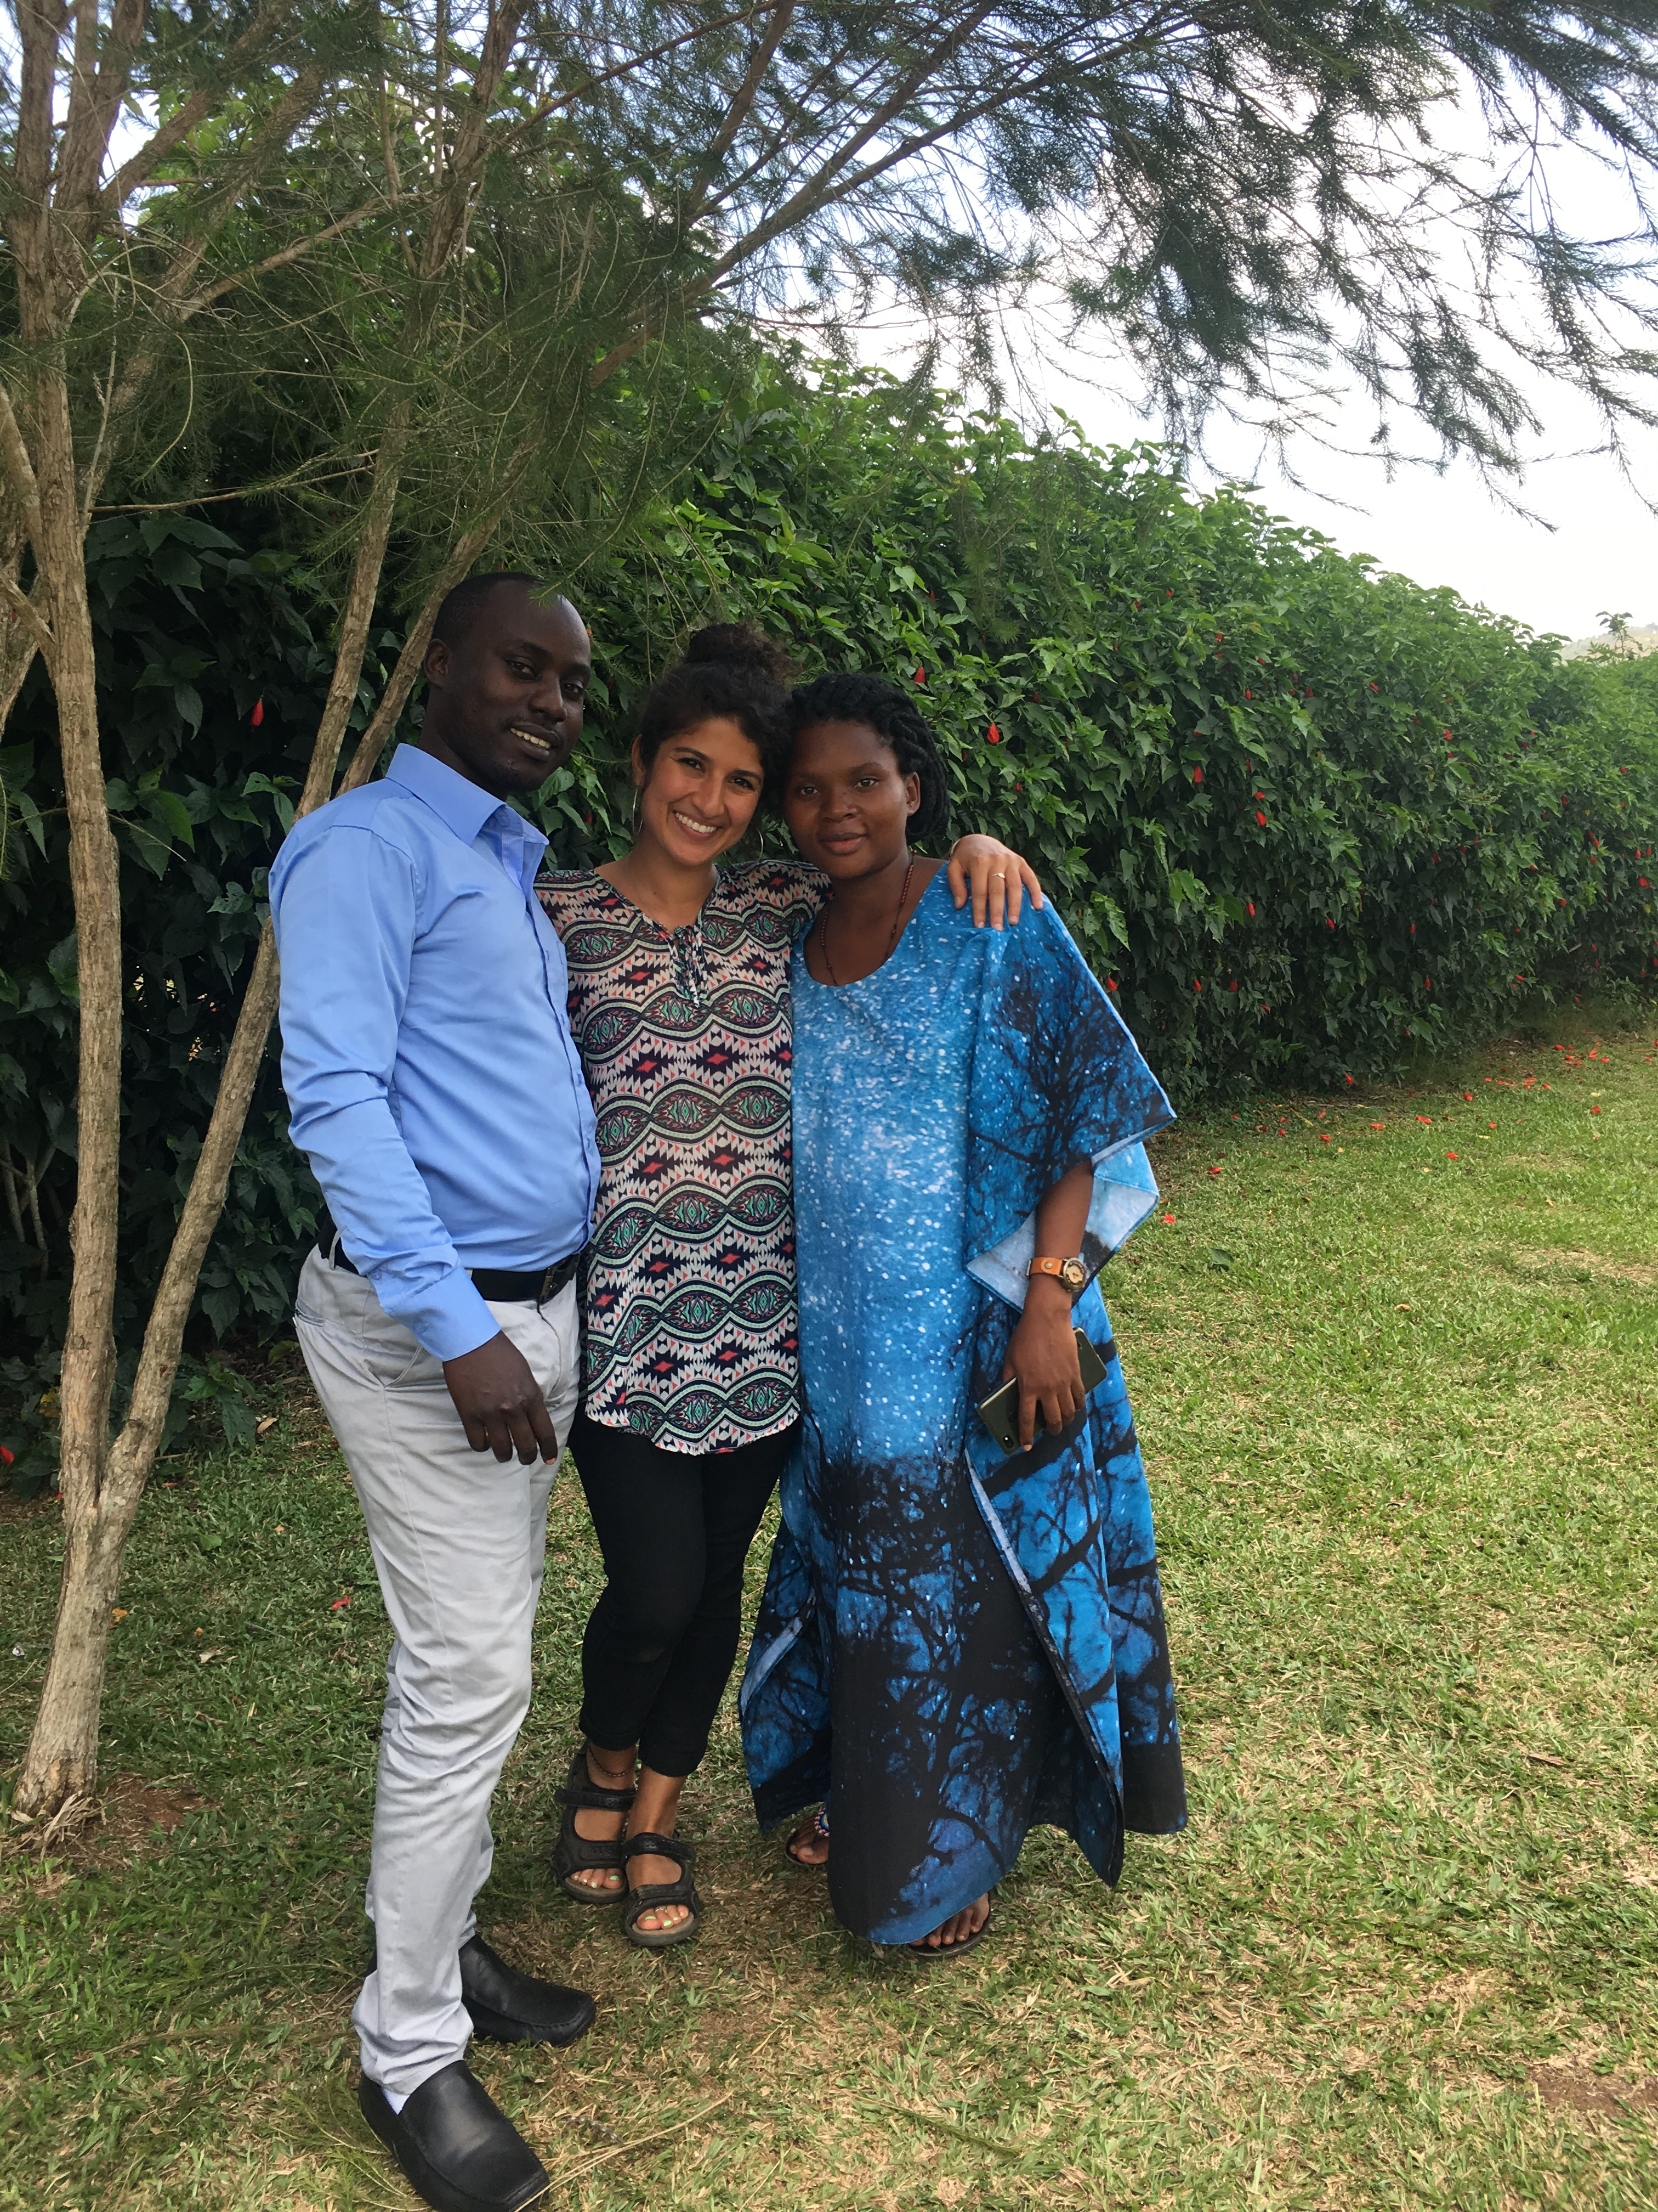
Maternal Health: Antenatal Care
Notes:
While I was there my strong interest in women’s health naturally drew me to the maternity ward
As a medical student early in my career my focus wasn’t so much clinical care as it was learning more about healthcare access issues in this community and how new mothers are using care
To your right you see the in charge midwife, Berna, who whole heartedly partnered with me in this project
I wanted to translate hand written medical records into electronic form because as you can imagine there was a lot of valuable information that could be extrapolated from their antenatal clinic
As a medical student very early in my education I appreciate looking at local issues and using the power of data to leverage change

Slide 12
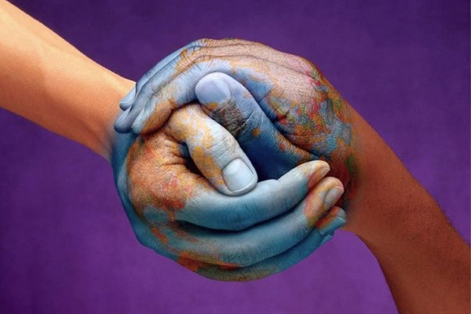
The essence of global health equity is the idea that something so precious as health might be viewed as a right
    -Paul Farmer
Notes:
In summary since my younger days in Iran until now global health has been one of my deepest passions in life and one of the main reasons that led me to michigan. At michigan I knew I would become more than just a knowledgeable physician but I would have infinite opportunities to grow as a leader and know that I would have the support and encouragement of an entire team to become part of a team of impactful health professionals at the local and international level

