Slide 1

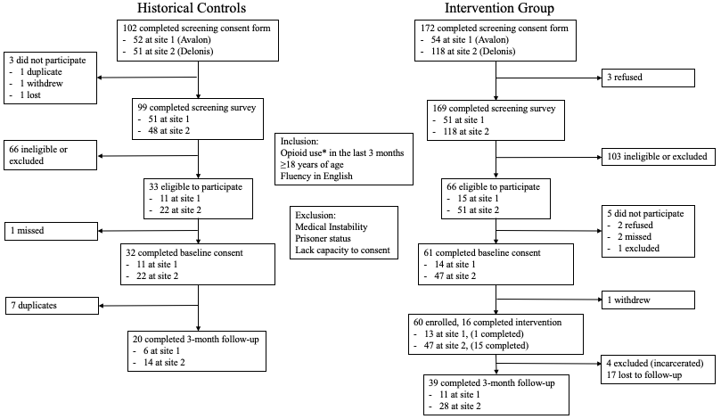
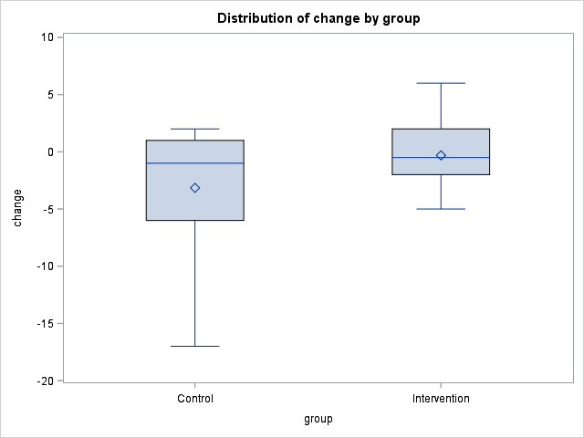
OPT-IN Project: Implementation and Evaluation of an Evidence-Based Online Toolkit to Improve Opioid Use Safety
Annie Murphey¹; Laura Thomas, MPH, LMSW, CCRP^{2,3,8}, Erin E. Bonar, PhD^{2,4,5}, Maureen A. Walton, MPH, PhD^{2,4,5}, Chin Hwa (Gina) Dahlem, PhD, FNP-C, FAANP⁷, Phillip Coffin, MD MIA⁶, & Amy S. B. Bohnert, PhD^{2,3,5,8}
Abstract
Methods
Results
Discussion
With the use of website-based training, a short motivation interviewing (MI)-based intervention and naloxone distribution was implemented for patients with a recent history of opioid misuse at community partner sites with the goal of reducing overdose risk behavior as assessed by baseline and follow-up surveys at 6 months. Emergency Department (ED) visits were recorded to follow behavioral in response to the intervention.
Purpose:
To implement MI-based intervention and naloxone distribution at community-partner sites for the reduction of opioid overdose risk behaviors.
To assess utility of tracking emergency department (ED) visits as an assessment of opioid overdose risk behaviors.
Setting: Site 1 is a local homeless outreach center with primary care and social services. Site 2 is local transitional housing.
Staff Training: An 8-hour in-person training provided by research staff trained in MI. Fidelity assured with formally evaluated mock sessions.
Online Toolkit: Created and refined based on community site needs and feedback in the form of qualitative interviews. Includes training videos on MI, screening tool and intervention guide, and supplemental MI techniques
Recruitment and Follow-up: See Figure 1. Across both groups, nearly 37% of individuals screened had a recent history of opioid use and were eligible. Only a portion of those in the intervention group (26%) were documented as receiving the intervention.
Evaluation: Surveys included several quantitative measures of prescription and illicit opioid misuse. The Current Opioid Misuse Measures (COMM) evaluates degree of opioid misuse. The Opioid Risk Behavior (ORB) is set of 9 questions assessing degree of risky behavior. For the statistical analysis, the ANCOVA model was applied to control for baseline values and estimate the effect size for ORB and COMM scores at 3-month follow-up.
Chart Review: ED visits were recorded six months pre- and post- enrollment date. The data analysis was generated using Qualtrics (Provo, UT, http://www.qualtrics.com/). There were 277 ED visits across groups included (97 in control group and 180 in intervention group).
There was not statistical significance in improvement in opioid misuse survey scores: COMM, ORB, or recent opioid street use (Table 1). However, when recruitment site, demographics, and baseline 3-month opioid street use were controlled for, there was a medium effect size with a Cohen’s D = 0.51 for the ORB Score and Cohen’s D = 0.49 for the COMM score. There were a similar number of total ED visits across groups with 4.85 per person in control group, 4.62 in intervention. There was only one participant with opioid-related ED visits in each group. Among individuals with ED visits, there was not a significant difference between groups in mean ED visits, in pre- or post-enrollment visit average, or in the difference in ED visit number between pre- and post-enrollment (Figure 2).
An online toolkit was developed and refined for the outpatient implementation of an MI-based intervention with naloxone distribution. Despite only a minority of participants in the intervention group receiving the full intervention, there was still a positive trend noted in the 3-month follow-up based on previously validated, opioid misuse scoring surveys. One explanation of the data is that the training and incorporation of several harm reduction techniques may have holistically contributed to the trend in outcomes seen in the intervention group.
There were a total of 277 ED visits recorded across groups with more than 25% of those being related to drug/alcohol intoxication and more than 50% being related to pain. There was not a significant relationship between the intervention and ED visit numbers or type of visit, which may be due to the large variation in participant behavior. In the 6 months pre-enrollment, the range of visits was large: [0,22]. ED ICD-9 codes have previously been found to be an insensitive measure of opioid overdose events that did not differ with naloxone distribution.⁹ One possible barrier in its utility as a measure for outpatient monitoring is the inability to identify the etiology of a participants visit as documented in the electronic medical record. Many visits related to pain or intoxication may have been secondary to opioid use but were not explicitly documented by the treatment team. ED utilization surveillance is more likely to be useful with a greater number of participants over a longer time period.
Outcome | Controls n=20 | Intervention n=39 | p-value
Participants with ED visits | 13 | 26 | 0.9
Participants with opioid-related ED visits | 1 | 1 | 1.0
Baseline Recent Opioid Street Use | 7 | 11 | 0.77
Follow-up Recent Opioid Street Use | 5 | 5 | 0.28
Baseline COMM Score | 10.9 | 10.2 | 0.8
Follow-up COMM Score | 7.5 | 4.0 | 0.15
Baseline ORB Score | 9.2 | 6.4 | 0.28
Follow-Up ORB Score | 8.1 | 3.6 | 0.09
Introduction
According to the Center for Disease Control, the rate of opioid-related deaths has continued to rise each year across demographics and urbanization levels with nearly 50,000 lives lost in 2017 alone.¹ Synthetic opioid involvement is driving the rise in opioid-related deaths in recent years, again across demographics.¹ A variety of interventions have been utilized to address this problem that range from decreasing patient use, decreasing availability, and harm reduction techniques.² Harm reduction techniques generally include medication-assisted therapy, naloxone prescription, and behavioral interventions.²
MI is an effective intervention in promoting a variety of behaviors, including smoking cessation, medication adherence, and physical activity.³⁻⁵ A pilot randomized trial conducted at the University of Michigan Emergency Department employed MI techniques to reduce overdose risk behaviors in patients found to have recent opioid misuse.⁶ There was a significantly greater reduction in overdose risk behaviors in the participants who received the MI session compared to those who only received standard of care (40.5% compared to 14.7%). This trial suggests MI is an effective means of behavioral modification. Naloxone distribution has been associated with reduced opioid-related ED visits and decreases in local opioid-related deaths.⁷⁻⁸ Community partner sites demonstrated interest in implementing an MI-based intervention in their outpatient clinics which predominantly serve people who experience poverty and homelessness. This study sought to apply the ED-based intervention to outpatient sites via an online toolkit to reduce overdose risk behavior in high-risk clients.
Table 1. Maximum COMM score is 32 and maximum ORB score is 40 with higher values indicating more misuse. The p-values between the historical controls and the intervention group were not significant (<0.05) for any of the recorded outcomes.
Conclusions
Community sites have interest and may benefit from formal implementation of MI-based interventions for opioid overdose risk behaviors. Through in-person training and an online toolkit, MI-based interventions can be implemented and will likely become more successful with future iterations. Novel interventions and community outreach will continue to be important in addressing the opioid epidemic.
ED visits, though an important indicator of a bad outcome in relation to opioid overdoses in the community, are less valuable for following small-scale behavior changes. However, the large number of ED visits in a one-year time period suggests modification of data collection could be useful. Using a screening tool to assess the involvement of opioids in a participant visit (i.e. whether the visit is secondary to misuse or active seeking of opioids) could also be a valuable means of assessing behavior. Future directions include expanding reach and independently evaluating ED usage patterns.
Figure 1. Recruitment Flow Chart. Research staff recruited potential participants at community sites. Historical controls were recruited during site staff training. Demographics were similar between groups for age and gender, there were significantly more black patients in the intervention group.
Figure 2. Average change in ED visit number (post- minus pre-enrollment visit number) in the control (n = 13, mean = -3.15) and intervention (n = 26, mean = -0.3077). Individuals without any ED visits across the time period were excluded. The p-value is 0.088 between groups.
Thank you to our community partner sites!
Contact
Affiliations
Support
References
Annie Murphey
University of Michigan Medical School
Email: acmurphe@med.umich.edu
1. University of Michigan Medical School; 2. Department of Psychiatry, University of Michigan; 3. VA Center for Clinical Management Research, Ann Arbor MI; 4. Addiction Center, University of Michigan, Ann Arbor MI; 5. Injury Prevention Center, University of Michigan, Ann Arbor MI; 6. San Francisco Department of Public Health, San Francisco CA; 7. School of Nursing, University of Michigan, Ann Arbor, MI; 8. Department of Anesthesiology, University of Michigan
Supported by a grant to the University of Michigan Injury Prevention Center by the Centers for Disease Control & Prevention Award Number R49-CE-002099. The content is solely the responsibility of the authors and does not necessarily represent the official views of the Centers for Disease Control & Prevention or the Department of Health and Human Services.
Scholl L, Seth P, Kariisa M, Wilson N, Baldwin G. Drug and Opioid-Involved Overdose Deaths — United States, 2013–2017. MMWR Morb Mortal Wkly Rep 2019;67:1419–1427. DOI: http://dx.doi.org/10.15585/mmwr.mm675152e1
Barglow, P. (2018), Commentary: The opioid overdose epidemic: Evidence‐based interventions. Am J Addict, 27: 605-607. https://doi.org/10.1111/ajad.12823
Lindson-Hawley N, Thompson TP, Begh R. Motivational interviewing for smoking cessation. Cochrane Database Syst Rev. 2015 Mar 2;(3):CD006936. doi: 10.1002/14651858.CD006936.pub3. PMID: 25726920.
Palacio A, Garay D, Langer B, Taylor J, Wood BA, Tamariz L. Motivational Interviewing Improves Medication Adherence: a Systematic Review and Meta-analysis. J Gen Intern Med. 2016 Aug;31(8):929-40. doi: 10.1007/s11606-016-3685-3. Epub 2016 May 9. PMID: 27160414; PMCID: PMC4945560.
Soderlund PD. Effectiveness of motivational interviewing for improving physical activity self-management for adults with type 2 diabetes: A review. Chronic Illn. 2018 Mar;14(1):54-68. doi: 10.1177/1742395317699449. Epub 2017 Mar 21. PMID: 29226694.
Bohnert AS, Bonar EE, Cunningham R, Greenwald MK, Thomas L, Chermack S, Blow FC, Walton M. A pilot randomized clinical trial of an intervention to reduce overdose risk behaviors among emergency department patients at risk for prescription opioid overdose. Drug Alcohol Depend. 2016 Jun 1;163:40-7. doi: 10.1016/j.drugalcdep.2016.03.018. Epub 2016 Mar 26. PMID: 27062245.
Coffin PO, Behar E, Rowe C, et al. Nonrandomized intervention study of naloxone coprescription for primary care patients receiving long-term opioid therapy for pain. Ann Intern Med. 2016;165(4):245–52.
Walley AY, Xuan Z, Hackman HH, et al. Opioid overdose rates and implementation of overdose education and nasal naloxone distribution in Massachusetts: interrupted time series analysis. BMJ (Clinical research ed). 2013;346:f174.
Rowe C, Vittinghoff E, Santos GM, Behar E, Turner C, Coffin PO. Performance Measures of Diagnostic Codes for Detecting Opioid Overdose in the Emergency Department. Acad Emerg Med. 2017 Apr;24(4):475-483. doi: 10.1111/acem.13121. Epub 2017 Mar 17. PMID: 27763703.
Notes:
Able to get more data on ED visits? Like pain-related visits or intoxication? Matt Myers – can ask about extra info.
Matt just redid analysis.. Analysis_OPT-IN_2 to fix p-values
Is this the avg count per person? Would do poisson regression.
Also is # of ED visits the % who had any ED visits or the number in the group? Confused because % next to value looks like the percent of participants…
LT not sure!
For conclusion: Phillp coffin did naloxone distr and o/d counseling: the outcome was ED visits. There is evidence that it is an important outcome! Need for automated methods --> natural language processing to pull info from charts. Chart template or just picking up on intoxication.

