Slide 1

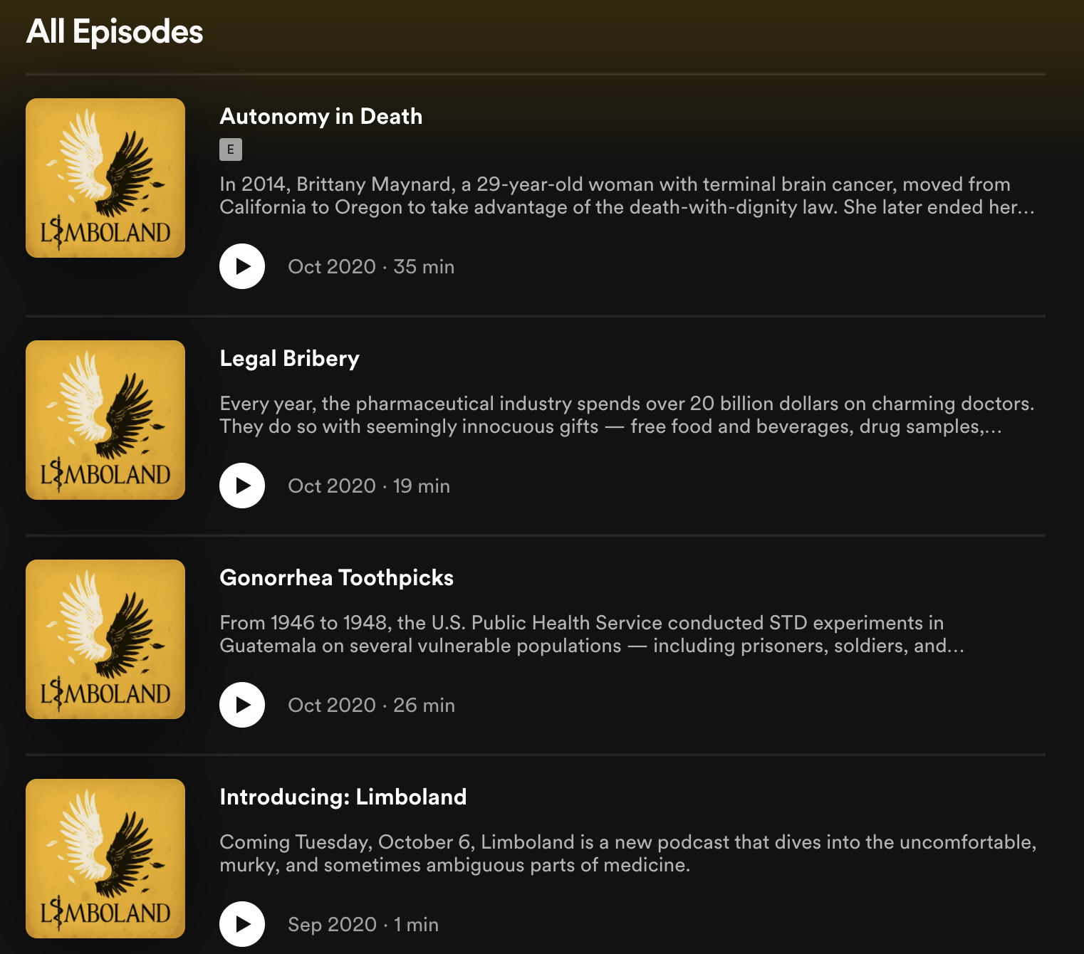
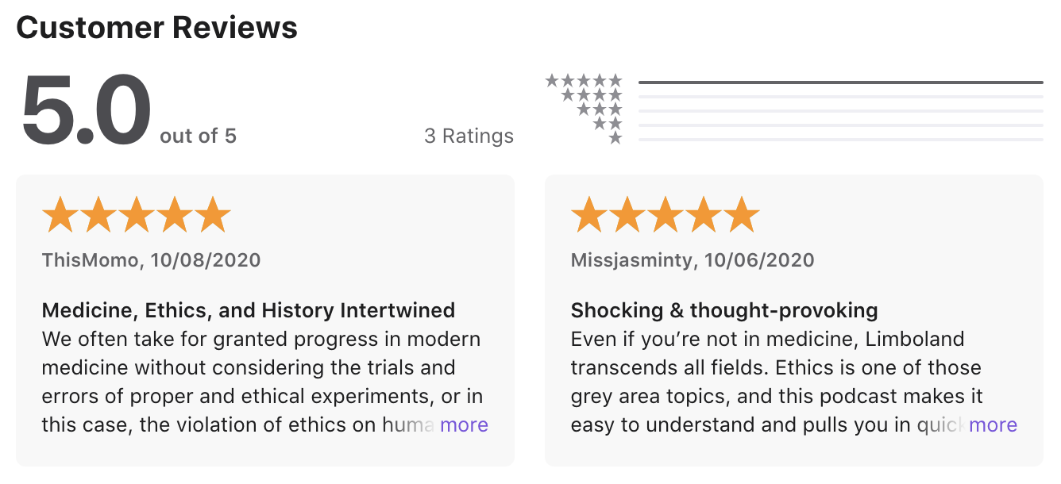
About
Autonomy, non-maleficence, beneficence, and justice. What happens when these principles of medical ethics go awry? Join almost-doctor, Yibing Zhang, on a journey into the uncomfortable, murky and sometimes ambiguous parts of medicine.

