Slide 1









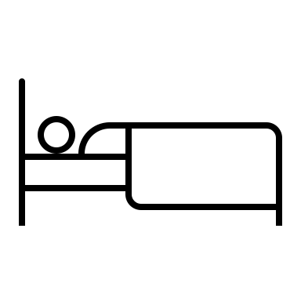











Better Together: How Rounding With Nurses Can Improve Patient Outcomes and Provider Satisfaction
Armani Minasian Hawes¹, Adam B. Stein, MD²
¹University of Michigan Medical School, ²Michigan Medicine Department of Cardiology
Background
Root Cause Analysis
Time
Communication
Nurses are busy with multiple patients
Teams failing to notify nurse of plan
Rounds overlap with med pass time
Things slip through cracks in pages and phone calls
Poor nurse-physician communication
Most medical errors are related to poor communication
Patient outcomes and interdisciplinary teamwork are better when doctors and nurses communicate
An intervention was completed to include nurses at Michigan Medicine on physician rounds
One nurse takes care of patients from multiple teams
“Things have always been done this way”
Patients are located on different floors
No time or resources to try to change the system
Location
Tradition
Current Condition
Target Condition
Results
Doctors Nurses
Gather nurses phone numbers before rounds
Obtain rounding order from senior resident
Call each nurse before reaching his or her patient’s room
Nurse joins physician team and participates in rounds
“Patient care is better when nurses are included on rounds”
96% strongly agree
Barriers to joining rounds:
Busy with patient care (68%)
Not called (23%)
“I was called to join rounds”
76% of nurses were called more than half the time
Separated workflows
Next Steps
Analyze remaining pre- and post-data
Continue intervention on the piloted floors
Expand throughout Michigan Medicine
Poor communication
Longer hospital stays
Increased readmissions

