Slide 1
Medical Student Consulting: Providing Students Leadership Opportunities While Positively Impacting the Community
Matthew Carey (presenter)
Paige VonAchen (presenter)
Matthew Carey
Taylor Standiford
Dr. Michael Englesbe
Dr. Brian Zink
Dr. Nell Kirst
Dean Rajesh Mangrulkar
September 14, 2019

Slide 2
There are a wide variety of problems in health care that healthcare providers aren’t trained to solve…

Slide 3
The purpose of Med ECG
Give medical students the tools and experiences needed to be leaders in healthcare
Improve the community through active engagement with local non-profits

Slide 4
The purpose of Med ECG
Provide medical students with new experiences outside of the explicit medical student curriculum enabling them to become future leaders in the industry
  Students will gain exposure to clinical and non-clinical factors affecting modern health care
  Members will develop teamwork, communication, and professional skills through collaboration with others outside of the physician space
  Active and practical problem solving strengthen critical thinking abilities and improve students’ growth into future physicians, researchers, and leaders
Improve the community through active engagement and problem solving with mission-minded health care organizations
  Local not-for-profit health care organizations greatly benefit from partnership with curious, eager, and motivated medical students for specific projects
  Well managed and scoped pro-bono work will provide new insights and tangible solutions for organizations with limited resources to improve our community

Slide 5



Our model includes three key components
Training
Intro to business basics
Problem scoping and framing
Analytics, presenting findings
Simulated case
4 weeks
Project
Issue identification with client
Assembling core team members
Project scoping
Data collection and analysis
Alignment on next steps w/ clients
2-5 months
Feedback
Seek feedback from clients and team members throughout
Ongoing

Slide 6
Our training consists of four sessions centered around a simulated mock consulting case
Intro to Med ECG
Consulting &
problem-solving
Analyzing & sharing data
Teamwork & presentation
Intro to organization & clients
How to get info about clients
Other data resources
Intro to accounting
How to frame a problem
Setting it up
Hypothesizing
Intro to Excel
Homework: Excel exercise
Review Excel homework
Intro to sharing data
Slide decks
Making a slide
How to communicate with clients
Homework: final presentation for mock case
Final presentations

Slide 7


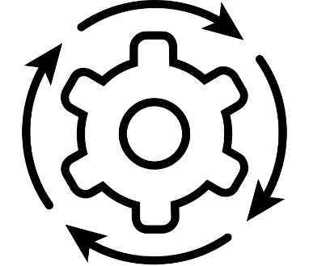
Med ECG has engaged a variety of clients to address a range of organizational challenges
1
2
3
Evaluated the strategic fit of new value-based contracting model for a FQHC
Assessed reasons for behavioral health no-shows at a local social services agency
Developed reporting tool for the evaluation of a diabetes management partnership for a local health consortium
4
5
6
Provided needs assessment for strategic expansion at a FQHC
Performed survey and benchmarking analysis to improve engagement in home-vising program at health department
Optimized operations to improve provider continuity for GME clinic within a FQHC

Slide 8
Client feedback has been positive and encouraging
“I was very impressed with all the aspects of Med ECG's work. It exceeded my expectations, given that the team members are students. In fact, I think the value of Med ECG's work for us exceeded some of the products we have received in the past from professional consultants!”
- Vice President of Partnerships at local health consortium
“Everything was positive. It seemed very much that we were working together to find answers and possible opportunities to improve. Excellent interpersonal communication skills, enthusiasm, planning and knowledge!! Looking forward to working with Med ECG in the near future!”
- CMO of local FQHC

Slide 9
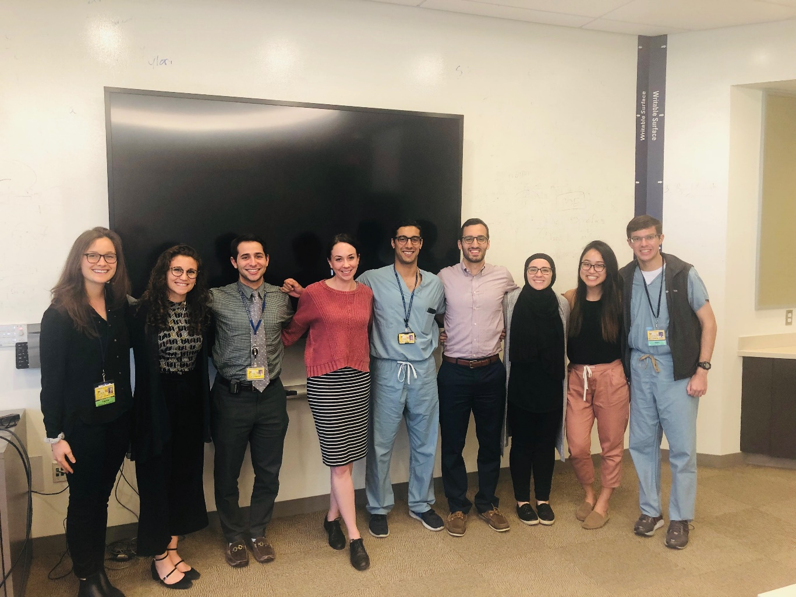
Students also find the work to be engaging and valuable
“This was an outstanding introduction to the consulting world. Projects were well scoped and team leaders set an excellent example.”
“Being a project leader of a very nebulous case was an incredible opportunity for me to figure out how to drive the direction of a team, delegate tasks, etc”
2018-2019 Med ECG team

Slide 10
Skills students gained during experience through Med ECG
100%
Data analysis
Describe their experience with Med ECG as valuable
Presentation skills
79%
Ambiguous problem solving
Average percentage of students who reported improvement in a given skill
Professional interviewing
3.6
Specific healthcare content
Average improvement score (out of 5) for a given skill
PowerPoint & Excel
93%
Plan to continue involvement with Med ECG
Working with team members
Notes:
Each skill improved in at least 43% of members, with an average of 79% of members
Average improvement score was 3.56 out of 5 (n=140) where 3 corresponded to mild improvement and 4 corresponded to moderate improvement
100% describe their experience of valuable

Slide 11
Next steps
Student leadership elective
February 2020
“Strategic Management & Problem Solving for Physicians”
Introduction to finance, accounting, strategy, organizational behavior, managerial “soft skills”
Lectures from Ross faculty and Michigan Medicine administrators
Business case discussions
Technical training in Excel data analysis, PowerPoint, etc.
Overview of approaches to framing and structuring a problem
Develop a framework for your own impact project…
…or have the option of doing a project with Med ECG

Slide 12
Appendix

Slide 13
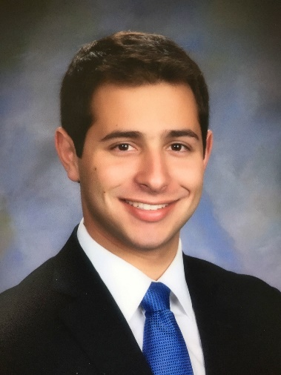
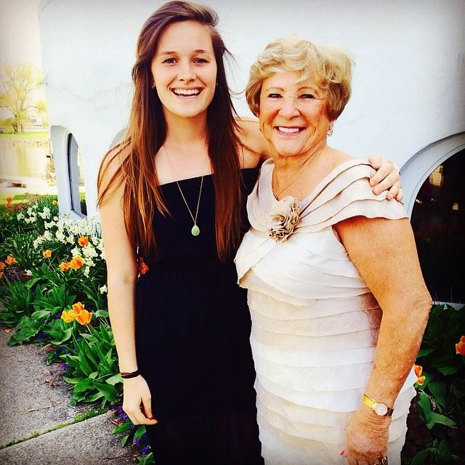
Med ECG was founded in Fall 2017 by 4 medical students
David Portney
Paige
VonAchen
Taylor Standiford
Matt
Carey
Current M2
Former BCG Associate, who has worked with payers, providers, and biopharmaceutical companies in a consulting role
Current M3
Former BCG Associate, who has worked with healthcare clients. Current research in healthcare payment reform
Current M2
Former VillageMD Analyst, who has worked alongside providers and payers for operational and quality analytics
Current M3, MBA
Former McKinsey Business Analyst, who served healthcare clients, working with both payer and provider clients in the United States and overseas

