Slide 1
Medical Student Consulting: Providing Students Leadership and Business Opportunities While Positively Impacting the Community
Paige VonAchen (presenter)
David Portney (presenter)
Matthew Carey
Taylor Standiford
Dr. Michael Englesbe
Dr. Brian Zink
Dr. Nell Kirst
Dean Rajesh Mangrulkar
September 21, 2019

Slide 2



A disconnect – The making of a clinician
Preclinical
Core clerkships
Sub-Is
Intern
Senior resident
Fellow
Attending

Slide 3

A disconnect – The making of a leader in health care
New medical student
“Leader”
“Change agent”
Notes:
Comment that we never learn how to:
Lead teams
Identify and address system problems
Control rising costs and improve quality
Support organizational change

Slide 4
The purpose of Med ECG
Give medical students the tools and experiences needed to be leaders in healthcare
Improve the community through active engagement with local non-profits

Slide 5
The purpose of Med ECG
Provide medical students with new experiences outside of the explicit medical student curriculum enabling them to become future leaders in the industry
  Students will gain exposure to clinical and non-clinical factors affecting modern health care
  Members will develop teamwork, communication, and professional skills through collaboration with others outside of the physician space
  Active and practical problem solving strengthen critical thinking abilities and improve students’ growth into future physicians, researchers, and leaders
Improve the community through active engagement and problem solving with mission-minded health care organizations
  Local not-for-profit health care organizations greatly benefit from partnership with curious, eager, and motivated medical students for specific projects
  Well managed and scoped pro-bono work will provide new insights and tangible solutions for organizations with limited resources to improve our community

Slide 6
Med ECG executes on its vision by partnering with organizations to develop sustainable and creative operational and strategic solutions
Med ECG is a team of intellectually curious medical students at the University of Michigan Medical School. Our goal is to combine our clinical skills, analytical abilities, and unique perspective to develop sustainable business solutions for community-oriented health care organizations. Together, we can create a better future in health care.
Sustainable and creative
partner-led solutions
  Trained with medical and clinical skills
  Active in hospital and outpatient facilities
  Interdisciplinary research
Medical and clinical expertise
  Focused and precise analytical skills based in scientific roots
  Strong fluid problem solving skills
Detail-oriented analysis
  Out-of-the-box business solutions coming from medical background
  Clinician and patient perspectives
Unique perspective and creativity

Slide 7



Our model includes three key components
Training
Intro to business basics
Problem scoping and framing
Analytics, presenting findings
Simulated case
4 weeks
Project
Issue identification with client
Assembling core team members
Project scoping
Data collection and analysis
Alignment on next steps w/ clients
2-5 months
Feedback
Seek feedback from clients and team members throughout
Ongoing

Slide 8
Our training consists of four sessions centered around a simulated mock consulting case
Intro to Med ECG
Consulting &
problem-solving
Analyzing & sharing data
Teamwork & presentation
Intro to organization & clients
How to get info about clients
Other data resources
Intro to accounting
How to frame a problem
Setting it up
Hypothesizing
Intro to Excel
Homework: Excel exercise
Review Excel homework
Intro to sharing data
Slide decks
Making a slide
How to communicate with clients
Homework: final presentation for mock case
Final presentations

Slide 9






Our client base includes a combination of FQHCs, non-profit providers, government entities, and quality consortiums

Slide 10


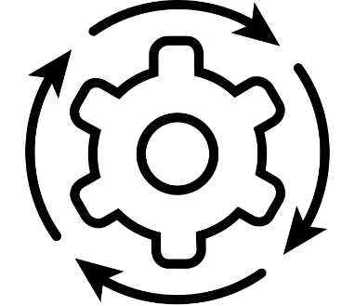
Med ECG has engaged a variety of clients to address a range of organizational challenges
1
2
3
Evaluated the strategic fit of new value-based contracting model for a FQHC
Assessed reasons for behavioral health no-shows at a local social services agency
Developed reporting tool for the evaluation of a diabetes management partnership for a local health consortium
4
5
6
Provided needs assessment for strategic expansion at a FQHC
Performed survey and benchmarking analysis to improve engagement in home-vising program at health department
Optimized operations to improve provider continuity for GME clinic within a FQHC

Slide 11
Client feedback has been positive and encouraging
“I was very impressed with all the aspects of Med ECG's work. It exceeded my expectations, given that the team members are students. In fact, I think the value of Med ECG's work for us exceeded some of the products we have received in the past from professional consultants!”
- Vice President of Partnerships at local health consortium
“Very organized, great follow-up, project helped get approval for a key strategic partnership. Thank you for your help and really nice job!”
- Executive Director of local FQHC
“Med ECG has provided clarity to an issue that we knew was present but lacked the data analysis to back it up. We anticipate that this will help us move in the right direction to find a permanent solution to the issue
- CFO of local FQHC
“Everything was positive. It seemed very much that we were working together to find answers and possible opportunities to improve. Excellent interpersonal communication skills, enthusiasm, planning and knowledge!!” Looking forward to working with Med ECG in the near future!
- CMO of local FQHC

Slide 12
Student also find the work to be engaging and valuable
“Being a project leader of a very nebulous case was an incredible opportunity for me to figure out how to drive the direction of a team, delegate tasks, etc.”
“This was a great way to gain real-world experience working on actual healthcare problems. It was also a great opportunity to work in a professional setting where a client has expectations as to what will be done and the team has to deliver on that commitment”
“This was an outstanding introduction to the consulting world. Projects were well scoped and team leaders set an excellent example.”
“It was a cool micro—chasm of typical consulting work in that the engagement forces you to become an expert in a subject you’re not necessarily familiar with”

Slide 13
Results from student surveys have revealed a positive correlation between the amount of exposure to learning leadership skills and students improvement in the skills

Slide 14
However, establishing the organization has not been without its challenges:
Sustainability
AOA Leadership Grant
Buy-in from administration
Med ECG M3/M4 elective
Recruiting
Adapting timeline to new curriculum
Med ECG M3/M4 elective
Client engagement
Upfront expectations
Longitudinal client relationships

Slide 15
Next steps
Development of “Strategic Management for Physicians” M3/M4 elective course
Continued client expansion
Longitudinal client relationships

Slide 16
Appendix

Slide 17
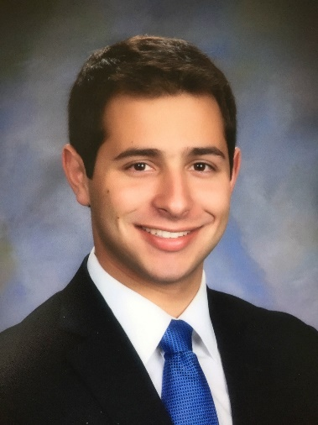
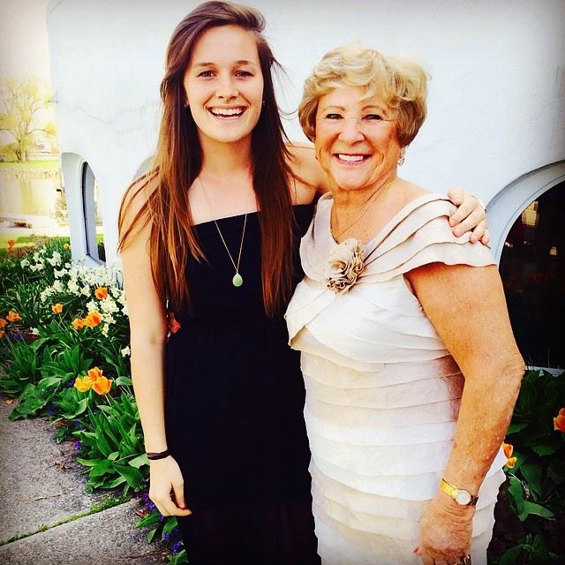
Med ECG was founded in Fall 2017 by 4 med students
David Portney
Paige
VonAchen
Taylor Standiford
Matt
Carey
Current M2
Former BCG Associate, who has worked with payers, providers, and biopharmaceutical companies in a consulting role
Current M3
Former BCG Associate, who has worked with healthcare clients. Current research in healthcare payment reform
Current M2
Former VillageMD Analyst, who has worked alongside providers and payers for operational and quality analytics
Current M3, MBA
Former McKinsey Business Analyst, who served healthcare clients, working with both payer and provider clients in the United States and overseas

Slide 18
Next steps
Student leadership elective
February 2020
“Mini-MBA”
Introduction to finance, accounting, strategy, organizational behavior, managerial “soft skills”
Lectures from Ross faculty and Michigan Medicine administrators
Business case discussions
Technical training in Excel data analysis, PowerPoint, etc.
Overview of approaches to framing and structuring a problem
Develop a framework for your own impact project…
…or have the option of doing a project with Med ECG

