Slide 1
Asthma Disparities During the COVID-19 Pandemic: A Survey of Patients and Physicians
Capstone For Impact:
CFI By Desmond Lowe

Slide 2
Background & Objective
The COVID-19 pandemic has demonstrated significantly worse outcomes for minority (Black and Hispanic) individuals compared to White individuals.
Understanding the reasons for COVID-19 related disparities among patients with asthma has important public health implications.
To determine factors contributing to health disparities in those with asthma during the COVID-19 pandemic.

Slide 3
Methods
Two anonymous surveys were distributed via social media to:
  Patients with asthma
  Physicians who provide asthma care
The surveys addressed demographic information including socioeconomic status, asthma control, and attitudes/health behaviors during COVID-19.
*We received total ~1100 patient responses (10% minority) and ~225 physician responses

Slide 4

Results (Physician Survey)
~ 80% of physicians believed minorities with asthma were more likely to die during the pandemic
~ 30% of physicians noted they encountered more obstacles when providing asthma care for black patients than for white patients
~ 25% of physicians believed it would be more challenging to care for black patients during COVID-19 than white patients regardless of education, income level, or other SES factors
< 5% believed that minority patients would be less likely to adhere to their asthma medications during the pandemic

Slide 5

Results (Patient Survey)
  Minorities were more likely to have been affected by COVID
    Become unemployed
    Live in a community with high COVID-19 cases
    More difficulty affording asthma medications
  Minorities were more likely to have worse asthma control
    Lower Asthma Control Test score
    Increased Emergency Room visits for asthma
  Minorities were less likely to have a PCP
  Minorities were more likely to believe the state or federal government response to COVID-19 was insufficient

Slide 6
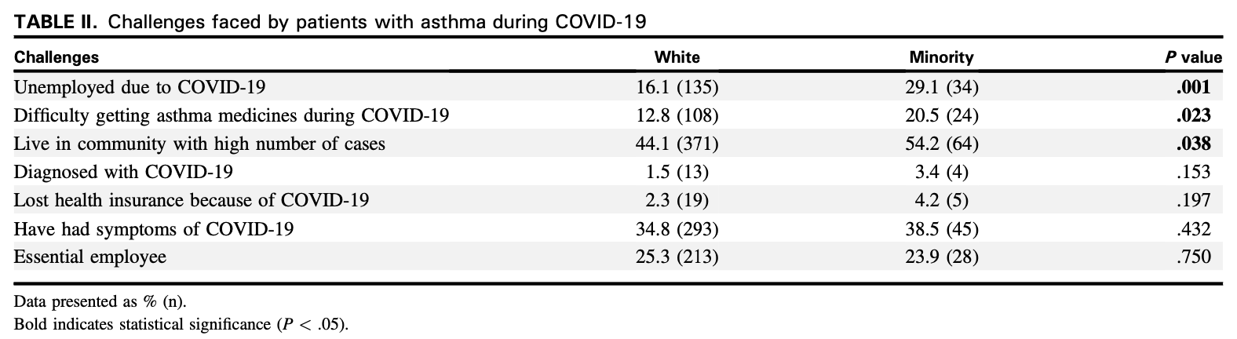
Figure of Patient Survey Results
Challenges faced by patients with asthma during COVID-19

Slide 7

Other Factors Considered
Analyzed for differences between:
  Sources of patient information
  Cultural factors
  Social distancing practices
  Understanding of severity of COVID-19
  Health seeking behaviors
*However, after controlling for SES factors, there was no significant difference
between minorities and non-minorities in the above categories

Slide 8
Discussion
The finding that minorities have similar health-seeking behaviors and practices as white individuals has important public health implications
The sources of information related to COVID-19 are the same in both groups
  A “minority-specific” campaign to distribute info related to COVID-19 may not be effective
Does institutional racism play a role?
  Our findings showed there were more difficulties affording medications, establishing a PCP, maintaining insurance, and ability to attend doctor’s visits amongst minorities
Does physician implicit bias play a role?
  Biases such as believing minorities are more difficult to care for based solely on race, or that minorities are more likely to die of COVID can have significant impact on the care we as providers are giving patients.
Notes:
However, even when controlling for socioeconomic factors, previous studies have found unequal outcomes for minority individuals, thought to be due to larger social inequalities within societies, of which SES is only one part.

Slide 9
Conclusion
Differences in socioeconomic status and the effects of institutional racism, but not health behaviors, sources of information, or attitudes, are playing a role in disparities seen for patients with asthma during COVID-19.

Slide 10
So What Can We Do…?
Implicit Bias training workshops
Recognize our biases and actively work to eliminate/overcome them
Ask ourselves why are these disparities happening and what role do we as providers play in perpetuating them
Take the time to communicate with our patients rather than make assumptions
Meet our patient’s needs where they need us to meet them most
Remember if YOU are finding it difficult to care for a patient, that patient is likely having an even harder time accessing the minimal care that they are receiving

Slide 11
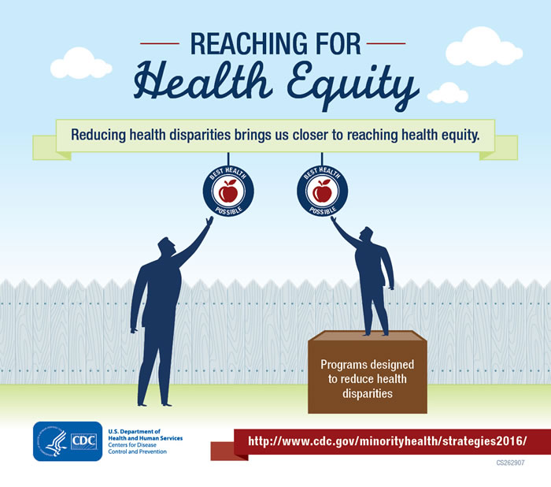
Thank You!!
Special thanks to:
  Dr. Alan Baptist Sanaz Eftekhari
  Nadeen Sarsour Laurie Carpenter
  Hannah Jaffee Priya Bansal

