Slide 1

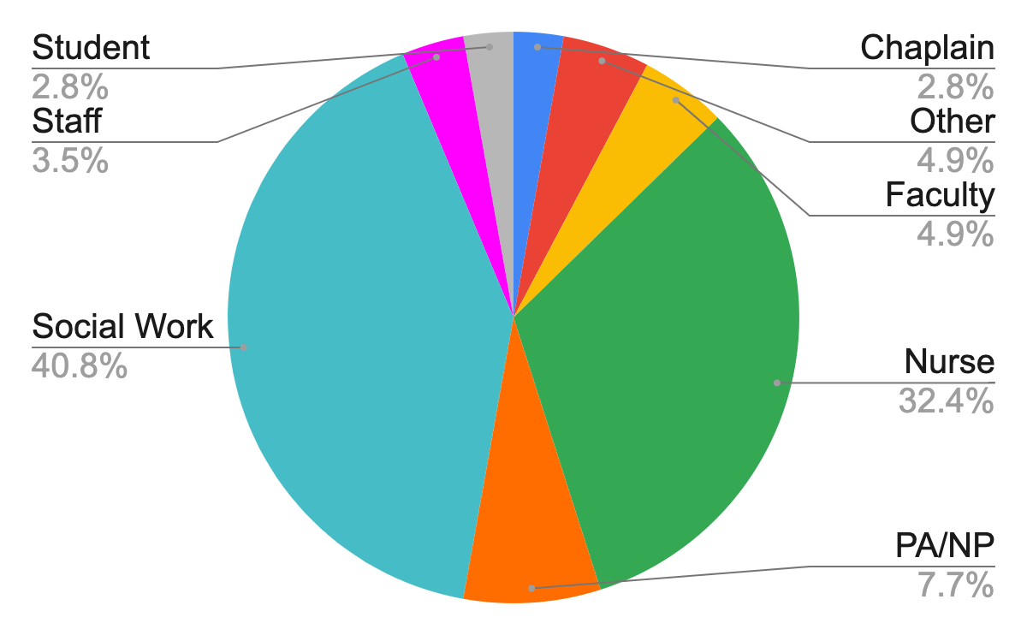
Evaluating the Effectiveness of Virtual Schwartz Rounds
Devin Shen, MS¹; Thomas Valley MD, MSc²
¹University of Michigan Medical School, ²Michigan Medicine
Background
Results
Discussion
Schwartz Rounds (SR) is a monthly conference where an interdisciplinary group of panelists openly discuss topics related to providing compassionate patient care.
Three panelists share experiences for 15 minutes, followed by 45 minutes of facilitated dialogue.
Audience participation includes a microphone passed around the auditorium.
The aim of the capstone project was to transition SR from in-person to virtual as a result of the COVID-19 pandemic.
The virtual platform is Zoom Webinar, augmented with a new registration form, polling questions, and Q&A feature.
Table 1. Examples of Audience Feedback from 10/2020
Fewer panelists if you want audience participation.
Short bio on presenters and short overview of what/who they talked about.
I would prefer an in-person session, but my workday can be very unpredictable, so the virtual platform does make it more accessible.
More Q&A time would have been nice. Knowing we have to do this virtually for the time being, I think this went very well!
Liked the Q&A for questions, facilitator did a good job of introducing speakers and tracking Q&A.
I cannot often leave clinic for in person programs. Virtual allows me to at least participate a bit.
While we had a lot of people there, we couldn't see who was there, there was no back channel conversation permitted, and no way to privately or directly contact the speakers. I liked the presentations very much, but I felt isolated from the community.
From October results, the virtual platform improved access to SR during the pandemic.
68% of respondents reported only being able to attend Schwartz Rounds because it was virtual.
If given the choice, 63% would rather attend a virtual conference than an in-person conference.
94% did not find it more difficult to connect emotionally to panelists in a virtual platform.
69% did not find it difficult to stay engaged virtually.
Figure 1. Attendee professions from the October 2020 session.
Lessons Learned
We learned that the virtual platform maintains the emotional connection between panelists and audience, improves access, and maintains social distancing.
From feedback, the following changes were made:
Decreased speakers from 6 to 4 per session to increase time for audience participation.
Increased use of Zoom polling.
Updated introduction slides to include instructions to "raise hands for participation."
Started internal "practice session" 20 minutes before the session to troubleshoot Zoom difficulties.
Objectives
Assess whether the virtual platform improves access to SR.
Assess whether the audience can establish an emotional connection with panelists over a virtual platform.
Figure 2. Responses from the Google Form evaluation for the October 2020 session.
Evaluation Methodology
SR’s evaluation form was on paper. We transitioned to a Google Form and added 9 items to the survey. Figure 2 lists 6 example questions. For each session, the evaluation form is distributed through:
Intro slides at the start of the webinar.
Chat box during the webinar.
Post-attendance URL after the webinar.
Post-attendance email one day after the webinar.
Next Steps
Studying the effectiveness of virtual conferences outside of SR (i.e., Grand Rounds, morning report)
Will the virtual platform continue to be the mainstay after distancing measures are relaxed?
If we return to an in-person/virtual hybrid model, how do we maximize participation of the audience who could only attend through Zoom?
Email: shdevin@med.umich.edu
Huge thank you to Dr. Daniel Cronin and the Scholarship of Learning and Teaching Path of Excellence for guidance and feedback during the project.

