Slide 1

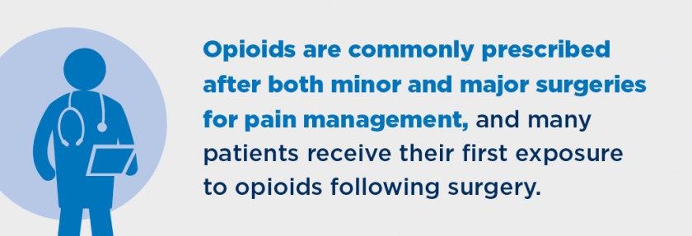
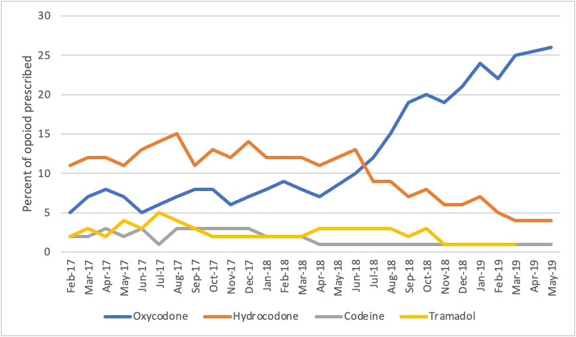
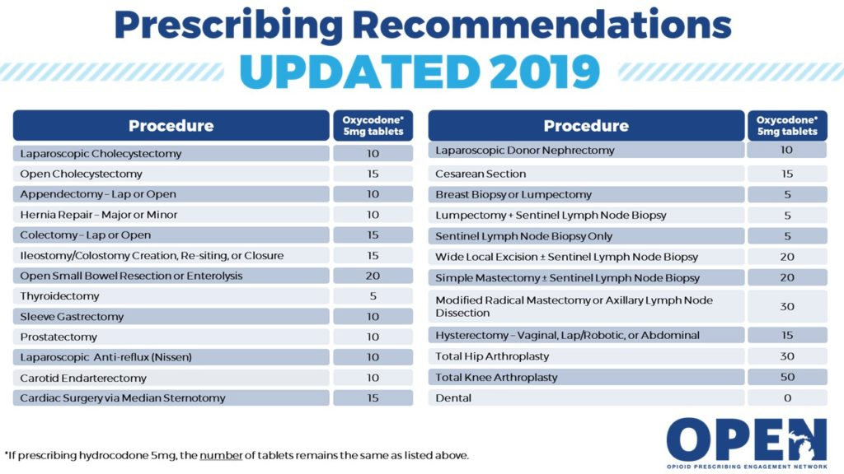
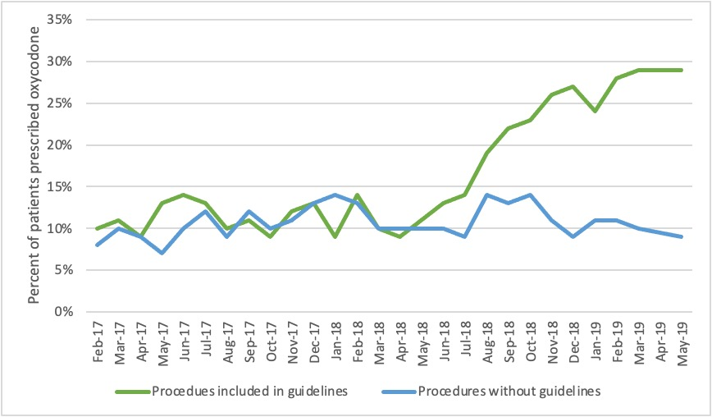
Trend in Oxycodone and Hydrocodone Prescribing following Implementation of Postoperative Opioid Prescribing Guidelines
Dominique Donatelli, Shannon Zikovich, Chad Brummett, M.D.
Introduction
The Michigan Opioid Prescribing Engagement Network released opioid prescribing guidelines for surgeries in October 2017. Previous studies have shown that decreased opioid prescribing is associated with implementation of prescribing guidelines. It is not known whether the language of these guidelines has an impact on the type of opioid prescribed and if there is an associated trend toward oxycodone prescribing. The aim of this study is to examine if these recommendations are being utilized and what effect these guidelines have had on postoperative opioid prescribing practices. We hypothesize that the release of prescribing recommendations that preference the use of oxycodone would lead to an increase in the rate of oxycodone prescribing after surgery. In addition, we examined identifiable characteristics of the hospital or providers where this change is occurring.
2
Methods and Materials
All data was obtained from a database maintained by the Michigan Surgical Quality Collaborative (MSQC)
The MSQC is a partnership between the American College of Surgeons and Blue Cross Blue Shield of Michigan
Data was prospectively collected on patient demographics and 30day clinical outcomes
Cases were then reviewed using a sampling algorithm to minimize selection bias
MSQC data is de-identified and deemed IRB exempt
This study included all patients 18 years and older who underwent surgery between February 2017 and March 2019
Patient characteristics examined included age, gender, opioid use in last 12months, surgical procedure underwent
Figure 2. [Mock figure] Graph illustrates the percentage of opioid type prescribed at the time of discharge from surgery in opioid-naïve patients. NOTE this data has not been finalized and no conclusions can be drawn from it.
Results
Data analysis remains ongoing and results have not been finalized
Graph figures were created with mock data
Mock data was based on the hypothesis that the language of opioid prescribing guidelines would have an impact on the type of opioid prescribed
Discussion
Figure 1. Michigan Opioid Prescribing Engagement Network released revised opioid prescribing guidelines in 2019 with recommendations for a set number of 5mg Oxycodone tablets based on the surgery performed¹
It is important to continue to follow how these opioid prescribing guidelines are being utilized as well as develop a further understanding of any unintended impact as a result of their implementation.
Figure 3. [Mock figure] Graph illustrates the percentage of patients prescribed oxycodone at discharge from a surgery with and without a prescribing guideline in place. NOTE this data has not been finalized and no conclusions can be drawn from it.
Contact
References and Figures
Dominique M Donatelli
University of Michigan Medical School
Capstone for Impact
Email: ddonatel@umich.edu
1. Prescribing Recommendations. (2019). Retrieved from Michigan OPEN: https://michigan-open.org/prescribing-recommendations/
2. University of Michigan. (2021, January). Retrieved from Michigan Institute for Healthcare & Policy Innovation: https://ihpi.umich.edu/featured-work/michigan-opioid-prescribing-engagement-network
3. Brown, C. S., J. V. Vu, R. A. Howard, V. Gunaseelan, C. M. Brummett, J. Waljee and M. Englesbe (2020). "Assessment of a quality improvement intervention to decrease opioid prescribing in a regional health system." BMJ Qual Saf.
4. Clarke, H., N. Soneji, D. T. Ko, L. Yun and D. N. Wijeysundera (2014). "Rates and risk factors for prolonged opioid use after major surgery: population based cohort study."
Bmj 348: g1251.
5. Howard, R., B. Fry, V. Gunaseelan, J. Lee, J. Waljee, C. Brummett, D. Campbell, Jr., E. Seese, M. Englesbe and J. Vu (2019). "Association of Opioid Prescribing With Opioid Consumption After Surgery in Michigan." JAMA Surg 154(1): e184234.
6. Vu, J. V., R. A. Howard, V. Gunaseelan, C. M. Brummett, J. F. Waljee and M. J. Englesbe (2019). "Statewide Implementation of Postoperative Opioid Prescribing Guidelines." N Engl J Med 381(7): 680-682.
*additional references available in manuscript draft

